Slide 1
Nim
CSLP
Group 6:
Pedro Ponte 98059
André Cardoso 108269
Bruno Páscoa 107418
05 December 2023

Slide 2
Why nim?
Syntax
Performance
Flexibility

Slide 3




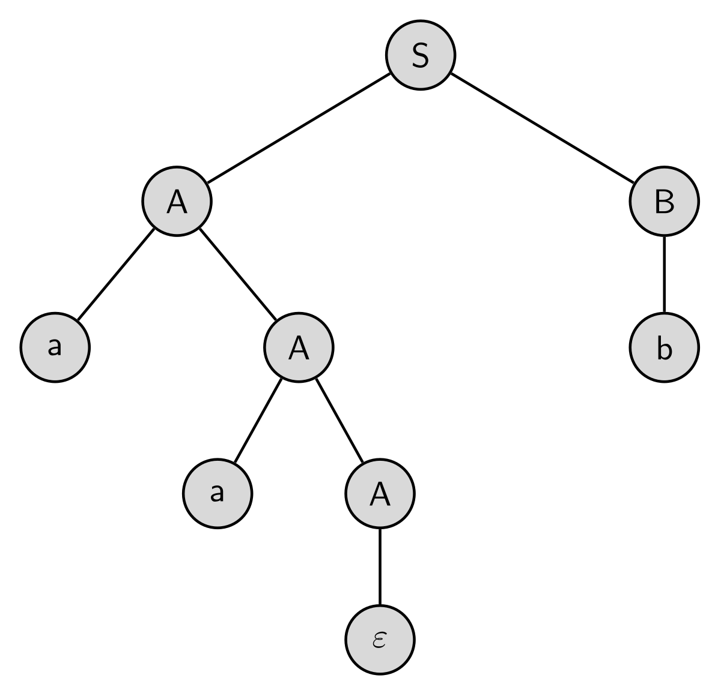


Features
Executables
Memory management
Front-End / Back-End
Self-contained
Macros
Concurrency

Slide 4
Data Structures
Mathematics
Lists, Sets, Hash Tables, Bitsets, etc.
Basic math operations, Complex Numbers, Trigonometry, Statistics
File I/O
Cryptography
File manipulation,
File system traversal, Streams,
etc.
Pseudo random number generation, Hashing, Encryption
Networking
Regular Expressions
Sockets, HTTP and
other Network Protocols
Pattern Matching and Manipulation
Concurrency
Date and Time
Threads, Locks, Channels, Async/Await support
Timezone-aware date and time operations

Slide 5
Conclusion
Syntax – Similar to Python
Performance – C and C++
Features – Rich stdlib, with vast array of bindings to C and C++ libraries

Slide 6
Questions?
Nim
CSLP
Group 6:
Pedro Ponte 98059
André Cardoso 108269
Bruno Páscoa 107418
05 December 2023

