Slide 1
Converting Regular Expressions to DFA
Csink László
2017

Slide 2
Literature
https://www.itu.dk/courses/BPRD/E2012/regex-to-nfa.pdf [retrieved March 29, 2017]

Slide 3
Regular Expression
A regular expression can be
the empty string ε
a symbol α from the alphabet of the language
either of two regular expressions r1 and r2, written r1|r2.
a sequence of two regular expressions r1 and r2, written r1r2
zero or more instances of a regular expression r, written r*.

Slide 4


Conversion to ϵ-NFA
The base cases ϵ or α

Slide 5
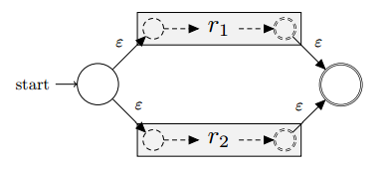
+ (or union or |)
A choice between r1 and r2, written r1|r2, is constructed by creating a new start state with ε-transitions to the start states of r1’s and r2’s automata, and an accepting state with ε-transitions from their accepting states, as follows:

Slide 6

Sequence (concatenation)
A sequence of two regular expressions r1 and r2, written r1r2, is converted to an NFA by simply attaching the accepting states of r1’s NFA to the initial state of r2’s NFA:

Slide 7
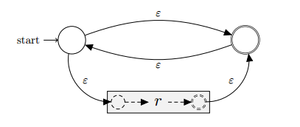
*
The NFA of the repeating expression r* has an ε-transition from its start state to r’s start state, and an ε-transition from r’s accepting state to its accepting state. Additionally, there are ε-transitions from the start state to the accepting state and back again. This enables r to be skipped or to be repeated as many times as necessary.

Slide 8
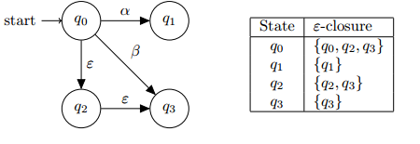
Converting NFAs to DFAs - 1
The first concept we need is the ε-closure, pronounced “epsilon closure”. The ε-closure of an NFA state q is the set containing q along with all states in the automaton that are reachable by any number of ε-transitions from q. In the following automaton, the ε-closures are given in the table to the right:

Slide 9
Converting NFAs to DFAs - 2
To convert our NFA to its DFA counterpart, we begin by taking the ε-closure of the start state q0 of our NFA and constructing a new start state S0 in our DFA corresponding to that ε-closure.
Next, for each symbol α in our alphabet, we record the set of NFA states that we can reach from S0 on that symbol. For each such set, we make a DFA state corresponding to its ε-closure, taking care to do this only once for each set. In the case two sets are equal, we simply reuse the existing DFA state that we already constructed.
This process is then repeated for each of the new DFA states (that is, set of NFA states) until we run out of DFA states to process.
Finally, every DFA state whose corresponding set of NFA states contains an accepting state is itself marked as an accepting state.

Slide 10
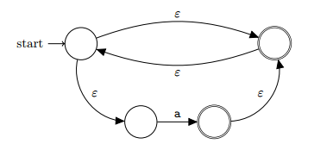

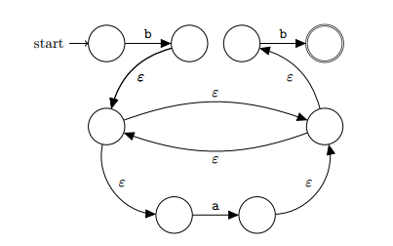
Example: ba*b
a and b
a*
ba*b

Slide 11
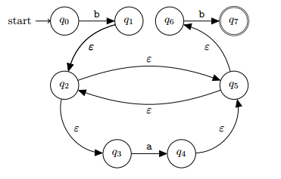
The ϵ-NFA for ba*b

Slide 12
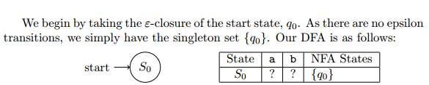
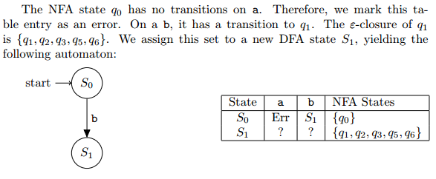
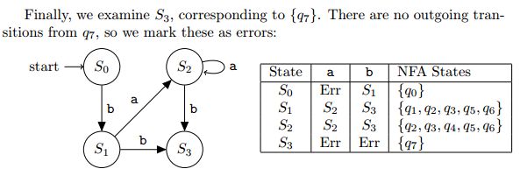
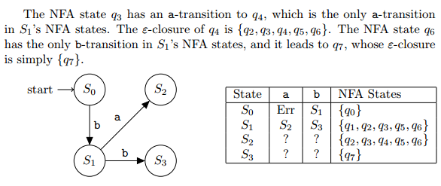
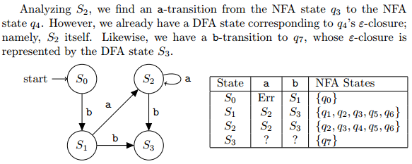
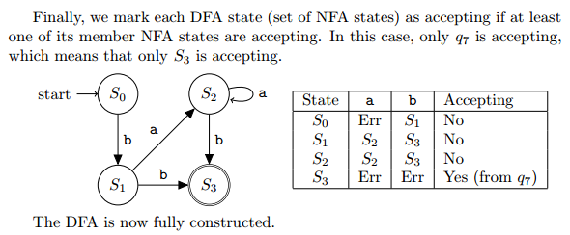
ba*b

Slide 13

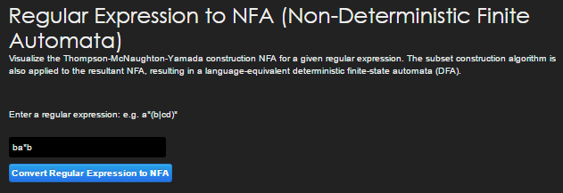
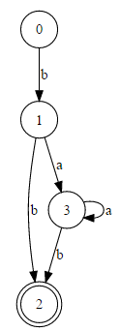
Using a tool for the above ☺
http://hackingoff.com/compilers/regular-expression-to-nfa-dfa

Slide 14
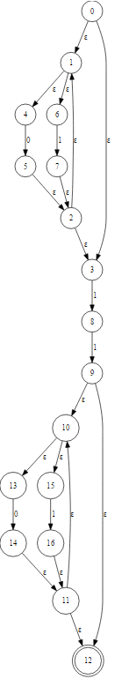
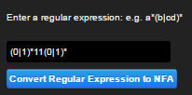
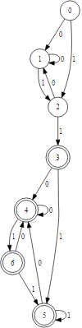
DFA accepting binary words that contain 11 at least once

Slide 15
Thank you for your attention.

