Slide 1
Database fundamentals
Intro, Data Models, RDBMS design, Oracle basics, SQL Fundamentals
Rita Fleiner
fleiner.rita@nik.uni-obuda.hu
Room 3.18

Slide 2
Course overview
1-2. Advanced relational DB topics
3-4. DB tuning
4. week: Test
5. Cassandra (Epam)
6. MongoDB (Epam)
7. Caccandra, MongoDB: refresh, practise
8. Hadoop (Epam)
9. Spark (Epam)
10. Hadoop, Spark: refresh, practise, test

Slide 3
Midterm requirements
There will be two tests during the course:
1. test is on the 5th week. Topic: Relational databases, tuning. Theory and practise (40 points)
2. test is on the 13th week. Topic: Big data and Spark (10 points)
Prerequisite for obtaining a mid-year grade: students must pass both tests and all homework with at least 51% each.
Weekly summary of each lecture (20 points)*
Student has to solve a homework project in the topics of Cassandra, MongoDB and Spark (30 points)
A student who has missed more than 30% of the classes will not receive a mid-year grade.
(*) Student’s participation during lectures is considered as part of the Homework.
Notes:
A kurzus során két tesztre kerül sor:
teszt: 5. héten. Téma: Relációs adatbázisok, tuning. Elmélet és gyakorlat (40 pont).
teszt: 13. héten. Téma: Big data és Spark. Elmélet (10 pont).
Az évközi jegy megszerzésének feltétele: mindkét teszt és a házi feladatok egyenkénti legalább 51%-os teljesítése. Heti összefoglalókat kell írni az előadásokról (20 pont)*.
A hallgatónak házi feladatot kell megoldania a Cassandra, MongoDB és Spark témakörökben (30 pont).
Az a hallgató, aki az órák több mint 30%-át elmulasztotta, nem kap évközi jegyet. (*)
A hallgató előadásokon való részvétele a házi feladat részének számít

Slide 4
Oracle Virtual Machine
VM can be downloaded from here:
https://obudaiegyetem-my.sharepoint.com/:u:/g/personal/legradi_gabor_uni-obuda_hu/EXYR68hpKE5LoVZaNmTJOzkBD2-Q6FCL4O-DQ0SNYrJMiQ?e=fjWls2
Client tools to Oracle Database
SQL Developer
SQL Plus
Schema: hr / hr
Online possibility to reach the database: apex.oracle.com
hr schema has to be created by scripts

Slide 5
Data Models

Slide 6

Data Model
Data structures
Data objects and association between them
Independent of hardware and software
Notes:
Conceptual representation of data structures required by a database
Data structures include data objects and association between them
Focuses on what data is required and how it should be organised
Independent of hardware and software

Slide 7

Data Model Elements
Entity – a unique real world thing
Entity type
Logical category
Objects described with same attributes
Eg.: Milk, Bread, Chocolate: → Product
Entity Instance - One specific member of an entity type

Slide 8
Data Model Elements
Attribute
Piece of information that describes an entity
Multiple attributes Product{Name, price, instock}
Relationship
How entities depend on or connect to each other
Entity Key
Attrubute or a set of attributes of an entity that are used to determine identity
The attributes that make up an entity key are chosen at design time.
The values of entity key attributes must uniquely identify an entity instance
The key value should not be modified
Notes:
Entity – a unique real world thing
Entity type
Logical category
Objects described with same attributes
Eg.: Milk, Bread, Chocolate: → Product
Entity Instance - One specific member of an entity type
Attribute
Piece of information that describes an entity
We describe things with multiple attributes Product{Name, price, instock}
Relationship
How entities depend on or connect to each other
Entity Key
A property or a set of properties of an entity that are used to determine identity
The properties that make up an entity key are chosen at design time.
The values of entity key properties must uniquely identify an entity instance
The key value should not be modified

Slide 9
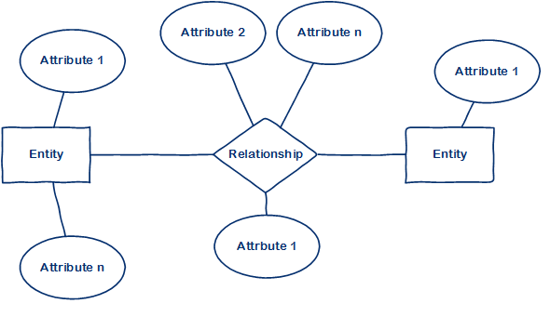
Entity-Relationship (ER) Model

Slide 10
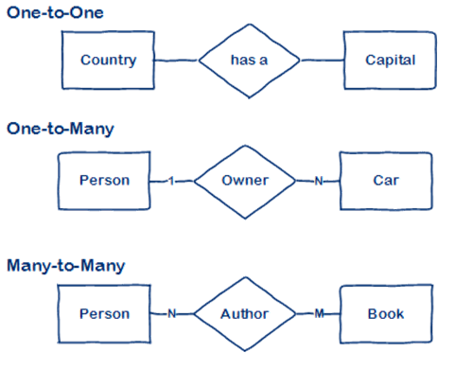
Types Of Relationship

Slide 11
Levels Of Data Modeling
Conceptual data model
Logical data model
Physical data mode
User’s view
Independence of physical implementation
Meets the requirements of the database system
Implementation within the database system

Slide 12
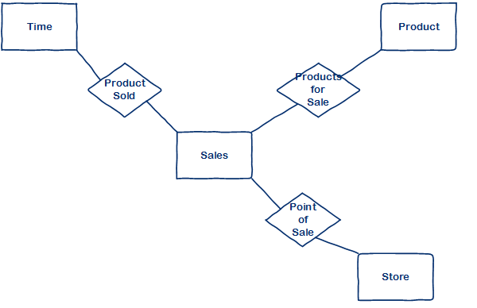
Conceptual Data Model
Conceptual data model
Logical data model
Physical data model
Notes:
Identifies entities and the highest level relation between entities
No attributes specified

Slide 13
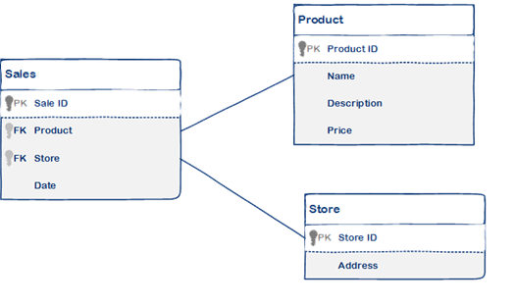
Logical Data Model
Conceptual data model
Logical data model
Physical data model
HOW the system will be implemented
Specified:
All attributes
Primary key(s)
Foreign key(s)
Normalization
Notes:
Describes HOW the system will be implemented, regardless of the DBMS
Includes all entities and relationships among them.
All attributes for each entity are specified.
The primary key for each entity is specified.
Foreign keys (keys identifying the relationship between different entities) are specified.
Normalization occurs at this level.

Slide 14
Physical Data Model
Conceptual data model
Logical data model
Physical data model
HOW the system will be implemented using a specific DBMS
Specifies:
Tables
Columns
Notes:
Describes HOW the system will be implemented using a specific DBMS
Specifies the tables and the columns.
Foreign keys are used to identify relationships between tables.
Denormalization may occur based on user requirements.
Physical considerations may cause the physical data model to be quite different from the logical data model.

Slide 15
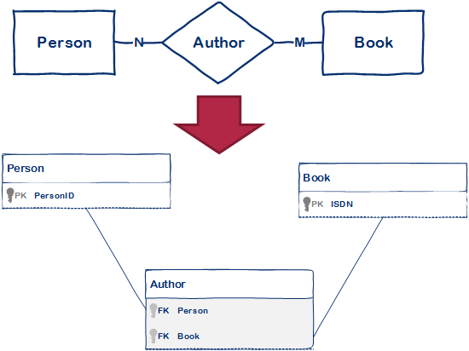
Transforming ER model into relational model
Many-to-many relationship transforms into a table
One-to-many doesn’t transform into a table
Notes:
In relational database design, a many-to-many relationship is not allowed.
Need to break apart the many-to-many relationship into two one-to-many relationships.
Using a third table, commonly called a “join table
Each record in the “join table” would have the foreign key fields of the two tables it is joining together.
Join table has at least two columns, holding Primary keys from the tables it joins.
Can have additional columns, holding properties of the relationship

Slide 16
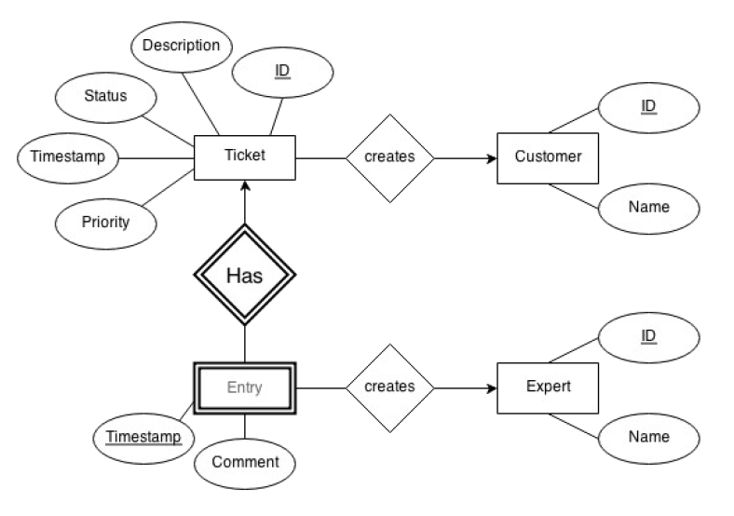
ER model: ticketing system logging service errors
Entity
Weak entity
Realtionship
One to many
Attribute
Key attribute

Slide 17
Relations
Customer<ID, Name>
Expert<ID, Name>
Ticket<ID, Timestamp, Description, Status, Priority, C_ID>
Entry<???>
PK, FK????

Slide 18
Relations
Customer<ID, Name>
Expert<ID, Name>
Ticket<ID, Timestamp, Description, Status, Priority, Customer_ID>
Entry<Ticket_ID, Timestamp, Comment, Expert_ID >
PK, FK

Slide 19
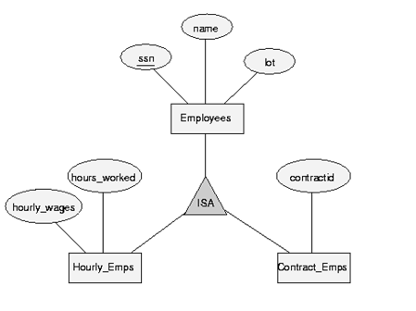
ER model
ISA Realtionship

Slide 20
Relations
Employess< >
Hourly_Emps< >
Contract_Emps< >
PK, FK

Slide 21
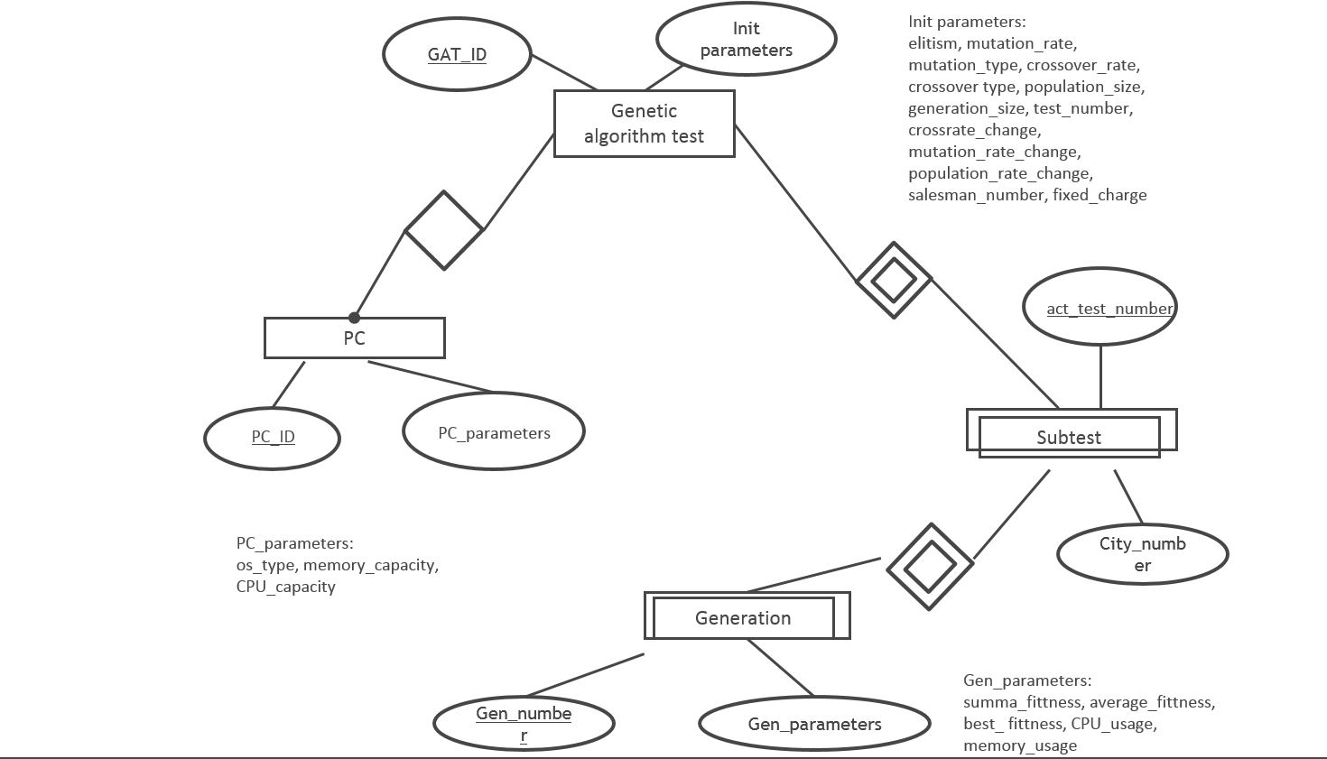
ER model

Slide 22
Relations
PC(PC_ID, PC_paraméterek)
GAT(GAT_ID, PC_ID, Kezdő paraméterek)
FK: PC_ID to the PC relation PC_ID column
SUBTEST(GAT_ID, act_test_number, City_number)
FK: GAT_ID to the GAT relation GAT_ID columns
GENERATION(GAT_ID, act_test_number Gen_number, Gen_paraméterek)
FK: (GAT_ID, act_test_number) to the SUBTEST relation (GAT_ID, act_test_number) columns

Slide 23
Normalization
Normalization is a database design technique that reduces data redundancy and eliminates undesirable characteristics like Insertion, Update and Deletion Anomalies. Normalization rules divides larger tables into smaller tables and links them using relationships. The purpose of Normalisation in SQL is to eliminate redundant (repetitive) data and ensure data is stored logically.
Includes creating tables and establishing relationships between the tables
Eliminates redundant data

Slide 24
Database Normalization
The inventor of the relational model Edgar Codd proposed the theory of normalization of data with the introduction of the First, Second and Third Normal Forms. Later he joined Raymond F. Boyce to develop the theory of Boyce-Codd Normal Form.
Normalization forms:
1NF Eliminate Repeating Groups
2NF Eliminate Redundant Data
3NF Eliminate Columns Not Dependent on Key
BCNF Only key dependency exists
Notes:
Normalization the process of organizing data in a database that includes creating tables and establishing relationships between the tables
Process is used to help eliminate redundant data

Slide 25
Functional Dependencies
If one set of attributes in a table determines another set of attributes in the table, then the second set of attributes is said to be functionally dependent on the first set of attributes.
Example 1
Table: Book {ISBN, Title, Price}
Functional Dependencies: {ISBN} -> {Price, Title}, {ISBN} -> {Price}

Slide 26
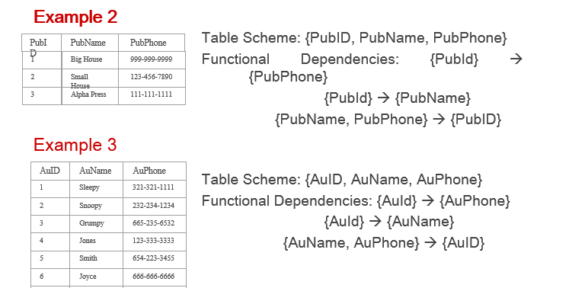
Functional Dependencies
Notes:
Student(NeptunID, Name, DateOfBirth, Address, Faculty, StudyProgramme, MobilePhone)

Slide 27
Functional Dependencies
Student(NeptunID, Name, DateOfBirth, Address, Faculty, Faculty_Address, StudyProgramme, MobilePhone)

Slide 28
First Normal Form (1NF)
The relation must have atomic domains.
Eliminate repeating groups
Horizontal or vertical extension of the table
Identify with primary key
Student# | Advisor | Adv-Room | Class
1022 | Jones | 412 | 101-07, 143-01, 159-02
4123 | Smith | 216 | 201-01, 211-02, 214-01
Student# | Advisor | Adv-Room | Class#
1022 | Jones | 412 | 101-07
1022 | Jones | 412 | 143-01
1022 | Jones | 412 | 159-02
4123 | Smith | 216 | 201-01
4123 | Smith | 216 | 211-02
4123 | Smith | 216 | 214-01
1NF
2NF
3NF
BCNF
Notes:
This rule defines that all the attributes in a relation must have atomic domains. The values in an atomic domain are indivisible units:
Eliminate repeating groups in individual tables
Create separate table for each set of related data
Identify each set of related data with primary key
Do not use multiple fields in a single table to store similar data
Primary key
A primary key is a candidate key that is most appropriate to be the main reference key for the table.
It is used to help establish relationships with other tables.
Always choose a single simple key over a composite key if possible

Slide 29
Second Normal Form (2NF)
For a table to be in 2NF, there are two requirements
The table is in first normal form
All non-key attributes in the table must be functionally dependent on the entire primary key
Note: Remember that we are dealing with non-key attributes
Example 1 (Not 2NF)
Scheme : {City, Street, HouseNumber, HouseColor, CityPopulation}
Key: {City, Street, HouseNumber}
{City, Street, HouseNumber} → {HouseColor}
{City} → {CityPopulation}
CityPopulation does not depend on the entire key.
CityPopulation is functionally dependent on the City which is a proper subset of the key

Slide 30
2NF - Decomposition
If a data item is fully functionally dependent on only a part of the primary key, move that data item and that part of the primary key to a new table.
If other data items are functionally dependent on the same part of the key, place them in the new table also
Make the partial primary key copied from the original table the primary key for the new table. Place all items that appear in the repeating group in a new table
Example 1 (Convert to 2NF)
Old Scheme → {City, Street, HouseNumber, HouseColor, CityPopulation}
New Scheme → {City, Street, HouseNumber, HouseColor}
New Scheme → {City, CityPopulation}
Notes:
If there is a table with columns A,B,C,D with Primary Key (A,B) & D is dependant on A (alone) then to be 2NF, you should reduce (split) tables as:
Table with columns A,D with Primary Key (A)
Table with columns A,B,C with Primary Key (A,B)

Slide 31
Third Normal Form (3NF)
For a table to be in 3NF, there are two requirements
The table should be in 2NF
There can be no interdependencies among non-key attributes
Example (Not in 3NF)
Scheme : {Studio, StudioCity, CityTemp}
Primary Key : {Studio}
{Studio} → {StudioCity}
{StudioCity} → {CityTemp}
{Studio} → {CityTemp}
Both StudioCity and CityTemp depend on the entire key hence 2NF
CityTemp transitively depends on Studio hence violates 3NF
Notes:
In the Book Schema Third Normal Form is violated since a non-key field is dependent on another non-key field and is transitively dependent on the primary key.

Slide 32
3NF - Decomposition
Move all interdependent non-key items to a new entity.
Identify a primary key for the new entity.
Place the primary key for the new entity as a foreign key on the original entity.
Example 1 (Convert to 3NF)
Old Scheme → {Studio, StudioCity, CityTemp}
New Scheme → {Studio, StudioCity}
New Scheme → {StudioCity, CityTemp}
Notes:
If there is a table with columns A,B,C with Primary Key (A) and C is dependant on B (B → C) then to be 3NF, the tables become
Table with columns B,C with Primary Key (B)
Table with fields A,B with Primary Key ( A), and Foreign Key (B)

Slide 33
SQL Fundamentals

Slide 34
DDL, DML, DCL, TCL
Data Definition Language
(DDL) statements are used to define the database structure or schema. Some examples:
CREATE - to create objects in the database
ALTER - alters the structure of the database
DROP - delete objects from the database
TRUNCATE - remove all records from a table, including all spaces allocated for the records are removed
COMMENT - add comments to the data dictionary
RENAME - rename an object
Data Manipulation Language
(DML) statements are used for managing data within schema objects. Some examples:
SELECT - retrieve data from the a database
INSERT - insert data into a table
UPDATE - updates existing data within a table
DELETE - deletes all records from a table, the space for the records remain
MERGE - UPSERT operation (insert or update)
CALL - call a PL/SQL or Java subprogram
EXPLAIN PLAN - explain access path to data
LOCK TABLE - control concurrency
Data Control Language
(DCL) statements. Some examples:
GRANT - gives user's access privileges to database
REVOKE - withdraw access privileges given with the GRANT command
Transaction Control (TCL) statements are used to manage the changes made by DML statements. It allows statements to be grouped together into logical transactions.
COMMIT - save work done
SAVEPOINT - identify a point in a transaction to which you can later roll back
ROLLBACK - restore database to original since the last COMMIT
SET TRANSACTION - Change transaction options like isolation level and what rollback segment to use

Slide 35
History of SQL standards
SEQUEL (70's)
SQL-86, first ANSII
SQL-89 / SQL 1
SQL-92 / SQL 2 – this had most of the basic commands
SQL:1999 / SQL 3, recursive queries, triggers, object-oriented features, ...
SQL:2003, window functions, XML-related features, ...
SQL:2006, XML Query Language (XQuery) support, ...
SQL:2008

Slide 36
There are standards but still different implementations
Differences between implementations
This is important to understand clearly
Each specific SQL implementation by a database vendor is called a dialect
The vendors implement parts of the SQL standard (e.g. most implement SQL-92) but add their vendor-specific extensions
Most relational database vendors conform to a set of Core SQL features but portability might still be limited due to missing or additional features

Slide 37
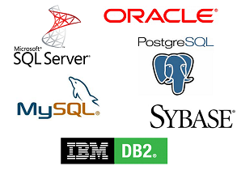
RDBMS Systems

