Slide 1
Information and Coding Theory
3

Slide 2
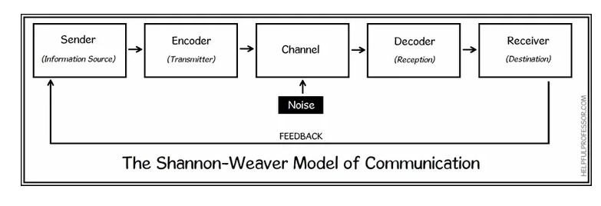
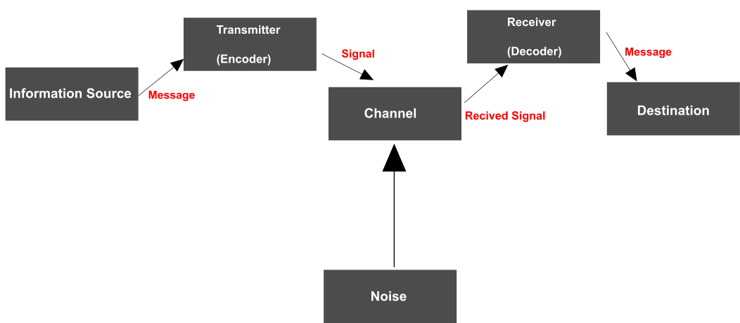
The basic idea is: to assign a shorter channel code to the more common source code.
The goal is to have „optimal” code.
The code with the smallest average word length length is called the optimum-optimal code.

Slide 3
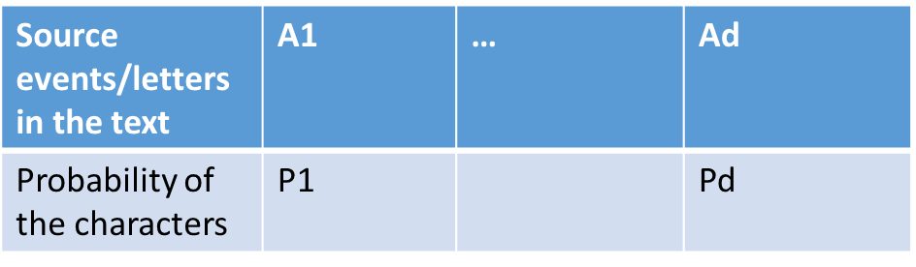
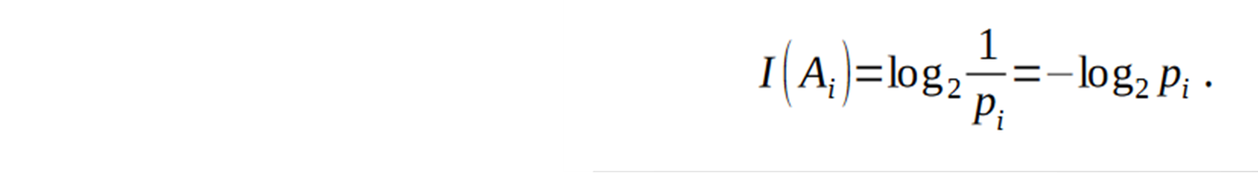
Information-entropy-code lenght
The more often a letter occurs in a text, the less uncertainty it carries. So, it carries less information for us.
It follows that the amount of information is inversely proportional to the frequency (relative frequency) of the sign / letter.

Slide 4
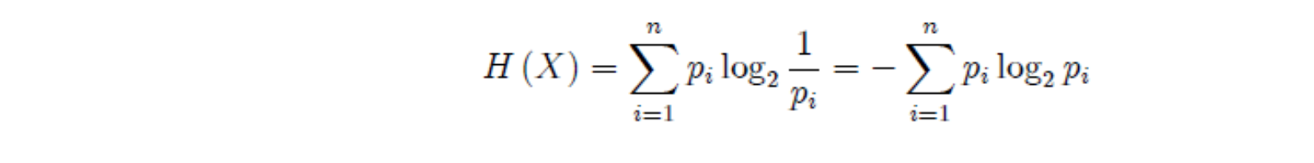
Entropy
In information theory, the entropy of a random variable is the average level of "information", "surprise", or "uncertainty" inherent in the variable's possible outcomes. ... An equivalent definition of entropy is the expected value of the self-information of a variable.
The weighted information measure – The entropy
Source events/letters in the text Set X | x1 | … | xn
Probability of the characters | P1 |  | Pn

Slide 5
Variable length code
Source alphabet | X1 | … | Xd
Frequency | N1 |  | Nd
Probability of the characters | P1 |  | Pd
Length of the codes | L1 |  | Ld
N length message,
encoded message length:
Averge length:
⇒

Slide 6
Example
Source characters | Relative frequency, pi | Prefix code –variable lenght | Fix lenght code | Variable lenght – not correct | Decodable, not prefix
1 | 1/2 | 0 | 00 | 0 | 0
2 | 1/4 | 10 | 01 | 1 | 01
3 | 1/8 | 110 | 10 | 00 | 011
4 | 1/8 | 111 | 11 | 11 | 111
Entropy | 1,75
Average code lengnt |  | 1,75 | 2 | 1,25 | 1,75

Slide 7
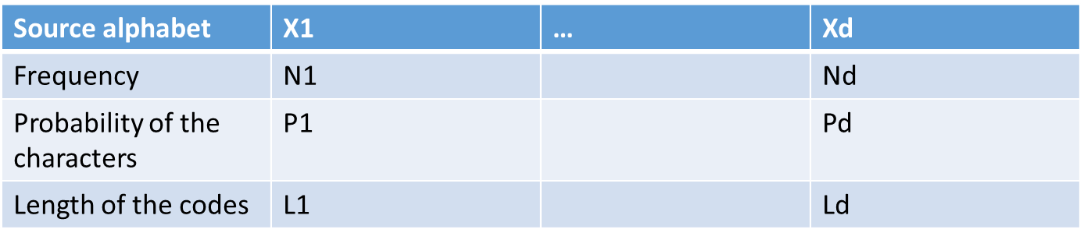
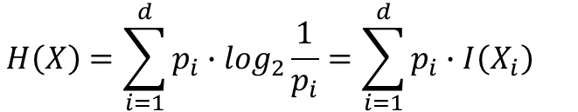

Average code lenght
Entropy:
$${L\left(X\right)=\sum_{i=1}^{d}{p_{i}∙L_{i}}}^{}$$
$${H\left(X\right)=\sum_{i=1}^{d}{p_{i}∙\log_{2}}\frac{1}{p_{i}}=\sum_{i=1}^{d}{p_{i}∙I\left(X_{i}\right) } }^{}$$

Slide 8
An other approach - Kraft inequality
Let each source symbol from the alphabet
{x1,x2,…,xd} coded in an alphabet of r characters,
Let be code lengths {L1,L2,…,Ld}.
Then holds:

Slide 9
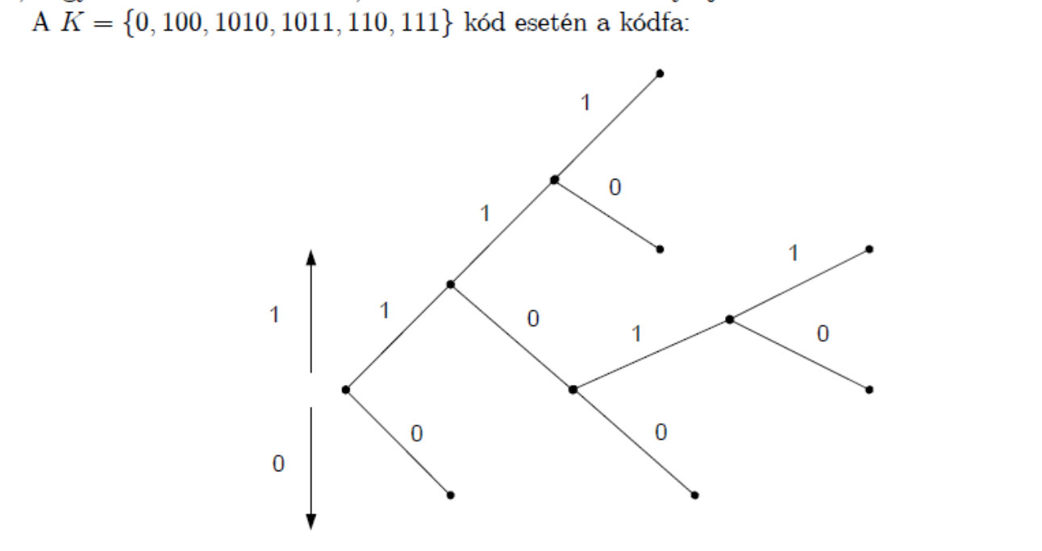
Kraft inequality – proof based on coding tree
Code tree - a "tool" for encoding and decoding
Consider an r-ary tree (example: r=2, channel alphabet: {0,1})
Each code-word is represented by a leaf node.
Path from the root traces out the symbol code.
Prefix code: no codeword is an ancestor of any other codeword on the tree.
Each code eliminates its descendants as codewords.
https://www.eit.lth.se/fileadmin/eit/courses/eit080/InfoTheorySH/InfoTheoryPart1b.pdf
https://www2.isye.gatech.edu/~yxie77/ece587/Lecture7.pdf

Slide 10
Kraft inequality – proof based on coding tree
x1 | 0
Code tree - a "tool" for encoding and decoding
Consider an r-ary tree (example: r=2, channel alphabet: {0,1})
Each codeword is represented by a leaf node
Path from the root traces out the symbol code.
Prefix code: no codeword is an ancestor of any other codeword on the tree.
Each code eliminates its descendants as codewords
https://www.eit.lth.se/fileadmin/eit/courses/eit080/InfoTheorySH/InfoTheoryPart1b.pdf
https://www2.isye.gatech.edu/~yxie77/ece587/Lecture7.pdf

Slide 11
Kraft inequality – proof based on coding tree
x1 | 0
x2 | 100
Code tree - a "tool" for encoding and decoding
Consider an r-ary tree (example: r=2, channel alphabet: {0,1})
Each codeword is represented by a leaf node..
Path from the root traces out the symbol code.
Prefix code: no codeword is an ancestor of any other codeword on the tree.
Each code eliminates its descendants as codewords.
https://www.eit.lth.se/fileadmin/eit/courses/eit080/InfoTheorySH/InfoTheoryPart1b.pdf
https://www2.isye.gatech.edu/~yxie77/ece587/Lecture7.pdf

Slide 12
Kraft inequality – proof based on coding tree
x1 | 0
x2 | 100
x3 | 1010
x4 | 1011
x5 | 111
x6 | 110
Code tree - a "tool" for encoding and decoding
Consider an r-ary tree (example: r=2, channel alphabet: {0,1})
Each codeword is represented by a leaf node.
Path from the root traces out the symbol code.
Prefix code: no codeword is an ancestor of any other codeword on the tree.
Each code eliminates its descendants as codewords.
https://www.eit.lth.se/fileadmin/eit/courses/eit080/InfoTheorySH/InfoTheoryPart1b.pdf
https://www2.isye.gatech.edu/~yxie77/ece587/Lecture7.pdf

Slide 13
Remark:
If the r>2, we have r edges from the nodes.
r=3

Slide 14
Ones more – the Kraft inequality
Let each source symbol from the alphabet
{x1,x2,…,xd} coded in an alphabet of r characters,
Let be code lengths {L1,L2,…,Ld}.
Then holds:
Source alphabet | X1 | … | Xd
Codes | K1 |  | Kd
Length of the codes | L1 |  | Ld

Slide 15
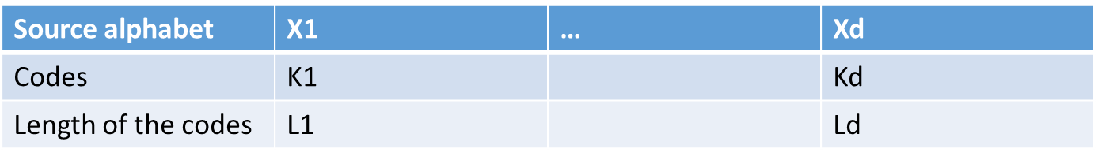
Proof.
Let m = max (Li) be the length of the longest codeword.
Supplement each paths in the code tree to have path length m everywhere (we supplement the existing codes to the fix-length codes with length m).
As illustrated in the code tree of the previous example (m=4, r=2):
Thick (bold) edges indicate the original paths.
In the original code tree has a path of length Li can be extended in r^{m -Li} ways. So from given point the path on the tree can be supplemented to length m by drawing the missing edge m-Li.
The original length was 3, we supplement the tree with 2⁴⁻³ paths
The original length was 1, we supplement the tree with 2⁴⁻¹ =2³ paths

Slide 16
Proof.
The extended code tree will have
completed paths, so looking on the all paths in a binary tree, where the number of the pats is r^{m}
Dividing the inequality with r^{m}, we have the Karft inequality:

Slide 17
Theorem in both ways:
If we have a prefix code:
where we use a channel alphabet with r characters (for example, r=2, if we use {0,1}), then it holds:
Opposite way:
If for the set of natural numbers L1, L2, …Ld and r≥2 holds:
then exist a prefix code like presented in the table above.

Slide 18
McMillan theorem:
The inequality
holds for all uniquely decodable codes
where we use a channel alphabet with r characters.

Slide 19
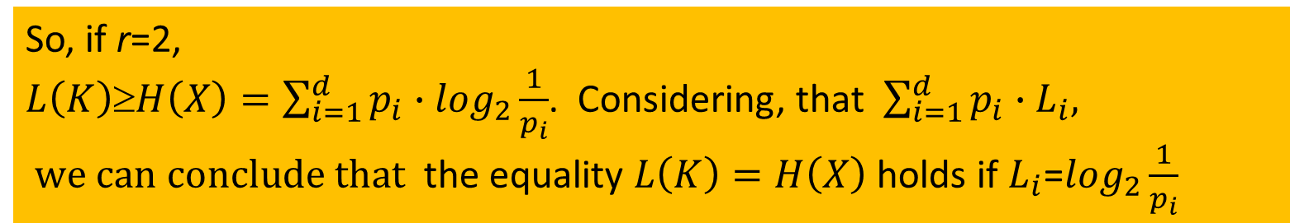
What can be the minimum (average) code lenght knowing this inequality?
It is an optimization problem:
Minimize the average code length:
Subject to:
Solution:
Source alphabet | X1 | … | Xd
Probability of the characters | P1 |  | Pd
Length of the codes | L1 |  | Ld
So, if r=2,
$L\left(K\right)≥H\left(X\right)=\sum_{i=1}^{d}{p_{i}∙\log_{2}\frac{1}{p_{i}}}$. Considering, that $\sum_{i=1}^{d}{p_{i}∙L_{i}, \text{we} \text{can} \text{conclude} \text{that} }$the equality $L\left(K\right)=H\left(X\right)$holds if $L_{i}$=$\log_{2}\frac{1}{p_{i}}$

Slide 20
The previous was lower boundary for the code lenght, and the upper boundary?
Theorem (without proof):
Whatever the P(X) distribution of the source alphabet X we have, if we construct codes from the signals of the r channel alphabet signs, we can always create a prefix code for which

Slide 21
Previous theorems can be summarized as follows:
For the known conditions (source alphabet: X={X, …, Xd}, with probability distribution P(Xi)=pi, i=1,…d, with the entropy H(X), channel alphabet of r characters, and code lengths L1, …Ld),
for the arbitrarily constructed, uniquely decodable code we have average code length:
and it is possible to construct prefix code where
It is the Shanon channel theorem for noiseless channels.

Slide 22
Efficiency of the coding procedure
The efficiency of the code K of the source alphabet X with entropy H (X)
and using channel code set of r elements, the proportion:
is the efficiency of the coding procedure.

Slide 23
The binary code tree types and the code length - statistical based coding
Shannon-Fano codes
1. Determining the probability of occurrence of symbols.
2. Arrange the symbols in descending order of probability.
3. Assign elements to the interval [0, 1] based on probability.
4. Divide the interval into two equal parts as long as there are more than one symbol in the interval.
In the case where the symbol is just at the boundary of the intervals,
it is considered to belong to the right-hand interval.
Based on Laufer Edit: Informatika alapjai jegyzet

Slide 24
Shannon-Fano example:
Calculate the H(X), average code length!

Slide 25
Gilbert-More code
Determining the probability of occurrence of symbols.
Assign elements to the interval [0, 1] based on probability.
Divide the interval into two equal parts as long as there are more than one symbol in the interval.
In case the symbol is just at the boundary of the intervals,
it is considered to belong to the right-hand interval.
4. Code tree generation
5. Assign code marks to branches.
6. Read codewords from the root point to the letter.
0,25
0,4
0,875
0,05
1
0,75
0001
0,9=0,05+0,2+0,15+0,5

Slide 26
What characterizes the optimal code?
If P1$≤P2≤…≤Pd t$hen L1 ≥ L2 ≥ … ≥ Ld.
2. The code should form a complete code tree, ie exactly r edge should start from each node (example, r=2). The entire code tree is balanced, resulting in a shorter code length by keeping the code tree depth to a minimum.
3. If the code is optimal, then the code lengths of the two least probable elements are equal (Huffman code).

Slide 27
Huffman code construction based on the frequency of the characters
https://people.ok.ubc.ca/ylucet/DS/Huffman.html
„Today is March day and nice weather”

Slide 28
Home work
1. Extend your previous example with code construction based on the character frequency!
2. Construct for the example the Shanon-Fano and Gilbert –More code!
3. Compare the code lengths!
4. Controll the boundaries of the average code lengths! (You need H(X) of your source code!)

