Slide 1
Analysis of Survey

Slide 2
SAGE Survey validation
One of the “issues” we had with the SAGE survey was whether the tool would work well to measure the intended traits:
Group effectiveness
Equity and fairness of group work
Sense of belonging
Social, psychological and other benefits
Reduced their 54-item questionnaire down to ~20
Different populations (high school vs college)
Need to validate the survey
Does the survey measure the intended factors, and is it reliable?

Slide 3
Confirmatory Factor Analysis
Define the factors (taken from Kouros and Abrami, and cross-reference with the asked questions)
Quality of product and process
['When I work in a group, I do higher quality work.', 'The material is easier to understand when I work with other students.’, 'My group members help explain things that I do not understand.', 'I feel working in groups is a waste of time.', #'The work takes more time to complete when I work with other students.’, 'The workload is usually less when I work with other students.’]
Peer support
['My group members respect my opinions.', 'My group members make me feel that I am not as smart as they are.', 'My group members do not care about my feelings.’, 'I feel I am part of what is going on in the group.', 'When I work in a group, I am able to share my ideas.']
Student interdependence
['Everyone’s ideas are needed if we are going to be successful.', 'We cannot complete the assignment unless everyone contributes.', 'I let the other students do most of the work.’, 'I also learn when I teach the material to my group members.', 'I learn to work with students who are different from me.']
Frustration with group members
['I become frustrated when my group members do not understand the material.', 'When I work with other students, we spend too much time talking about other things.', 'I have to work with students who are not as smart as I am.']
Total 19 questions
Pass the data through the factors:
SAGE_CFA.csv, .png
“The four factors extracted with principal components analysis (with varimax rotation) accounted for 46.10% of the total variance in the data (eigenvalues ranged from 13.90 to 2.04). Items that failed to load .40 or higher were deleted, as well as, items that loaded on more than one factor. Ultimately, 11 items were eliminated from the SAGE questionnaire (items 2, 3, 15, 18, 21, 22, 24, 35, 39, 42, and 51).”
*The python package fails to converge so we use R instead

Slide 4
Confirmatory Factor Analysis
CFI = 0.875
TLI = 0.854
RMSEA = 0.060

Slide 5
Our survey
32 total questions
23 from SAGE
2 on Leadership preference
4 on Task preferences
3 on Mindset
3 have “negatively-worded” alternatives
5-point Likert scale
Physics growth mindset are 6-point scales to have respondents “choose a side”
Demographic questions

Slide 6
Items
0 When I work in a group, I do higher quality work.
1 When I work in a group, I end up doing most of the work.
2 The work takes more time to complete when I work with other students.
3 My group members help explain things that I do not understand.
4 When I work in a group, I am able to share my ideas.
5 My group members make me feel that I am not as smart as they are.
6 The material is easier to understand when I work with other students.
7 The workload is usually less when I work with other students.
8 My group members respect my opinions.
9 I feel I am part of what is going on in the group.
10 I prefer when one student regularly takes on a leadership role.
11 I prefer when the leadership role rotates between students.
12 I do not think a group grade is fair.
13 I try to make sure my group members learn the material.
14 I learn to work with students who are different from me.
15 My group members do not care about my feelings.
16 I let the other students do most of the work.
17 I feel working in groups is a waste of time.
18 I have to work with students who are not as smart as I am.
19 When I work with other students the work is divided equally.
20 We cannot complete the assignment unless everyone contributes.
21 I prefer to take on tasks that I’m already good at.
22 I prefer to take on tasks that will help me better learn the material.
23 I also learn when I teach the material to my group members.
24 I become frustrated when my group members do not understand the material.
25 Everyone’s ideas are needed if we are going to be successful.
26 When I work with other students, we spend too much time talking about other things.
27 My group did higher quality work when my group members worked on tasks together.
28 My group did higher quality work when group members worked on different tasks at the same time.
29 You have a certain amount of physics intelligence, and you can’t really do much to change it.
30 Your physics intelligence is something about you that you can change.
31 You can learn new things, but you can’t really change your basic physics intelligence.

Slide 7
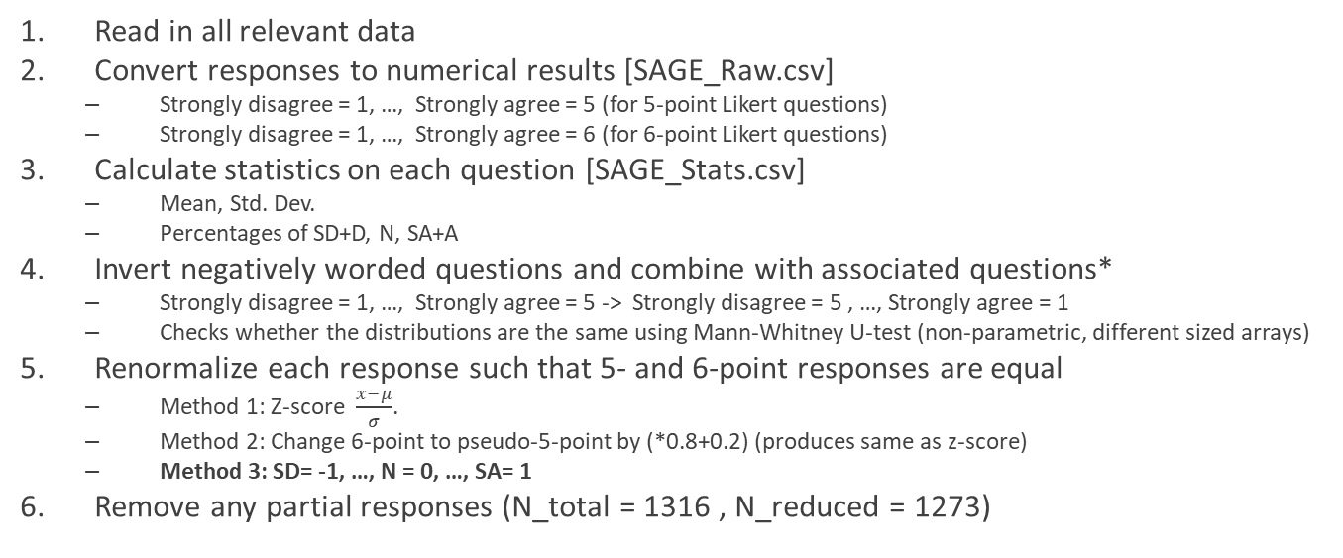
Data Prep
Read in all relevant data
Convert responses to numerical results [SAGE_Raw.csv]
Strongly disagree = 1, …, Strongly agree = 5 (for 5-point Likert questions)
Strongly disagree = 1, …, Strongly agree = 6 (for 6-point Likert questions)
Calculate statistics on each question [SAGE_Stats.csv]
Mean, Std. Dev.
Percentages of SD+D, N, SA+A
Invert negatively worded questions and combine with associated questions*
Strongly disagree = 1, …, Strongly agree = 5 -> Strongly disagree = 5 , …, Strongly agree = 1
Checks whether the distributions are the same using Mann-Whitney U-test (non-parametric, different sized arrays)
Renormalize each response such that 5- and 6-point responses are equal
Method 1: Z-score $\frac{x−μ}{σ}$.
Method 2: Change 6-point to pseudo-5-point by (*0.8+0.2) (produces same as z-score)
Method 3: SD= -1, …, N = 0, …, SA= 1
Remove any partial responses (N_total = 1316 , N_reduced = 1273)

Slide 8
Negatively Worded Questions
My group members respect my opinions.
My group members respect my opinions.: 4.28 ± 0.78
My group members do not respect my opinions.: 4.35 ± 0.84
Mann-Whitney U p-value=0.007
I prefer when no one takes on a leadership role.
I prefer when one student regularly takes on a leadership role.: 3.13 ± 1.01
I prefer when no one takes on a leadership role.: 3.23 ± 1.08
Mann-Whitney U p-value=0.102
I do not let the other students do most of the work.
I let the other students do most of the work.: 1.62 ± 0.83
I do not let the other students do most of the work.: 2.08 ± 1.09
Mann-Whitney U p-value=3.0E-16

Slide 9
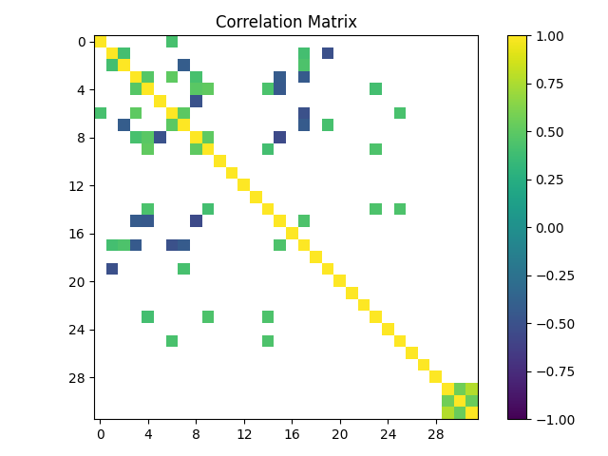
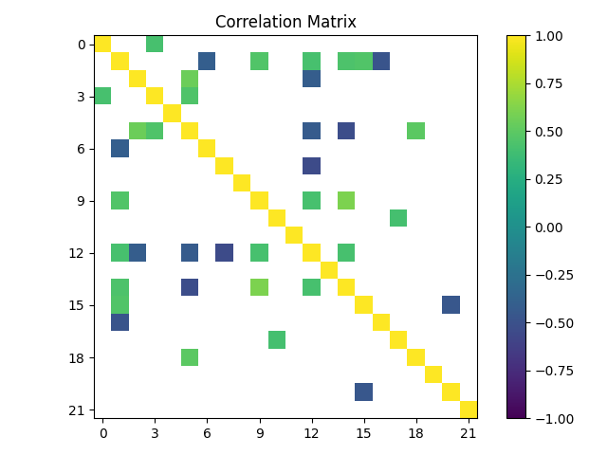
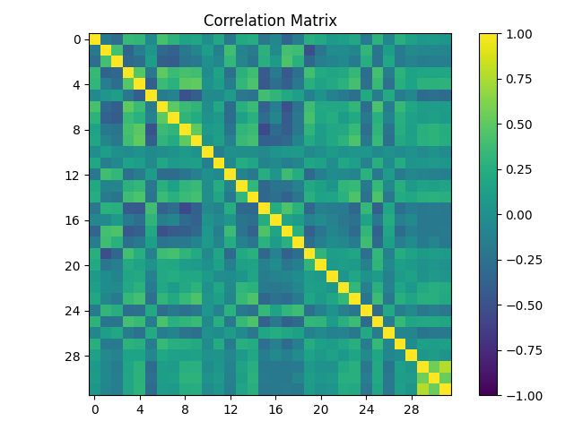
Correlation Matrix
Spearman correlation
SAGE_CorrM.csv, .png
Correlations >0.4

Slide 10
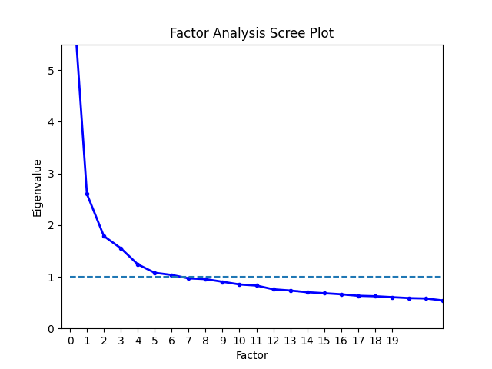
Exploratory Factor Analysis
First produce eigenvalues for arbitrary number of factors
Scree plot (SAGE_Scree.png)
Kaiser Criterion (ε>1) to determine number of factors
(though Kouros and Abrami had ε>2)

Slide 11
Exploratory Factor Analysis
Follows algorithm described in Section II.A from Eaton et al 2019
Calculate the Kaiser-Meyer-Olkin (KMO) values for every item. If any items have a KMO below the cutoff value, then the item with the lowest value is removed and the step is repeated. KMO values above 0.6 are kept, though above 0.8 are preferred.
KMO measures the suitability for factor analysis by estimating the proportion of variance among all observed variables
Check whether the items can be factored using Bartlett's test of sphericity. A low p-score indicates that factor analysis can be performed.
Compares the correlation matrix to the identity matrix (checks whether there are correlations)
Calculate the EFA model using factoring and a specified number of factors.
Calculate the commonalities, which are the proportion of the item's variance explained by the factors. If any item is below the cutoff (<0.2), then the item with the lowest value is dropped and then restart at Step 1.
Calculate the item loadings. If there are items that fail to load to any factor, then remove the item with the smallest max loading and then restart at Step 1.
Create a model for the CFA by placing each item onto the factor that contains the item's largest loading. If any items load equally onto more than one factor, then add to all factors where this is the case.
Fit this model using Confirmatory Factor Analysis and extract a fit statistic (Akaike information criterion, or similar) to be used as a comparison for the ideal number of factors.
Change the number of factors and repeat the above steps.
Plot the fit statistic vs the number of factors. The model with the local minimum index is the preferred model.
Outputs
SAGE_EFA_n=(2, 3,…).png
SAGE_EFA_ 0.4_n=(2, 3,…).png to show significant factor correlations (>0.4)
EFA_labels_n=(2,3,…).txt
EFA_n=(2,3,…).txt contains the CFA information from step 7
fit_stats.png – plot of fit statistic vs number of factors
P. Eaton, K. Johnson, B. Frank, and S. Willoughby, Classical test theory and item response theory comparison of the Brief Electricity and Magnetism Assessment and the Conceptual Survey of Electricity and Magnetism, Phys. Rev. Phys. Educ. Res. 15, 010102 (2019).

Slide 12
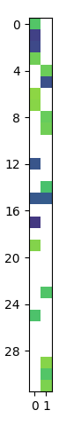
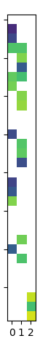
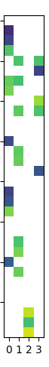
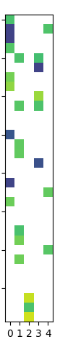
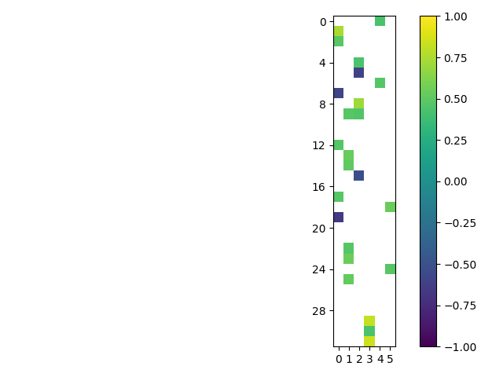
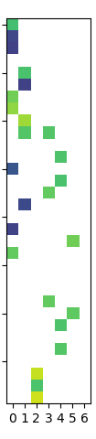
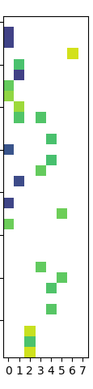
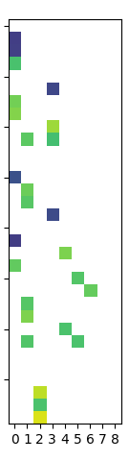
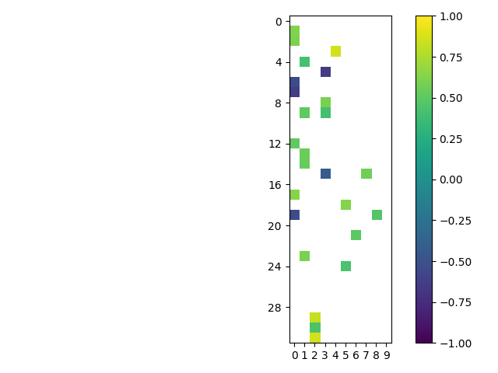
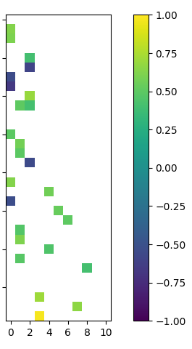
Factor Analysis (vs number of factors)
2 factors
11 factors
*
*
*
* Items not included for Kouros and Abrami

Slide 13
Factor Analysis
Items that failed to load on any number of factors
10: I prefer when one student regularly takes on a leadership role.
16 I let the other students do most of the work.
20: We cannot complete the assignment unless everyone contributes.
21: I prefer to take on tasks that I’m already good at.
26: When I work with other students, we spend too much time talking about other things.
28: My group did higher quality work when group members worked on different tasks at the same time.
Items that failed to load .40 or higher were deleted as well as, items that loaded on more than one factor. Ultimately, 11 items were eliminated from the SAGE questionnaire
*2: When I work in a group, I end up doing most of the work.
3: When I work with other students, I am able to work at my own pace
15: My group members get a good grade even if they do not do much work.
18: One student usually makes the decisions in the group
21: I do not think a group grade is fair
*22: I try to make sure my group members learn the material.
24: It is difficult to get together outside of class
*35: When I work with other students the work is divided equally.
39: My group members compete to see who does better work
42: I like to help my group members learn the material
51: Same as 31 (repeat for reliability)
*questions used

Slide 14
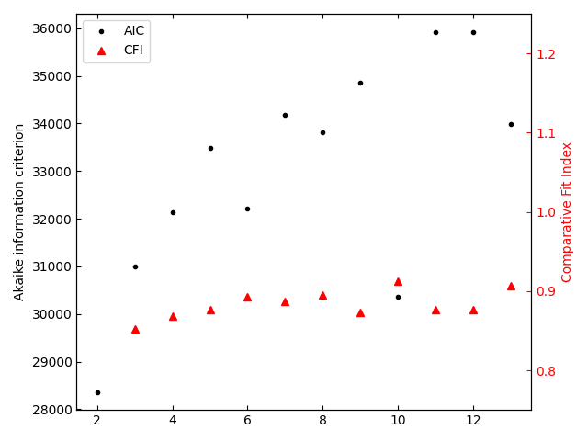
So… how many factors?
6
“8”
“10”…
We can use fitting index to determine ideal number of factors (minimize the amount of variance)
Akaike information criterion vs “number of factors”
6, 8, or 10 “optimal” number of factors
Dashed lines show factors with 1 or no items loading
What do we do for items that load onto multiple factors? (SAGE drops them)

Slide 15
Exploratory Factor Analysis (n=6)
Quality of process
'When I work in a group, I end up doing most of the work.', 'The work takes more time to complete when I work with other students.', 'The workload is usually less when I work with other students.', 'I do not think a group grade is fair.', 'I feel working in groups is a waste of time.', 'When I work with other students the work is divided equally.’
Collective Learning
'I feel I am part of what is going on in the group.', 'I try to make sure my group members learn the material.', 'I learn to work with students who are different from me.', 'I prefer to take on tasks that will help me better learn the material.', 'I also learn when I teach the material to my group members.', 'Everyone’s ideas are needed if we are going to be successful.’
Individual Belonging
'When I work in a group, I am able to share my ideas.', 'My group members make me feel that I am not as smart as they are.', 'My group members respect my opinions.', 'My group members do not care about my feelings.’
Mindset
'You have a certain amount of physics intelligence, and you can’t really do much to change it.', 'Your physics intelligence is something about you that you can change.', 'You can learn new things, but you can’t really change your basic physics intelligence.’
Impact on Individual
'When I work in a group, I do higher quality work.', 'The material is easier to understand when I work with other students.'
Frustrations
'I have to work with students who are not as smart as I am.', 'I become frustrated when my group members do not understand the material.'

Slide 16
Exploratory Factor Analysis (old)
Quality of process
‘When I work in a group, I end up doing most of the work.', 'The work takes more time to complete when I work with other students.', 'The material is easier to understand when I work with other students.', 'The workload is usually less when I work with other students.', 'I do not think a group grade is fair.', 'I feel working in groups is a waste of time.', 'When I work with other students the work is divided equally.'
Individual Belonging
'When I work in a group, I am able to share my ideas.', 'My group members make me feel that I am not as smart as they are.', 'My group members respect my opinions.', 'I feel I am part of what is going on in the group.', 'My group members do not care about my feelings.'
Mindset
'You have a certain amount of physics intelligence, and you can’t really do much to change it.', 'Your physics intelligence is something about you that you can change.', 'You can learn new things, but you can’t really change your basic physics intelligence.'
Forms of Learning (giving)
'I learn to work with students who are different from me.', 'I also learn when I teach the material to my group members.'
Collective Learning
'I prefer when the leadership role rotates between students.', 'I try to make sure my group members learn the material.', 'Everyone’s ideas are needed if we are going to be successful.', 'My group did higher quality work when my group members worked on tasks together.'
Frustrations with Group Members (but more specific)
'I have to work with students who are not as smart as I am.', 'I become frustrated when my group members do not understand the material.'
Forms of Learning (receiving)
'My group members help explain things that I do not understand.'

Slide 17
Exploratory Factor Analysis
Questions we still have:
When we do the analysis, what is our baseline, intercept?
Intervention -> Control
Gender -> (Male, Female, Other)
Race and Ethnicity -> (Underrepresented, well represented)
Education -> (1st Gen, Not 1st Gen)
Based on the “average UT Austin student?” (Control, Female, Well-represented, Not 1st Gen)
Suggestion to refine our hypothesis and base our control from that

Slide 18
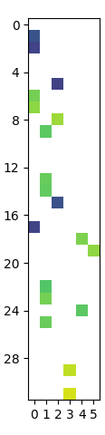
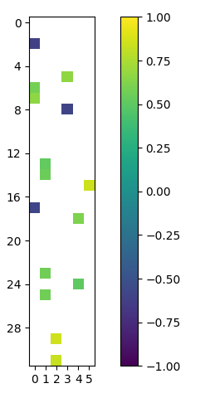
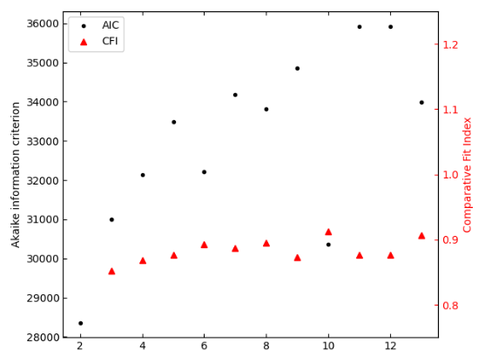
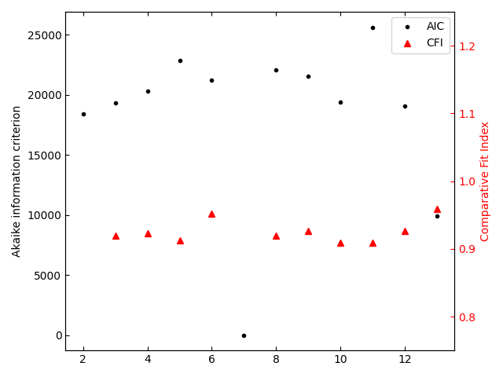
What happens if we increase cutoffs? (n=6)
0.4
0.45
0.5
Decrease of items loading on factors
No more items loading onto multiple factors (item 9)
CFI increases: 0.893 -> 0.952
AIC picture is more difficult to determine
0.4
0.5

Slide 19
Linear Regression
Create a “factor score” for each student response
Dot each student’s responses by the item loading for each factor (include only significant loadings) and normalize by sum of factor item loadings
StudentRatings.csv – each student’s rating of each factor (n=6)
Condense demographics
Gender: Female, Male, Other
Race and Ethnicity: Well-represented (White, Asian), Underrepresented, Mixed race and ethnicity (dropped)
Education: 1st gen, Not 1st gen
Produce plots for each factor based on each demographic
Factor_ratings….png
Turn demographic categories into N-1 binary “dummy” variables
Run regression model for each factor as function of each demographic variable

Slide 20
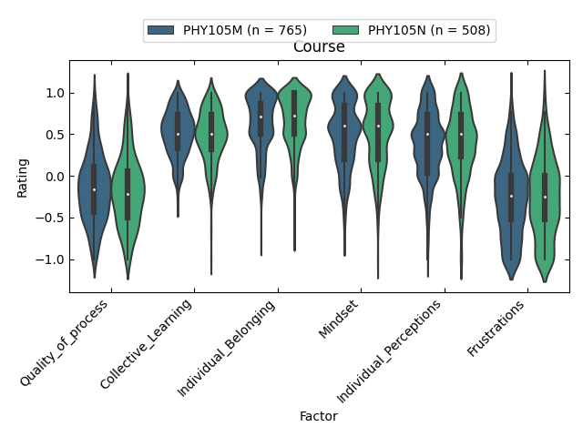
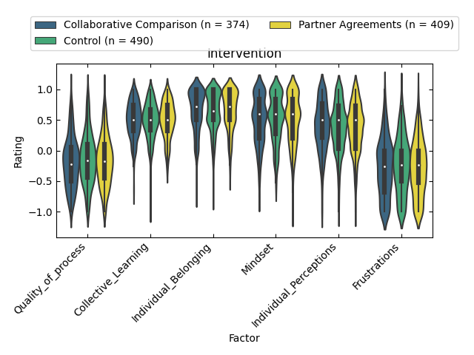
Factor Ratings

Slide 21
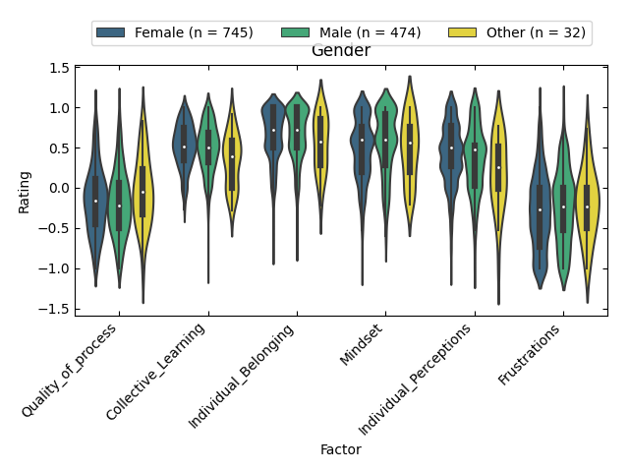
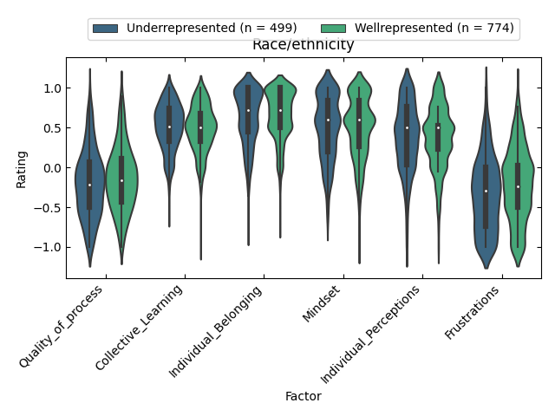
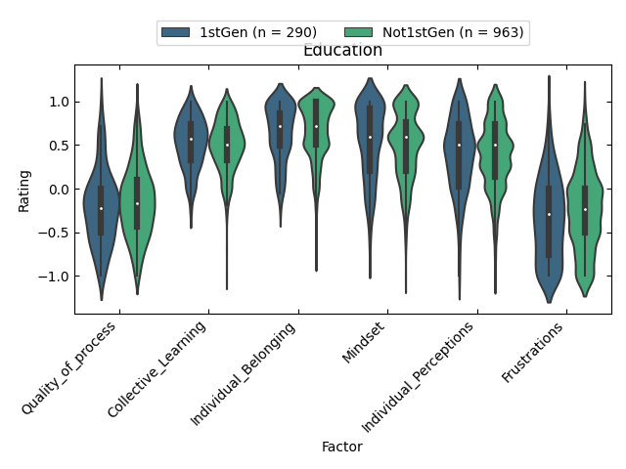
Factor Ratings

Slide 22
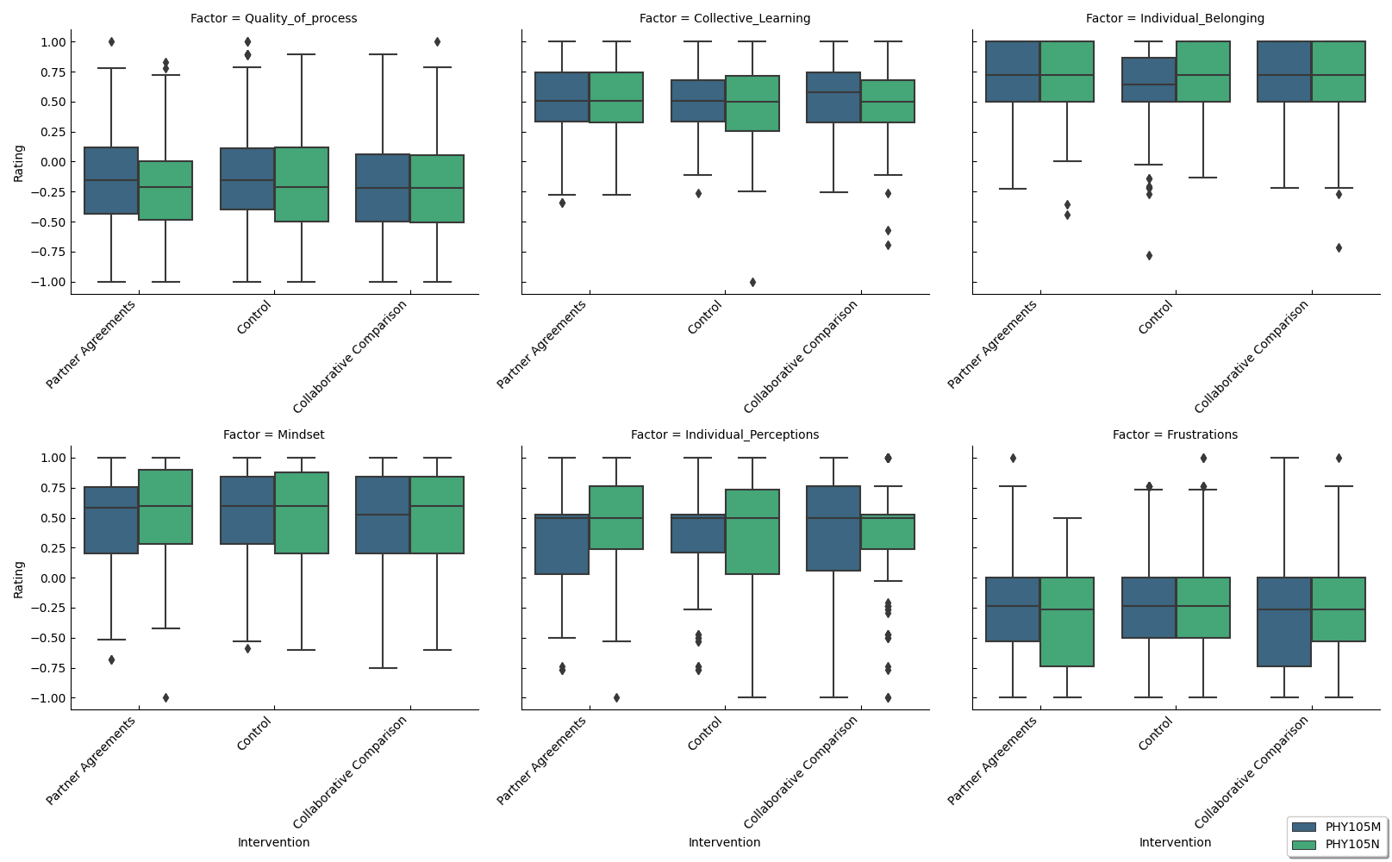

Slide 23
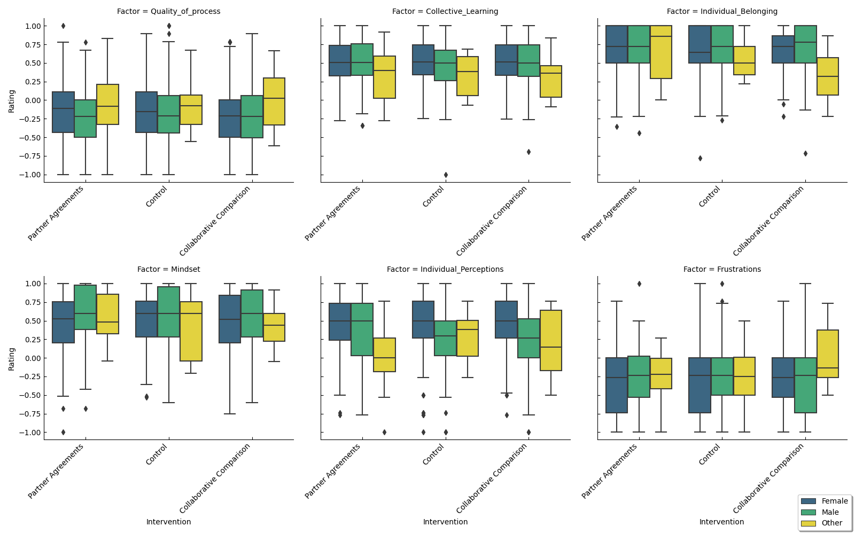

Slide 24
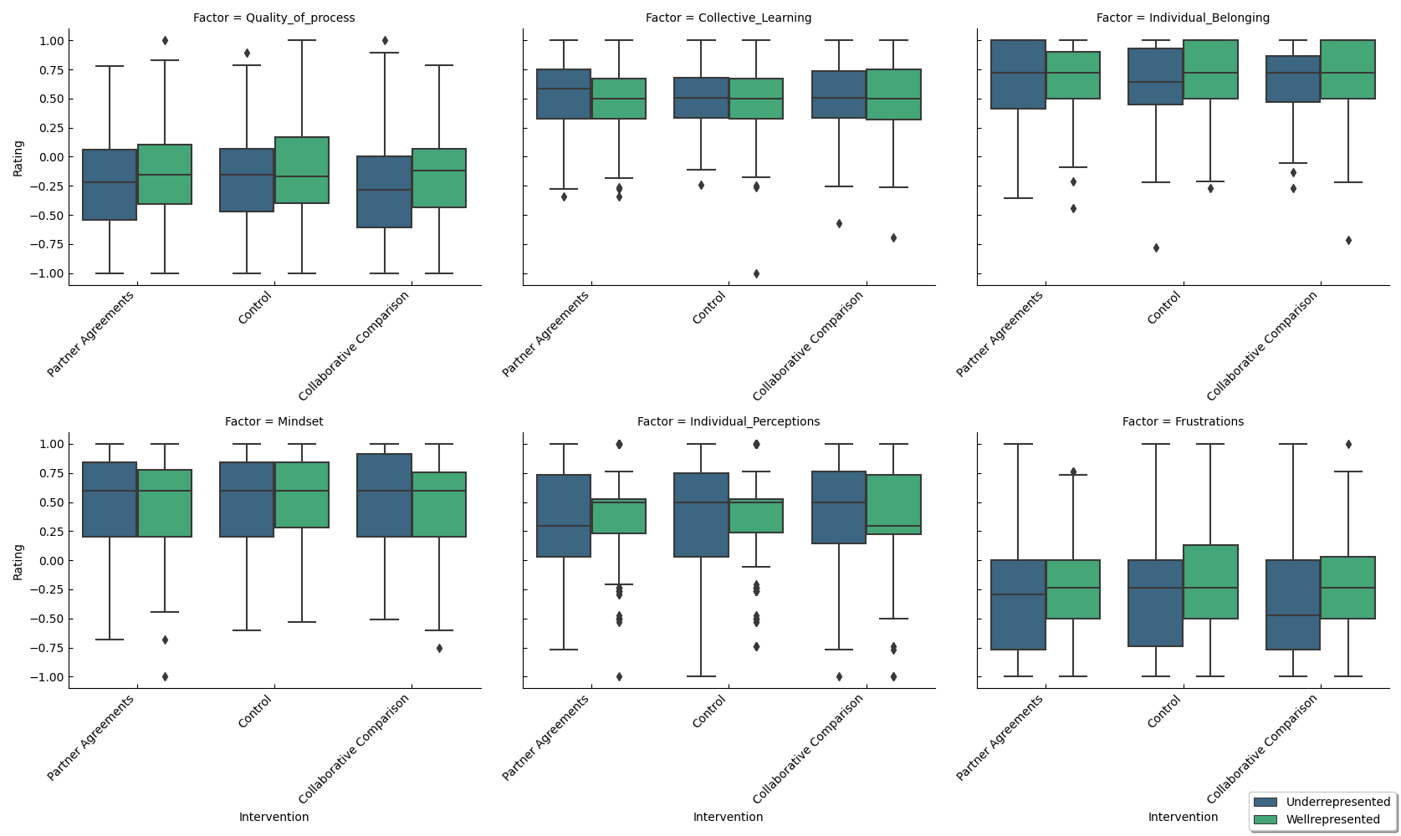

Slide 25
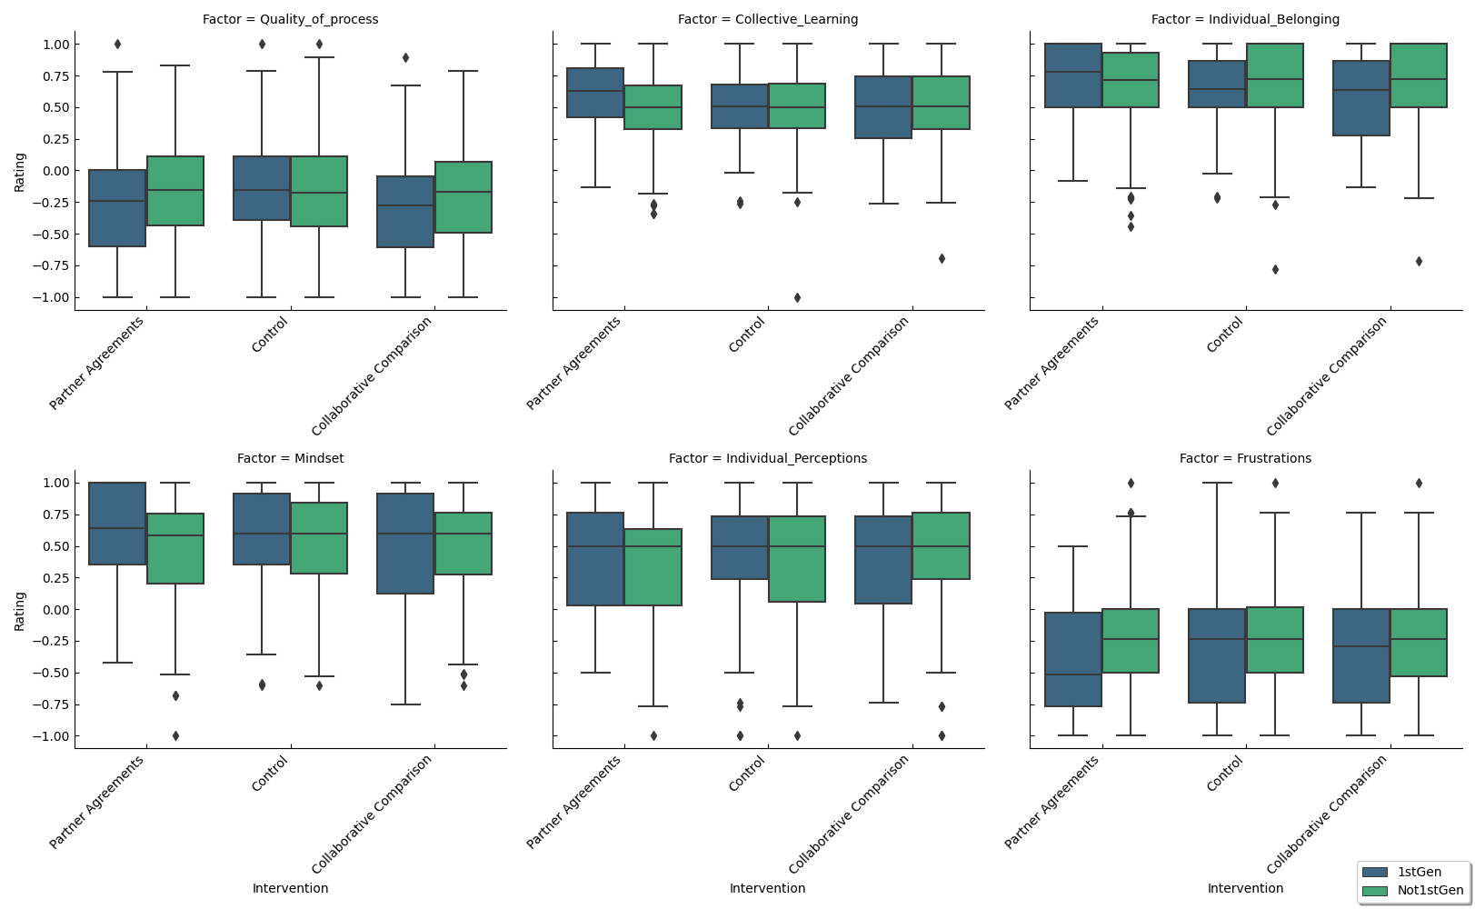

Slide 26
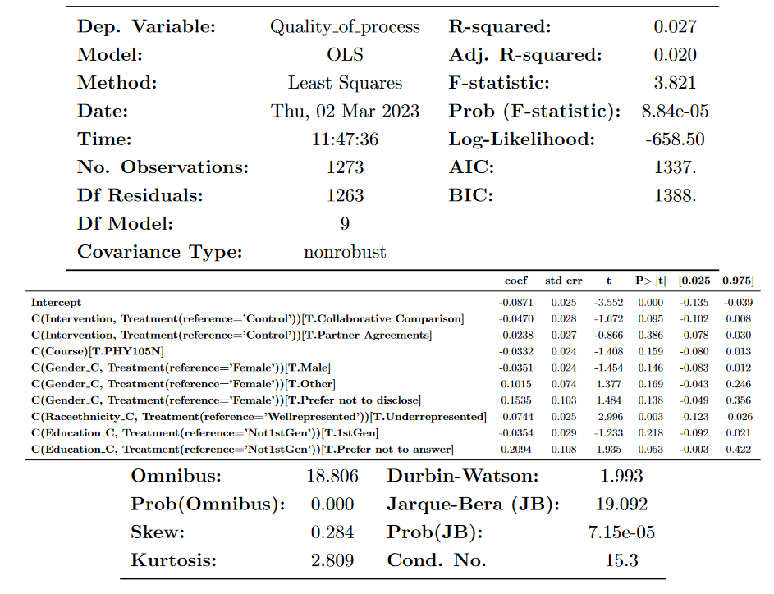
Linear Regression – Quality of Process

Slide 27
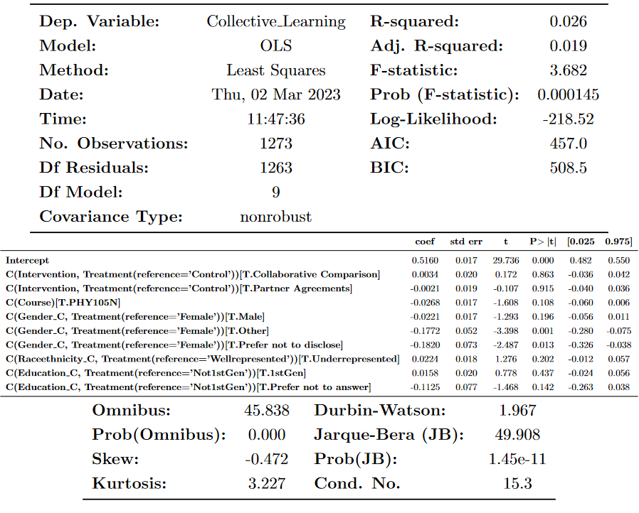
Linear Regression – Collective Learning

Slide 28
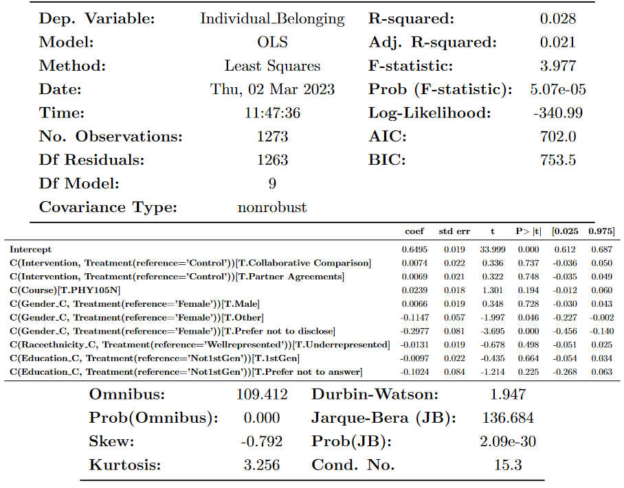
Linear Regression – Individual Belonging

Slide 29
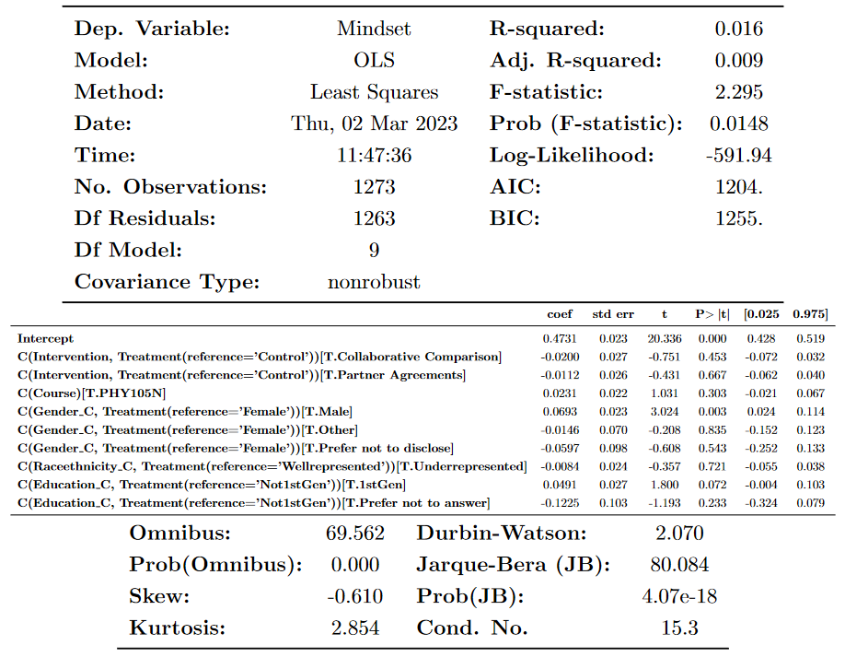
Linear Regression – Mindset

Slide 30
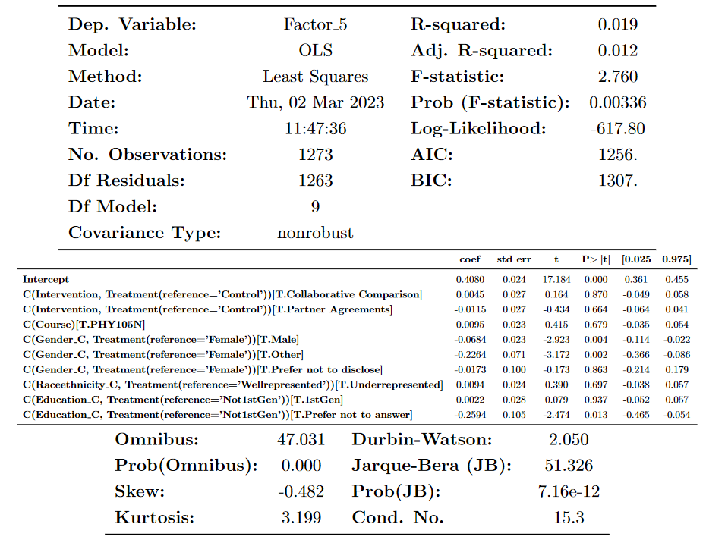
Linear Regression – Individual Perceptions

Slide 31

Linear Regression – Frustrations

Slide 32
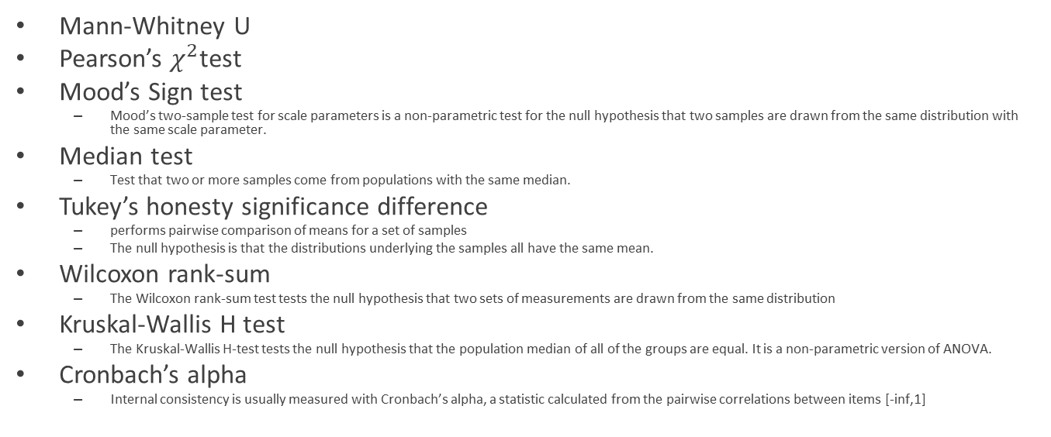
Statistical Tests
Mann-Whitney U
Pearson’s $χ^{2}$test
Mood’s Sign test
Mood’s two-sample test for scale parameters is a non-parametric test for the null hypothesis that two samples are drawn from the same distribution with the same scale parameter.
Median test
Test that two or more samples come from populations with the same median.
Tukey’s honesty significance difference
performs pairwise comparison of means for a set of samples
The null hypothesis is that the distributions underlying the samples all have the same mean.
Wilcoxon rank-sum
The Wilcoxon rank-sum test tests the null hypothesis that two sets of measurements are drawn from the same distribution
Kruskal-Wallis H test
The Kruskal-Wallis H-test tests the null hypothesis that the population median of all of the groups are equal. It is a non-parametric version of ANOVA.
Cronbach’s alpha
Internal consistency is usually measured with Cronbach’s alpha, a statistic calculated from the pairwise correlations between items [-inf,1]

Slide 33
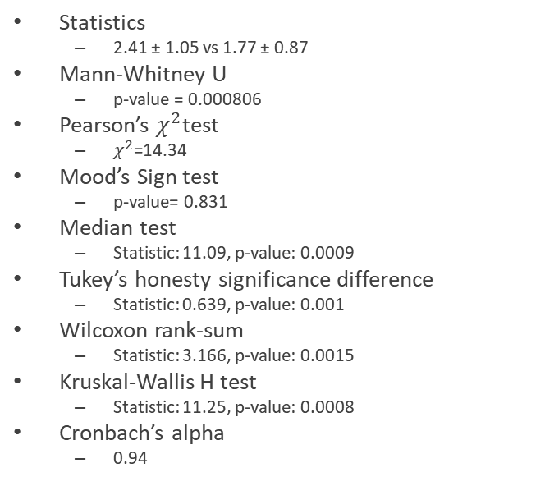
The work takes more time to complete when I work with other students The work takes less time complete when I work with other students
Statistics
2.41 ± 1.05 vs 1.77 ± 0.87
Mann-Whitney U
p-value = 0.000806
Pearson’s $χ^{2}$test
$χ^{2}$=14.34
Mood’s Sign test
p-value= 0.831
Median test
Statistic: 11.09, p-value: 0.0009
Tukey’s honesty significance difference
Statistic: 0.639, p-value: 0.001
Wilcoxon rank-sum
Statistic: 3.166, p-value: 0.0015
Kruskal-Wallis H test
Statistic: 11.25, p-value: 0.0008
Cronbach’s alpha
0.94
Conclusion:
The two questions have different responses
We should keep only one question
Takes more time
Typically in lab, I feel the work takes more time to complete when I work with other students

Slide 34
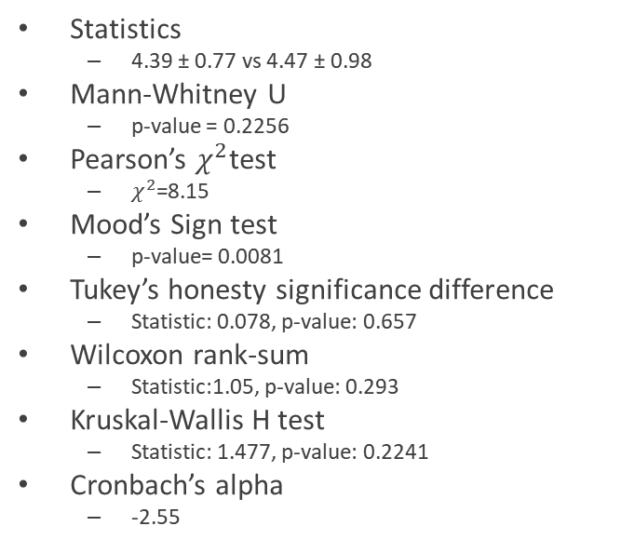
My group members respect my opinions My group members do not respect my opinions
Statistics
4.39 ± 0.77 vs 4.47 ± 0.98
Mann-Whitney U
p-value = 0.2256
Pearson’s $χ^{2}$test
$χ^{2}$=8.15
Mood’s Sign test
p-value= 0.0081
Tukey’s honesty significance difference
Statistic: 0.078, p-value: 0.657
Wilcoxon rank-sum
Statistic:1.05, p-value: 0.293
Kruskal-Wallis H test
Statistic: 1.477, p-value: 0.2241
Cronbach’s alpha
-2.55
Conclusion:
The two questions have similar responses
We can keep using these questions as negatively-worded

Slide 35
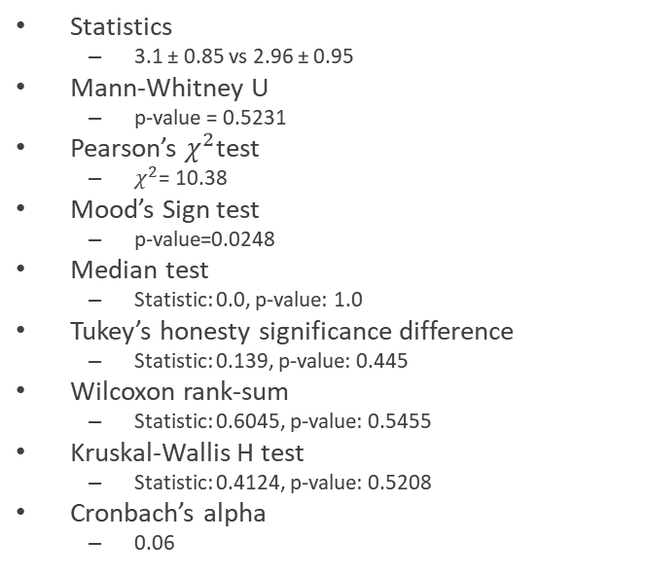
I prefer when one student regularly takes on a leadership role I prefer when no one takes on a leadership role
Statistics
3.1 ± 0.85 vs 2.96 ± 0.95
Mann-Whitney U
p-value = 0.5231
Pearson’s $χ^{2}$test
$χ^{2}$= 10.38
Mood’s Sign test
p-value=0.0248
Median test
Statistic: 0.0, p-value: 1.0
Tukey’s honesty significance difference
Statistic: 0.139, p-value: 0.445
Wilcoxon rank-sum
Statistic: 0.6045, p-value: 0.5455
Kruskal-Wallis H test
Statistic: 0.4124, p-value: 0.5208
Cronbach’s alpha
0.06
Conclusion:
The two questions have similar responses
We can keep using these questions as negatively-worded

Slide 36
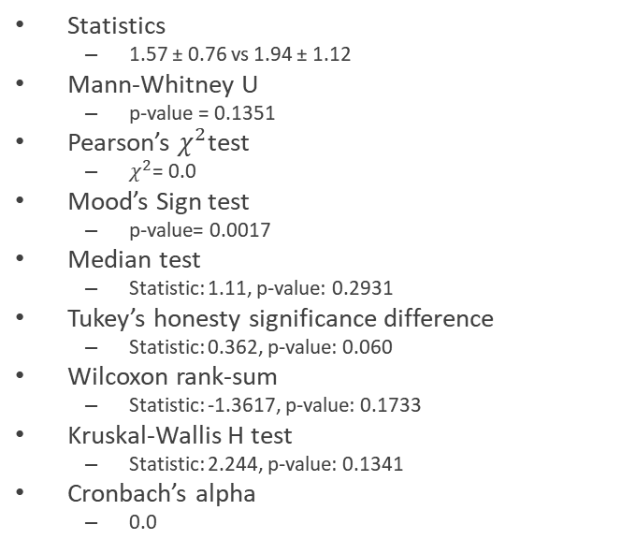
I let the other students do most of the work I do not let the other students do most of the work
Statistics
1.57 ± 0.76 vs 1.94 ± 1.12
Mann-Whitney U
p-value = 0.1351
Pearson’s $χ^{2}$test
$χ^{2}$= 0.0
Mood’s Sign test
p-value= 0.0017
Median test
Statistic: 1.11, p-value: 0.2931
Tukey’s honesty significance difference
Statistic: 0.362, p-value: 0.060
Wilcoxon rank-sum
Statistic: -1.3617, p-value: 0.1733
Kruskal-Wallis H test
Statistic: 2.244, p-value: 0.1341
Cronbach’s alpha
0.0
Conclusion:
The two questions have similar responses
We can keep using these questions as negatively-worded

Slide 37
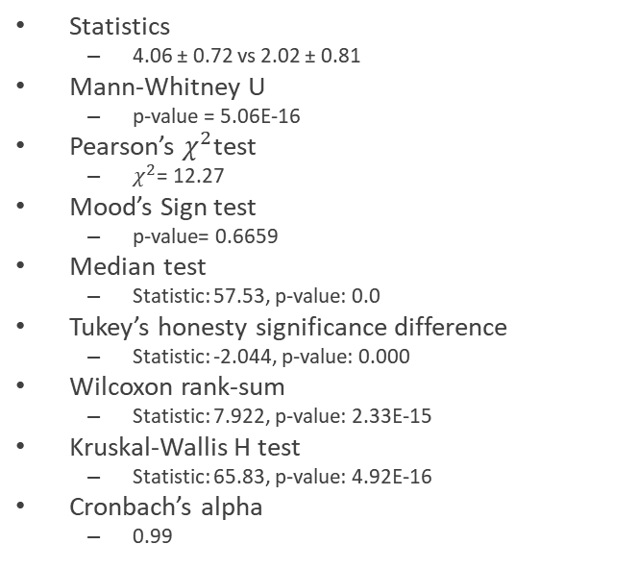
I prefer to take on tasks that I’m already good at I prefer to take on tasks that will help me better learn the material
Statistics
4.06 ± 0.72 vs 2.02 ± 0.81
Mann-Whitney U
p-value = 5.06E-16
Pearson’s $χ^{2}$test
$χ^{2}$= 12.27
Mood’s Sign test
p-value= 0.6659
Median test
Statistic: 57.53, p-value: 0.0
Tukey’s honesty significance difference
Statistic: -2.044, p-value: 0.000
Wilcoxon rank-sum
Statistic: 7.922, p-value: 2.33E-15
Kruskal-Wallis H test
Statistic: 65.83, p-value: 4.92E-16
Cronbach’s alpha
0.99
Conclusion:
The two questions have different responses
We should ask both questions

Slide 38
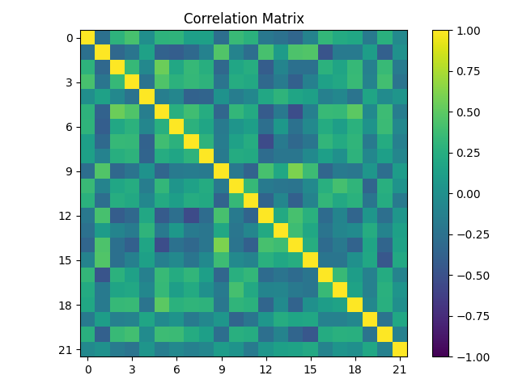
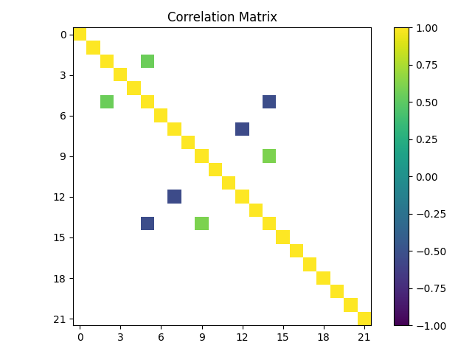
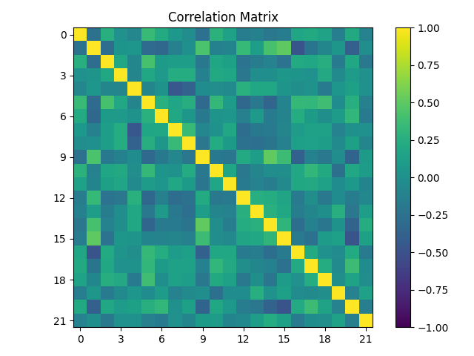
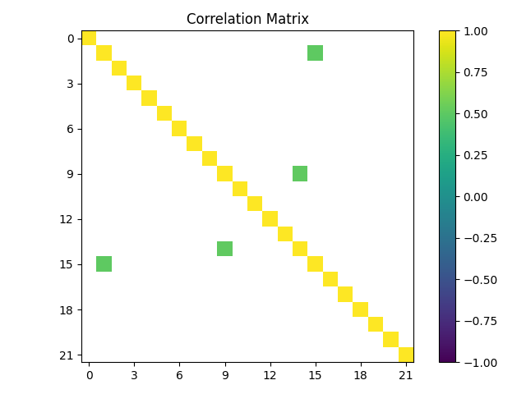
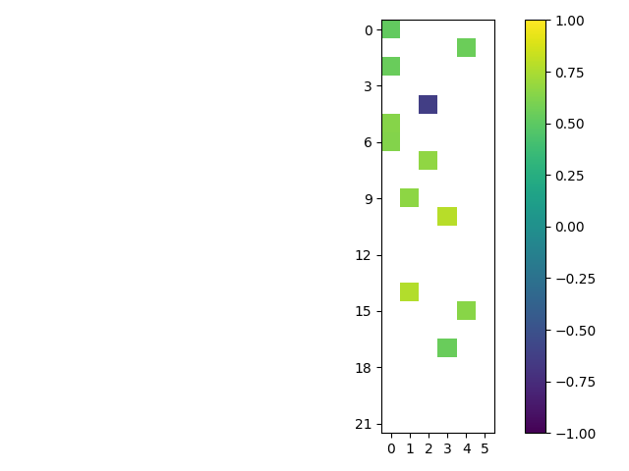
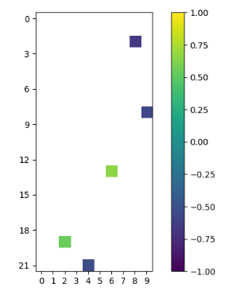
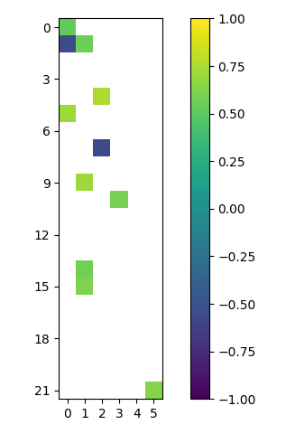
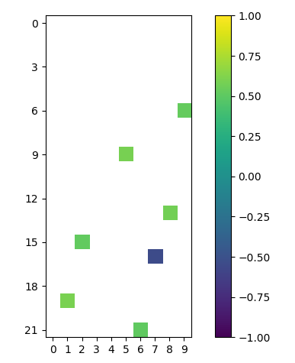
Differences between normalizations
Z-score/scaling to 5
SD+D = -1, N = 0, SA+A = 1

Slide 39
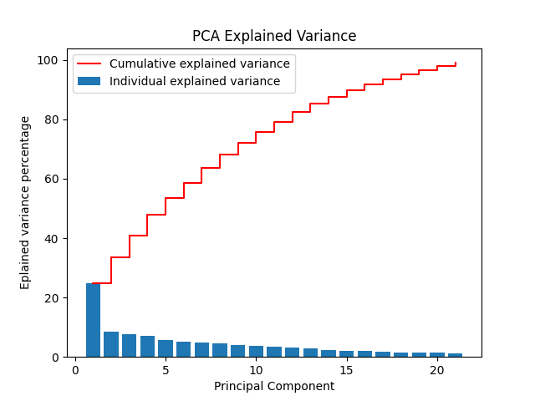
Principal Component Analysis
Look at total explained variance
Specify the explained variance to be somewhere between 70 and 80%
Kouros and Abrami had explained variance ~40%

Slide 40
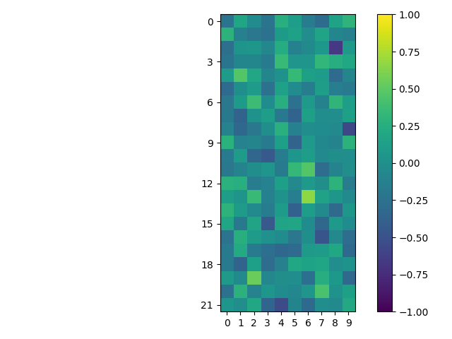


Principal Component Analysis
Look at total explained variance
Specify the explained variance to be somewhere between 70 and 80%
Perform PCA with 75% variance explained
N=10

Slide 41

Comparison between EFA and PCA

