Slide 1
Data, Platforms and Digitalization
Ioanna Constantiou, ic.digi@cbs.dk
Department of Digitalization

Slide 2

Forces of Change
What do the changes mean for the firm?
Trends likely to continue and intensify
Age of Networks
Age of Data
FIRM
Networks connect physical, digital, and social
Surge in data and tools that can manage and analyze data
Age of Platforms
New business models that that leverage networks and intelligence
Source: P. Evans, “Networks, Data and Platforms,” in Growing Global: Lessons for the New Enterprise, Center for Global Enterprise, 2015.
2016 Parker & Van Alstyne, with Choudary – licensed under Creative Commons Attribution-ShareAlike 4.0 International (CC BY-SA 4.0).

Slide 3
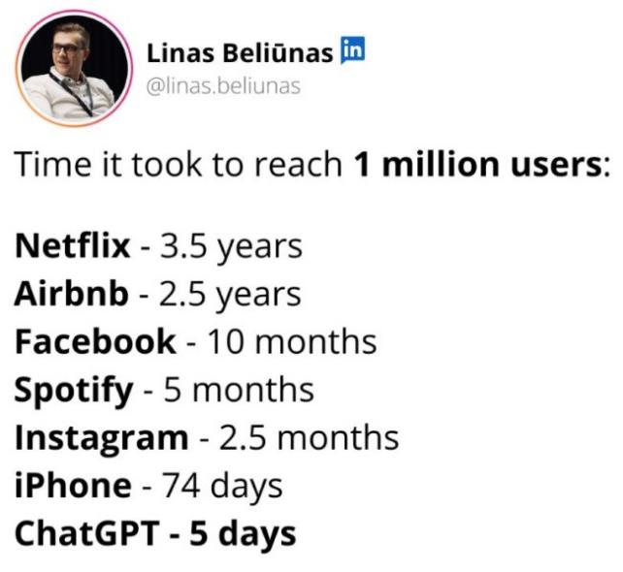
The latest developments
Tech Giants Revised Ethics Policies and focus on Bold innovation vs EU AI Act with risk levels
GenAI use and critical thinking

Slide 4






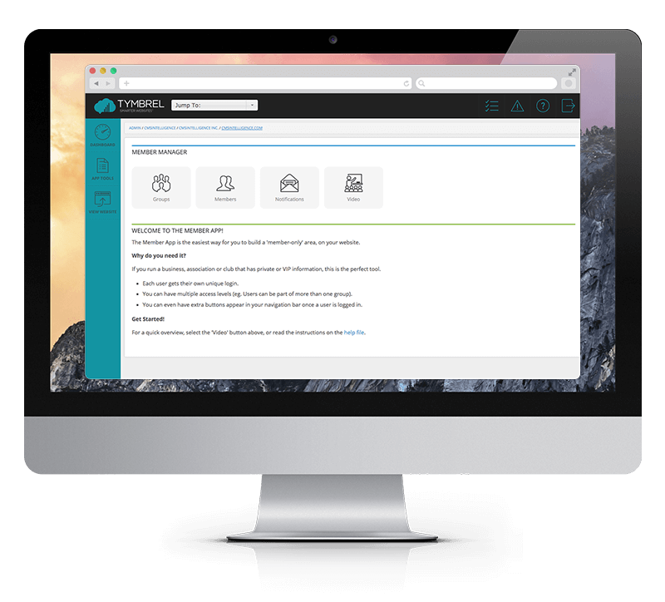






How can a firm exploit the data?
‘Walking Data Generator
BI&A 1.0
«Walking Data Generator»
Big Data Analytics
Data Collection
Communication data
Web data
BI&A 2.0
Social media data
Sensor data
BI&A 2.0
Targeted communication; personalized products & services
…

Slide 5

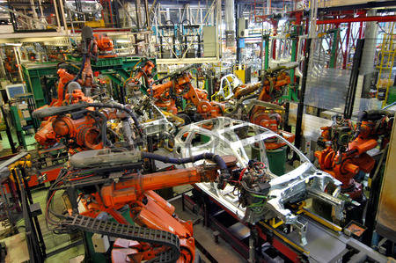
Difference between IT and Digital
What is different for strategy?
Multiple simultaneous business transformations
IT enabled and Digital

Slide 6
Digital Mindset
Digital mindset- a set of attitudes and behaviors that enable people and organizations to see how data, algorithms, and AI open up new possibilities and to chart a path for success in a business landscape increasingly dominated by data-intensive and intelligent technologies
preparing people for a new digital organizational culture
Continuous learning culture
designing and aligning systems and processes.
Data, Cloud computing & Algorithms

Slide 7
The Adoption Matrix: Digital transformation sparks a range of responses in employees

Slide 8
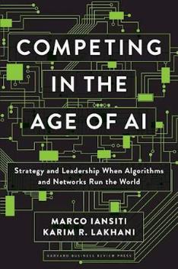
How AI-Driven companies outstrip traditional firms (Iansiti & Lakhani, 2020)

Slide 9
Value creation, capture and delivery (Iansiti & Lakhani, 2020)

Slide 10
AI adoption in Organizations
Is there a relationship between Digitalization and AI adoption?
→ Survey results

Slide 11
What business needs can AI support?
Process Automation
Automating repetitive tasks
Example: Customer Service - Transferring data from emails into systems of record
Gaining Insights
Detecting patterns in huge amounts of data
Examples: Prediction of customer preferences, fraud detection, targeted advertising, drug-discovery in pharma
Fostering Engagement
Engaging customers and employees
Examples: service chatbot, roboadvisor, recommender systems for products or content
Davenport & Ronanki (2018). Artificial intelligence for the real world. Harvard Business Review
Notes:
Gaining Insights
Using ML / DL to discover patterns in huge amounts of data
Models are trained on some parts of the data set
Models learn from feedback and improve their performance over time (i.e., make better predictions, or more correct classifications)

Slide 12
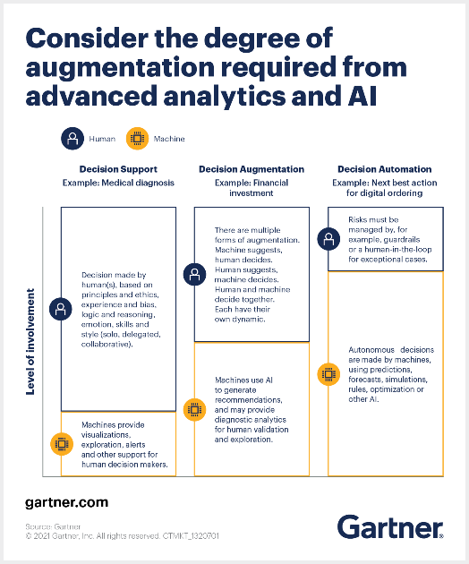

Slide 13
The AI Factory metaphor (Iansiti & Lakhani, 2020)
At the core of the new firm is a decision factory—what we call the “AI factory.” Its software runs the millions of daily data (e.g., Google ads).
Its algorithms make decisions on resources allocation (e.g., which cars offer rides, pricing strategy in retail, runs the robots, chatbots diagnositcs etc).
In each case the AI factory treats decision-making as a science. Analytics systematically convert internal and external data into predictions, insights, and choices, which in turn guide and automate operational workflows.

Slide 14
AI Factory components (Iansiti & Lakhani, 2020)

Slide 15
Discussion in Class: Economic and Strategic considerations from the introduction of AI
Consider an organization that you know relatively well
What type of AI solutions are they using, or planning to and in which business activities?
What should the company choose for future AI solutions, to buy them or develop the internally? (Pros and Cons in bullet points)

