Slide 1
Data, Platforms and Digitalization
Ioanna Constantiou, ic.digi@cbs.dk
Department of Digitalization

Slide 2
Conversation starter
Consider you favorite social media platform, how easy would be to switch to a new European version of it? Why?

Slide 3
Questions related to learning objectives
How can firms compete in newly vulnerable markets?
How can firms manage network effects and exploit data network effects?

Slide 4
Newly Vulnerable Markets
Newly easy to enter
Attractive to attack
opportunistic pickoff of the best customers
3. Difficult to defend

Slide 5
OPEN FORUM
Is the Danish newspapers market a newly vulnerable market?

Slide 6
Questions related to learning objectives
How can firms compete in newly vulnerable markets?
How can firms manage network effects and exploit data network effects?

Slide 7






Network Effects
A same-side effect for each side, i.e., preference regarding number of other users on own side
A cross-side effect in each direction, i.e., preference regarding number of users on other side
Side
1
Side
2
PLATFORM
Source: Eisenmann, Parker, Van Alstyne, 2006. “Strategies for Two Sided Markets.” Harvard Business Review.
2016 Parker & Van Alstyne, with Choudary – licensed under Creative Commons Attribution-ShareAlike 4.0 International (CC BY-SA 4.0).

Slide 8


A two-sided network has four network effects
THESE CAN BE POSITIVE OR NEGATIVE.
+ same-side : Player-to-player contact in Xbox MMOG, end-user PDF sharing.
+ cross-side : merchants & consumers for Visa, developers & end-users for Windows
Side
1
Side
2
- same-side : competing suppliers in auction, competing dates on Match.com
- cross-side : Advertising clutter to viewers.
PLATFORM
Source: Eisenmann, Parker, Van Alstyne, 2006. “Strategies for Two Sided Markets.” Harvard Business Review.
2016 Parker & Van Alstyne, with Choudary – licensed under Creative Commons Attribution-ShareAlike 4.0 International (CC BY-SA 4.0).

Slide 9
Positive Feedback
100
Winner
Market Share (%)
50
Battle zone
Loser
0
Time

Slide 10
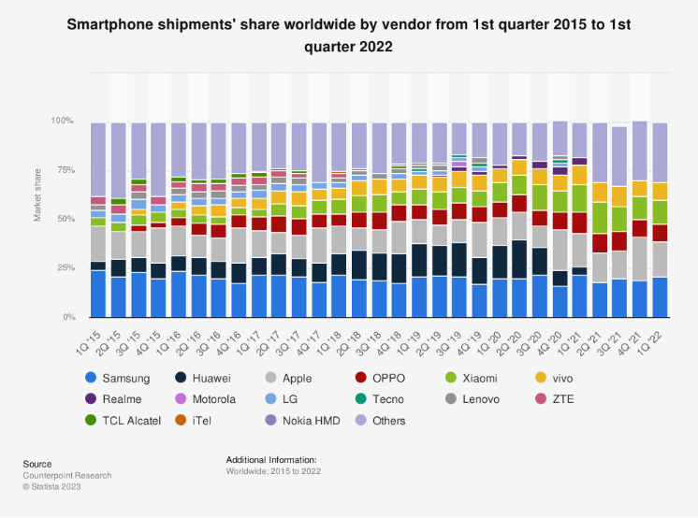
Is this a winner-take-all market?

Slide 11
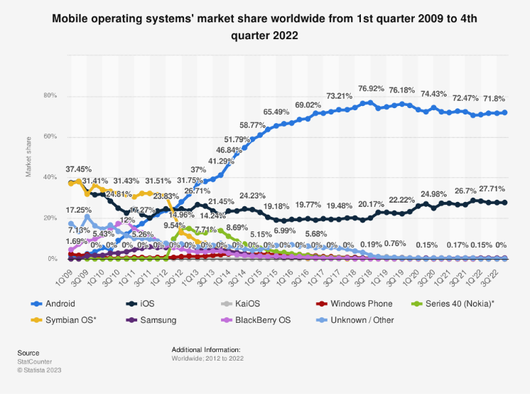
Is this a winner-take-all market?

Slide 12
Positive feedback (Shapiro and Varian 1998)
 | Low economies of scale | High economies of scale
Low demand for Variety | Unlikely | High
High demand for variety | Low | Depends
Not all markets exhibit network effects!
Likelihood of tipping to single technology/product/application
It is the sum of all scale economies (supply and demand side) that may drive a market towards tipping

Slide 13
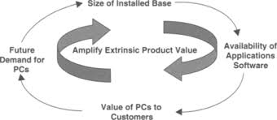
How to generate and manage network effects?
Increase customer participation
Increase time spent with the product and product’s perceived value
Increase opportunities of customer interactions
Manage complements to the core product

Slide 14
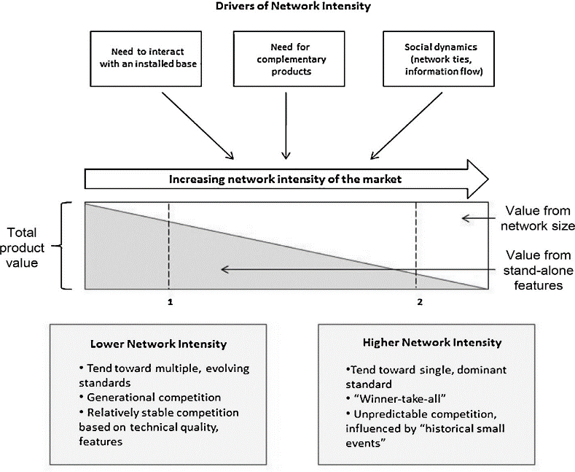
Intensity of network effects

Slide 15
Switching Costs
Costs of switching from one product to another
Individual switching costs
Firms
Consumers
Accumulated, e.g. group of individual users
Firms switching costs: Disruption of operation costs
Tension: the supplier wants to lock-in the customer, the customer wants to avoid lock-in

Slide 16
The Lock-in cycle
High market shares don't imply high switching costs
Low market share can still mean large lock-in
Brand Selection
Lock-In
Sampling
Entrenchment

Slide 17
Some reflections for strategy making
Shift from industry analysis to network analysis
Value Creation Dynamics
Network effects and Learning effects
Clusters
Synergies with other networks
Value Capture Dynamics
Pricing
Multi-homing
Disintermediation
Network Bridging

Slide 18
Data Network Effects
How is value for each user of a platform created from data?
The more the platform learns from the data it collects on users, the more valuable the platform becomes to each user
learning from one user should translate into a better product or experience for other users,
product experience enhancement from learning should happen fast enough to affect the current value of the product.
data-driven learning and improvements on a platform contributes to user value through data network effects
AI capability: Data-driven Learning→ Machine Learning
The ability of a platform to learn from data to improve its products or services

Slide 19
But…
If a digital platform develops an AI solution to automate the provision of some services currently offered by one side of the market (service providers), then what happens to those providers?

Slide 20
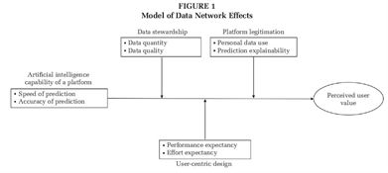
The model of Data Network Effects
Source: Gregory et al., 2021

Slide 21
OPEN FORUM
The Digital Markets Act (DMA) became applicable on May 2, 2023. The regulation focuses on companies providing one or more ‘core platform services’ and designates them as “gatekeepers” for their economic significance as intermediaries between businesses and users.
Here are some key provisions related to data:
Data Sharing: Gatekeepers must allow business users to access the data they generate on the platform, including data related to customer interactions.
Data Combination Restrictions: Gatekeepers are prohibited from combining personal data sourced from their core platform services with data from other services, unless explicit consent is obtained from users.
What could be the costs and benefits from DMA for business users in case of online search and online advertising?

