Slide 1
Data, Platforms and Digitalization
Ioanna Constantiou, ic.digi@cbs.dk
Department of Digitalization

Slide 2
Conversation starter
Consider Apple’s pricing for smartphones.
Consider Spotify’s pricing
What are the differences when pricing physical or digital products?
Can you identify some pricing strategies from today’s session?

Slide 3
Questions related to learning objectives
How can a firm price digital products/services?
What are the alternative revenue models in digital markets?

Slide 4
Price Discrimination
Personalised pricing
Charging each consumer, the maximum amount he/she is willing to pay for each unit of the product
Extract all surplus from consumers
Versioning
Offering versions tailored to the needs of different consumers leading to self-selection
Group pricing
Charging different groups of consumers different prices for the same product/service
Price sensitivity, lock-in and product endorsement

Slide 5
Versioning Principles
Versions tailored to the needs of different customers
The differences between the versions are accentuated
Prices for different buyers who acquire distinct:
Quantities
Qualities
Product versions
Market segmentation
Value based pricing for digital goods

Slide 6
How Many Versions?
Market analysis
Does it naturally subdivide into different categories?
Are their behaviors sufficiently different?
Is there possibility of user confusion?
Product analysis
Dimensions to version
High and low end for each dimension
Low end advertises for high end
Users trade up
The rule of three versions

Slide 7
Pricing to increase and sustain the user base
Versioning and market segmentation
Criteria
commitments to existing customers
information on existing and new customers
customer’s ability for arbitrage
3 Groups:
installed base -> premium services
rival’s customers -> discounts
new customers ->introductory offers

Slide 8
OPEN FORUM
Let’s observe the pricing strategies of Booking.com

Slide 9
Bundling
Price bundles
Separate products
Discount of the products/services in the bundle
No value added for the consumer from the bundle
Product/service bundles
A package of services/products which work together
Value added for the consumer through integration

Slide 10
Why bundle: reduce dispersion
Profits: With Bundling: $440 Without: $400

Slide 11
Some Bundling considerations
Conditional Reservation prices asymmetry
pure price or product bundling
Variation of reservation prices for the bundle
mixed price or product bundling
For increasing market penetration pure price bundling
Competitive environments mixed price /product bundling
But! Consumer behaviour and costs could influence bundling strategy

Slide 12
Questions related to learning objectives
How can a firm price digital products/services?
What are the alternative revenue models in digital markets?

Slide 13
Pricing Strategies in a Platform
Charging one side (users) little or nothing, the platform will attract participants on the other side (service/application providers) which generate revenue
When there is no price transaction charge more the side that benefits more from the presence of other
When price transaction, charge more the side that extracts the highest value
What is the impact on the other side’s growth or willingness to pay?
“Subsidy-side”: group of users are highly valued on the “money-side”
The challenge: how much subsidy should one side get and how much premium should the other side pay?

Slide 14
Value Capture
Value capture and the challenges of monetizing network effects
For users: access to value created on the platform
For producers/third party providers: access to community or the market
For both users/consumers and producers: access to tools and services that facilitate interaction
For both users/consumers and producers: access to curation mechanisms that enhance the quality of interactions

Slide 15




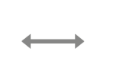

OPEN FORUM
When does the “free” make sense?
WRITERS
READERS
PLATFORM
2016 Parker & Van Alstyne, with Choudary – licensed under Creative Commons Attribution-ShareAlike 4.0 International (CC BY-SA 4.0).

Slide 16

Key principles to ensure transition from free to fee
Consider value capture in the platform design phase
Avoid charging for value that users previously receive for free
Avoid reducing access to value that users have become accustomed to receive
When transition from free to fee, create additional value that justifies the charge
Example:

Slide 17
Intrinsic characteristics
Delivery mode: downloadable/interactive
When the product is downloaded, the value is transferred to customers in a clear-cut fashion
Granularity: divisibility
Highly divisible products allow versioning by bundling or limiting certain features
Trialability: allowing preview
Not desirable for all products

Slide 18
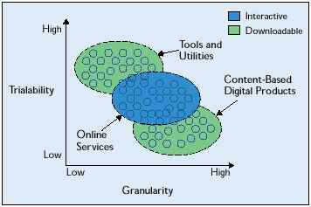
Classification of digital products (Hui and Chau 2002)

Slide 19
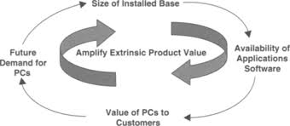
How to generate and manage network effects?
Increase user participation
Increase time spent with the product and product’s perceived value
Increase opportunities of user interactions
Manage complements to the core product

Slide 20
Pricing strategy
Classical market | Network effects
Intrinsic Value | Extrinsic Value
Skimming pricing | Penetration pricing
Price as quality signal | When lock-in then change prices
 | Bundling-compatibility-variety -upgrades
For products with network effects, penetration pricing and bundling are more conductive to long-term performance than skimming pricing or unbundling

Slide 21
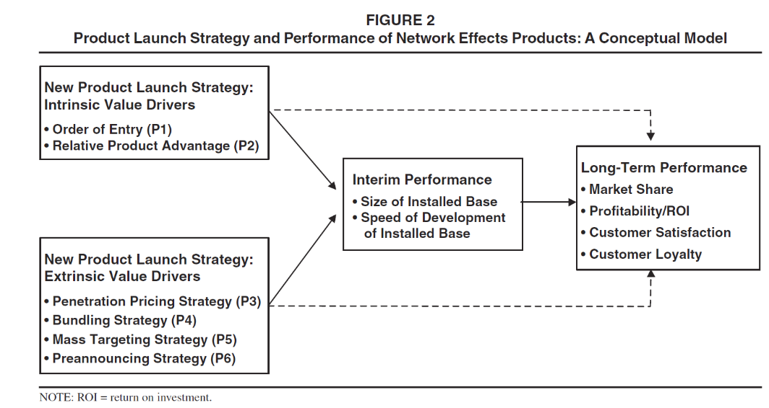
Product launch strategy & network effects

Slide 22
OPEN FORUM: Which pricing strategy should MyCoach choose at launch — and why?
Background
MyCoach is a startup offering an AI-powered coaching app for young professionals. The platform provides:
Personalized AI coaching conversations
Habit tracking and behavioral nudges
A dashboard for companies to monitor employee development (B2B feature)
After a beta test with 500 individuals and 3 SME pilot customers, the founders must now decide on a pricing strategy for launch.
Key Characteristics of the Business
High fixed development costs
Near-zero marginal cost per additional user
Many free substitutes (AI tools, YouTube, podcasts)
Potential data advantages: more users → better AI → higher value
The Strategic Dilemma: The founders disagree
Option A: Freemium Model Free basic version + 100DKK/month premium → Goal: scale quickly and build data advantage
Option B: Premium Subscription 200DKK/month, no free tier → Goal: signal high quality and monetize early
Option C: B2B Focus
100DKK per employee/month (annual contracts) → Goal: stable, predictable revenue
The company cannot fully pursue all three at once due to limited resources.

