Slide 1
Data, Platforms and Digitalization
Ioanna Constantiou, ic.digi@cbs.dk
Department of Digitalization

Slide 2

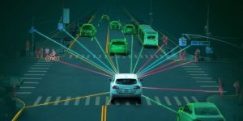



Slide 3
Conversation starter
Consider the case of Amazon as described on the book, can you identify any dynamic capabilities?

Slide 4
Questions related to learning objectives
How does digitalization influence dynamic capabilities?
How is digital transformation challenge the firm’s key resources?

Slide 5
How do firms sustain competitive advantages?
In environments of rapid technological change firms remain competitive by
Identifying new opportunities and organizing effectively and efficiently to embrace them
Exploiting firm specific competences to address changing environments
Winners have been firms that can demonstrate:
timely responsiveness
rapid and flexible product innovation
management capability to effectively coordinate and redeploy internal and external competences

Slide 6
Dynamic capabilities
The ability to achieve new forms of competitive advantage
Dynamic: the capacity to renew competence so as to compete in the changing business environment
Capabilities: the role of strategic management in adapting, integrating and reconfiguring skills, resources and competences to match the changing environment
Firm’s ability to integrate, build, and reconfigure internal and external competences to address rapidly changing environments

Slide 7
The evolution of strategic thinking
Copyright Teece 2015
Deep Uncertainty
Dynamic Capabilities
-Markets are dynamic and competition is often disruptive
-Asset orchestration & strategy drive advantage
-Reshaping ecosystems & biz models is critical
RBV
VRIN assets drive value creation
barriers to competition determine longevity
all 4 VRIN
traits necessary to sustain advantage
Risk
5 Forces
industry attractiveness is the central focus
external forces
dominate
fate = static, purely competitive markets (low profit)
1980s
1990s
2000+

Slide 8

Asset Orchestration is Central to Dynamic Capabilities
“Apple still has strong growth opportunities because of its ability to work simultaneously on hardware, software and services… Apple has the ability to innovate in all three of these spheres and create magic… This isn’t something you can just write a check for. This is something you build over decades.”
-Tim Cook, Apple CEO (Taipei Times, February 2013)

Slide 9
Dynamic Vs. Ordinary Capabilities
Ordinary
Capabilities
Dynamic
Capabilities
Purpose
Purpose
Technical efficiency in basic business functions
Operational, administrative, and governance
Relatively easy; imitable
Technical efficiency in basic business functions
Operational, administrative, and governance
Relatively easy; imitable
Strategic “fit” over the long run (evolutionary fitness)
Sensing, seizing, shaping and transforming
Difficult ; inimitable
Schemes
Imitability

Slide 10
Three categories of dynamic capabilities according to Teece (2007)
Sensing
Identification of
opportunities &
threats at home
and abroad
Seizing
Mobilization of
resources to
deliver value and
shape markets
Transforming
Continuous renewal
and periodic major
strategic shifts

Slide 11
The dynamic capabilities framework
Firm Performance
Opportunity Recognition & Creation
Strategic Investment & Business Model Design
Asset Alignment & Overcoming Change Resistance
Potential Strategic Impacts
Dynamic Managerial Capabilities
Transforming
Sensing
Co-creating and Seizing
Sample Managerial Cognitive Capabilities
Perception and Attention
Problem Solving and Reasoning
Communication and Social Cognition
Source: Helfat & Peteraf (2015, p.837)

Slide 12
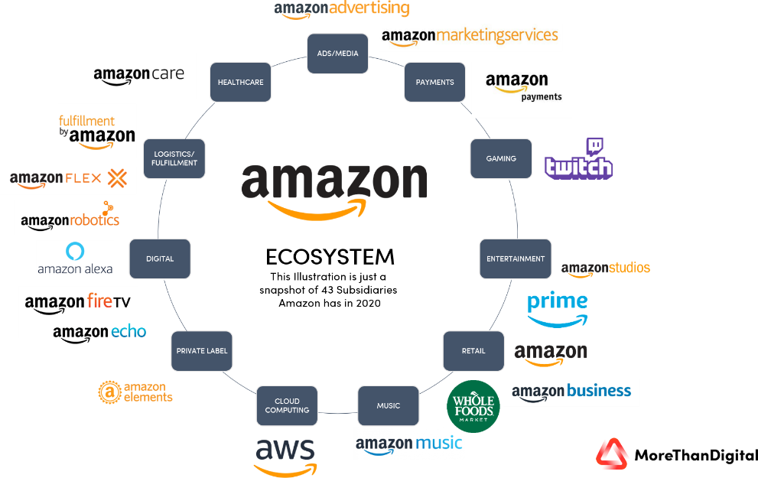
OPEN FORUM: Example of Amazon

Slide 13
Questions related to learning objectives
How does digitalization influence dynamic capabilities?
How is digital transformation challenge the firm’s key resources?

Slide 14
Business view of AI as an entity- plug-and-play view
MIT report (Furr & Shipilov, 2025) found that 95% of enterprise generative AI pilots fail to deliver measurable returns
AI entity view: a self-contained system that “lives” inside algorithms and can think and act on its own.
Underestimate the organizational work needed and assume success depends mainly on the technical quality of the model
Unprepare for the changes in roles, processes, and responsibilities that actually determine whether AI delivers value.

Slide 15
AI as an Organizing Capability
AI as a connective, codependent, and emergent capability of a system of relations––among human and algorithmic actors––to organize by analyzing, learning, and acting in pursuit of organizational goals.
Stelmaszak, M., Joshi, M. P. & Constantiou, I. (Forthcoming). Artificial Intelligence as an Organizing Capability Arising from Human–Algorithm Relations, Journal of Management Studies

Slide 16
AI requires connectivity, not adoption
AI does not reside in technology alone; it only emerges when humans and algorithms work together.
AI isn’t a product that can be purchased and “rolled out”. It is a capability that develops through cocreation.
Domain experts, must engage as co-producers of capability, not as passive recipients of model insights.
Their interpretive inputs, contextual knowledge, and iterative feedback are what make AI work.
They need to decide when and how to involve algorithmic actors in solving problems.

Slide 17
Managing AI means managing relations
AI is not a decision-maker on its own but a capability that depends on relations between human and algorithmic actors.
Codependence implies that humans and algorithms need each other for AI to arise, and managers are the ones responsible for structuring opportunities for such encounters.
Not to “delegate” to AI, but to design and manage those relations.
Managing AI entails creating environments where humans and algorithms are intentionally orchestrated
Domain experts need clarity on how their professional judgment interacts with algorithmic recommendations, how disagreements are resolved, and how accountability is shared.
Recognizing that responsibility lies in the system of relations, not in individual tools, allows domain experts to negotiate oversight and control more effectively.

Slide 18
AI can reshape organizational goals
AI not only helps organizations achieve existing goals but can also shift how those goals are defined.
As relations evolve, and so too does the organization’s intelligence.
surface new patterns, nudge priorities, or narrow attention in ways that alter organizational goals.
Domain experts need to revisit the fundamental basis of their expertise.
developing expertise in discovering and substantiating novel problems that could be solved in collaboration with algorithmic actors.

Slide 19
Building intelligence together: New mindset
Leaders must see themselves not only as technology adopters but as architects of organizational intelligence, responsible for shaping how human and algorithmic reasoning interact across their organizations.
The question is no longer “How do we adopt AI?” but “How do we design the systems of relations that make AI work?”

Slide 20
Expertise and Gen AI
Expertise →competitive advantage
Expertise: a combination of deep theoretical knowledge and practical know-how in a specific domain
Two forces at play create strategic dilemmas:
the increasing effort required to stay at the leading edge in a specific area
the decreasing cost of accessing that expertise

Slide 21
Gen AI on workforce
AI “copilots,” “chatbots,” and “assistants” into applications to augment employees’ workflows.
These tools offer expertise in many domains
They bring low performers up to levels previously considered average and boost the capabilities of high performers
coding

Slide 22
Triple product
Cost and time savings: transform business processes and achieve efficiency by empowering employees to leverage AI for discrete tasks.
Increased workforce productivity.
More investment in activities that matter, rethink how to deploy resources.

Slide 23
Strategy and Key Questions about AI Resources
Which aspects of the problem we now solve for customers will customers use AI to solve themselves?
Which types of expertise that we currently possess will need to evolve most if we are to remain ahead of AI’s capabilities?
Which assets can we build or augment to enhance our ability to stay competitive as AI advances?

