Slide 1
MINI PROJECT
TITLE : WEB BASED COLLEGE FEEDBACK SYSTEM
DOMAIN : WEB DEVELOPMENT

Slide 2
TEAM MEMBERS:
MOHAMMED SHIYAS S - 19EUCS089
MOHAMED ASIM V A – 19EUCS087
PONVARSHINI A - 19EUCS105
GUIDE NAME : KARTHIKEYAN N , M.E., (PH.D)

Slide 3
ABSTRACT:
Nowadays, educational Institutions are increasing attention to the views of Student’s on the involvement in learning and teaching through reviews or feedbacks
It is a web application which provides base for the colleges to know about the all information about the college
The goal of this project is , fresher can know about the real info of all colleges in one common website
Also, the particular college students can give the feedback about their college.
This college feedback system is the perfect place to find all college information, feedback evaluated according to the requirements and it is the efficient one to get feedback analysis of students

Slide 4
EXISTING SYSTEM:
Students who are searching for college details should go physically and make enquire about college which takes a lot of time and effort
If an user search for any information about a college , the user gets only the website issued by that particular college and information available on that website
And also, the user won’t get sufficient information about the college and its infrastructures in it
Furthermore, the student is not able to give a common feedback about a college

Slide 5
PROPOSED SYSTEM:
The proposed system gives a simple path to a student who is scanning for college data
All the information is added by admin where students and fresher’s can easily access the information
Particularly, it was a good platform for the students who have completed their schooling, because it helps to know about all the information about the particular colleges in single website based on the district wise
Furthermore, when the college students give a negative feedback about their college instantly , it can be viewed by the admin and there is a chance of removing it before any freshers could view.

Slide 6
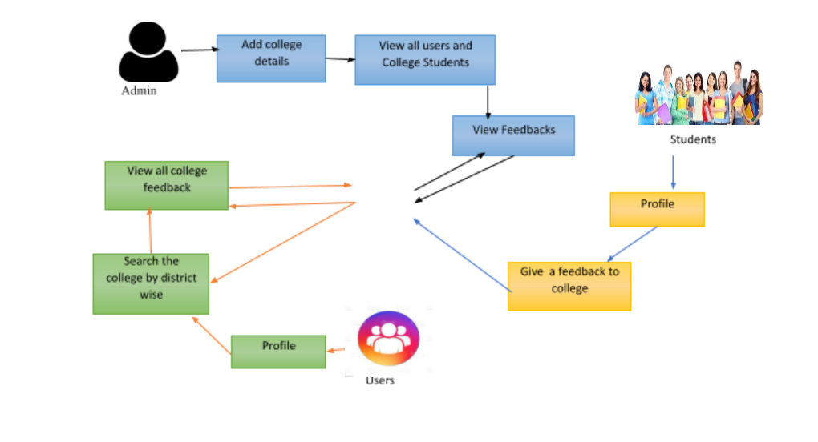
SYSTEM ARCHITECTURE:

Slide 7
MODULES:
1) ADMIN:
Home
Add Colleges
College Details
View Users
View students
View Feedback
Logout

Slide 8
2) STUDENT:
Home
Profile
Search College
Give students feedback
Logout
3) USER:
Home
Profile
Search College
View Students Feedback
Logout

Slide 9
MODULE DESCRIPTION:
ADMIN:
Admin needs to get logged in with valid username and password.
Admin can add colleges , college details and can view the feedbacks.
Also, the admin is the who can view both students , users
STUDENT:
The student needs to get registered with the application by entering all the details in the registration page.
A student can get logged in by entering college name, username, and password.
A student can view profile, View College, and can give feedback.

Slide 10
USER:
User can get registered with the application by entering all the details in the registration page.
Then user can get logged in by entering username, and password.
Now user can view their profile, View Colleges and can see the feedback according to their need.

Slide 11
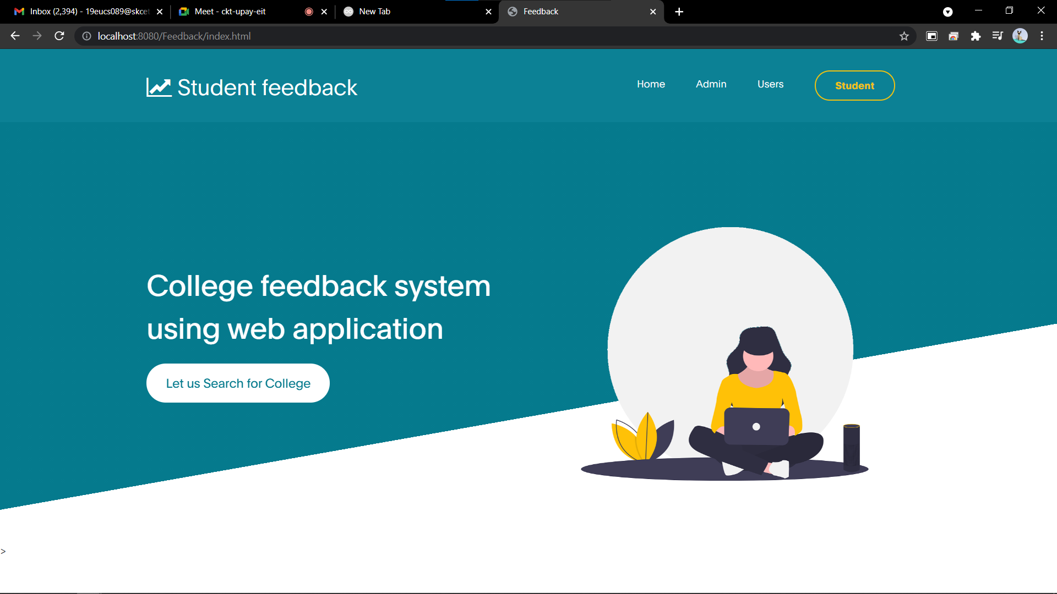
IMPLEMENTATION :

Slide 12
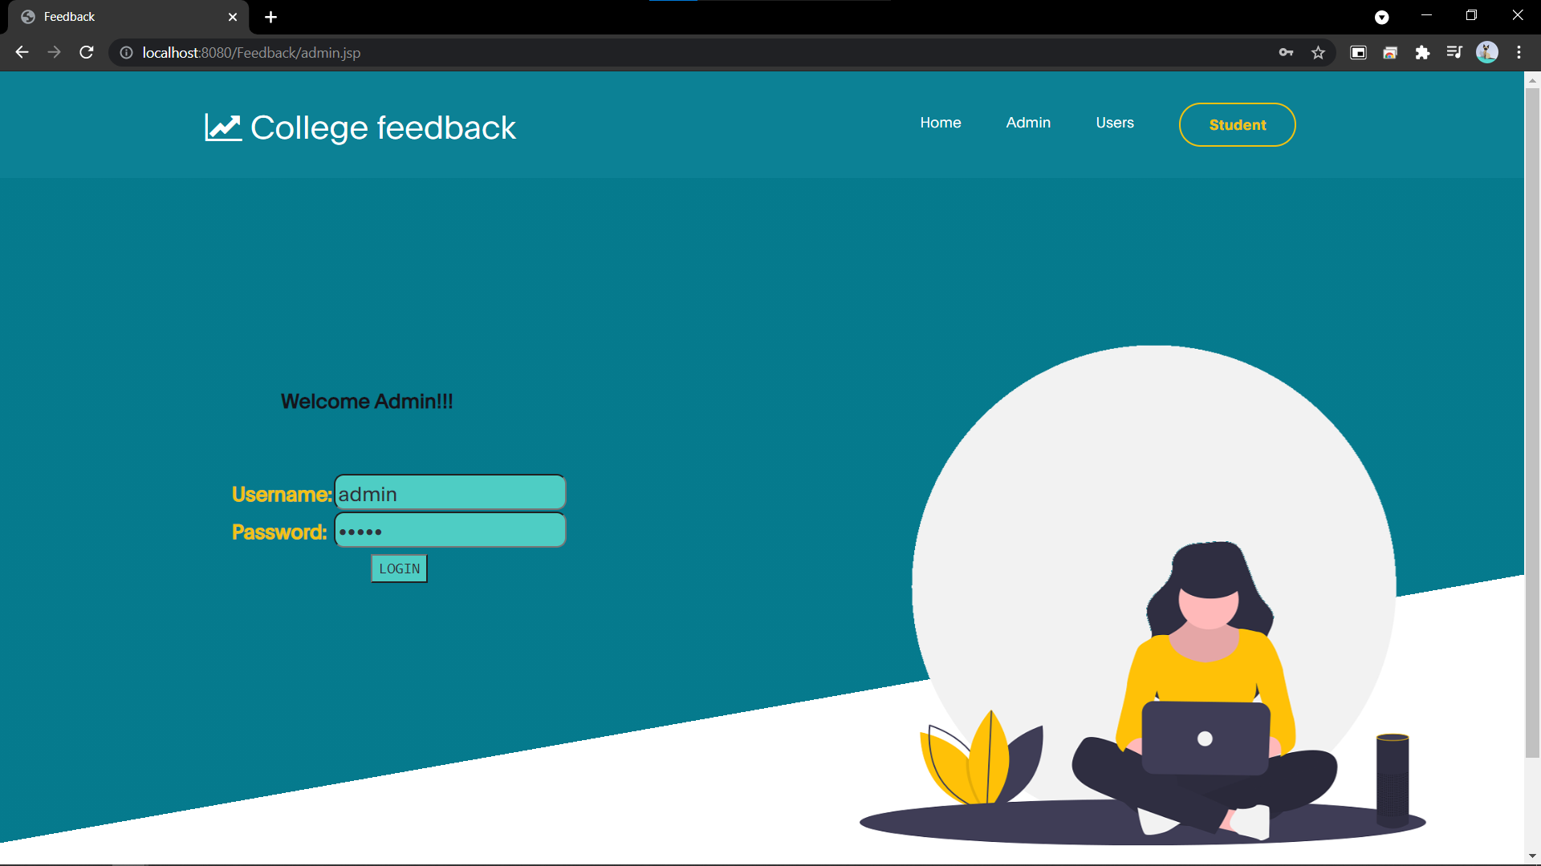

Slide 13


Slide 14
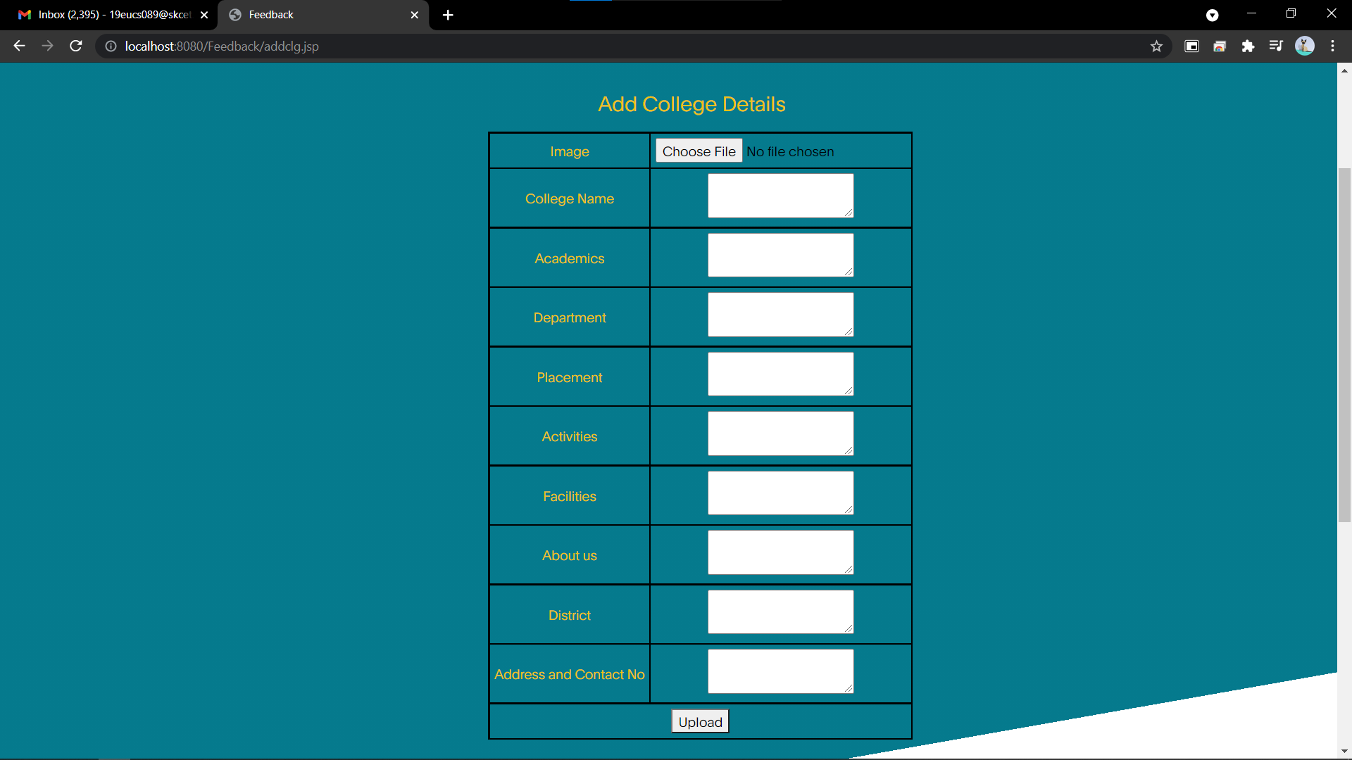

Slide 15
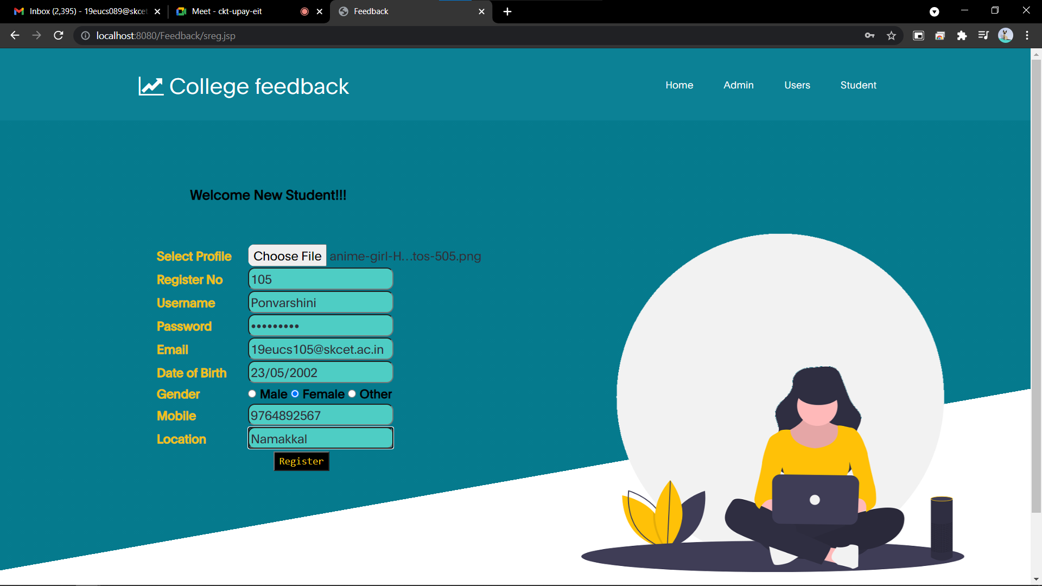

Slide 16
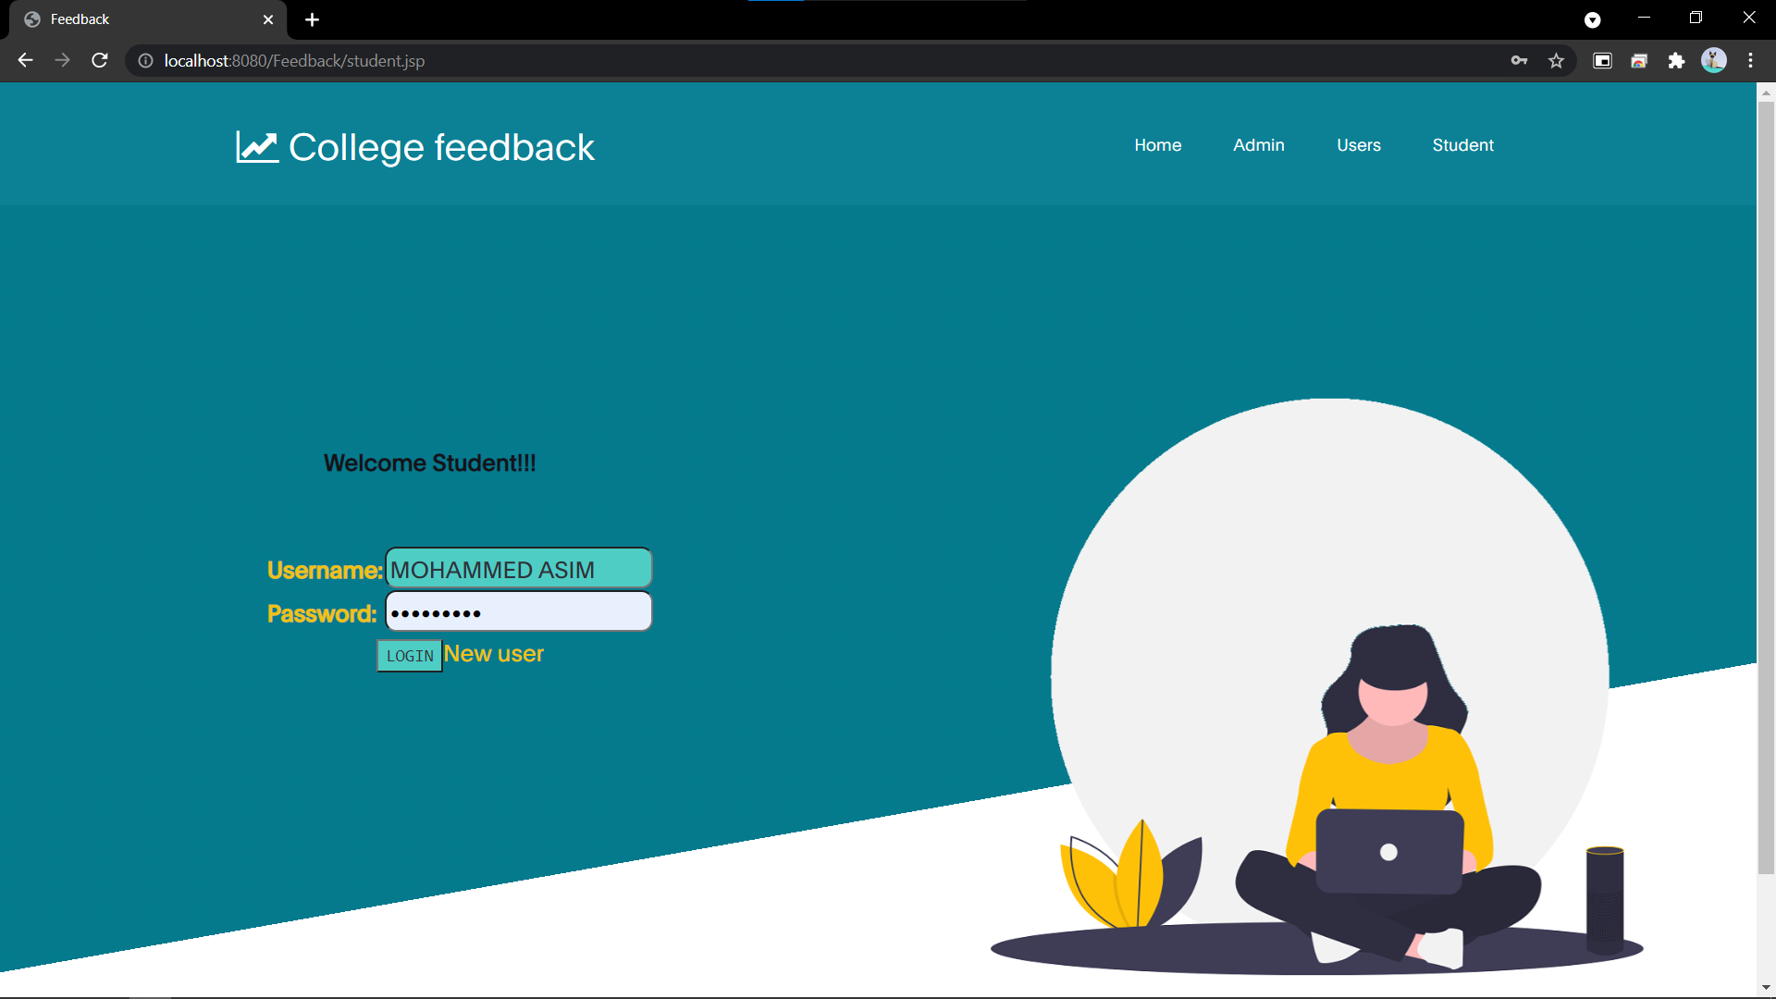

Slide 17
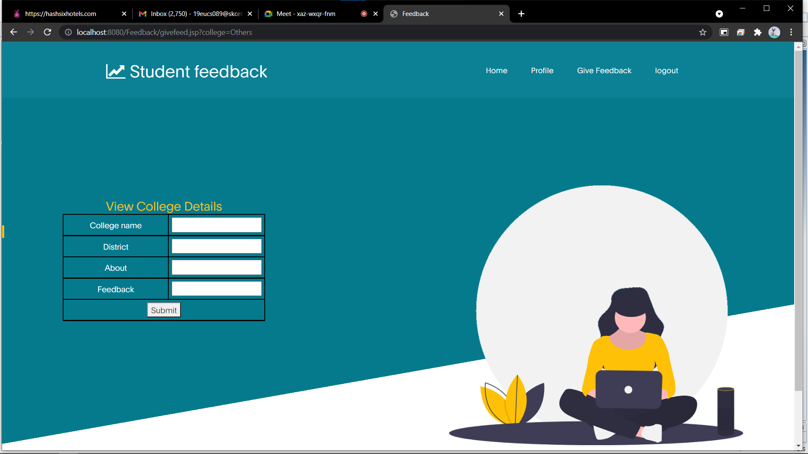

Slide 18
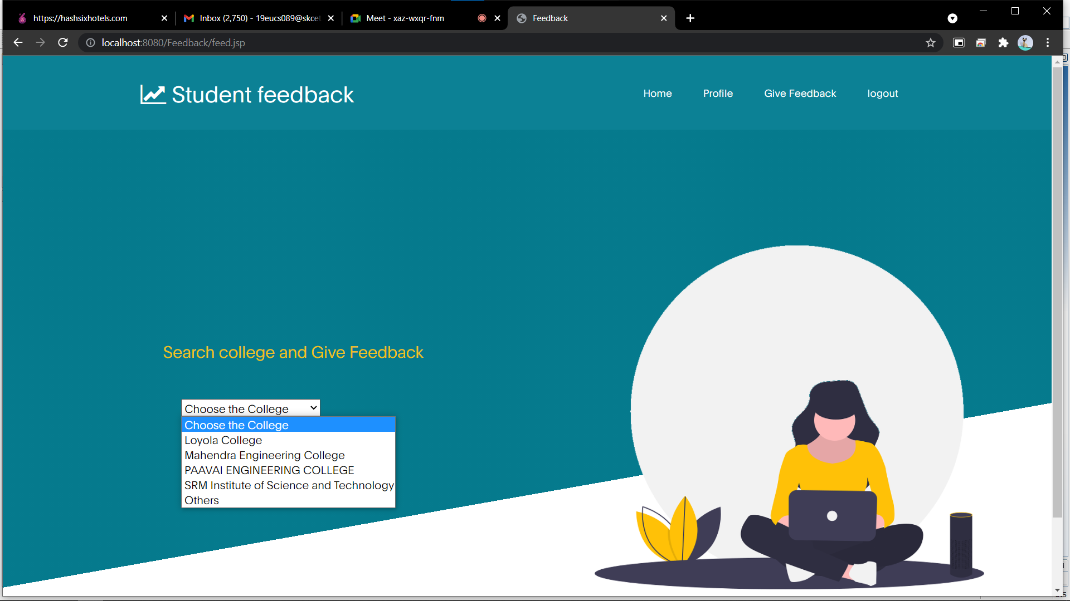

Slide 19
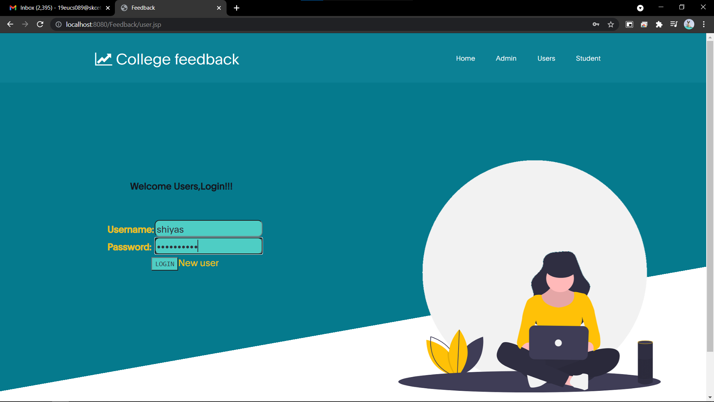

Slide 20
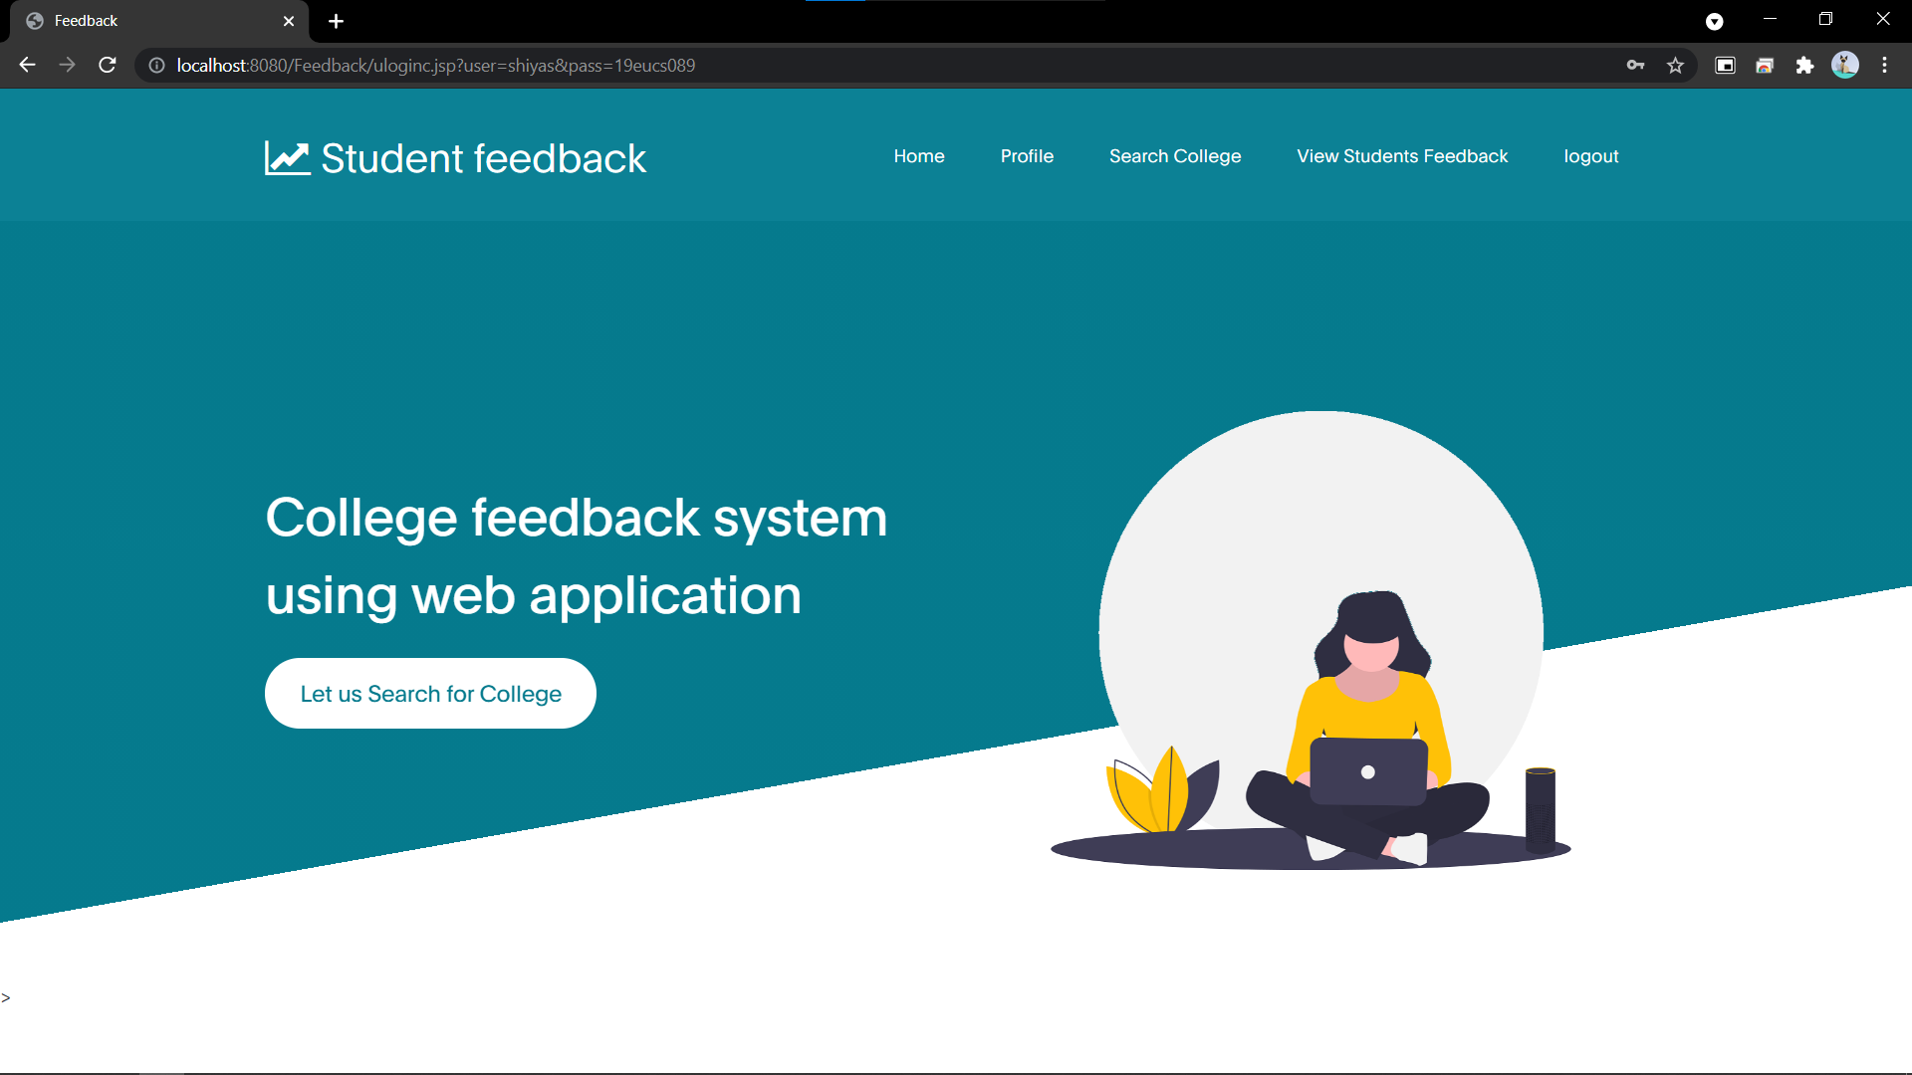

Slide 21
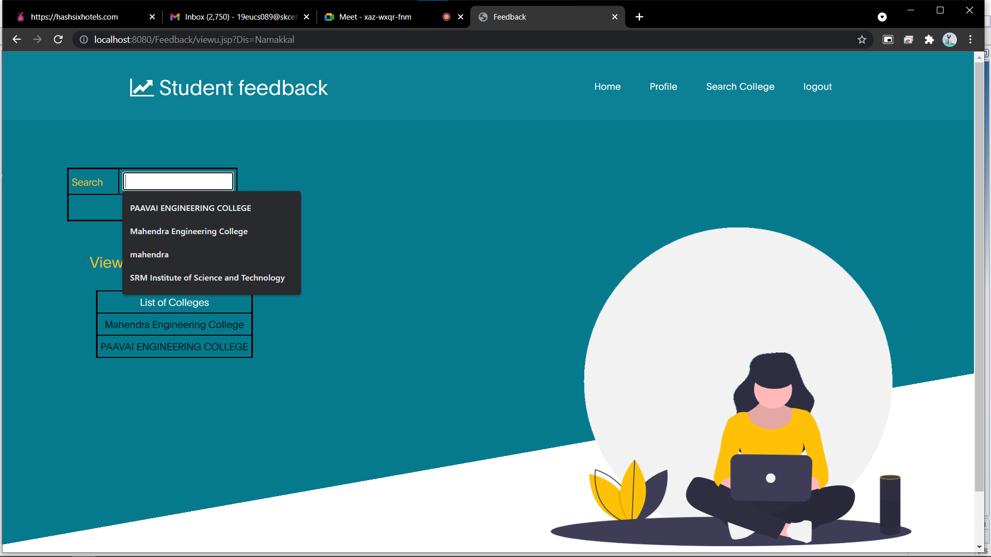

Slide 22
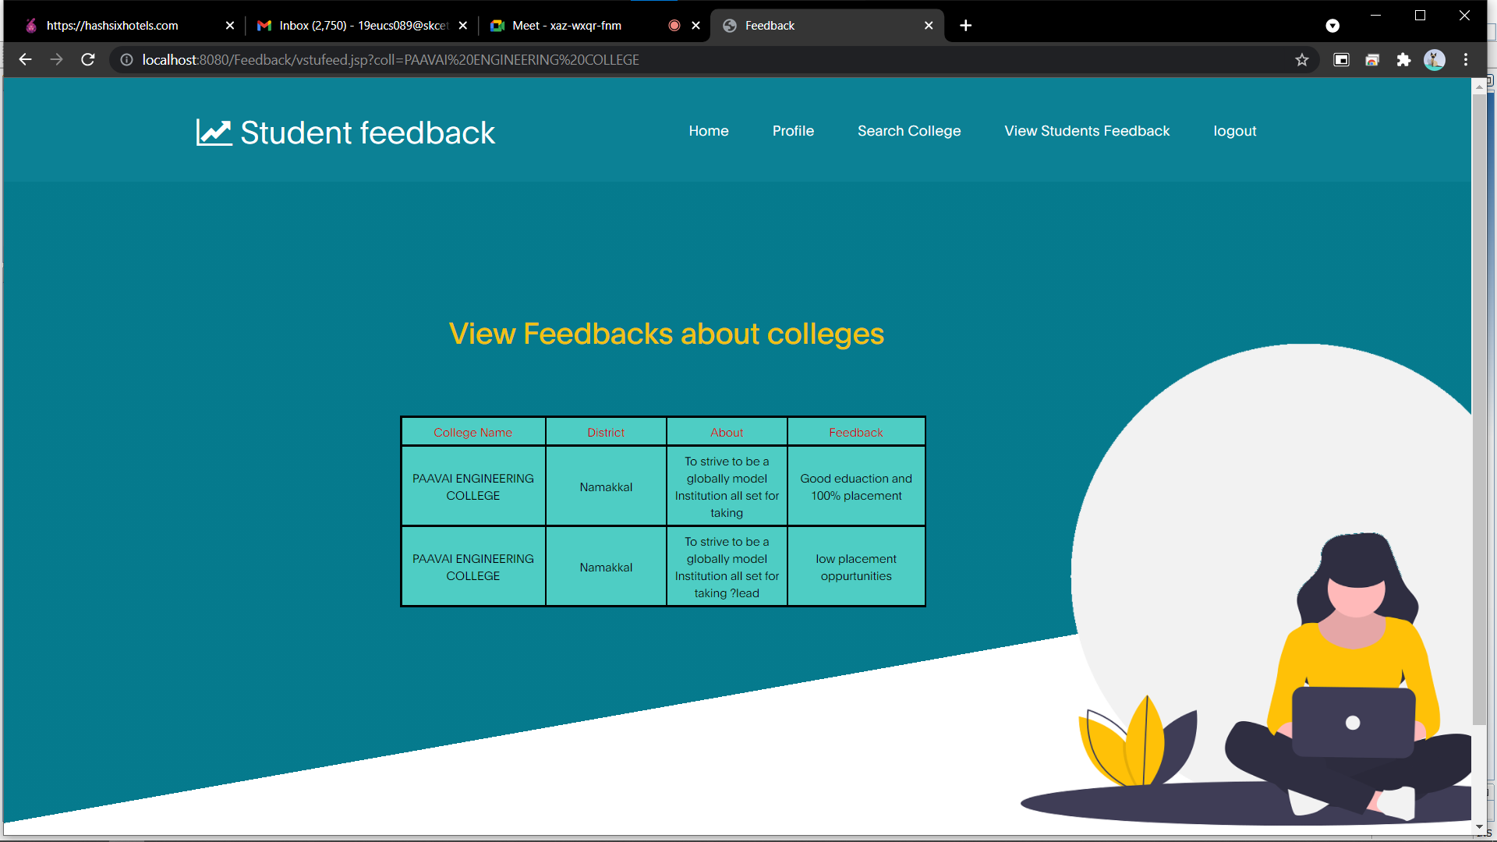

Slide 23
SOFWARE REQUIRED:
Front end : Netbeans
Back end : Mysql
Chrome Browser

Slide 24
CONCLUSION:
In today’s world where education has become a basic necessity for every child/adult so to ensure that proper education Is being delivered or not their lefts only one way ‘by taking feedback’ so as to reduce the manpower the software is build which automatically takes the feedback .
Currently , due to the covid pandemic situation students are not able to go directly to the colleges ,so It will be helpful to get every information through internet in a single website
Meanwhile it helps the freshers to analyse the colleges regarding to the feedback given by the college students.

