Slide 1
CSCI315 – Operating Systems Design Department of Computer Science Bucknell University
Handling Deadlocks
Ch 8.4-8.5
This set of notes is based on notes from the textbook authors, as well as L. Felipe Perrone, Joshua Stough, and other instructors.
Xiannong Meng, Fall 2020.
online 2 of 2

Slide 2
Resource-Allocation Graph Algorithm
Goal: prevent the system from entering an unsafe state.
Claim edge P_{i} → R_{j} indicates that process P_{j} may request resource R_{j}; represented by a dashed line.
Claim edge converts to request edge when a process requests a resource.
When a resource is released by a process, assignment edge reconverts to a claim edge.
Resources must be claimed a priori in the system.
If there is no cycle as the result of allocation, the system is safe.

Slide 3
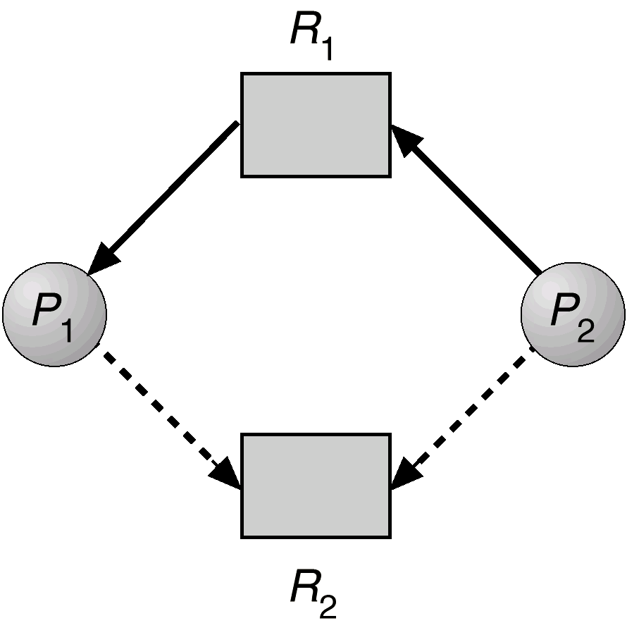
Resource-Allocation Graph for Deadlock Avoidance

Slide 4
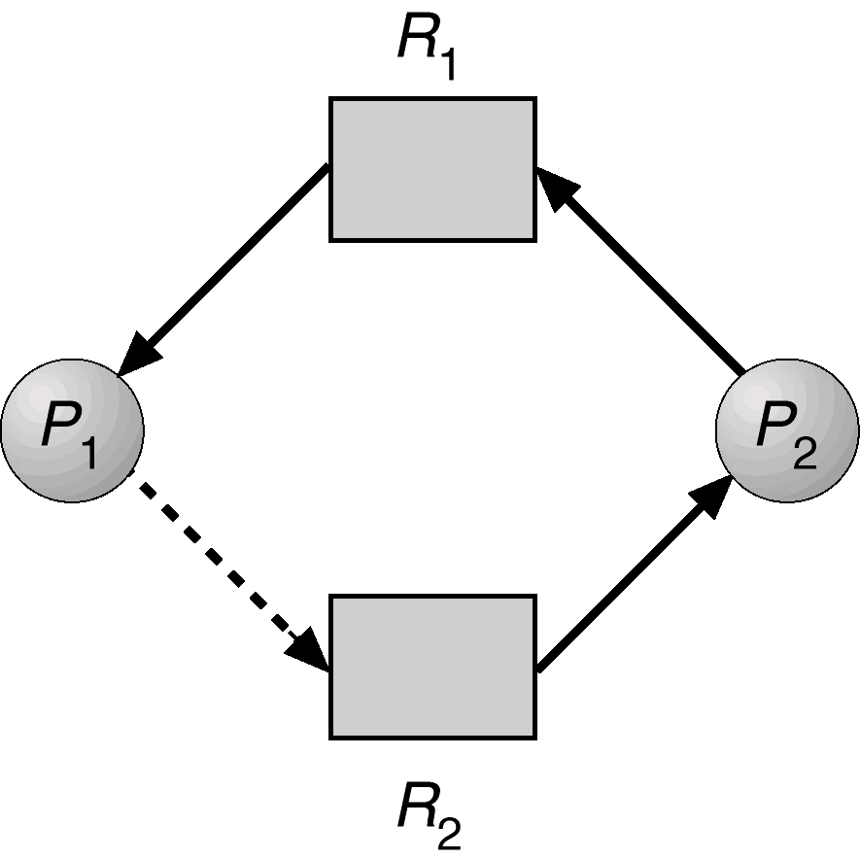
Unsafe State In Resource-Allocation Graph

Slide 5
Banker’s Algorithm
Applicable when there are multiple instances of each resource type.
In a bank, the cash must never be allocated in a way such that it cannot satisfy the need of all its customers.
Each process must state a priori the maximum number of instances of each kind of resource that it will ever need.
When a process requests a resource it may have to wait.
When a process gets all its resources it must return them in a finite amount of time.

Slide 6
Banker’s Algorithm: Data Structures
Let n = number of processes, and m = number of resources types.
Available: Vector of length m. If available [j] = k, there are k instances of resource type R_{j} available.
Max: n x m matrix. If Max [i,j] = k, then process P_{i} may request at most k instances of resource type R_{j}.
Allocation: n x m matrix. If Allocation[i,j] = k then P_{i} is currently allocated k instances of R_{j.}
Need: n x m matrix. If Need[i,j] = k, then P_{i} may need k more instances of R_{j} to complete its task.
Need[i,j] = Max[i,j] – Allocation [i,j]

Slide 7
Safety Algorithm
1. Let Work and Finish be vectors of length m and n, respectively. Initialize:
Work = Available
Finish [i] = false for i = 0,1,2,3, …, n-1.
Find an i such that both:
(a) Finish [i] = false
(b) Need_{i} ≤ Work
If no such i exists, go to step 4.
Work = Work + Allocation_{i} Finish[i] = true go to step 2.
4. If Finish [i] == true for all i, then the system is in a safe state.

Slide 8
Resource-Request Algorithm for Process P_{i}
Request = request vector for process P_{i}. If Request_{i} [j] = k then process P_{i} wants k instances of resource type R_{j.}
If Request_{i} ≤ Need_{i} go to step 2. Otherwise, raise error condition, since process has exceeded its maximum claim.
If Request_{i} ≤ Available, go to step 3. Otherwise P_{i} must wait, since resources are not available.
3. Pretend to allocate requested resources to P_{i} by modifying the state as follows:
Available = Available - Request_{i};
Allocation_{i} = Allocation_{i} + Request_{i};
Need_{i} = Need_{i} – Request_{i;;}
If safe ⇒ the resources are allocated to P_{i}. (run safe algorithm)
If unsafe ⇒ P_{i} must wait, and the old resource-allocation state is restored

Slide 9
Example of Banker’s Algorithm
5 processes P₀ through P₄; 3 resource types A (10 instances), B (5 instances), and C (7 instances).
Snapshot at time T₀:
Allocation Max Available
A B C A B C A B C
P₀ 0 1 0 7 5 3 3 3 2
P₁ 2 0 0 3 2 2
P₂ 3 0 2 9 0 2
P₃ 2 1 1 2 2 2
P₄ 0 0 2 4 3 3

Slide 10
Example (Cont.)
The content of the matrix. Define Need = Max – Allocation.
Need
Max
Allocation
Available
 | A | B | C
P0 | 7 | 4 | 3
P1 | 1 | 2 | 2
P2 | 6 | 0 | 0
P3 | 0 | 1 | 1
P4 | 4 | 3 | 1
A | B | C
7 | 5 | 3
3 | 2 | 2
9 | 0 | 2
2 | 2 | 2
4 | 3 | 3
A | B | C
0 | 1 | 0
2 | 0 | 0
3 | 0 | 2
2 | 1 | 1
0 | 0 | 2
A | B | C
3 | 3 | 2
=
-
The system is in a safe state since the sequence < P₁, P₃, P₄, P₂, P₀> satisfies safety criteria.

Slide 11
Example P₁ Request (1,0,2) (Cont.)
Check that Request ≤ Available that is, (1,0,2) ≤ (3,3,2) ⇒ true.
Allocation Need Available
A B C A B C A B C
P₀ 0 1 0 7 4 3 2 3 0
P₁ 3 0 2 0 2 0
P₂ 3 0 1 6 0 0
P₃ 2 1 1 0 1 1
P₄ 0 0 2 4 3 1
Executing safety algorithm shows that sequence <P1, P3, P4, P0, P2> satisfies safety requirement.
Can request for (3,3,0) by P4 be granted?
Can request for (0,2,0) by P0 be granted?
Allocation(P1) = (2,0,0) + (1,0,2) = (3,0,2)

