Slide 1
SJF

Slide 2
Scenario 1: Processes with Same Arrival Time
Example: Consider the following table of arrival time and burst time for three processes P1, P2 and P3.
Process | Burst Time | Arrival Time
P1 | 6 ms | 0 ms
P2 | 8 ms | 0 ms
P3 | 5 ms | 0 ms

Slide 3
Step-by-Step Execution:
Time 0-5 (P3): P3 runs for 5 ms (total time left: 0 ms) as it has shortest remaining time left.
Time 5-11 (P1): P1 runs for 6 ms (total time left: 0 ms) as it has shortest remaining time left.
Time 11-19 (P2): P2 runs for 8 ms (total time left: 0 ms) as it has shortest remaining time left.
Process | Burst Time | Arrival Time
P1 | 6 ms | 0 ms
P2 | 8 ms | 0 ms
P3 | 5 ms | 0 ms

Slide 4
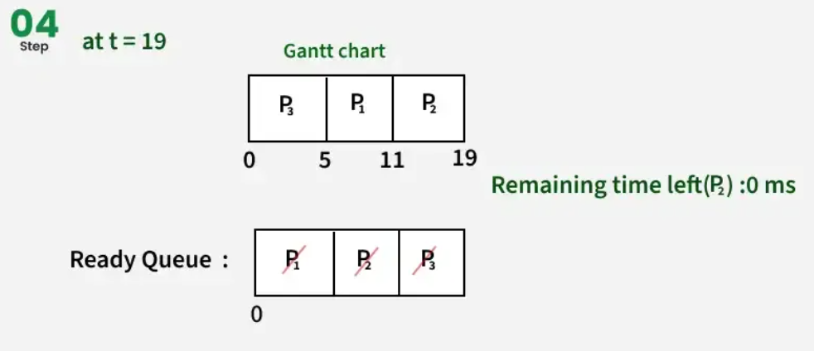
Gantt Chart

Slide 5
Turn Around time = Completion time – arrival time
Waiting Time = Turn around time – burst time

Slide 6
Process | Arrival Time (AT) | Burst Time (BT) | Completion Time (CT) | Turn Around Time (TAT) | Waiting Time (WT)
P1 | 0 | 6 | 11 | 11-0 = 11 | 11-6 = 5
P2 | 0 | 8 | 19 | 19-0 = 19 | 19-8 = 11
P3 | 0 | 5 | 5 | 5-0 = 5 | 5-5 = 0
Now,
Average Turn around time = (11 + 19 + 5)/3 = 11.6 ms
Average waiting time = (5 + 0 + 11 )/3 = 16/3 = 5.33 ms

Slide 7
Scenario 2: Processes with Different Arrival Times
Consider the following table of arrival time and burst time for three
processes P1, P2 and P3.
Process | Burst Time | Arrival Time
P1 | 6 ms | 0 ms
P2 | 3 ms | 1 ms
P3 | 7 ms | 2 ms

Slide 8
Step-by-Step Execution:
Time 0-1 (P1): P1 runs for 1 ms (total time left: 5 ms) as it has shortest remaining time left.
Time 1-4 (P2): P2 runs for 3 ms (total time left: 0 ms) as it has shortest remaining time left among P1 and P2.
Time 4-9 (P1): P1 runs for 5 ms (total time left: 0 ms) as it has shortest remaining time left among P1 and P3.
Time 9-16 (P3): P3 runs for 7 ms (total time left: 0 ms) as it has shortest remaining time left.

Slide 9
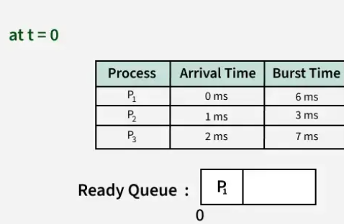
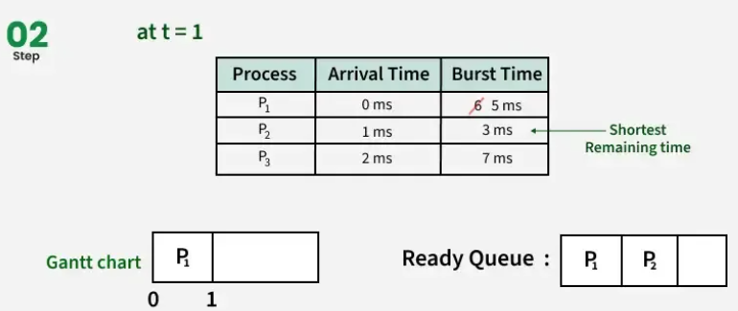
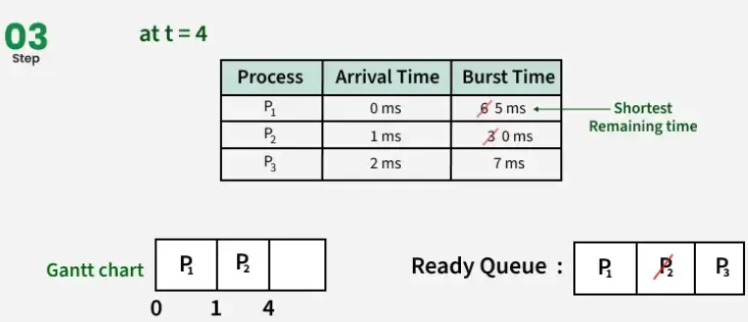
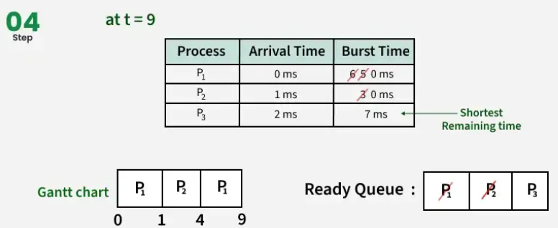

Slide 10
Process | Arrival Time (AT) | Burst Time (BT) | Completion Time (CT) | Turn Around Time (TAT) | Waiting Time (WT)
P1 | 0 | 6 | 9 | 9-0 = 9 | 9-6 = 3
P2 | 1 | 3 | 4 | 4-1 = 3 | 3-3 = 0
P3 | 2 | 7 | 16 | 16-2 = 14 | 14-7 = 7
Average Turn around time = (9 + 14 + 3)/3 = 8.6 ms
Average waiting time = (3 + 0 + 7 )/3 = 10/3 = 3.33 ms

Slide 11
class Process: def __init__(self, pid, burst_time):
self.pid = pid self.burst_time = burst_time
def sjf_scheduling(processes): processes.sort(key=lambda x: x.burst_time) # Sort processes by burst time
total_processes = (processes) current_time = 0 waiting_time = 0
("Process ID\tBurst Time\tWaiting Time") for p in processes:
(f"{p.pid}\t\t{p.burst_time}\t\t{waiting_time}") waiting_time += current_time current_time
+= p.burst_time average_waiting_time = waiting_time / total_processes
("\nAverage Waiting Time:", average_waiting_time)
# Example usage if __name__ == "__main__":
processes = [Process(1, 6), Process(2, 8), Process(3, 7), Process(4, 3)]
sjf_scheduling(processes)

