Slide 1
Smart Water System
DEPARTMENT OF COMPUTER SCIENCE AND ENGINEERING
Project name : Smart Water System
Team members
Meygnaanaselva | (312121104014)
Poobathy | (312121104018)
Ajith Kumar | (312121104001)
Karthikeyan | (312121104012)

Slide 2
PROBLEM DEFINITION:
▶ The project’s focus is the integration of IoT sensors for the monitoring of water usage in public areas, specifically parks and gardens. Its core mission is to foster water conservation by offering real-time water consumption data to the public.
▶ This project encompasses several key phases, which include defining objectives, designing an IoT sensor system, developing a data sharing platform, and integrating them using IoT technology and Python.

Slide 3
OBJECTIVES:
▶ This project encompasses several key phases, which include defining objectives, designing an IoT sensor system, developing a data sharing platform, and integrating them using IoT technology and Python.
▶ Addressing water management issues, including problems related to water usage and tank overflow, requires the implementation of effective monitoring solutions.
▶ Using a network of sensors, the system gathers real-time data regarding water quality and consumption, with subsequent processing occurring on a cloud- based platform.
▶ The statement underscores the IoT’s potential to revolutionize water management practices, guaranteeing sustainable access to clean water for both present and future generations.

Slide 4
EXISTING SYSTEM:
▶ Manual Meter Reading involves the use of conventional meters, which necessitate physical visits by utility personnel for reading and recording water usage. This method is often time-consuming and susceptible to errors.
▶ In the realm of water quality monitoring, the conventional approach is characterized by periodic assessments, which may not identify issues until they have escalated to critical levels. The presence of contaminants and impurities often goes undetected until they have already impacted water quality.
▶ Under the existing system, data collected is subject to limited analysis, resulting in the failure to identify trends, predict maintenance requirements, or optimize resource allocation.

Slide 5
PROPOSED SYSTEM:
▶ IoT Sensors and Devices:
The deployment strategy involves establishing a network of IoT sensors and devices across the entire water distribution network, encompassing water treatment plants, reservoirs, pipelines, and consumer premises.
The sensors will maintain continuous monitoring of various parameters, including water flow rate, pressure, temperature, pH levels, turbidity, and contaminants.
▶ Real-time Data Collection:
Real-time data collection from the sensors and devices offers a holistic perspective on the status of the entire water system.
For secure and efficient data transmission, wireless communication protocols like LoRaWAN and NB-IoT will be employed.

Slide 6
IoT SENSOR DESIGN:
▶ There are several IoT sensors and components that are used in the smart water system using IoT. Some of them are as follows.
▶ 1. The ultrasonic sensor serves the purpose of providing real-time water level indication. When the water level drops below a predefined threshold, it triggers the automatic activation of the motor.
▶ 2. Temperature Sensor component is utilized to detect and monitor the temperature within the water tank.
▶ 3. Water Flow Sensor is employed to track the usage of water in liters per hour. Through the use of the ESP8266 Wi-Fi module, real-time data is recorded and continuously updated in the cloud.

Slide 7
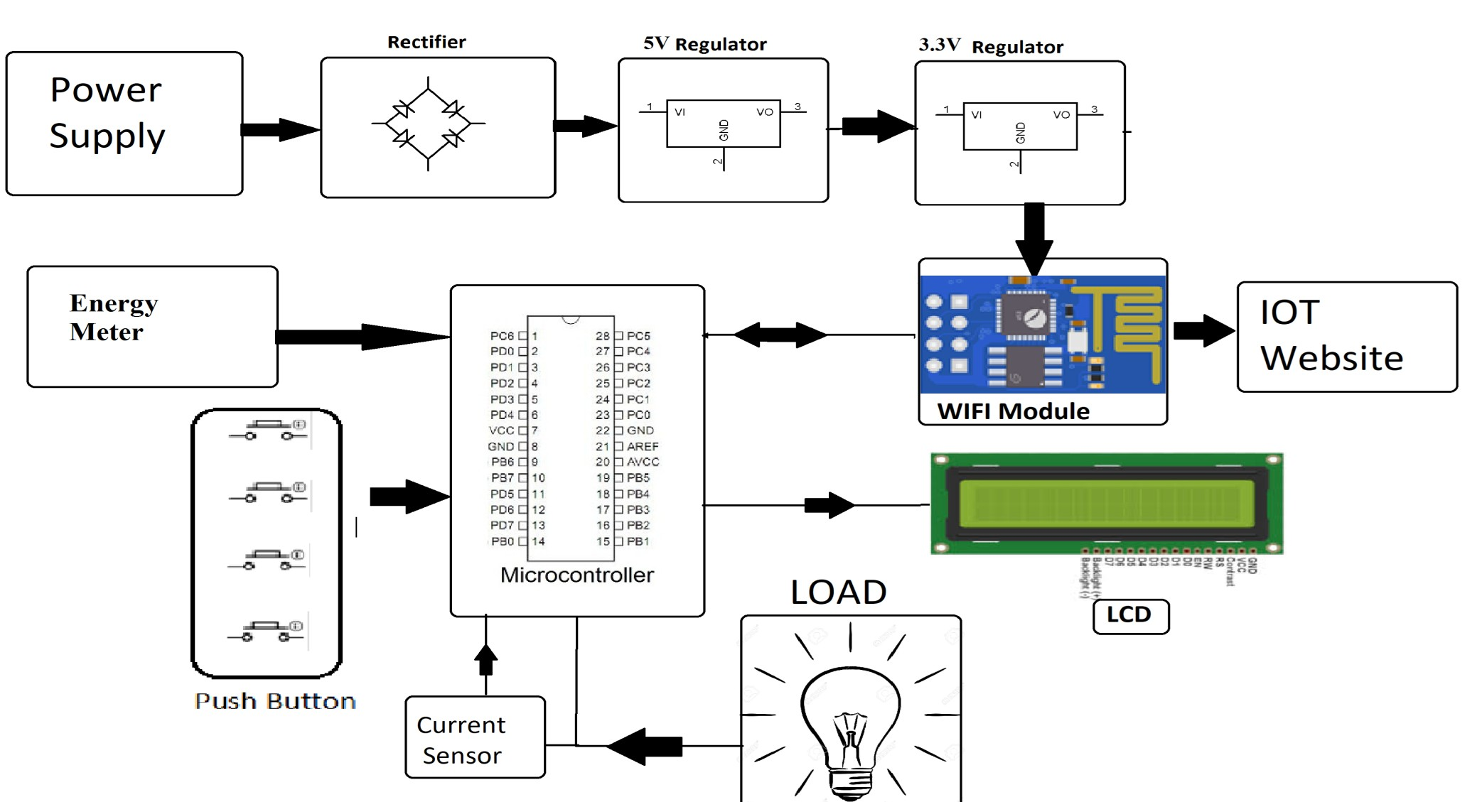

Slide 8
REAL-TIME TRANSIST INFORMATION PLATFORM:
▶ The Smart Water Transit Information Platform (SWTIP) represents a digital ecosystem that harnesses real-time data and IoT technology to deliver essential information and services pertaining to water distribution and management.
Real-Time Water Flow Monitoring: This feature offers continuous data regarding water flow rates, pressures, and distribution throughout the water network. Users have the capability to monitor the flow of water within pipes and pipelines.
Water Quality Monitoring: This functionality involves real-time monitoring of water quality parameters, including pH levels, turbidity, and contaminants. It also provides alerts for possible issues or violations of quality standards.

Slide 9
INTEGRATION APPROACH:
▶ 1. Standardize Communication Protocols:
Ensure that all devices and software components adhere to standardized communication protocols to facilitate smooth data exchange. Some common IoT communication protocols include MQTT, CoAP, and HTTP/HTTPS.
▶ 2. Central Data Platform:
Establish a central data platform or data hub as the system's core. This platform should
consolidate and store data from multiple sources while offering APIs for data access.
▶ 3. IoT Device Management:
Implement an IoT device management system responsible for tasks such as device provisioning, monitoring, and firmware updates. This system guarantees the optimal functionality of all devices.

Slide 10
INTEGRATION BENEFITS:
Seamless Data Flow: Integration guarantees a continuous and unhindered data flow between different system components. This enables the prompt collection, processing, and utilization of real-time information.
Improved Decision-Making: The integration of data from diverse sources offers a comprehensive perspective of the water system. This empowers utilities, operators, and other stakeholders to make more informed decisions.
Efficient Resource Allocation: Integration aids in resource allocation optimization by offering insights into water usage patterns. This empowers utilities to allocate water resources more efficiently, consequently reducing wastage.

Slide 11
THANK YOU

