Slide 1

Exploring transfer learning with transformers.

Slide 2
Agenda
Overview of Transfer Learning.
Why Transfer Learning is becoming an active research area, especially in NLP.
Transformers!
A unified approach to transfer learning in NLP

Slide 3
Transfer Learning
Transfer learning is a machine learning technique where a model trained on one task is re-purposed on a second related task.
Training a model on a data-rich task and fine-tuning it on a related downstream task

Slide 4
Overview of Transfer Learning
Traditionally, in transfer learning, pre-training is done using supervised learning on large labeled datasets.
In Modern techniques, pre-training is often done via unsupervised learning on the unlabeled datasets.

Slide 5
Transformers
The Transformer in NLP is a novel architecture that aims to solve sequence-to-sequence tasks while handling long-range dependencies with ease.
Earlier, Recurrent Neural Networks were leveraged in transfer learning for NLP.
Example: Translation, Summarization.

Slide 6
Why Transformers for Transfer Learning
Due to en masses availability of unlabeled text data (Thanks to the Internet), transfer learning in NLP has become an active research area.
Major NLP tasks like question answering, machine translation, summarization can be treated as a related task.

Slide 7
Unified Approach
Key – For related NLP tasks, treat every text-based/ text processing task as a “text-to-text” task.
Using a text-to-text framework, one can apply the same model, objective, training procedure, and decoding process to every task one considers.

Slide 8
Input Output Format
To specify which task the model should perform, a task-specific (text) prefix is added to the original input sequence before feeding it to the model.
For instance, to ask the model to translate the sentence “That is good.” from English to German, the model would be fed the sequence “translate English to German: That is good.” and would be trained to output “Das ist gut.”

Slide 9
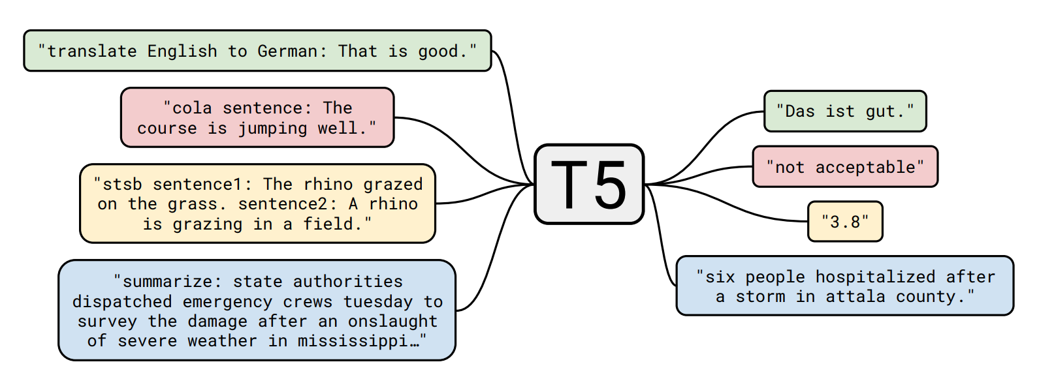
T5 model - Text-to-Text Transfer Transformer
Source - https://arxiv.org/pdf/1910.10683v3.pdf

Slide 10
Dataset
Colossal Clean Crawled Corpus (C4)
Publicly-available web archive provides “web extracted text” by removing markup and other non-text content from the scraped HTML files.

Slide 11
Model Structures
A major distinguishing factor for different architectures is the “mask” used by different attention mechanisms in the model.
The self-attention operation in a Transformer takes a sequence as input and outputs a new sequence of the same length.

Slide 12
Model Structure
Fully Visible
Casual
Casual with prefix

Slide 13
Model Structure
An encoder-decoder Transformer, consists of two-layer stacks:
The encoder, which is fed an input sequence, and the decoder, which produces a new output sequence.
The encoder uses a “fully-visible” attention mask.
This form of masking is appropriate when attending over a “prefix”, i.e. some context provided to the model that is later used when making predictions.

Slide 14
Model Structure
The self-attention operations in the Transformer’s decoder use a “causal” masking pattern.
This is used during training so that the model can’t “see into the future” as it produces its output.

Slide 15
Thank You

