Slide 1
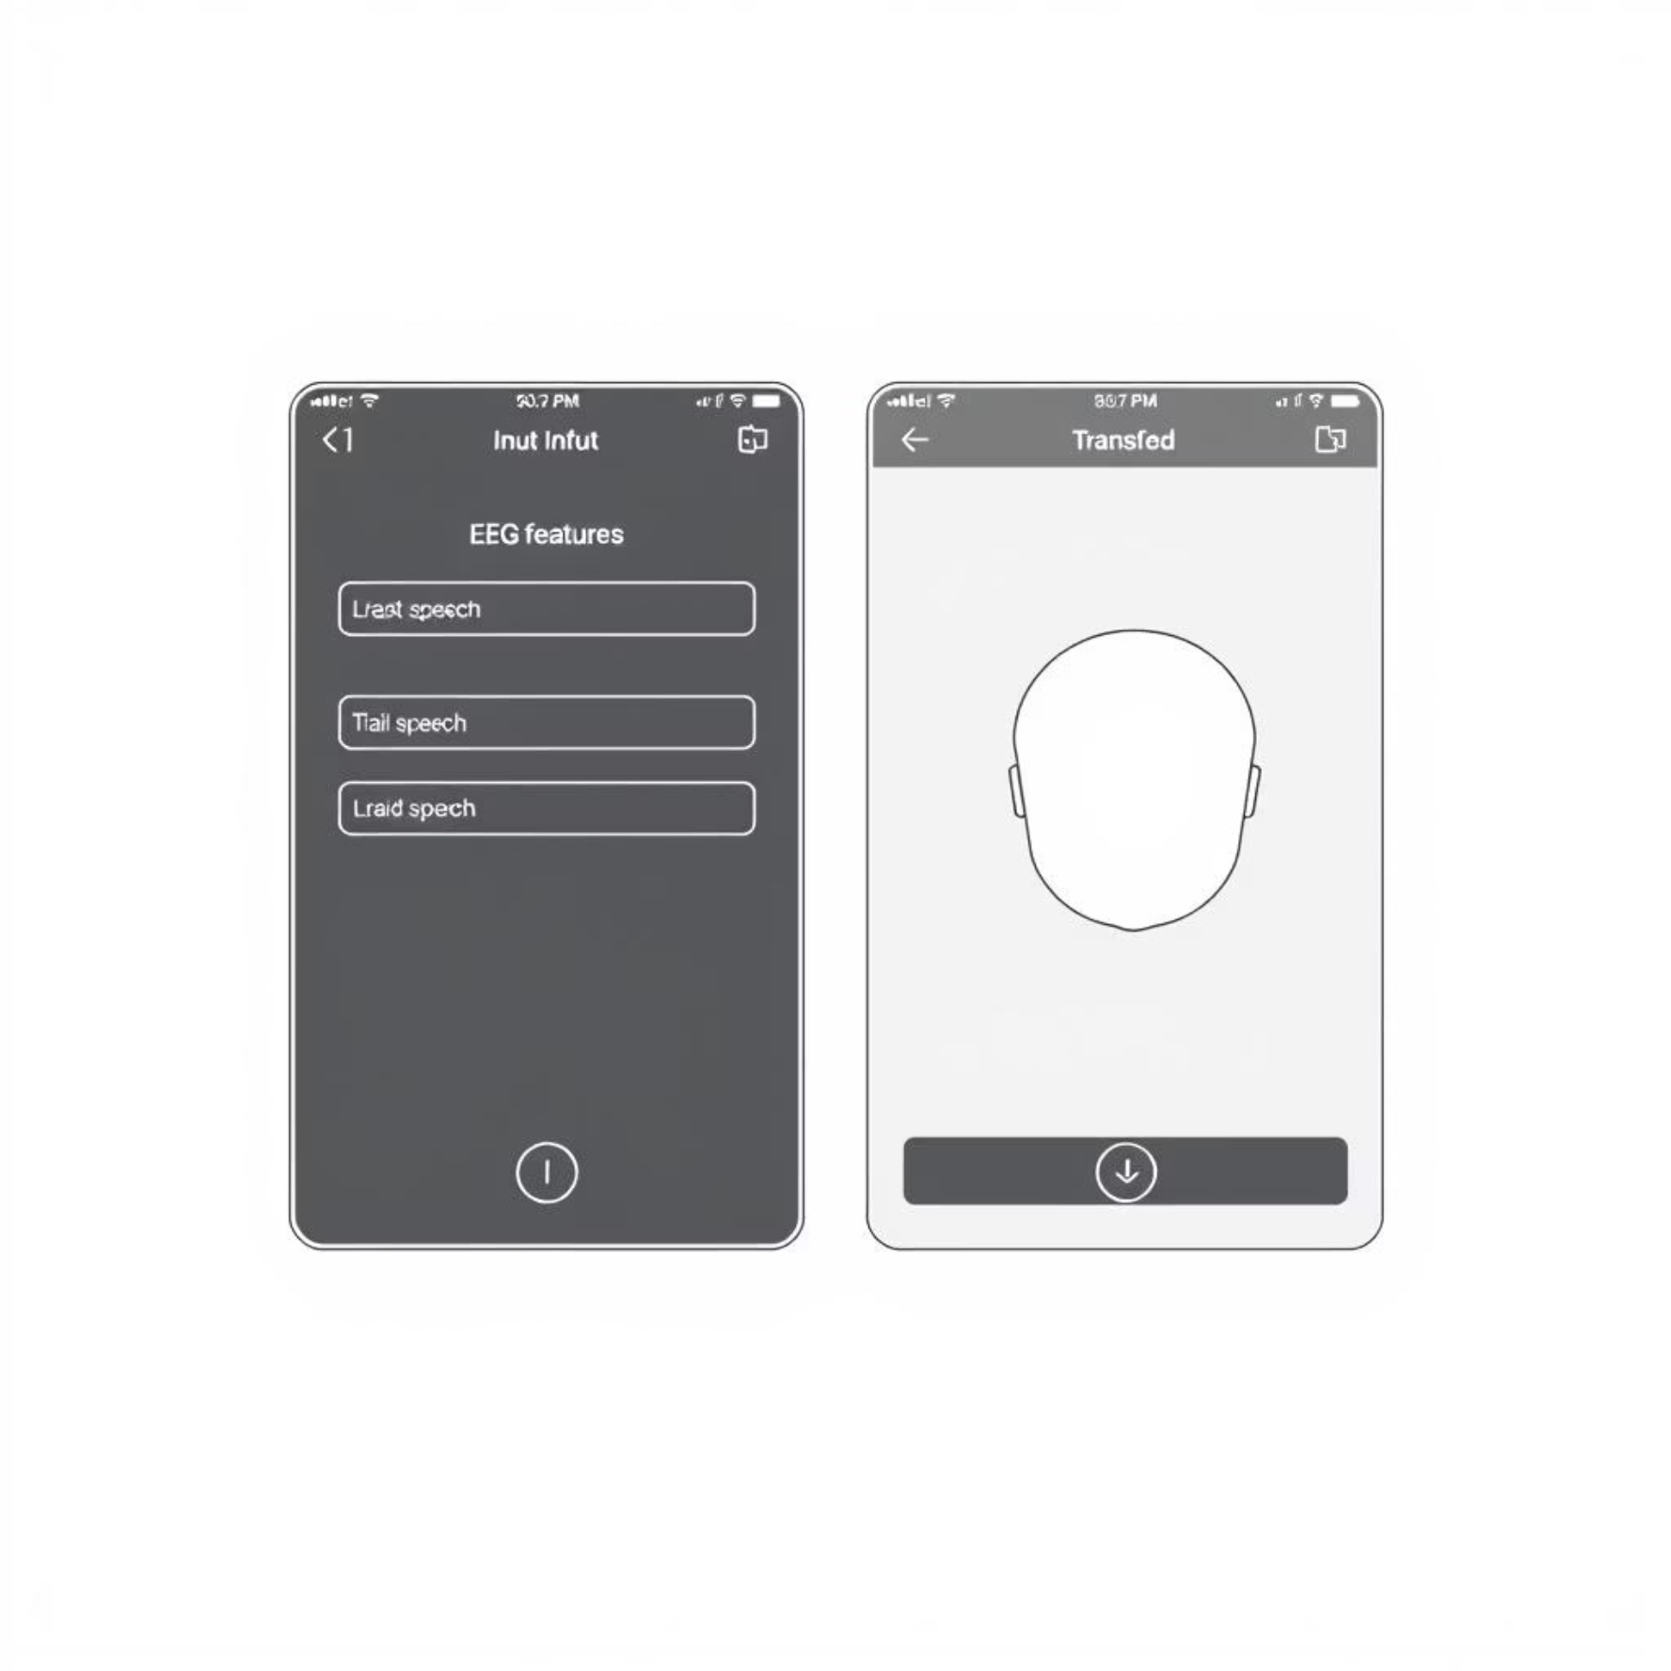
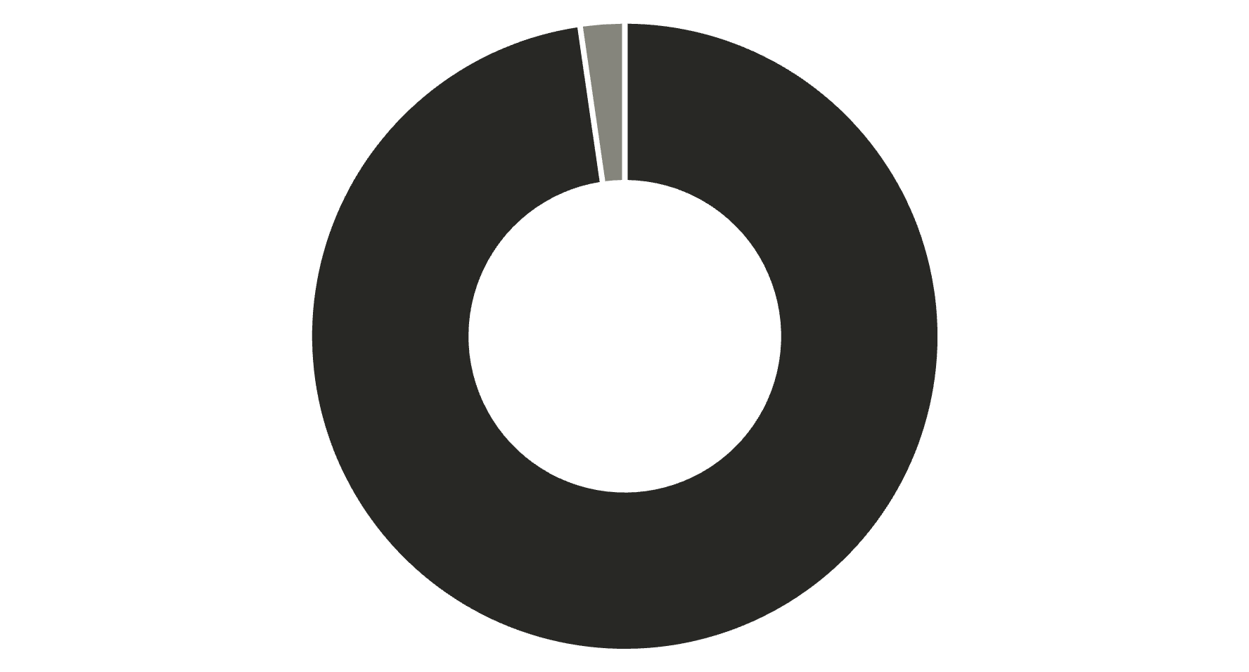
Visualization & Analysis
UI Wireframes
Communication Time Comparison
Eye-tracking (Avg)
Vaani (Avg)
Vaani drastically reduces communication time from minutes to seconds.
Intuitive design for seamless interaction.
Impact & Accuracy
95%
100%
Intent Prediction Accuracy
Personalized Empathy
Accuracy significantly increases with patient-specific training sessions.
Custom-trained models enhance not just accuracy, but also the emotional connection.

