Slide 1


K.RAMAKRISHNAN COLLEGE OF TECHNOLOGY
(AUTONOMOUS), TRICHY.
DEPARTMENT OF
COMPUTER SCIENCE AND ENGINEERING
20CS5501 DESIGN PROJECT-1
Batch No. : 17
Date : 6.12.2024

Slide 2
SENTIMENTAL ANALYSIS USING
GOOGLE GEMINI LLM
Guided by Team
Ms. S Uma Mageshwari M.E Nandhini K (811722104098)
Assistant Professor, CSE Pooja P (811722104108)
Priyadharshini A (811722104114)

Slide 3
OBJECTIVE OF THE PROJECT
The objective is to revolutionize mental wellness in healthcare by leveraging advanced sentiment analysis technology to assess individual’s mental states, provide personalized recommendations for improvement, and empower users to track their emotional journey for informed decision-making and self-improvement.

Slide 4
ABSTRACT
“Sentimental analysis using Google Gemini LLM” improves mental well-being through daily narrative analysis, assessing emotional states and offering personalized suggestions. It provides real-time insights and comprehensive reports for managing emotional health, promotes mental wellness with simple daily tasks, and encourages self-care.
Utilizing Django, Figma, Google Gemini LLM, and Git, it ensures a secure, seamless user experience. It offers a safe space for emotional expression, supporting individuals on their mental health journeys.

Slide 5
LITERATURE SURVEY
TITLE OF THE PAPER | PUBLISHER | PAPER GIST | TECHNOLOGY USED
Sentimental Analysis with Amazon Review Data | IEEE 2018 | This paper explores various machine learning algorithms such as Naive Bayes, Support Vector Machine (SVM) | Machine learning models, Natural Language Processing (NLP), Python, and libraries like Scikit-learn were employed to analyze textual data
Sentimental Analysis of Twitter Data using Classifier Algorithms | Springer 2024 | The paper presents an approach for analyzing sentiments expressed in Twitter data using various classifier algorithms | TensorFlow/Keras or PyTorch,Gensim,Pandas and NumPy,Tweepy or Twitter API
Sentiment Analysis of Amazon Products Using Ensemble Machine Learning Algorithms | IEEE 2019 | The paper focuses on analyzing the sentiment of Amazon product reviews by leveraging multiple machine learning algorithms in an ensemble approach. | Programming Language: Python scikit-learn,Natural Language Toolkit (NLTK),Pandas and NumPy.

Slide 6
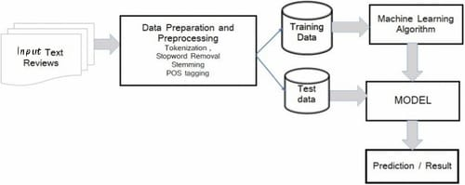
PROPOSED SYSTEM ARCHITECTURE

Slide 7
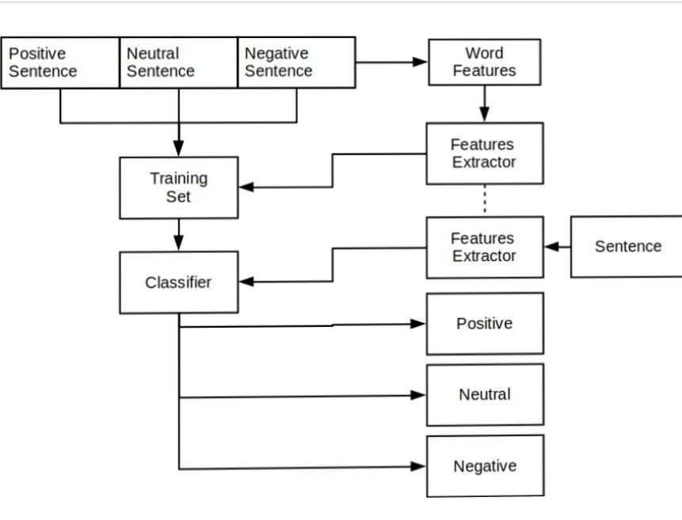
EXISTING SYSTEM ARCHITECTURE

Slide 8
SOFTWARE AND HARDWARE REQUIREMENTS
HARDWARE
SOFTWARE
Front-end Development
HTML,CSS,JavaScript
Backend Development
Django
User Interface Design
Version Control
Django Backend Server:
RAM: Minimum 16GB
Processor: Multi-core processor
Storage: SSD (minimum 500GB)
Google Gemini LLM Integration
Internet Connection SentiStrength

Slide 9
MODULES
NLTK (Natural Language Toolkit)
TextBlob
Transformers (Hugging Face)
spaCy
SentiStrength

Slide 10
SUMMARY OF MODULE-1
NLTK (Natural Language Toolkit)
Purpose: Provides tools for text preprocessing, tokenization, stemming, lemmatization, and more.
Use in Mental Health: Useful for preparing and cleaning text data, removing stop words, and employing basic sentiment analysis using tools like VADER, which works well with social media and mental health-related text.

Slide 11
SUMMARY OF MODULE-2
TextBlob
Purpose: Simplifies NLP tasks like part-of-speech tagging, noun phrase extraction, and sentiment analysis.
Use in Mental Health: Good for basic sentiment classification (positive, negative, neutral) and extracting insights from user reviews, forum posts, or survey responses related to mental health.

Slide 12
SUMMARY OF MODULE-3
Transformers (Hugging Face)
Purpose: Provides pre-trained state-of-the-art NLP models like BERT, RoBERTa, and GPT for various tasks, including sentiment analysis.
Use in Mental Health: Ideal for fine-tuning models to detect nuanced emotions and sentiments specific to mental health contexts, such as detecting anxiety, depression, or other mental health issues from text data.

Slide 13
SUMMARY OF MODULE-4
spaCy
Purpose: A fast and efficient NLP library for tasks like named entity recognition, dependency parsing, and text preprocessing.
Use in Mental Health: Helps identify specific terms and phrases related to mental health conditions and entities, enabling a more context-aware sentiment analysis.

Slide 14
SUMMARY OF MODULE-5
SentiStrength
Purpose: Designed specifically to estimate the strength of positive and negative sentiments in short texts like social media messages.
Use in Mental Health: Well-suited for analyzing sentiment in short, informal texts (e.g., tweets, posts) that are common in mental health discussions, and can capture both positive and negative emotions simultaneously.

Slide 15
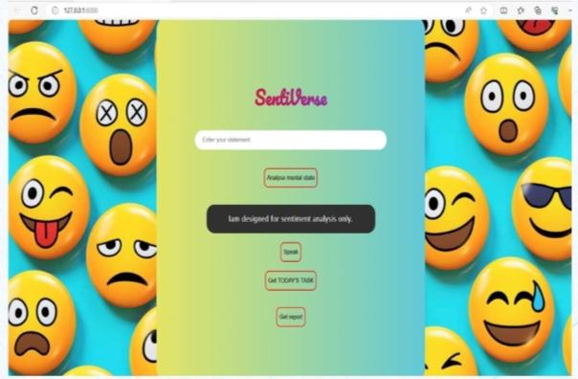
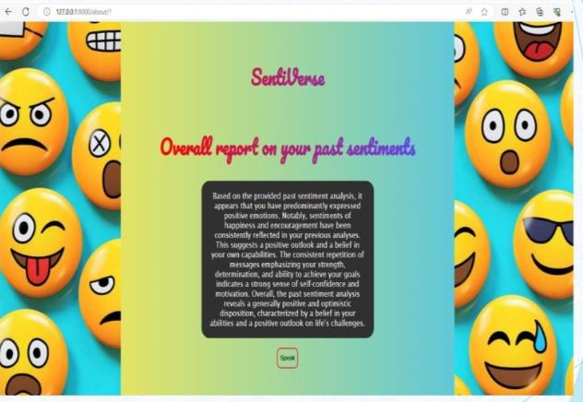
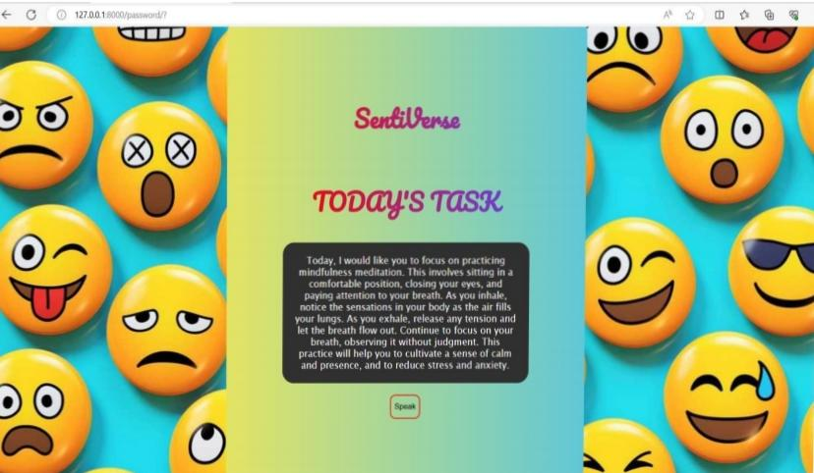
RESULTS AND DISCUSSION

Slide 16
CONCLUSION
In conclusion, Python-based sentiment analysis offers a powerful tool for understanding and interpreting textual data by determining the sentiment behind user inputs. By leveraging libraries like NLTK, TextBlob, and spaCy, developers can effectively analyze sentiment from various sources such as social media posts, customer reviews, and surveys.
These libraries provide robust methods for natural language processing, enabling the classification of text into categories such as positive, negative, or neutral.

Slide 17
THANK YOU

