Slide 1
FinGuard UPI Fraud Investigation & Merchant Analytics
AgentIQ Datathon 2026 | FinTech & BFSI Track
Team Name: TrustPay Analysis
Team Members: Pooja Kumari, Srushti Patrange, Suchita Jagtap
Institution: Lovely Professional University

Slide 2
The Problem
Digital payment systems generate huge numbers of transactions every day. Analysts need to identify unusual transaction patterns, risky merchants, repeated disputes and suspicious connections.
The challenge is that transaction, KYC, merchant and chargeback data can be messy, inconsistent and difficult to analyze together.
Messy Payment Data
→
Difficult Relationships
→
Hidden Risk Patterns
→
Slow Investigation
Challenge | Impact
Missing / inconsistent data | Incorrect analysis
Duplicate records | Inflated metrics
Broken relationships | Difficult investigation
Multiple status formats | Unreliable KPIs
Chargeback records | Hard to connect disputes

Slide 3
Our Solution
“FinGuard converts fragmented UPI, KYC, merchant and chargeback data into an interactive investigation and analytics platform.”
1. Data Rescue
2. Analytics Layer
3. Interactive Dashboard
4. Investigation & NL Query
Clean, standardize, and validate raw payment data
→
Compute KPIs, risk metrics, and relationships
→
Visual exploration of transactions and disputes
→
Entity investigation and natural-language questions

Slide 4
Data Used
UPI Transactions
KYC Records
Merchant Master
Chargebacks
Dataset | Purpose | Key Fields
UPI Transactions | Payment activity | Transaction ID, User ID, Merchant ID, Amount, Timestamp, Status, UTR
KYC Records | Customer risk context | User ID, KYC Status, Risk Segment, City, State
Merchant Master | Merchant context | Merchant ID, MCC, Category, Business Type, Status
Chargebacks | Payment disputes | Transaction ID, User ID, Merchant ID, Disputed Amount, Reason, Severity
All data used in the project is synthetic.

Slide 5
Data Rescue & Quality Layer
BEFORE
CLEANING
AFTER
• Missing UTRs
• Currency symbols
• Duplicate records
• Inconsistent statuses
• Inconsistent IDs
• Invalid relationships
• Messy KYC formats
• Standardization
• Deduplication
• Type conversion
• ID normalization
• Date/time normalization
• Status normalization
• Missing-value handling
Query-ready analytical datasets
→
→
Quality Check | Result
Duplicate transactions | Removed/flagged
Missing UTR | Flagged
Status values | Standardized
IDs | Normalized
Relationships | Validated
Chargebacks | Linked where possible

Slide 6
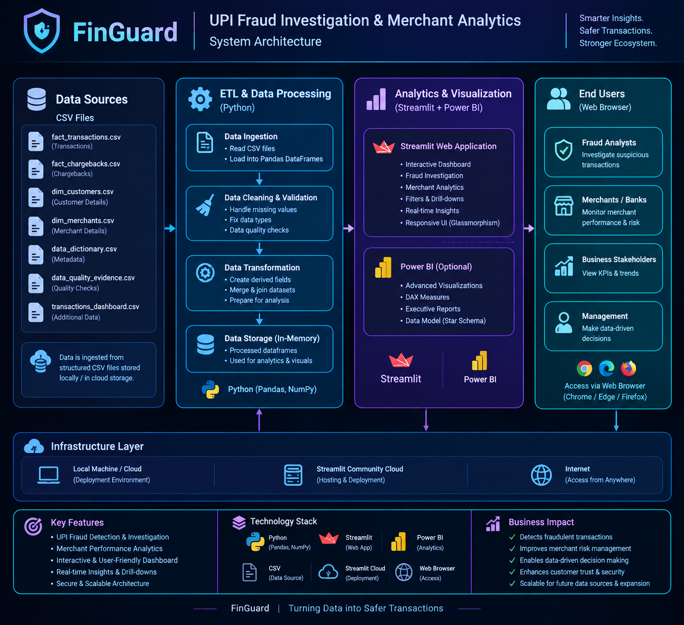
FinGuard System Architecture
[MISSING IMAGE: arch.png]
Figure: End-to-end data flow from CSV sources to end-user dashboards.

Slide 7
Analytics Layer
20,000
₹239.2M
₹11,962
2,800
9.8%
Cleaned Transactions
Transaction Value
Average Transaction
Cleaned Chargebacks
Failed Rate
Chargeback Severity
KYC Risk Distribution
Transaction Status
High
Low Risk
Success
Medium
Medium
Failed
Low
High Risk
Pending

Slide 8
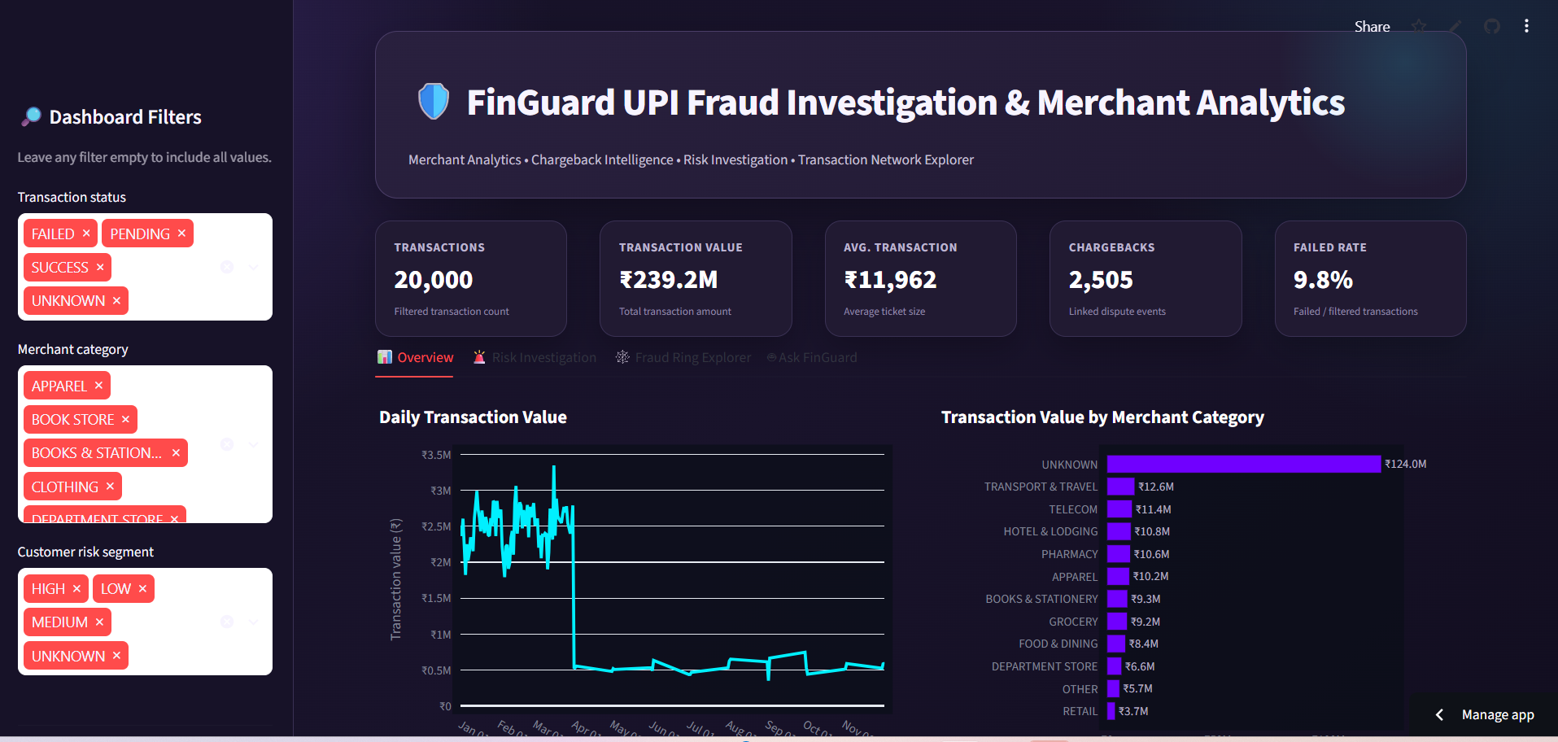
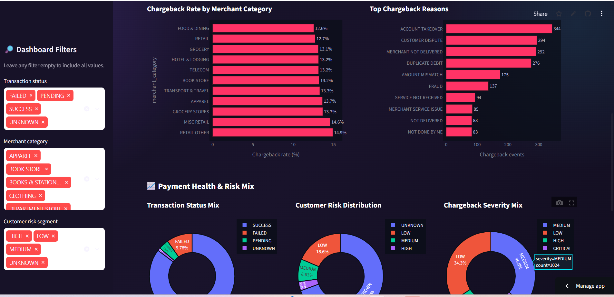
Interactive Dashboard
Executive KPIs • Category Analysis • Chargeback Monitoring • Interactive Filters

Slide 9
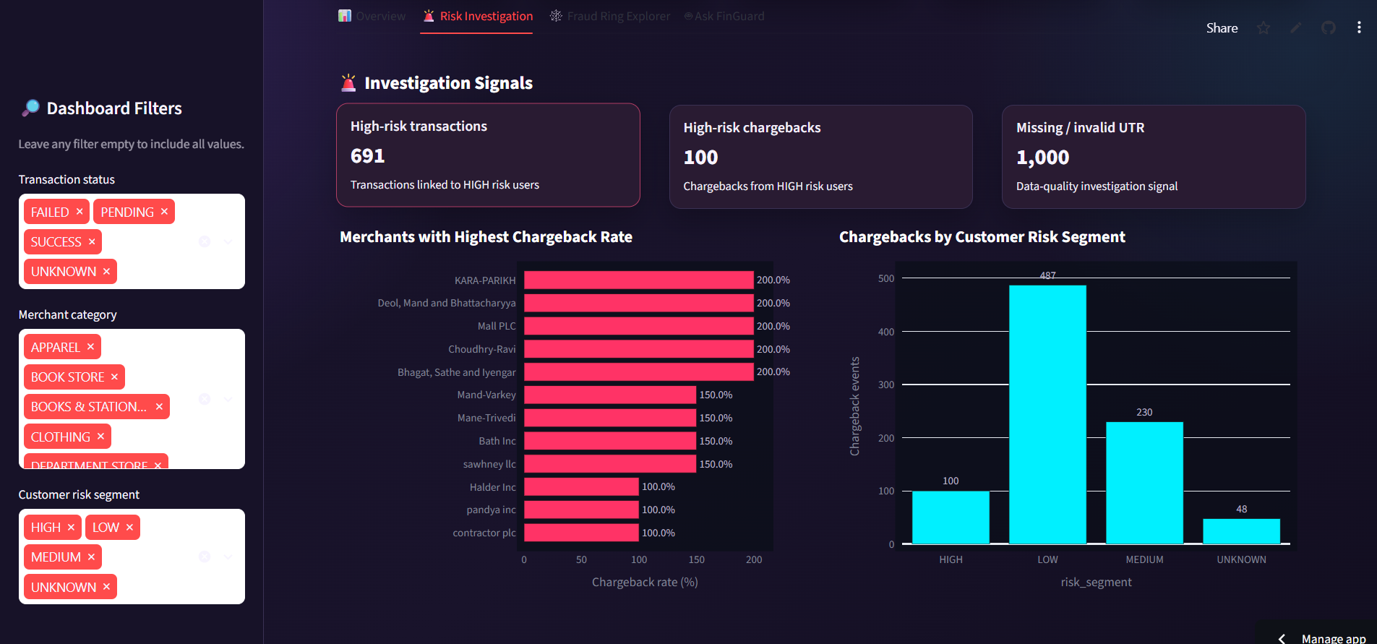
Risk Investigation
Analysts can investigate merchant/user activity by combining:
• Transaction activity
• Chargeback activity
• KYC risk segment
• UTR quality signals
• Repeated merchant relationships
[MISSING IMAGE: risk.png]
Risk indicators are investigation signals, not confirmed fraud verdicts.

Slide 10
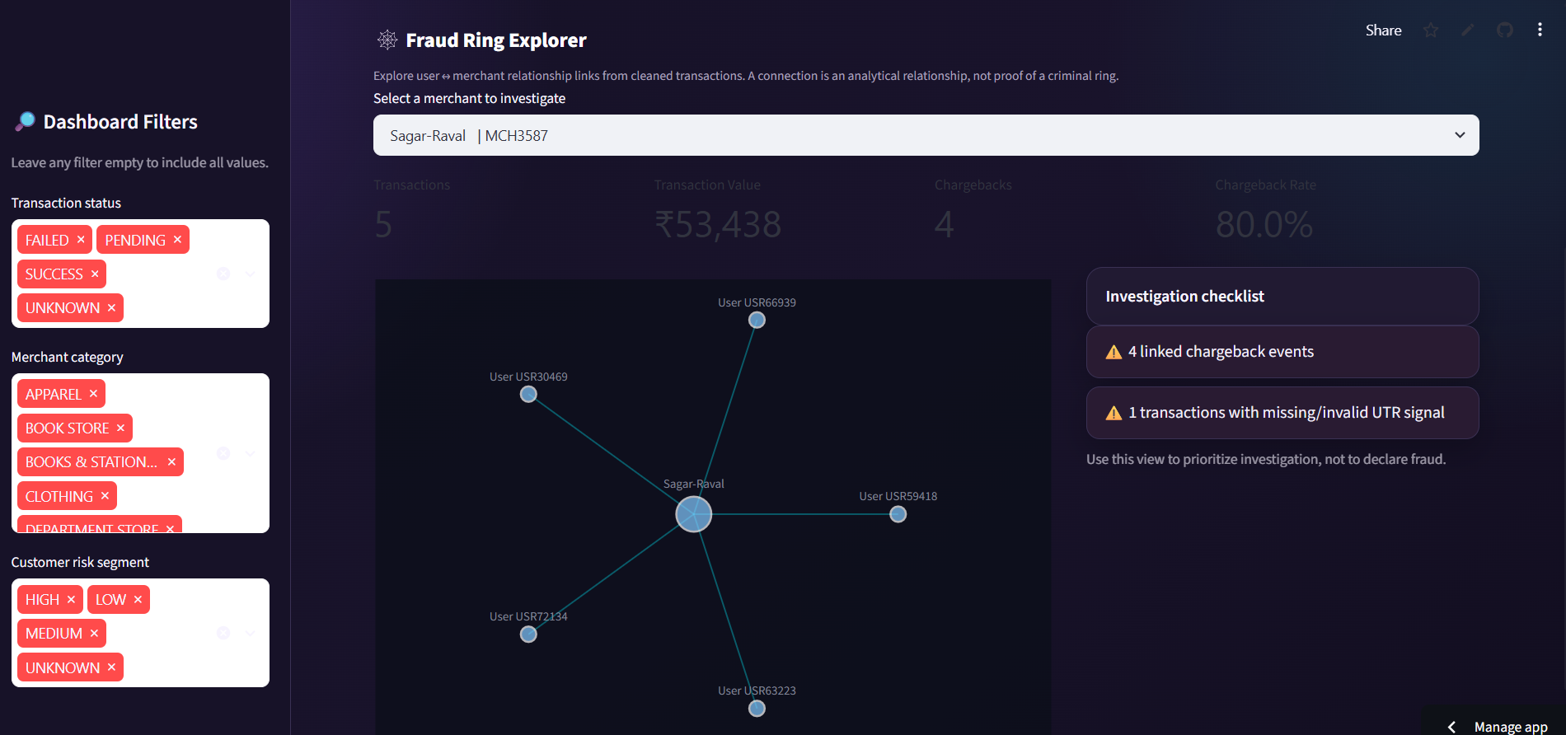
Fraud Ring Explorer
Network View
• Blue nodes = Users
• Pink nodes = Merchants
• Lines = Transaction relationships
The network view helps analysts identify unusual connectivity, shared merchants, and concentrated transaction relationships.
Potentially suspicious connection patterns — not confirmed fraud rings.

Slide 11
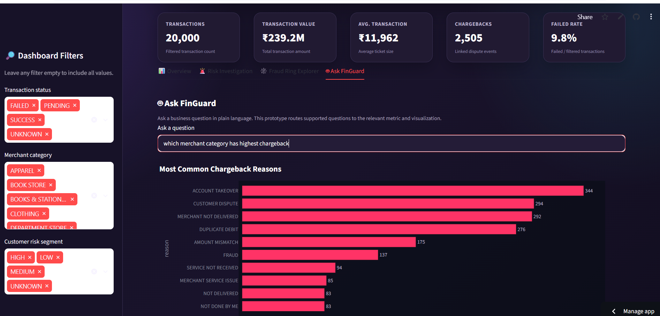
Ask FinGuard
Supported Queries
• Top chargeback reasons?
• Highest chargeback category?
• How many failed transactions?
• Total transaction value?
• Chargeback patterns by category?
The current prototype uses rule-based query routing to map supported natural-language questions to analytical views.

Slide 12
Technology Stack
Python
Pandas
Plotly
Streamlit
PyArrow
GitHub
Python + Pandas
→
Data Processing
→
Plotly Analytics
→
Streamlit Dashboard
→
GitHub Deployment

Slide 13
Key Features & Business Value
FEATURES
BUSINESS VALUE
• Data quality validation
• Interactive KPIs
• Merchant analytics
• Chargeback monitoring
• Risk investigation
• Network visualization
• NL query prototype
• Explainable signals
• Faster investigation
• Better merchant risk visibility
• Easier chargeback analysis
• Connected payment relationships
• Reliable analytics from cleaned data
• Single dashboard for multiple sources
“From fragmented payment data to an investigation-ready analytical workflow.”

Slide 14
Results & Future Scope
RESULTS
20,000
2,800
28,920
4,343
₹239.2M
Cleaned Transactions
Cleaned Chargebacks
Unique Customers
Unique Merchants
Transaction Value
FUTURE SCOPE
• Real-time transaction streaming
• Graph-based anomaly detection
• Machine learning risk scoring
• Device/location risk signals
• More advanced LLM agent
• Real-time fraud alerts
• Advanced graph algorithms

Slide 15
Conclusion
“FinGuard UPI Fraud Investigation & Merchant Analytics transforms messy payment data into a practical investigation and decision-support platform.”
CLEAN
ANALYZE
CONNECT
INVESTIGATE
Reliable analytical data
Understand transactions and disputes
Explore user–merchant relationships
Identify patterns that deserve analyst attention

