Slide 1
REVIEW PRESENTATION
CloudDQ AI
Serverless, AI-Assisted Data Quality Assessment and Monitoring Platform on AWS
Team: [Team name]
Pooja Palani
Dewlyn Mary
Lathika Shree
Reg. No.: [Reg. No.]
Reg. No.: [Reg. No.]
Reg. No.: [Reg. No.]
Backend & API — Lambda, API Gateway, DynamoDB, Bedrock invoke
Frontend & Identity — Amplify, Cognito, S3
Operations & Governance — CloudWatch, IAM, config, Bedrock access
Live: https://main.d3ffgcfvtof2u.amplifyapp.com/

Slide 2
WHY CLOUDDQ AI
Objective
Organisations make decisions on data they rarely measure. CloudDQ AI lets a Data User upload a CSV dataset, scores it across six standard data-quality dimensions with an explainable rule engine, shows the result as a dashboard, writes a plain-language executive summary with Amazon Bedrock, and lets a Business User raise an alert that the Data User corrects and re-validates. The whole platform is serverless on AWS, keeps raw data private, and sends only aggregated metrics to the AI model.
▪ Measure dataset quality with a transparent, weighted six-dimension score (0–100).
▪ Classify health as Healthy (80–100), Warning (60–79) or Critical (<60) and decide fitness for analytics.
▪ Visualise dimensions, column quality, score trend, severity and issues for each dataset.
▪ Detect personal data (names, emails, phone numbers) in uploaded columns with Amazon Comprehend.
▪ Generate an executive summary and top-3 fixes with Amazon Bedrock from metrics only, never raw rows.
▪ Support two roles: Data Users run quality checks; Business Users review results and raise alerts.
▪ Close the loop with a correction workflow: alert (emailed through Amazon SNS) → acknowledge → re-upload → re-analyse → resolve.
▪ Run fully serverless on AWS with no stored AWS keys in the browser.
DQ score
0.25·Completeness + 0.20·Validity + 0.15·Uniqueness
+ 0.15·Consistency + 0.15·Accuracy + 0.10·Timeliness
Healthy 80–100 · Warning 60–79 · Critical <60
CloudDQ AI · 2

Slide 3
SCOPE
List of Modules
M1
Authentication & Role-Based Access
M2
Frontend SaaS Application
Email sign-in and two user roles enforced in both the UI and the API.
React + TypeScript single-page app with role-aware navigation.
Cognito, API Gateway authorizer
Amplify Hosting
M3
Dataset Upload & Repository
M4
Data Quality Engine (Six Dimensions)
Secure CSV upload with presigned URLs and a per-user dataset catalogue.
Explainable profiling, scoring, rules, anomaly detection and PII detection.
S3, Lambda, DynamoDB
Lambda, Comprehend
M5
Dashboard, Reports & Analytics
M6
AI Executive Summary
Visual quality report per dataset with export and print.
Business-friendly explanation and top-3 recommendations from aggregated metrics.
Lambda, DynamoDB, Amplify
Bedrock, Lambda
M7
Alerts & Soft Correction Workflow
M8
API, Data Store & Cloud Deployment
Business → Data User collaboration with email notification and re-validation.
One REST API, one Lambda, one table — monitored and least-privilege.
Lambda, DynamoDB, SNS
API Gateway, Lambda, DynamoDB, CloudWatch, SNS, IAM
CloudDQ AI · 3

Slide 4
MODULES M1–M2
Detailed Description of Modules
M1 · Authentication & Role-Based Access
M2 · Frontend SaaS Application
AWS: Cognito, API Gateway authorizer
AWS: Amplify Hosting
▪ Amazon Cognito user pool with email sign-in and a strong password policy (upper, lower, number, symbol).
▪ Public SPA app client (no secret) using SRP authentication through amazon-cognito-identity-js.
▪ Two Cognito groups, DataUser and BusinessUser; the group claim in the ID token decides the role.
▪ Every API call carries the ID token as Authorization: Bearer; API Gateway's Cognito authorizer rejects missing or invalid tokens with 401.
▪ Lambda re-checks the role for each action (e.g. only DataUser can upload; only BusinessUser can raise alerts) and returns 403 otherwise.
▪ React 19, TypeScript, Vite and Tailwind CSS; charts with Recharts; routing with React Router.
▪ Pages: Landing, Login, Home (role workspace), Datasets repository, Upload, Dataset detail, Alerts.
▪ Protected routes redirect signed-out users to login; the Upload route is visible only to Data Users.
▪ Built and hosted by AWS Amplify from the GitHub main branch; configuration is injected at build time through VITE_ environment variables.
CloudDQ AI · 4

Slide 5
MODULES M3–M4
Detailed Description of Modules
M3 · Dataset Upload & Repository
M4 · Data Quality Engine (Six Dimensions)
AWS: S3, Lambda, DynamoDB
AWS: Lambda, Comprehend
▪ The browser asks the API for a short-lived presigned S3 PUT URL (15 minutes), then uploads the CSV directly to the private bucket.
▪ The dataset is registered in DynamoDB (DATASET#id / META) with owner, file, S3 key, status and a status timeline.
▪ Uploads are keyed datasets/<user>/<dataset>/<file>.csv; the bucket blocks all public access and is encrypted (SSE-S3).
▪ The repository page lists the user's datasets through the GSI1 index (USER#sub) with score and health badges.
▪ Profiler infers each column's type (id, email, phone, date, numeric, categorical, string) and null rate.
▪ Dimension scores: Completeness (null cells), Validity (format checks), Uniqueness (duplicate keys), Consistency (case/format variants), Accuracy (range checks), Timeliness (future and stale dates).
▪ DQ score = 0.25·Completeness + 0.20·Validity + 0.15·Uniqueness + 0.15·Consistency + 0.15·Accuracy + 0.10·Timeliness.
▪ Rules with thresholds and severities (e.g. Uniqueness ≥ 98 HIGH, Validity ≥ 90 MEDIUM) turn failures into issues.
▪ Anomaly detection compares with the previous run: null-rate spike, volume drop, freshness delay and dimension score drop. No ML model is needed.
▪ Amazon Comprehend DetectPiiEntities scans up to five sample values per column and flags columns holding personal data (NAME, EMAIL, PHONE, ADDRESS…) with a confidence score; generic types such as dates are ignored.
CloudDQ AI · 5

Slide 6
MODULES M5–M6
Detailed Description of Modules
M5 · Dashboard, Reports & Analytics
M6 · AI Executive Summary
AWS: Lambda, DynamoDB, Amplify
AWS: Bedrock, Lambda
▪ Score card with health and fit-for-analytics flag; status timeline (Uploaded → Processing → Analyzed → ReportGenerated → Completed).
▪ Six-dimension bar chart, DQ score trend across runs, column quality heatmap, severity and rule coverage.
▪ Issue list with severity filter (High / Medium / Low) and audit history.
▪ Export the report as CSV and print it; the run history is kept on the dataset item for trend charts.
▪ Lambda builds a metrics JSON (score, health, dimensions, issue counts, anomalies, top issue messages) — no raw CSV rows.
▪ Calls the Amazon Bedrock Converse API (Amazon Nova Lite, inference profile us.amazon.nova-lite-v1:0) and asks for JSON with an executive summary and exactly three recommendations.
▪ The summary is cached on the dataset per analysis run, and the UI shows exactly which metrics the model received.
▪ If Bedrock is unavailable, a deterministic summary is built from the same metrics so the feature degrades gracefully.
CloudDQ AI · 6

Slide 7
MODULES M7–M8
Detailed Description of Modules
M7 · Alerts & Soft Correction Workflow
M8 · API, Data Store & Cloud Deployment
AWS: Lambda, DynamoDB, SNS
AWS: API Gateway, Lambda, DynamoDB, CloudWatch, SNS, IAM
▪ A Business User sends a quality alert with a note; the dataset workflow moves to AlertRaised and the Data User sees it in the inbox.
▪ Lambda publishes the alert to the Amazon SNS topic clouddq-alerts, which emails subscribers with the score, health, note and a link to the dataset.
▪ The Data User acknowledges, moves the dataset to correction, re-uploads a fixed CSV and re-runs the analysis.
▪ Issue lifecycle OPEN → ASSIGNED → IN_PROGRESS → RESOLVED, with reopen and a full audit history.
▪ An issue can only be resolved when the latest dimension score meets the rule threshold (re-validation).
▪ API Gateway REST API (stage prod) with / and /{proxy+} ANY methods routed to one Python 3.12 Lambda by Lambda proxy integration.
▪ DynamoDB single-table design: PK/SK plus GSI1 for a user's datasets and alerts; on-demand capacity.
▪ Lambda logs to CloudWatch (/aws/lambda/clouddq-api); alarm clouddq-api-errors fires on any error in 5 minutes and notifies the SNS topic.
▪ Three IAM users (one per team member) with role-scoped policies and an execution role clouddq-lambda-role for the function.
CloudDQ AI · 7

Slide 8
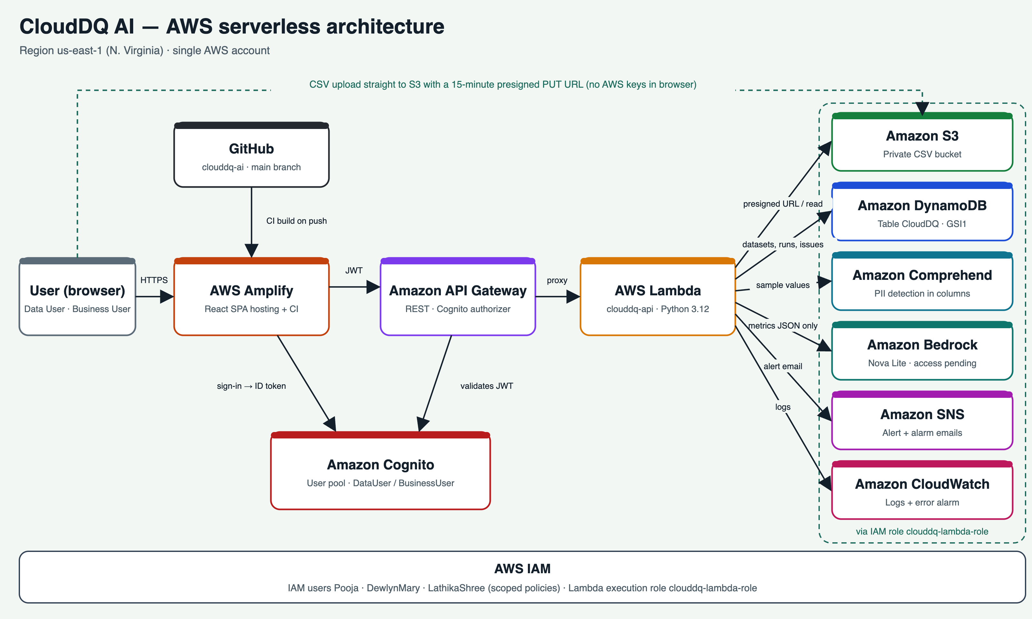
AWS SERVERLESS DESIGN
Architecture
CloudDQ AI · 8

Slide 9
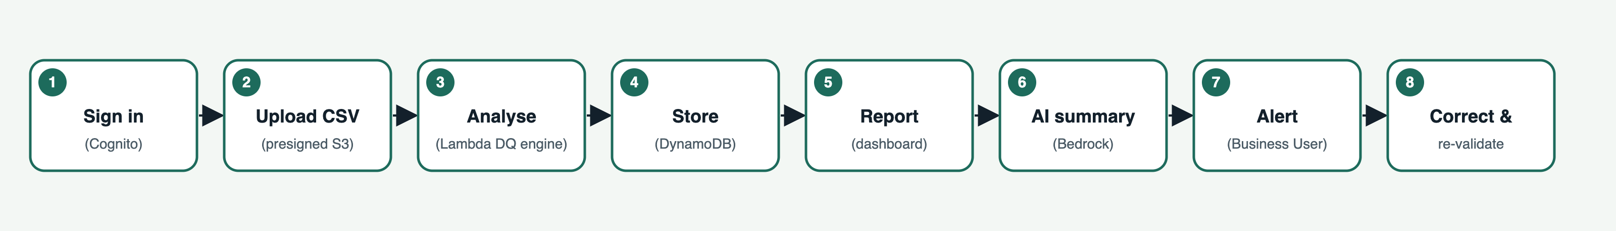
ARCHITECTURE
End-to-End Workflow & Data Model
Entity | PK | SK | GSI1
Dataset | DATASET#<id> | META | USER#<sub> / DATASET#…
Analysis run | DATASET#<id> | RUN#<iso time> | —
Issue | DATASET#<id> | ISSUE#<id> | —
Alert | ALERT#<id> | META | USER#<sub> / ALERT#…
Security by design
▪ Cognito JWT checked by API Gateway on every call
▪ Roles re-checked inside Lambda (403 on wrong role)
▪ Private encrypted S3, 15-min presigned uploads
▪ Browser never holds AWS keys
▪ Bedrock sees metrics JSON only, never raw rows
▪ Separate IAM user per member, scoped policies
CloudDQ AI · 9

Slide 10
CLOUD STACK · US-EAST-1
AWS Services Used (10 + IAM)
Service | Use in CloudDQ AI | Resource
AWS Amplify | Builds and hosts the React app from GitHub; injects VITE_ configuration at build time. | clouddq-ai · main branch
Amazon Cognito | User pool for sign-in; DataUser / BusinessUser groups; issues the JWT used by the API. | us-east-1_DT3M9ZhMz
Amazon API Gateway | REST API with a Cognito authorizer; forwards requests to Lambda (proxy). | fdro0463k8 · stage prod
AWS Lambda | Python 3.12 backend: routing, DQ engine, alerts, presigned URLs, AI integrations. | clouddq-api
Amazon S3 | Private, encrypted storage for uploaded CSVs; presigned PUT uploads. | clouddq-datasets-121835991420
Amazon DynamoDB | Single table for datasets, runs, issues, alerts; GSI1 for per-user queries. | CloudDQ
Amazon Comprehend | AI service: detects personal data (PII) in sample column values during analysis. | DetectPiiEntities
Amazon SNS | Emails business alerts to the Data User and CloudWatch alarm notifications. | clouddq-alerts
Amazon CloudWatch | Lambda logs and error alarm for monitoring. | /aws/lambda/clouddq-api
Amazon Bedrock | Generative AI executive summary from aggregated metrics (Converse API); account access pending with AWS. | us.amazon.nova-lite-v1:0
AWS IAM | Team IAM users with scoped policies; Lambda execution role. | clouddq-lambda-role
CloudDQ AI · 10

Slide 11
TEAM
Individual Contribution
Pooja Palani
Dewlyn Mary
Lathika Shree
[Reg. No.] · Backend, API and AI integration
[Reg. No.] · Frontend, identity and storage
[Reg. No.] · Operations, monitoring and governance
Modules: M3, M4, M6, M8
Modules: M1, M2, M3 (upload), M5
Modules: M6 (model access), M7 testing, M8 (monitoring, IAM)
▪ Created the DynamoDB table CloudDQ with the PK/SK keys and GSI1 index.
▪ Created the Lambda execution role and the clouddq-api function (Python 3.12, us-east-1); packaged and deployed the backend code and set environment variables.
▪ Built the REST API in API Gateway: Cognito authorizer, / and /{proxy+} routes, CORS, deployment to the prod stage.
▪ Implemented the Bedrock Converse call and the metrics-only payload for the AI summary.
▪ Integrated Amazon Comprehend PII detection into the analysis and added its IAM permission to the Lambda role.
▪ Ran the first Lambda test so CloudWatch logging started.
▪ Created the Cognito user pool, public SPA app client, DataUser / BusinessUser groups and demo users.
▪ Created the private, encrypted S3 bucket and its CORS rule for browser uploads.
▪ Set up AWS Amplify Hosting from GitHub, the monorepo build specification and the VITE_ environment variables.
▪ Connected the frontend sign-in (Cognito) and API configuration; added the Amplify URL to Cognito and S3 CORS.
▪ Checked Amazon Bedrock model availability (Nova Lite) and the inference profile used by Lambda.
▪ Verified the Amplify environment variables before release.
▪ Confirmed the CloudWatch log group and created the clouddq-api-errors alarm.
▪ Created the Amazon SNS topic clouddq-alerts for alert emails and connected the CloudWatch alarm to it.
▪ Reviewed IAM users and policies for least privilege.
▪ Tested the end-to-end alert and correction workflow with both roles.
Shared by all three: Requirement analysis, architecture design, DQ dimension and rule design, testing, documentation and the review presentation.
CloudDQ AI · 11

Slide 12
ENVIRONMENT
Tools / Software Requirements
Category | Tools
Languages | Python 3.12 (backend), TypeScript (frontend)
Frontend | React 19, Vite 8, Tailwind CSS 4, React Router 7, Recharts 3, Axios, amazon-cognito-identity-js
Backend | boto3 / botocore (AWS SDK for Python), Python standard library (csv, re, statistics)
AWS tooling | AWS Management Console, AWS CLI v2, AWS SAM (template.yaml)
Dev tools | Cursor / VS Code, Git and GitHub, Node.js 20+, npm, Postman, Google Chrome DevTools
Testing | Python unittest/pytest for the DQ engine; local API server (backend/local_server.py)
Hardware | Any laptop with 8 GB RAM and internet access; AWS account (region us-east-1)
CloudDQ AI · 12

Slide 13
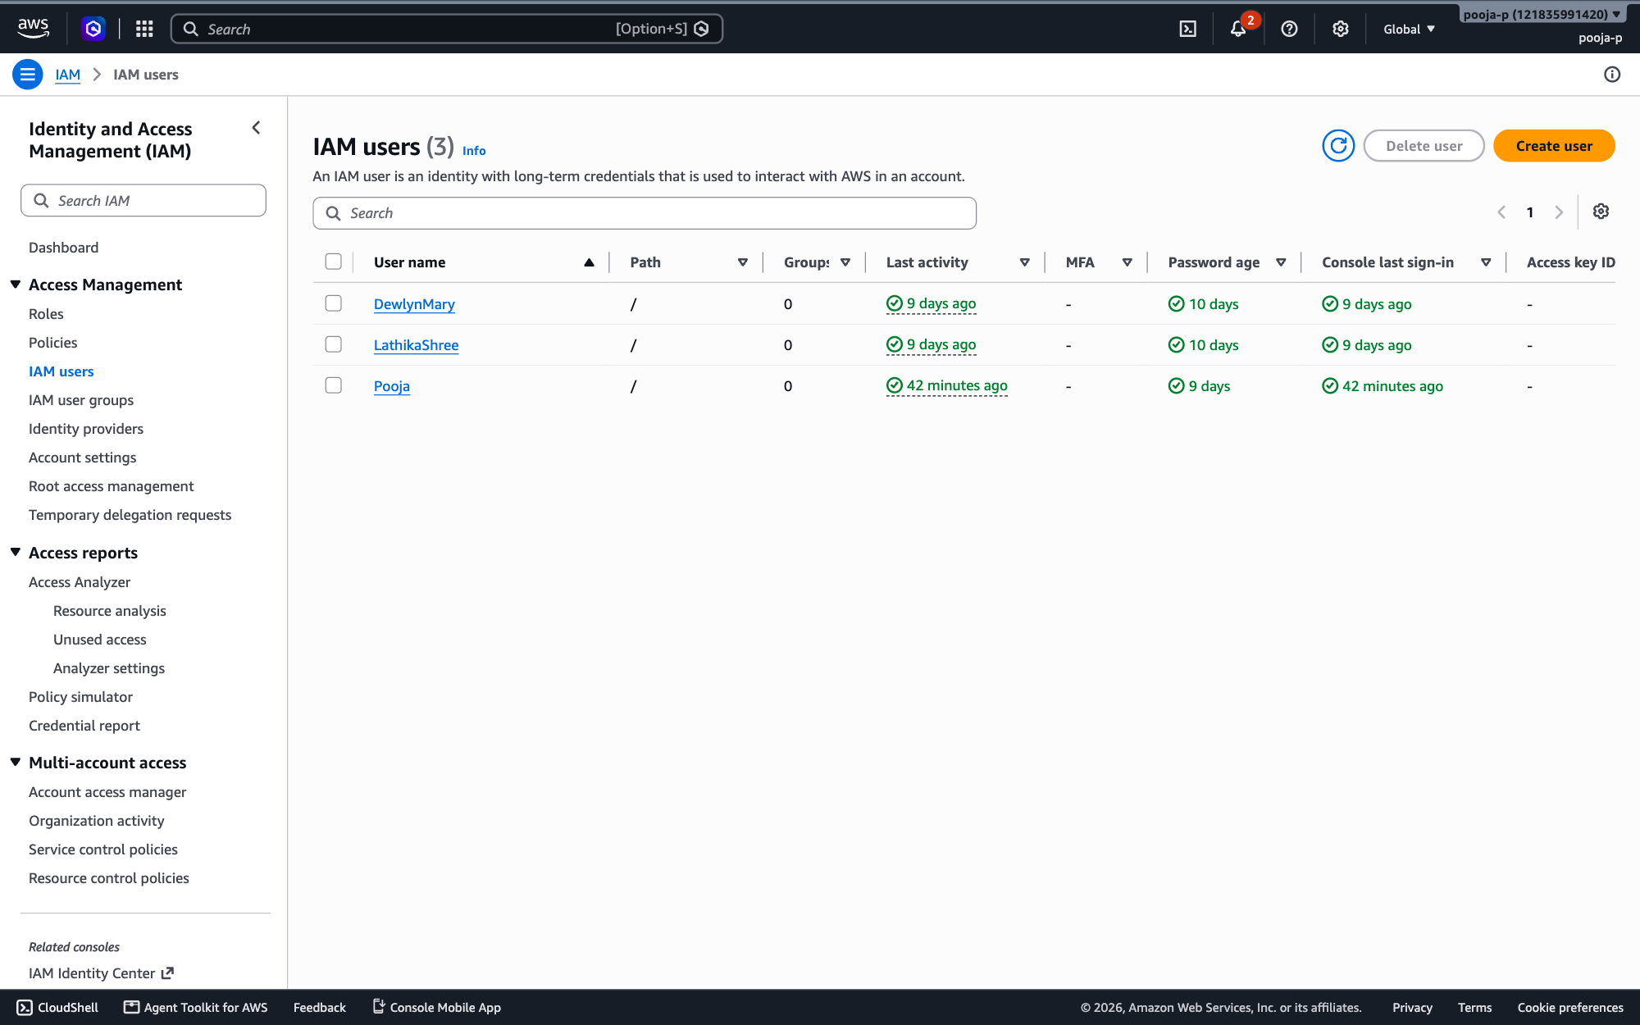
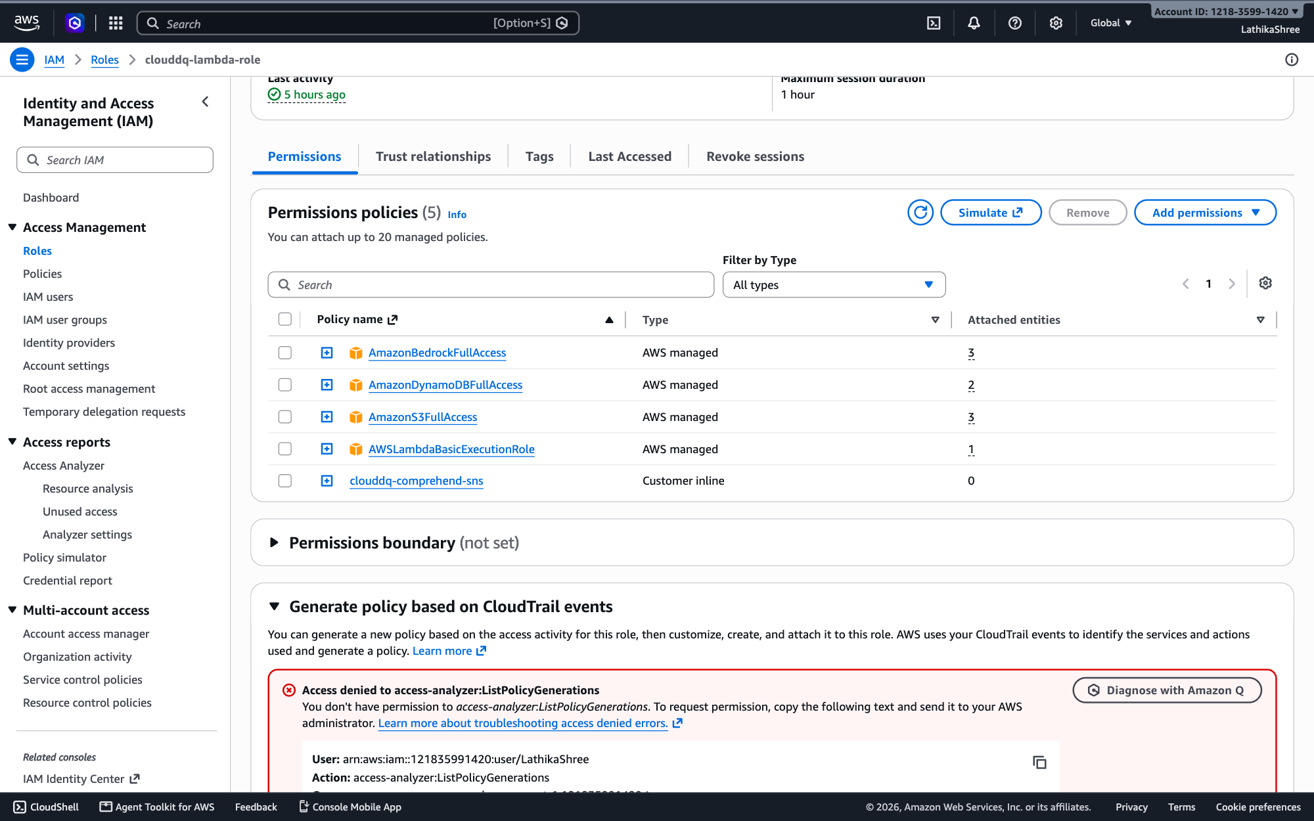
AWS CONSOLE
Screenshots of AWS Services
AWS IAM
AWS IAM
IAM → Users: Pooja, DewlynMary, LathikaShree
Roles → clouddq-lambda-role → Permissions
CloudDQ AI · 13

Slide 14
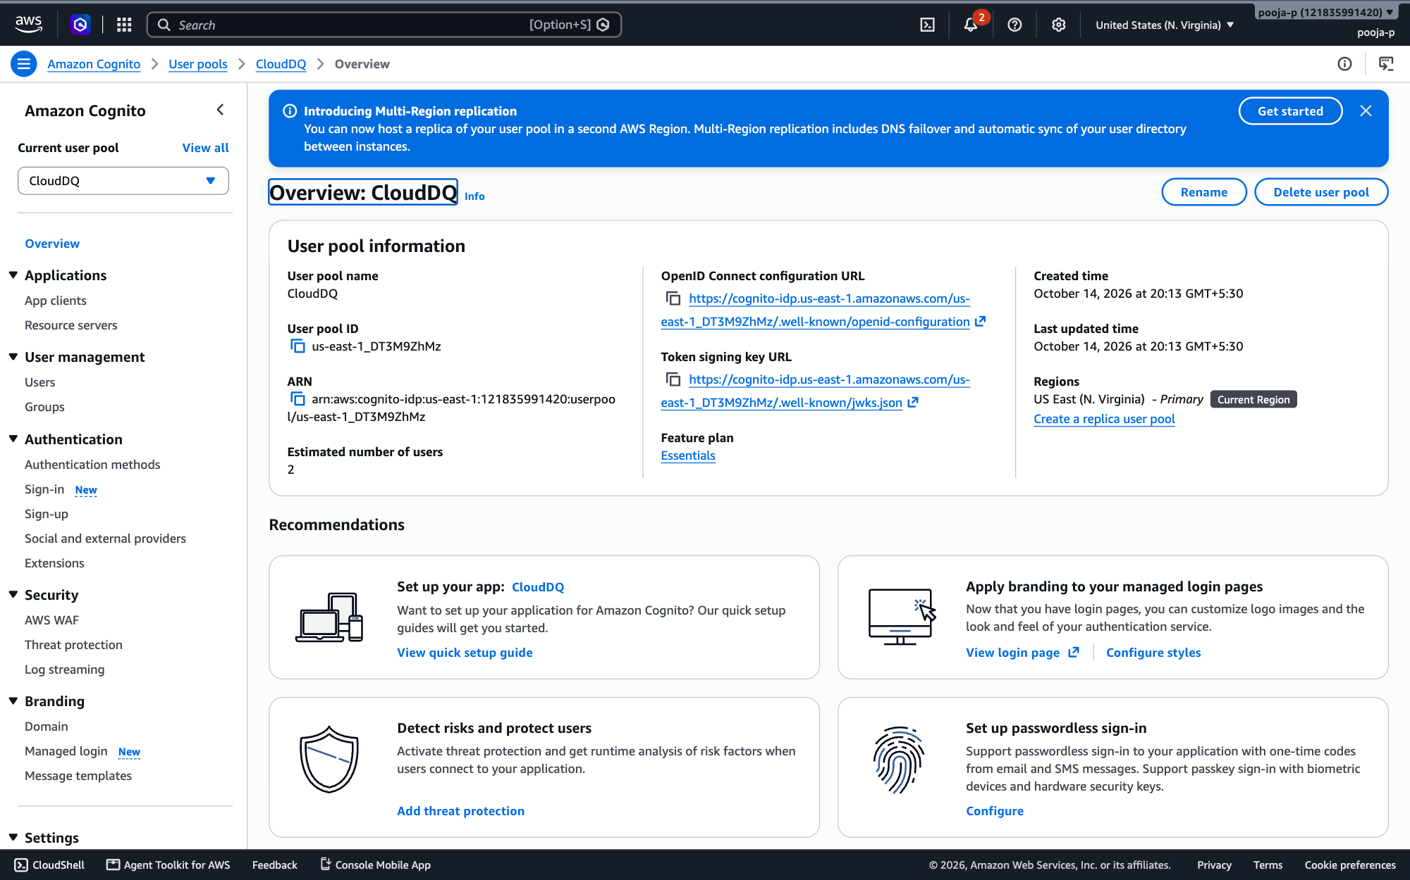
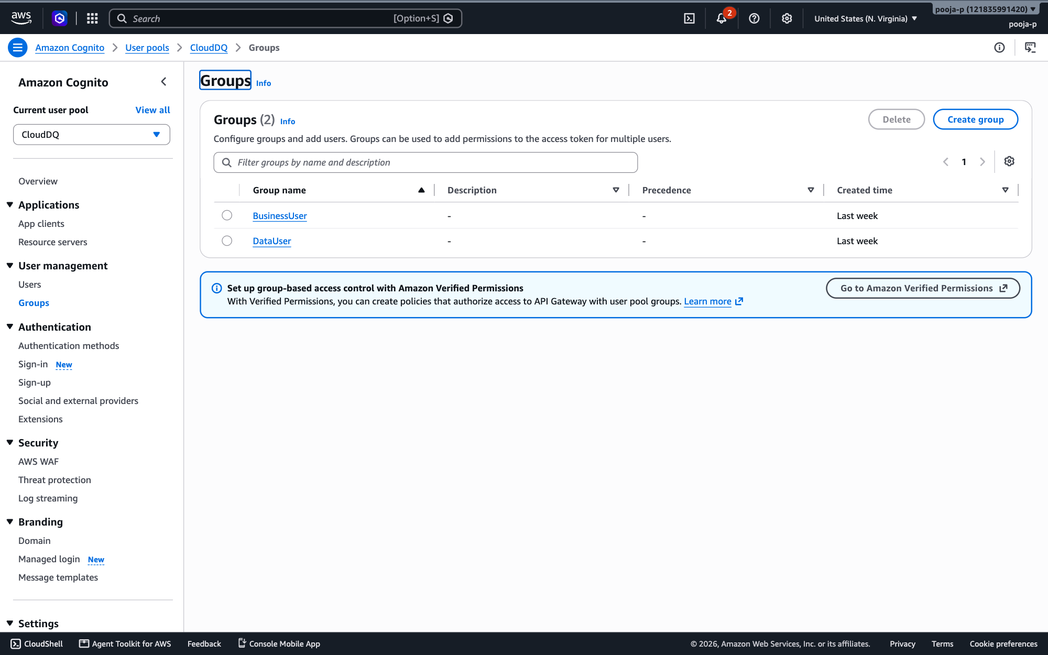
AWS CONSOLE
Screenshots of AWS Services
Amazon Cognito
Amazon Cognito
User pool us-east-1_DT3M9ZhMz → Overview
User pool → Groups: DataUser, BusinessUser
CloudDQ AI · 14

Slide 15
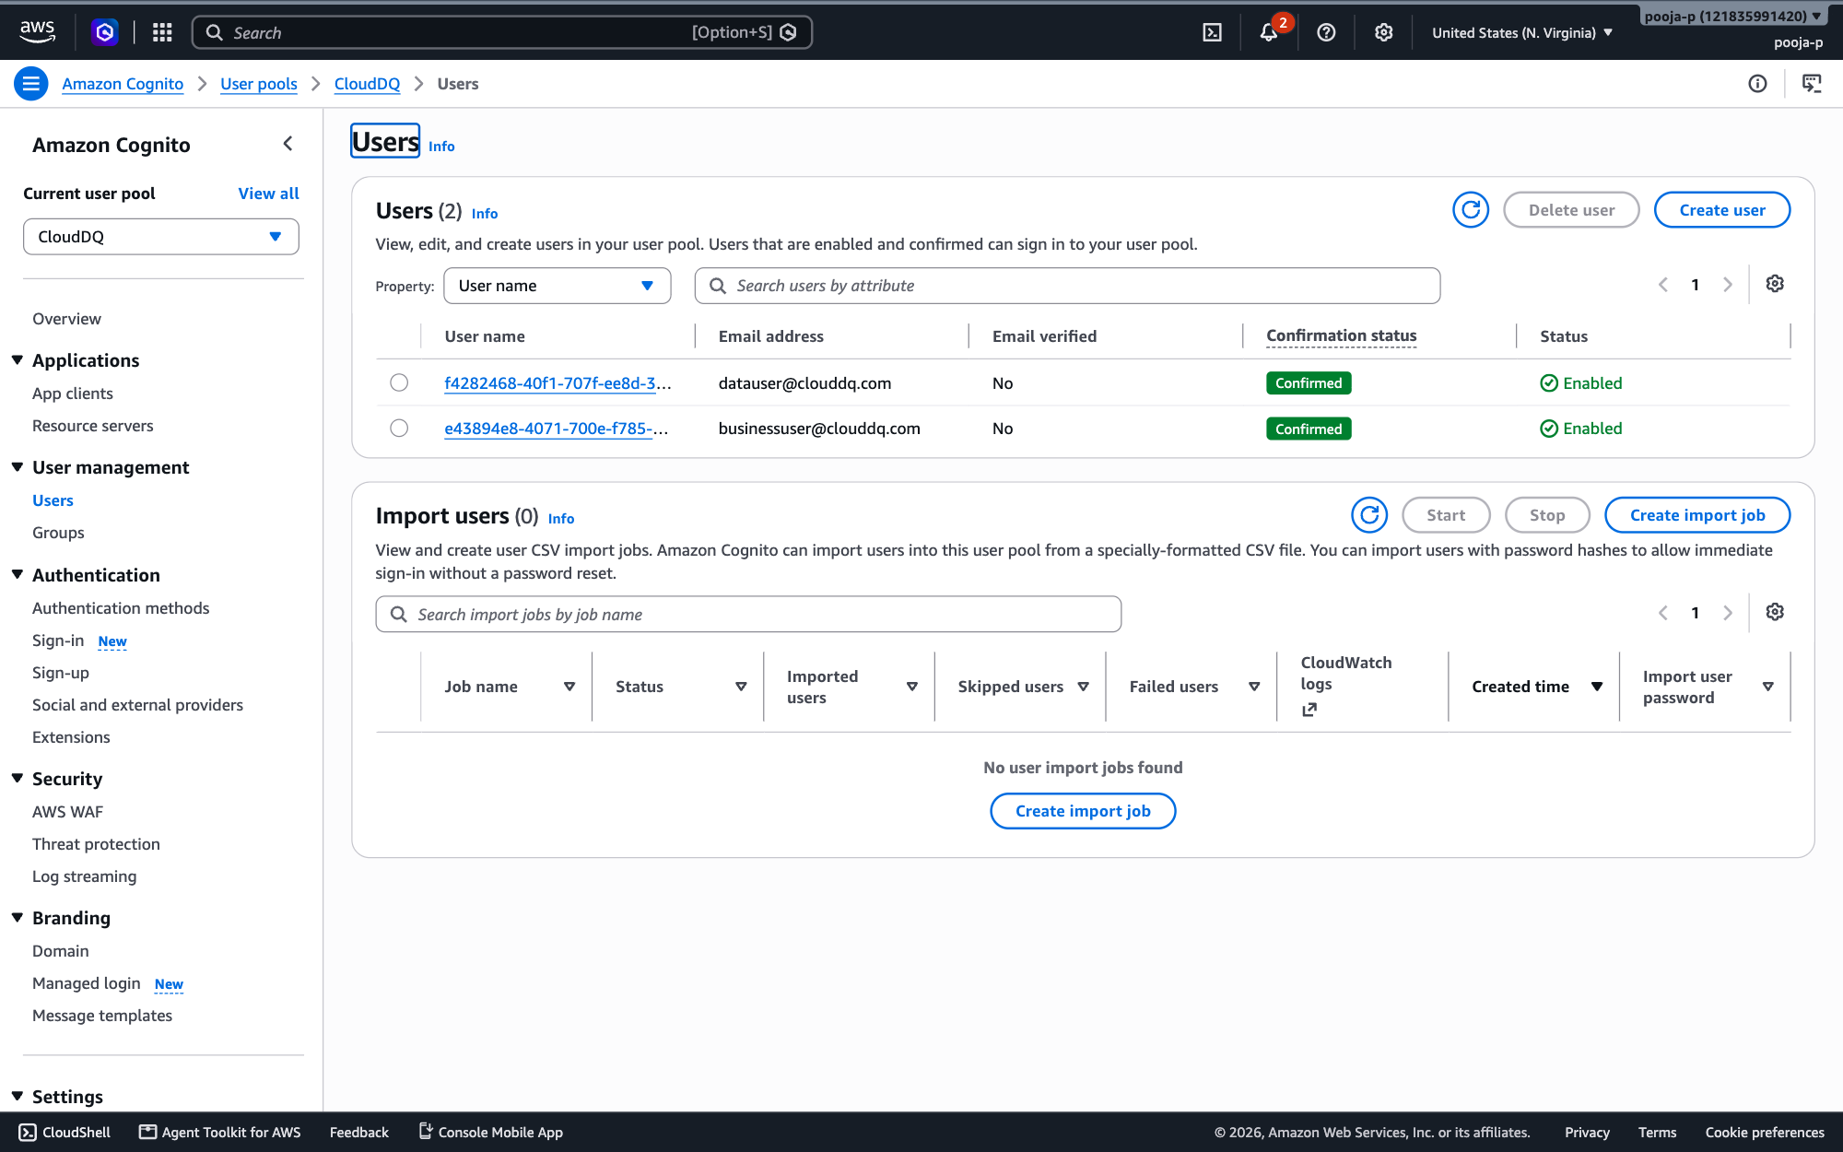
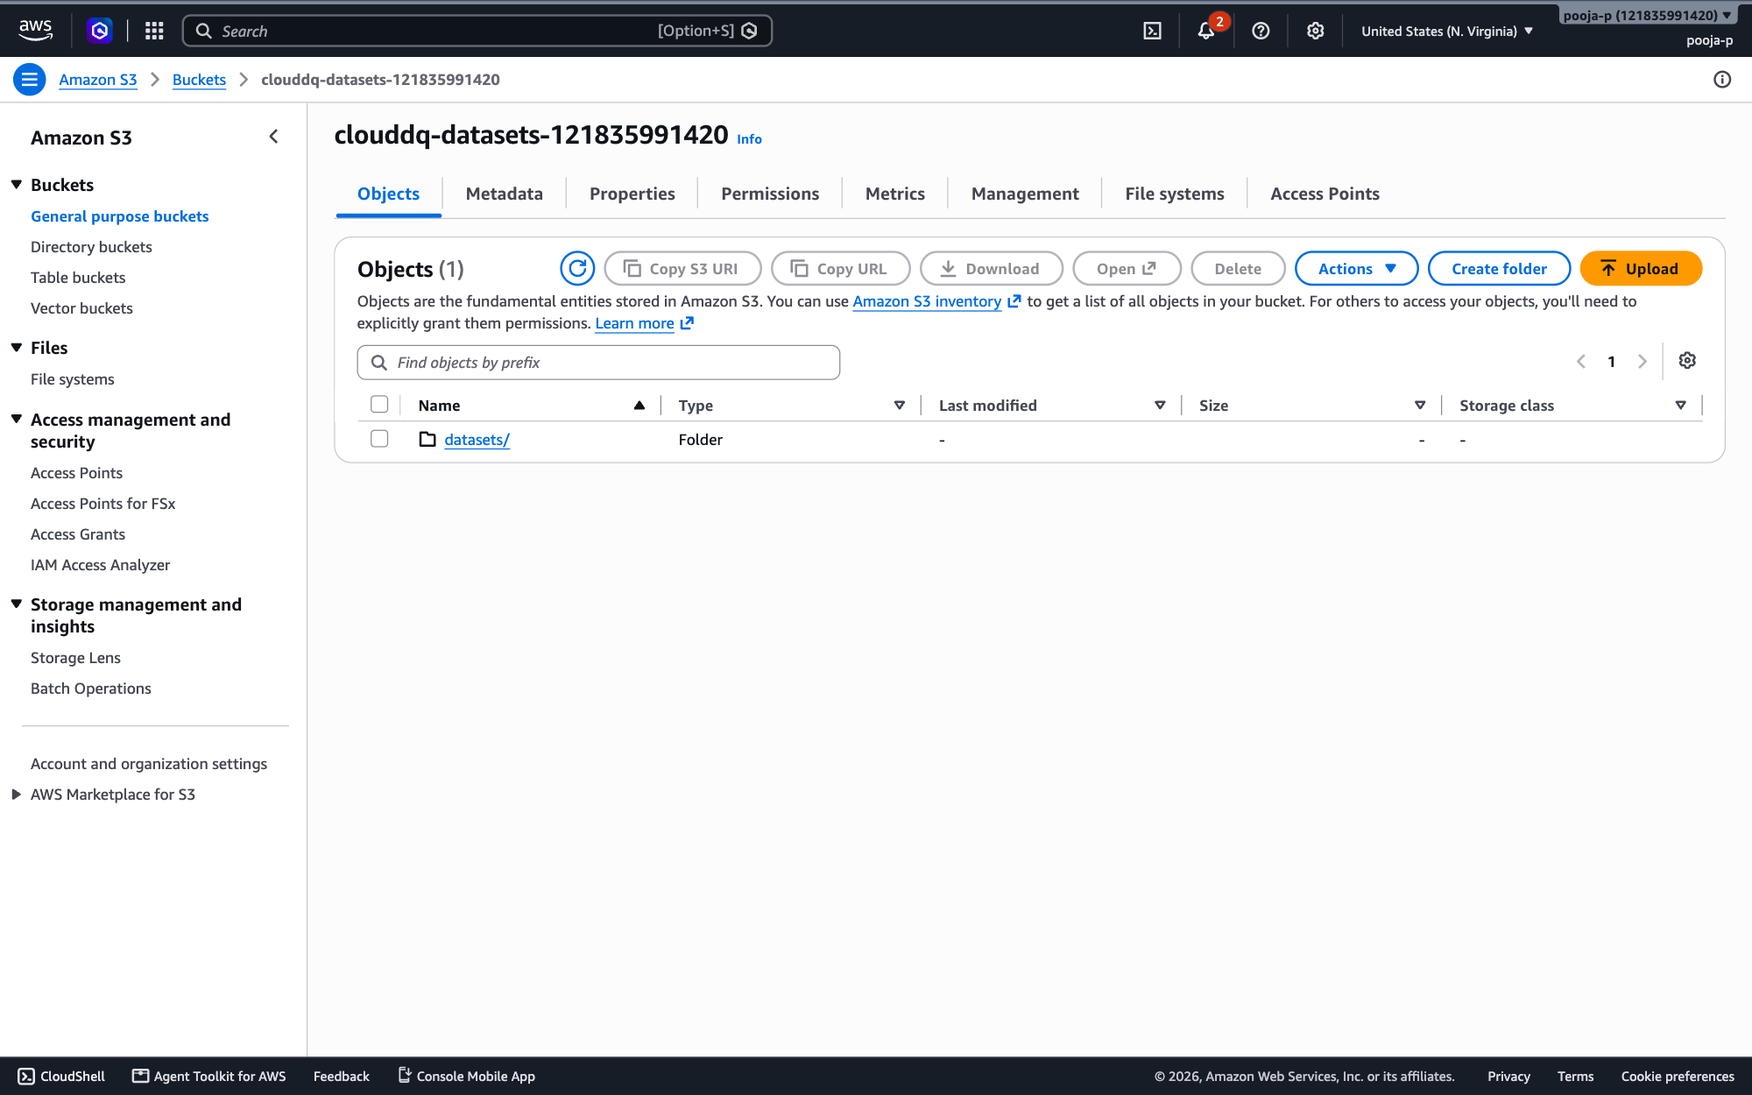
AWS CONSOLE
Screenshots of AWS Services
Amazon Cognito
Amazon S3
User pool → Users (demo Data User and Business User)
Bucket clouddq-datasets-121835991420 → Objects
CloudDQ AI · 15

Slide 16
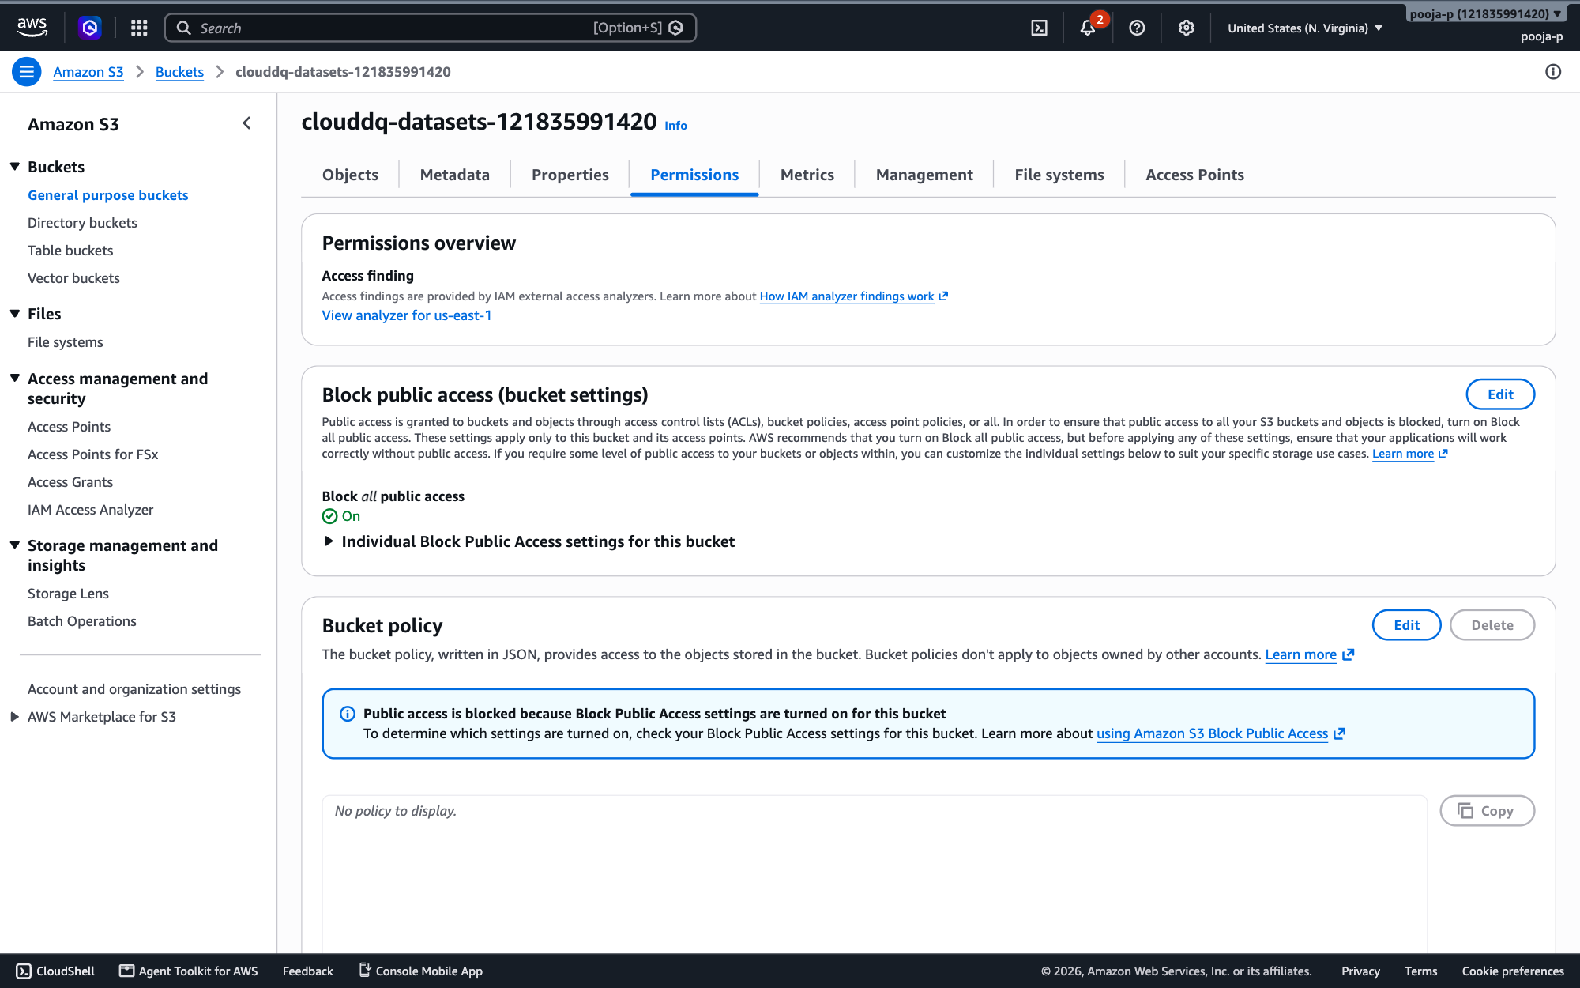
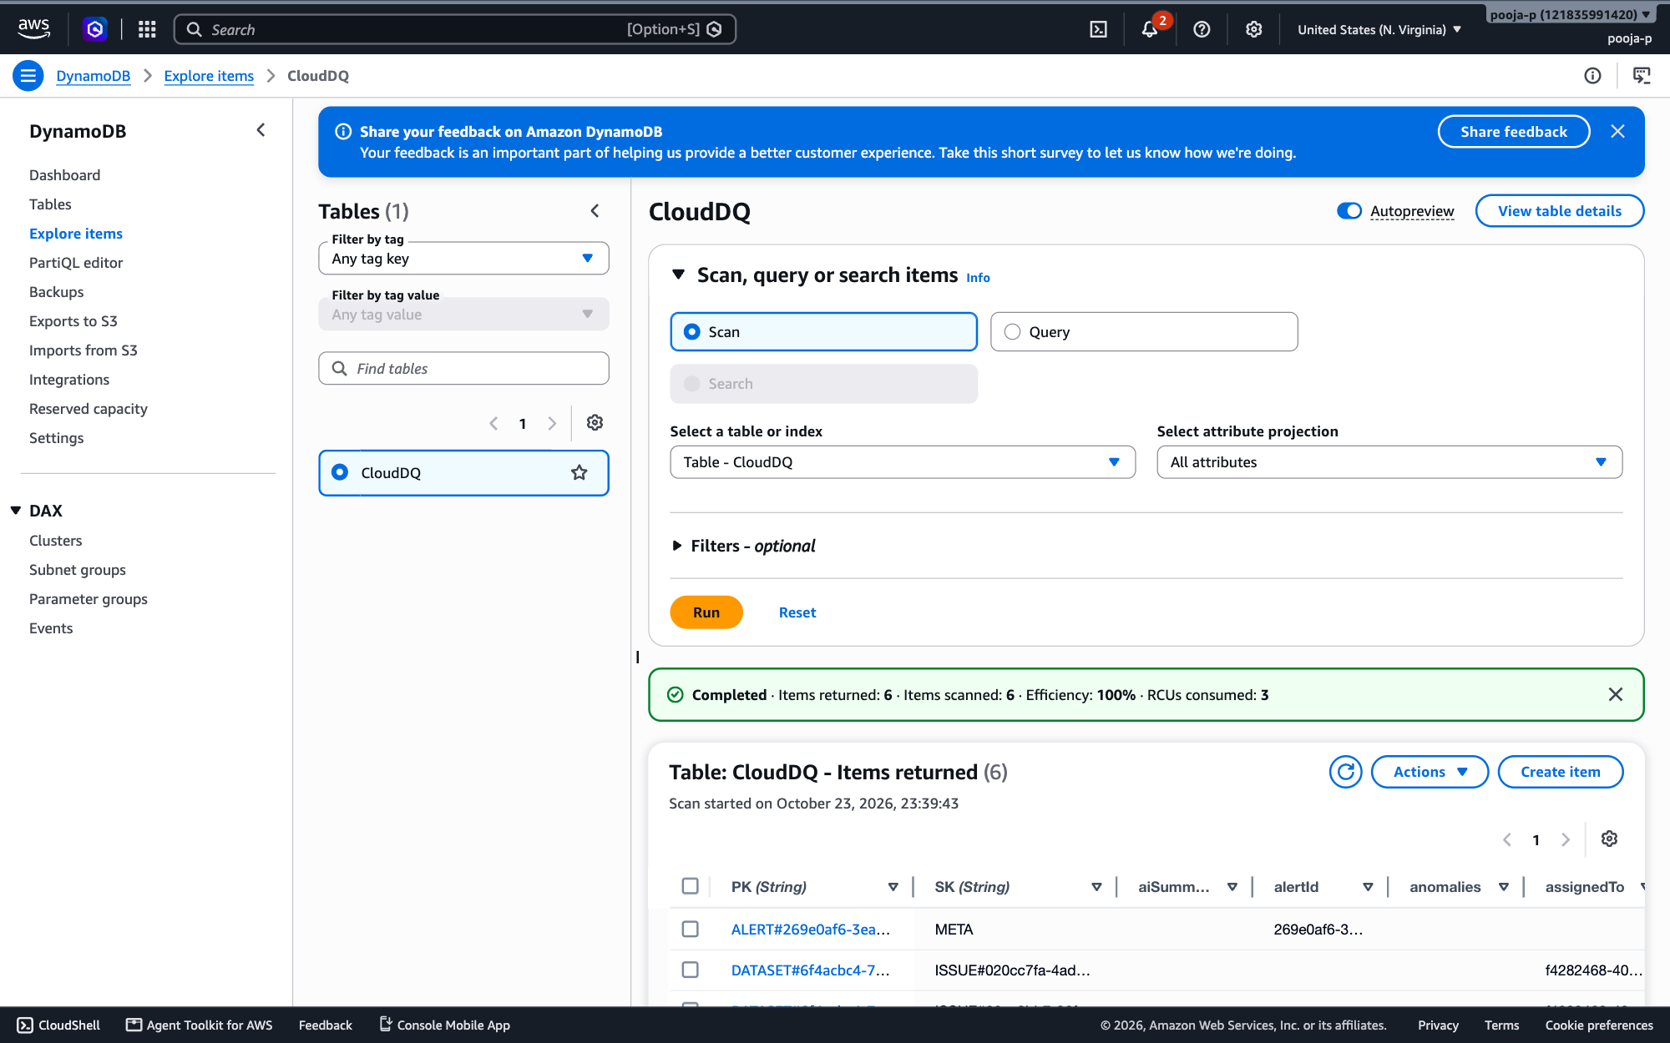
AWS CONSOLE
Screenshots of AWS Services
Amazon S3
Amazon DynamoDB
Bucket → Permissions: Block all public access On
Table CloudDQ → Explore items
CloudDQ AI · 16

Slide 17
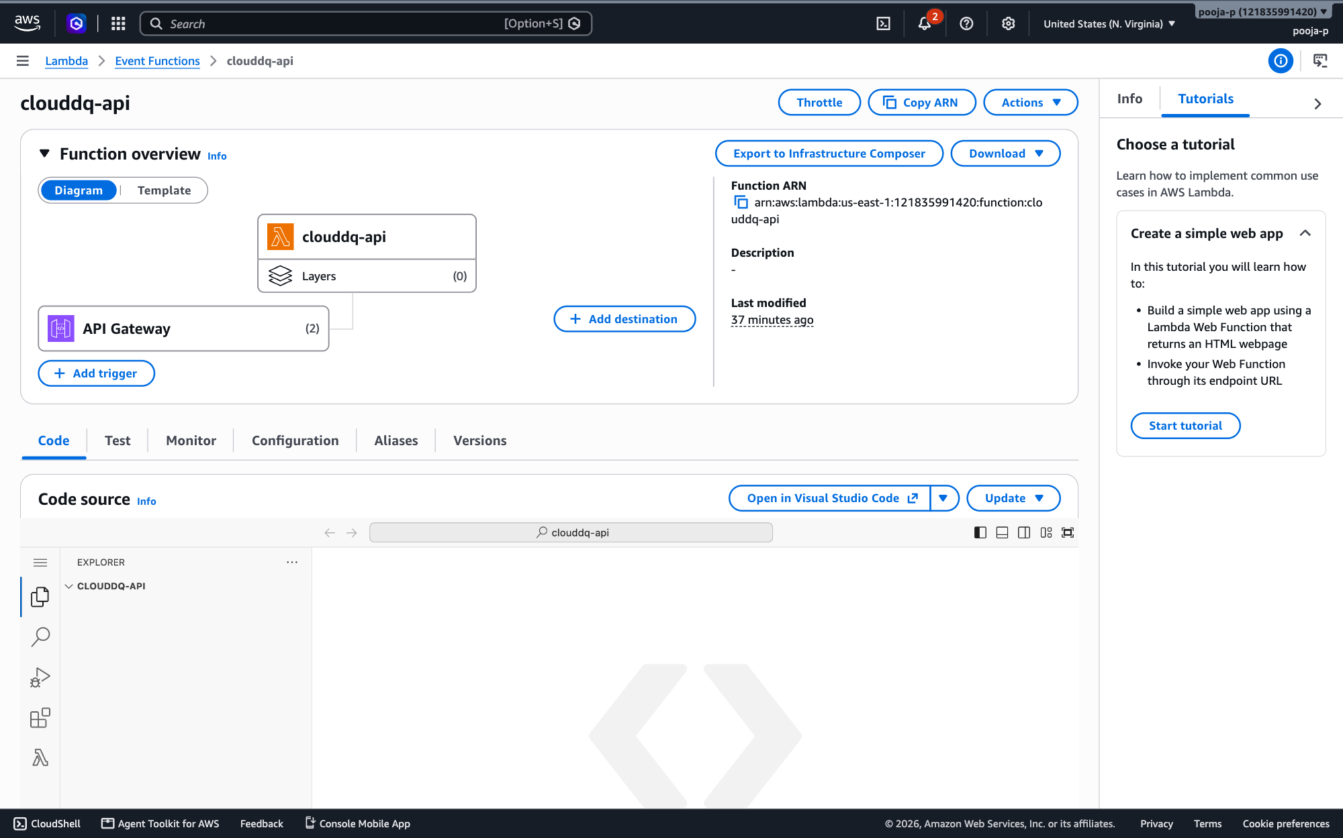
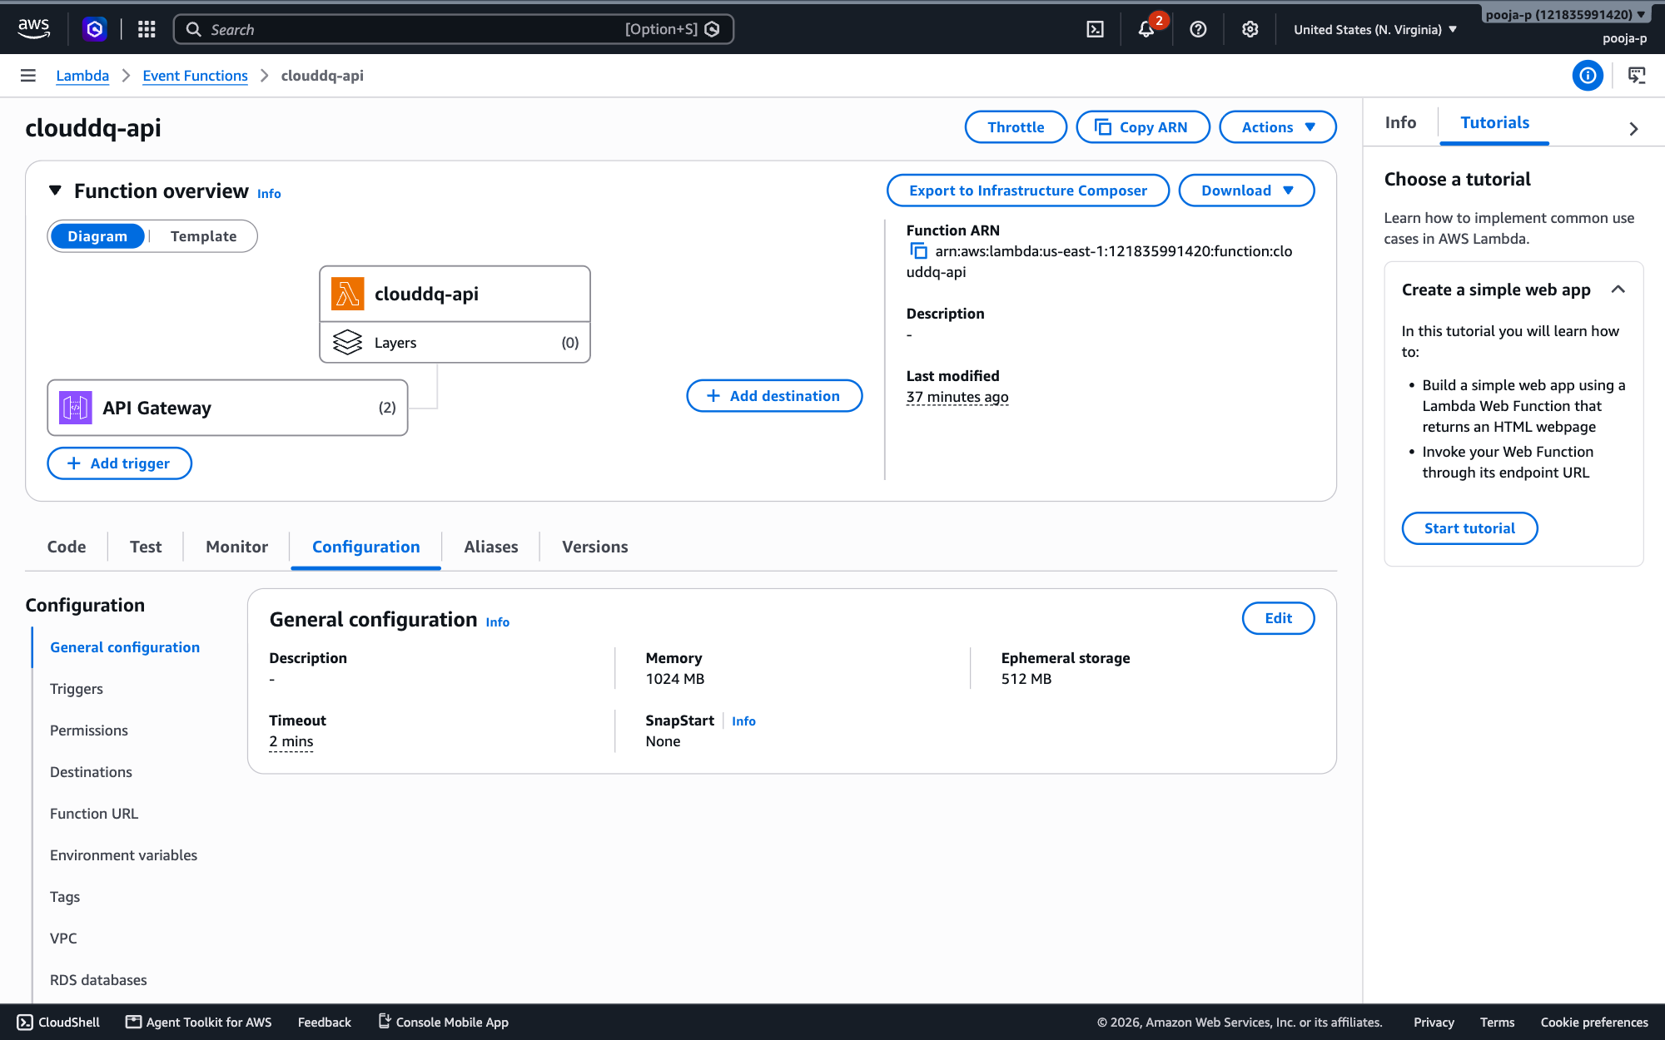
AWS CONSOLE
Screenshots of AWS Services
AWS Lambda
AWS Lambda
Function clouddq-api → overview with API Gateway trigger
Function clouddq-api → Configuration
CloudDQ AI · 17

Slide 18
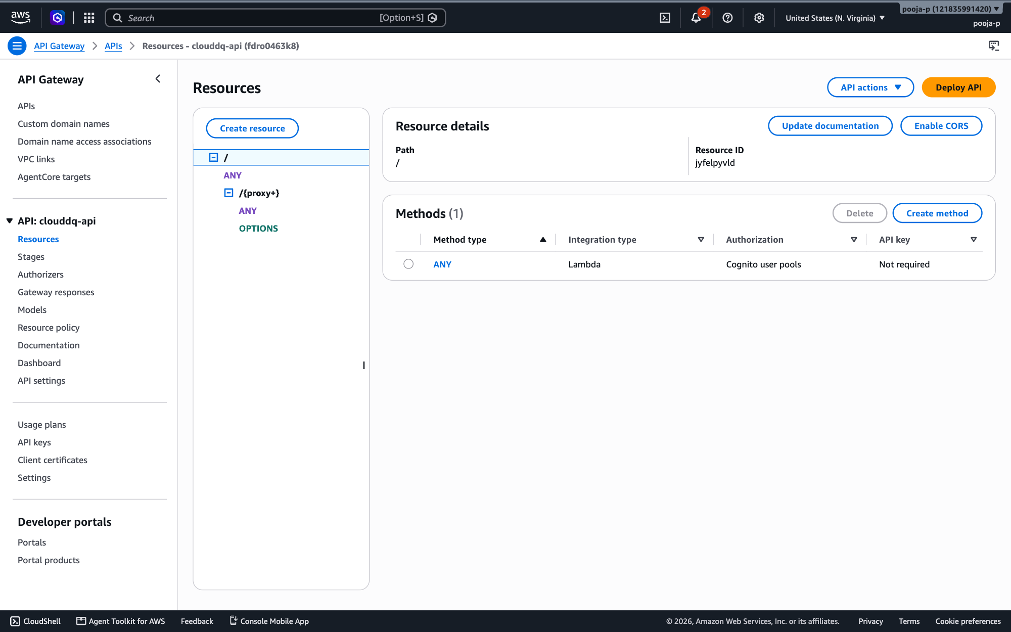
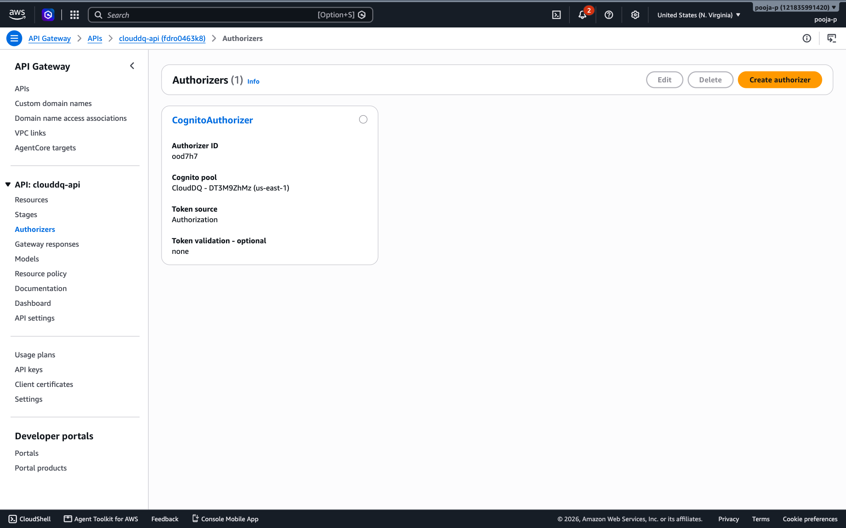
AWS CONSOLE
Screenshots of AWS Services
Amazon API Gateway
Amazon API Gateway
REST API fdro0463k8 → Resources: / and /{proxy+} ANY
REST API → Authorizers: CognitoAuthorizer
CloudDQ AI · 18

Slide 19
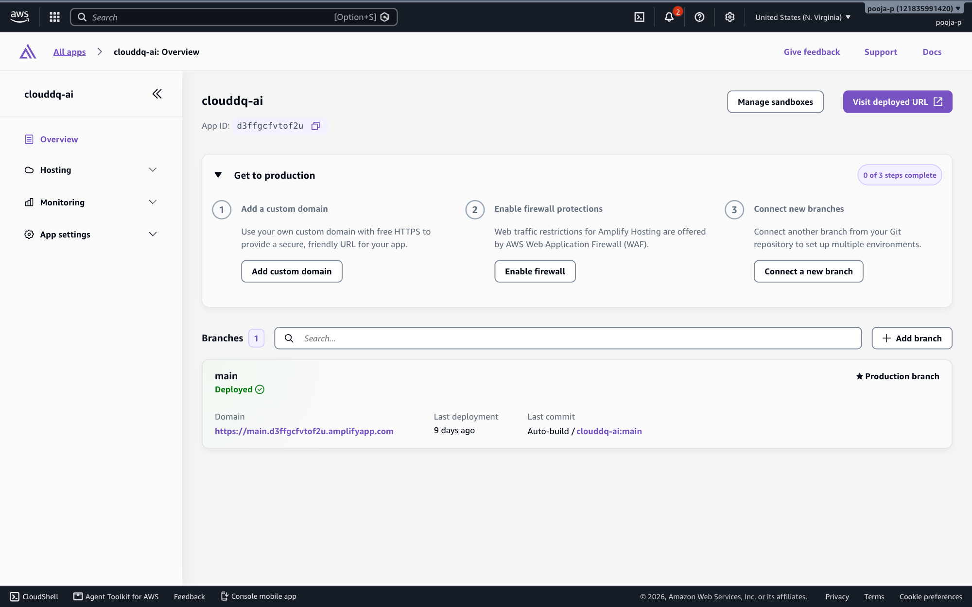
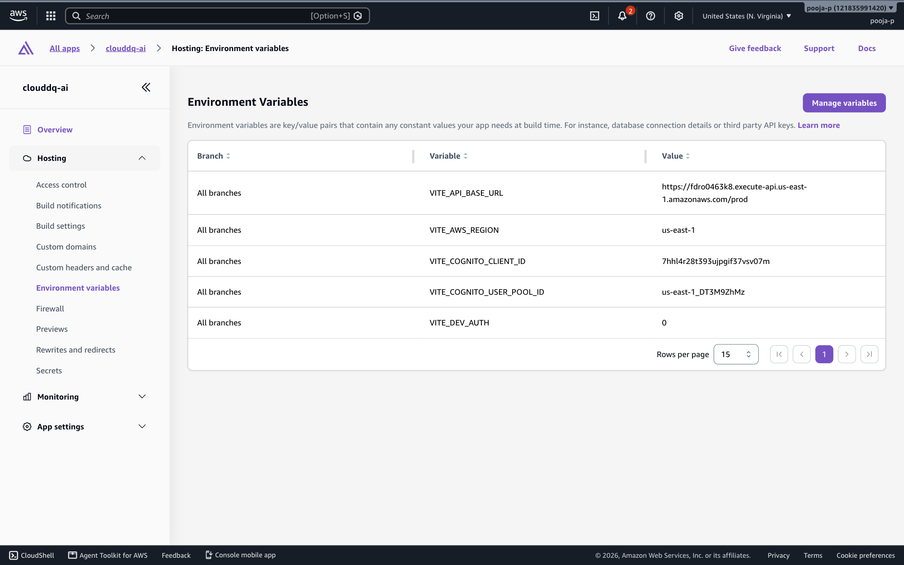
AWS CONSOLE
Screenshots of AWS Services
AWS Amplify
AWS Amplify
App clouddq-ai → Overview (main branch deployed)
App clouddq-ai → Environment variables
CloudDQ AI · 19

Slide 20
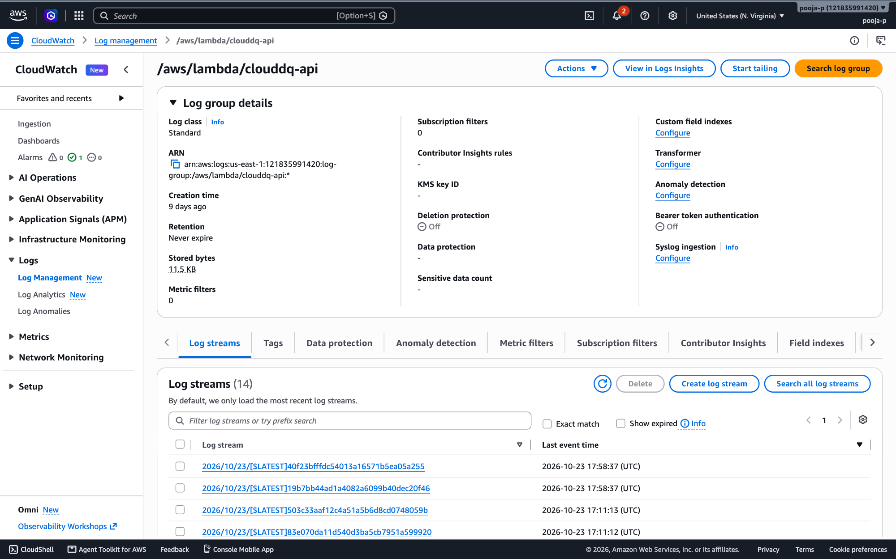
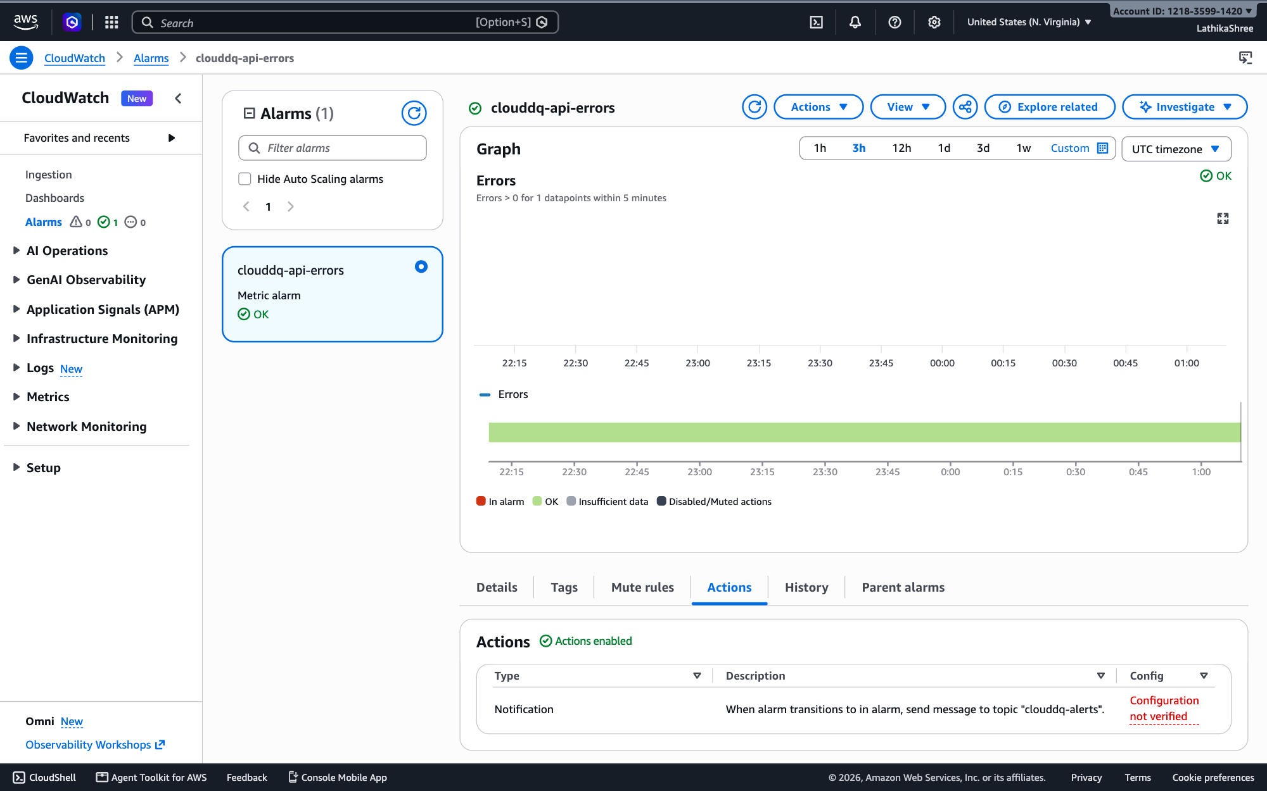
AWS CONSOLE
Screenshots of AWS Services
Amazon CloudWatch
Amazon CloudWatch
Log group /aws/lambda/clouddq-api
Alarm clouddq-api-errors
CloudDQ AI · 20

Slide 21
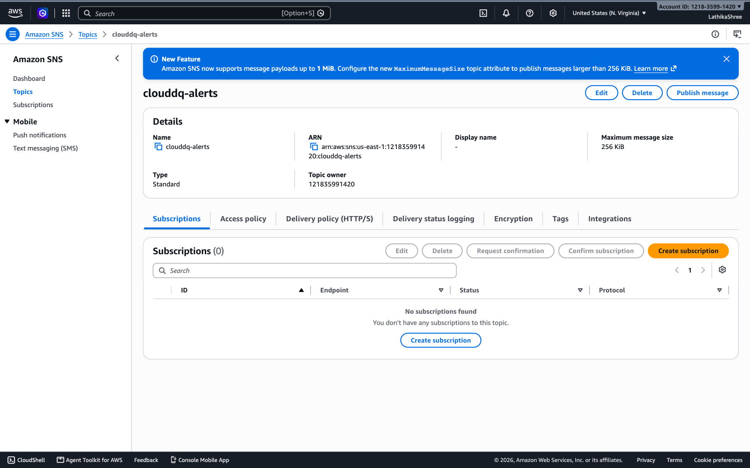
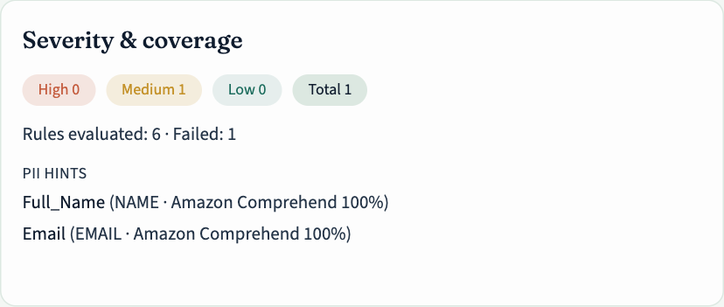
AWS CONSOLE
Screenshots of AWS Services
Amazon SNS
Amazon Comprehend
Topic clouddq-alerts (alert emails and alarm notifications)
PII detection result inside CloudDQ (Employee Directory dataset)
CloudDQ AI · 21

Slide 22
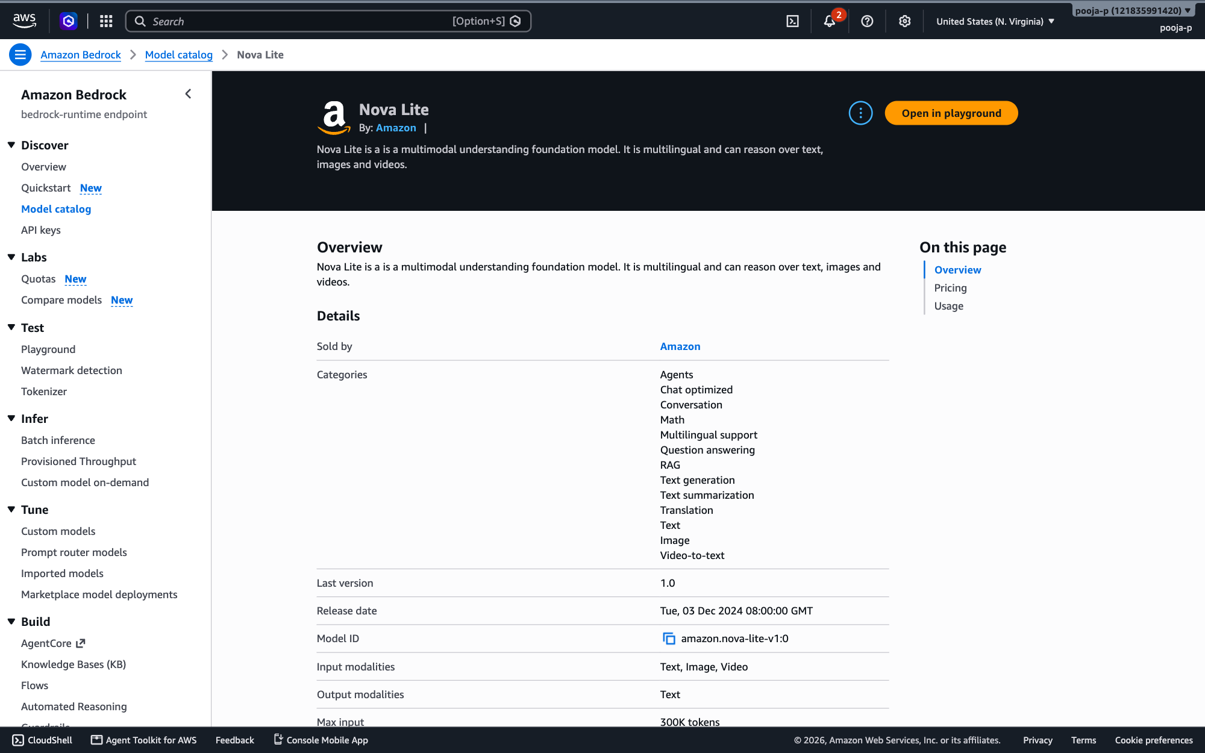
AWS CONSOLE
Screenshots of AWS Services
Amazon Bedrock
Model catalog → Amazon Nova Lite
CloudDQ AI · 22

Slide 23
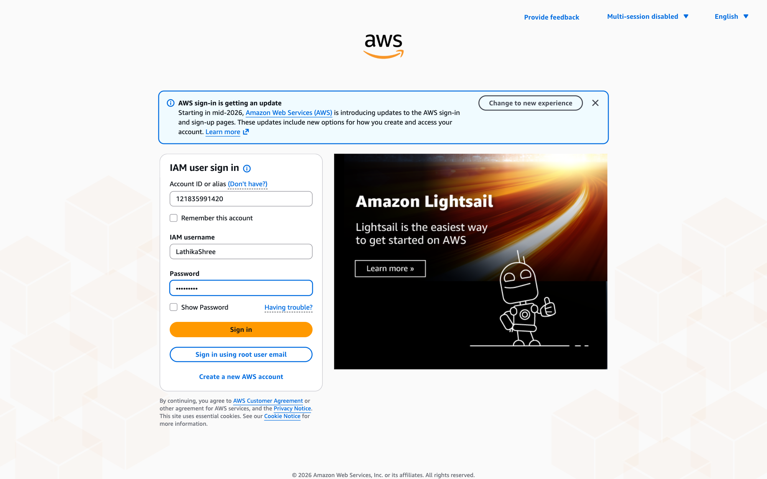
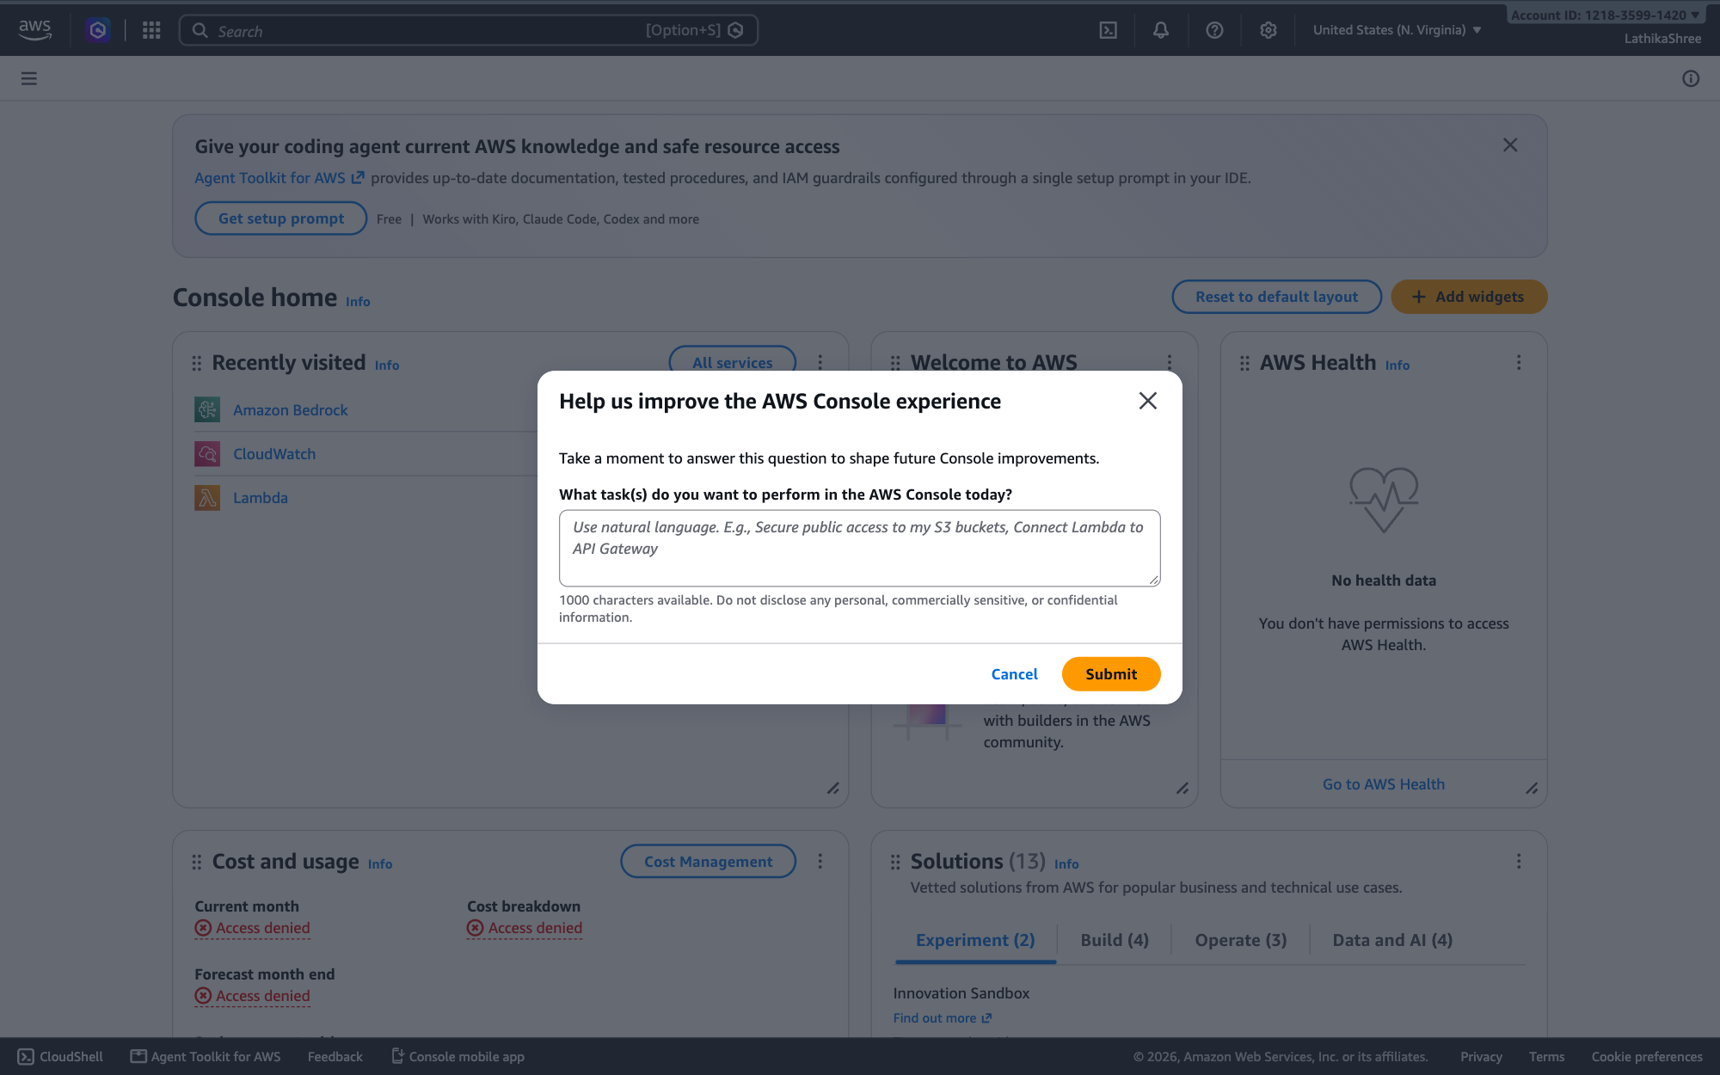
STEPS 1–2 OF 14 · LATHIKASHREE
Walkthrough: Lathika connects SNS
1. Sign in as LathikaShree
2. Console home
IAM user sign-in with account 121835991420 and username LathikaShree.
Signed in as LathikaShree in US East (N. Virginia).
CloudDQ AI · 23

Slide 24
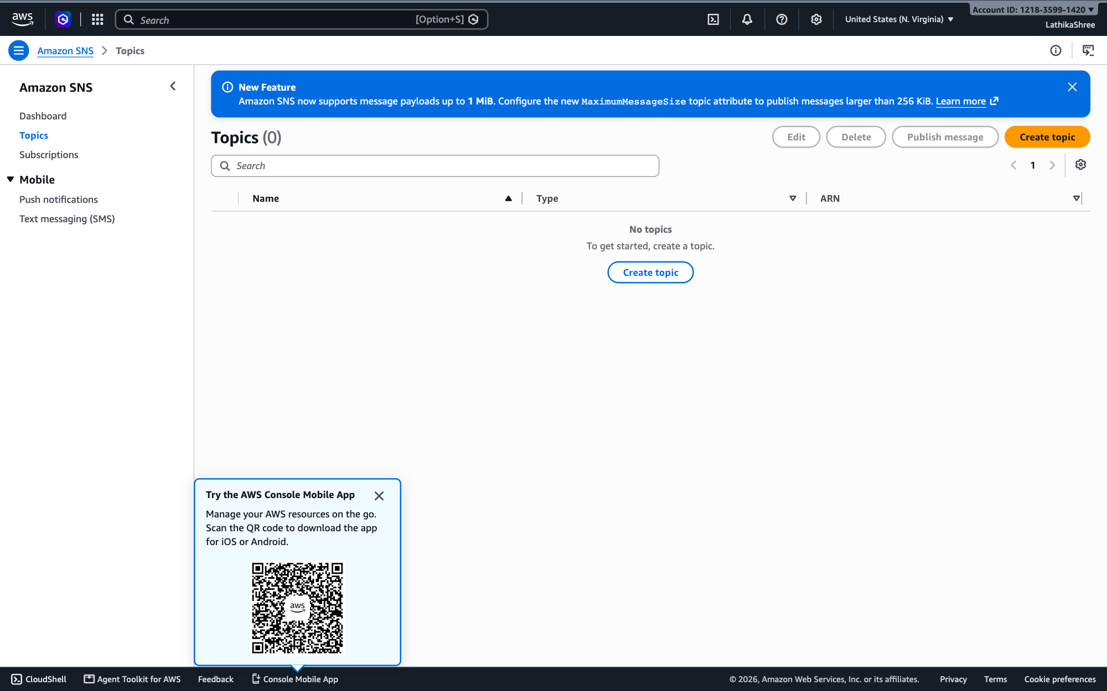
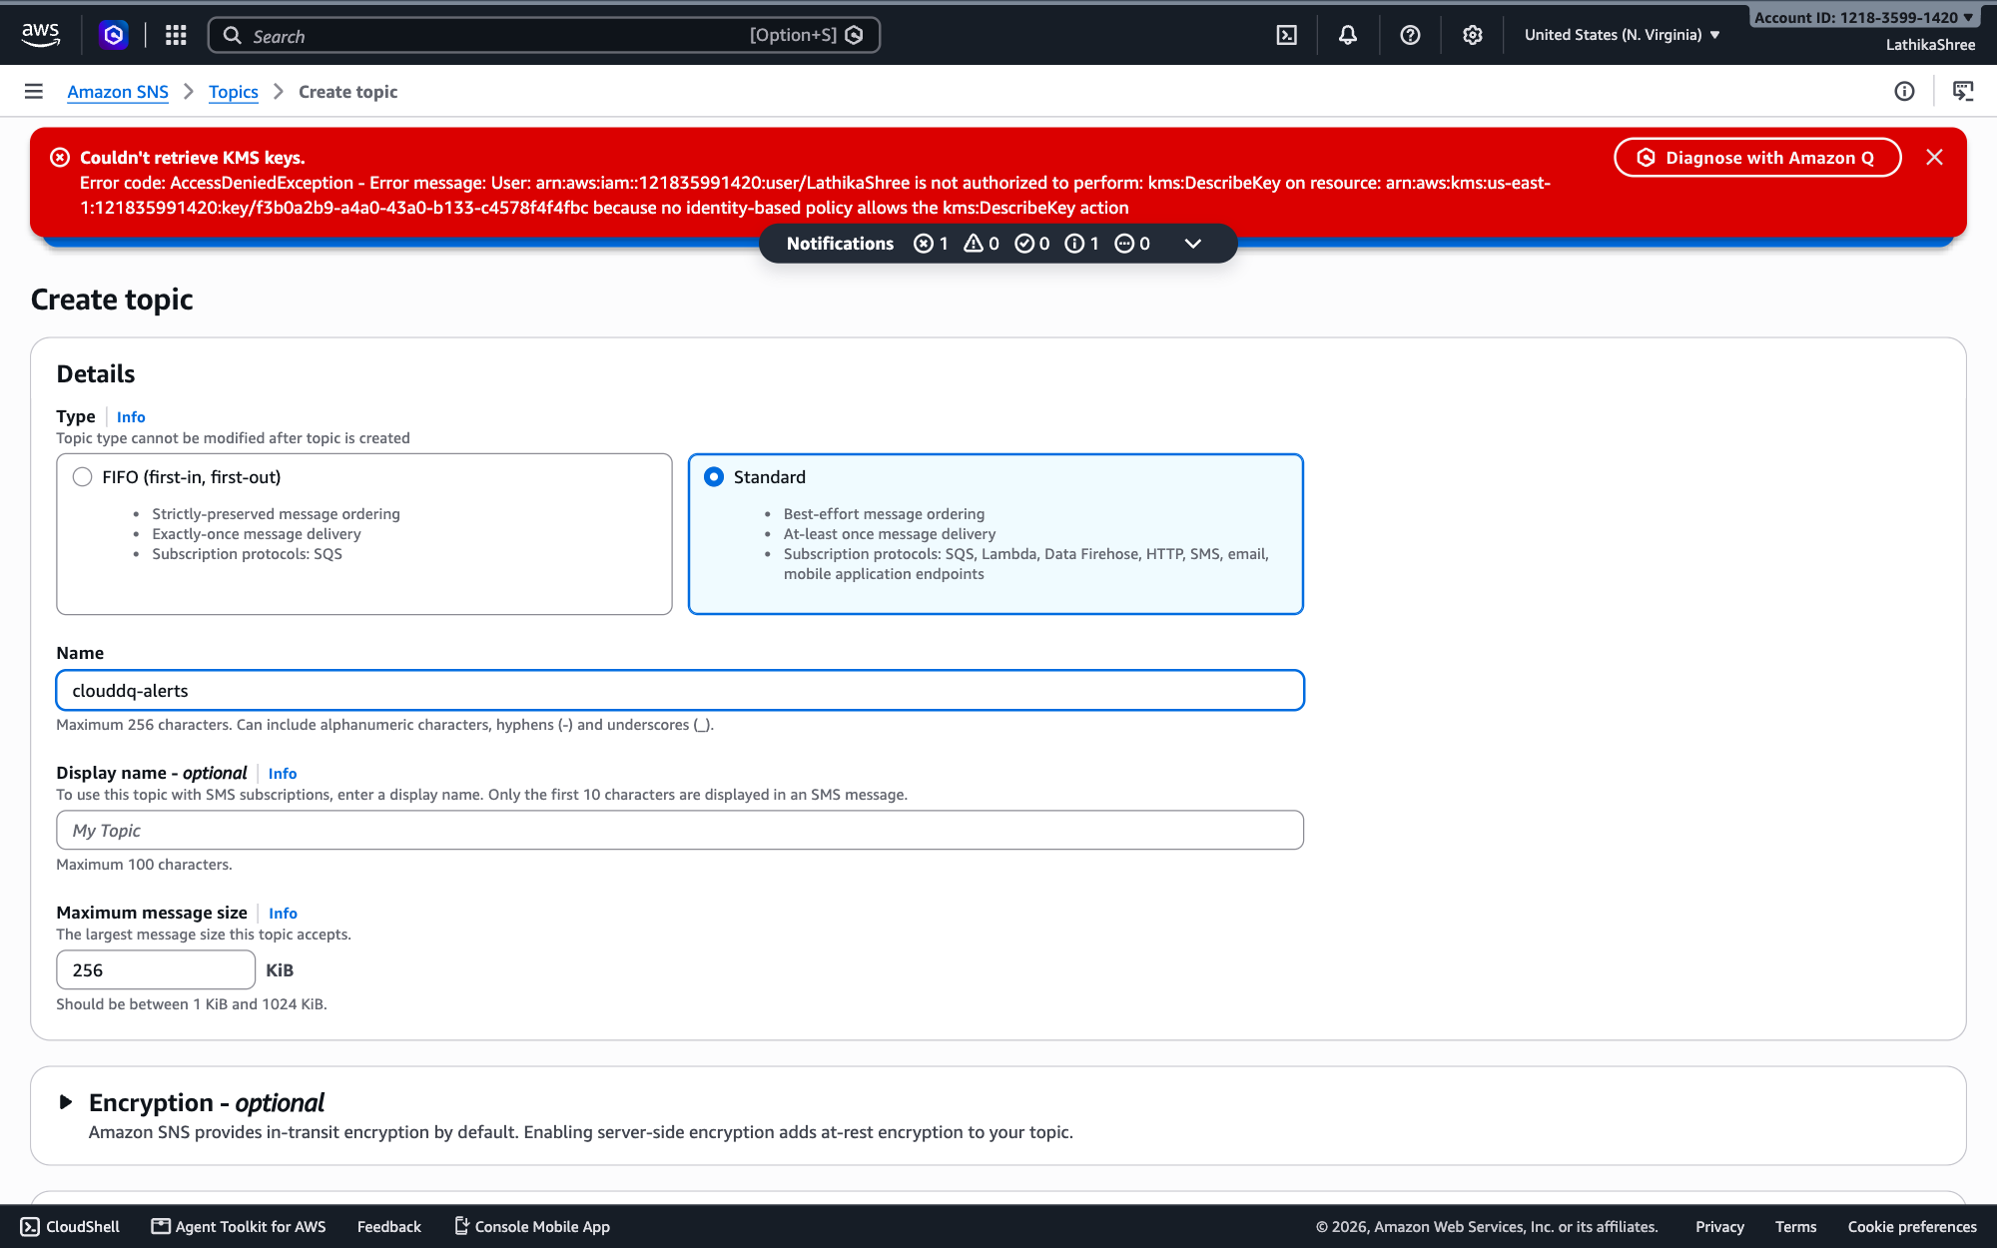
STEPS 3–4 OF 14 · LATHIKASHREE
Walkthrough: Lathika connects SNS
3. Amazon SNS → Topics
4. Create topic
No topics yet. Choose Create topic.
Type Standard, name clouddq-alerts. The red KMS banner only means Lathika can't list encryption keys; this topic uses default encryption, so it can be ignored.
CloudDQ AI · 24

Slide 25
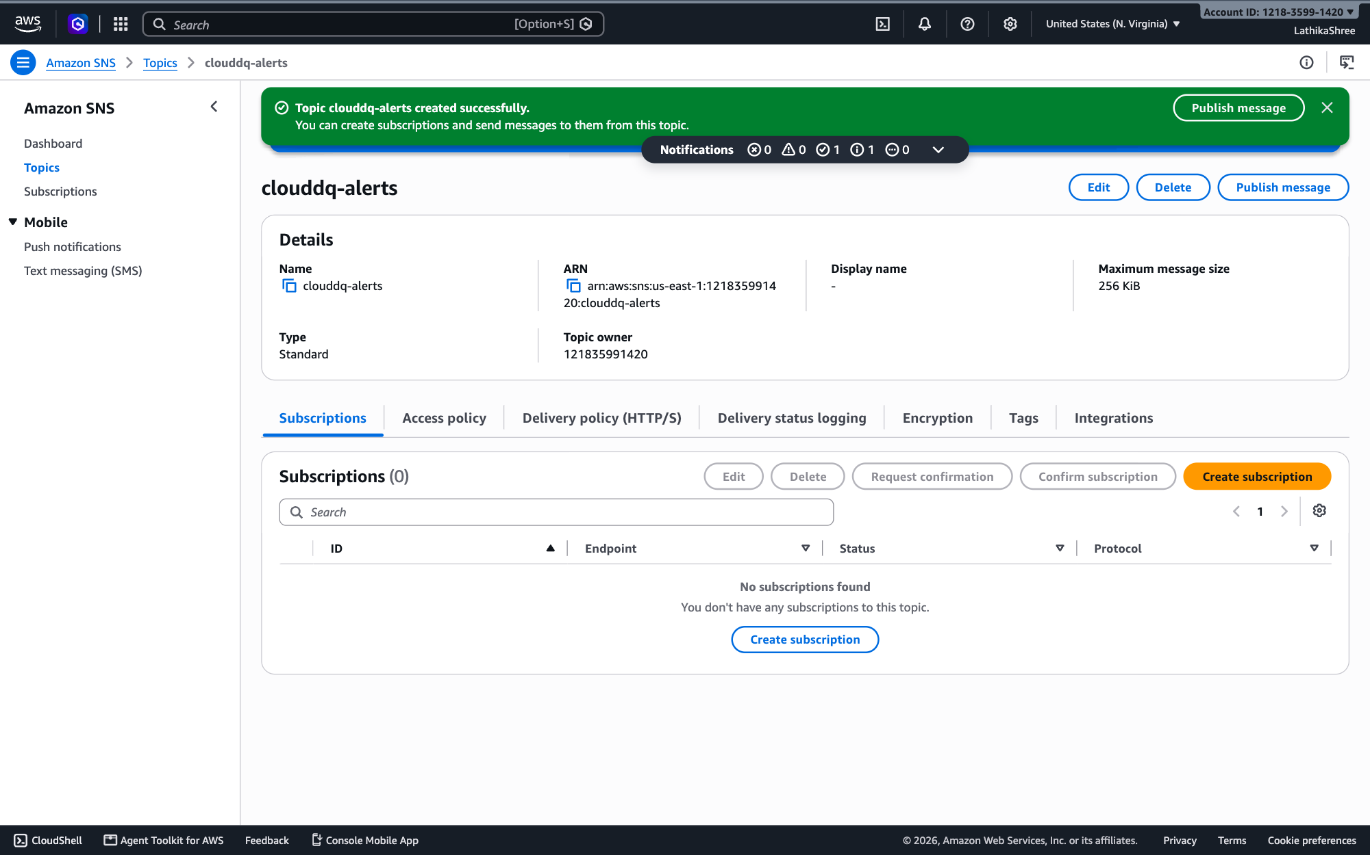
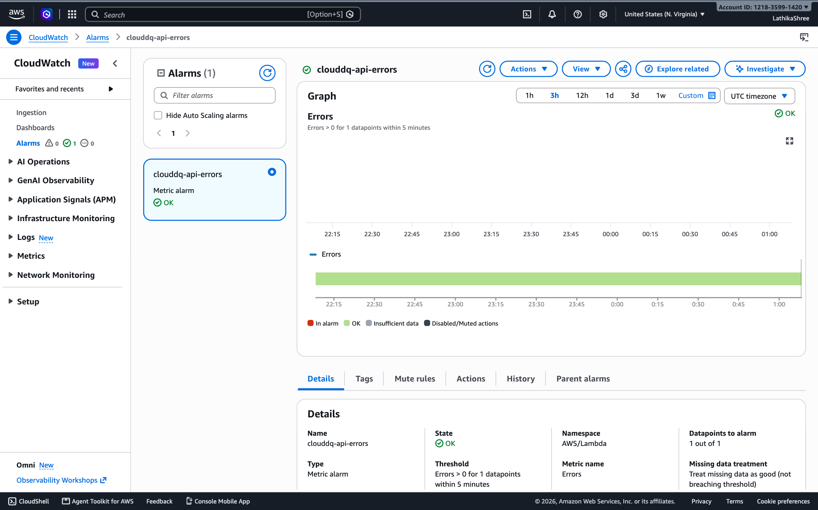
STEPS 5–6 OF 14 · LATHIKASHREE
Walkthrough: Lathika connects SNS
5. Topic created
6. CloudWatch → Alarms → clouddq-api-errors
ARN arn:aws:sns:us-east-1:121835991420:clouddq-alerts — the same ARN Lambda uses in ALERT_TOPIC_ARN. Subscriptions are added from this page.
Open the alarm, then Actions → Edit.
CloudDQ AI · 25

Slide 26
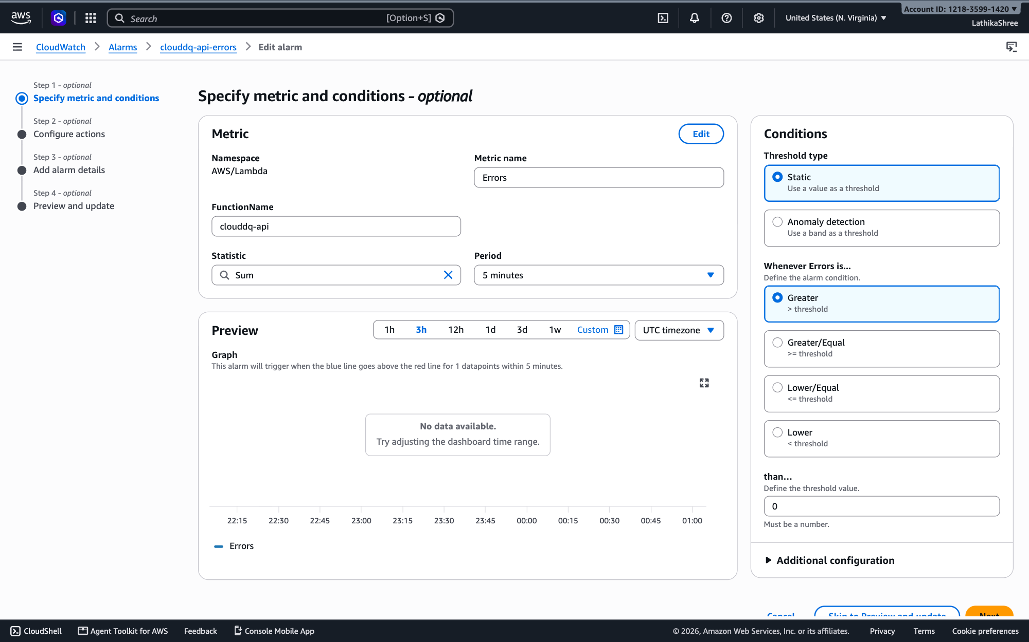
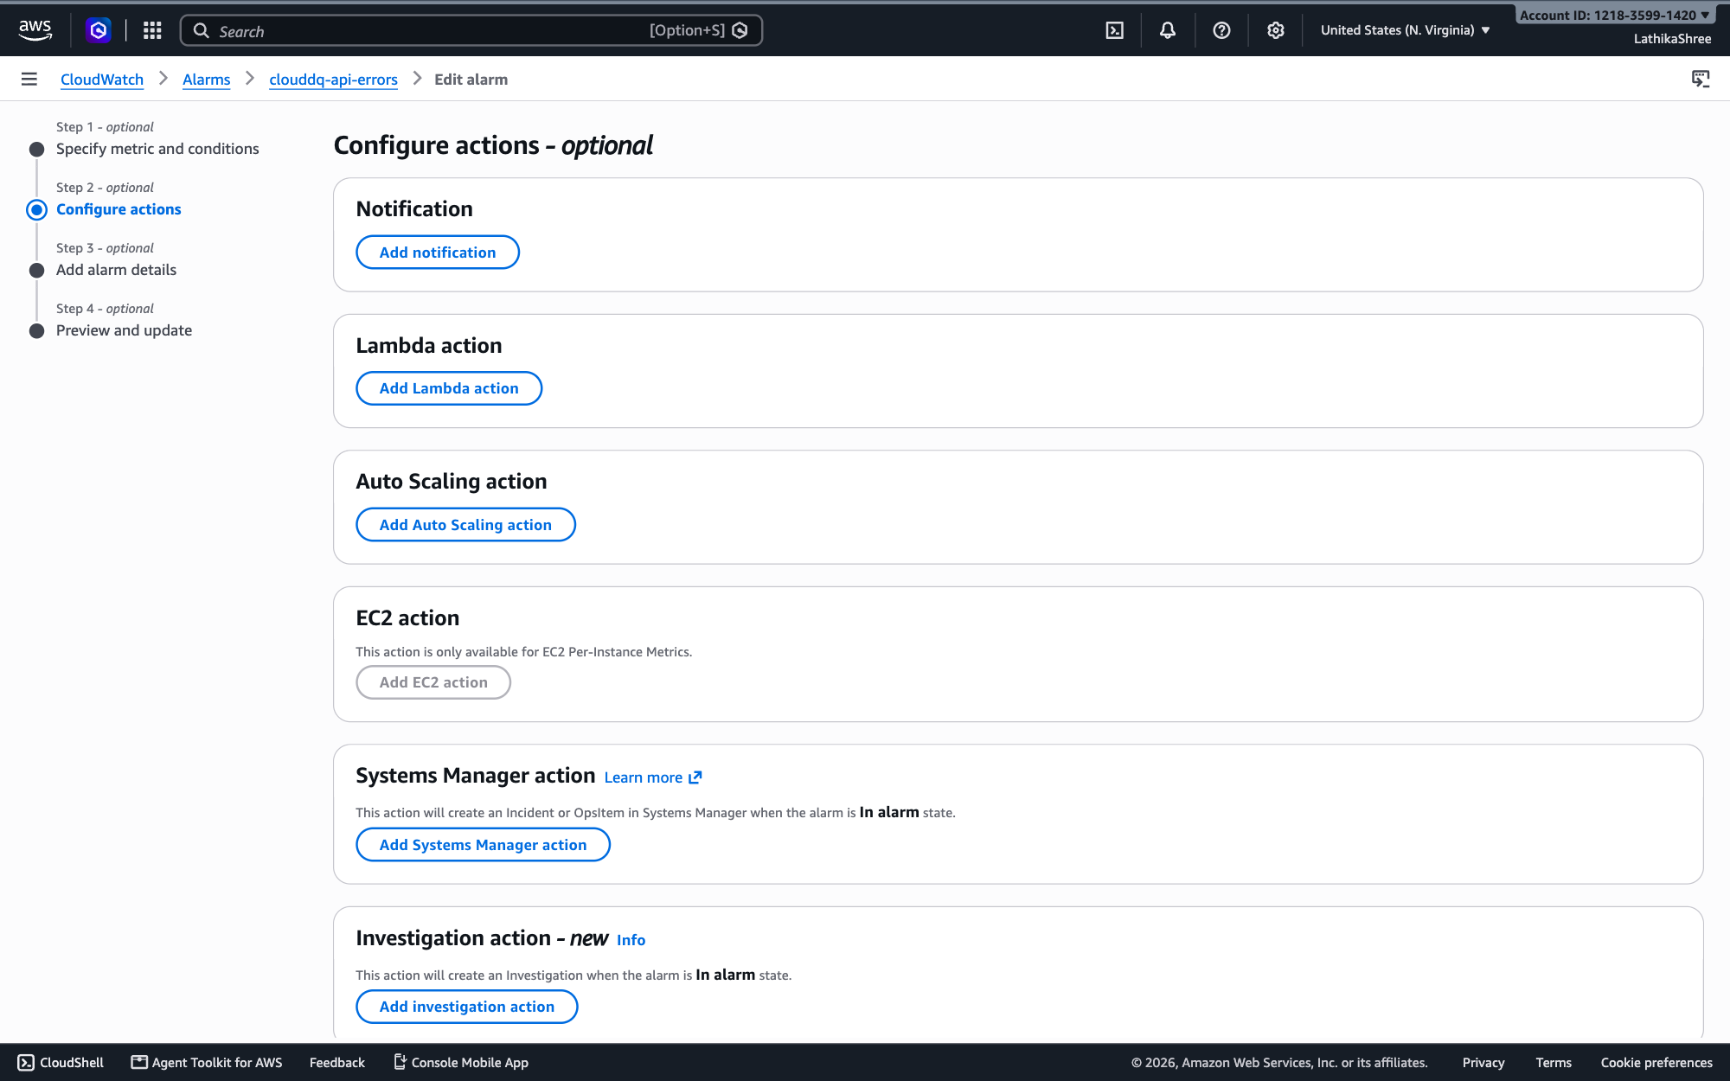
STEPS 7–8 OF 14 · LATHIKASHREE
Walkthrough: Lathika connects SNS
7. Edit alarm — step 1
8. Edit alarm — step 2
Metric and condition stay the same (Lambda Errors > 0 in 5 minutes). Choose Next.
Configure actions. Choose Add notification.
CloudDQ AI · 26

Slide 27
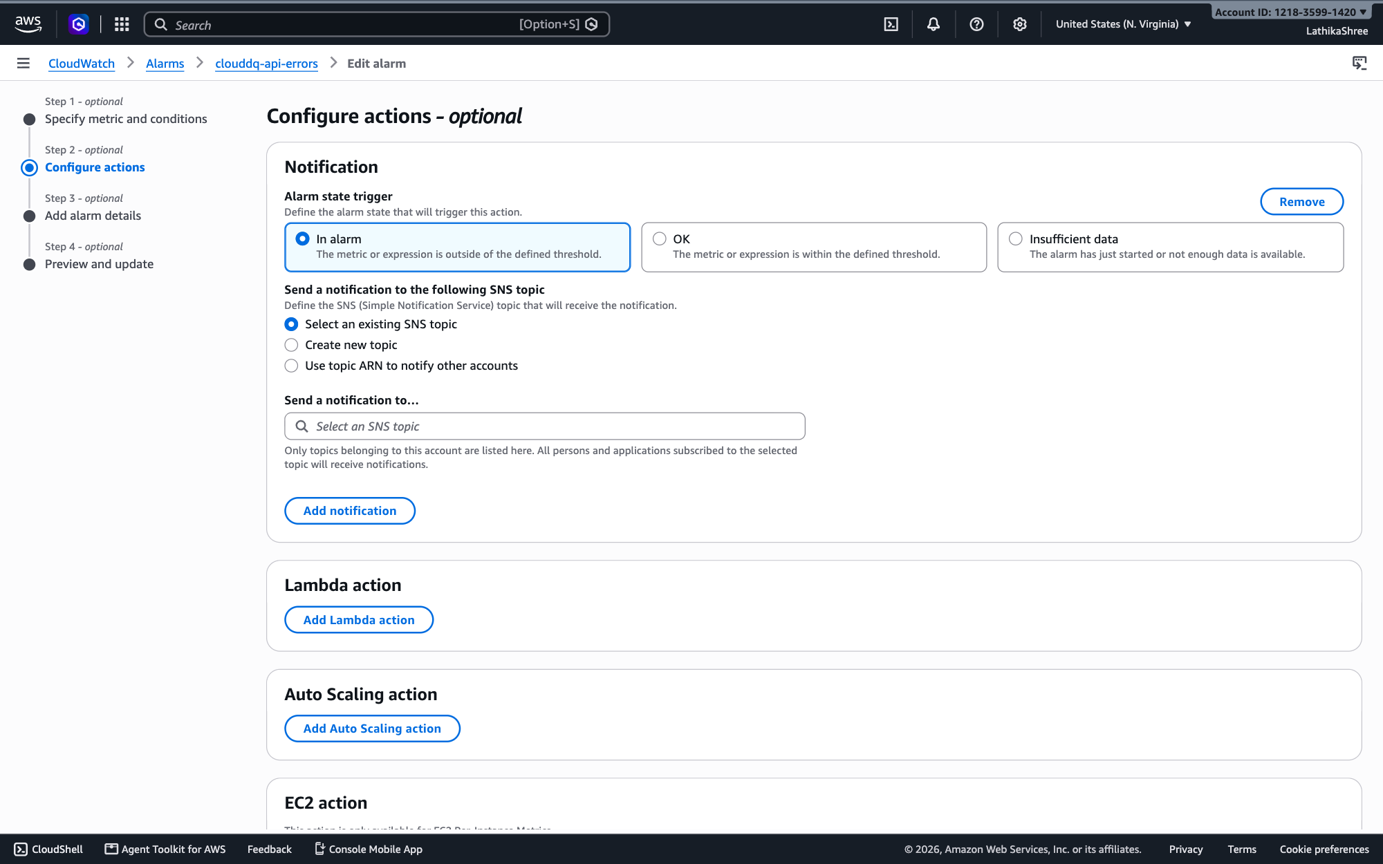
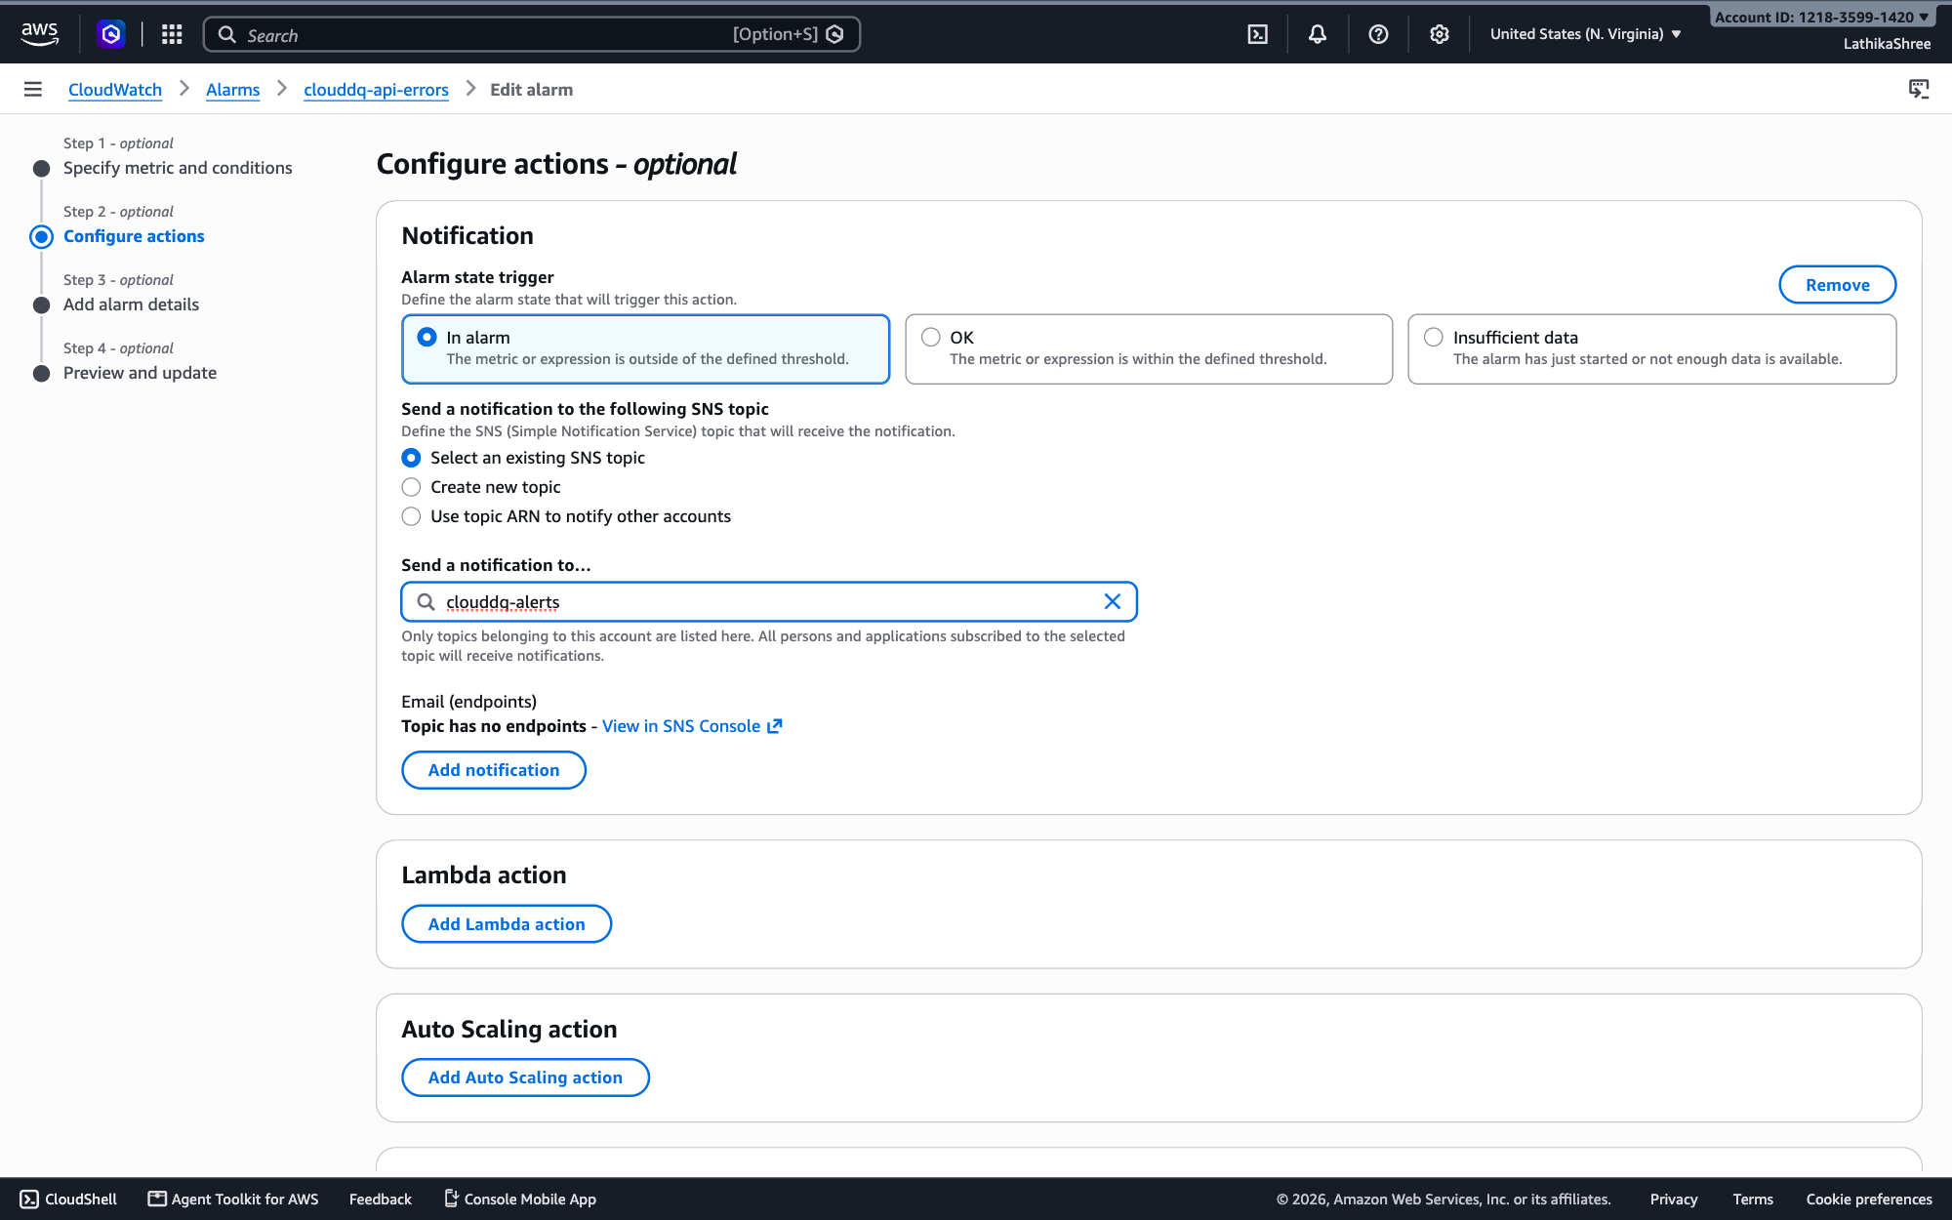
STEPS 9–10 OF 14 · LATHIKASHREE
Walkthrough: Lathika connects SNS
9. Add notification
10. Choose the topic
Trigger In alarm, Select an existing SNS topic.
Send a notification to clouddq-alerts. Then Next.
CloudDQ AI · 27

Slide 28
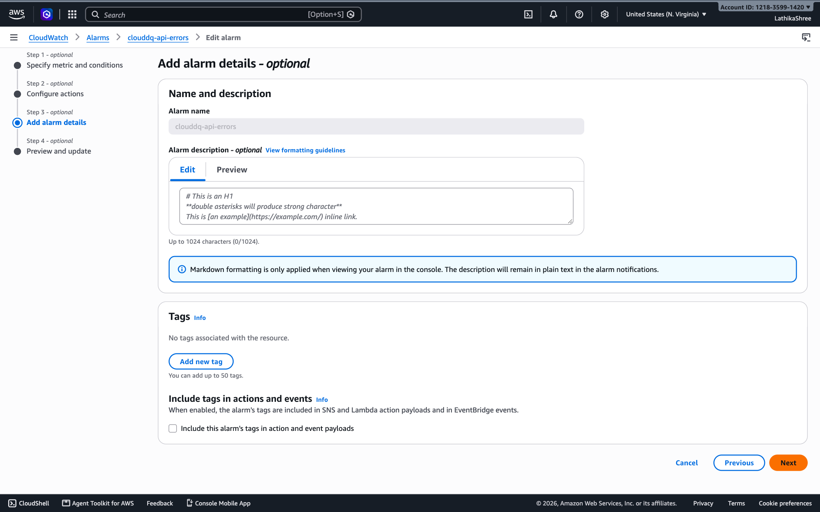
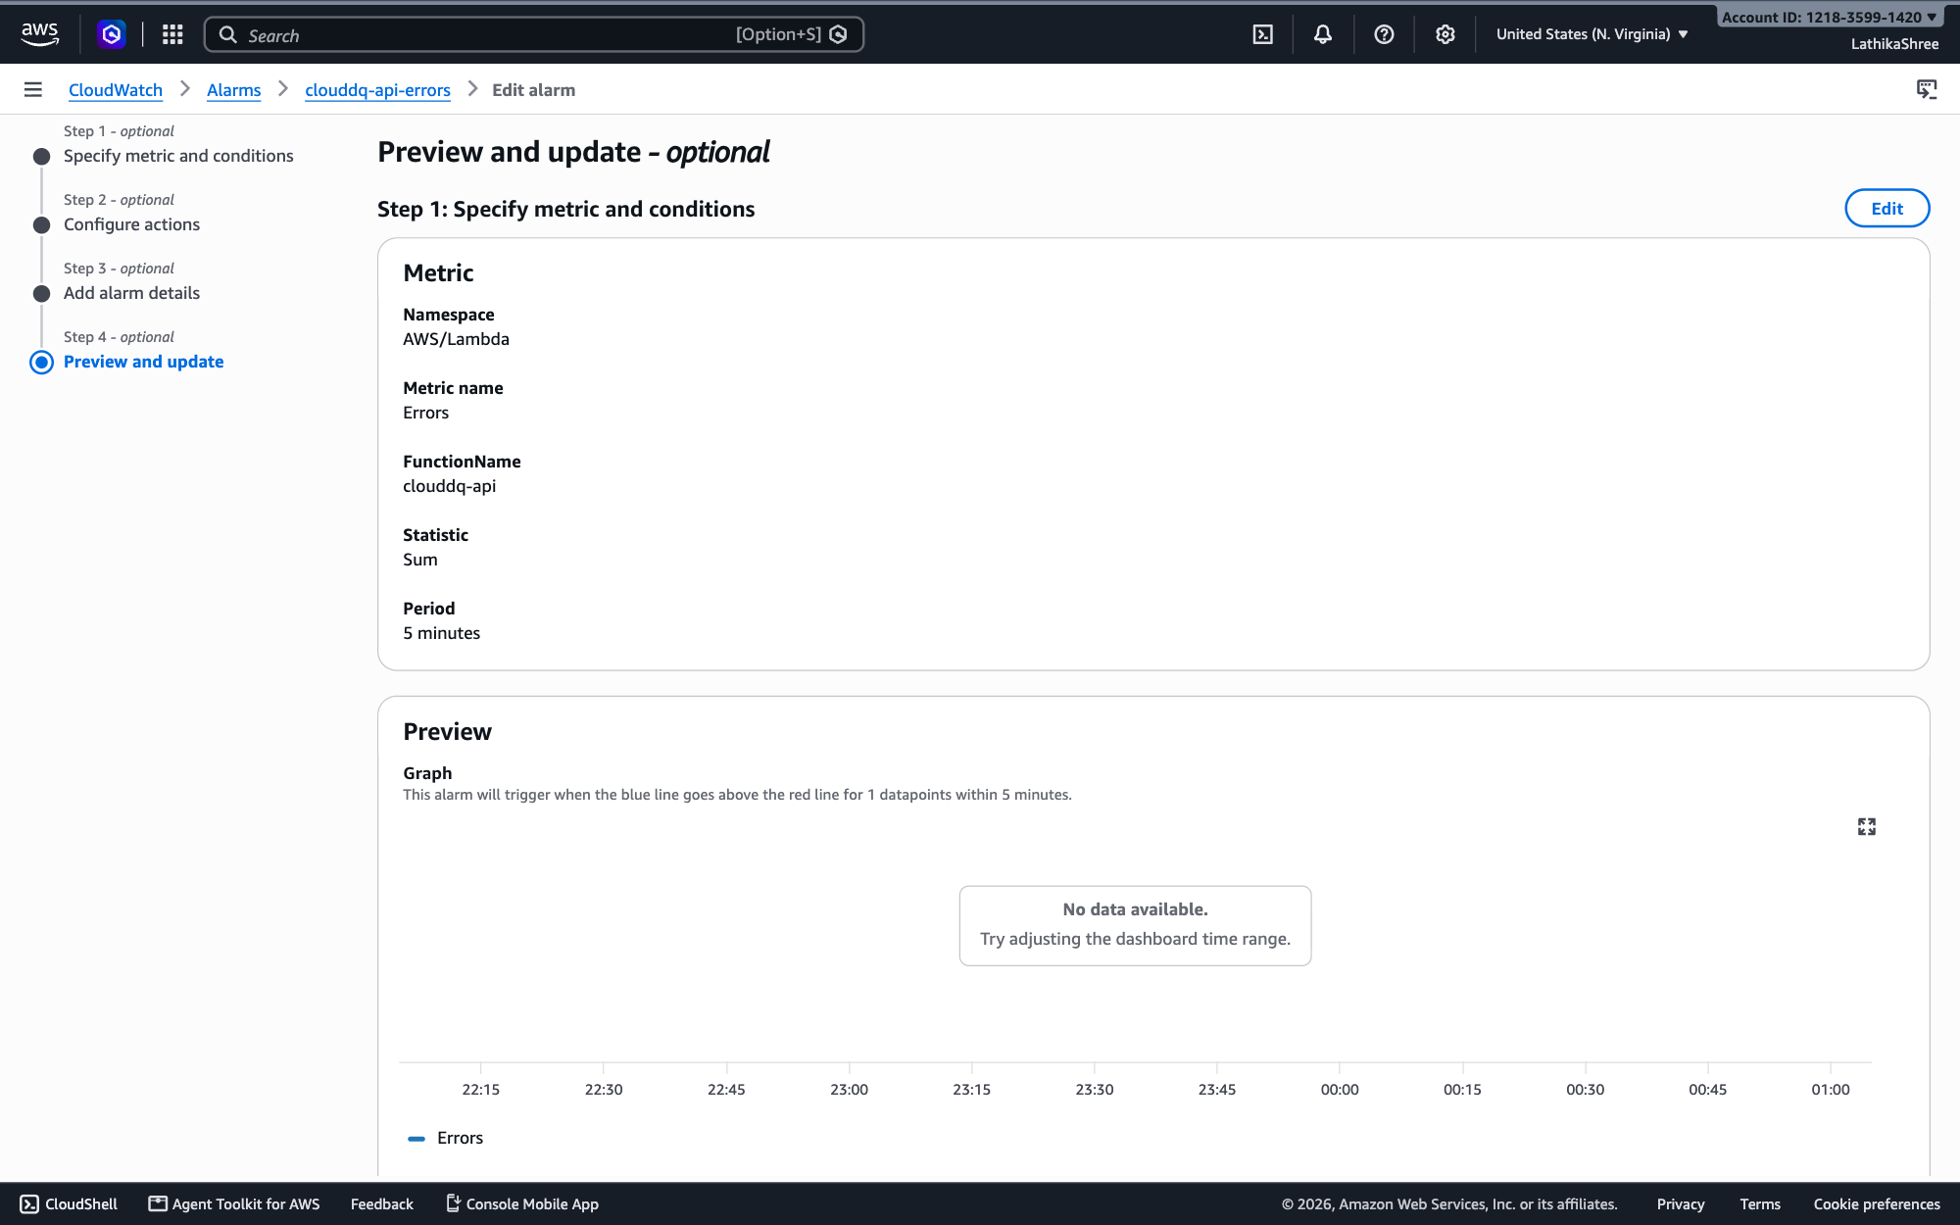
STEPS 11–12 OF 14 · LATHIKASHREE
Walkthrough: Lathika connects SNS
11. Edit alarm — step 3
12. Edit alarm — step 4
Name stays clouddq-api-errors. Choose Next.
Preview the change and choose Update alarm.
CloudDQ AI · 28

Slide 29
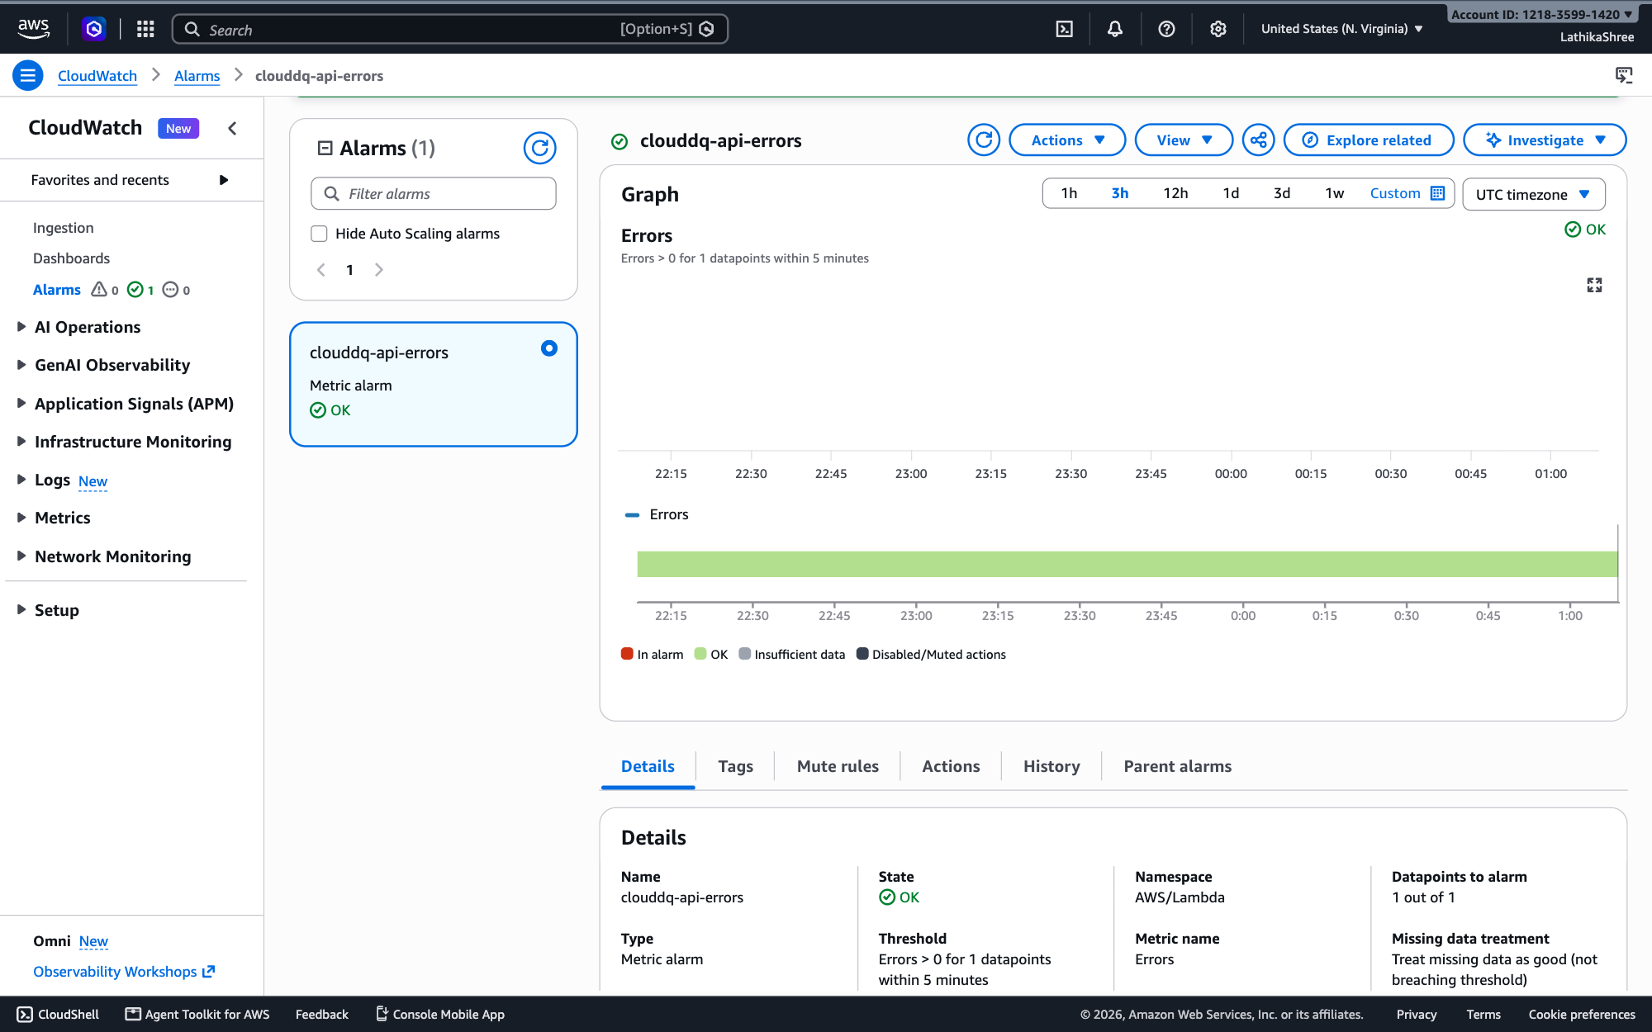
STEPS 13–14 OF 14 · LATHIKASHREE
Walkthrough: Lathika connects SNS
13. Alarm updated
14. Actions tab
Back on the alarm page.
Notification to clouddq-alerts when the alarm goes In alarm. 'Configuration not verified' disappears once an email subscription is confirmed.
CloudDQ AI · 29

Slide 30
MODULE CODE (COMPLETE CODE IN REPORT APPENDIX)
M4 · DQ engine — weighted score and health
backend/src/dq_engine/dimensions.py (lines 215–237)
def compute_dimensions(profile: dict) -> dict[str, Any]:
rows = profile.get("rows") or []
completeness, c_detail = score_completeness(profile)
validity, v_detail = score_validity(profile, rows)
uniqueness, u_detail = score_uniqueness(profile, rows)
consistency, k_detail = score_consistency(profile, rows)
accuracy, a_detail = score_accuracy(profile, rows)
timeliness, t_detail = score_timeliness(profile, rows)
dimensions = {
"completeness": completeness,
"validity": validity,
"uniqueness": uniqueness,
"consistency": consistency,
"accuracy": accuracy,
"timeliness": timeliness,
}
overall = round(
sum(dimensions[k] * WEIGHTS[k] for k in WEIGHTS),
2,
)
health = classify_health(overall)
CloudDQ AI · 30

Slide 31
MODULE CODE (COMPLETE CODE IN REPORT APPENDIX)
M8 · Lambda entry point — routing
backend/src/handler.py (lines 23–57)
def lambda_handler(event, context):
method = (event.get("httpMethod") or event.get("requestContext", {}).get("http", {}).get("method") or "GET").upper()
# Support both REST (proxy+) and HTTP API path styles
path = event.get("path") or event.get("rawPath") or "/"
# Strip stage prefix e.g. /prod
path = re.sub(r"^/prod", "", path) or "/"
logger.info("request %s %s", method, path)
if method == "OPTIONS":
return ok({"ok": True})
try:
user = user_from_event(event)
# Local/dev authorizer bypass for SAM local without Cognito
if user["role"] == "Unknown" and os.environ.get("ALLOW_DEV_AUTH") == "1":
headers = {k.lower(): v for k, v in (event.get("headers") or {}).items()}
role = headers.get("x-dev-role", "DataUser")
user = {
"sub": headers.get("x-dev-sub", "dev-user"),
"email": headers.get("x-dev-email", "dev@example.com"),
"username": "dev",
"groups": [role],
"role": role if role in {"DataUser", "BusinessUser"} else "DataUser",
}
body = parse_body(event)
params = path_params(event)
# Health
if method == "GET" and path in {"/", "/health"}:
return ok({"service": "CloudDQ AI", "status": "ok"})
# Datasets
if method == "POST" and path == "/datasets/upload-url":
CloudDQ AI · 31

Slide 32
MODULE CODE (COMPLETE CODE IN REPORT APPENDIX)
M6 · Bedrock Converse — metrics only
backend/src/ai/bedrock.py (lines 97–117)
def _invoke_bedrock(prompt: str, metrics: dict) -> tuple[str, list[str], str | None]:
"""Call Bedrock Converse on each configured model; fall back to a template if all fail."""
client = _bedrock()
last_error = "no model configured"
for model_id in _model_ids():
try:
resp = client.converse(
modelId=model_id,
messages=[{"role": "user", "content": [{"text": prompt}]}],
inferenceConfig={"maxTokens": 800, "temperature": 0.2},
)
except Exception as exc: # noqa: BLE001 — try the next model, then fall back
last_error = f"{model_id}: {exc}"
continue
text = ""
for block in resp.get("output", {}).get("message", {}).get("content", []):
if "text" in block:
text += block["text"]
parsed = _parse_ai_json(text)
if parsed:
return parsed["executive_summary"], parsed["recommendations"][:3], model_id
CloudDQ AI · 32

Slide 33
MODULE CODE (COMPLETE CODE IN REPORT APPENDIX)
M3 · Presigned S3 upload URL
backend/src/store/s3.py (lines 20–32)
def presigned_put_url(key: str, content_type: str = "text/csv", expires: int = 900) -> str:
return _client().generate_presigned_url(
"put_object",
Params={
"Bucket": BUCKET_NAME,
"Key": key,
"ContentType": content_type,
},
ExpiresIn=expires,
)
def get_object_bytes(key: str) -> bytes:
CloudDQ AI · 33

Slide 34
MODULE CODE (COMPLETE CODE IN REPORT APPENDIX)
M1 · Cognito sign-in in the browser
frontend/src/lib/cognito.ts (lines 39–78)
export function login(email: string, password: string): Promise<AuthUser> {
if (config.devAuth) {
const role: Role = email.toLowerCase().includes('business') ? 'BusinessUser' : 'DataUser'
const user: AuthUser = {
email,
sub: `dev-${role.toLowerCase()}`,
role,
token: 'dev-token',
}
localStorage.setItem('clouddq_dev_user', JSON.stringify(user))
return Promise.resolve(user)
}
const userPool = pool()
if (!userPool) {
return Promise.reject(new Error('Cognito is not configured. Set VITE_COGNITO_* or VITE_DEV_AUTH=1'))
}
const cognitoUser = new CognitoUser({ Username: email, Pool: userPool })
const authDetails = new AuthenticationDetails({ Username: email, Password: password })
return new Promise((resolve, reject) => {
cognitoUser.authenticateUser(authDetails, {
onSuccess: (session) => {
const groups = groupsFromSession(session)
resolve({
email,
sub: session.getIdToken().payload.sub as string,
role: roleFromGroups(groups),
token: session.getIdToken().getJwtToken(),
})
},
onFailure: (err) => reject(err),
newPasswordRequired: () => {
reject(new Error('New password required — set permanent password in Cognito console'))
},
})
})
}
CloudDQ AI · 34

Slide 35
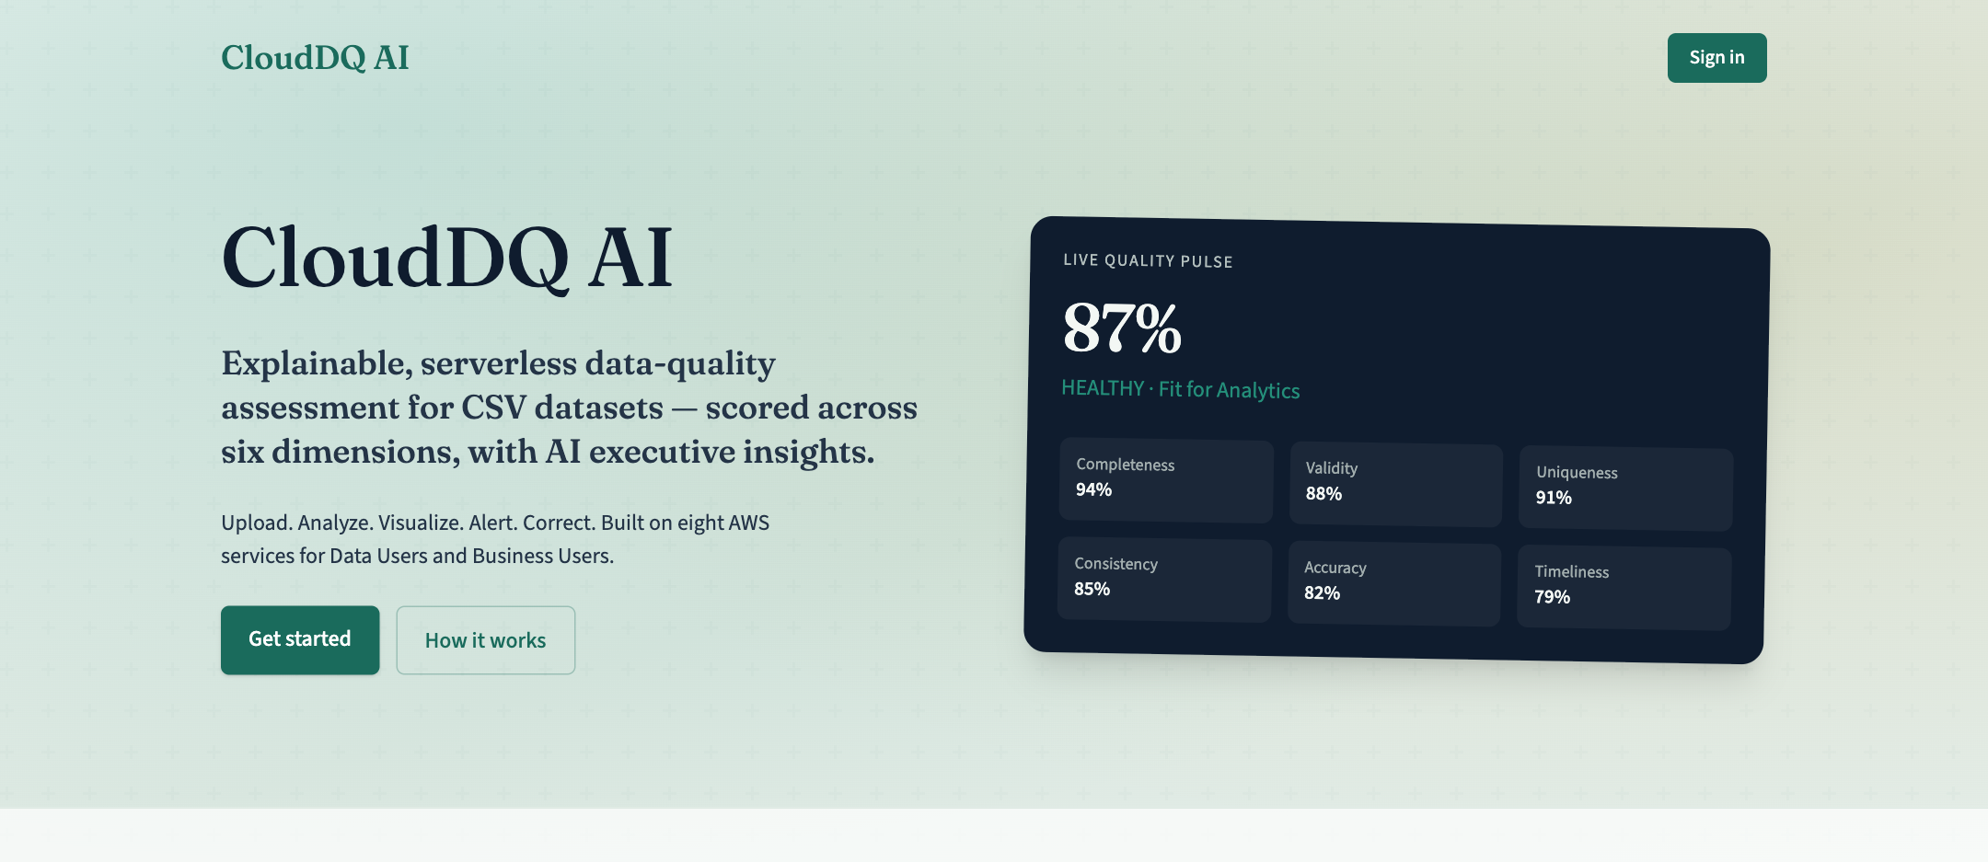
FEATURE OUTPUT 1/17
Landing page
Public landing page describing the platform and the six dimensions.
CloudDQ AI · 35

Slide 36
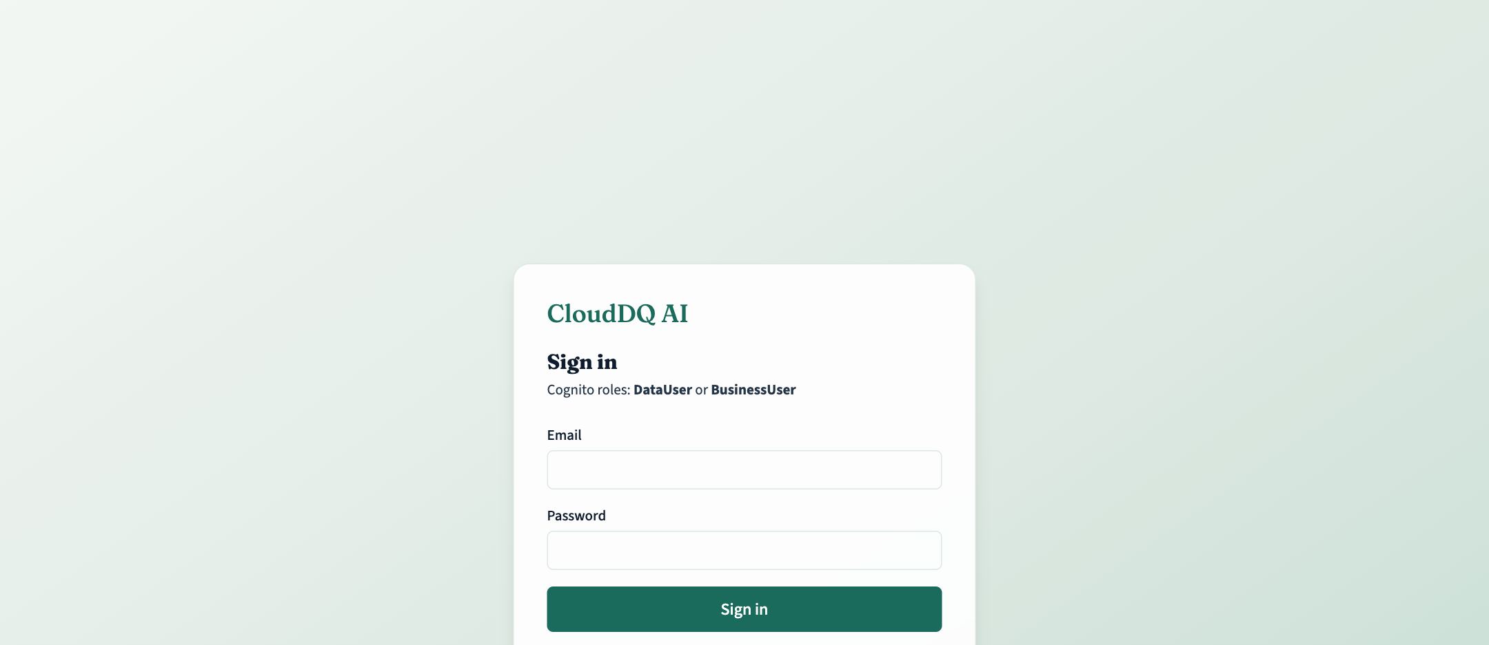
FEATURE OUTPUT 2/17
Cognito sign-in
Email and password sign-in against the Amazon Cognito user pool.
CloudDQ AI · 36

Slide 37
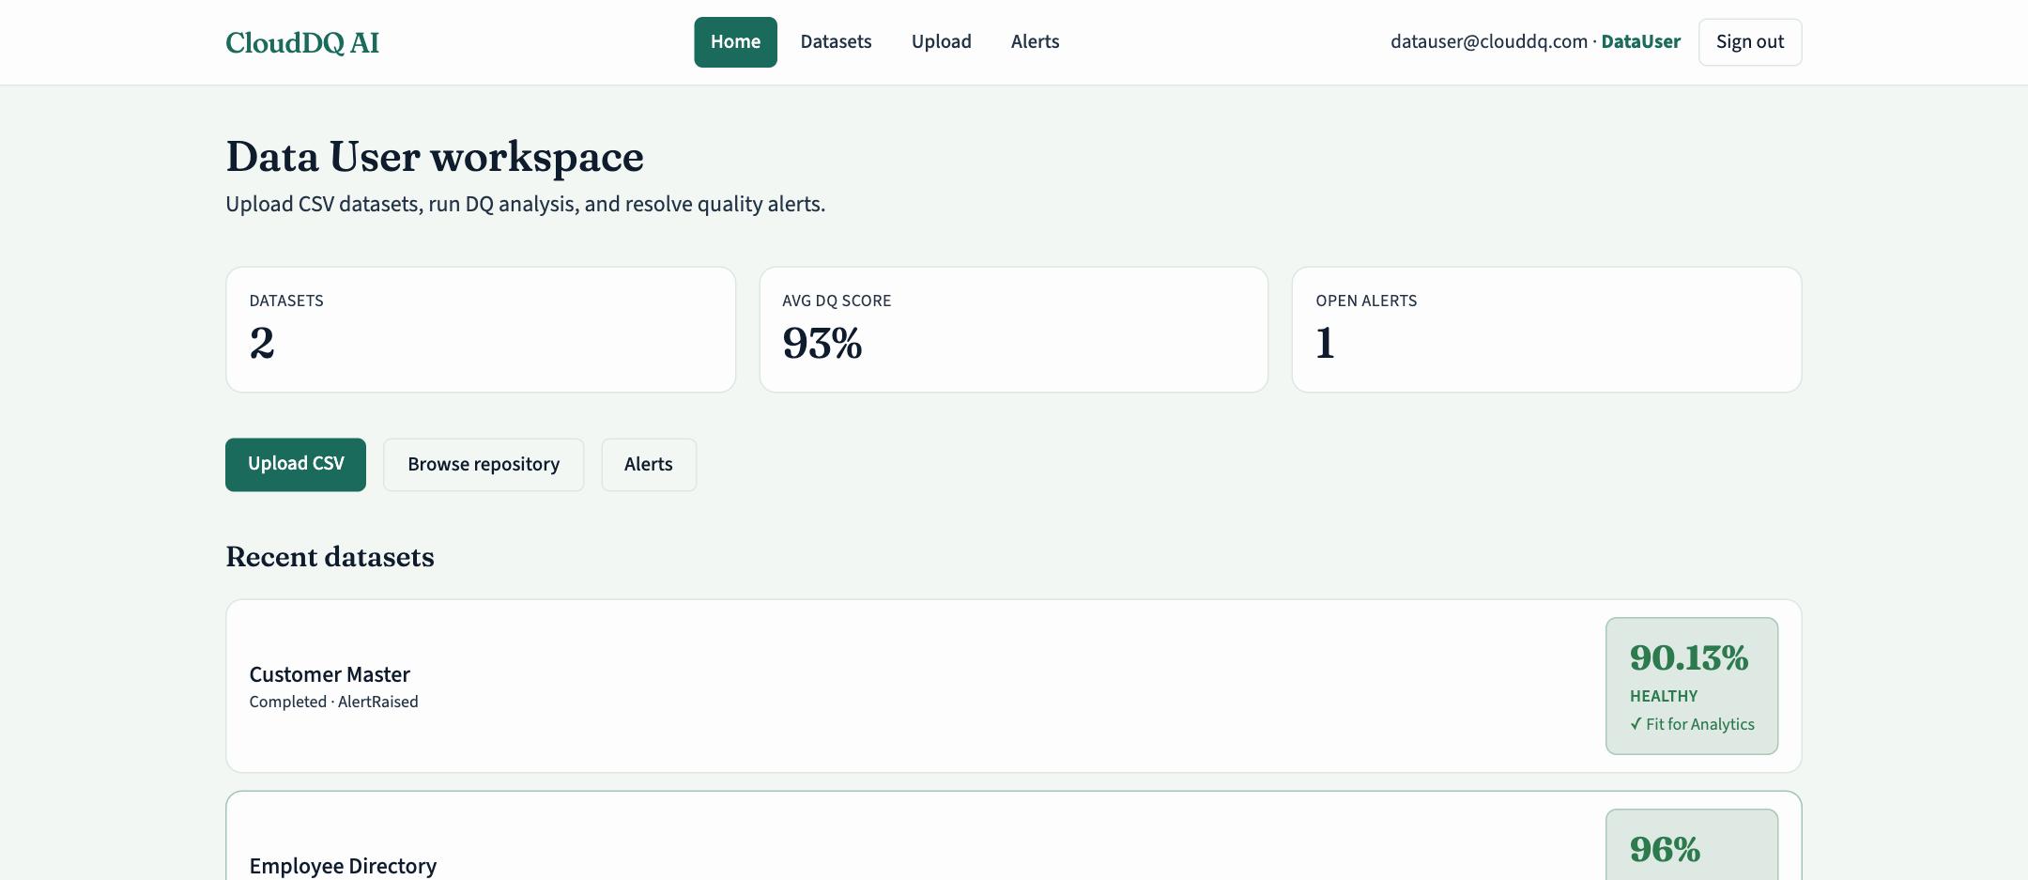
FEATURE OUTPUT 3/17
Data User workspace
Role-aware home with dataset and alert counts for the Data User.
CloudDQ AI · 37

Slide 38
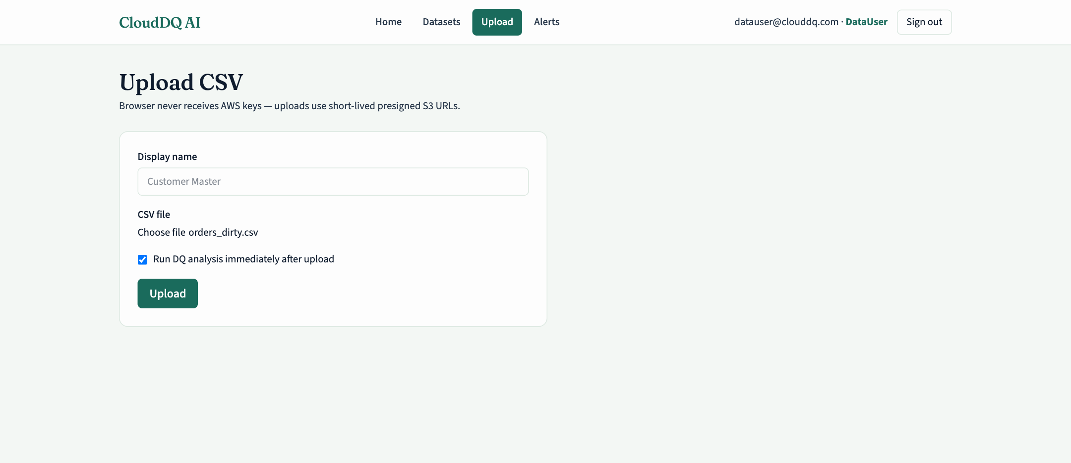
FEATURE OUTPUT 4/17
CSV upload
Upload form; the file goes straight to S3 through a presigned URL.
CloudDQ AI · 38

Slide 39
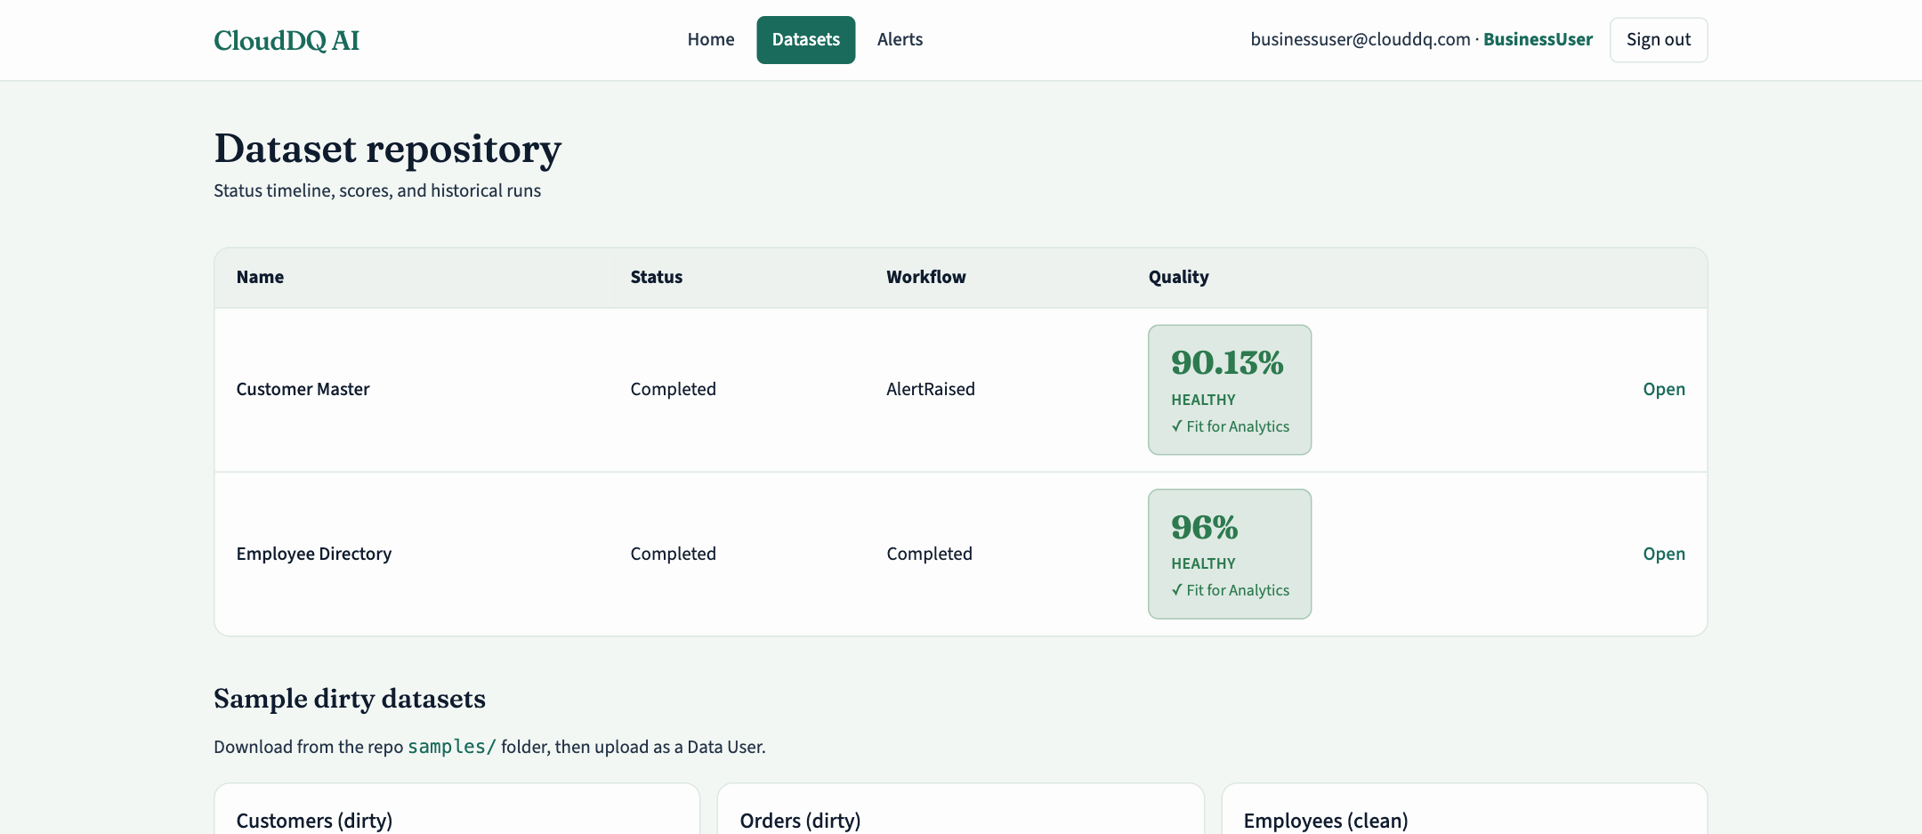
FEATURE OUTPUT 5/17
Dataset repository
All datasets with DQ score, health and workflow status.
CloudDQ AI · 39

Slide 40
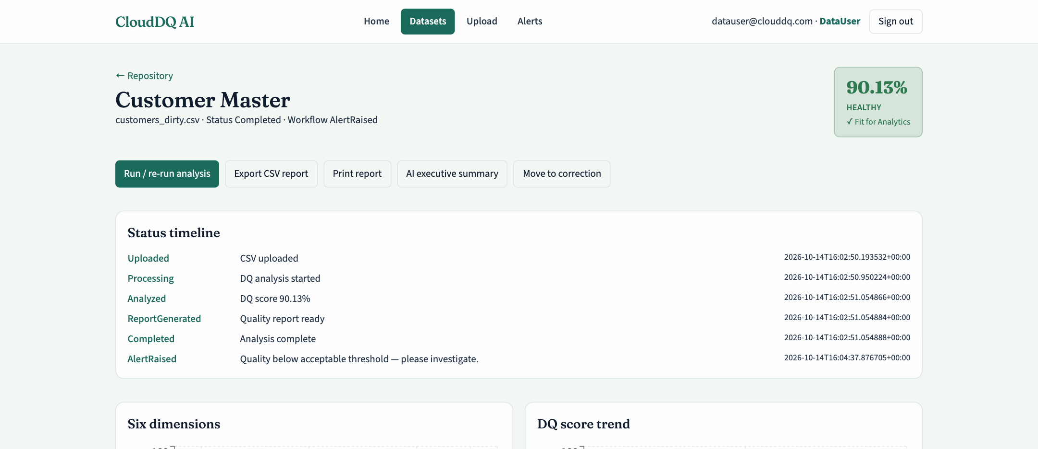
FEATURE OUTPUT 6/17
Quality report
Score 90.13% Healthy, actions, status timeline, dimensions and trend.
CloudDQ AI · 40

Slide 41
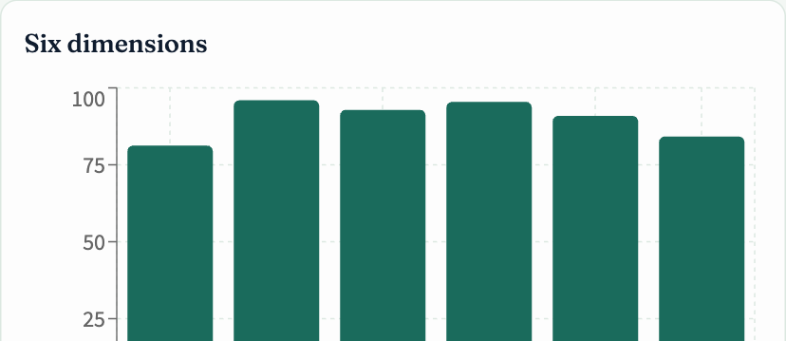
FEATURE OUTPUT 7/17
Six-dimension scores
Accuracy, completeness, consistency, timeliness, uniqueness, validity.
CloudDQ AI · 41

Slide 42
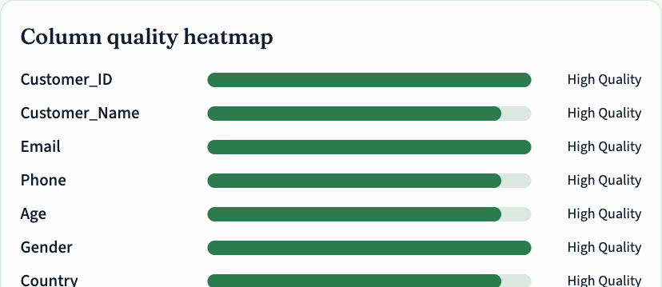
FEATURE OUTPUT 8/17
Column quality heatmap
Per-column quality from null rates and type checks.
CloudDQ AI · 42

Slide 43
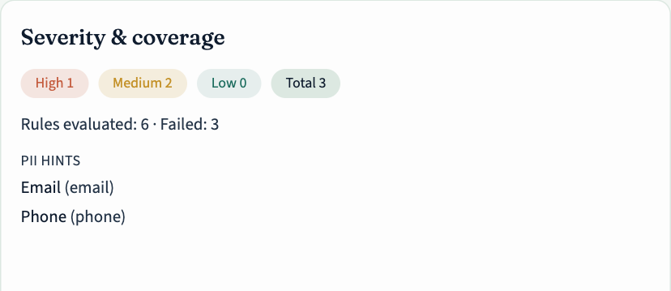
FEATURE OUTPUT 9/17
Severity & rule coverage
Issue counts by severity and how many rules passed.
CloudDQ AI · 43

Slide 44
FEATURE OUTPUT 10/17
Personal data detection (Amazon Comprehend)
Comprehend flags Full_Name as NAME and Email as EMAIL with 100% confidence.
CloudDQ AI · 44

Slide 45
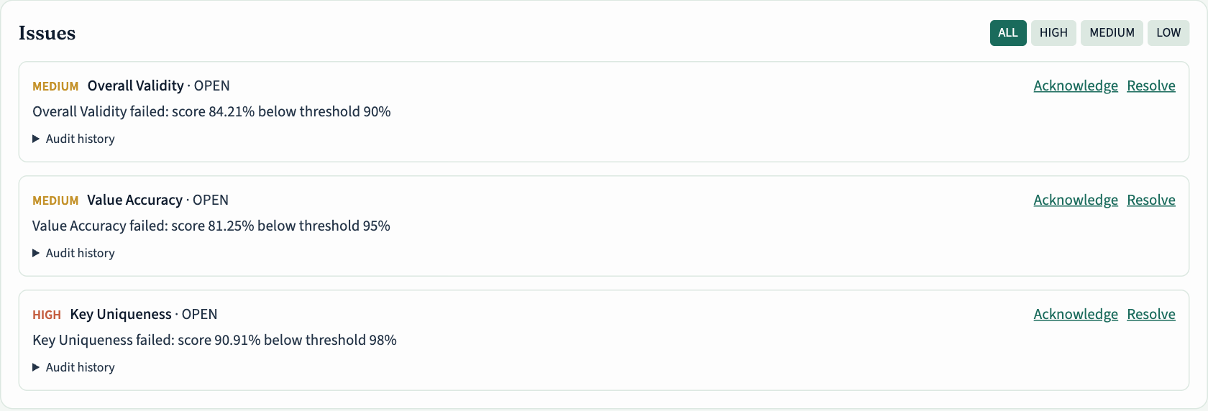
FEATURE OUTPUT 11/17
Issues with lifecycle actions
Rule failures with severity, acknowledge / resolve and audit history.
CloudDQ AI · 45

Slide 46
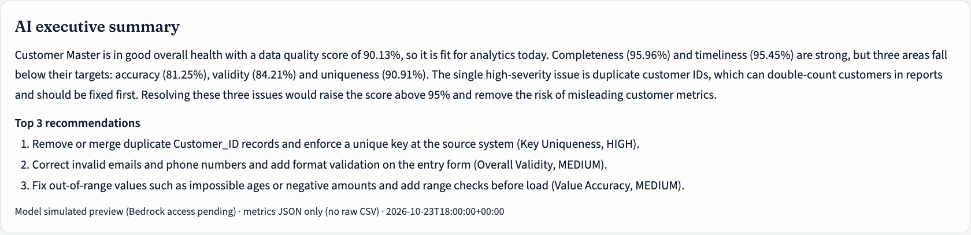
FEATURE OUTPUT 12/17
AI executive summary
Executive summary and top-3 recommendations from metrics JSON only (simulated preview while Bedrock access is pending).
CloudDQ AI · 46

Slide 47
FEATURE OUTPUT 13/17
Soft correction
Data User re-uploads a corrected CSV to re-validate.
CloudDQ AI · 47

Slide 48
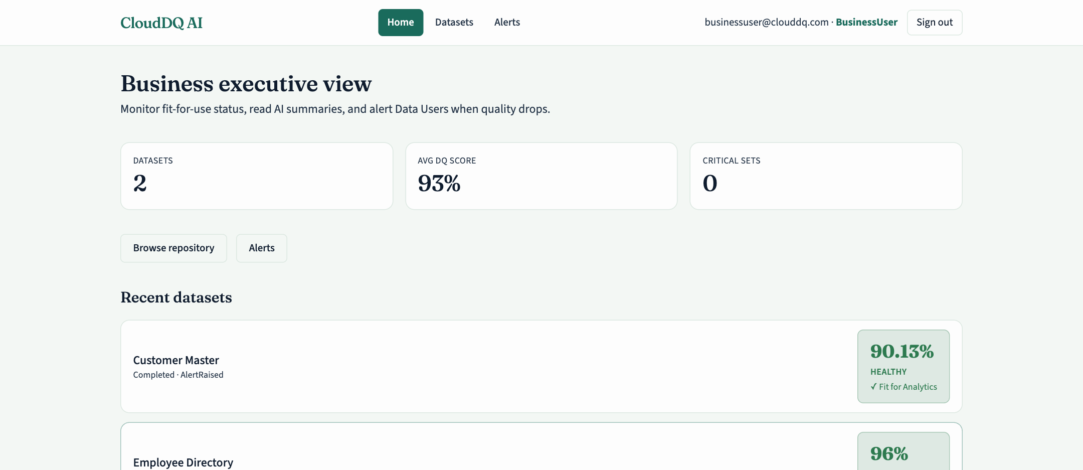
FEATURE OUTPUT 14/17
Business User workspace
Business User view — no upload, read results and raise alerts.
CloudDQ AI · 48

Slide 49
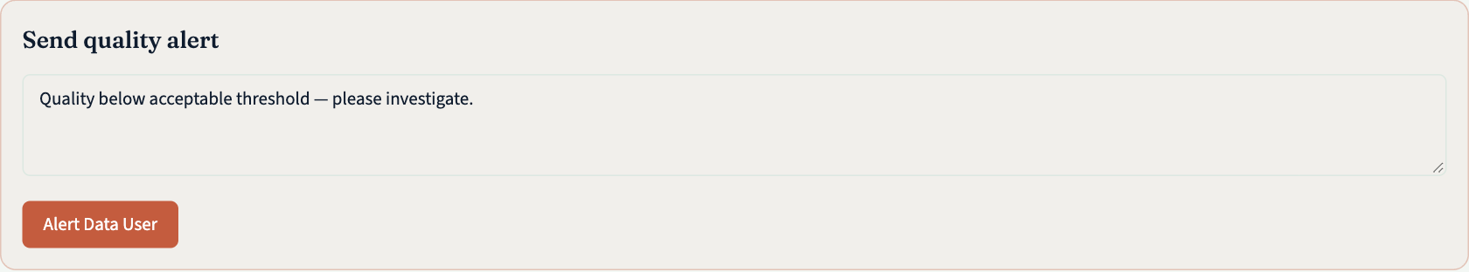
FEATURE OUTPUT 15/17
Send quality alert
Business User sends an alert with a note to the Data User.
CloudDQ AI · 49

Slide 50
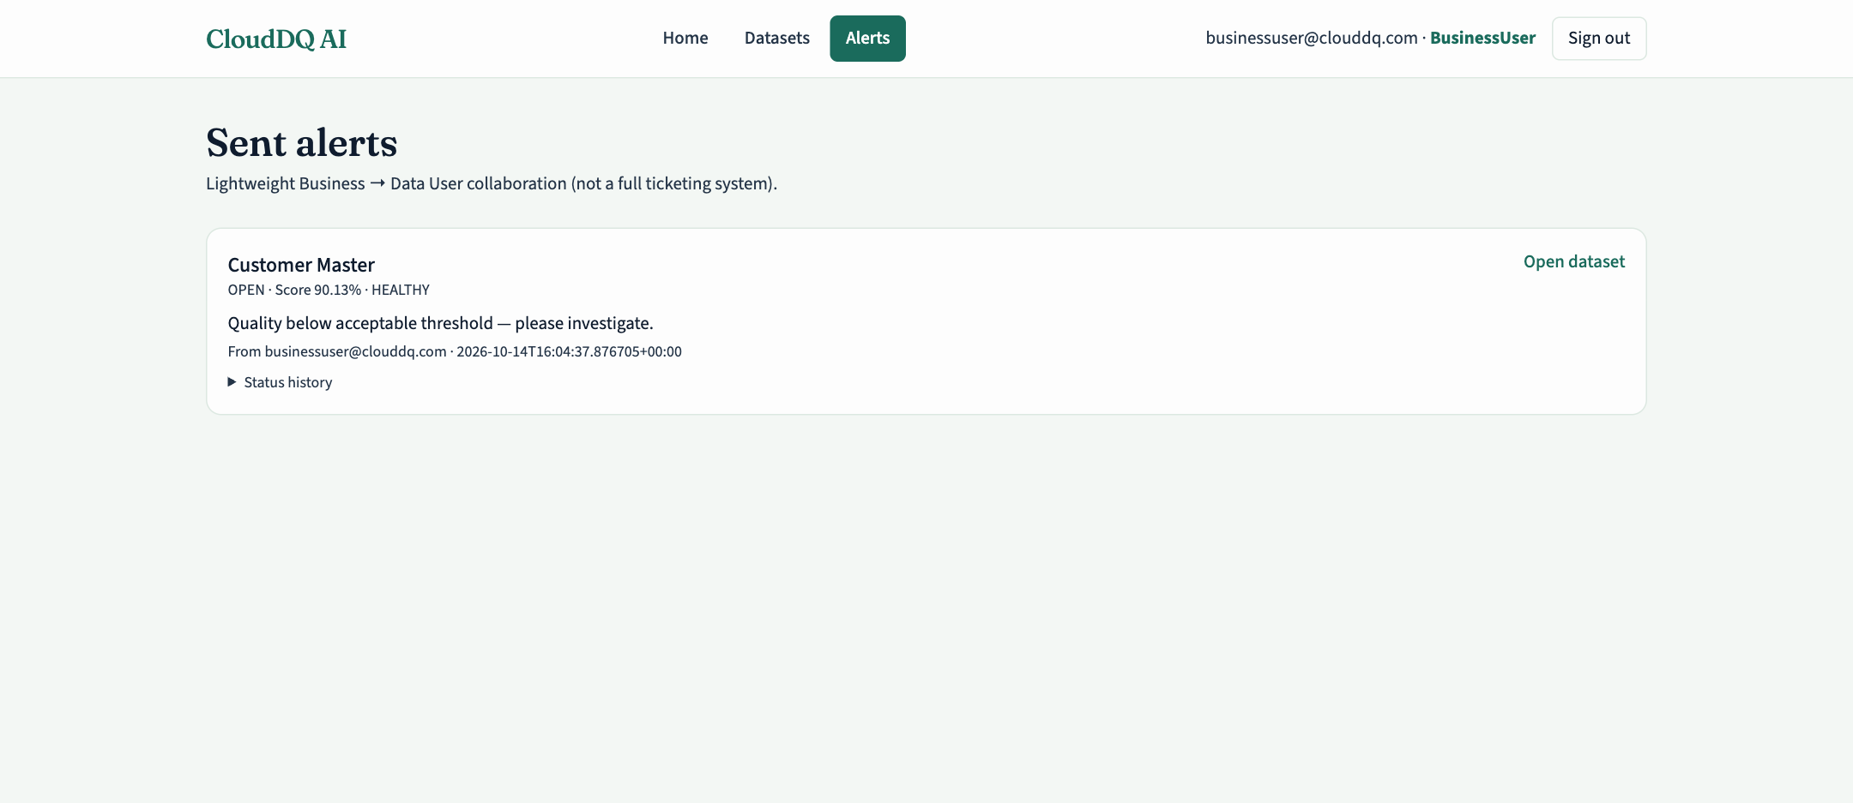
FEATURE OUTPUT 16/17
Sent alerts
Alert status OPEN with score and health, plus status history.
CloudDQ AI · 50

Slide 51
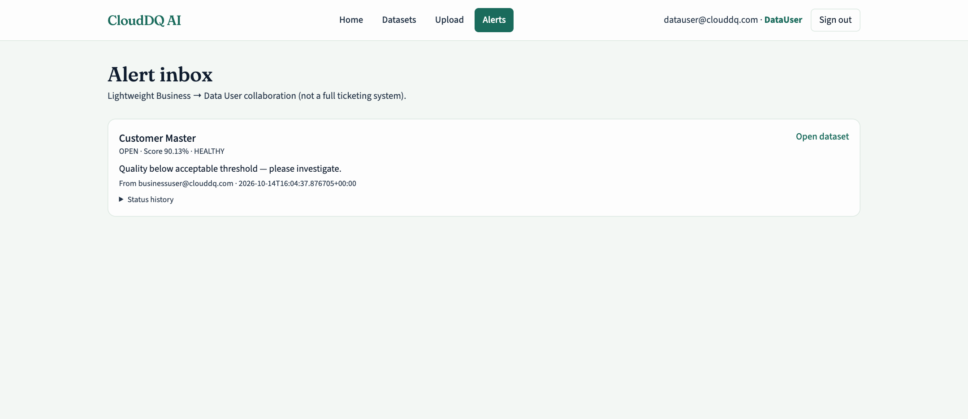
FEATURE OUTPUT 17/17
Data User alert inbox
Data User receives the alert and starts the correction workflow.
CloudDQ AI · 51

Slide 52
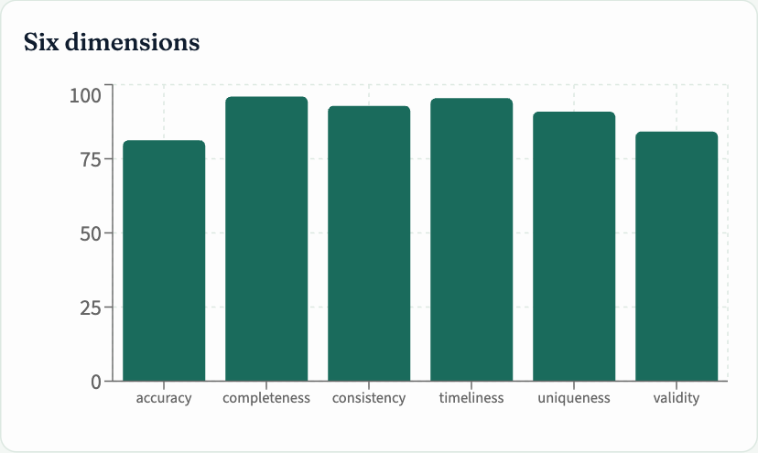
OUTCOME
Results
▪ Sample dataset Customer Master (customers_dirty.csv) scored 90.13% — HEALTHY, fit for analytics.
▪ Dimension scores: completeness 95.96, validity 84.21, uniqueness 90.91, consistency 92.86, accuracy 81.25, timeliness 95.45.
▪ Three open issues raised: Key Uniqueness (HIGH), Overall Validity (MEDIUM), Value Accuracy (MEDIUM).
▪ Employee Directory (employees_clean.csv) scored 96.0% — Comprehend flagged Full_Name (NAME) and Email (EMAIL) at 100% confidence.
▪ Business User alert moved the dataset workflow to AlertRaised, appeared in the Data User inbox and was published to SNS.
▪ Requests without a token are rejected by API Gateway with 401, and wrong-role actions by Lambda with 403.
CloudDQ AI · 52

Slide 53
LEARNING
Challenges & Future Scope
Challenges
Future scope
▪ Bedrock access on a new account — The account returned NOT_AUTHORIZED for Bedrock models with a quota of 0. The Converse integration and IAM are in place; the app falls back to a deterministic summary from the same metrics until AWS lifts the restriction (support case).
▪ Monorepo build on Amplify — The app root is the repository root, so the build spec runs cd frontend and publishes frontend/dist.
▪ Greedy proxy resource in API Gateway — The /{proxy+} resource needs the greedy path parameter and the authorizer on ANY only, never on the OPTIONS preflight.
▪ Cognito first sign-in — Admin-created users start in FORCE_CHANGE_PASSWORD; passwords were set as permanent to match the in-app login.
▪ S3 event notifications → automatic analysis on upload; Step Functions for the analysis workflow.
▪ Per-user SNS subscriptions or Amazon SES templated emails, and Comprehend-driven masking of PII columns.
▪ AWS Glue Data Quality and Athena for very large datasets and SQL exploration.
▪ Bedrock Guardrails and Knowledge Bases for safer, rule-aware explanations.
▪ Infrastructure as code (SAM / CDK) with a CI/CD pipeline and multiple environments.
CloudDQ AI · 53

Slide 54
SOURCES
References
▪ Amazon Web Services, “AWS Amplify Hosting User Guide.” https://docs.aws.amazon.com/amplify/latest/userguide/
▪ Amazon Web Services, “Amazon Cognito Developer Guide — User pools.” https://docs.aws.amazon.com/cognito/latest/developerguide/cognito-user-pools.html
▪ Amazon Web Services, “Use Amazon Cognito user pools as authorizer for a REST API.” https://docs.aws.amazon.com/apigateway/latest/developerguide/apigateway-integrate-with-cognito.html
▪ Amazon Web Services, “Lambda proxy integrations in API Gateway.” https://docs.aws.amazon.com/apigateway/latest/developerguide/set-up-lambda-proxy-integrations.html
▪ Amazon Web Services, “AWS Lambda Developer Guide — Building with Python.” https://docs.aws.amazon.com/lambda/latest/dg/lambda-python.html
▪ Amazon Web Services, “Uploading objects with presigned URLs.” https://docs.aws.amazon.com/AmazonS3/latest/userguide/PresignedUrlUploadObject.html
▪ Amazon Web Services, “Best practices for DynamoDB — single-table design.” https://docs.aws.amazon.com/amazondynamodb/latest/developerguide/bp-general-nosql-design.html
▪ Amazon Web Services, “Amazon Bedrock — Converse API.” https://docs.aws.amazon.com/bedrock/latest/userguide/conversation-inference.html
▪ Amazon Web Services, “Amazon Nova User Guide.” https://docs.aws.amazon.com/nova/latest/userguide/
▪ Amazon Web Services, “Amazon Comprehend — Detecting PII entities.” https://docs.aws.amazon.com/comprehend/latest/dg/how-pii.html
▪ Amazon Web Services, “Amazon SNS Developer Guide — Email notifications.” https://docs.aws.amazon.com/sns/latest/dg/sns-email-notifications.html
▪ Amazon Web Services, “Using Amazon CloudWatch alarms.” https://docs.aws.amazon.com/AmazonCloudWatch/latest/monitoring/AlarmThatSendsEmail.html
▪ Amazon Web Services, “Security best practices in IAM.” https://docs.aws.amazon.com/IAM/latest/UserGuide/best-practices.html
▪ DAMA International, DAMA-DMBOK: Data Management Body of Knowledge, 2nd ed. Technics Publications, 2017.
▪ ISO/IEC 25012:2008, Software engineering — Software product Quality Requirements and Evaluation (SQuaRE) — Data quality model.
▪ R. Y. Wang and D. M. Strong, “Beyond accuracy: What data quality means to data consumers,” Journal of Management Information Systems, 12(4), 5–33, 1996.
▪ React documentation. https://react.dev/ · Vite documentation. https://vite.dev/ · Recharts. https://recharts.org/
CloudDQ AI · 54

Slide 55
Thank you
Questions? · https://main.d3ffgcfvtof2u.amplifyapp.com/
Pooja Palani · Dewlyn Mary · Lathika Shree

