Slide 1
TEAM NAME : PHOENIX
TEAM MEMBERS :
Pooja Mane
Swati Kasar
Neha Mahajan
INSTITUTE NAME : ​Walchand College of Engineering,Sangli.

Slide 2
THEME : BLOCKCHAIN & IOT
TITLE :
SAFETURE - ​Translucent & Trackable Smart Container and safe Transportation.

Slide 3
Problem Statement :
Certain pharmaceuticals compulsory need to be maintained at a precise temperature to retain their efficiency. Any ups & downs can cause huge loss of money,life,etc.
Pharmaceutical companies loose average of $1,50,000 per package shipment due to temperature slips.
In addition to this, according to the estimation around 1 million deaths occur annually due to counterfeit medicines.

Slide 4
Solution
Traceability :
By keeping log of all the checkpoints and processes which would help the manufacturer & the retailer to identify the troublespots.
Transparency :
Ability to see where the shipments are, what quality the shipments are and transparency to the consumer regarding the quality of the medicine.

Slide 5
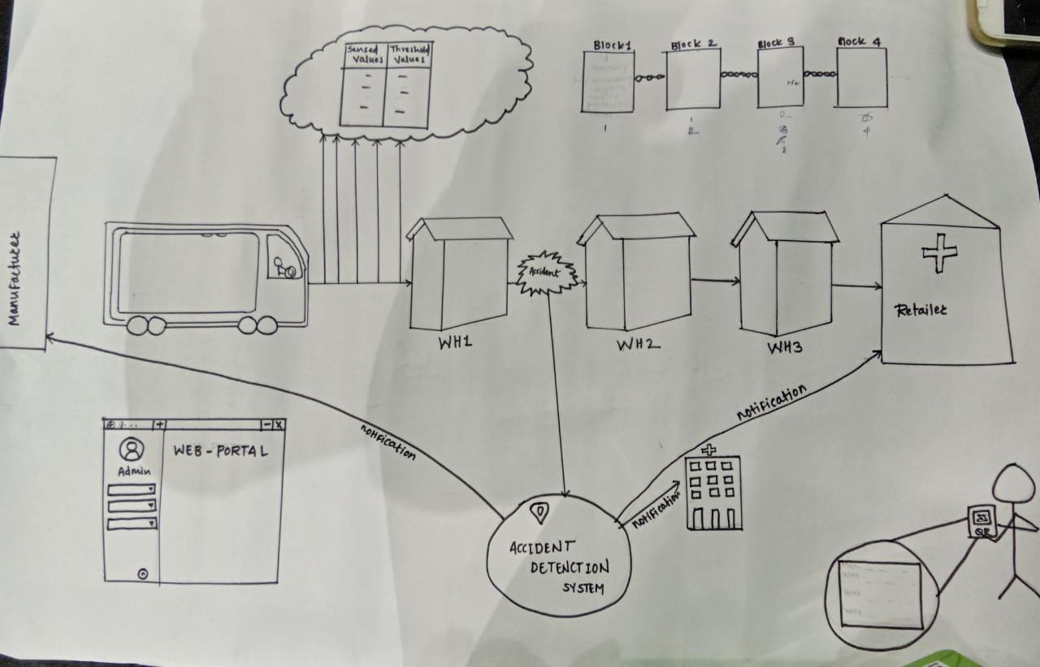
Solution :

Slide 6
Implementation
Utilising the amalgamation of Blockchain and IOT we have,
A Web Portal to the manufacturer.
-trackability
-translucency
-accident detection
2. An Android App to the enduser.
-transparency

Slide 7
Business Model
Customers :
Manufacturer
Retailer
pricing structure :
Charge from warehouse to warehouse : Rs.100
On an average if we consider 5 warehouses in between manufacturer and retailer, then from 1 whole shipment we could get 6*100=600
Likewise, suppose in a day 5 such shipments occur then we would earn 600*5=3000

Slide 8
THANK YOU !

