Slide 1


CV5100: Modelling, Uncertainty and Data for Engineers MODULE 2: TIME SERIES ANALYSIS, lecture 1: COMPONENTS

Slide 2
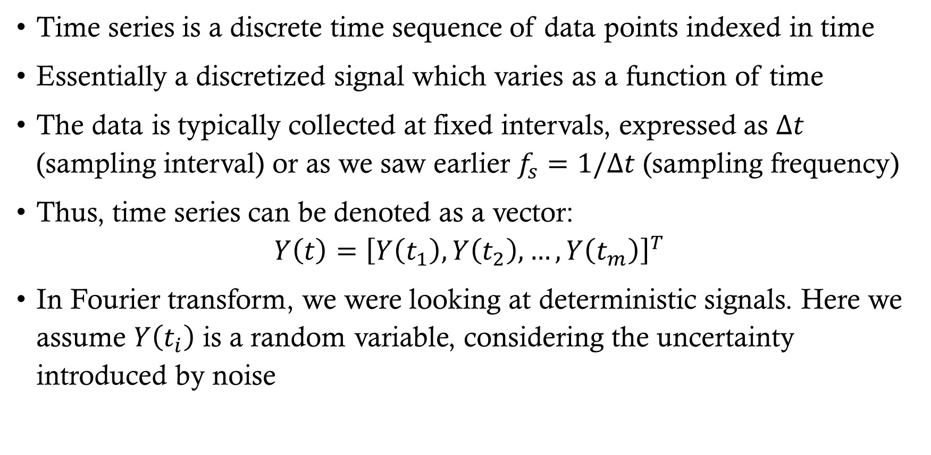
Time series
Time series is a discrete time sequence of data points indexed in time
Essentially a discretized signal which varies as a function of time
The data is typically collected at fixed intervals, expressed as $Δt$ (sampling interval) or as we saw earlier $f_{s}=1/Δt$ (sampling frequency)
Thus, time series can be denoted as a vector:
$$Y\left(t\right)={\left[Y\left(t_{1}\right),Y\left(t_{2}\right), …,Y\left(t_{m}\right)\right]}^{T}$$
In Fourier transform, we were looking at deterministic signals. Here we assume $Y\left(t_{i}\right)$ is a random variable, considering the uncertainty introduced by noise

Slide 3
Time series analysis (TSA)
TSA is identifying trends, seasonality and other such patterns so that we can forecast time series and make informed decisions
Why should we care?
Time series is everywhere around us!
Examples?
We just don’t care about what happened! We also want to predict what will happen next
Will the bridge be health after 20 years?
What signs of early damage can the building show?
How much will a skyscraper foundation settle 5 years later?
If a bridge starts behaving differently today than it did last year, could you detect it before failure?
Time series analysis lets you do that
Notes:
Fatigue in bridges, sway of buildings, growth of cracks, vibration of structures,

Slide 4
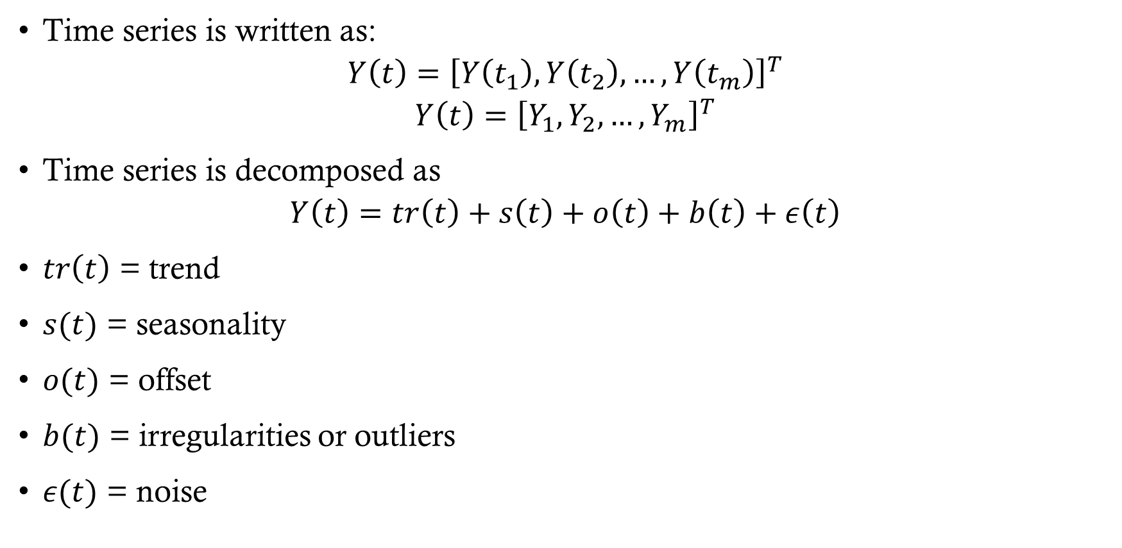
Components
Time series is written as:
$$Y\left(t\right)={\left[Y\left(t_{1}\right),Y\left(t_{2}\right), …,Y\left(t_{m}\right)\right]}^{T}$$
$$Y\left(t\right)={\left[Y_{1},Y_{2},…, Y_{m}\right]}^{T}$$
Time series is decomposed as
$$Y\left(t\right)=tr\left(t\right)+s\left(t\right)+o\left(t\right)+b\left(t\right)+ε\left(t\right)$$
$tr\left(t\right)$ = trend
$s(t)$ = seasonality
$o(t)$ = offset
$b(t)$ = irregularities or outliers
$ε(t)$ = noise

Slide 5
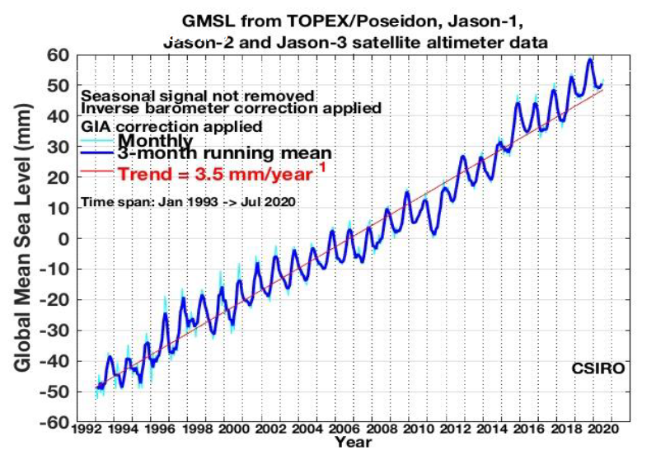

components
Trend
$$Y\left(t\right)=y_{0}+rt+ε_{t}$$

Slide 6

components
Seasonality
$$Y\left(t\right)=\sum_{k=1}^{p}{a_{k}\cos{(kω_{0}t)+b_{k}sin⁡(kω_{0}}}t)+ε_{t}$$

Slide 7
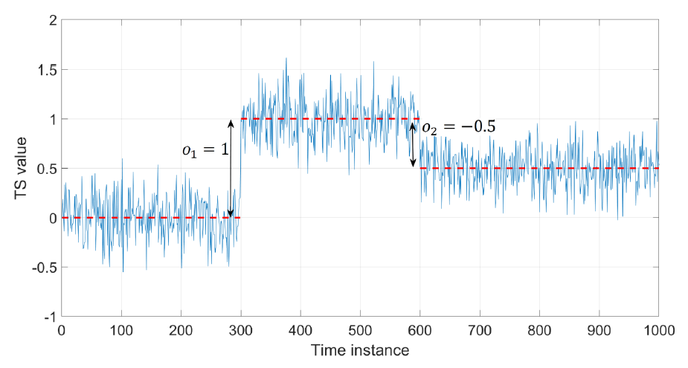

components
Offset
$$Y\left(t\right)=\sum_{a}^{b}{o_{k}u_{k}}+ε_{t}$$

Slide 8
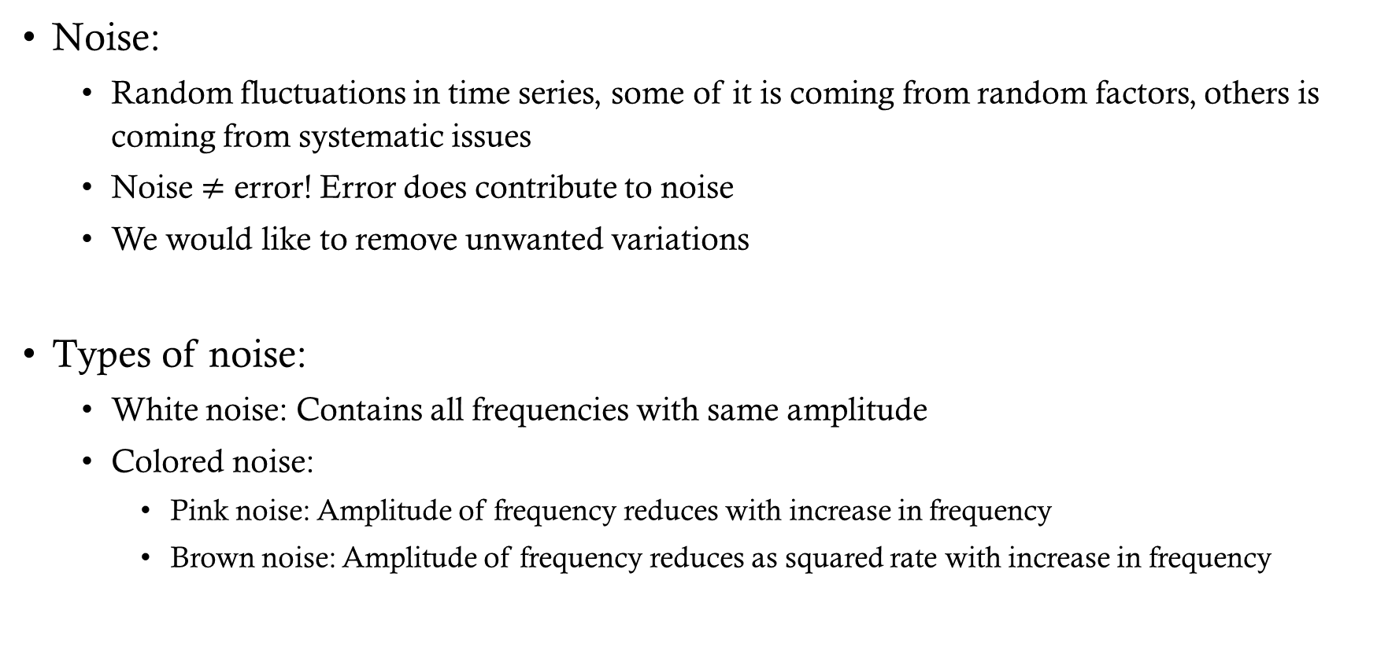
components
Noise:
Random fluctuations in time series, some of it is coming from random factors, others is coming from systematic issues
Noise $≠$ error! Error does contribute to noise
We would like to remove unwanted variations
Types of noise:
White noise: Contains all frequencies with same amplitude
Colored noise:
Pink noise: Amplitude of frequency reduces with increase in frequency
Brown noise: Amplitude of frequency reduces as squared rate with increase in frequency

Slide 9
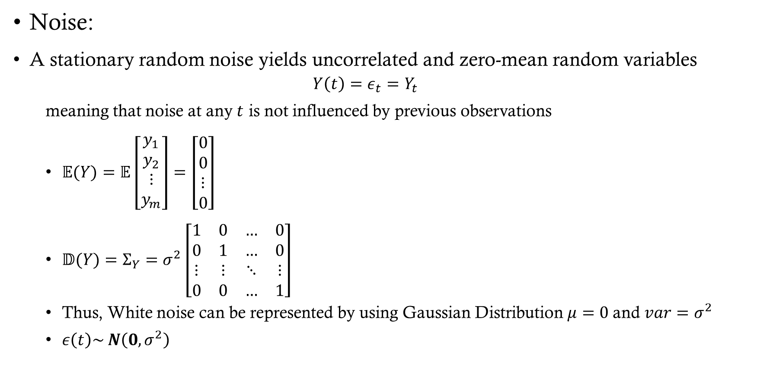
components model
Noise:
A stationary random noise yields uncorrelated and zero-mean random variables
$$Y\left(t\right)=ε_{t}=Y_{t}$$
meaning that noise at any $t$ is not influenced by previous observations
$\begin{aligned}𝔼(Y)=𝔼\left[\begin{aligned}y_{1} \\ y_{2} \\ ⋮ \\ y_{m}\end{aligned}\right]=\left[\begin{aligned}0 \\ 0 \\ ⋮ \\ 0\end{aligned}\right]\end{aligned}$
$\begin{aligned}𝔻(Y)=Σ_{Y}=σ^{2}\left[\begin{matrix}1 & 0 & … & 0 \\ 0 & 1 & … & 0 \\ ⋮ & ⋮ & ⋱ & ⋮ \\ 0 & 0 & … & 1\end{matrix}\right]\end{aligned}$
Thus, White noise can be represented by using Gaussian Distribution $μ=0$and $var=σ^{2}$
$ε\left(t\right)\sim N\left(0, σ^{2}\right)$

Slide 10
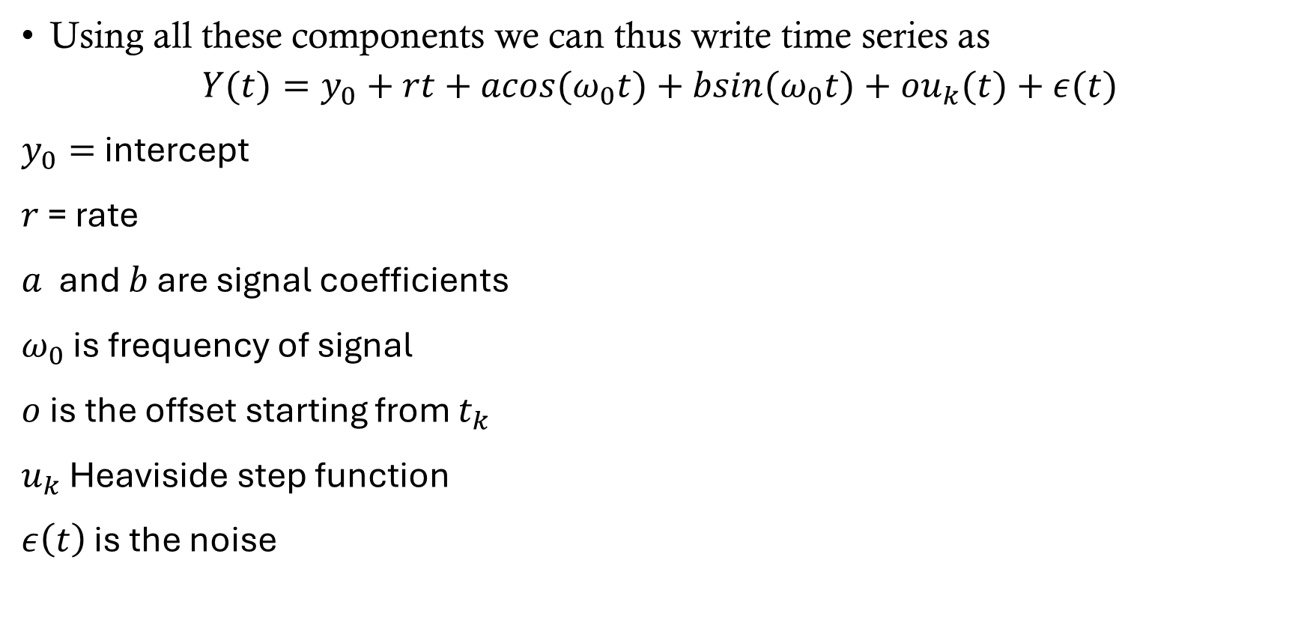
Time series expression
Using all these components we can thus write time series as
$$Y(t)=y_{0}+rt+acos(ω_{0}t)+bsin(ω_{0}t)+ou_{k}(t)+ε(t)$$
$y_{0}=$ intercept
$r$ = rate
$a$ and $b$ are signal coefficients
$ω_{0}$ is frequency of signal
$o$ is the offset starting from $t_{k}$
$u_{k}$ Heaviside step function
$ε\left(t\right)$ is the noise

Slide 11
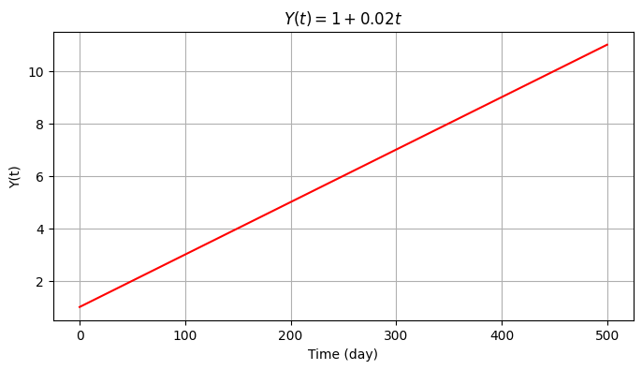
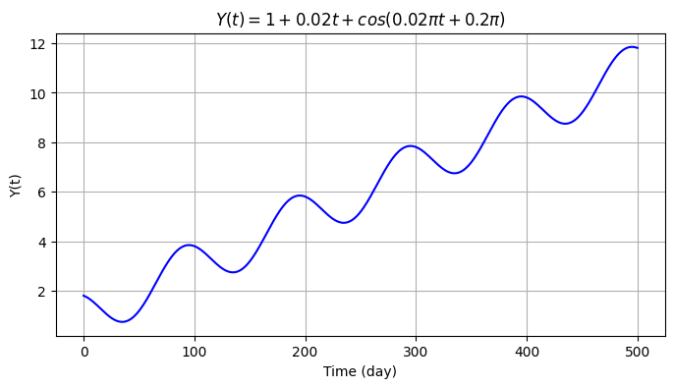
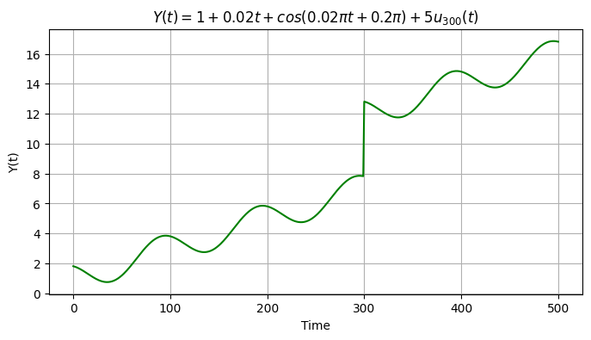
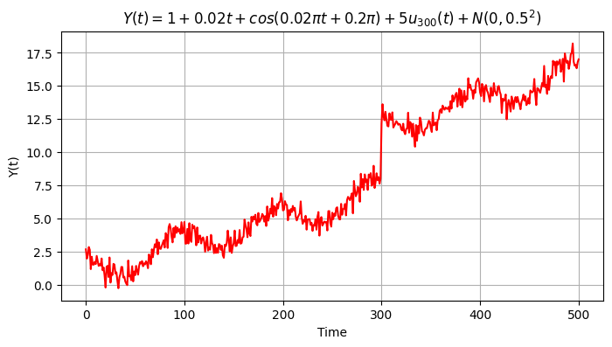
Example

