Slide 1
CV5100 – MUDE Modeling, Uncertainty, and Data for Engineers Ch4 – Linear Algebra
Course instructors:
Prof. Phanisri Pradeep Pratapa
Prof. Prakash Singh Badal
Prof. Sudheendra Herkal
Department of Civil Engineering
Indian Institute of Technology Madras
27 August 2025

Slide 2
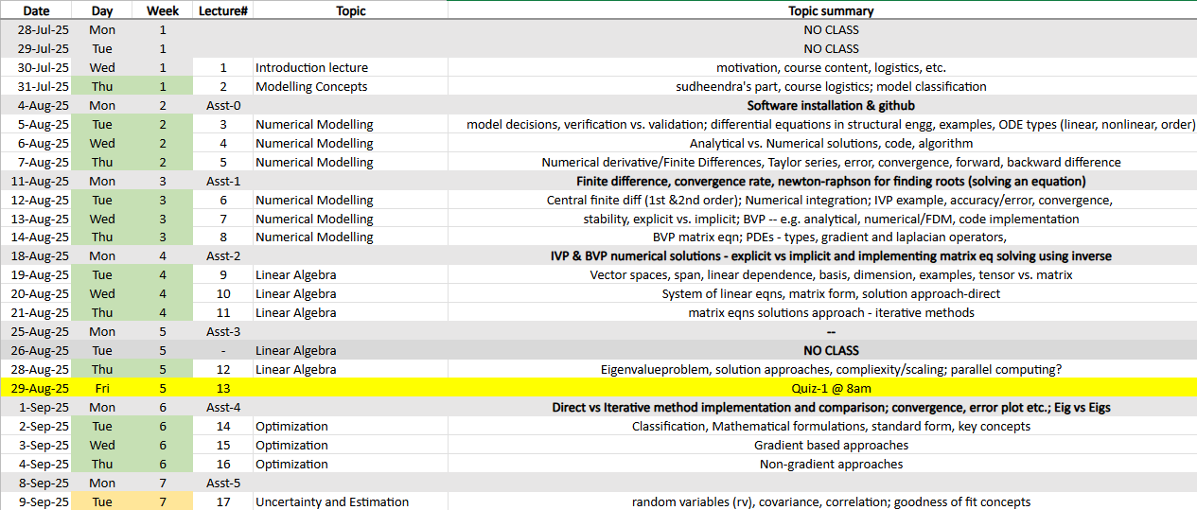
Numerical Modelling, Linear Algebra, Optimization

Slide 3
Outline
Vector space concepts
System of linear equations
Solution using direct methods
Solution using indirect (iterative) methods
Eigenvalue problem
Orthogonality and orthogonalization

Slide 4
Vector space concepts
Vector (Linear) space and subspace
Span
Linear dependence/independence
Basis
Dimension
Orthogonal vs. non-orthogonal basis
Column space, null space, rank
Notes:
Need for computers…

Slide 5
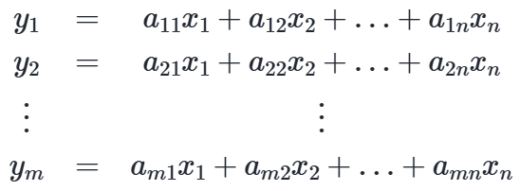
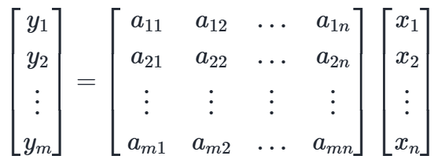

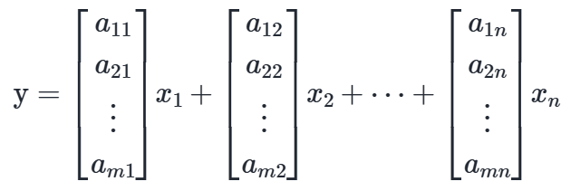
System of Linear Equations
Algebraic to Matrix form
Give an example of linear equation in structural engineering
Notes:
Need for computers…

Slide 6
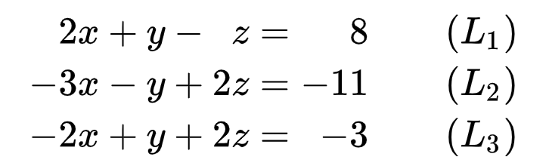
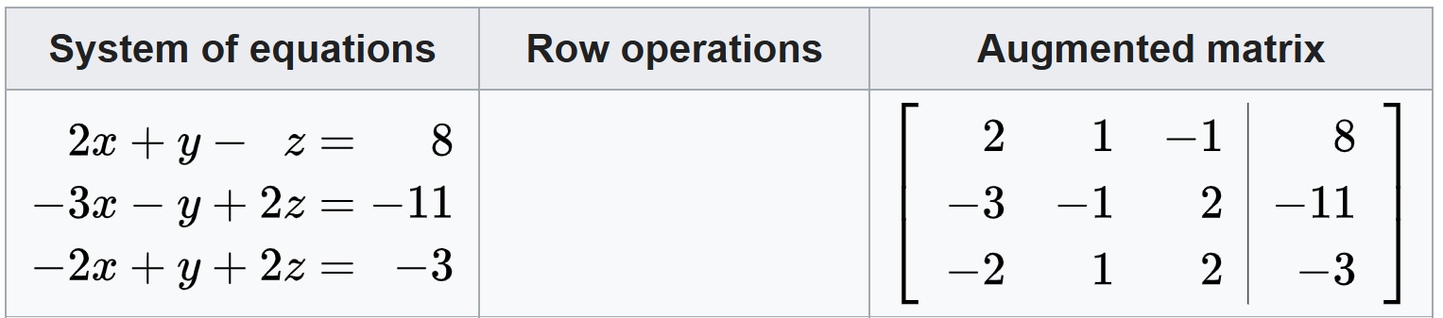
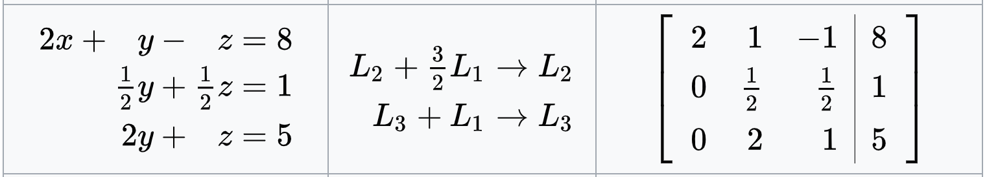
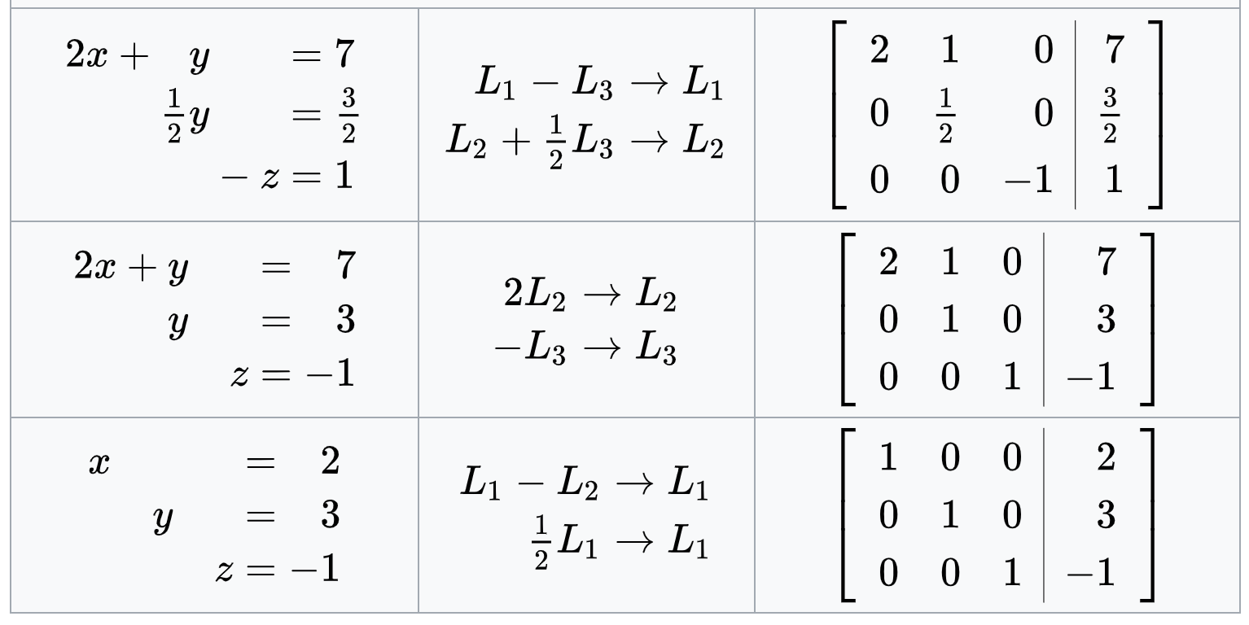
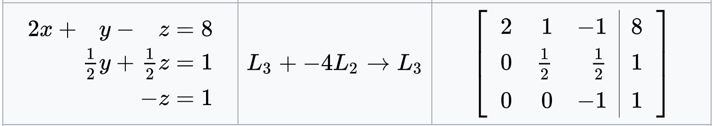
Solution using direct methods
Gaussian Elimination
Elementary row operations to get row echelon form:
Interchanging two rows.
Multiplying a row by a non-zero scalar.
Adding a scalar multiple of one row to another.
https://en.wikipedia.org/wiki/Gaussian_elimination

Slide 7
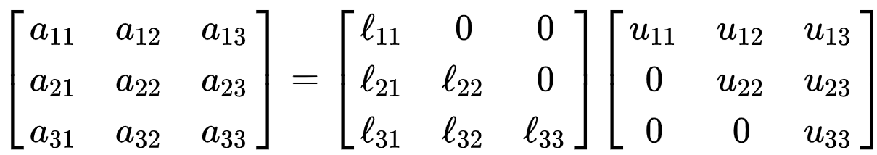
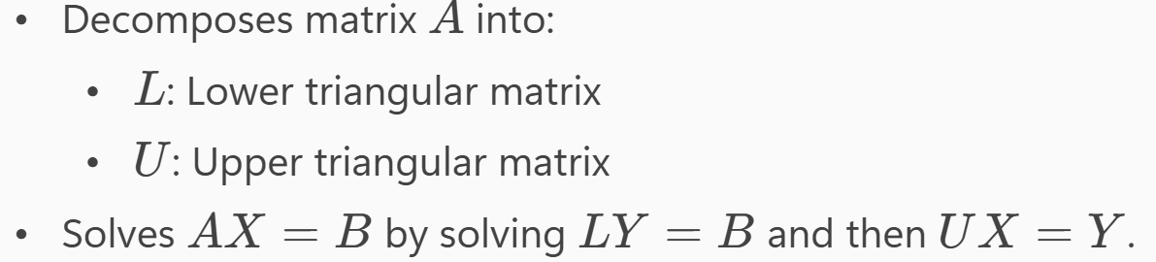
Solution using direct methods
LU decomposition
Useful for multiple RHS e.g.?
What if A is symmetric? LU → LL^T Cholesky
Notes:
Need for computers…

Slide 8
Solution using direct methods
Gaussian Elimination – Computational efficiency
Eliminate elements of first column – nxn ops
For every subsequent column reduce n by 1
Sum of squares of n natural number – O(n^3)
Run time scaling
Memory scaling (storing the matrix); 8 bytes per number in 64-bit (double precision) – 15 decimals
Triangular matrix – solved sequentially (not efficient for parallel computing)
Finds the exact solution in a finite number of steps
Notes:
Need for computers…

Slide 9
Eigenvalue problem
Definition and details
Computational complexity/scaling
eig vs. eigs eigensolvers (numpy vs scipy) – full vs sparse matrices – direct vs indirect/iterative methods
Inverse and pseudoinverse
Energy and eigenvalues
Where do we come across eigenvalues in structural engineering?
Notes:
Need for computers…

Slide 10
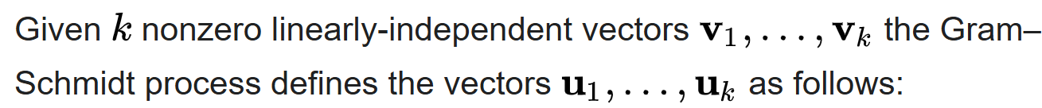
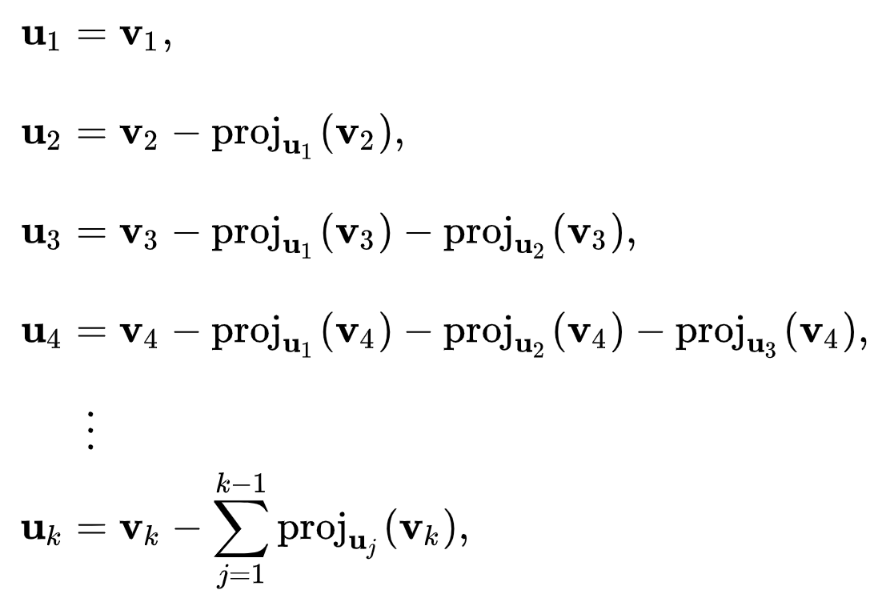
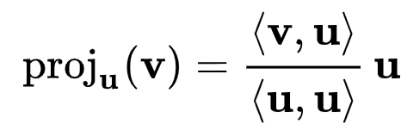
Orthogonalization
Gram-Schmidt process
https://en.wikipedia.org/wiki/Gram%E2%80%93Schmidt_process

Slide 11
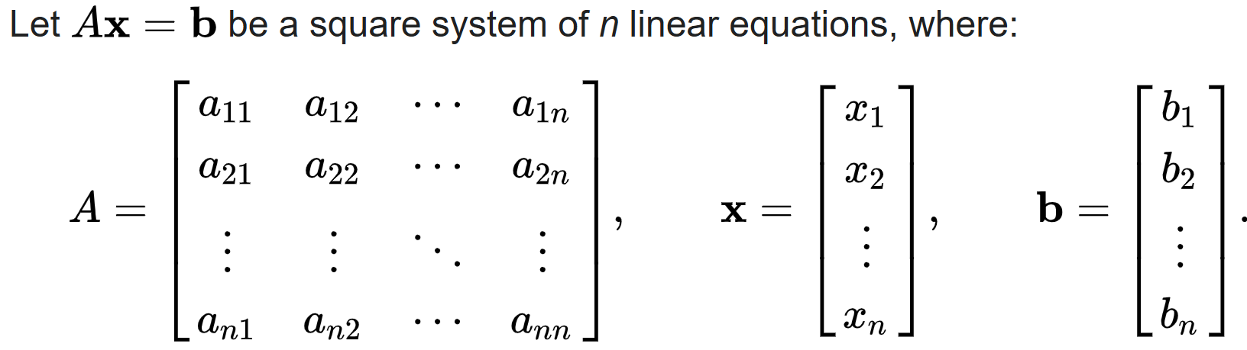




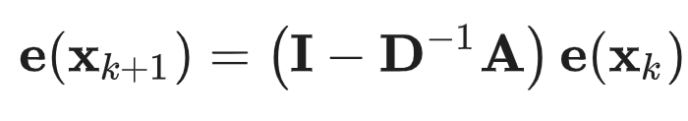

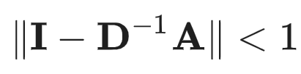


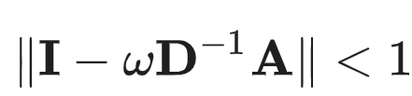

Solution using indirect methods
Jacobi iteration
Fixed-point iteration
Residual vs. Error
L^2 norm
Condition number
Spectral radius
Notes:
Need for computers…

Slide 12
Solution using indirect methods
Gauss-Seidel Method
Conjugate Gradient Method
GMRES
Preconditioned Conjugate Gradient (PCG)
Multigrid methods
Anderson-Jacobi
Alternating Anderson Jacobi
Pratapa, P. P., Suryanarayana, P., & Pask, J. E. (2016). Anderson acceleration of the Jacobi iterative method: An efficient alternative to Krylov methods for large, sparse linear systems. Journal of Computational Physics, 306, 43-54.
Notes:
Need for computers…

Slide 13
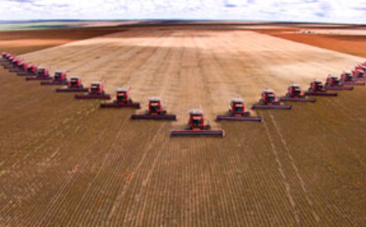
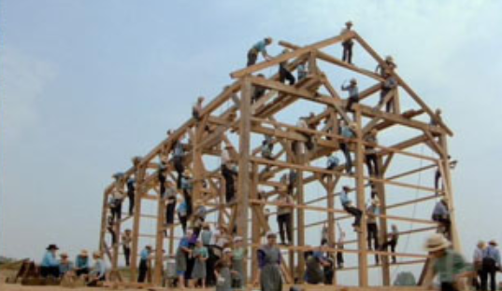
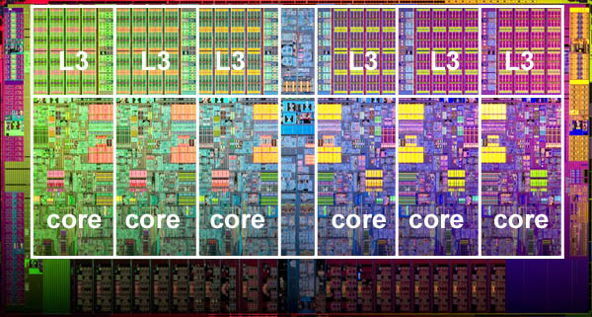
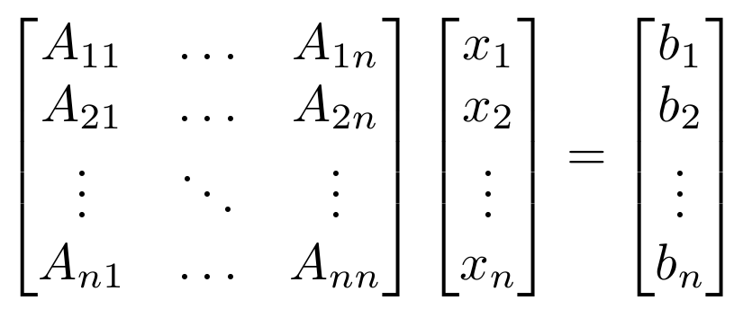
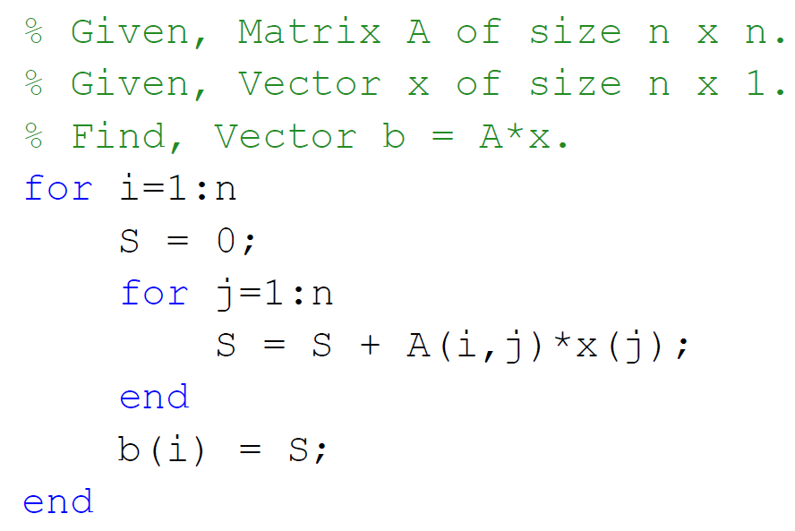
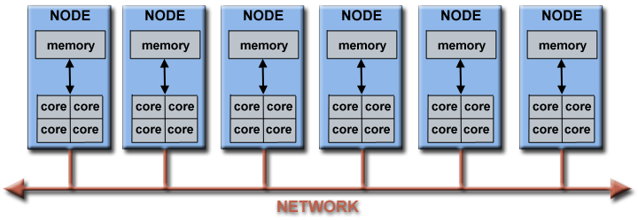
High Performance & Parallel Computing
Run on multiple computers
Computer Cluster
Ref: https://computing.llnl.gov/tutorials/parallel_comp/
Notes:
Scientific and parallel computing, double for loop and separate (MATLAB code)

Slide 14
Other things if you are curious
Scientific/High-performance computing
Profiling
BLAS
LAPACK
MPI
PETSc
Threading
Parallel scaling, parallel computing
Cache, retrieval
Communication
Petaflops, Exaflops, Supercomputers
Notes:
Need for computers…

