Slide 1


CV5100: Modelling, Uncertainty and Data for Engineers MODULE 1: Signal processing, lecture 6-7: Fourier Transform

Slide 2


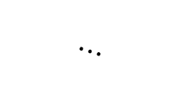





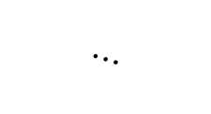




Complex fourier series
Im part
Im part
$$⋯$$
Real part
$${−θ}_{k}$$
Im part
$$−\frac{2π}{T_{0}}$$
$$k=−1$$
$$\left|X_{1}\right|$$
$$X_{0}$$
Real part
$$X_{1}$$
$$X_{−1}$$
$$0$$
$$k=0$$
$$\left|X_{1}\right|$$
Real part
$$θ_{k}$$
$$\frac{2π}{T_{0}}$$
$$k=1$$
$$⋯$$
$$Frequency$$

Slide 3
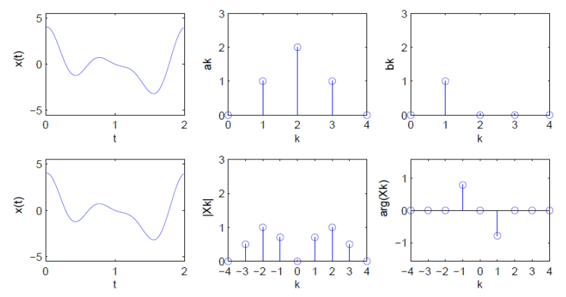
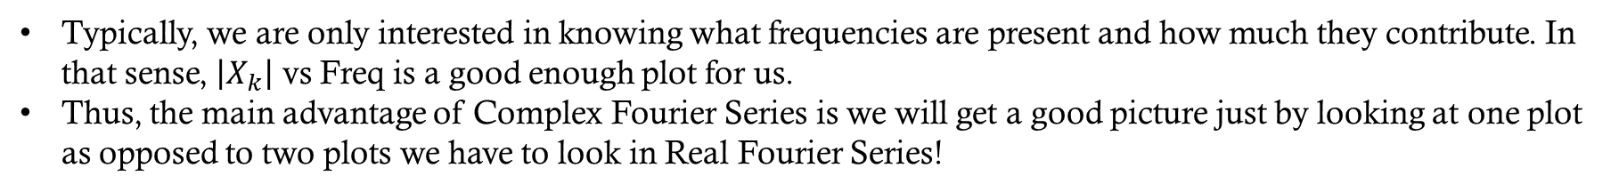
Real vs complex Fourier series
Typically, we are only interested in knowing what frequencies are present and how much they contribute. In that sense, $\left|X_{k}\right|$ vs Freq is a good enough plot for us.
Thus, the main advantage of Complex Fourier Series is we will get a good picture just by looking at one plot as opposed to two plots we have to look in Real Fourier Series!

Slide 4
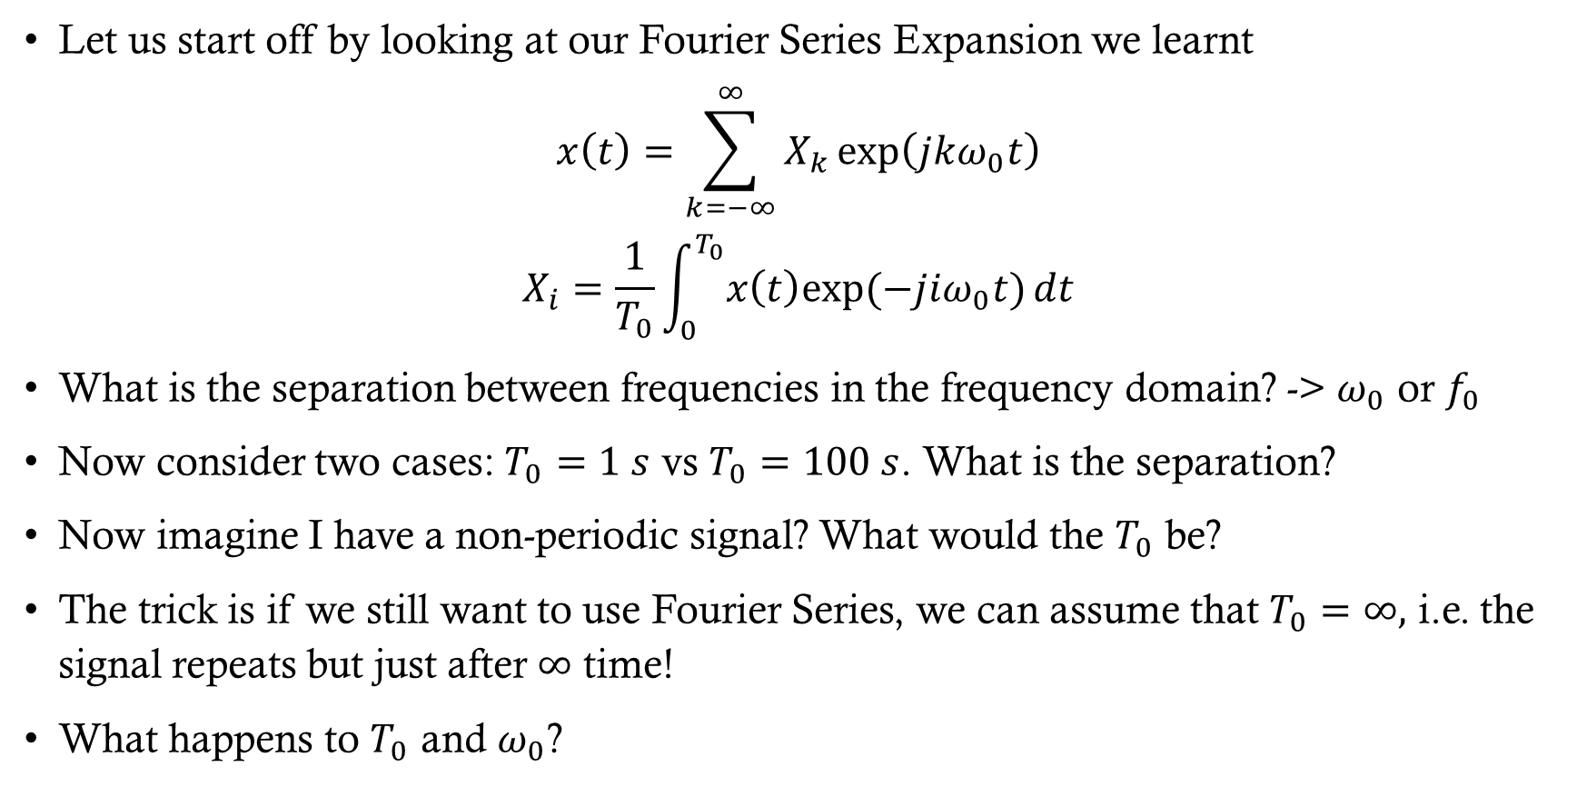
Fourier Transform
Let us start off by looking at our Fourier Series Expansion we learnt
$$x\left(t\right)=\sum_{k=−∞}^{∞}{X_{k}\exp\left(jkω_{0}t\right)}$$
$$X_{i}=\frac{1}{T_{0}}\int_{0}^{T_{0}}{x\left(t\right)exp⁡(−jiω_{0}t)}dt$$
What is the separation between frequencies in the frequency domain? -> $ω_{0}$ or $f_{0}$
Now consider two cases: $T_{0}=1 s$ vs $T_{0}=100 s$. What is the separation?
Now imagine I have a non-periodic signal? What would the $T_{0}$ be?
The trick is if we still want to use Fourier Series, we can assume that $T_{0}=∞,$ i.e. the signal repeats but just after $∞$ time!
What happens to $T_{0}$ and $ω_{0}$?

Slide 5
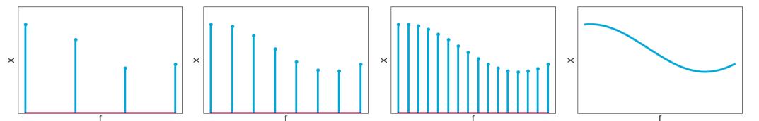
Fourier transform
Nonperiodic case!

Slide 6
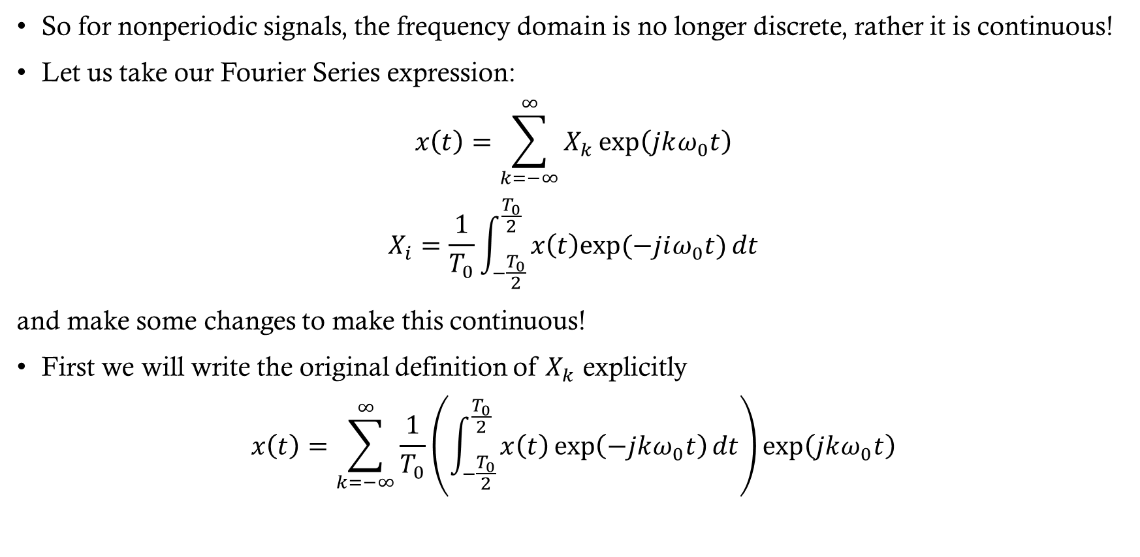
Fourier transform
So for nonperiodic signals, the frequency domain is no longer discrete, rather it is continuous!
Let us take our Fourier Series expression:
$$x\left(t\right)=\sum_{k=−∞}^{∞}{X_{k}\exp\left(jkω_{0}t\right)}$$
$$X_{i}=\frac{1}{T_{0}}\int_{−\frac{T_{0}}{2}}^{\frac{T_{0}}{2}}{x\left(t\right)exp⁡(−jiω_{0}t)}dt$$
and make some changes to make this continuous!
First we will write the original definition of $X_{k}$ explicitly
$$x\left(t\right)=\sum_{k=−∞}^{∞}{\frac{1}{T_{0}}\left(\int_{−\frac{T_{0}}{2}}^{\frac{T_{0}}{2}}{x\left(t\right)\exp\left(−jkω_{0}t\right)}dt\right)\exp\left(jkω_{0}t\right)}$$

Slide 7


Fourier transform
$$x\left(t\right)=\sum_{k=−∞}^{∞}{\frac{1}{T_{0}}\left(\int_{−\frac{T_{0}}{2}}^{\frac{T_{0}}{2}}{x\left(t\right)\exp\left(−jkω_{0}t\right)}dt\right)\exp\left(jkω_{0}t\right)}$$
Now let us make following changes:
$kω_{0}→ω=2πf$
$\frac{1}{T_{0}}=f_{0}\left(spacing\right)→df$
Inner integral limit $−T_{0}/2$ and $T_{0}/2$ $→$-$∞$ and $∞$
Summation over $k$s will become integral
$$x\left(t\right)=\int_{−∞}^{∞}{\left(\int_{−∞}^{∞}{x\left(t\right)\exp\left(−j2πft\right)}dt\right)\exp\left(j2πft\right)df }$$
$$x\left(t\right)=\int_{−∞}^{∞}{X_{f}\exp\left(j2πft\right)df }$$
$$X\left(f\right)=\int_{−∞}^{∞}{x\left(t\right)exp\left(−j2πft\right)dt }$$
$$X_{k}→ X(f)$$

Slide 8
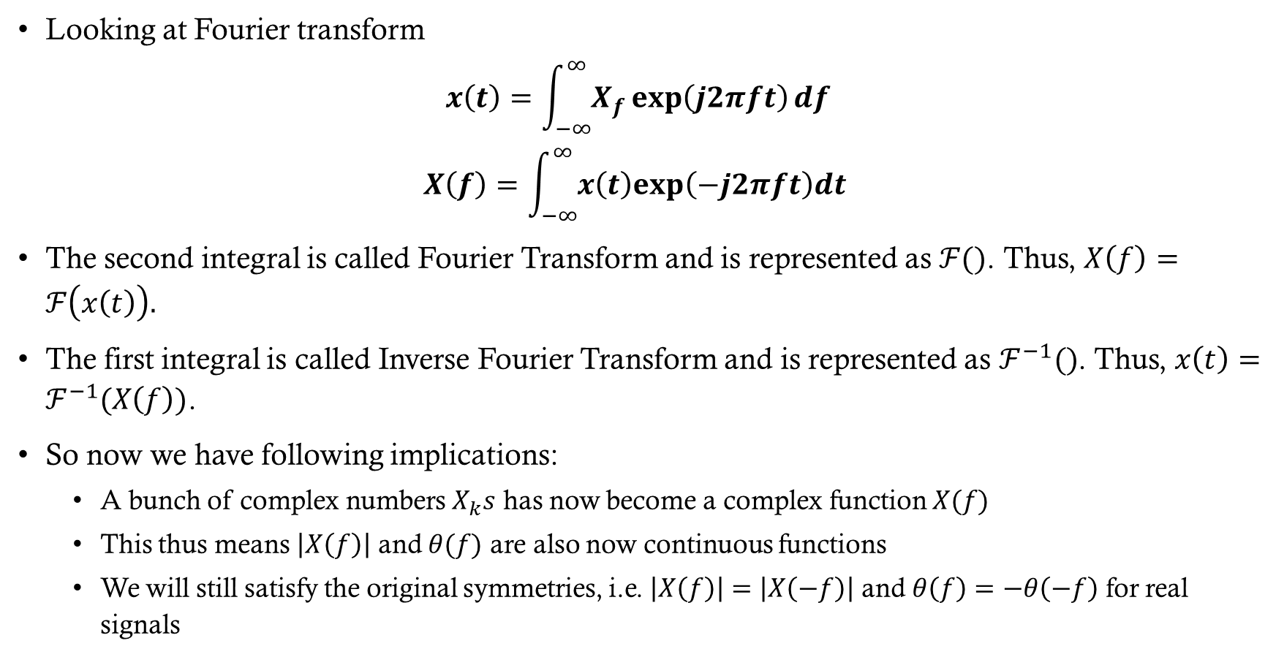
Fourier transform
Looking at Fourier transform
$$x\left(t\right)=\int_{−∞}^{∞}{X_{f}\exp\left(j2πft\right)df }$$
$$X\left(f\right)=\int_{−∞}^{∞}{x\left(t\right)exp\left(−j2πft\right)dt }$$
The second integral is called Fourier Transform and is represented as $ℱ()$. Thus, $X\left(f\right)=ℱ\left(x\left(t\right)\right).$
The first integral is called Inverse Fourier Transform and is represented as $ℱ^{−1}()$. Thus, $x\left(t\right)=ℱ^{−1}(X\left(f\right))$.
So now we have following implications:
A bunch of complex numbers $X_{k}s$ has now become a complex function $X(f)$
This thus means $\left|X\left(f\right)\right|$ and $θ(f)$ are also now continuous functions
We will still satisfy the original symmetries, i.e. $\left|X\left(f\right)\right|=\left|X\left(−f\right)\right|$ and $θ\left(f\right)=−θ\left(−f\right)$ for real signals

Slide 9
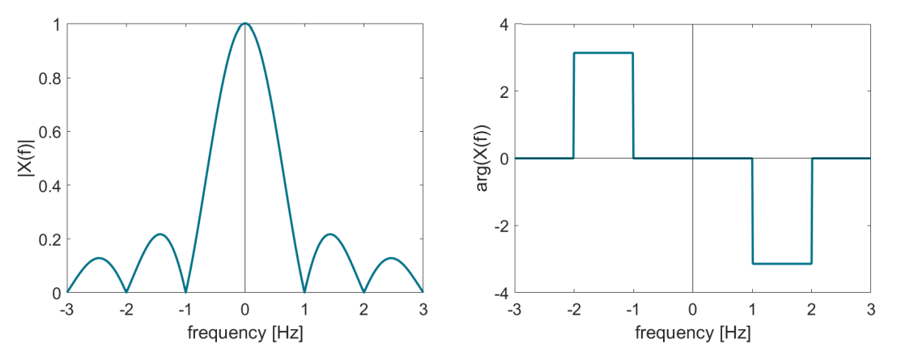
Fourier transform example
$$X\left(f\right)=\left|X\left(f\right)\right|\exp\left(jθ\left(f\right)\right)$$

Slide 10






Fourier transform example
Find the Fourier Transform of the following signal:
$X\left(f\right)=\int_{−\frac{τ}{2}}^{\frac{τ}{2}}{\exp\left(−j2πft\right)dt }=\frac{−1}{j2πf}\exp\left(−j2πft\right){\left.​\right|}_{−\frac{τ}{2}}^{\frac{τ}{2}}$
$X\left(f\right)=\frac{−1}{j2πf}\left(\exp\left(−\frac{j2πfτ}{2}\right)−\exp\left(\frac{j2πfτ}{2}\right)\right)=\frac{\sin\left(πfτ\right)}{πf}$
$X\left(f\right)=τsinc\left(τf\right)$
How do magnitude and phase of this function look?
$$x\left(t\right)$$
$$1$$
$$t$$
$$−\frac{τ}{2}$$
$$\frac{τ}{2}$$
Notes:
$sinc$(x) = sin(pi x)/ pi x

Slide 11
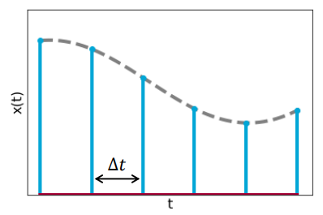
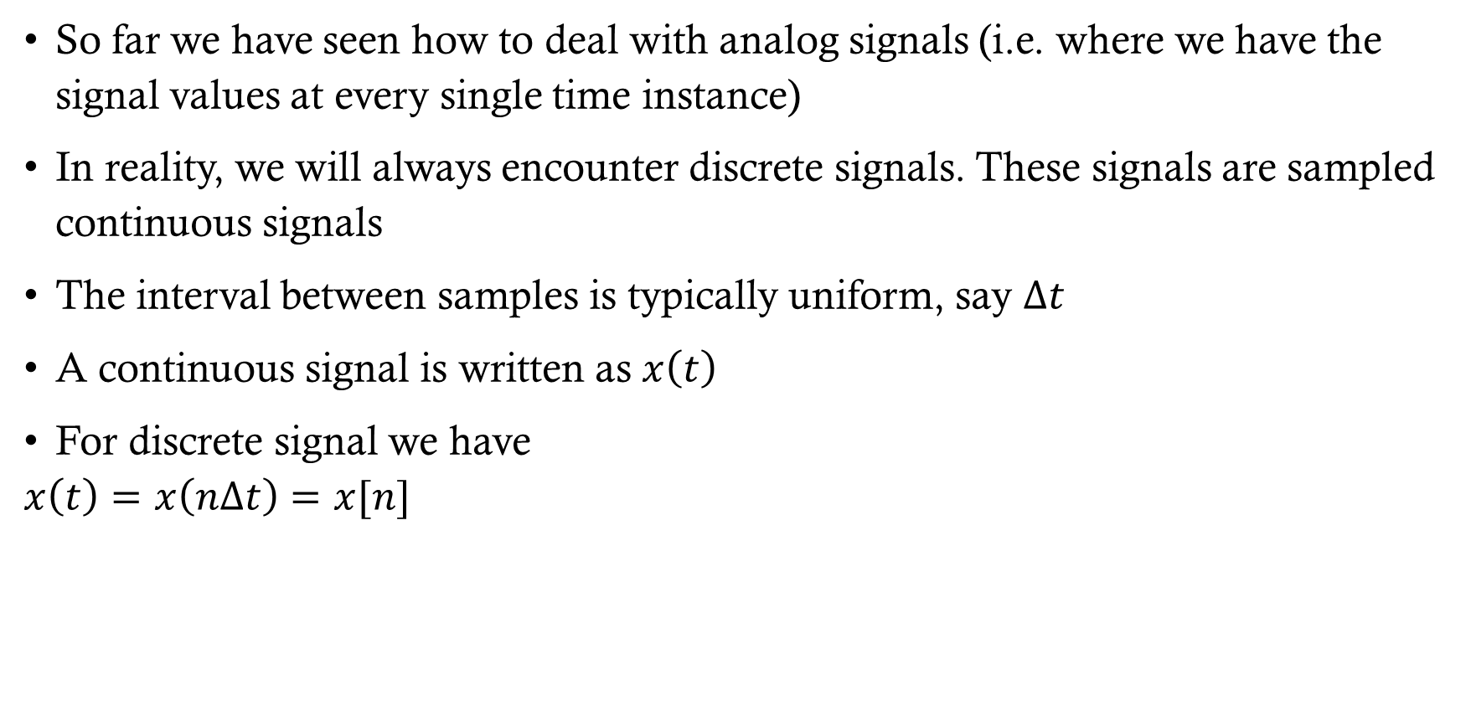
sampling
So far we have seen how to deal with analog signals (i.e. where we have the signal values at every single time instance)
In reality, we will always encounter discrete signals. These signals are sampled continuous signals
The interval between samples is typically uniform, say $Δt$
A continuous signal is written as $x\left(t\right)$
For discrete signal we have
$$x\left(t\right)=x\left(nΔt\right)=x[n]$$

Slide 12
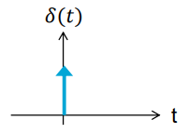
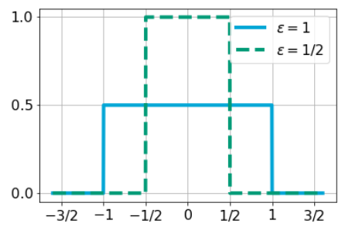
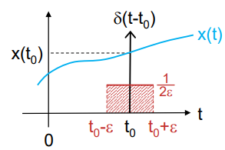
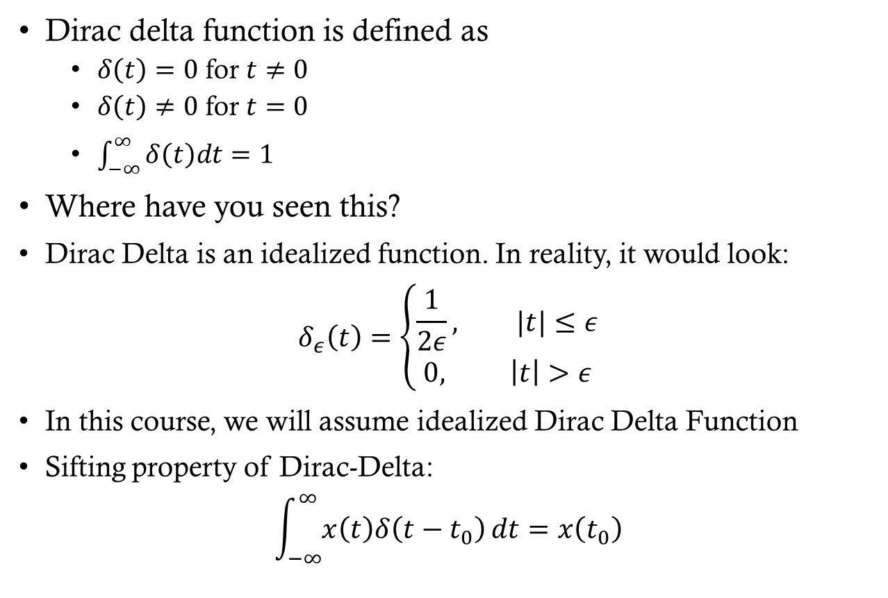
Dirac delta function
Dirac delta function is defined as
$δ\left(t\right)=0$ for $t≠0$
$δ\left(t\right)≠0$ for $t=0$
$\int_{−∞}^{∞}{δ\left(t\right)dt=1}$
Where have you seen this?
Dirac Delta is an idealized function. In reality, it would look:
$$δ_{ε}\left(t\right)=\left\{\begin{aligned}\frac{1}{2ε}, |t|≤ε \\ 0, \left|t\right|>ε\end{aligned}\right.$$
In this course, we will assume idealized Dirac Delta Function
Sifting property of Dirac-Delta:
$$\int_{−∞}^{∞}{x\left(t\right)δ\left(t−t_{0}\right)}dt=x\left(t_{0}\right)$$

Slide 13
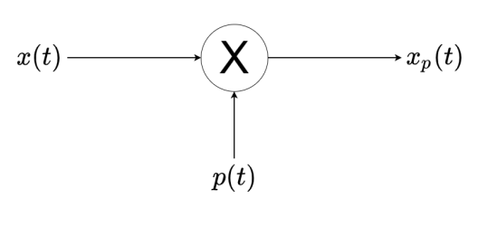
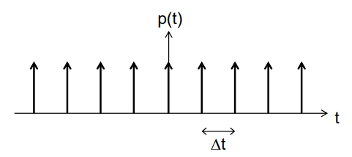
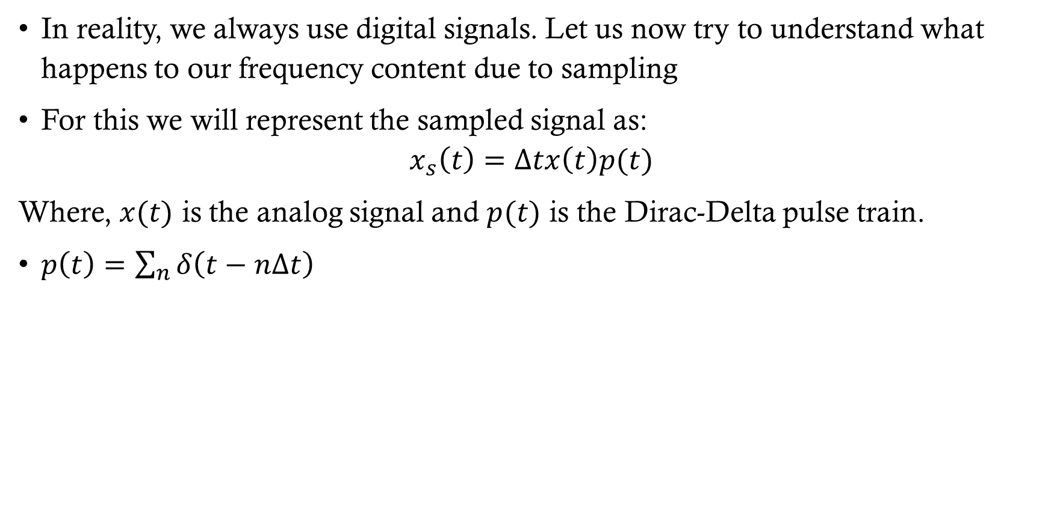
Analog to digital conversion
In reality, we always use digital signals. Let us now try to understand what happens to our frequency content due to sampling
For this we will represent the sampled signal as:
$$x_{s}\left(t\right)=Δtx\left(t\right)p(t)$$
Where, $x(t)$ is the analog signal and $p(t)$ is the Dirac-Delta pulse train.
$p\left(t\right)=\sum_{n}{δ\left(t−nΔt\right)}$

Slide 14
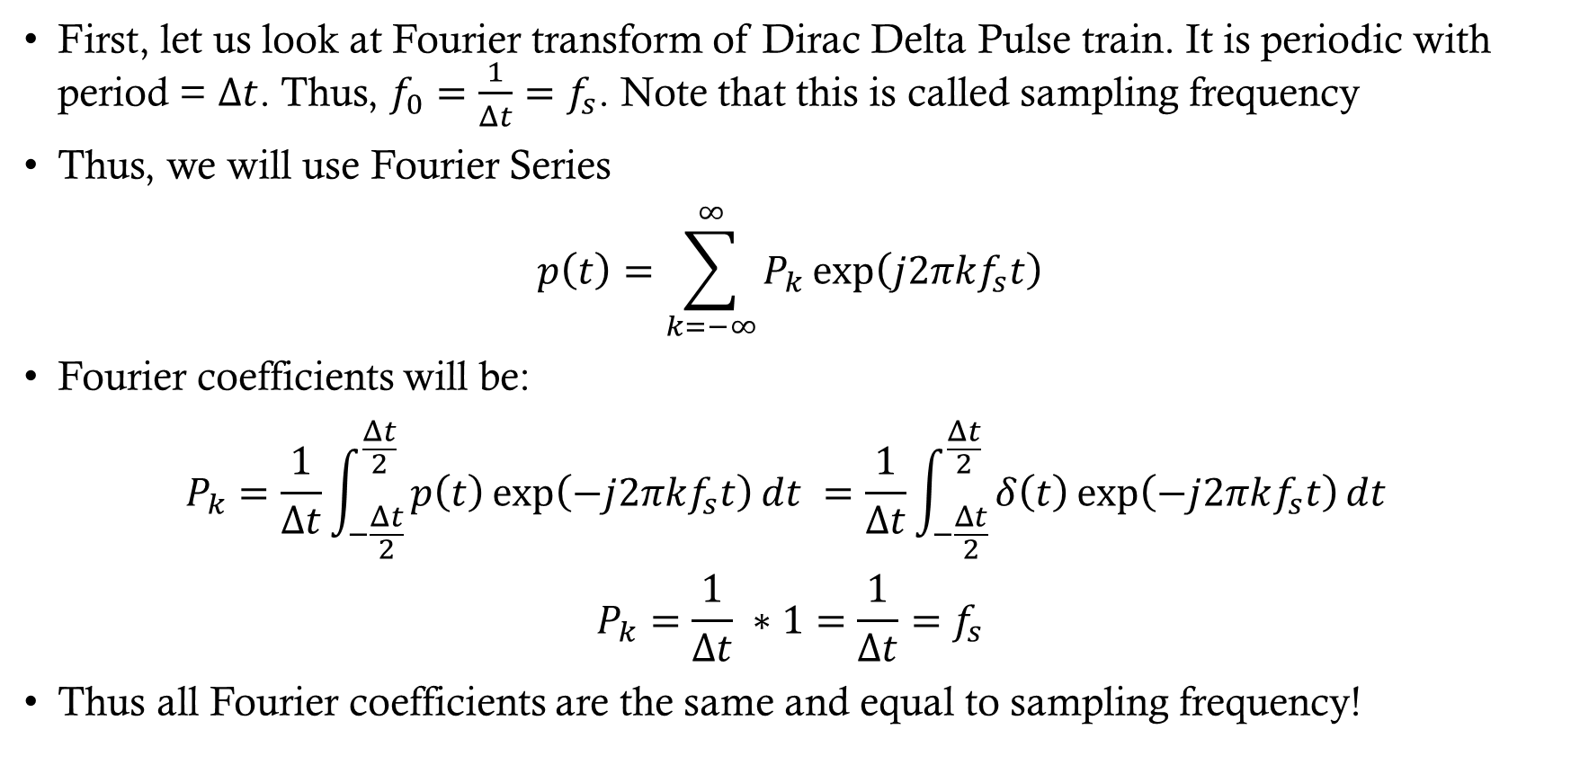
Fourier transform of sampled signal
First, let us look at Fourier transform of Dirac Delta Pulse train. It is periodic with period = $Δt$. Thus, $f_{0}=\frac{1}{Δt}=f_{s}$. Note that this is called sampling frequency
Thus, we will use Fourier Series
$$p\left(t\right)=\sum_{k=−∞}^{∞}{P_{k}\exp\left(j2πkf_{s}t\right)}$$
Fourier coefficients will be:
$$P_{k}=\frac{1}{Δt}\int_{−\frac{Δt}{2}}^{\frac{Δt}{2}}{p\left(t\right)\exp\left(−j2πkf_{s}t\right)dt }=\frac{1}{Δt}\int_{−\frac{Δt}{2}}^{\frac{Δt}{2}}{δ\left(t\right)\exp\left(−j2πkf_{s}t\right)dt }$$
$$P_{k}=\frac{1}{Δt} ∗1=\frac{1}{Δt}=f_{s}$$
Thus all Fourier coefficients are the same and equal to sampling frequency!

Slide 15
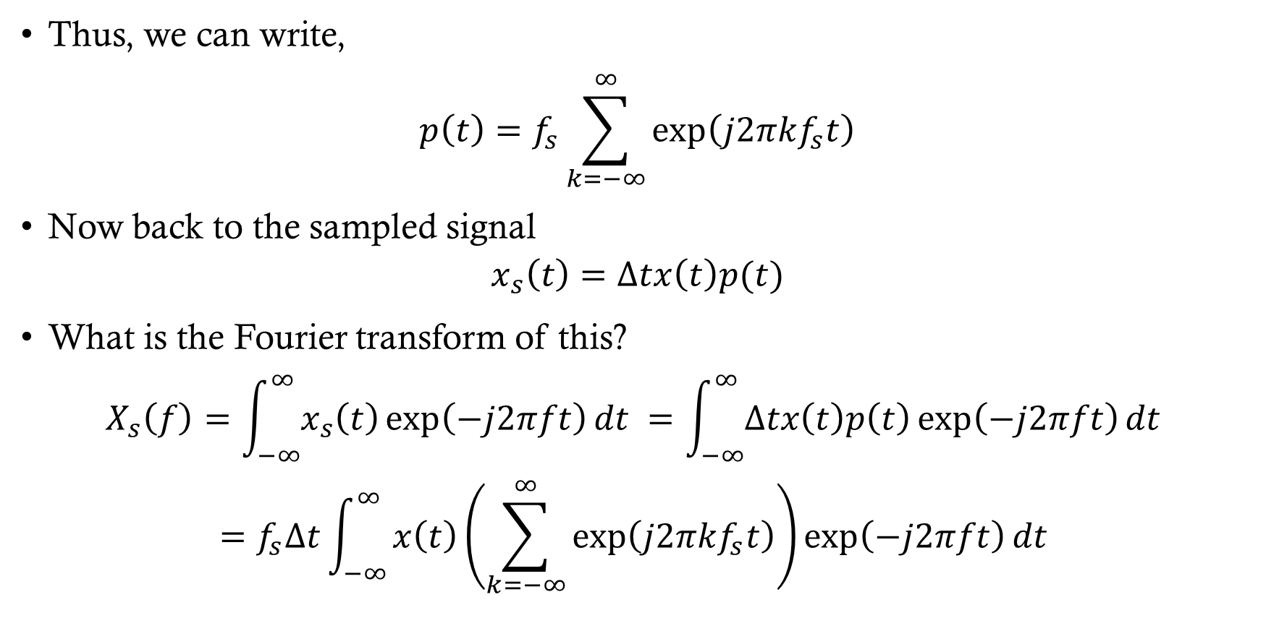
Fourier transform of sampled signal
Thus, we can write,
$$p\left(t\right)=f_{s}\sum_{k=−∞}^{∞}{\exp\left(j2πkf_{s}t\right)}$$
Now back to the sampled signal
$$x_{s}\left(t\right)=Δtx\left(t\right)p(t)$$
What is the Fourier transform of this?
$$X_{s}\left(f\right)=\int_{−∞}^{∞}{x_{s}\left(t\right)\exp\left(−j2πft\right)dt }=\int_{−∞}^{∞}{Δtx\left(t\right)p\left(t\right)\exp\left(−j2πft\right)dt }$$
$$=f_{s}Δt\int_{−∞}^{∞}{x\left(t\right)\left(\sum_{k=−∞}^{∞}{\exp\left(j2πkf_{s}t\right)}\right)\exp\left(−j2πft\right)dt }$$

Slide 16
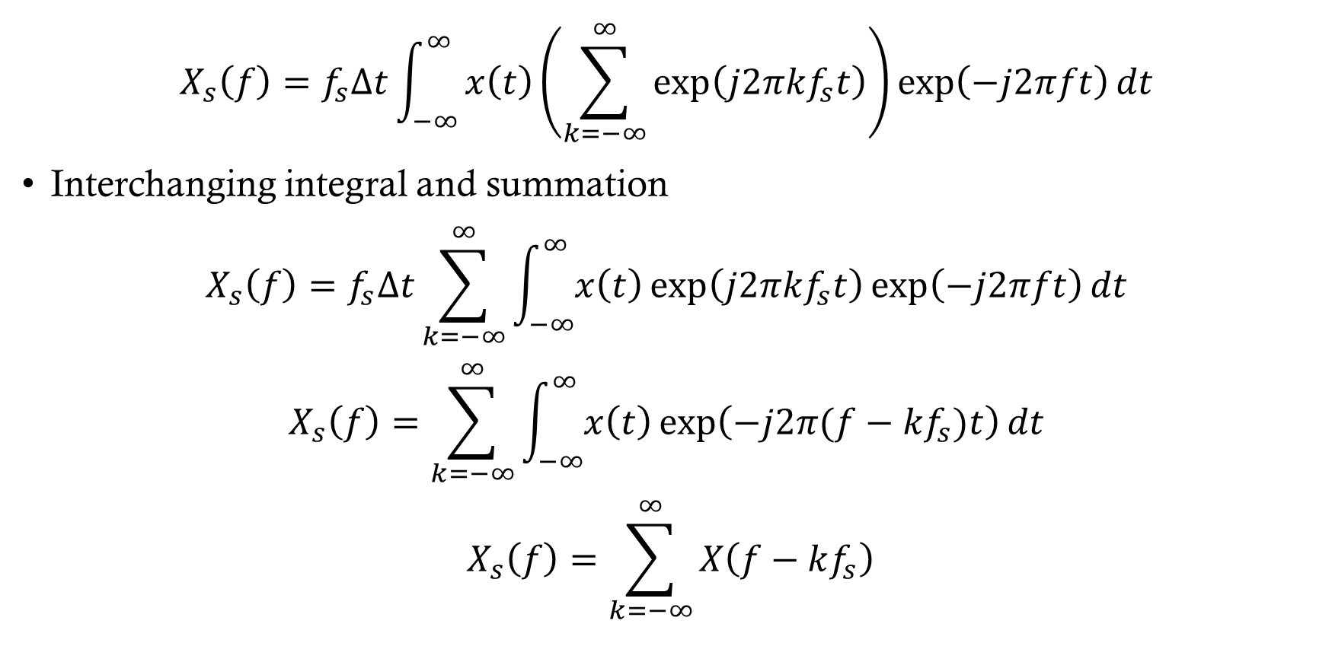
Fourier transform of sampled signal
$$X_{s}\left(f\right)=f_{s}Δt\int_{−∞}^{∞}{x\left(t\right)\left(\sum_{k=−∞}^{∞}{\exp\left(j2πkf_{s}t\right)}\right)\exp\left(−j2πft\right)dt }$$
Interchanging integral and summation
$$X_{s}\left(f\right)=f_{s}Δt\sum_{k=−∞}^{∞}{\int_{−∞}^{∞}{x\left(t\right)\exp\left(j2πkf_{s}t\right)\exp\left(−j2πft\right)dt }}$$
$$X_{s}\left(f\right)=\sum_{k=−∞}^{∞}{\int_{−∞}^{∞}{x\left(t\right)\exp\left(−j2π{(f−kf}_{s})t\right)dt }}$$
$$X_{s}\left(f\right)=\sum_{k=−∞}^{∞}{X\left(f−kf_{s}\right)}$$

Slide 17
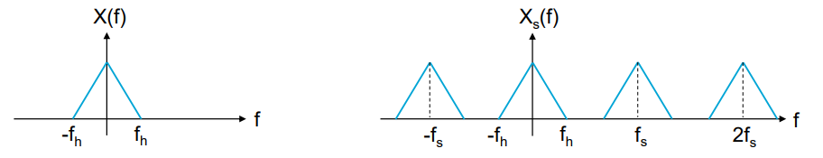
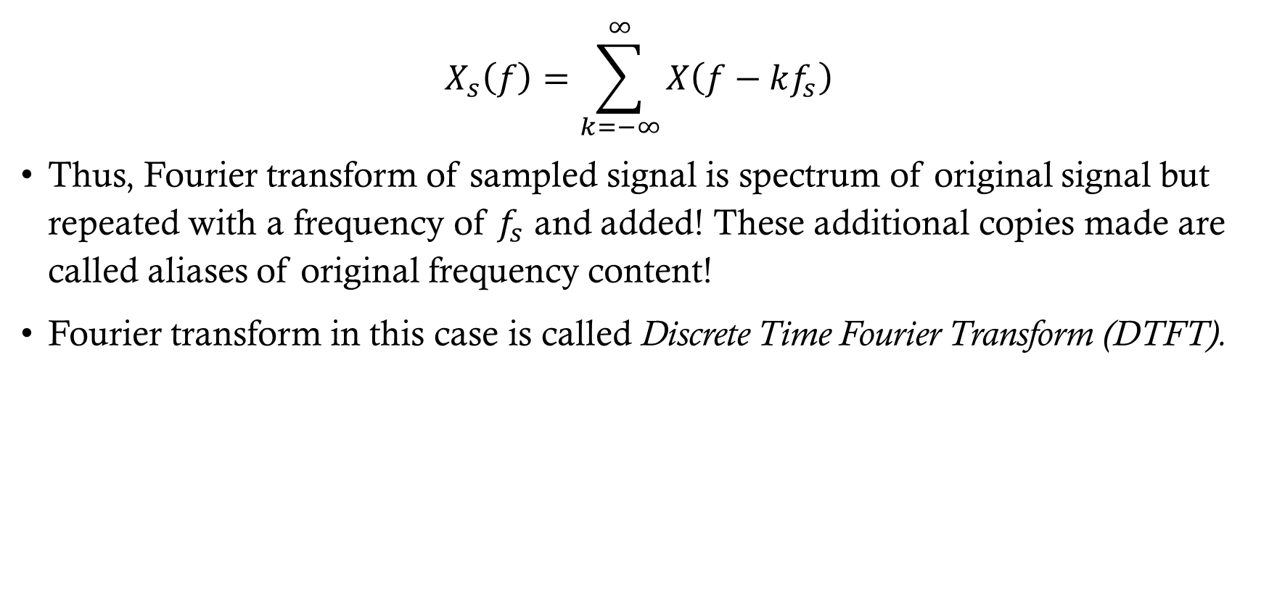
Fourier transform of sampled signal
$$X_{s}\left(f\right)=\sum_{k=−∞}^{∞}{X\left(f−kf_{s}\right)}$$
Thus, Fourier transform of sampled signal is spectrum of original signal but repeated with a frequency of $f_{s}$ and added! These additional copies made are called aliases of original frequency content!
Fourier transform in this case is called Discrete Time Fourier Transform (DTFT).

Slide 18





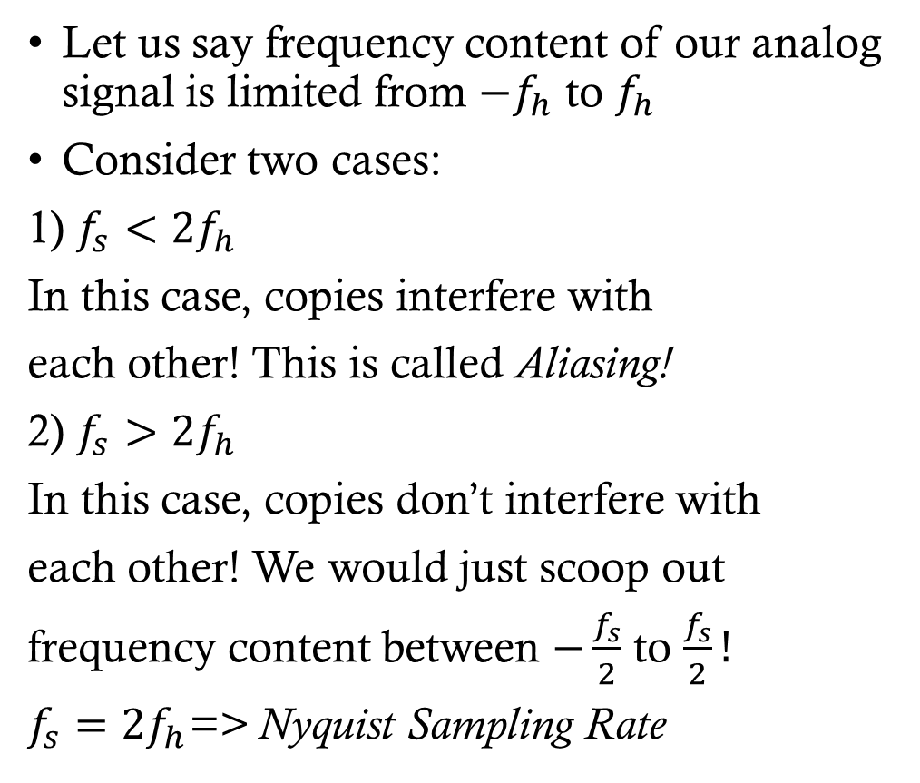









Sampling theory and aliasing
Let us say frequency content of our analog signal is limited from $−f_{h}$ to $f_{h}$
Consider two cases:
1) $f_{s}<2f_{h}$
In this case, copies interfere with
each other! This is called Aliasing!
2) $f_{s}>2f_{h}$
In this case, copies don’t interfere with
each other! We would just scoop out
frequency content between $−\frac{f_{s}}{2}$ to $\frac{f_{s}}{2}!$
$f_{s}=2f_{h}$=> Nyquist Sampling Rate
$$X_{s}(f)$$
$${−f}_{h}$$
$${−f}_{s}$$
$$f_{s}$$
$$f_{h}$$
$$f$$
$$X_{s}(f)$$
$$\frac{{−f}_{s}}{2}$$
$$\frac{f_{s}}{2}$$
$${−f}_{s}$$
$${−f}_{h}$$
$$f_{h}$$
$$f_{s}$$
$$f$$

Slide 19
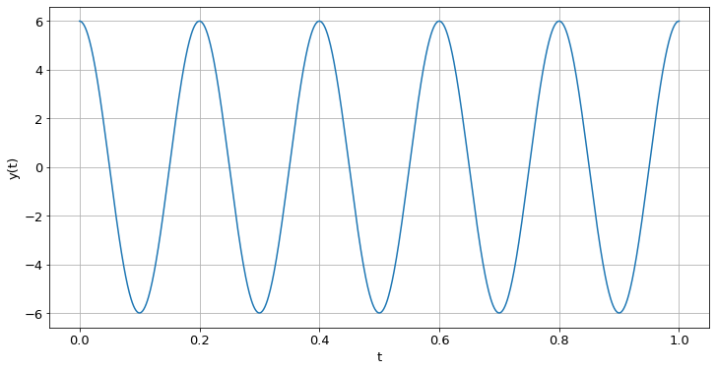
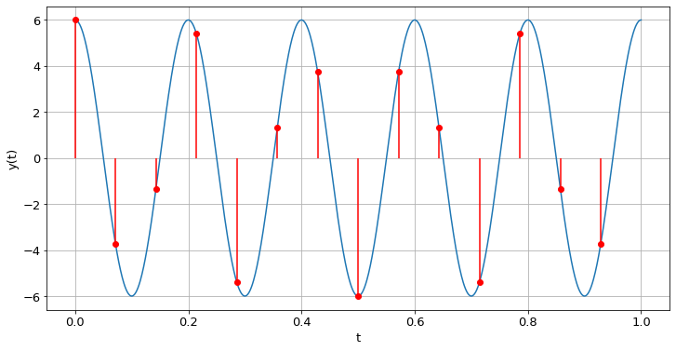
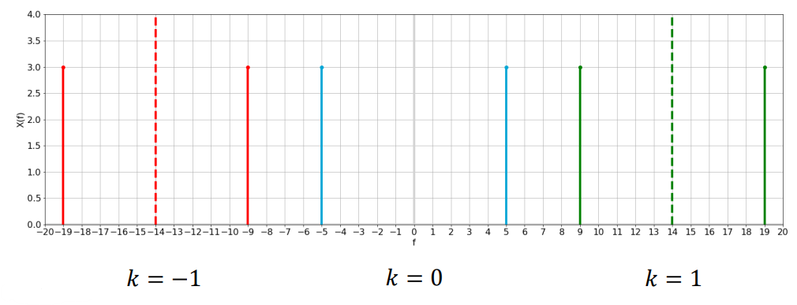

Aliasing example
$$f_{s}=14 Hz$$
Sampling rate > Nyquist Rate

Slide 20
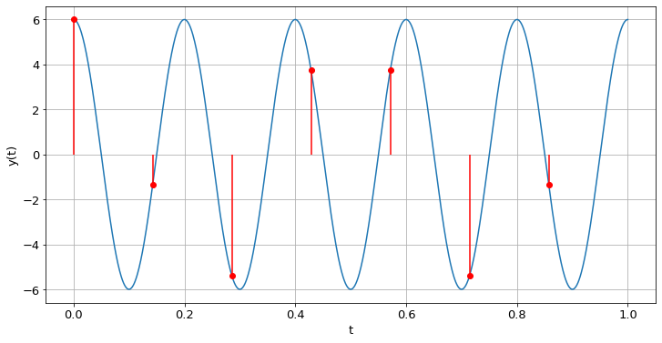
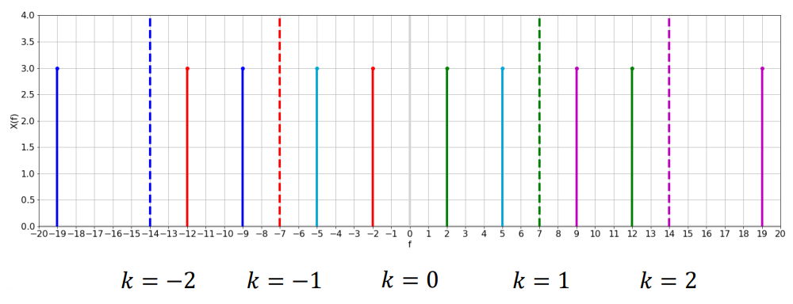
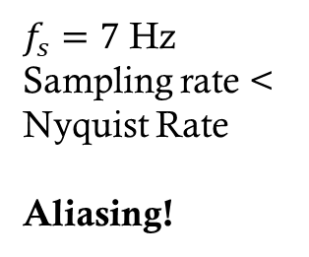
Aliasing example
$f_{s}=7$ Hz
Sampling rate < Nyquist Rate
Aliasing!
Notes:
Emphasize if you would have tried to fit a cosine here, you would have gotten

Slide 21
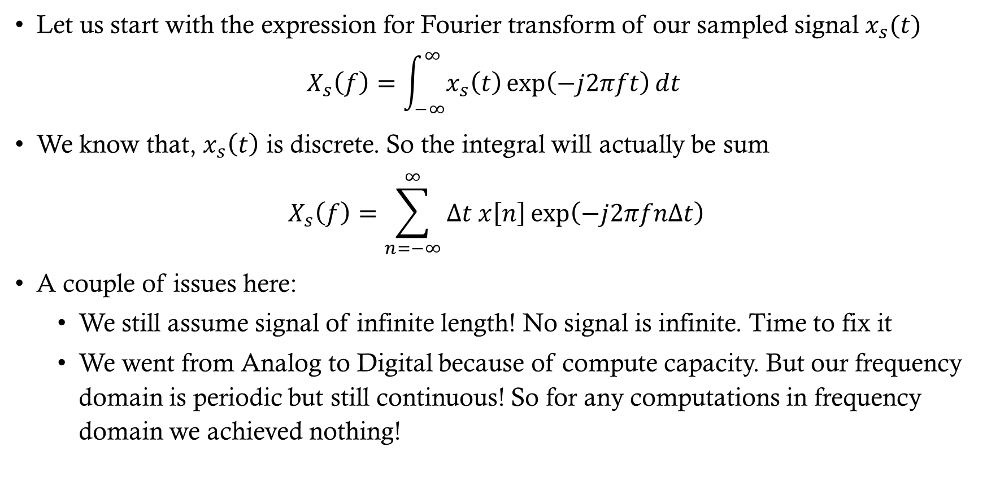
Discrete fourier transform
Let us start with the expression for Fourier transform of our sampled signal $x_{s}(t)$
$$X_{s}\left(f\right)=\int_{−∞}^{∞}{x_{s}\left(t\right)\exp\left(−j2πft\right)dt }$$
We know that, $x_{s}\left(t\right)$ is discrete. So the integral will actually be sum
$$X_{s}\left(f\right)=\sum_{n=−∞}^{∞}{Δt x\left[n\right]\exp\left(−j2πfnΔt\right)}$$
A couple of issues here:
We still assume signal of infinite length! No signal is infinite. Time to fix it
We went from Analog to Digital because of compute capacity. But our frequency domain is periodic but still continuous! So for any computations in frequency domain we achieved nothing!

Slide 22

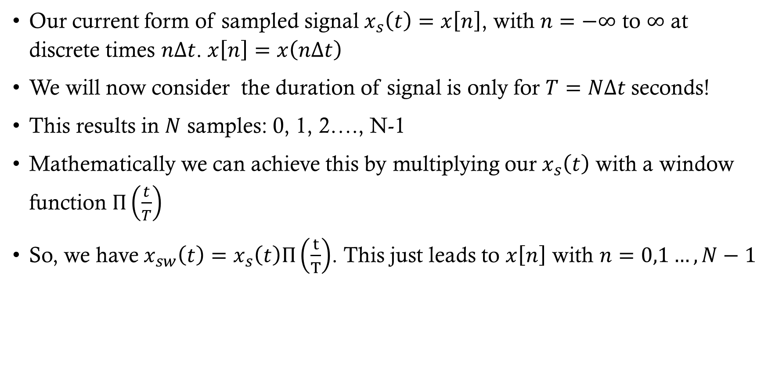

Action item 1
Our current form of sampled signal $x_{s}\left(t\right)=x\left[n\right]$, with $n=−∞$ to $∞$ at discrete times $nΔt$. $x\left[n\right]=x\left(nΔt\right)$
We will now consider the duration of signal is only for $T=NΔt$ seconds!
This results in $N$ samples: 0, 1, 2…., N-1
Mathematically we can achieve this by multiplying our $x_{s}\left(t\right)$ with a window function $Π\left(\frac{t}{T}\right)$
So, we have $x_{sw}\left(t\right)=x_{s}\left(t\right)Π\left(\frac{t}{T}\right)$. This just leads to $x\left[n\right]$ with $n=0,1…, N−1$
$$Π\left(\frac{t}{T}\right)$$
$$t$$

Slide 23
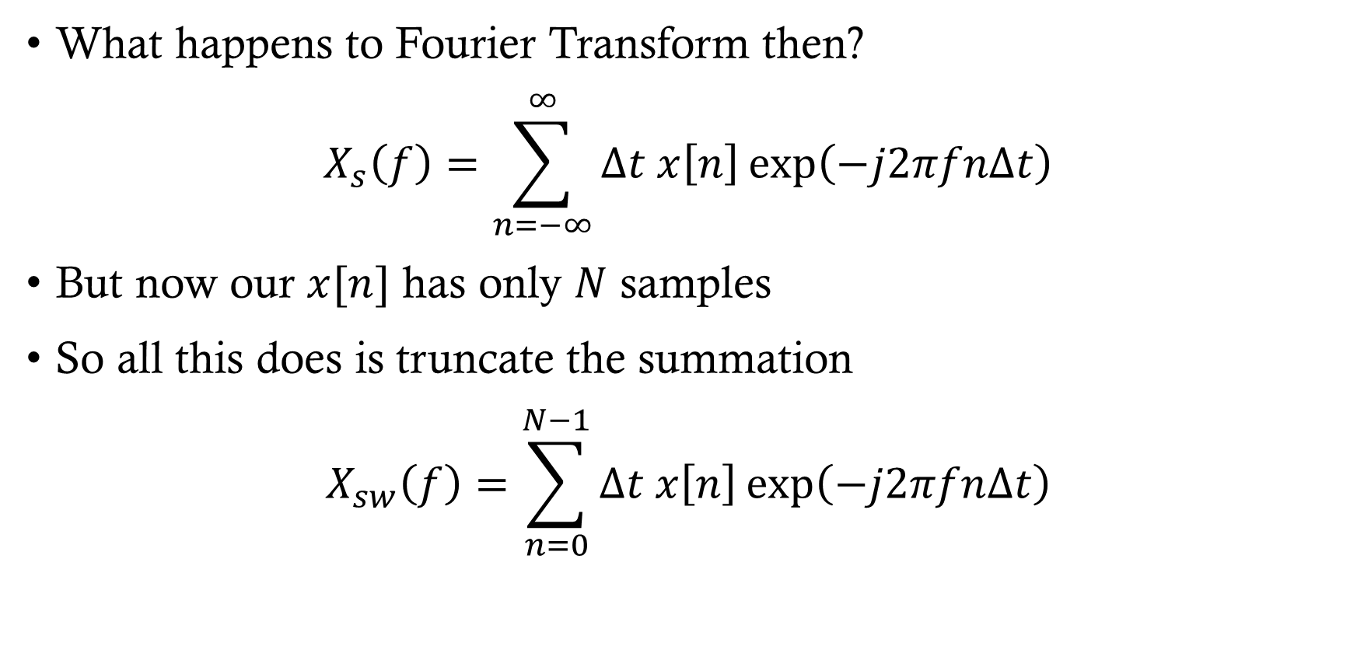
Action item 1
What happens to Fourier Transform then?
$$X_{s}\left(f\right)=\sum_{n=−∞}^{∞}{Δt x\left[n\right]\exp\left(−j2πfnΔt\right)}$$
But now our $x[n]$ has only $N$ samples
So all this does is truncate the summation
$$X_{sw}\left(f\right)=\sum_{n=0}^{N−1}{Δt x\left[n\right]\exp\left(−j2πfnΔt\right)}$$

Slide 24
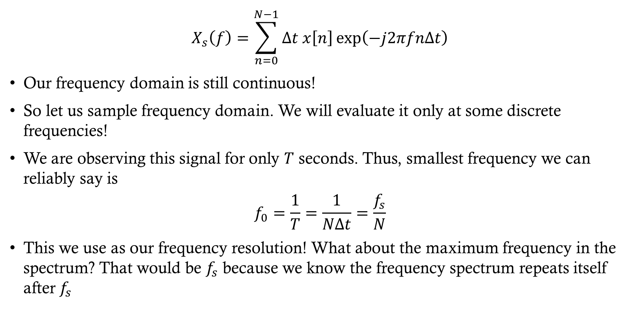
Action item 2
$$X_{s}\left(f\right)=\sum_{n=0}^{N−1}{Δt x\left[n\right]\exp\left(−j2πfnΔt\right)}$$
Our frequency domain is still continuous!
So let us sample frequency domain. We will evaluate it only at some discrete frequencies!
We are observing this signal for only $T$ seconds. Thus, smallest frequency we can reliably say is
$$f_{0}=\frac{1}{T}=\frac{1}{NΔt}=\frac{f_{s}}{N}$$
This we use as our frequency resolution! What about the maximum frequency in the spectrum? That would be $f_{s}$ because we know the frequency spectrum repeats itself after $f_{s}$

Slide 25
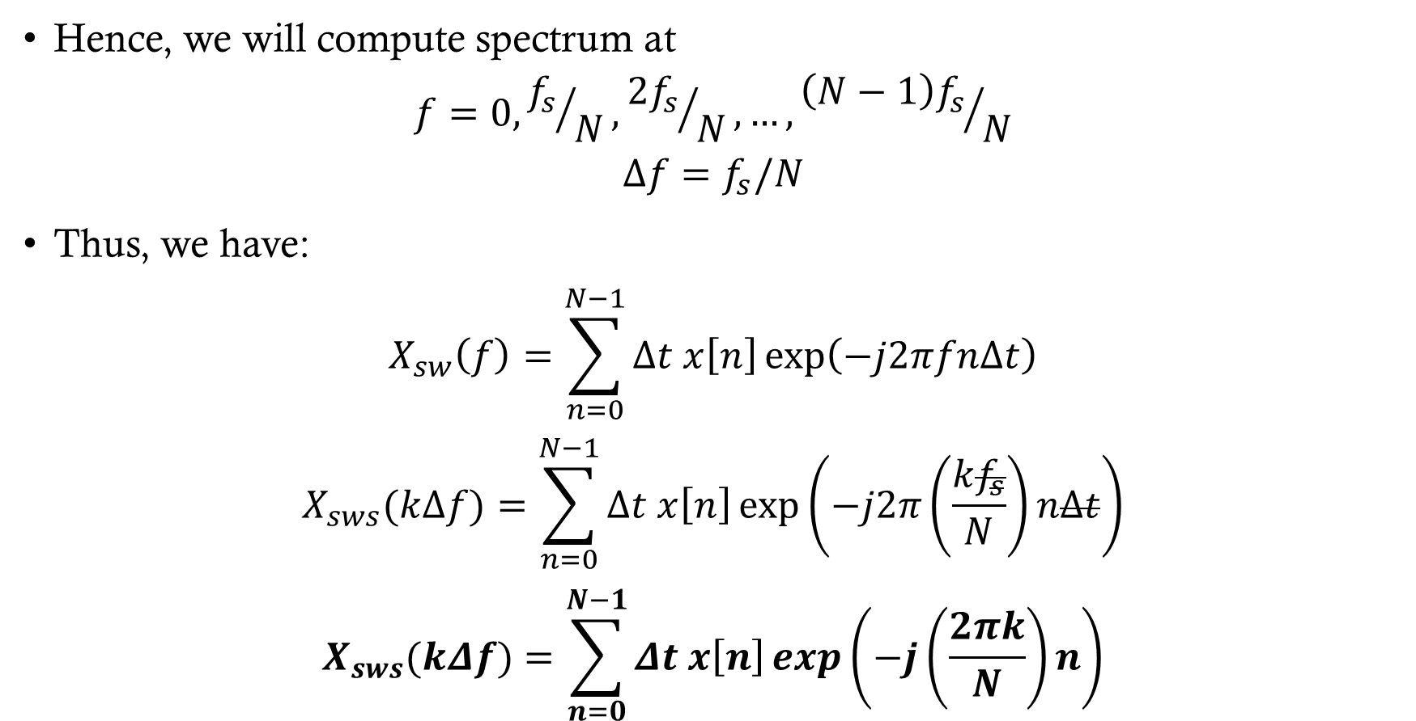
Action item 2
Hence, we will compute spectrum at
$$f=0, {f_{s}}/N, {2f_{s}}/N, …, {\left(N−1\right)f_{s}}/N$$
$$Δf=f_{s}/N$$
Thus, we have:
$$X_{sw}\left(f\right)=\sum_{n=0}^{N−1}{Δt x\left[n\right]\exp\left(−j2πfnΔt\right)}$$
$$X_{sws}(kΔf)=\sum_{n=0}^{N−1}{Δt x\left[n\right]\exp\left(−j2π\left(\frac{kf_{s}}{N}\right)nΔt\right)}$$
$$X_{sws}(kΔf)=\sum_{n=0}^{N−1}{Δt x\left[n\right]\exp\left(−j\left(\frac{2πk}{N}\right)n\right)}$$

Slide 26
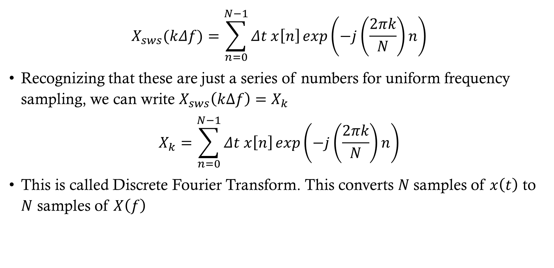
Discrete fourier transform
$$X_{sws}(kΔf)=\sum_{n=0}^{N−1}{Δt x\left[n\right]\exp\left(−j\left(\frac{2πk}{N}\right)n\right)}$$
Recognizing that these are just a series of numbers for uniform frequency sampling, we can write $X_{sws}\left(kΔf\right)=X_{k}$
$$X_{k}=\sum_{n=0}^{N−1}{Δt x\left[n\right]\exp\left(−j\left(\frac{2πk}{N}\right)n\right)}$$
This is called Discrete Fourier Transform. This converts $N$samples of $x\left(t\right)$ to $N$ samples of $X\left(f\right)$

Slide 27
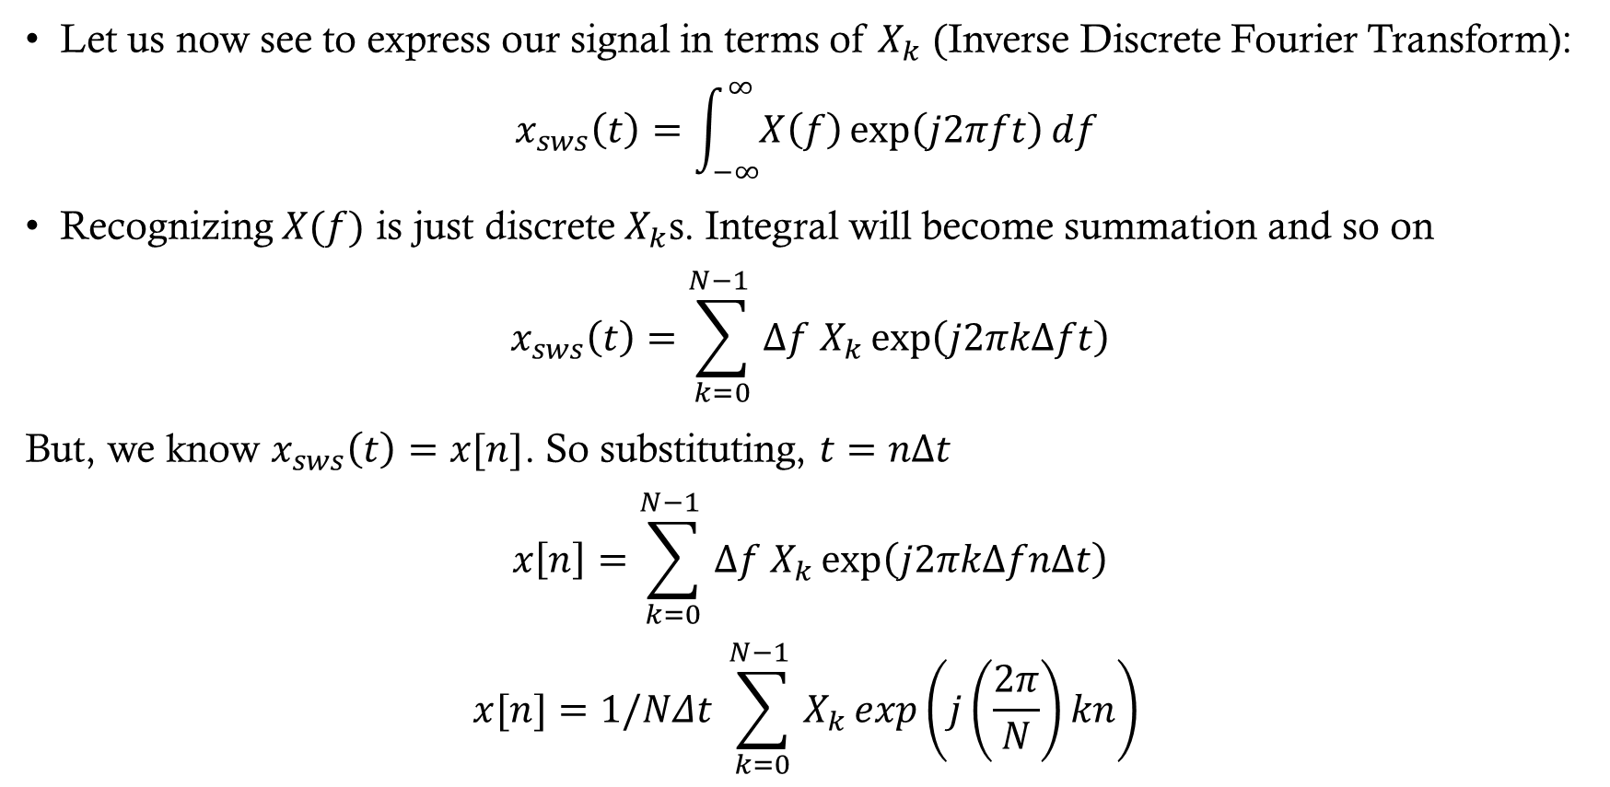
Inverse discrete fourier transform
Let us now see to express our signal in terms of $X_{k} ($Inverse Discrete Fourier Transform):
$$x_{sws}\left(t\right)=\int_{−∞}^{∞}{X\left(f\right)\exp\left(j2πft\right)df }$$
Recognizing $X(f)$ is just discrete $X_{k}$s. Integral will become summation and so on
$$x_{sws}\left(t\right)=\sum_{k=0}^{N−1 }{Δf X_{k}}\exp\left(j2πkΔft\right)$$
But, we know $x_{sws}\left(t\right)=x[n]$. So substituting, $t=nΔt$
$$x\left[n\right]=\sum_{k=0}^{N−1 }{Δf X_{k}}\exp\left(j2πkΔfnΔt\right)$$
$$x[n]=1/NΔt \sum_{k=0}^{N−1 }{X_{k}}\exp\left(j\left(\frac{2π}{N}\right)kn\right)$$

Slide 28
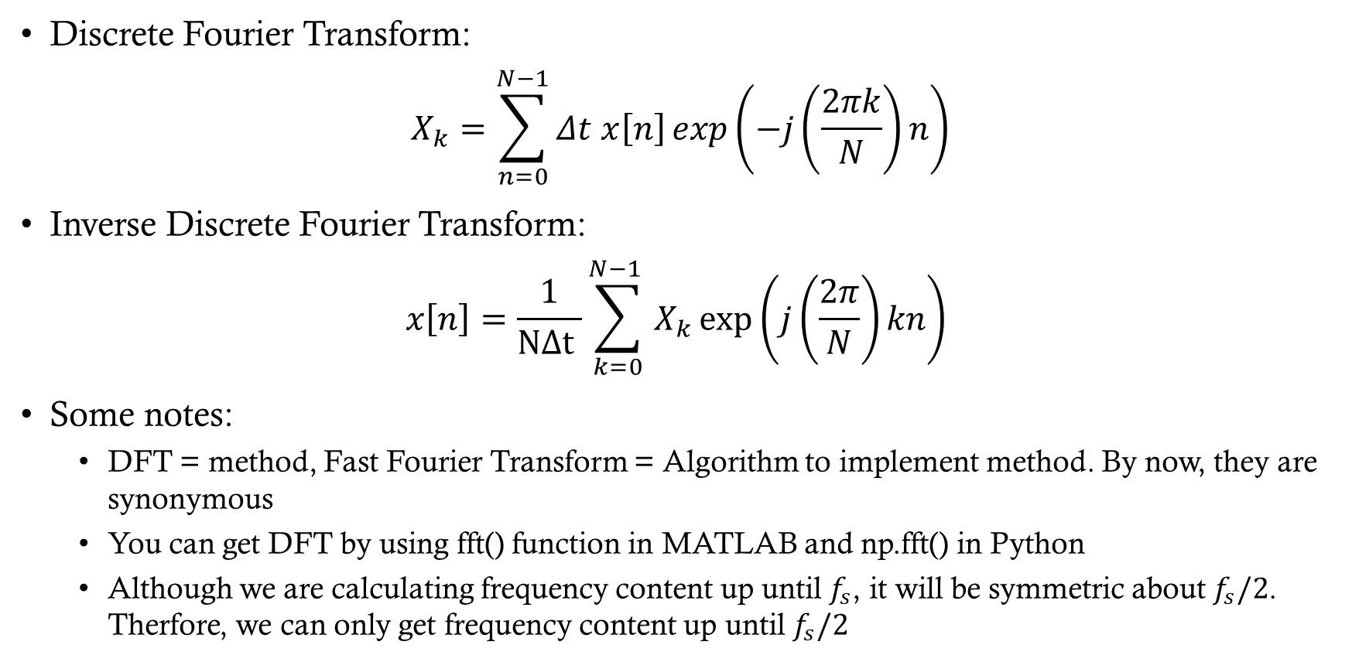
Discrete fourier transform
Discrete Fourier Transform:
$$X_{k}=\sum_{n=0}^{N−1}{Δt x\left[n\right]\exp\left(−j\left(\frac{2πk}{N}\right)n\right)}$$
Inverse Discrete Fourier Transform:
$$x\left[n\right]=\frac{1}{NΔt }\sum_{k=0}^{N−1 }{X_{k}}\exp\left(j\left(\frac{2π}{N}\right)kn\right)$$
Some notes:
DFT = method, Fast Fourier Transform = Algorithm to implement method. By now, they are synonymous
You can get DFT by using fft() function in MATLAB and np.fft() in Python
Although we are calculating frequency content up until $f_{s}$, it will be symmetric about $f_{s}/2$. Therfore, we can only get frequency content up until $f_{s}/2$

Slide 29


DTFT to DFT
Transform: | Time Domain | Frequency Domain
DTFT | Sampled Infinite Length | Continuous Periodic
DFT | Sampled Finite Length | Sampled Periodic
$$X_{s}(f)$$
$$\frac{f_{s}}{2}$$
$$\frac{{−f}_{s}}{2}$$
$$DTFT$$
$$DFT$$
$${−f}_{s}$$
$${−f}_{h}$$
$$f_{h}$$
$$f_{s}$$
$$f$$

