Slide 1
Project name : Advanced Calculator organization : nexthikeitsolution By pooja sonwane

Slide 2
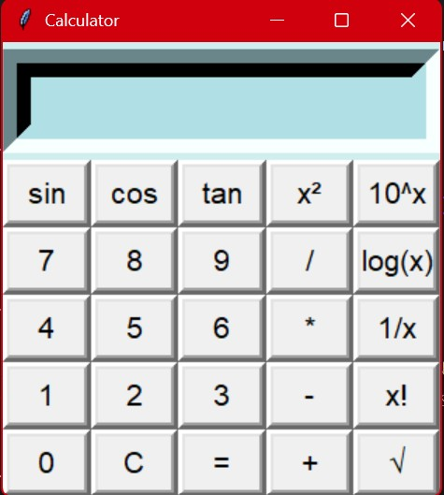
Features of calculator :
This calculator is designed for performing basic as well as complex mathematical calculations
Basic Arithmetic operations
Trigonometry functions
Logarithmic functions
Advanced functions
Error handling
Display

Slide 3
What technologies used ?
Language :python
Library: Tkinter
Code editor's code
Github link : https://github.com/Pooja0369/Calculator.git

Slide 4
Challenges Faced :
Input validation
Error handling(e.g divide by zero)
Desingning a user friendly interface

Slide 5
REFERENCES :
https://medium.com/@nishithakalathil/crafting-dynamic-user-interfaces-with-tkinter-0824ba5f051b

Slide 6
Thank you …

