Slide 1
Mobile Price Prediction Project
Using Multiple Machine Learning Models

Slide 2
Project Name :
Feature Extraction and Price Prediction for Mobile Phones Organization : NexthikeItsolution Projected By : Pooja Sonwane

Slide 3
Problem Statement :
The goal is to predict the price of a mobile phone based on its features such as Processor, camera quality, battery, etc.

Slide 4
Dataset Description :
Features include:
Model, Memory, RAM, Battery, Rear Camera, Front Camera, AI Lens, Mobile Height, Processor_Unisoc T606 etc.
Target Variable: Price
Dataset Size: 541+ entries

Slide 5
Data Preprocessing :
Handling Missing Values
Label Encoding / One-Hot Encoding
Normalization / Standardization
Splitting into Train-Test Sets

Slide 6
Feature Engineering:
Created new features:
Price per GB RAM
Screen Area (height x width)
Battery to Weight Ratio

Slide 7
Machine Learning Models Used:
Linear Regression
Decision Tree Regressor
Random Forest Regressor
Gradient Boosting Regressor

Slide 8
Model Evaluation Metrics :
MAE: Mean Absolute Error
MSE: Mean Squared Error
RMSE: Root Mean Squared Error
R² Score

Slide 9
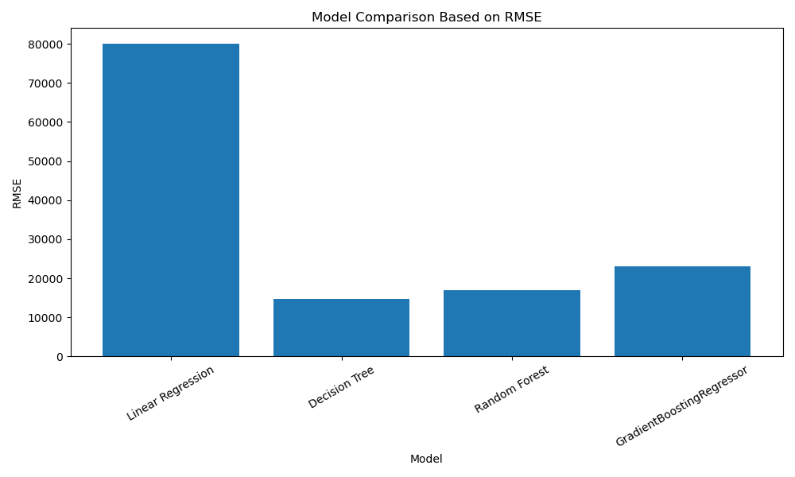
Model Comparison Chart (RMSE)
The Random Forest and Gradient Boosting performed the best in terms of RMSE.

Slide 10
Conclusion & Recommendation :
Gredient Boost and Random Forest are the most accurate models.
Recommend using Random Forest for deployment due to high accuracy and scalability.
Further improvements Hyperparameter tuning, advanced ensemble models

Slide 11
Thank you…!!!

