Slide 1
LVV Portal Guideline - GFAB6
Suraj Pardule Udhay R Prashant Tripathi
March 2026

Slide 2
Agenda
LVV Portal Overview
Interface Down Issue
LLDP Mismatch Error
Interface Optics Issue
Interface FEC-BER Error
Power Supply Down Issue

Slide 3
LLV Portal Overview

Slide 4
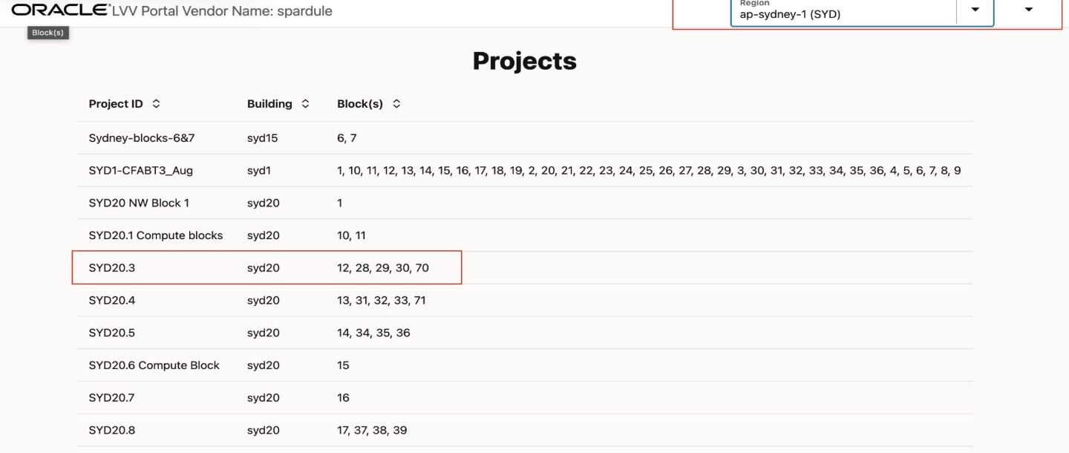
LVV Portal Overview LVV Portal Link - https://lvv.us-phoenix-1.oci.oraclecloud.com/ 1. Select the expected region Example: (ap-sydney-a(SYD)) 2. Select the building and DataHall Example: (SYD20.3)

Slide 5
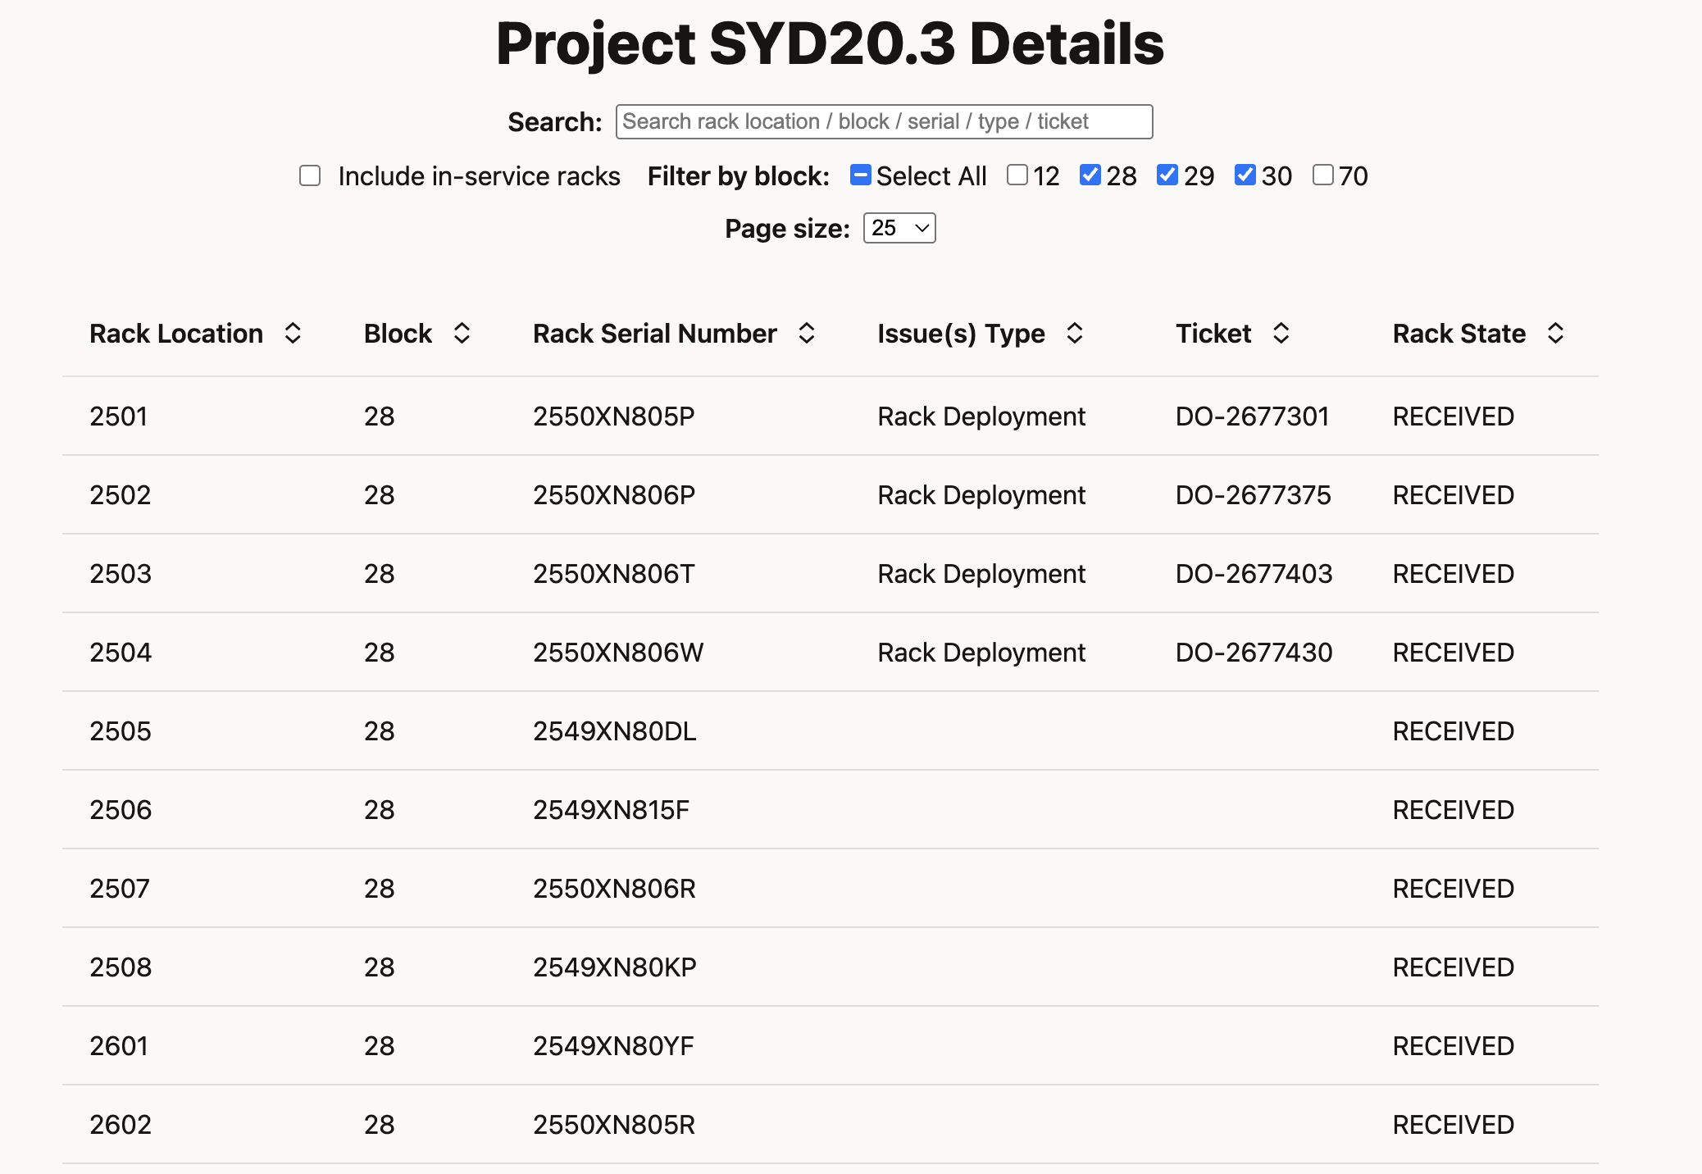
LVV Portal Overview 1. Select the expected Blocks OR search for the Rack number 2. Select the Rack from list

Slide 6
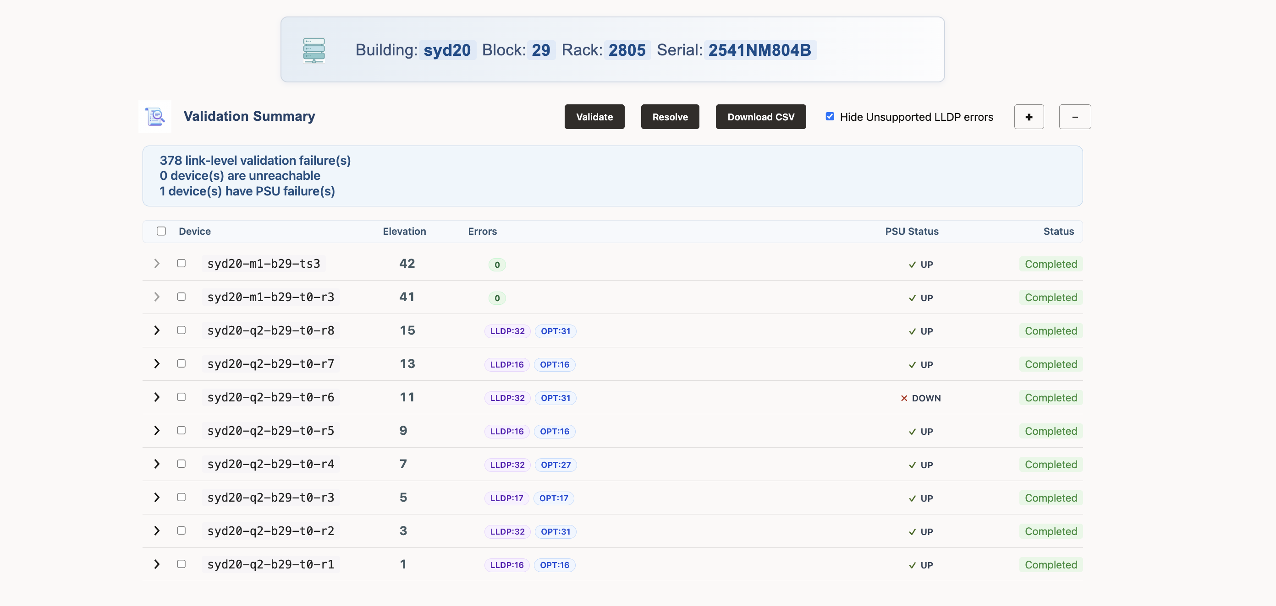
LVV Portal Overview

Slide 7
Interface Down issues

Slide 8
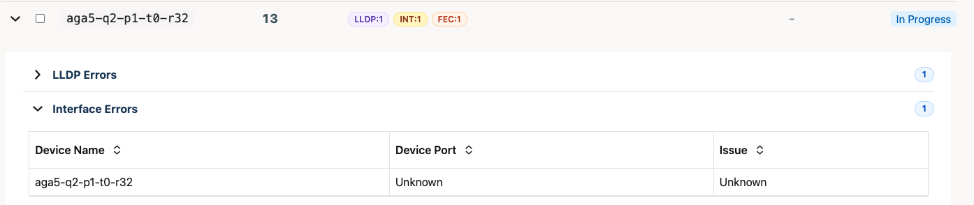
Interface down issue

Slide 9
Steps to be performed to resolve this error.
Verify Physical Connection
Inspect the physical connectivity and ensure the following:
Confirm that the fiber or copper cable is properly connected.
Ensure the correct ports are patched as per the design.
Verify the TX ↔ RX polarity for fiber connections.
Inspect and clean fiber connectors
Inspect and clean optical transceiver
If required:
Reseat the cable to ensure a proper connection.
Replace the cable with a spare to rule out any cable-related issues.

Slide 10
Steps to be performed to resolve this error.
Check Optics (SFP/QSFP)
Verify the status of the optic module and check for:
Optic presence
Temperature alarms
RX/TX optical power levels
Inspect and clean fiber connectors
Inspect and clean optical transceiver
If necessary: Inspect and clean optical transceiver
Reseat the optic module.
Replace it with a spare optic to eliminate potential hardware issues.
Escalation Metric: Even after LVV has completed all troubleshooting steps, if the issue still persists, please reach out to the CNE-AI2ND team for further investigation from the switch side.

Slide 11
LLDP Mismatch Error

Slide 12
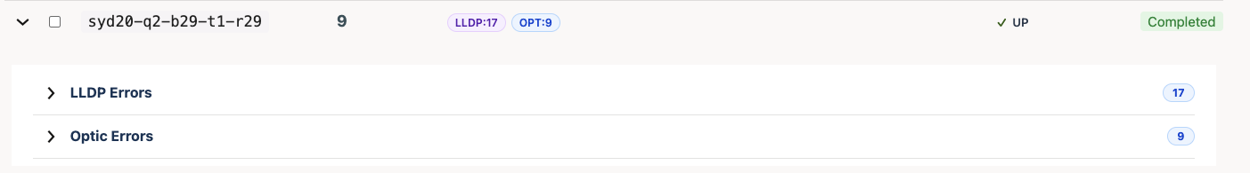
LLDP Mismatch Error
Expand the tab to view error
Choose LLDP

Slide 13
LLDP Mismatch Error
1
2
3
4
5
6
7
8
9
10
Device A Rack: Rack number and elevation of the source device.
Device A Name: Name of the source device.
Device A Port: Port on the source device.
Device B Rack: Rack number and elevation of the device currently connected.
Device B Name: Name of the device currently connected.
Device B Port: Port of the device currently connected.
Expected Device B Rack: Rack number and elevation of the device that should be connected.
Expected Device B Name: Name of the device that is expected to be connected.
Expected Device B Port: Port that should be connected according to the design.

Slide 14
LLDP Mismatch issue
Steps to be performed to resolve this error.
If the Link Status shows “Mismatch”, it means the source device port is connected to a different device than specified in the design / cutsheet.
Connect the interface to the “Expected Device” as shown in the portal.
Check for physical layer issues:
Correct fiber patching
Proper optic insertion
Fiber TX/RX polarity
No damaged cable
Escalation Metric: Even after LVV has completed all troubleshooting steps, if the issue still persists, please reach out to the CNE-AI2ND team for further investigation from the switch side.

Slide 15
Interface Optic error

Slide 16
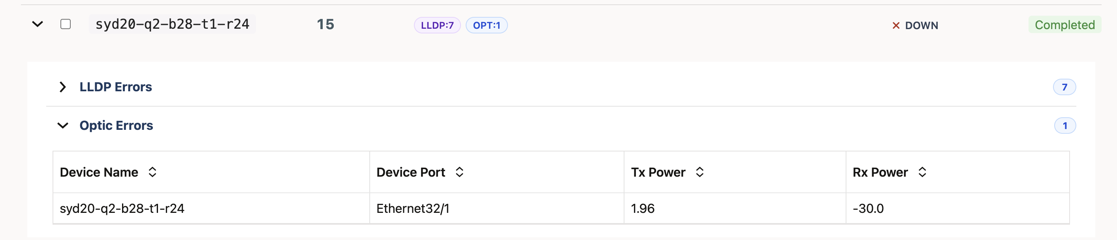
Interface Optic issues
Expand the tab to veiw error

Slide 17
Steps to be performed to resolve this error.
Inspect Fiber Cable
Check the physical fiber connection and ensure the following:
Confirm that the fiber cable is properly connected.
Verify the correct patching between the devices.
Check the TX ↔ RX polarity of the fiber.
Inspect and clean fiber connectors
Inspect and clean optical transceiver
If required:
Reseat the fiber cable to ensure a proper connection.
Replace it with a spare fiber cable to rule out any cable-related issues.
Clean Fiber Connectors
Dirty fiber connectors are a common cause of optical power issues.
Inspect the fiber ends for dust or contamination.
Clean the connectors using appropriate fiber cleaning tools.
Reconnect the fiber and test the link again.

Slide 18
Steps to be performed to resolve this error.
Verify Optic Modules
Check the health of the optic module and look for:
Temperature alarms
Voltage warnings
Laser faults
Inspect and clean fiber connectors
Inspect and clean optical transceiver
If necessary:
Reseat the optic module to ensure proper seating.
Replace it with a spare optic module to eliminate potential hardware issues.
Escalation Metric: Even after LVV has completed all troubleshooting steps, if the issue still persists, please reach out to the CNE-AI2ND team for further investigation from the switch side. Reference Document - Suspected Bad Optical Side RX Power

Slide 19
Interface FEC-BER Error

Slide 20
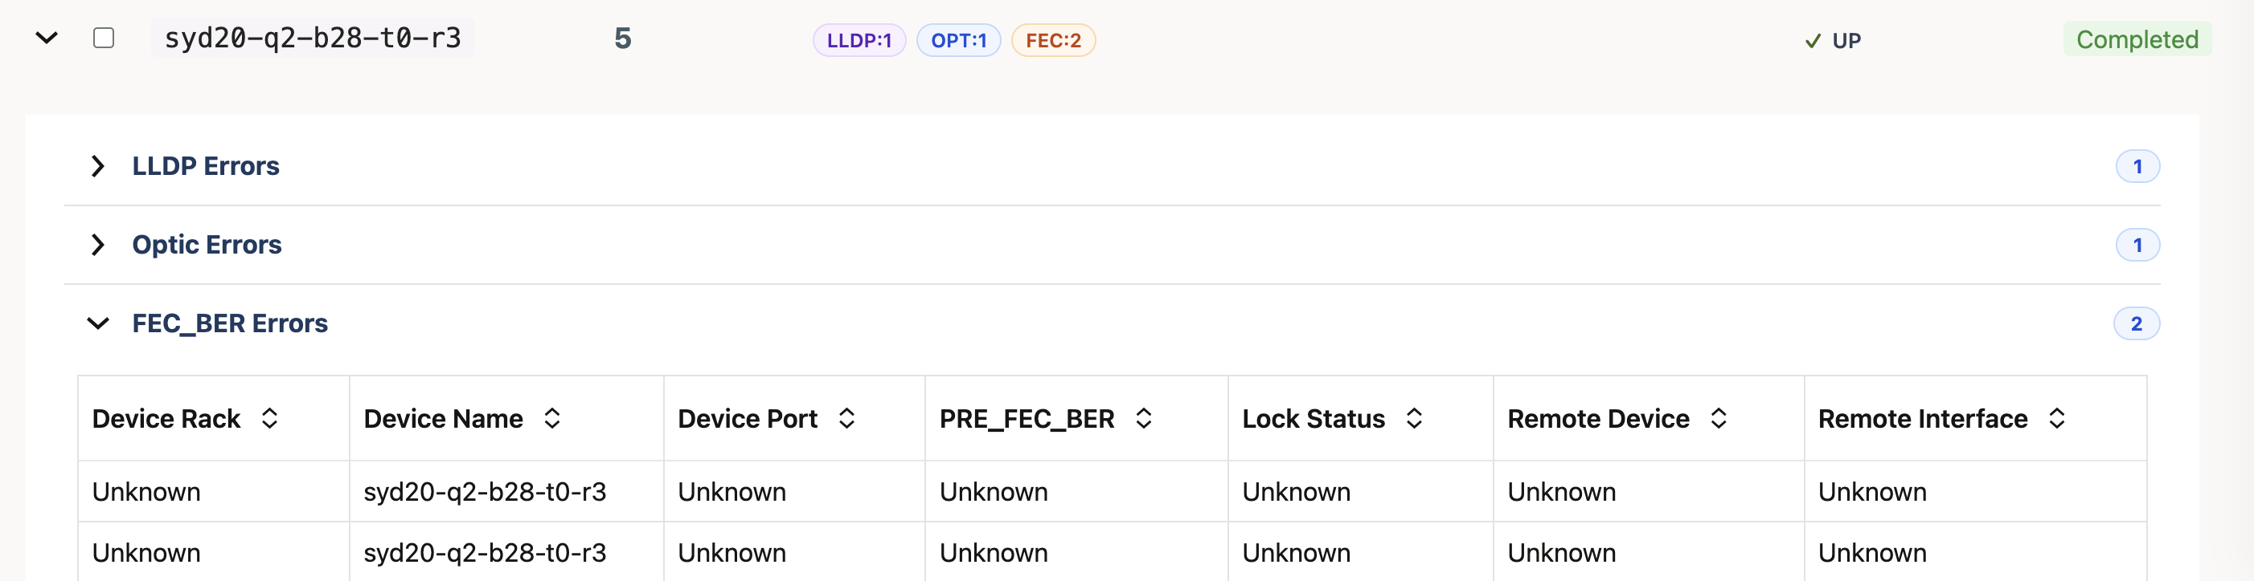
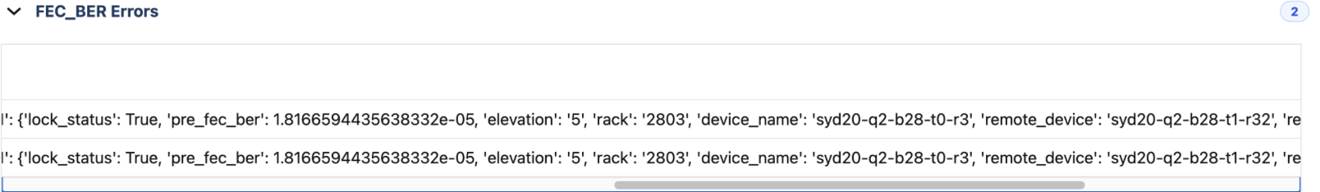
Interface FEC-BER Error

Slide 21
Steps to be performed to resolve this error.
Inspect Fiber Cable
Check the physical fiber connection and ensure the following:
Confirm that the fiber cable is securely connected.
Verify the correct port patching between the devices.
Ensure the TX ↔ RX polarity is correct.
Inspect and clean fiber connectors
Inspect and clean optical transceiver
If required:
Reseat the cable to ensure a proper connection.
Replace the cable with a spare fiber cable to rule out any cable-related issues.
Clean Fiber Connectors
Contaminated fiber connectors can cause signal degradation.
Inspect the fiber ends for dust or contamination.
Clean the connectors using appropriate fiber cleaning tools.
Reconnect the fiber and test the link again.

Slide 22
Steps to be performed to resolve this error.
Verify Optic Modules
Check the health of the optic module.
Look for:
Temperature alarms
Voltage warnings
Laser faults
Inspect and clean fiber connectors
Inspect and clean optical transceiver
If necessary:
Reseat the optic module.
Replace it with a spare optic module to eliminate potential hardware issues.

Slide 23
Steps to be performed to resolve this error.
Test with Spare Components
To isolate the root cause:
Replace the fiber cable.
Replace the optic module.
Test the connection using another interface port, if available.
Escalation Metric: Even after LVV has completed all troubleshooting steps, if the issue still persists, please reach out to the CNE-AI2ND team for further investigation from the switch side.

Slide 24
Power supply Down Issue

Slide 25
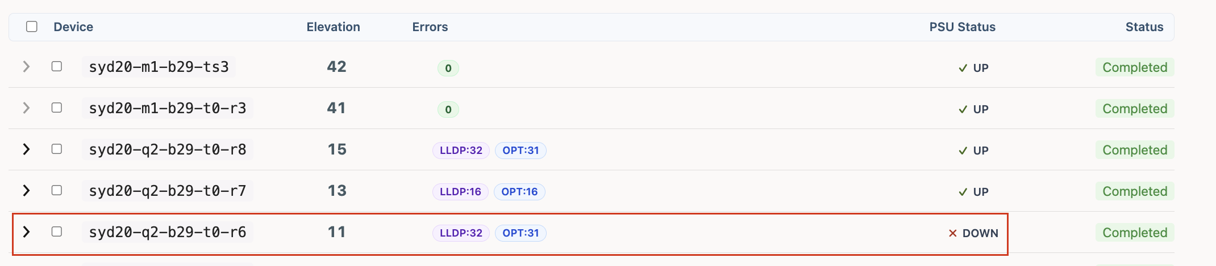
Power supply Down Issue

Slide 26
Power supply Down Issue Steps to be performed to resolve this error.
Physical Inspection
Ensure the power cable is firmly connected to the PSU and power source.
Check if the PSU LED indicators are on, off, or showing an error state.
Inspect for any visible damage or loose connections.
Power Source Validation
Verify that the Power Distribution Unit (PDU) or wall power outlet is active.
Check if the circuit breaker is tripped.
Confirm that the correct voltage and power rating are being supplied.
Cable and Port Check
Reseat the power cable from both ends (PSU and PDU).
Try another known-good power cable if available.
Move the PSU connection to a different PDU port to rule out port failure.

Slide 27
Power supply Down Issue Steps to be performed to resolve this error.
PSU Reseating
If the PSU is hot-swappable:
Carefully remove the PSU.
Inspect the connectors and slot for dust or damage.
Reinsert the PSU firmly and check if it powers up.
Cross Verification
Swap the suspected faulty PSU with a known working PSU (if available).
If the issue follows the PSU, it is likely hardware failure.
Hardware Replacement
If the PSU still shows down/failure status, open a hardware replacement ticket (RMA) with the vendor.
Provide logs, device model, PSU serial number, and troubleshooting steps performed.

Slide 28
Power supply Down Issue Steps to be performed to resolve this error.
Escalation Metric: Even after LVV has completed all troubleshooting steps, if the issue still persists, please reach out to the CNE-AI2ND team for further investigation from the switch side.

Slide 29
Thank You!

