Slide 1



SMART IRRIGATION
Name : Pooja Madarakhandi
AICTE Student ID: STU6824b5fcf0b911747236348
AICTE Internship ID: INTERNSHIP_1748923002683e727a876ea

Slide 2

Learning Objectives:
Understanding IOT applications : Learn how IoT sensors and devices can be used to monitor and control irrigation system .
Machine learning : understand how ML algorithms can be used to predict irrigation needs and optimize water usage .
Programming skills : develop programming skills in language such as PYTHON .
Data analysis : smart irrigation systems require data analysis
to interpret sensor data and optimize irrigation schedules.
Problem-solving skills :develop problem solving skills to troubleshoot & optimize smart irrigation systems.
GOAL

Slide 3
Tools and Technology used :
Programming language
Python : A popular choice for smart irrigation due to its simplicity and extensive libraries
Environment
VS code :A versatile code editor that supports Python development and can be used for
smart irrigation projects.
Jupyter notebook:An interactive environment for data analysis & visualization ,suitable for
smart irrigation projects.
Kaggle:A platform for Data Science competitions & hosting datasets , which can be used
for smart irrigation projects.
Algorithms
Machine Learning : Linear regression , decision trees used.
IoT-based algorithms: Algorithms for sensor data processing, automation, and control can be
used to optimize irrigation schedules.
Python libraries : Pandas , NumPy, Matplotlib, PyTorch, Scikit-learn, SciPy, Seaborn

Slide 4
Methodology :
Data Collection : Collect a data from irrigation_machine.csv file
Data preprocessing :
Import necessary libraries such as Pandas, NumPy, and Matplotlib.
Load Data: Load the CSV file into a Pandas dataframe.
Data Transformation: Convert data into suitable formats for analysis and modeling.
Exploratory Data Analysis (EDA):
Data Visualization: Use plots and charts to visualize the data and understand relationships
between variables
Modeling and Deployment :
Machine Learning Model: Train a machine learning model to predict irrigation needs based on historical data.
Model Evaluation: Evaluate the performance of the model using metrics such as accuracy, precision, and recall.
Streamlit Deployment: Deploy the model using Streamlit to create a user-friendly interface for farmers and agricultural professionals.

Slide 5
Methodology :
Streamlit Deployment :
Create a Streamlit App : Create a Streamlit app to visualize data, display predictions, and provide recommendations for irrigation schedules.
User Input : Allow users to input data, such as soil type, crop type, and weather forecasts.
Real-time Predictions: Use the deployed model to make real-time predictions and provide recommendations for irrigation schedules.

Slide 6
Problem Statement:
Inefficient traditional irrigation methods lead to significant water wastage, suboptimal crop yields, and increased operational costs.
This is primarily due to a lack of real-time data, reliance on fixed schedules, and uniform water application that ignores varying field conditions.
The result is over-irrigation in some areas, under-irrigation in others, and a negative environmental impact through water depletion and nutrient runoff.
There's a clear need for a smart, automated irrigation solution that uses data to deliver water precisely when and where it's needed, optimizing resource use and improving agricultural outcomes.

Slide 7
Solution:
An AI-Powered Smart Irrigation System
Our project offers a revolutionary and comprehensive solution to these critical farming problems through an intelligent, automated, and data-driven irrigation system.
The Smart System: Autonomous Data Acquisition and Control
At its core, our project is an automated system designed for precision agriculture. It leverages a network of 19 sophisticated sensors (as detailed in our irrigation_machine.csv dataset) strategically deployed across the farm. These sensors gather real-time, granular data on crucial parameters such as:
Soil moisture levels (at various depths)
Ambient temperature and humidity
Light intensity
Rainfall detection
Nutrient levels (e.g., NPK)
Crop health indicators
This rich dataset forms the foundation for informed decision-making.

Slide 8
Solution:
2. Pinpoint Watering : Precision Delivery with 3 Water Pumps
Based on the AI's intelligent decisions, the system precisely controls 3 independent water pumps.
Each pump is strategically linked to specific irrigation zones, allowing for:
Zonal Control: Water is directed only to the areas that require it, preventing over-watering in
other sections.
Variable Application Rates: The system can adjust the flow rate and duration of watering for
each zone, providing the exact amount of water needed, down to
the millimeter.
On-Demand Irrigation: Water is supplied only when the AI determines it's truly
eliminating wasteful scheduled irrigation.

Slide 9
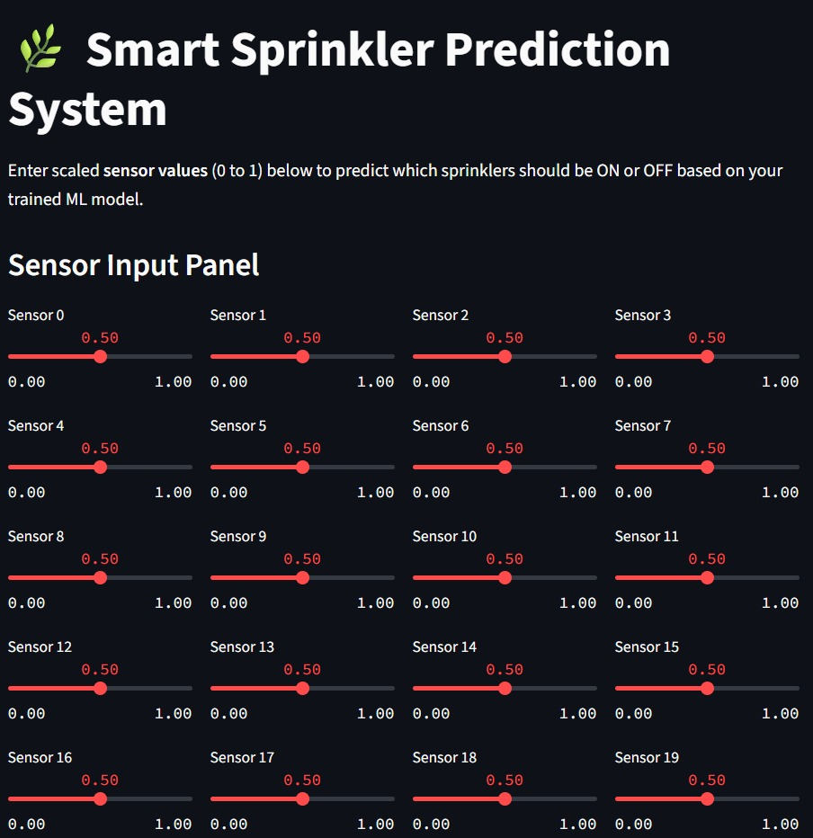
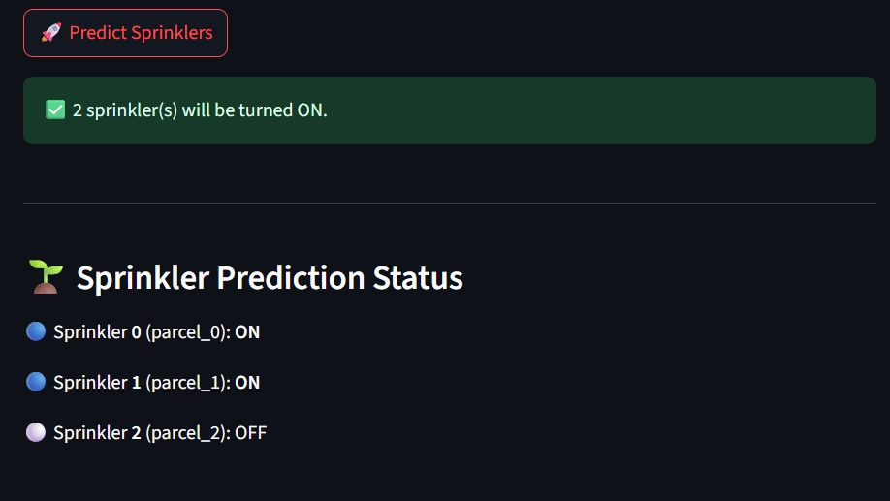
Screenshot of Output:

Slide 10
Conclusion:
Smart irrigation systems offer a powerful and sustainable approach to agriculture, significantly enhancing water efficiency and promoting healthier crop growth.
By integrating IoT and sensor technology, we can achieve automated, data-driven irrigation that responds precisely to plant needs.
Future Scope :
AI Integration: Incorporating artificial intelligence for predictive irrigation scheduling based on weather forecasts and crop models.
Solar-Powered Systems: Developing self-sufficient systems powered by renewable energy, reducing reliance on conventional power grids.
Advanced Sensor Networks: Utilizing hyperspectral imaging and other advanced sensors for detailed plant health analysis
link : https://github.com/Pooja8755/Smart_irrigation_AICTE_Shell.git

