Slide 1

Sentiment Analysis of McDonald’s Customer Reviews: A Comparative Study of Classical Machine Learning, Transformer and Lexicon-Based Methods with a Deployed Intelligence Platform
Index no: 22CDS0412
Name: Pooja Anbalagan
Internal Supervisor: Ms. Sweshthika Sureshkumar
Department of Data Science, Faculty of Computing
Capstone Project in Data Science II -DS4105
Notes:
Introduce the project: a comparative study of classical machine learning, a fine-tuned transformer and a lexicon baseline for three-class sentiment analysis of McDonald's Google Maps reviews, deployed as a web platform.

Slide 2
Contents
Introduction
Background
Specification and Design
Data Collection and Preprocessing
Feature Engineering and Selection
Model Selection, Training and Testing
Model Deployment and Integration
Results and Conclusion
Future Works and Recommendations
References
Demonstration
2026
Notes:
Outline of the talk, following the structure of the final report.

Slide 3
INTRODUCTION
The problem
Multi-outlet McDonald’s collects thousands of Google Maps reviews, far more than any team can read
Star ratings are a weak proxy for sentiment, and scraped text hides duplicates and label-leaking tags
Goal: a reliable Negative / Neutral / Positive classifier that turns reviews into insight
Motivation
Operational value: drive-thru delays, order accuracy and cleanliness complaints are directly actionable
Data quality: encoding errors, duplicates and auto-generated tags can silently leak the label
Evaluation honesty: Neutral is only 15.73% of reviews, so macro-F1 is used instead of accuracy alone
Scope of the completed project
English-language Google Maps reviews of 40 US McDonald’s outlets
Delivered: cleaning, hybrid labelling, 7 benchmarked approaches, error analysis and a deployed web platform
Out of scope: aspect-level, multilingual and other-domain sentiment (future work)
33,396
raw reviews scraped
22,448
labelled free-text reviews
7
sentiment approaches compared
40
McDonald’s outlets
Notes:
The problem: reviews arrive faster than anyone can read them. The project covers the whole data science lifecycle, from messy scraped data to a deployed platform, and is careful about data leakage and about evaluating the minority Neutral class honestly.

Slide 4
BACKGROUND
Background and related work
Objectives
Lexicon-based (VADER [3]): rule-based dictionary scoring, no training, but it cannot adapt to domain words such as “cold food”
Classical ML (TF-IDF [5] + linear models): fast and interpretable, but blind to word order and context
Transformers (DistilBERT [10]): contextual, handle negation and contrast, but costlier to train and serve
Star ratings are an imperfect proxy: a 3-star review can read clearly positive or negative
Neutral is a small, ambiguous minority, so a model can score high accuracy while ignoring it
1
Acquire, audit and clean the review corpus
2
Build trustworthy labels: human pilot + pseudo-labels
3
Explore class, length, recency and vocabulary profiles
4
Zero-leakage 70/15/15 stratified experimental design
5
Compare 5 TF-IDF classifiers, VADER and DistilBERT
6
Evaluate with imbalance-aware metrics and error analysis
7
Interpret sentiment drivers and deploy a FastAPI + React platform
Contribution: documented hybrid labelling with measured agreement, an explicit label-leakage audit, a like-for-like comparison of classical, lexicon and transformer models, and a deployed platform.
Notes:
Sentiment analysis has three families of methods. Earlier studies typically use star ratings as ground truth, one split and one or two model families. This project adds hybrid labelling with measured agreement, a leakage audit, a like-for-like comparison of all three families, and a deployed platform.

Slide 5
SPECIFICATION & DESIGN: USE CASE DIAGRAM
Sentiment Intelligence Platform
Key requirements
Single and batch scoring (CSV, XLSX, JSON) with class probabilities
Multi-model sandbox: classical models and DistilBERT side by side
Explainability: influential terms behind each prediction
Real-time inference: Linear SVM < 1 ms, DistilBERT ≈ 8.5 ms per review on CPU
One-command reproducibility, with no validation or test information used in fitting
Predict sentiment of a review
Compare models (sandbox)
Business user
Upload a batch of reviews
Browse and filter reviews
Model service
View analytics and KPIs
Technical user
Export executive report
Run evaluation pipeline
Notes:
Three actors: the business user (analysts and outlet managers), the technical user (data scientists) and the model service. The seven use cases range from live prediction to exporting an executive report and re-running the evaluation pipeline.

Slide 6
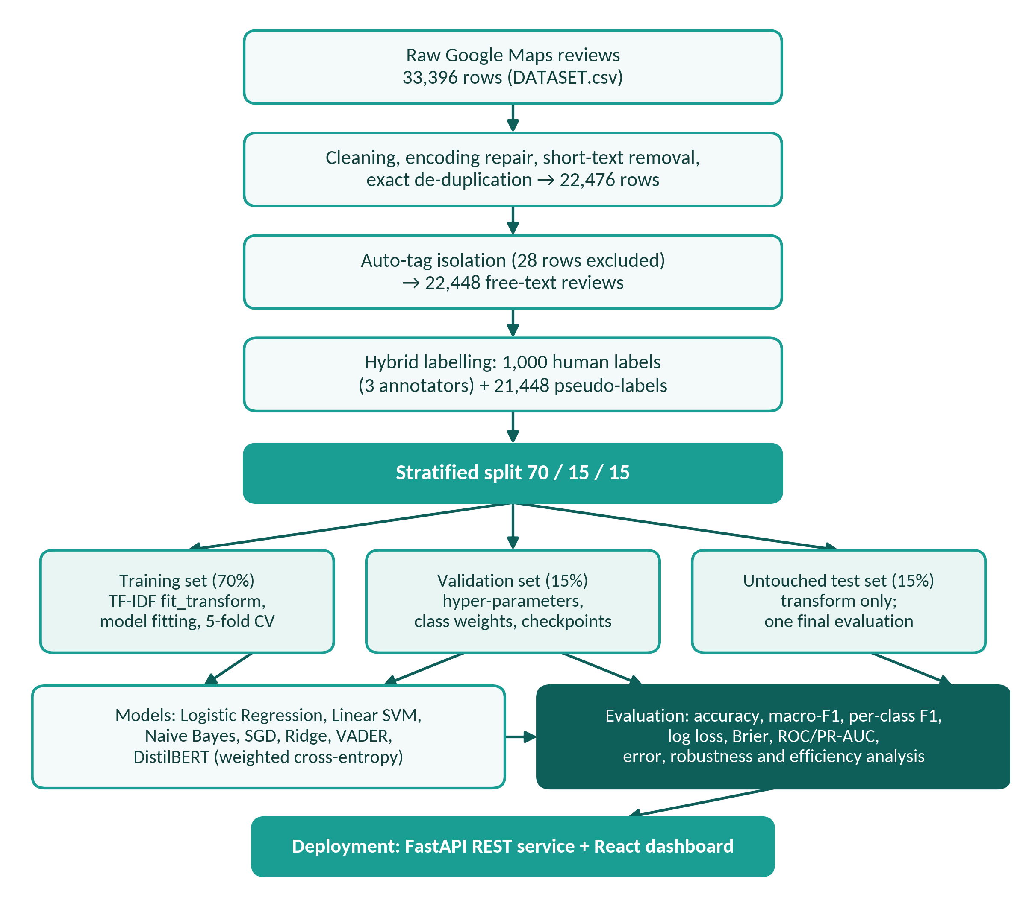
SPECIFICATION & DESIGN: MODEL PIPELINE
Notes:
Three actors: the business user (analysts and outlet managers), the technical user (data scientists) and the model service. The seven use cases range from live prediction to exporting an executive report and re-running the evaluation pipeline.

Slide 7
DATA COLLECTION & PREPROCESSING
Process of data collection
33,396 McDonald’s customer reviews scraped from Google Maps [18]
40 US outlets, all categorised as “Fast food restaurant”
Raw file read with cp1252 to recover mis-encoded characters
Nature of the dataset
Each record: reviewer id, store name and address, coordinates, star rating (as text), relative timestamp and free-text review
Polarised ratings: one-star (7,188) and five-star (6,176) reviews dominate
Negative reviews are longest (median ≈ 118 characters vs ≈ 53 Positive and ≈ 42 Neutral)
33,396
raw reviews
− 10,741 exact duplicates and − 179 unusable rows (fewer than 3 characters)
22,476
cleaned master dataset
− 28 auto-generated rating tags kept out of text modelling (5,167 flagged in total)
22,448
free-text reviews used for modelling
Row counts reconcile exactly from raw file to final labelled corpus
Notes:
The raw file has 33,396 reviews from 40 outlets. After removing 10,741 exact duplicates and 179 unusable rows there are 22,476 rows; excluding the 28 auto-tag rows that survived de-duplication leaves 22,448 genuine free-text reviews.

Slide 8
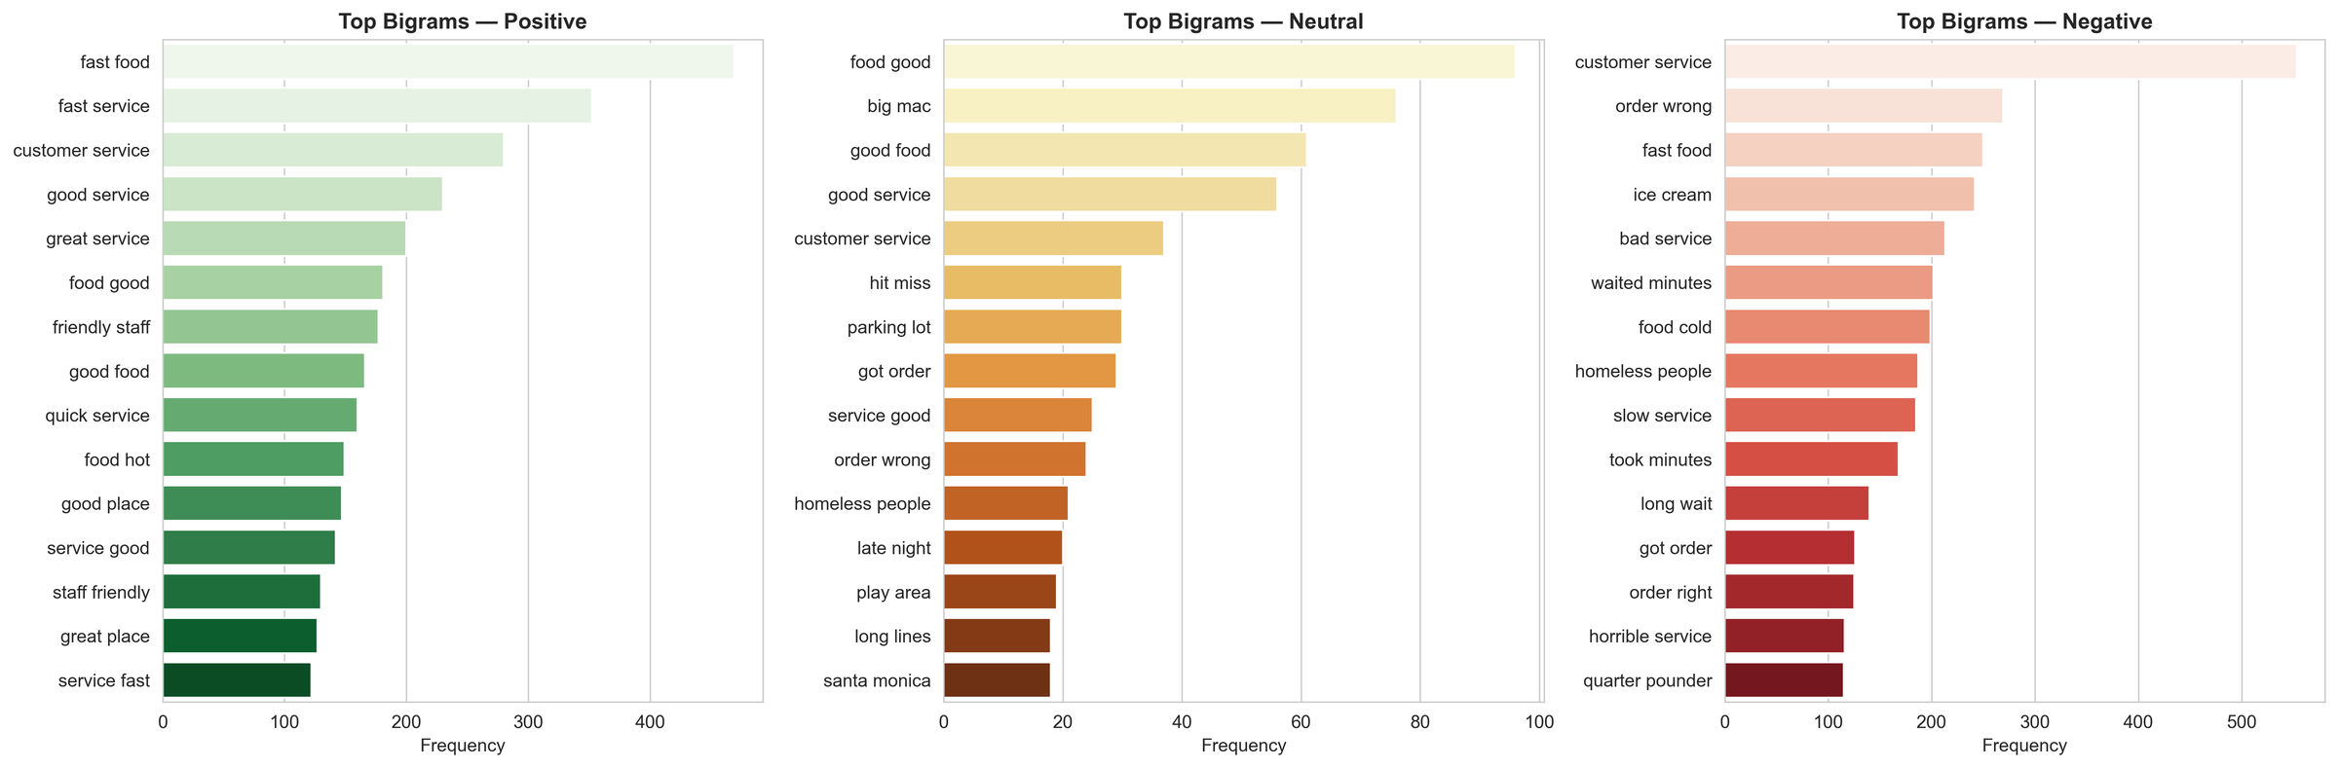
FEATURE ENGINEERING AND SELECTION
1 Clean the text
Lower-case, strip URLs and non-letters, normalise whitespace, remove stop-words and brand terms; keep negations (not, no, never)
2 Vectorise with TF-IDF [5]
Unigrams and bigrams capture phrases like “not good” and “fast service”; sublinear tf damps repeated words
3 Select features
Vocabulary capped at the 20,000 highest-frequency n-grams of the training split; ablation tests feature groups
TF-IDF feature configuration
Parameter | Value
N-gram range | Unigrams and bigrams
Maximum features | 20,000
Term-frequency scaling | Sublinear (1 + log tf)
Fitting rule | Fit on the training split only
Excluded inputs | Star rating, address, timestamps
Top bigrams by class. Positive: “fast service”, “friendly staff”. Negative: “order wrong”, “food cold”.
DistilBERT skips TF-IDF and uses its own sub-word tokenizer.
Notes:
Feature selection is implicit: the vocabulary is capped at the 20,000 most frequent n-grams from the training split only, and metadata never enters the text features. Negations are deliberately preserved because they reverse polarity.

Slide 9
MODEL SELECTION, TRAINING AND TESTING
Model | Representation | Key configuration
Logistic Regression | TF-IDF | L2 regularisation, balanced class weights
Linear SVM | TF-IDF | Balanced class weights
Multinomial Naive Bayes | TF-IDF | Laplace smoothing (α = 1.0), no class weights
SGDClassifier | TF-IDF | Linear model trained by stochastic gradient descent
RidgeClassifier | TF-IDF | L2-penalised least squares
VADER [3] | Raw-text lexicon | Standard compound-score thresholds, no training
DistilBERT [10] | Sub-word tokens | distilbert-base-uncased (≈ 66M parameters), class-weighted cross-entropy
Training and testing
Stratified 70 / 15 / 15 split: train, validation, test
Validation set tunes hyper-parameters and picks the best DistilBERT checkpoint
5-fold stratified CV for classical models
Test set (3,319 reviews) used once
Evaluation
Primary metric: macro-F1
Also accuracy, per-class F1, log loss, Brier score, ROC-AUC and PR-AUC
Balanced class weights protect the Neutral minority in Logistic Regression, Linear SVM and the transformer loss.
Notes:
Seven approaches from a rule-based baseline to a fine-tuned transformer, so the value of each step up in complexity can be measured. Macro-F1 is the primary metric because Neutral is only 15.73% of the data; a classifier that ignores Neutral can still reach about 84% accuracy.

Slide 10
MODEL DEPLOYMENT AND INTEGRATION
Serialised models
Four .pkl models, the TF-IDF vectoriser and the fine-tuned DistilBERT directory, loaded once at start-up
Technologies and tools
Component | Tools
Language and data | Python, pandas, NumPy
Classical ML | scikit-learn [12]
Transformer | PyTorch, Hugging Face Transformers [13]
Lexicon baseline | VADER [3]
Visualisation | Matplotlib, Seaborn, word clouds
Backend | FastAPI [19]
Frontend | React 18 [20], Vite, Axios
FastAPI REST service (port 8000)
Single and batch prediction, model metrics and figures returned as JSON
React 18 + Vite dashboard (port 5173)
Axios client with seven views for live, batch and analytical use
Requirements: Python environment (requirements.txt) and npm for the UI. Inference tested on CPU only.
Overview
Predictor
Batch Upload
Analytics
Reviews
Models
Reports
Notes:
The champion and baseline models are serialised and loaded once by FastAPI. The React dashboard offers seven views. Linear models stay in the platform as low-latency options, while DistilBERT gives the highest accuracy at roughly 8.5 ms per review on a CPU.

Slide 11
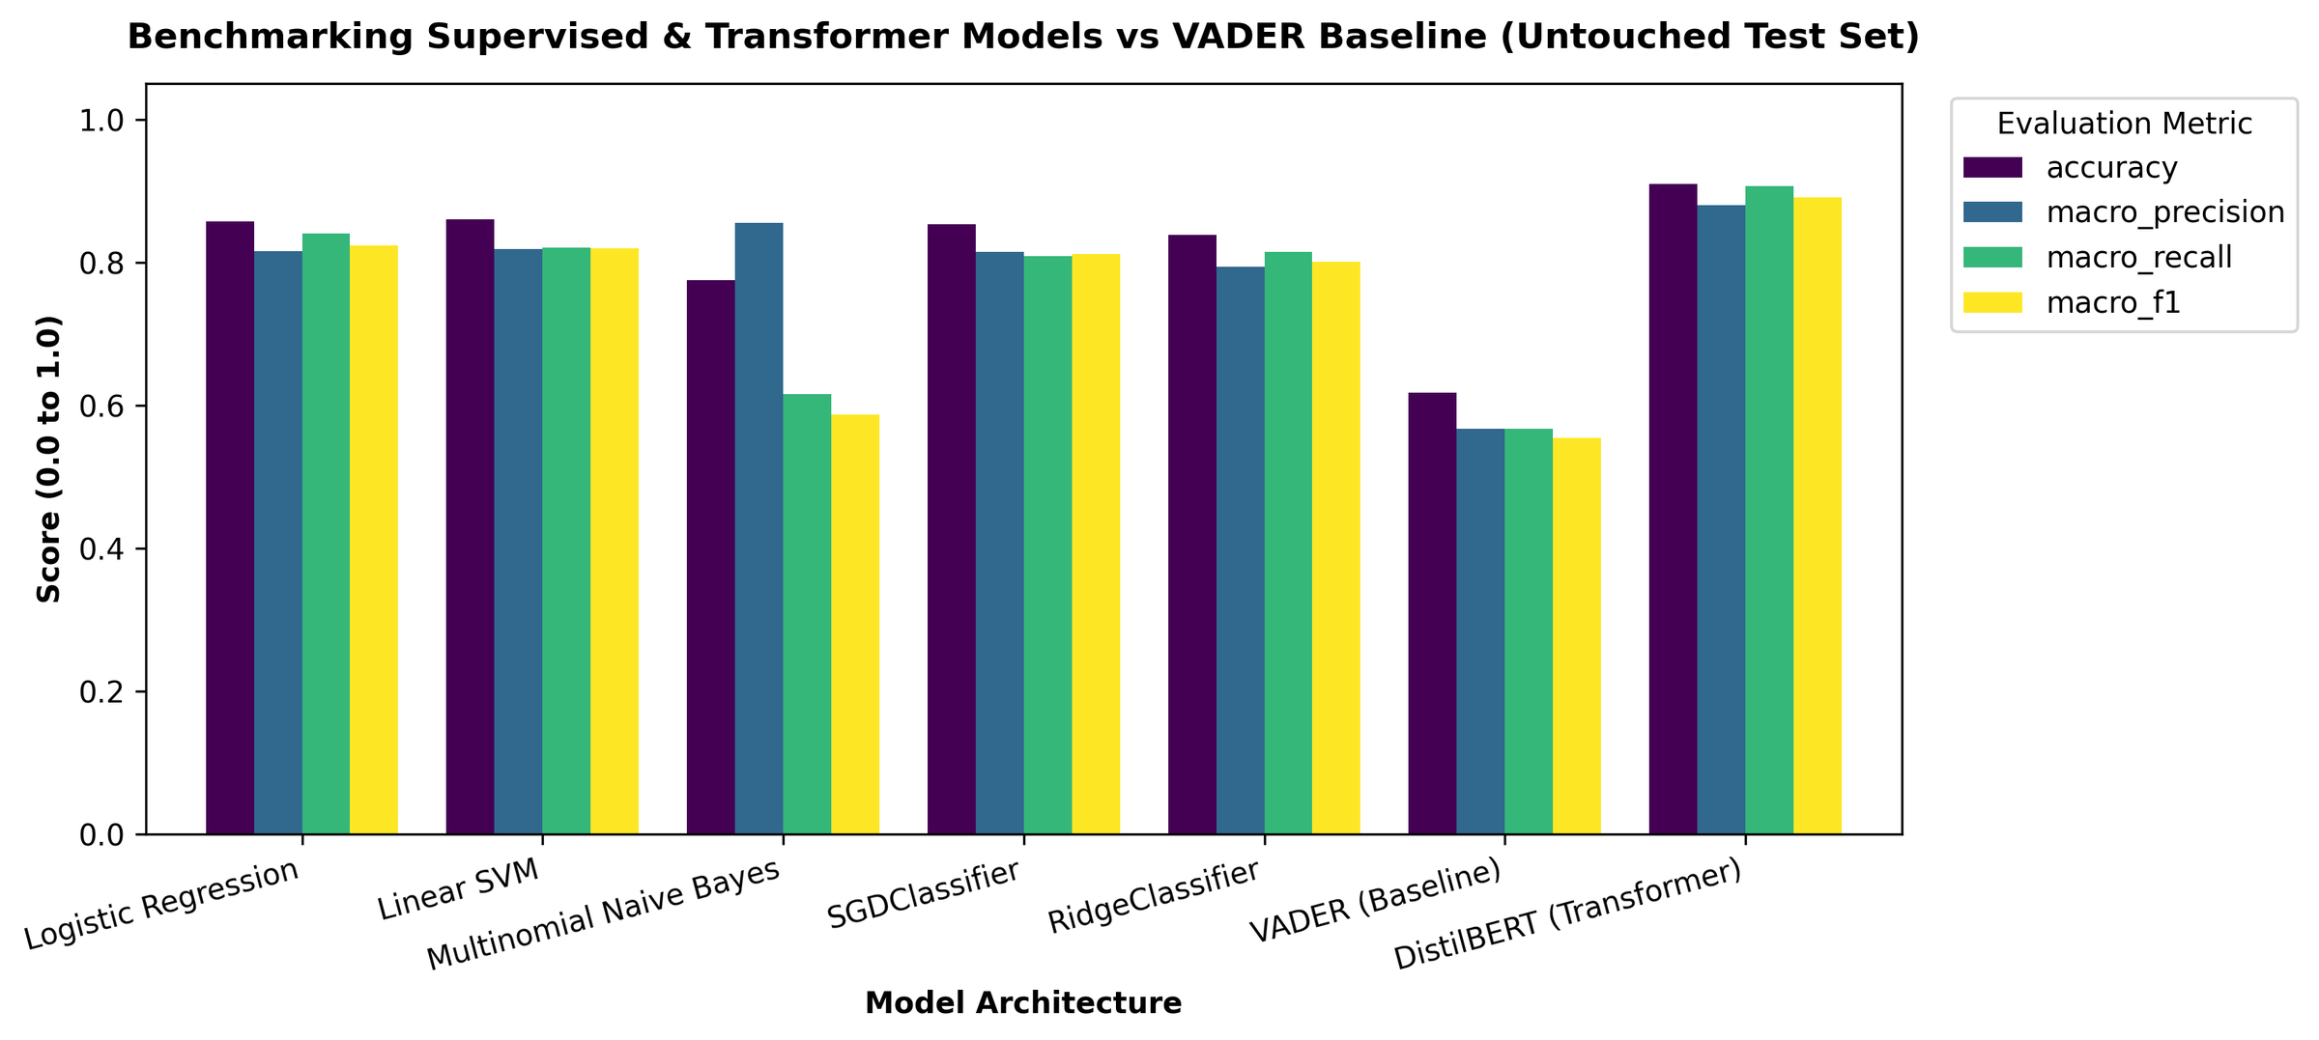
RESULTS: MODEL COMPARISON
Model | Accuracy | Macro-F1 | Neutral F1
DistilBERT | 0.9093 | 0.8906 | 0.8139
Logistic Reg. | 0.8569 | 0.8233 | 0.6819
Linear SVM | 0.8602 | 0.8195 | 0.6686
SGD | 0.8530 | 0.8111 | 0.6576
Ridge | 0.8382 | 0.8008 | 0.6494
Naive Bayes | 0.7749 | 0.5863 | 0.0894
VADER | 0.6171 | 0.5539 | 0.2963
0.9093
DistilBERT accuracy
0.8906
DistilBERT macro-F1
0.8139
DistilBERT Neutral F1
Untouched test set (3,319 reviews). Naive Bayes looks acceptable by accuracy but almost never predicts Neutral.
Notes:
DistilBERT is best on every metric: accuracy 0.9093, macro-F1 0.8906 and a Neutral F1 of 0.8139, about 0.13 higher than Logistic Regression. Logistic Regression and Linear SVM form a strong second tier, while Naive Bayes and VADER show why accuracy alone and generic lexicons are unreliable.

Slide 12
FUTURE WORKS & RECOMMENDATIONS
Larger human gold standard
Annotate Neutral and low-confidence reviews, report all models on a human-only test set, and use active learning to choose what to label next.
Aspect-based sentiment
Score speed, order accuracy, staff and cleanliness separately. so mixed reviews give actionable, aspect-level signals.
Stronger transformer experiments
Repeat DistilBERT over several seeds or folds, compare BERT or RoBERTa, and test other domains and languages.
Efficiency
Quantisation or ONNX export to cut DistilBERT latency, and a two-stage cascade where the linear model handles confident cases.
Calibration and explainability
Temperature scaling or isotonic regression for probabilities, and token-level attribution for the transformer.
Analytics and production hardening
Sentiment maps by outlet, drift and complaint-spike alerts, authentication, scheduled scoring and model versioning.
Notes:
The main gaps are the reliance on model-generated labels, single-split evaluation of the transformer and review-level rather than aspect-level sentiment. The proposals address each of these and add efficiency, calibration and production hardening.

Slide 13
REFERENCES
[1] B. Pang and L. Lee, “Opinion mining and sentiment analysis,” Found. Trends Inf. Retr., vol. 2, no. 1–2, pp. 1–135, 2008.
[2] B. Liu, Sentiment Analysis and Opinion Mining. San Rafael, CA, USA: Morgan & Claypool, 2012.
[3] C. J. Hutto and E. Gilbert, “VADER: A parsimonious rule-based model for sentiment analysis of social media text,” in Proc. ICWSM, Ann Arbor, MI, USA, 2014, pp. 216–225.
[4] B. Pang, L. Lee, and S. Vaithyanathan, “Thumbs up? Sentiment classification using machine learning techniques,” in Proc. EMNLP, Philadelphia, PA, USA, 2002, pp. 79–86.
[5] G. Salton and C. Buckley, “Term-weighting approaches in automatic text retrieval,” Inf. Process. Manage., vol. 24, no. 5, pp. 513–523, 1988.
[6] C. Cortes and V. Vapnik, “Support-vector networks,” Mach. Learn., vol. 20, no. 3, pp. 273–297, 1995.
[7] A. McCallum and K. Nigam, “A comparison of event models for Naive Bayes text classification,” in Proc. AAAI-98 Workshop Learn. Text Categorization, 1998, pp. 41–48.
[8] S. Wang and C. D. Manning, “Baselines and bigrams: Simple, good sentiment and topic classification,” in Proc. 50th Annu. Meeting ACL, Jeju Island, South Korea, 2012, pp. 90–94.
[9] J. Devlin, M.-W. Chang, K. Lee, and K. Toutanova, “BERT: Pre-training of deep bidirectional transformers for language understanding,” in Proc. NAACL-HLT, Minneapolis, MN, USA, 2019, pp. 4171–4186.
[10] V. Sanh, L. Debut, J. Chaumond, and T. Wolf, “DistilBERT, a distilled version of BERT: Smaller, faster, cheaper and lighter,” arXiv:1910.01108, 2019.
[11] A. Vaswani et al., “Attention is all you need,” in Adv. Neural Inf. Process. Syst. (NeurIPS), vol. 30, 2017, pp. 5998–6008.
[12] F. Pedregosa et al., “Scikit-learn: Machine learning in Python,” J. Mach. Learn. Res., vol. 12, pp. 2825–2830, 2011.
[13] T. Wolf et al., “Transformers: State-of-the-art natural language processing,” in Proc. EMNLP: Syst. Demonstrations, 2020, pp. 38–45.
[14] J. L. Fleiss, “Measuring nominal scale agreement among many raters,” Psychol. Bull., vol. 76, no. 5, pp. 378–382, 1971.
[15] D.-H. Lee, “Pseudo-label: The simple and efficient semi-supervised learning method for deep neural networks,” in Proc. ICML Workshop Challenges Representation Learn., 2013.
[16] H. He and E. A. Garcia, “Learning from imbalanced data,” IEEE Trans. Knowl. Data Eng., vol. 21, no. 9, pp. 1263–1284, Sep. 2009.
[17] J. R. Landis and G. G. Koch, “The measurement of observer agreement for categorical data,” Biometrics, vol. 33, no. 1, pp. 159–174, 1977.
[18] Google Maps, “McDonald’s outlet customer reviews,” scraped dataset (DATASET.csv), collected 2025–2026.
[19] S. Ramírez, “FastAPI.” [Online]. Available: https://fastapi.tiangolo.com
[20] Meta Platforms, “React.” [Online]. Available: https://react.dev
Notes:
References follow IEEE style, in the order used in the final report.

Slide 14
DEMONSTRATION
Demonstration link: https://drive.google.com/file/d/12NG3d6voljGYx98HZ-_qF4w8DiIenupo/view?usp=sharing
Demo walkthrough
Overview: executive KPIs and overall sentiment share
Predictor: live prediction with class probabilities and influential terms, plus the multi-model sandbox
Batch Upload: score CSV, XLSX or JSON review files
Models and Analytics: benchmark table, confusion matrices, diagnostic figures
Reports: generate and export the executive report
# backend (port 8000)
python server.py
# frontend (port 5173)
cd frontend
npm install && npm run dev
Run locally, as in the report’s Appendix B
Notes:
Demonstrate the platform: Overview, Predictor with the multi-model sandbox, Batch Upload, Models and Analytics, then the exported report.

Slide 15
Thank You!

