Slide 1

BAN632: Big Data Tech. & Apps.
Term Paper Presentation: Analysis of used cars data to make an educated buying decision
By:
Pooja Bhansali, gs6262
Pradeep Gupta, vs2545
Sanjith Ramesh, nf2544

Slide 2
AGENDA
Objective
Web-Scraping
Mapper Reducer
Analysis
Conclusion
Suggestions & Recommendation
Future Work

Slide 3
Objective

Slide 4

To compare depreciation for cars from different manufacturers over years.
To arrive at a data driven decision on buying used cars at optimal price based on desired age of car & budget.
To use appropriate technologies taught in this course esp. for big data e.g. MapReduce.

Slide 5
Web-Scraping

Slide 6
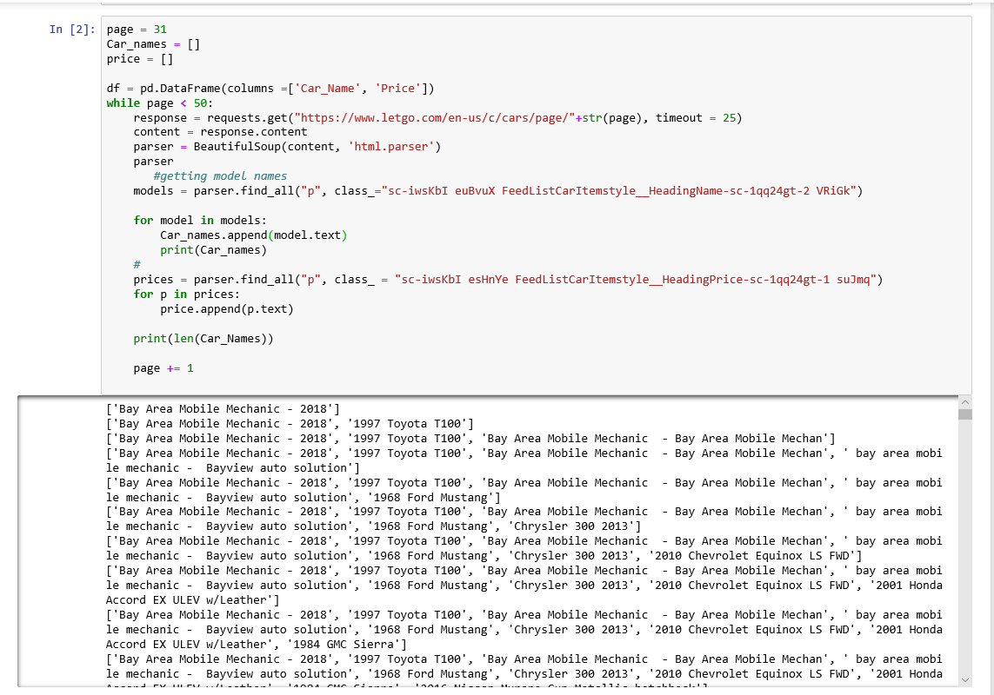

Slide 7
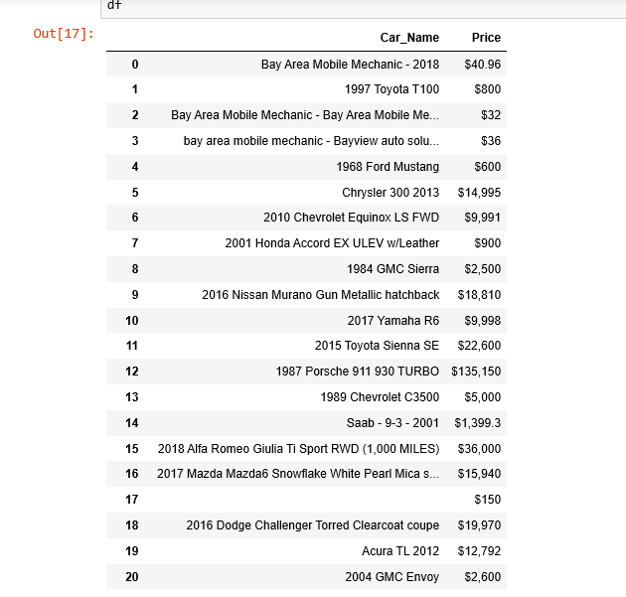
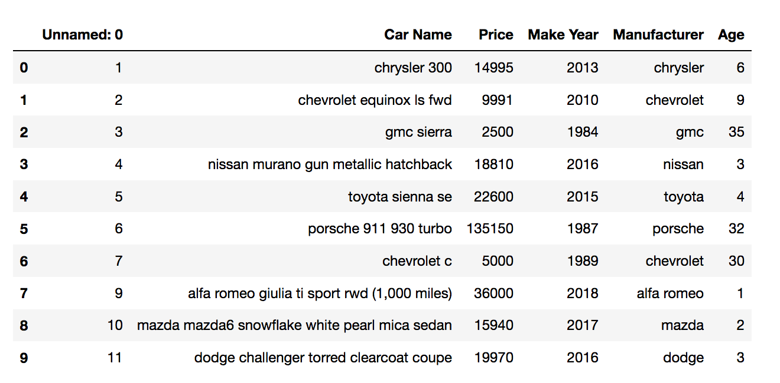
RAW DATA
Obtained approximately 2000 rows of data.
Removed special characters, outliers and NULL values.
Extracted year and manufacturer name.
Dropped duplicate records
Changed price and year to integer type
Shortlisted records with price between $1000 and $150,000, and year > 1900
Age as a calculated field from Make Year

Slide 8
ANALYSIS

Slide 9
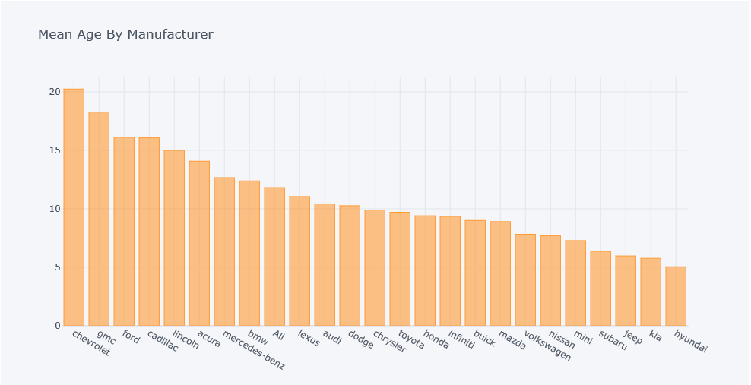
Top 10 Manufacturers by Mean Age of Cars

Slide 10
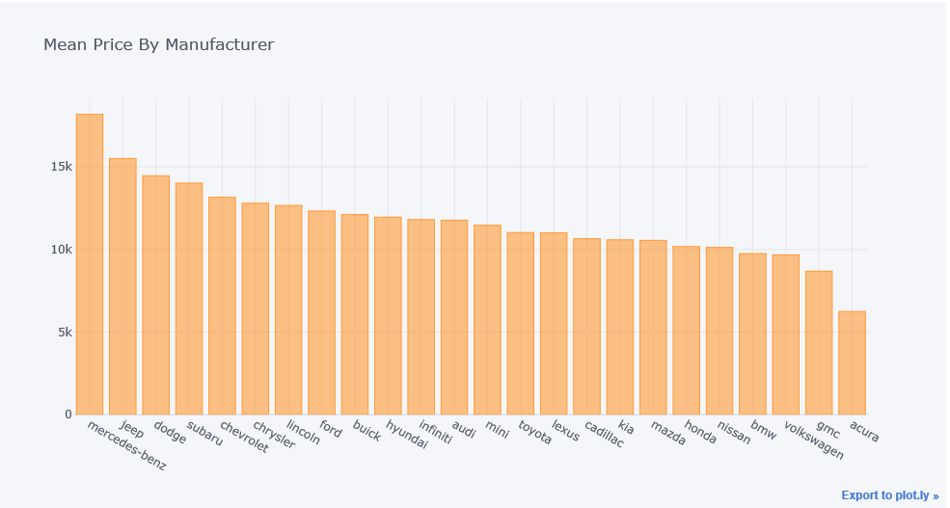
Top 10 Manufacturers by Average Price

Slide 11
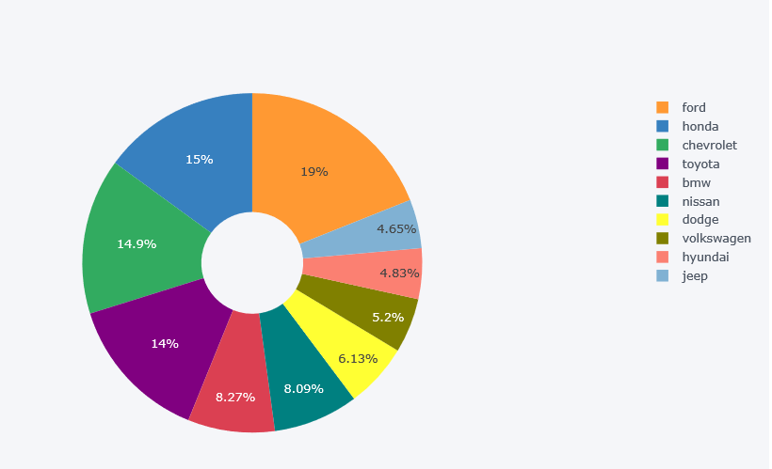
Manufacturer Market Share

Slide 12
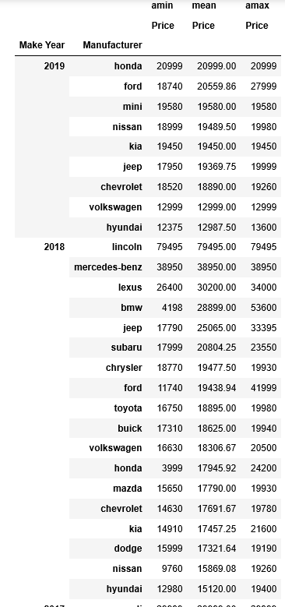
Prices of different manufacturers for each year
This analysis can be fruitfully utilized when a buyer is looking for an economical car with a pre-decided age (model year / make year).
e.g. if a user decides to buy a 2018 model car and has a budget of approx. $20,000, he should perhaps target Subaru, Chrysler or Ford. Or can go for Toyota and save some money.
Similar analysis can be done for a particular manufacturer’s average price for any make year.

Slide 13
Map-Reducer

Slide 14
Top 20 rows of input file to Mapreduce
1,chrysler 300 ,14995,2013,chrysler,6
2, chevrolet equinox ls fwd,9991,2010,chevrolet,9
3, gmc sierra,2500,1984,gmc,35
4, nissan murano gun metallic hatchback,18810,2016,nissan,3
5, toyota sienna se,22600,2015,toyota,4
6, porsche 911 930 turbo,135150,1987,porsche,32
7, chevrolet c,5000,1989,chevrolet,30
9," alfa romeo giulia ti sport rwd (1,000 miles)",36000,2018,alfa romeo,1
10, mazda mazda6 snowflake white pearl mica sedan,15940,2017,mazda,2
11, dodge challenger torred clearcoat coupe,19970,2016,dodge,3
12,acura tl ,12792,2012,acura,7
13, gmc envoy,2600,2004,gmc,15
14, jeep renegade alpine white hatchback,14690,2015,jeep,4
15,toyota - camry - ,2000,1999,toyota,20
16, toyota tacoma regular cab,4500,2001,toyota,18
17,hyundai elantra gt ,13600,2019,hyundai,0
18, jeep compass bright white clearcoat hatchback,15360,2016,jeep,3
19, hyundai genesis 3.8l,12750,2013,hyundai,6
20, bmw 3 series 330cic,3500,2004,bmw,15

Slide 15
Mapper
String line = value.toString().toLowerCase();
String[] cars = {"acura","audi","bmw","buick","cadillac","chevrolet","chrysler","dodge","ferrari",
"fiat","fisker","ford","gmc","honda","hyundai","infiniti","jaguar","jeep","kia",
"land rover","lexus","lincoln","maserati","mazda","mercedes-benz","mini","mitsubishi",
"mustang","nissan","porsche","rolls royce","scion","subaru","suzuki","tesla","toyota",
"volkswagon","volvo"};
for (String car : cars) {
int price = 0;
if (line.contains(car)) {
String[] str = line.split(",");
int length = str.length;
String price_txt = str[length-4];
price = Integer.valueOf(price_txt);
context.write(new Text(car), new IntWritable(price));

Slide 16
Reducer
int maxValue = Integer.MIN_VALUE;
int minValue = Integer.MAX_VALUE;
int count = 0, sum = 0;
for (IntWritable value : values) {
maxValue = Math.max(maxValue, value.get());
minValue = Math.min(minValue, value.get());
sum += value.get();
count++;
}
double avgValue = sum/(double)(count);
String str = "Min. price: " + minValue + ", Avg Price: " + avgValue + ", Max price: " + maxValue;
context.write(key, new Text(str));

Slide 17
Mapreduce Output
acura Min. price: 1440, Avg Price: 6247.142857142857, Max price: 18500
audi Min. price: 1200, Avg Price: 11770.576923076924, Max price: 62091
bmw Min. price: 1100, Avg Price: 9750.58426966292, Max price: 121432
buick Min. price: 1200, Avg Price: 12112.0, Max price: 19940
cadillac Min. price: 1260, Avg Price: 10649.555555555555, Max price: 18999
chevrolet Min. price: 1004, Avg Price: 13188.567901234568, Max price: 59990
chrysler Min. price: 1200, Avg Price: 12793.392857142857, Max price: 44990
dodge Min. price: 1100, Avg Price: 14420.820895522387, Max price: 81990
ferrari Min. price: 89990, Avg Price: 102970.0, Max price: 115950
fiat Min. price: 4700, Avg Price: 10831.25, Max price: 19100
fisker Min. price: 47000, Avg Price: 47000.0, Max price: 47000
ford Min. price: 1200, Avg Price: 12323.132352941177, Max price: 69990
gmc Min. price: 1100, Avg Price: 8684.95, Max price: 31890
honda Min. price: 1100, Avg Price: 10170.91304347826, Max price: 34636
hyundai Min. price: 1200, Avg Price: 11951.788461538461, Max price: 19580
infiniti Min. price: 1650, Avg Price: 11806.85, Max price: 23698
jaguar Min. price: 3000, Avg Price: 12133.333333333334, Max price: 35505
jeep Min. price: 1850, Avg Price: 15506.84, Max price: 33395
kia Min. price: 1100, Avg Price: 10582.206896551725, Max price: 21600
land rover Min. price: 3000, Avg Price: 7900.0, Max price: 12900
lexus Min. price: 2000, Avg Price: 11002.538461538461, Max price: 34000
lincoln Min. price: 1250, Avg Price: 12664.857142857143, Max price: 79495
maserati Min. price: 18500, Avg Price: 37981.666666666664, Max price: 47995
mazda Min. price: 1575, Avg Price: 10549.102564102564, Max price: 23995
mercedes-benz Min. price: 2500, Avg Price: 18176.206896551725, Max price: 125990
mini Min. price: 2200, Avg Price: 12459.70588235294, Max price: 19950
mitsubishi Min. price: 1760, Avg Price: 5790.0, Max price: 12810
mustang Min. price: 1200, Avg Price: 12747.113636363636, Max price: 57900
nissan Min. price: 1200, Avg Price: 10124.48275862069, Max price: 26000
porsche Min. price: 5000, Avg Price: 65205.444444444445, Max price: 138850
rolls royce Min. price: 39600, Avg Price: 62295.0, Max price: 84990
scion Min. price: 2500, Avg Price: 10750.666666666666, Max price: 17000
subaru Min. price: 1500, Avg Price: 14016.25, Max price: 23800
suzuki Min. price: 2000, Avg Price: 5799.333333333333, Max price: 10498
tesla Min. price: 37950, Avg Price: 37950.0, Max price: 37950
toyota Min. price: 1080, Avg Price: 11022.847682119205, Max price: 32355
volvo Min. price: 1050, Avg Price: 5131.0, Max price: 18350

Slide 18
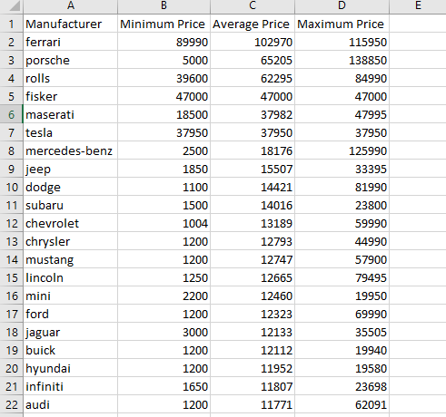
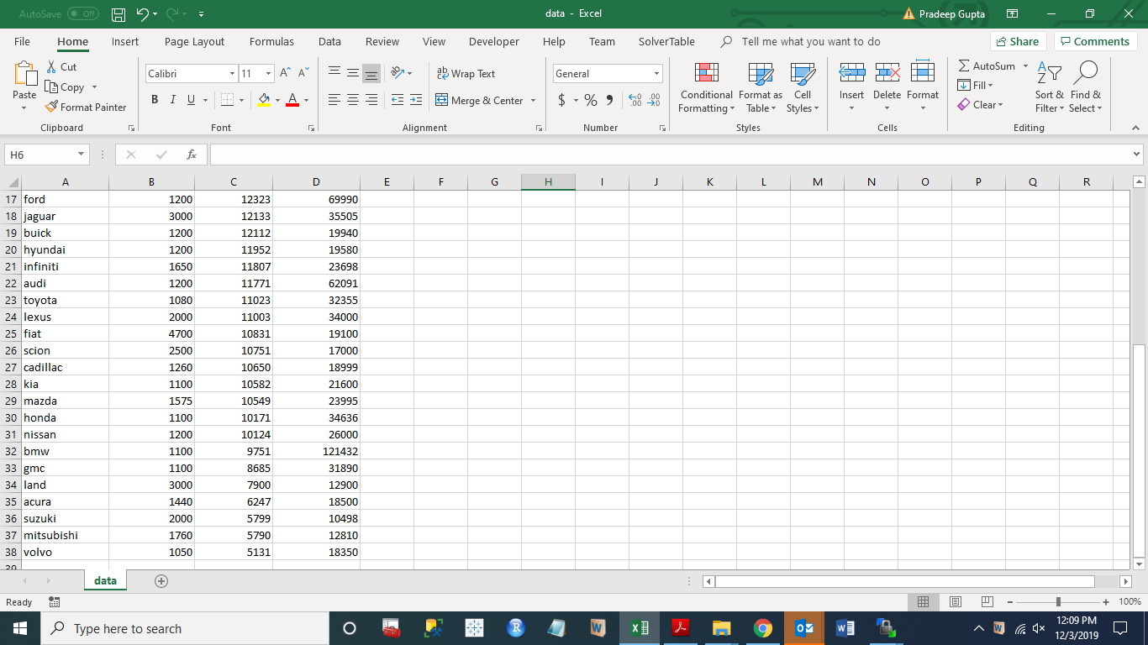
Mapreduce Output Formatted

Slide 19
REGRESSION

Slide 20
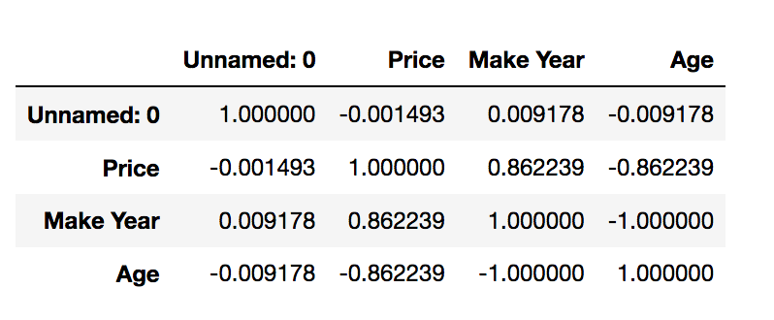
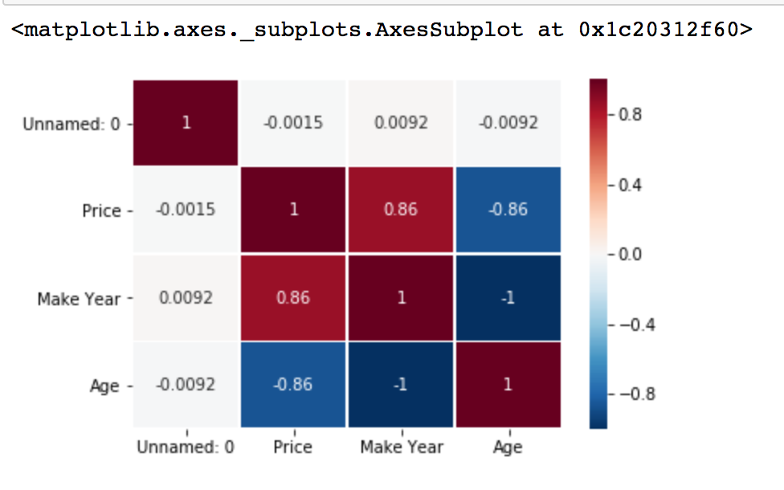
CORRELATION COEFFICIENT FOR HONDA
A coefficient close to 1 means that there's a Strong Negative correlation between Price and Age.
In our case there is strong negative correlations between the variables that means Higher the Depreciations lower the resale values.

Slide 21
Manufacturer Car Name | Score | Intercept | Co-efficient
BMW - Toyota | 0.09687424 | 15265.2037 | -440.91851
honda_manufacturer | 0.7443455 | 18283.51257 | -863.27067
Nissan_Volkswagen | 0.694232 | 17068.19469 | -905.49169
Toyota | 0.51817849 | 17915.33468 | -715.91479
ford_manufacturer | 0.045297 | 10077.74095 | 139.397397

Slide 22
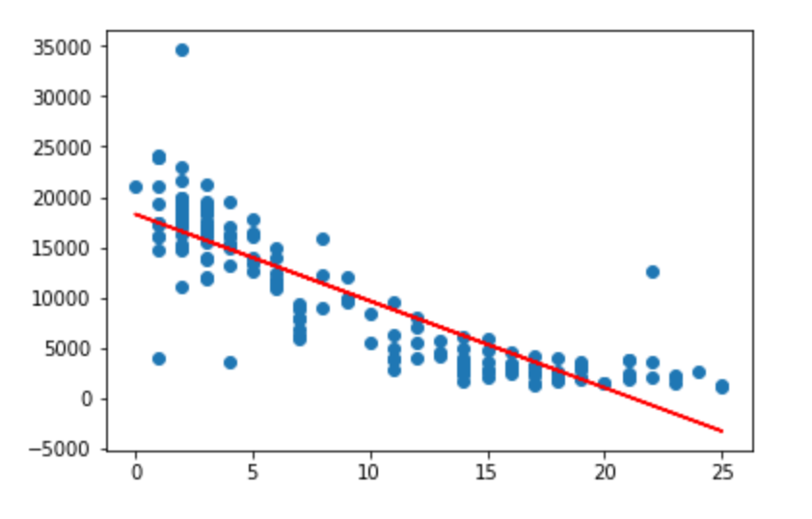
LINEAR REGRESSION FOR HONDA
Age is Independent Variable and Price is Dependent variable.
This plot presents overplotting as 169 samples are plotted. The plot shows a Strong Negative linear relation between Price and Age.

Slide 23
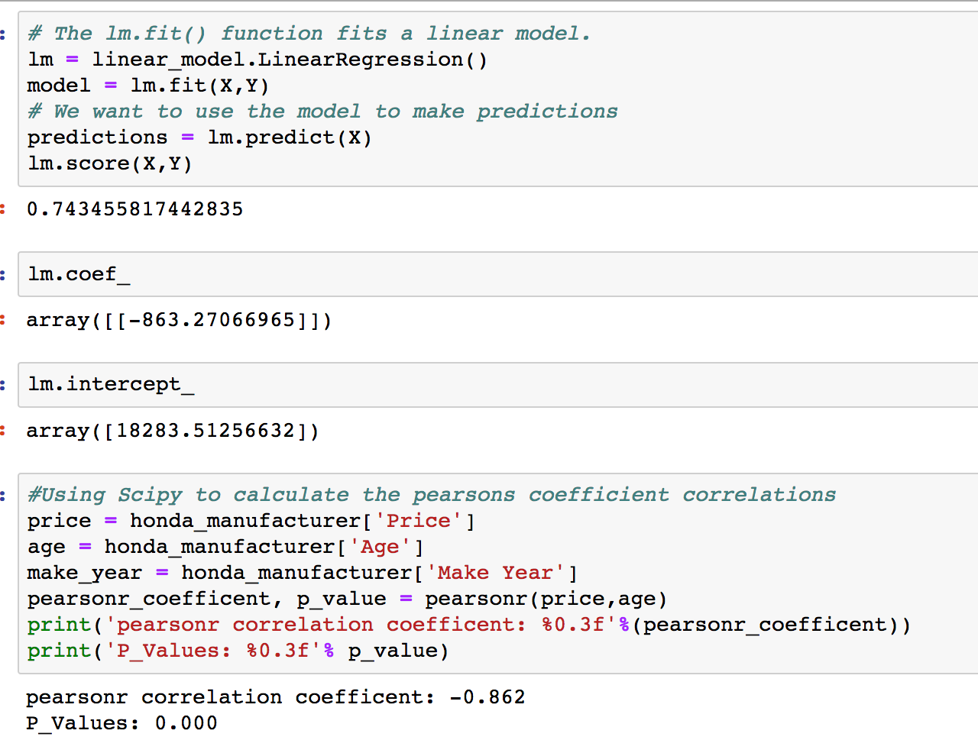
R² score = 0.743455.
The coefficient of 863 means that as age increases by 1 year, the average Price of Honda goes down by 863.
The Regression model is statistically significant as p-value is less than 0.05

Slide 24
CONCLUSION & Recommendation

Slide 25

CONCLUSION
Mercedes benz has the highest average price amongst all manufacturers
Average price shows that makes like BMW, Audi, Cadillac, Lexus, Acura, etc. have high depreciation, as their average initial purchase price are high but their used cars’ average price is low.
Japanese make and US make cars share almost equal market share in the US market.
By mean age of used cars, it is clear that users hold on to US make cars much longer than those for Japanese make cars.

Slide 26
RECOMMENDATIONS
If you want to buy a used luxury car, it is better to go for BMW or Acura, however, they will again fetch lesser resale value.
Toyota seems to be a safe car (good value for money) for low depreciation and good resale value.
If you want to hold on to a car for long duration go for Chevrolet, GMC or Ford.

Slide 27
Problems Faced
Web scraping beyond a certain page number resulted in denied access.
Extracted manufacturer name from car description by using list with all manufacturers’ names, string methods and join function.
MapReduce: had commas in description column of input file and hence, hit a temporary block while using comma as delimiter. Then changed to index number.
Model-wise analysis could not be done as model name is not uniformly entered and could not be captured like manufacturers’ name.

Slide 28
Utilization of learnings from the course
Used web-scraping for scraping around 2000 rows of unstructured data
Used regression analysis for comparing depreciation for cars from various manufacturers
Used MapReduce for analyzing average price for various makes. The same thing was done using Python code (without MapReduce) also but in case of millions of rows, MapReduce will be the technology to go for.

Slide 29
References / Source
https://www.letgo.com/en-us/c/cars (Source of data)
MapReduce files from the course materials of BAN632 were referred.

Slide 30
Thank You!
Pooja Bhansali
Pradeep Kumar Gupta
Sanjith Ramesh

