Slide 1
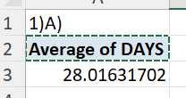
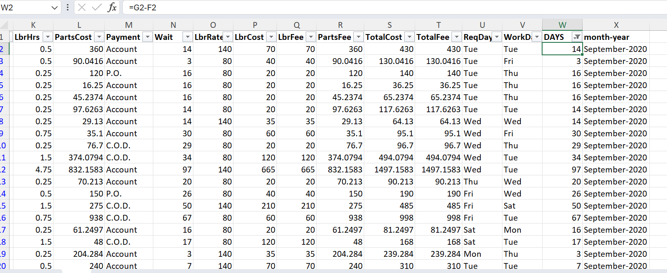
1.

Slide 2
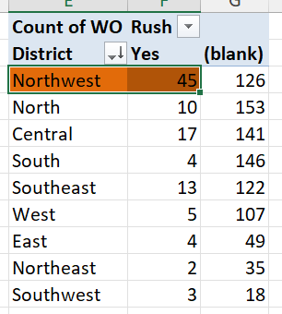
2.
Northwest district have highest no of rush jobs

Slide 3
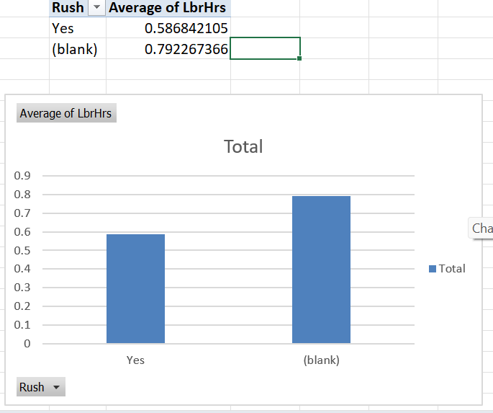
3.
Avg work hours of non-rush jobs is greater than the rush jobs

Slide 4
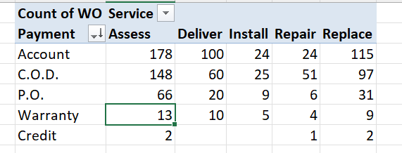
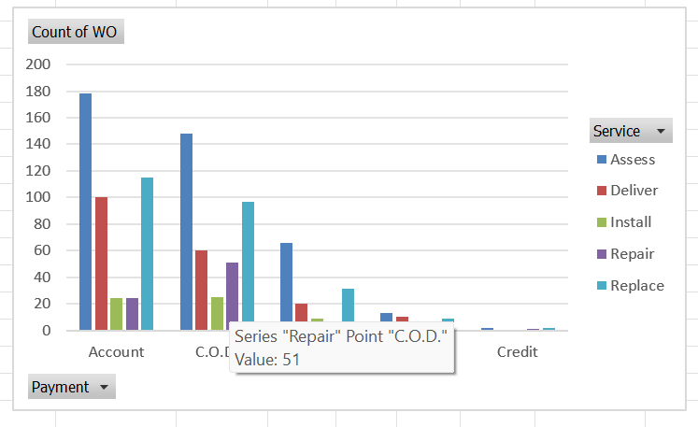
4.
Payment to assess through account is commonly used
Payment to install and deliver through credit has not done by anyone

Slide 5
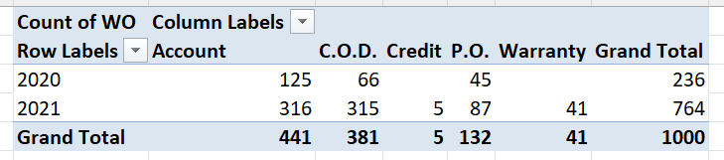
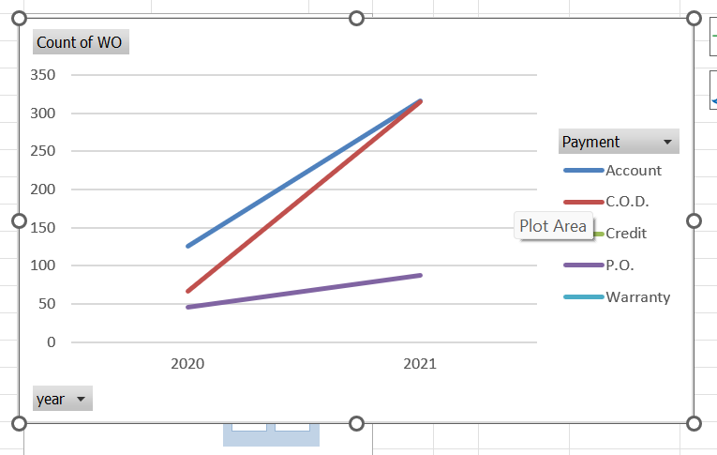
5.
Payments through different payment types have increased over time

Slide 6


6.
There is a positive correlation of 0.24 between technicians required and cost of the part

Slide 7
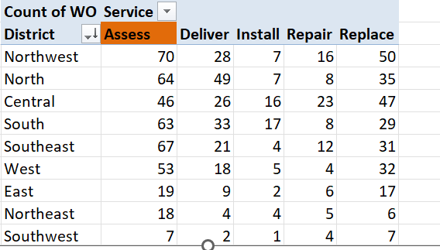
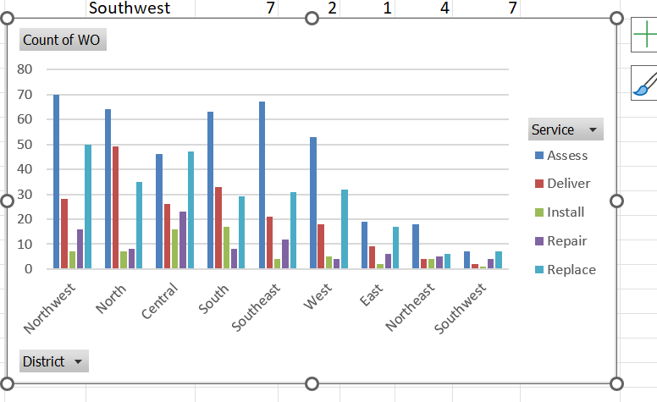
7.
Assess is the most requested service in each district

Slide 8
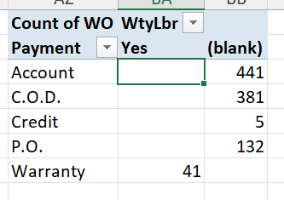
8.
Yes there is a clear difference in the distribution of payment types for work orders with warranty labour compared to those without
Only 41 have used warranty payment type

Slide 9
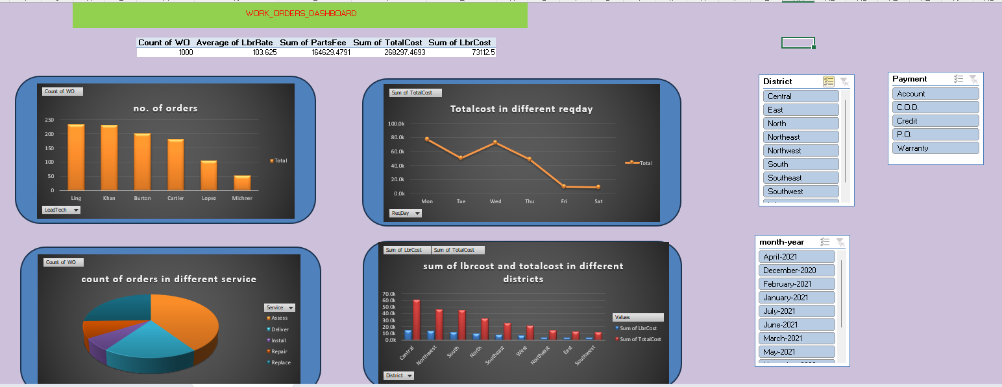
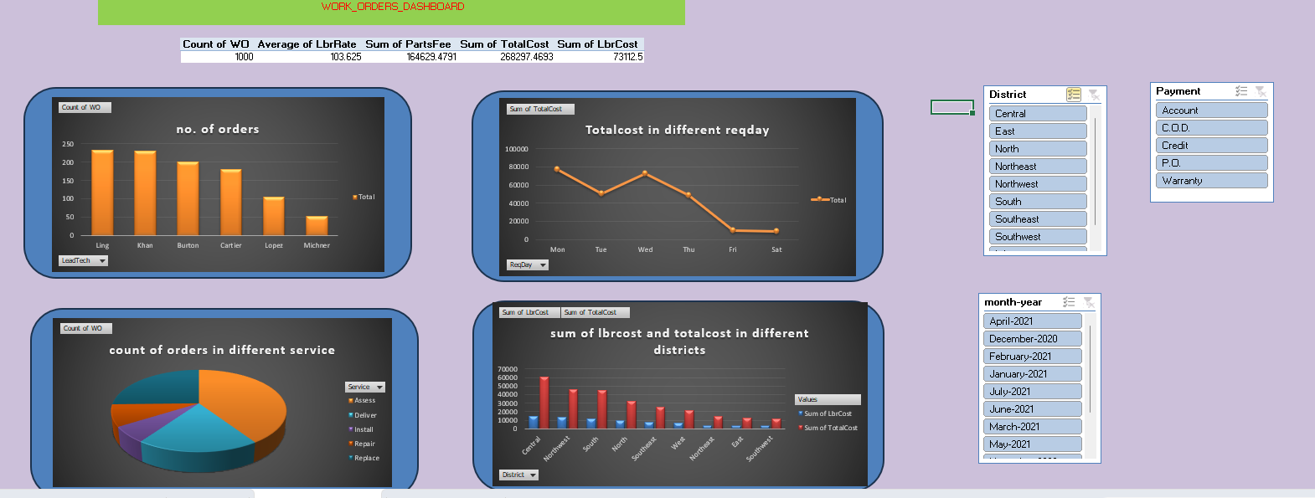
9.Dashboard

Slide 10
In the dashboard the below given charts have used
Pie chart for services types and no of orders in that services
Bar chart for leadtech and no of orders
Combo chart for sum of labourcost and totalcost in different districts
Line chart for total cost in different repdays
Payment type, District, month-year slicers are used to get required results after filtering

