Slide 1

1. AVG AGE OF EMPLOYEES IN FINANCE DEPARTMENT

Slide 2

2.TOTAL BONUS PAY OF FEMALE EMPLOYYES

Slide 3

3.HIGHEST AND LOWEST SALARY IN SPECIAL PRODUCTS

Slide 4
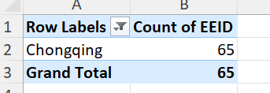
Maximum employes from which country

Slide 5
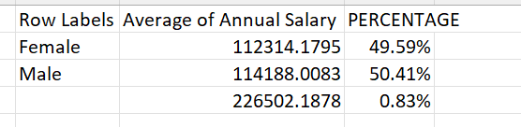

Slide 6
CASE STUDY

Slide 7
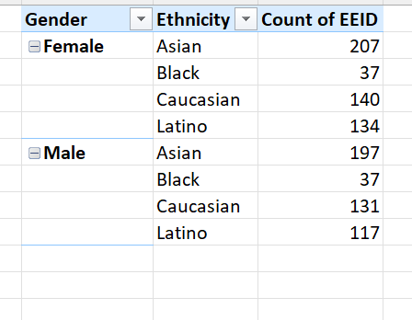
1.GENDER AND EHNICITY IN THE COMPANY
For this I used pivot table
Gender and ethnicity in rows
EEID in values

Slide 8
2.

Slide 9
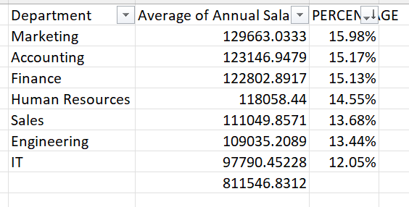
3. SIGNIFICANT CHANGE IN AVG SALARY IN DIFFERENT DEPARTMENT
NO, the percentage of average salaries in different department are quite close there is no significant change
To obtain the insights I used pivot table for departments and avg salaries in departments

Slide 10
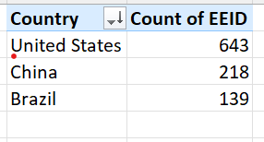
4. Country with more no of employees
United states have the most no of employees
For this I used pivot table
Country in rows
EEID in values(count)

Slide 11
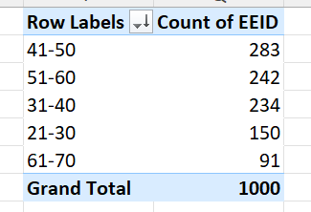
5. Most common age range among employes
Most common age range is 41-50
I used pivot table to get the answer
Age in rows are grouped by using group
EEID in values

Slide 12
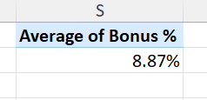
6. Avg bonus percentage given to employyes
Avg bonus percentage is 8.87%
For this I used pivot table
Bonus % in values field(average)

Slide 13
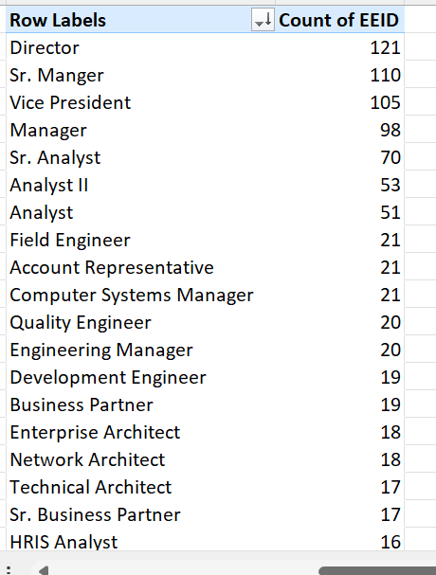
7. Which job title occurred more in dataset
Director title
For this I used pivot table
Job title in rows
EEID in values (count)
And filtered in descending order of count of EEID

Slide 14
8.

Slide 15
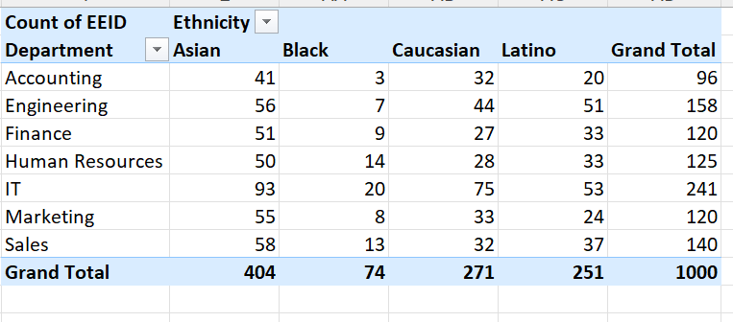
9.
Almost all the departments have the equal percent of ethnic background employees
For this I used pivot table
Department in rows
Ehinicity in columns
EEID in values

Slide 16
10.

