Slide 1

Amazon
Pooja Dhameliya

Slide 2

Objective
The objective of this project is to analyze Amazon product and customer review data using SQL queries. As a data analyst at Amazon, the goal is to extract meaningful insights by filtering, comparing, and evaluating products based on key attributes such as pricing, discount percentages, product categories, and customer review content. This analysis helps identify product performance trends, customer preferences, and pricing patterns, supporting data-driven decision-making and improving overall business strategy.

Slide 3
Problem Statement
1. List all products with a discounted price below ₹500.
2. Find products with a discount percentage of 50% or more.
3. Retrieve all products where the name contains the word "Cable."
4. Display the difference between the average of the actual price and the average of discounted price for each product.
5. Query reviews that mention "fast charging" in their content.
6. Identify products with a discount percentage between 20% and 40%.
7. Find products that have an actual price above₹1,000 and are rated 4 stars or above.
8. Find products where the discounted price ends with a 9 ?
9. Display review contents that contains words like worst, waste, poor, or not good.
10.List all products where the category includes "Accessories."

Slide 4
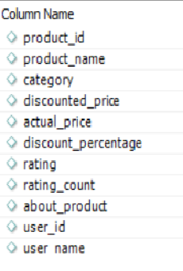
Dataset
Column in "mytable" Table
Column in "mytable" table
Total number of columns available in "mytable" table

Slide 5
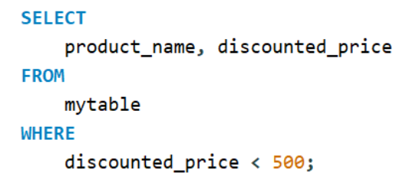
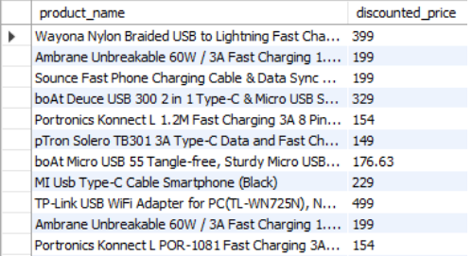
1. List all products with a discounted price below ₹500.
There are 576 products whose discounted price was below 500.
Output

Slide 6
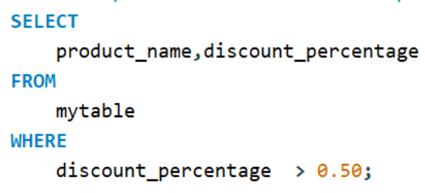
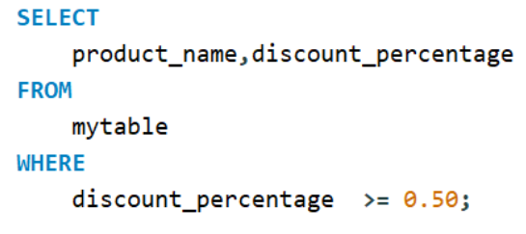
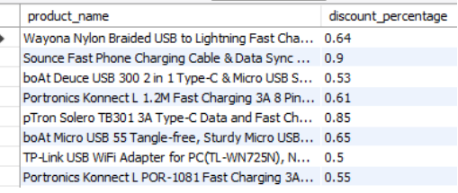
2. Find products with a discount percentage of 50% or more.
There are 751 number of products whose discount percentage of 50% or more
Output

Slide 7
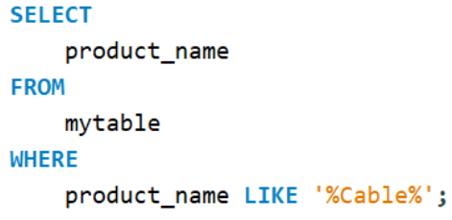
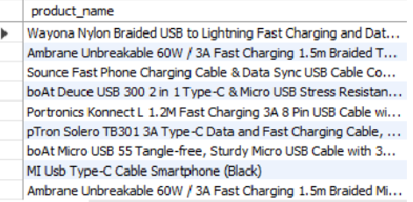
3. Retrieve all products where the name contains the word "Cable."
There are 304 number of products whose name contains word "Cable" in product name.
Output

Slide 8
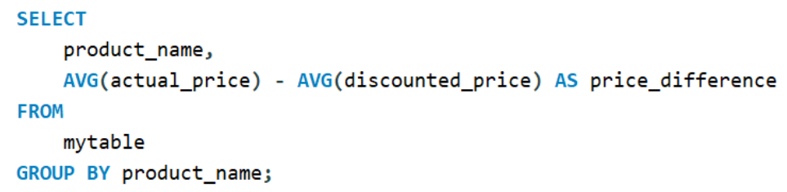
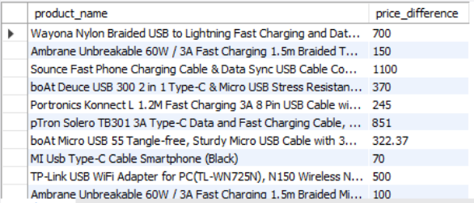
4. Display the difference between the average of the actual price and the average of discounted price for each product.
Output

Slide 9
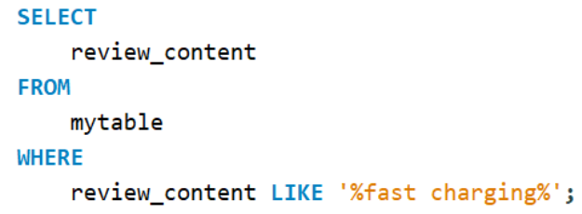
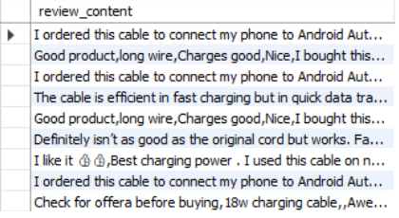
5. Query reviews that mention "fast charging" in their content.
There are 157 number of products which have word "fast charging" in review.
Output

Slide 10
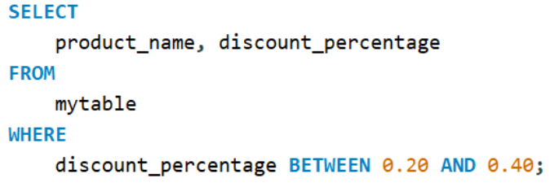
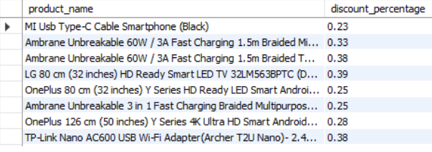
6. Identify products with a discount percentage between 20% and 40%.
There are 352 number of products whose discounted percentage is between 20% and 40%.
Output

Slide 11
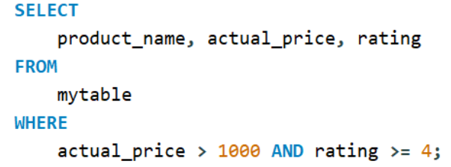
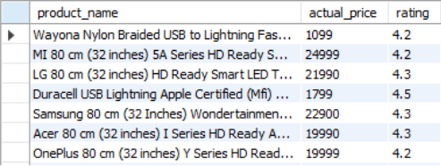
7. Find products that have an actual price above₹1,000 and are rated 4 stars or above.
There are 709 number of products whose actual price is more than ₹1,000 and rating is equal to or more than 4.
Output

Slide 12
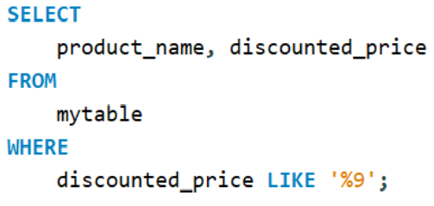
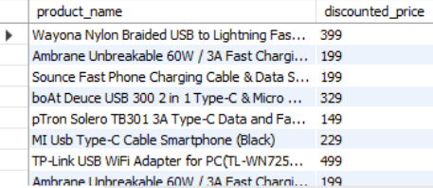
8. Find products where the discounted price ends with a 9 ?
There are 1054 number of products where discounted price ends with "9"
Output

Slide 13
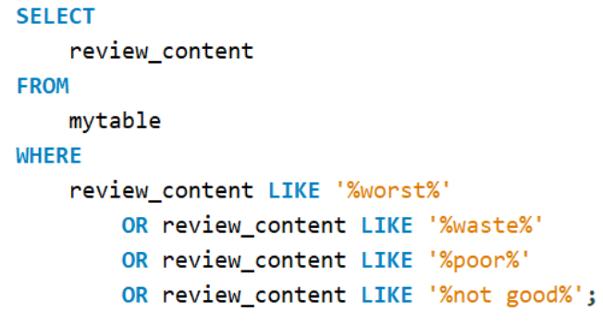
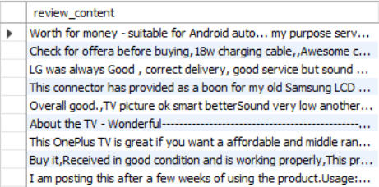
9. Display review contents that contains words like worst, waste, poor, or not good.
There are 293 number of products whose review contains the following words "worst","waste","poor" and "not good".
Output

Slide 14
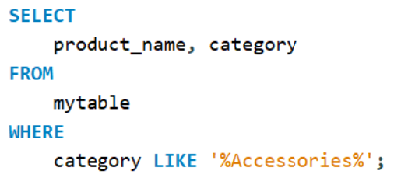
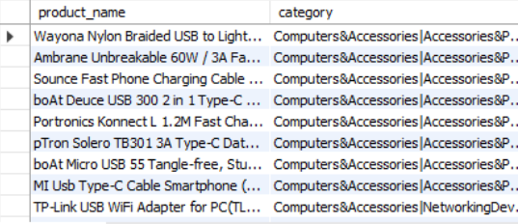
10. List all products where the category includes "Accessories."
There are 890 products which have word "Accessories" in there category.
Output

Slide 15

Thank You

