Slide 1


Submitted To: Prof. Nidhi Nigam
ACROPOLIS INSTITUTE OF TECHNOLOGY AND RESEARCH
nmap
Submitted By:
Pooja Dalai

Slide 2
Content Outline
01
Introduction
02
Types of Cyber Security
03
Types of Cyber Attacks
04
Benefits of Cyber Security
05
Nmap
06
Network Scanning Using Nmap

Slide 3

Introduction
The technique of protecting internet-connected systems such as computers, servers, mobile devices, electronic systems, networks, and data from malicious attacks is known as cybersecurity. We can divide cybersecurity into two parts one is cyber, and the other is security. Cyber refers to the technology that includes systems, networks, programs, and data. And security is concerned with the protection of systems, networks, applications, and information. In some cases, it is also called electronic information security or information technology security.

Slide 4

Types of Cyber Security
Network Security Application Security Information or Data Security Operational Security Cloud Security etc..

Slide 5
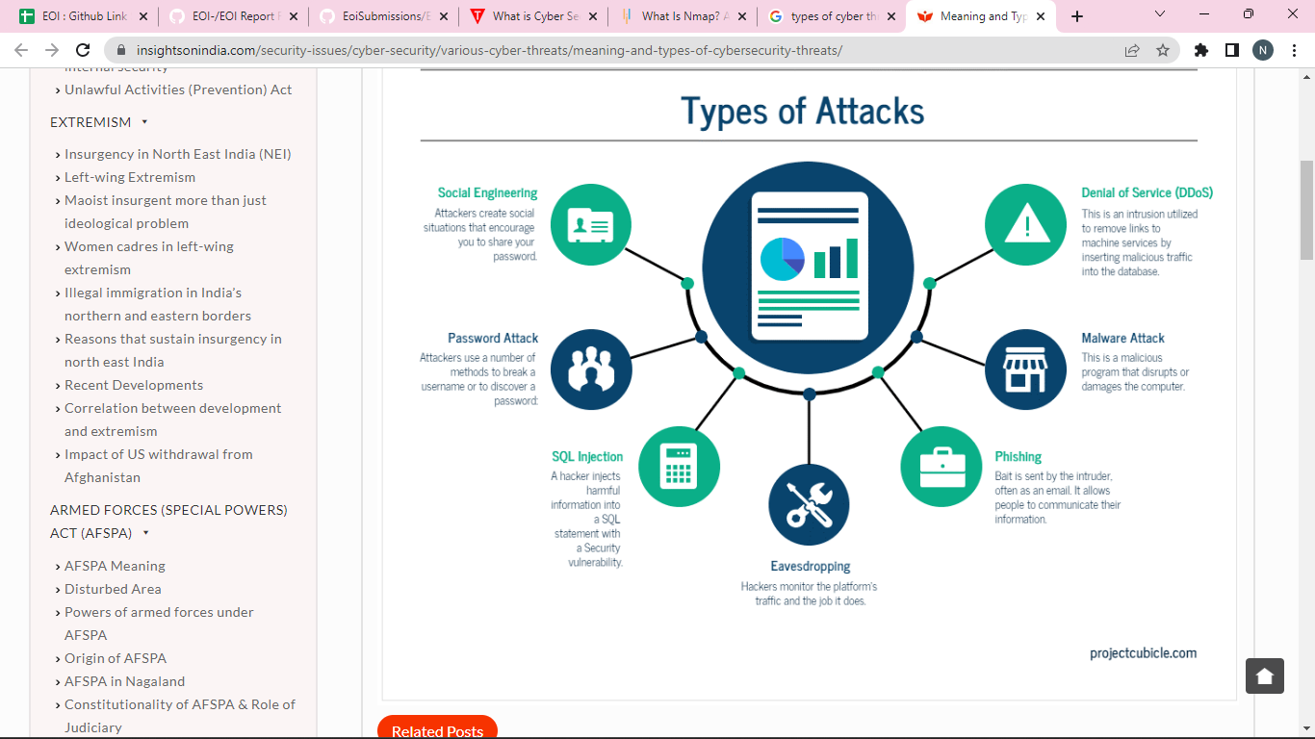
Problem Statement

Slide 6
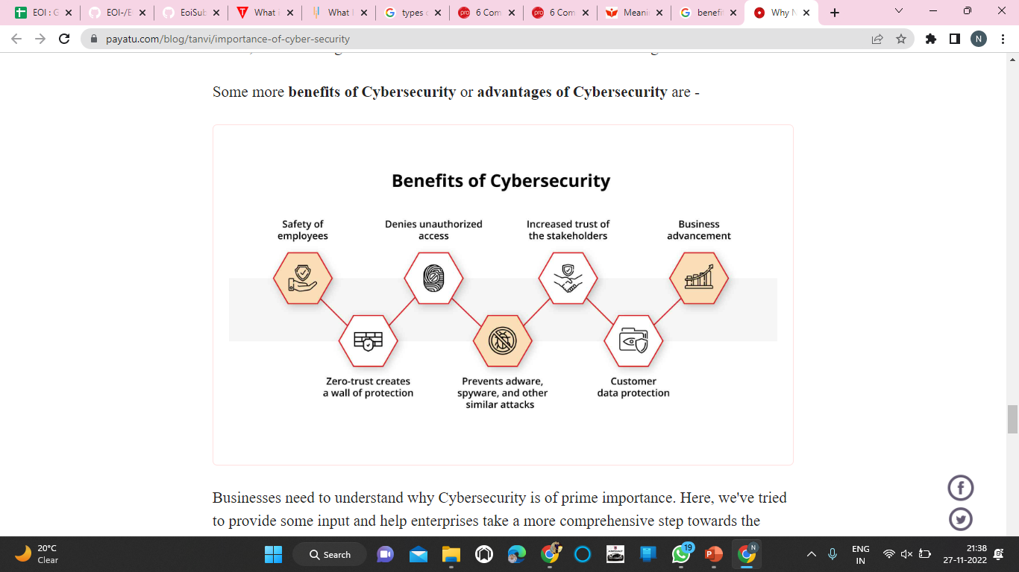


Slide 7
Nmap
Nmap, the acronym for Network Mapper, is an open-source security auditing and network scanning software designed by Gordon Lyon.
Nmap becomes helpful while performing network penetration testing. It not only gives network information but also assists in discovering security issues in the system. Nmap is platform-agnostic and may be run on various standard operating systems, including Linux, Windows, macOS, and BSD. It is straightforward to use and includes both a command-line interface(CLI) and a graphical user interface(GUI).

Slide 8
Some of the tasks that nmap can carry out are-
Nmap becomes helpful while performing network penetration testing.
Discovering connected hosts on a network
Analyzing free ports on a target host
Detecting running services on a system along with version number
Uncovering network vulnerabilities and system loopholes.

Slide 9
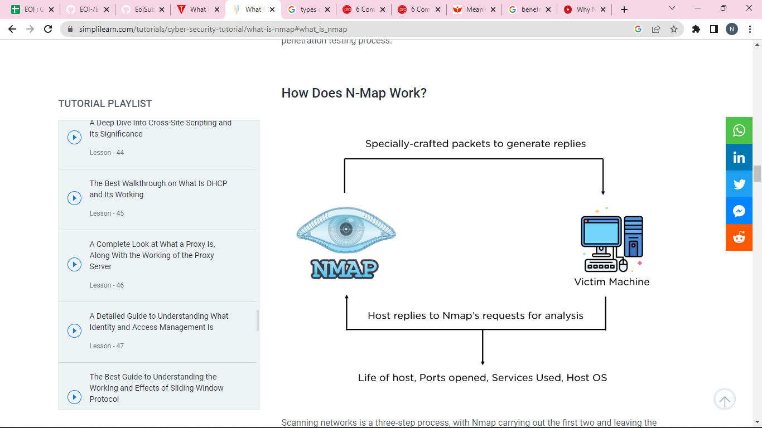
Block Diagram

Slide 10
Network Scanning Process using nmap
Scanning networks is a three-step process, with Nmap carrying out the first two and leaving the ethical hacker for the third. So, you will cover these phases sequentially. Sending Requests: Nmap sends raw IP packets to discover accessible hosts on a network system. According to network configurations, these packets need a response from the destination computer. Receiving Replies: Since these requests warrant a reply, the host sends back responses highlighting the ports that can communicate with other machines. Open ports will send some replies, while the closed ones can be filtered out since they will have no response. Analyzing Responses: Once the hackers have some information from the target's side, they must go through vulnerable services and open ports. After this step, one can move on to the third phase in ethical hacking, gaining access to the victim machine.

Slide 11


Thankyou

