Slide 1
Data Journalism (with Python)

Slide 2
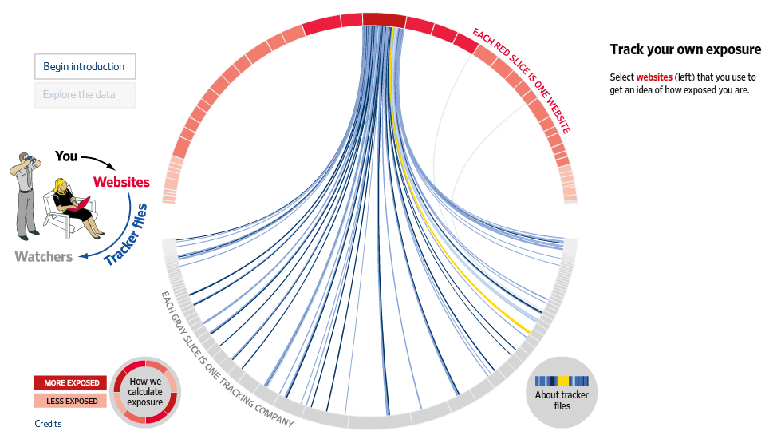

Slide 3
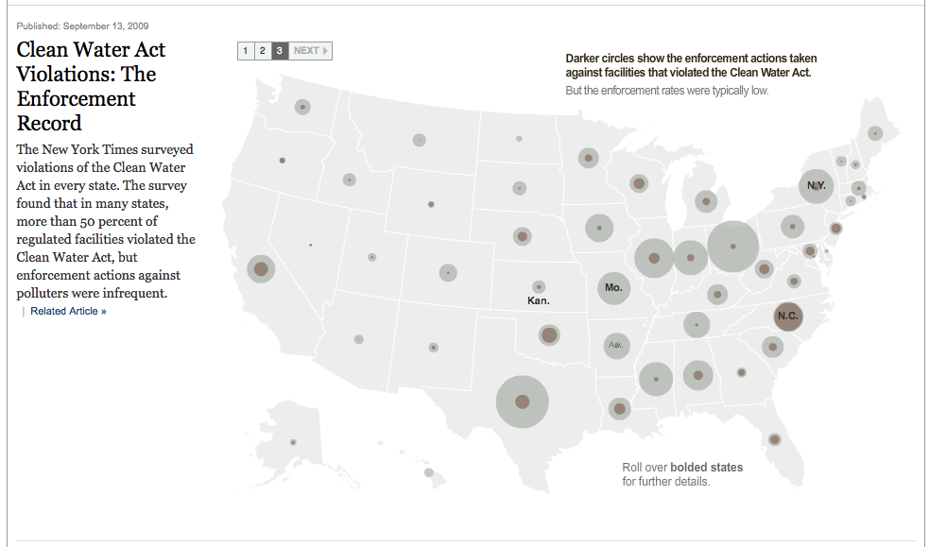

Slide 4
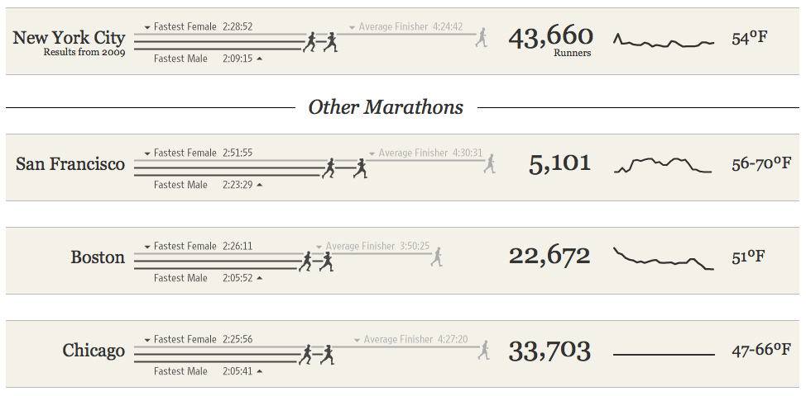

Slide 5
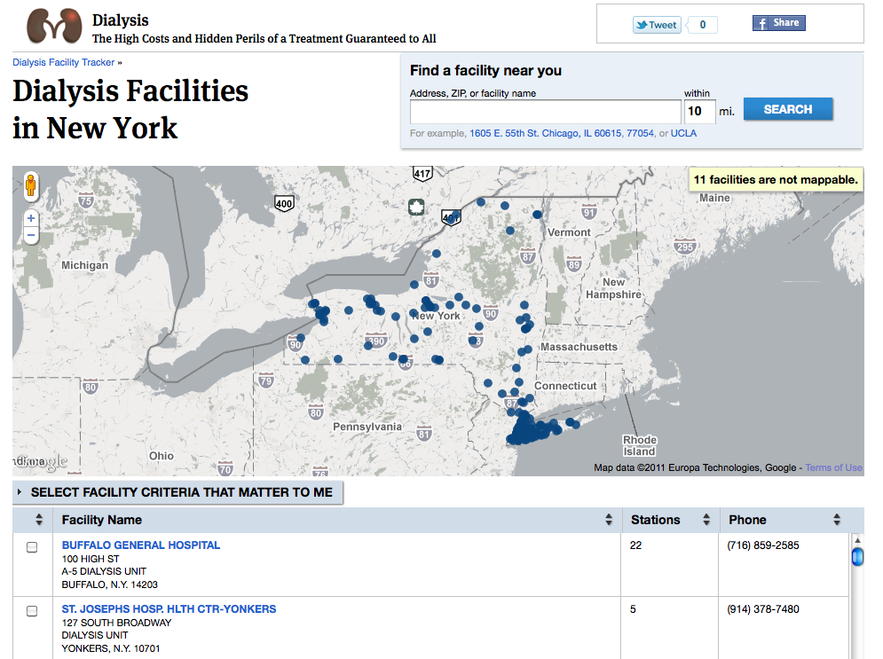

Slide 6
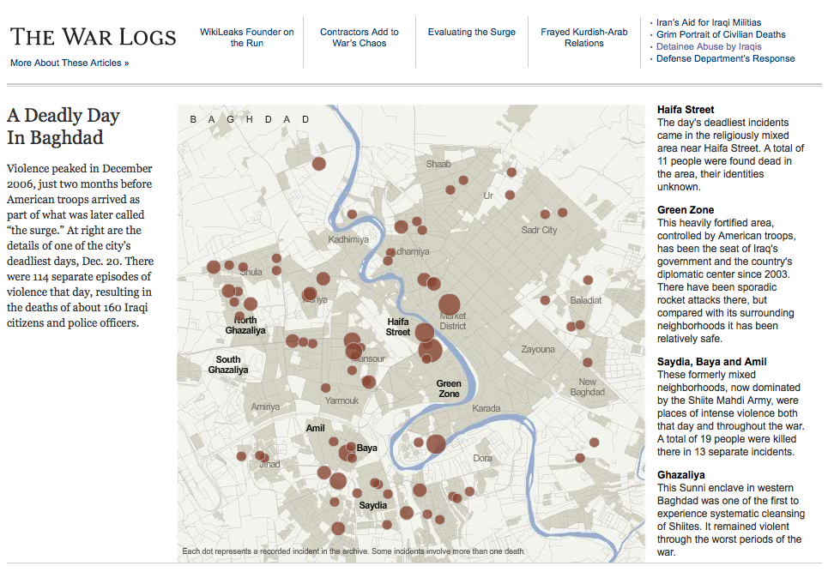

Slide 7
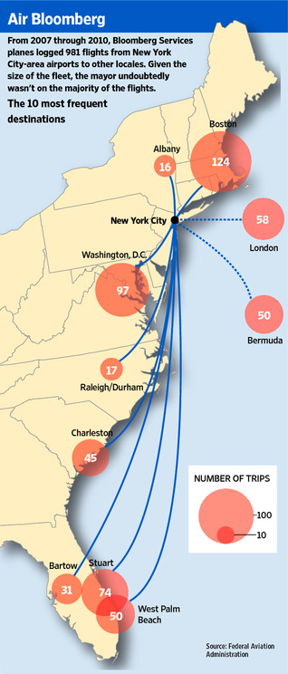

Slide 8
Get
Clean
Analyze
Present

Slide 9

http://python.org/about/gettingstarted/
https://github.com/albertsun/Intro-Data-Journalism-With-Python/

