Slide 1
TRAVEL PLANNER AGENT
CAPSTONE PROJECT
Presented By:
1. Pooja Dhamale-Smt. Indira Gandhi College of Engineering-AIDS

Slide 2
OUTLINE
Problem Statement (Should not include solution)
Proposed System/Solution
System Development Approach (Technology Used)
Algorithm & Deployment
Result (Output Image)
Conclusion
Future Scope
References

Slide 3
Problem Statement
A travel planner agent aims to assist users in planning their trips efficiently. The agent must gather user preferences, budget, and destination information. It should then optimize travel itineraries, accommodations, and activities. The goal is to create personalized travel plans that maximize user satisfaction. This requires integrating real-time data and handling complex logistics. It ensures a smooth travel experience.The agent can also manage bookings, alert users to changes, and optimize schedules on the go. This smart assistant transforms complex travel planning into a seamless,enjoyable process.

Slide 4
Proposed Solution
Gathers user inputs: Collects user preferences, budget, and destination choices through a user-friendly interface.
Optimizes travel plans: Uses algorithms to create personalized itineraries, booking optimal accommodations and activities based on user preferences and real-time data.
Integrates real-time data: Incorporates real-time weather updates, event schedules, and travel advisories to ensure seamless travel experiences.
Provides logistics support: Handles complex logistics, such as transportation arrangements and activity bookings, to minimize user hassle.
Maximizes user satisfaction: Continuously learns from user feedback to refine and personalize future travel plans.

Slide 5
System Approach
The "System Approach" section outlines the overall strategy and methodology for developing and implementing the travel panner agent.
a. Hardware Requirements
Device with an internet connection
b. Software Requirements
IBM Cloud account (Free Lite plan)
IBM Watson Studio
IBM Cloud Object Storage (Lite)
c. Cloud Services Used
IBM Watson Studio / Watsonx.ai
IBM Cloud Object Storage

Slide 6
Algorithm & Deployment
In the Algorithm section, describe the machine learning algorithm chosen for predicting bike counts. Here's an example structure for this section:
Algorithm Selection:
Provide a brief overview of the chosen algorithm (e.g., time-series forecasting model, like ARIMA or LSTM) and justify its selection based on the problem statement and data characteristics.
Data Input:
Specify the input features used by the algorithm, such as historical bike rental data, weather conditions, day of the week, and any other relevant factors.
Training Process:
Explain how the algorithm is trained using historical data. Highlight any specific considerations or techniques employed, such as cross-validation or hyperparameter tuning.
Prediction Process:
Detail how the trained algorithm makes predictions for future bike counts. Discuss any real-time data inputs considered during the prediction phase.

Slide 7
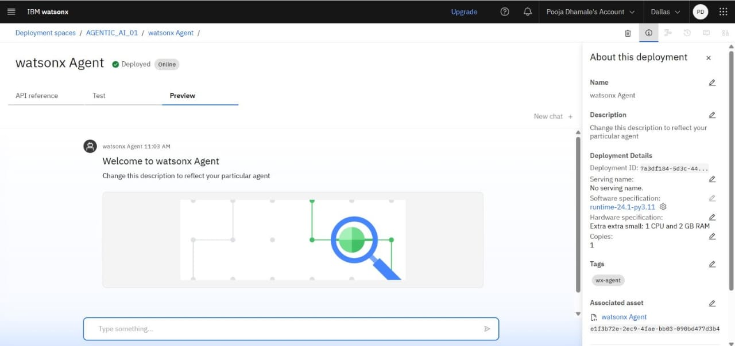
Result

Slide 8
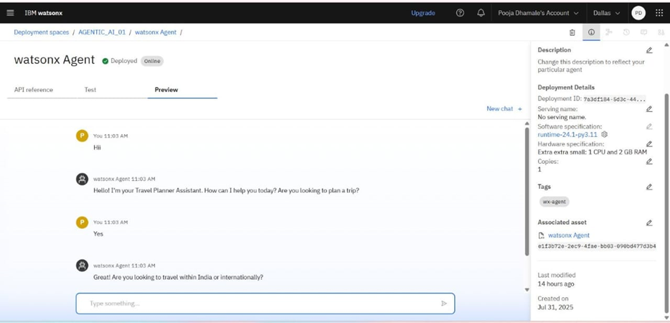
RESULT

Slide 9
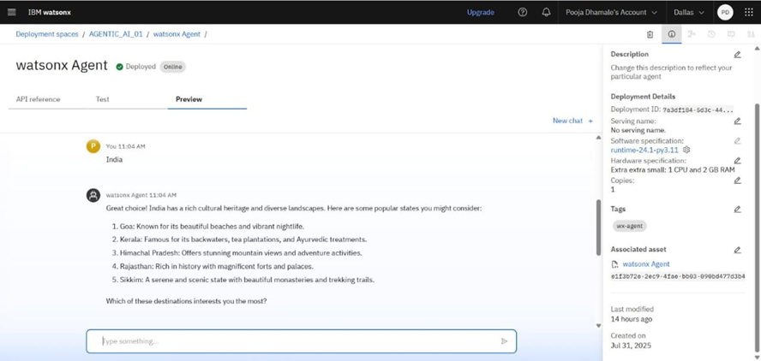
RESULT

Slide 10
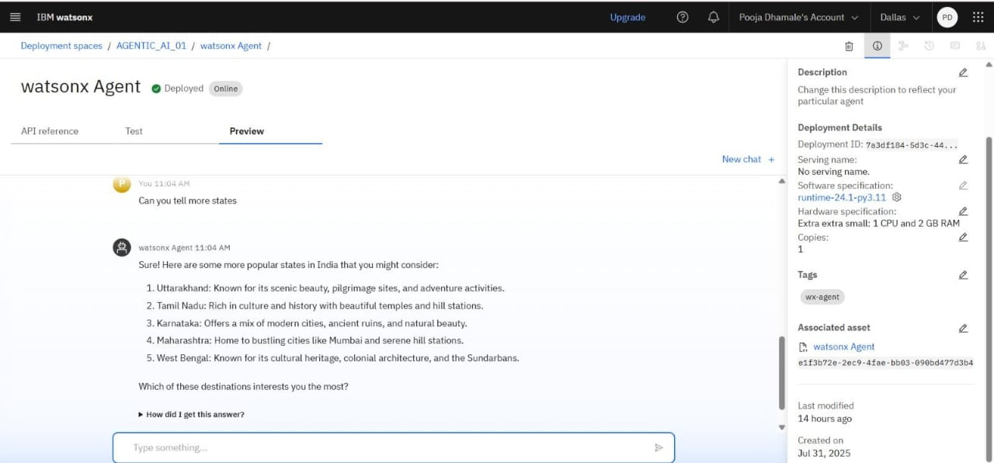
RESULT

Slide 11
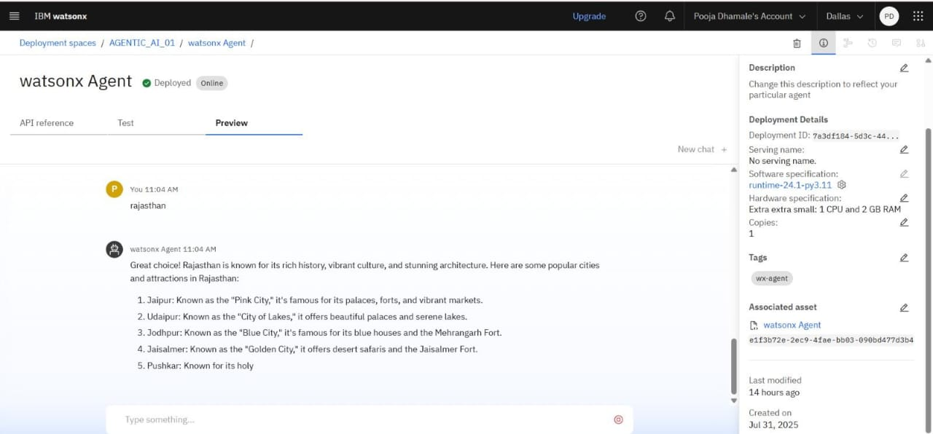
RESULT

Slide 12
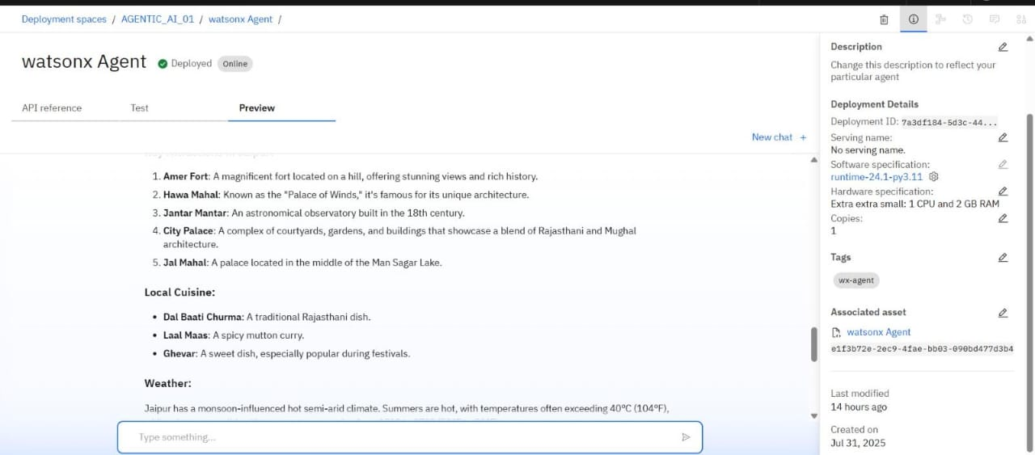
RESULT

Slide 13
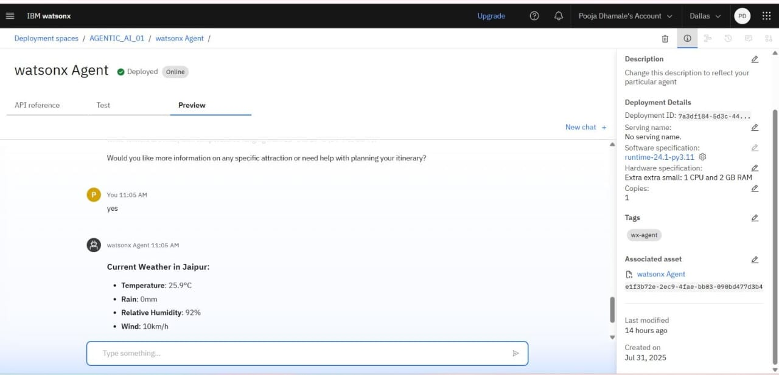
RESULT

Slide 14
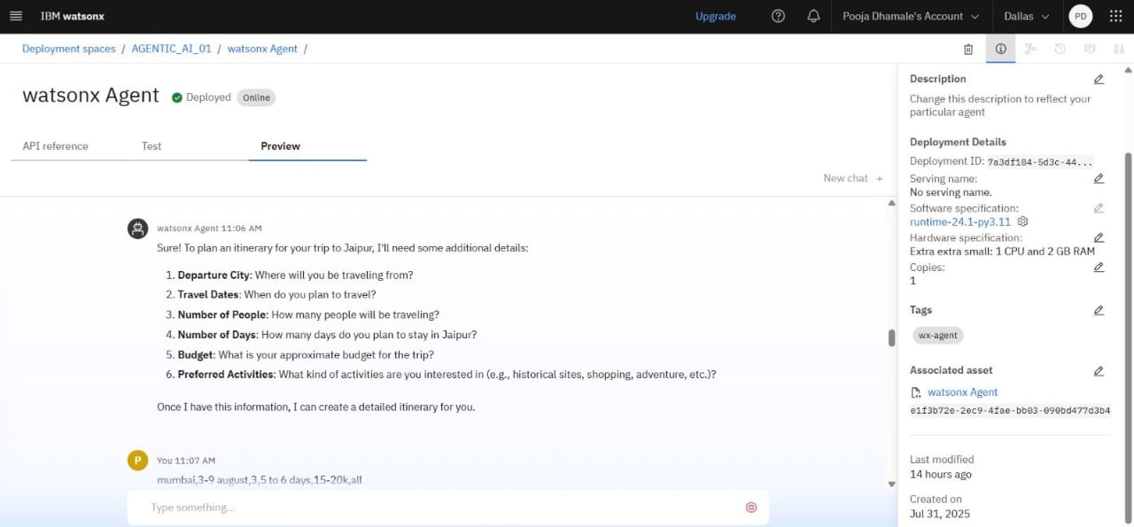
RESULT

Slide 15
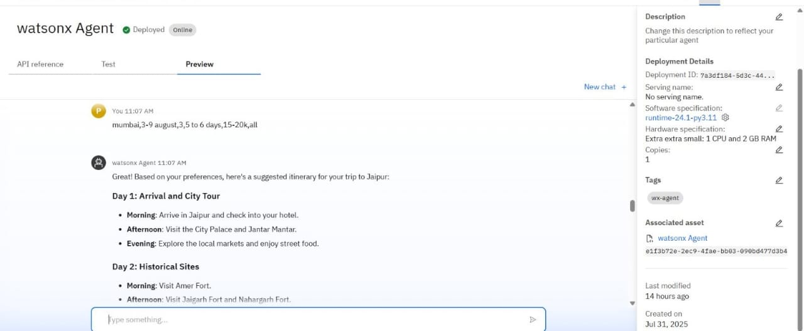
RESULT

Slide 16
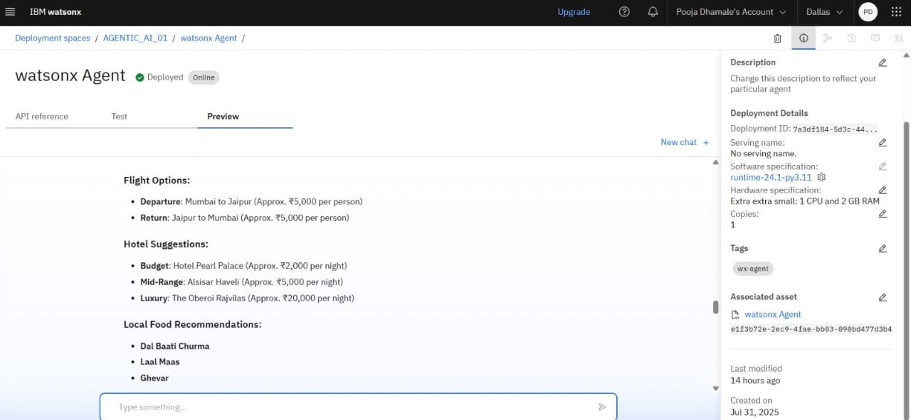
RESULT

Slide 17
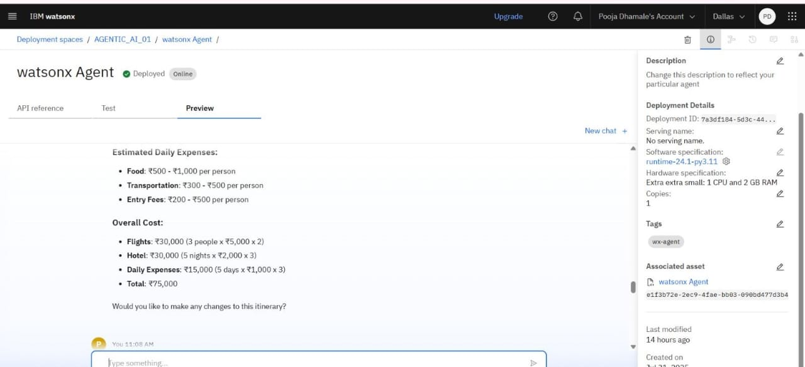
RESULT

Slide 18
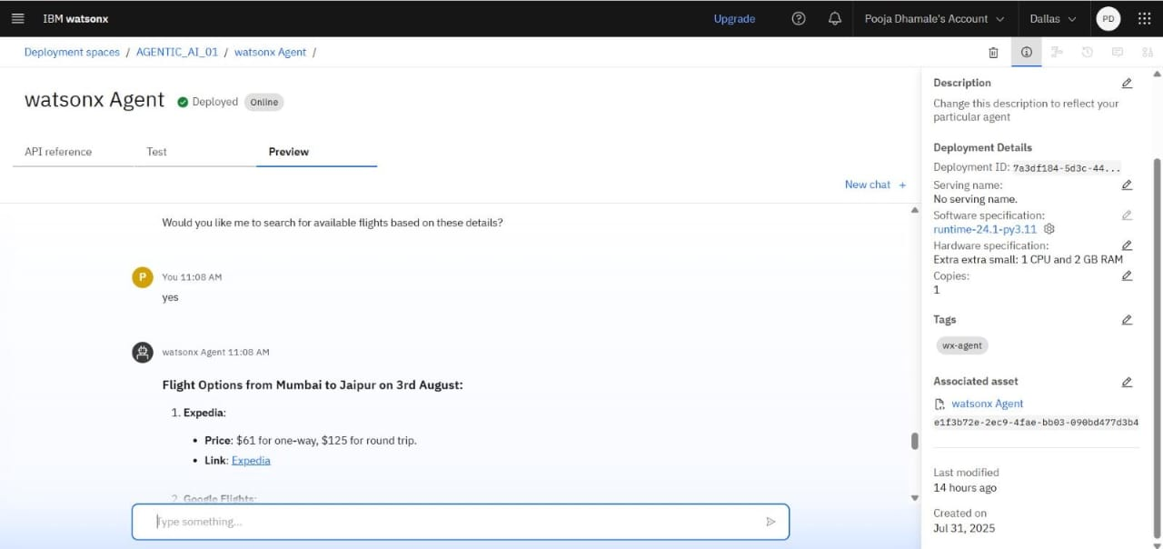
RESULT

Slide 19
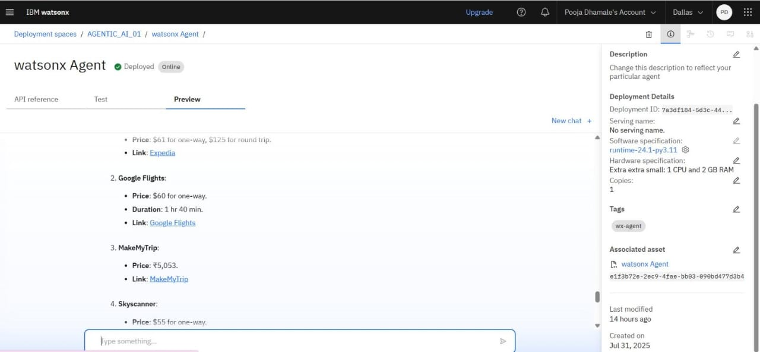
RESULT

Slide 20
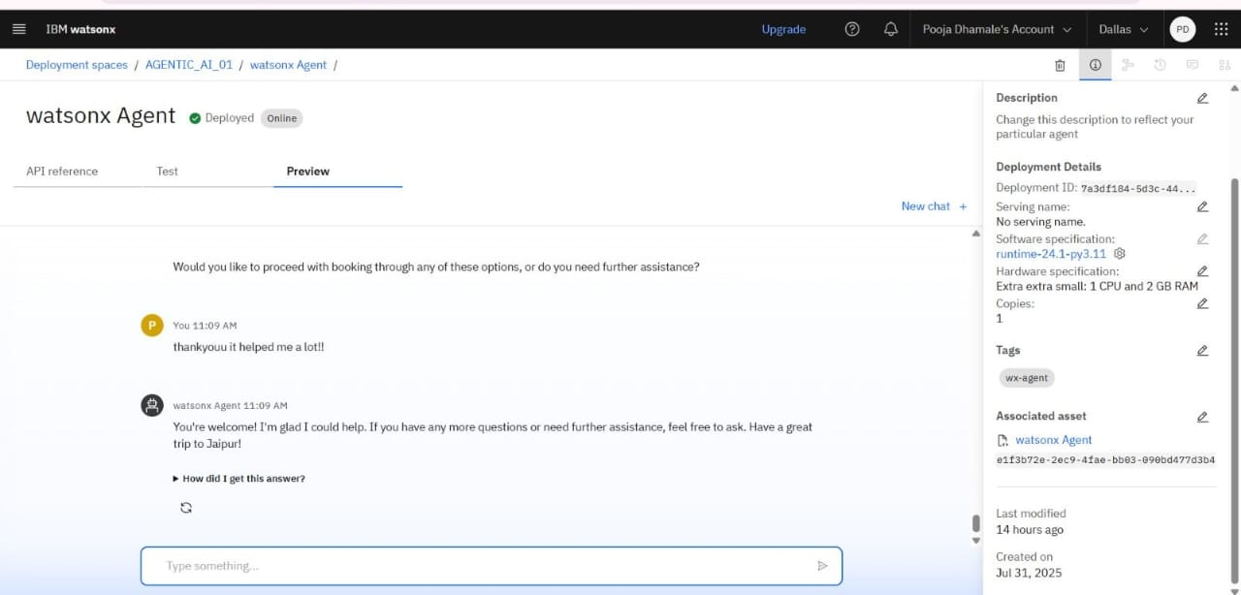
RESULT

Slide 21
Conclusion
The development of the Travel Planner Agent demonstrates the potential of agentic AI systems to simplify and personalize the travel planning process for users. By leveraging IBM Cloud’s no-code/low-code tools — such as Watsonx Ai Studio and cloud storage integration — the solution efficiently guides users through destination selection, itinerary building, and travel decision-making based on personal preferences and contextual data.The agent’s instruction-driven architecture allows for flexible, human-like interaction without requiring manual programming. This has proven effective in generating dynamic responses, tailoring recommendations to user inputs (e.g., budget, interests, duration), and improving user engagement. The integration of datasets (if applied) further enhances the relevance of suggestions, creating a more informed and practical planning experience. Intelligent agents like the Travel Planner reduce user frustration, minimize planning errors, and improve overall satisfaction — contributing to smarter, more connected digital experiences.

Slide 22
Future scope
The future scope of the Travel Planner Agent includes integrating real-time data sources such as weather, traffic, and public transportation APIs to enhance recommendation accuracy. The system can be expanded to support multiple cities and international destinations, offering broader coverage for diverse users. Advanced machine learning techniques could be employed to provide more personalized and adaptive travel suggestions based on user behavior and preferences. Voice-based interaction can be added to make the agent more accessible and user-friendly. Edge computing may be leveraged to enable offline or low-latency travel planning on mobile devices. Integration with booking platforms like hotels, flights, and local tours would offer end-to-end planning within a single interface. Multilingual support would help reach a global audience, while AI-powered itinerary optimization could balance cost, time, and user experience. Additionally, the agent could generate complete travel stories or plans using generative AI, further enhancing the user experience and engagement.

Slide 23
References
1 .TravelPlanner: A Benchmark for Real‑World Planning with Language Agents — Introduces a challenging planning benchmark to evaluate LLM‑powered travel planning systems and highlights current limitations (GPT‑4 success rate ~0.6%).
2. TRIP‑PAL: Travel Planning with Guarantees by Combining LLMs and Automated Planners — Proposes a hybrid system that combines LLMs with constraint‑based automated planners to produce coherent, constraint‑satisfying itineraries.
3. TravelAgent: An AI Assistant for Personalized Travel Planning — Describes a modular LLM‑based system focused on rational, comprehensive, and personalized itineraries using recommendation, planning, tool‑usage, and memory modules.
4. A Travel Recommender for Personalized Itineraries — A case‑study from 2018 showing cloud‑based itinerary recommendation leveraging user profiles and content/item similarity models

Slide 24
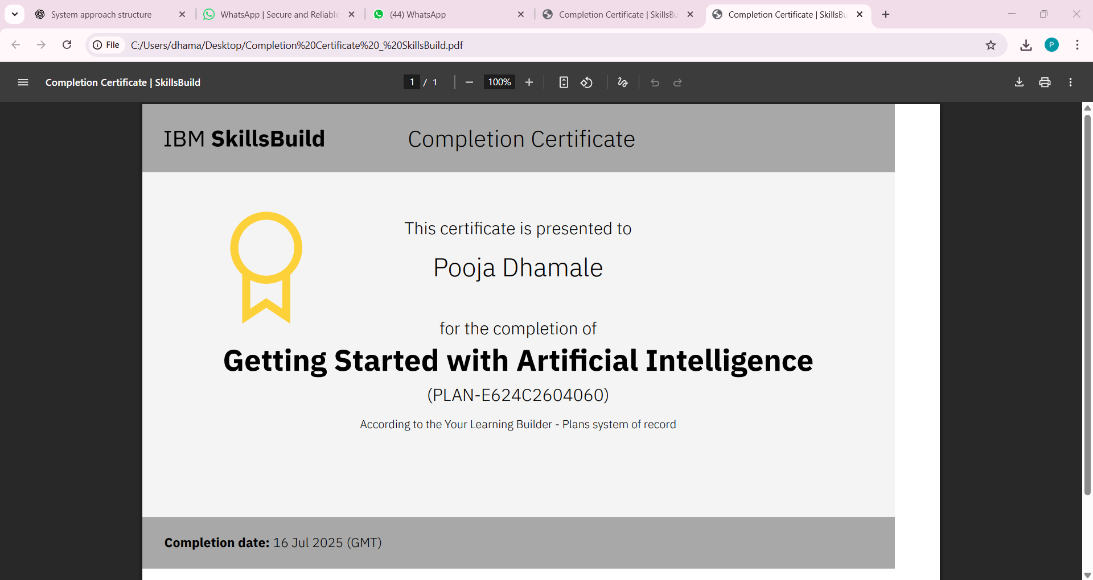
IBM Certifications
Screenshot/ credly certificate( getting started with AI)

Slide 25
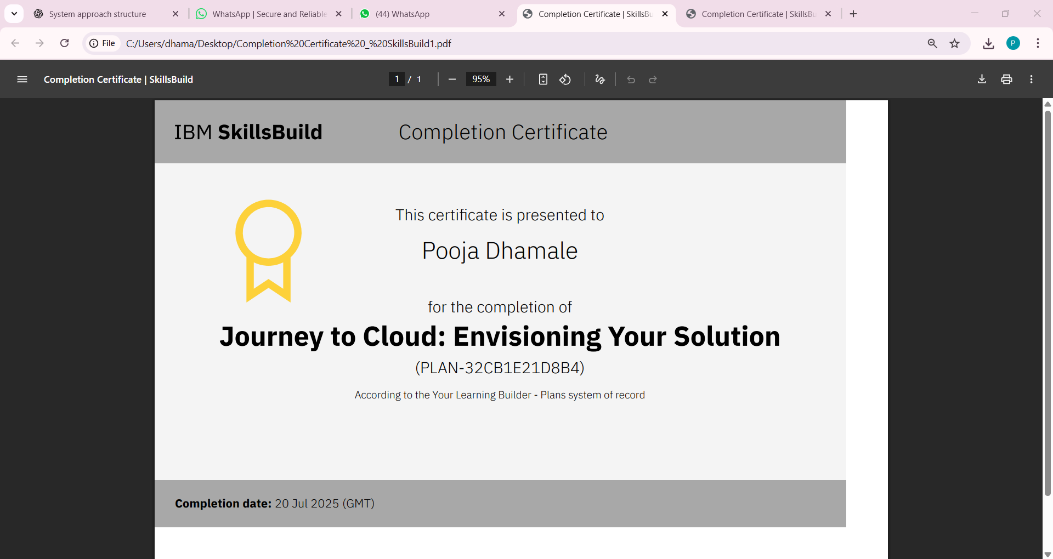
IBM Certifications
Screenshot/ credly certificate( Journey to Cloud)

Slide 26
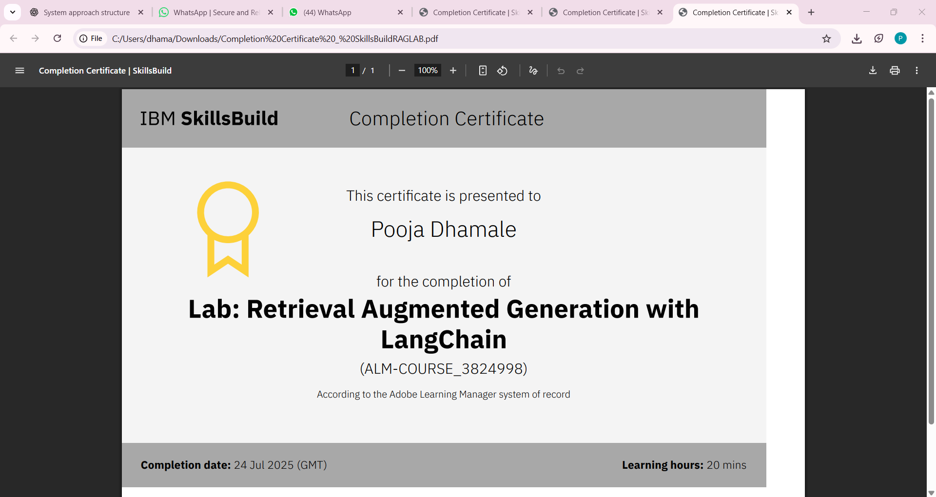
IBM Certifications
Screenshot/ credly certificate( RAG Lab)

Slide 27
THANK YOU

