Slide 1
TED Talk Data

Slide 2
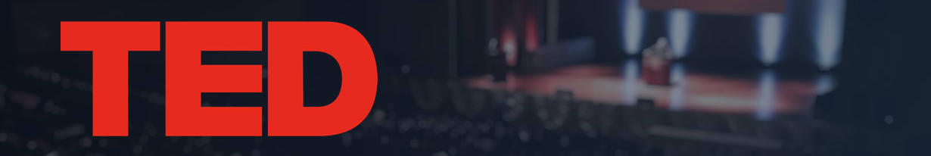
Data Set
Data Set
Collected from www.kaggle.com/rounakbanik/ted-talks
Contains information about all audio-video recordings of TED Talks uploaded to the official TED.com website until September 21st, 2019
About 2,500 different talks
Features include number of views, number of comments, descriptions, speakers and titles, as well as transcripts of the talks.

Slide 3
Inspirations & Impact of our Data Set
TED talks provide diverse & interesting content to people all over the world, from experts and leaders.
We wanted to apply the concepts learned in this class to explore things like, can we predict the popularity of a TED talk? Which talks are similar?
Do the languages of the talks matter, or the occupations of the speakers? What can be said about the sentiment of TED talks?

Slide 4
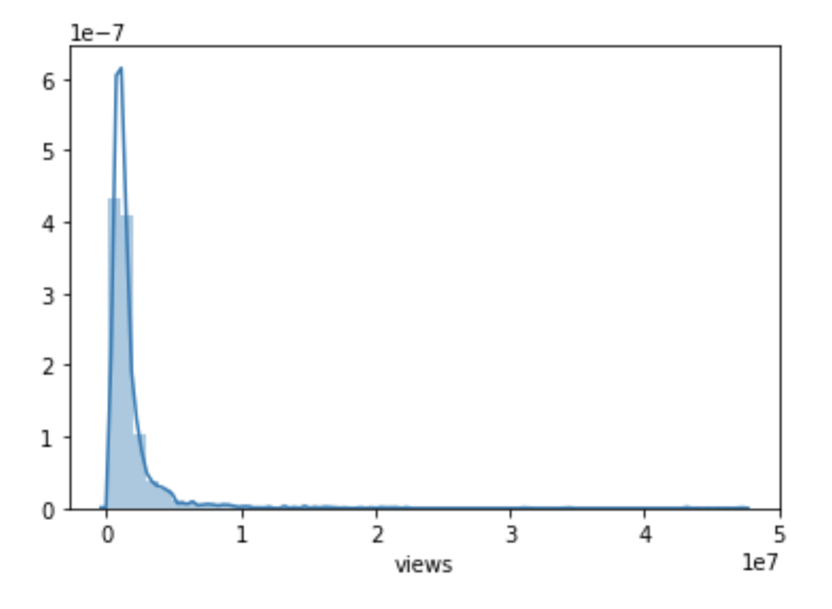
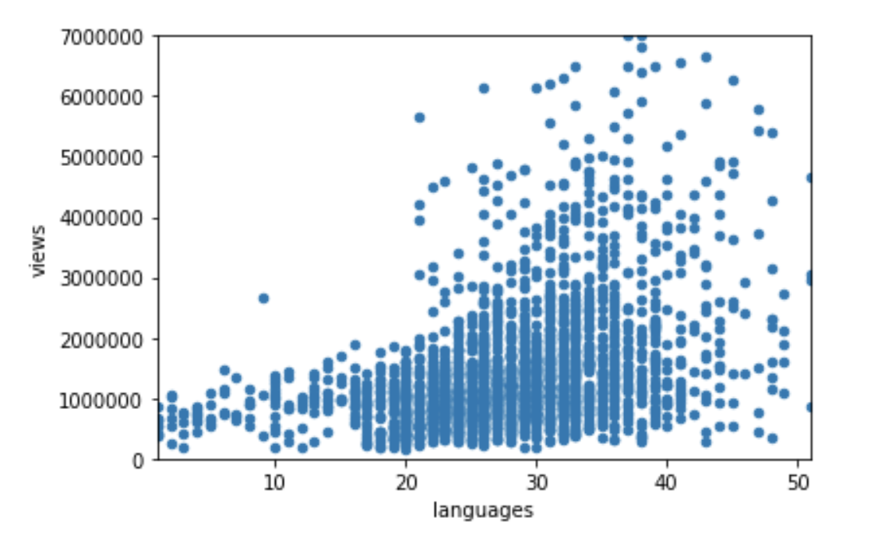
Data Discovery
Views v.s. Languages
View Distributions

Slide 5
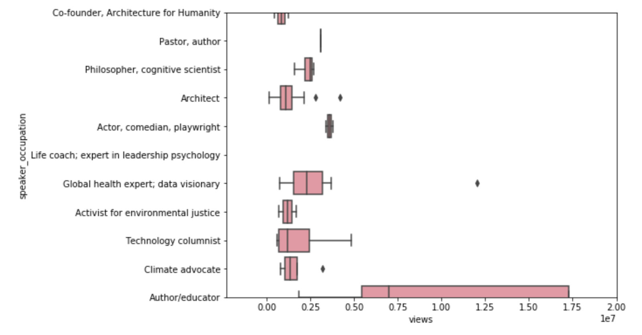
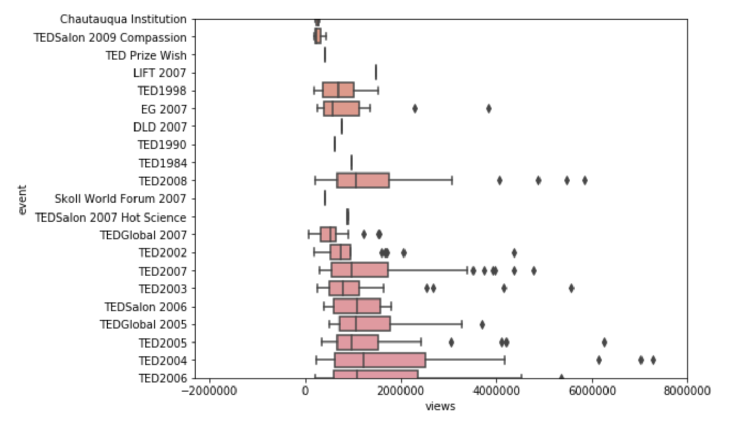
Data Discovery
Views v.s. Speakers’ Occupations
Events v.s. Views

Slide 6
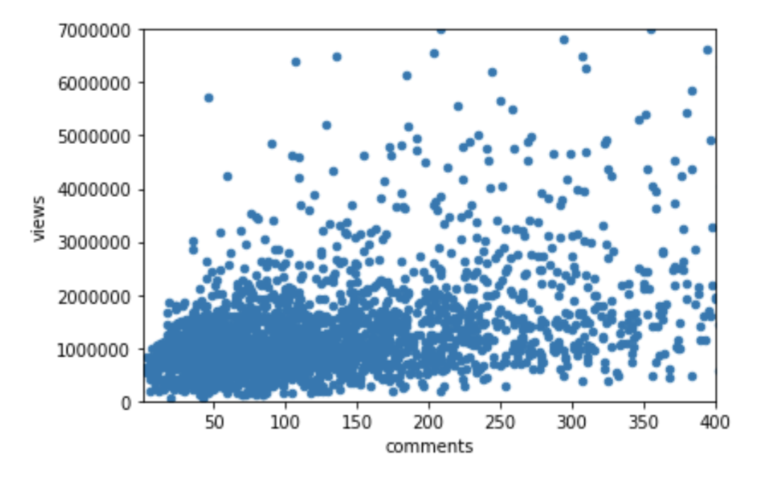
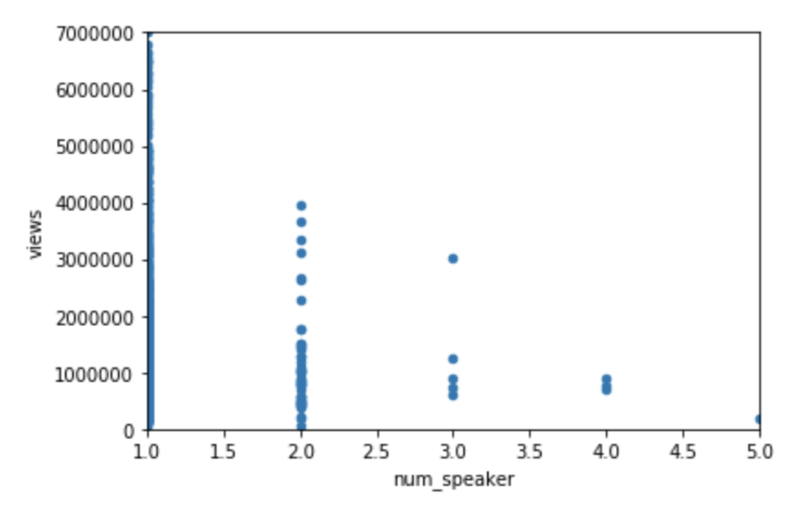
Data Discovery
Scatter Plot of Language v.s. Views
Views v.s. Number of Speakers

Slide 7
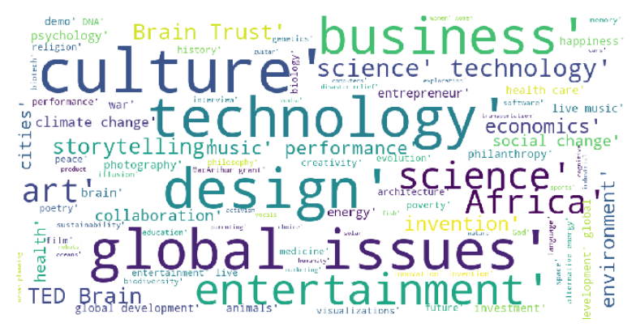
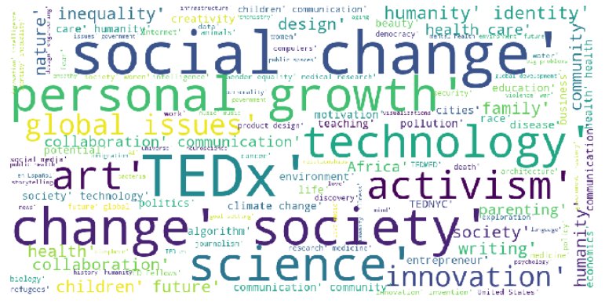
Data Discovery - Topics
Using tag data in 2007
Using tag data in 2017
Notes:
New topics show up on the map/get bigger - social change, personal growth, activism, refugees

Slide 8
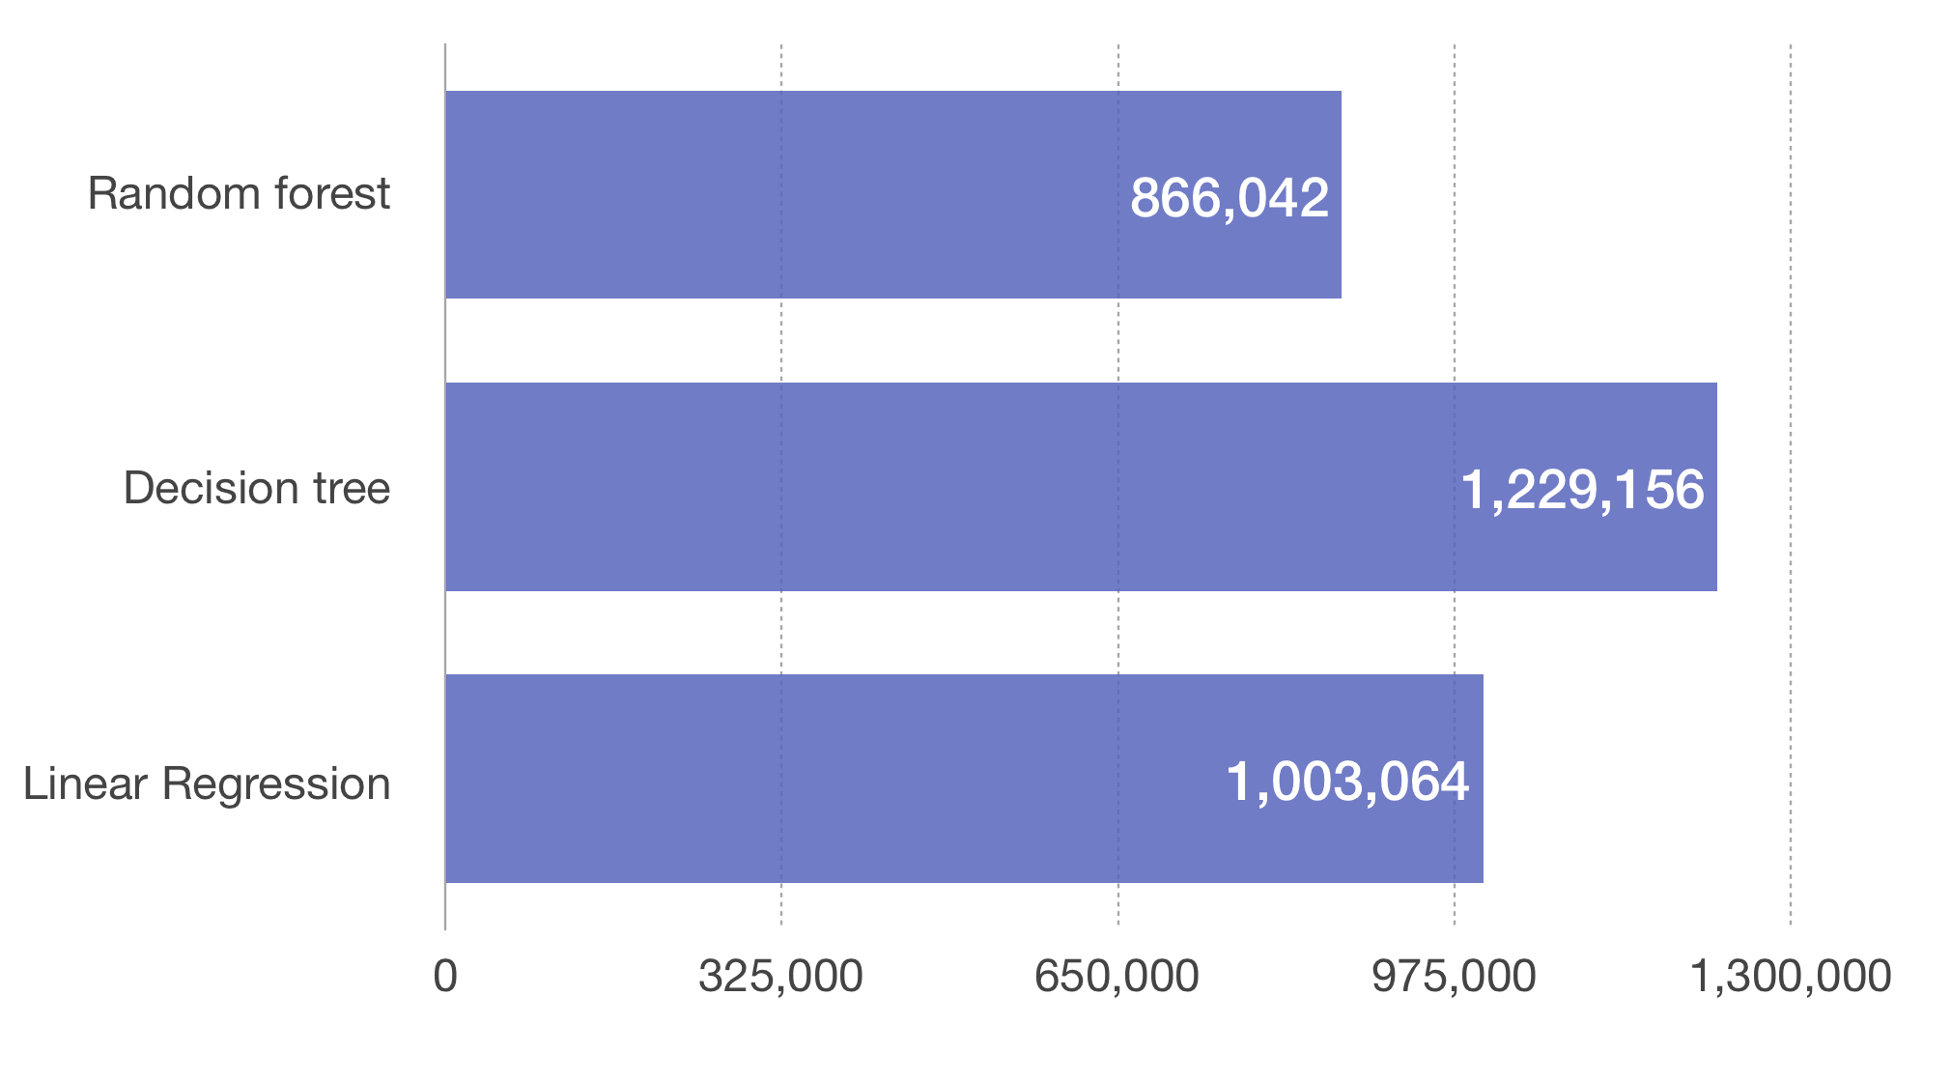
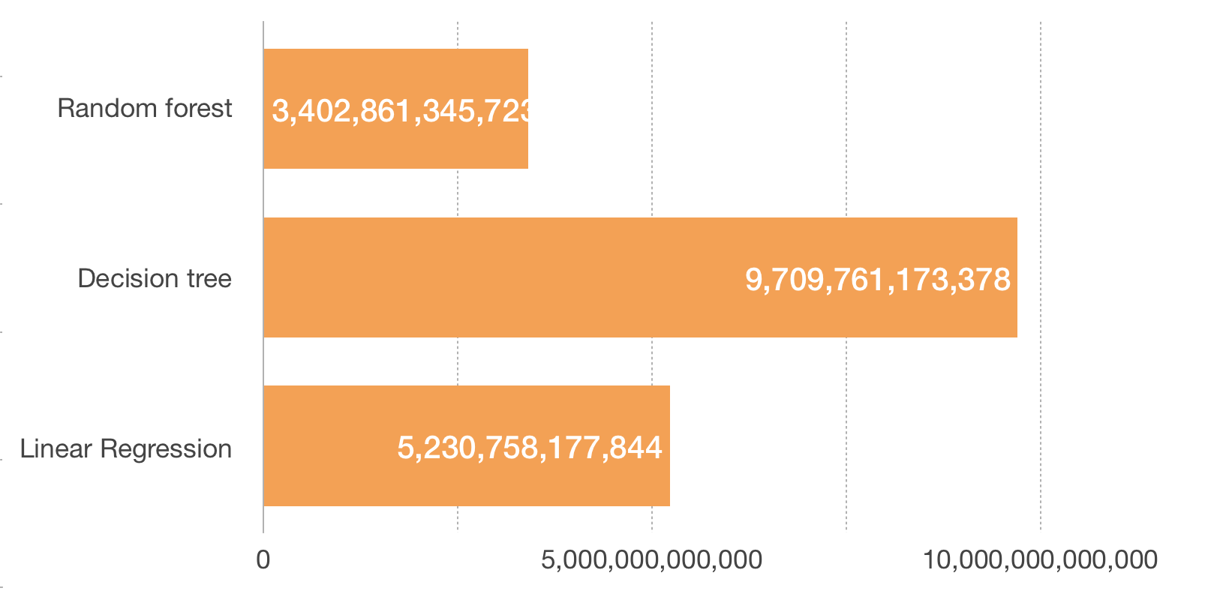
Using Random forest, Decision tree, and Linear Regression to predict views
Mean Absolute Error
Mean Squared Error

Slide 9
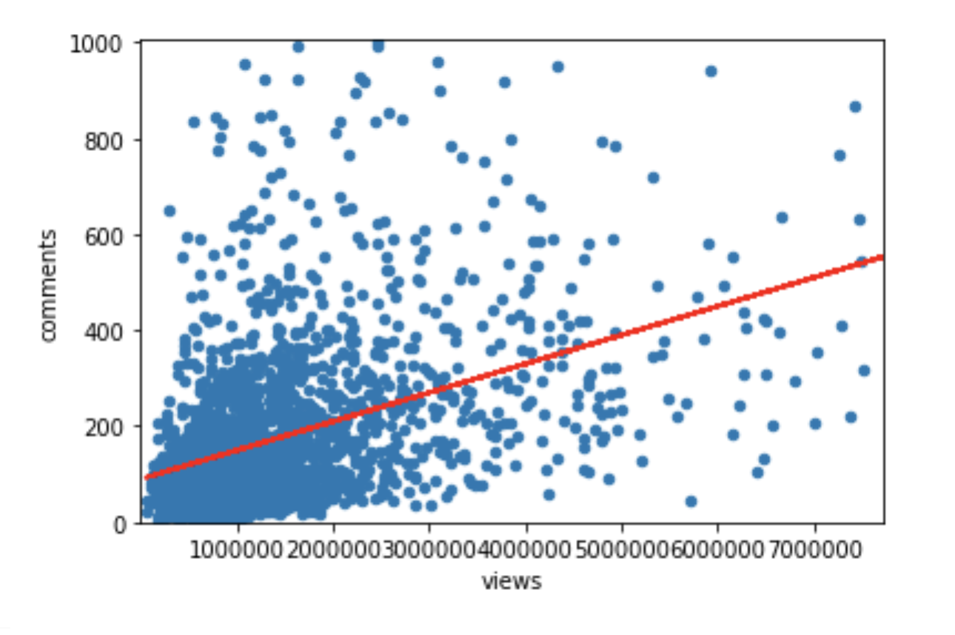
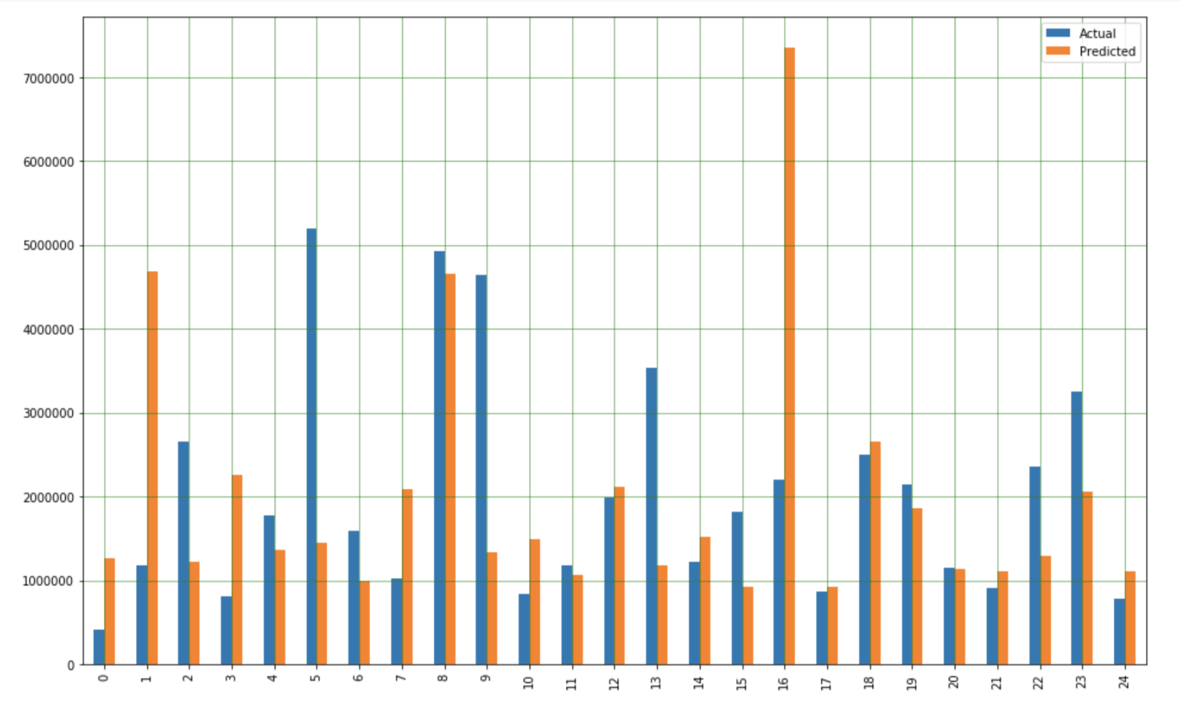
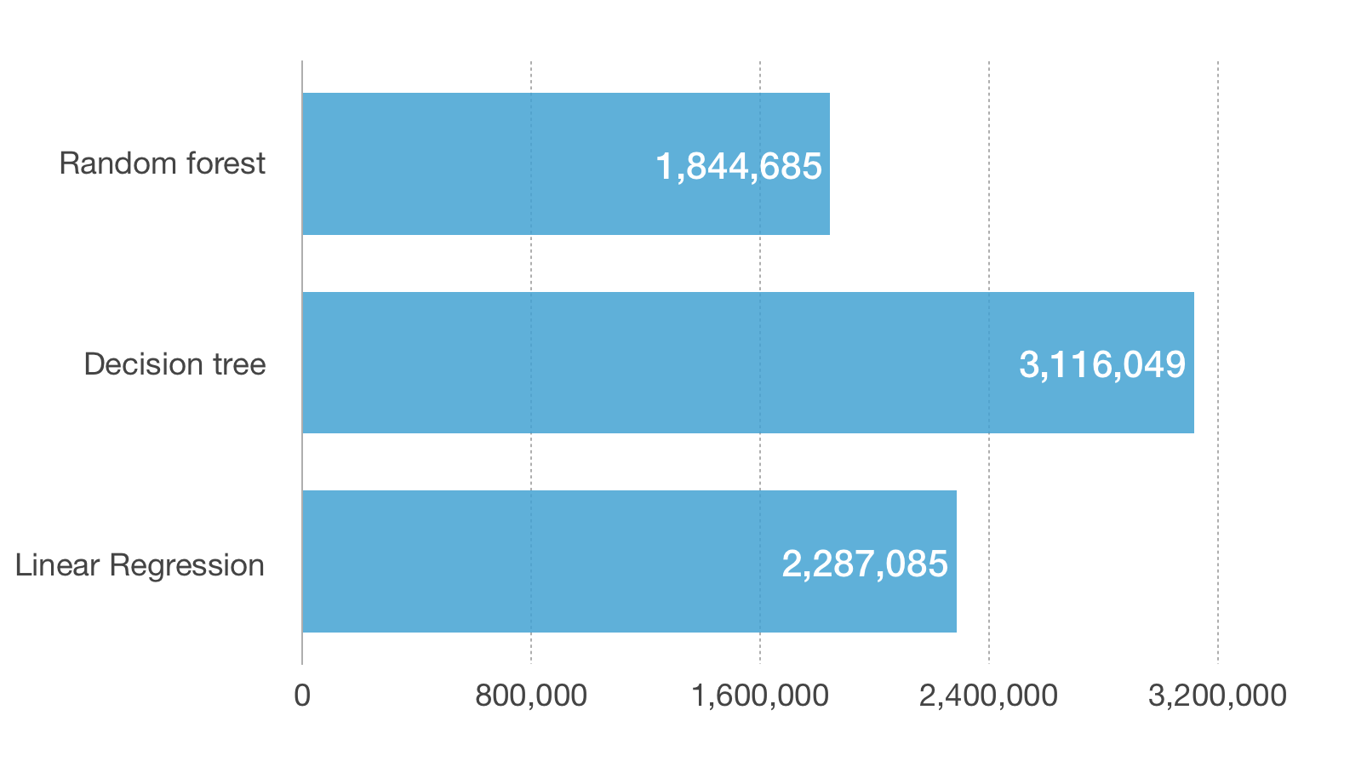
Using Random forest, Decision tree, and Linear Regression to predict views
Actual V.S. Predicted
Root Mean Squared Error

Slide 10
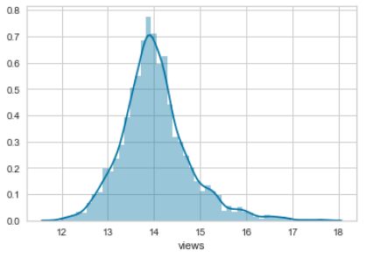
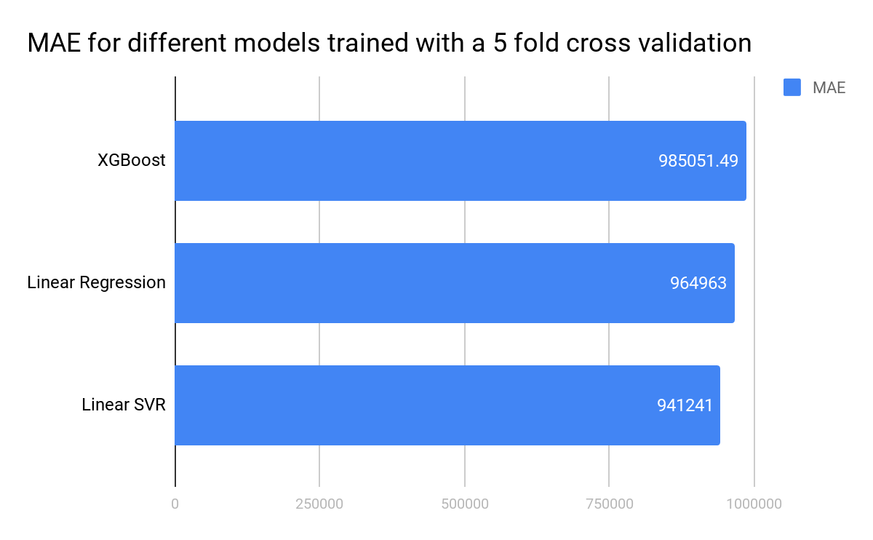
Using transcript data to predict views
MAE improved across the board when using the log transformation of views
Linear SVR was the model with the lowest MAE
Tuned the model hyperparameters
Previous approach of predicting the views based on numerical features using a Random Forest had a slightly better MAE
Ensemble predictions?
Notes:
Log base 10 of views training improved the mae
Text cleaning and tf-idf vectorizer
5 fold cross validation

Slide 11
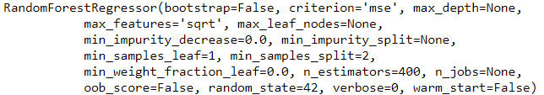

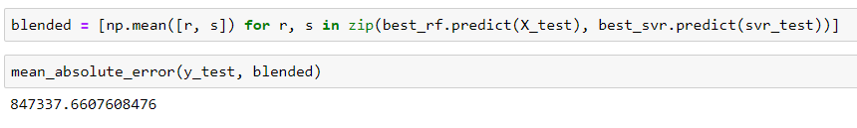
Tuning and Blending
Tuned the Random Forest Regressor and Linear Support Vector Regressor using a simple grid search that tried all combinations of parameters from a given range

Slide 12
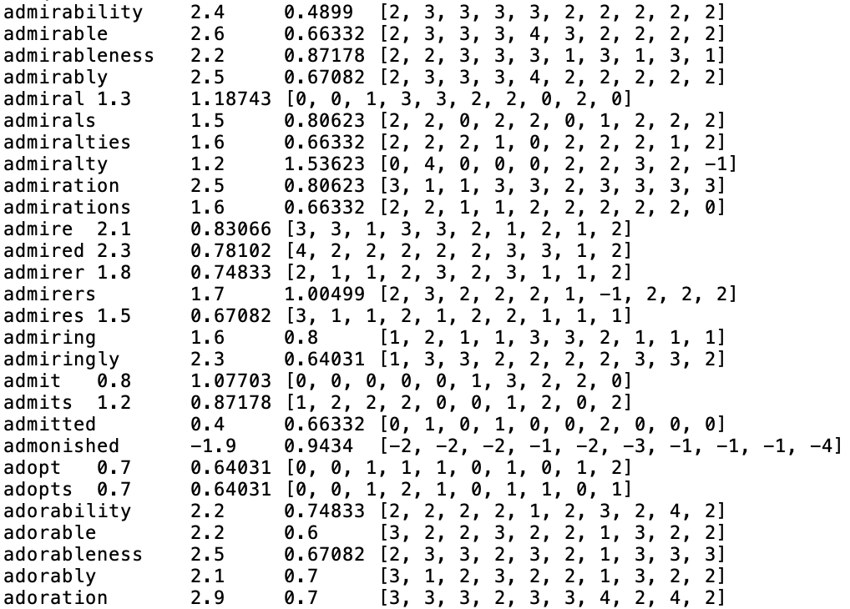
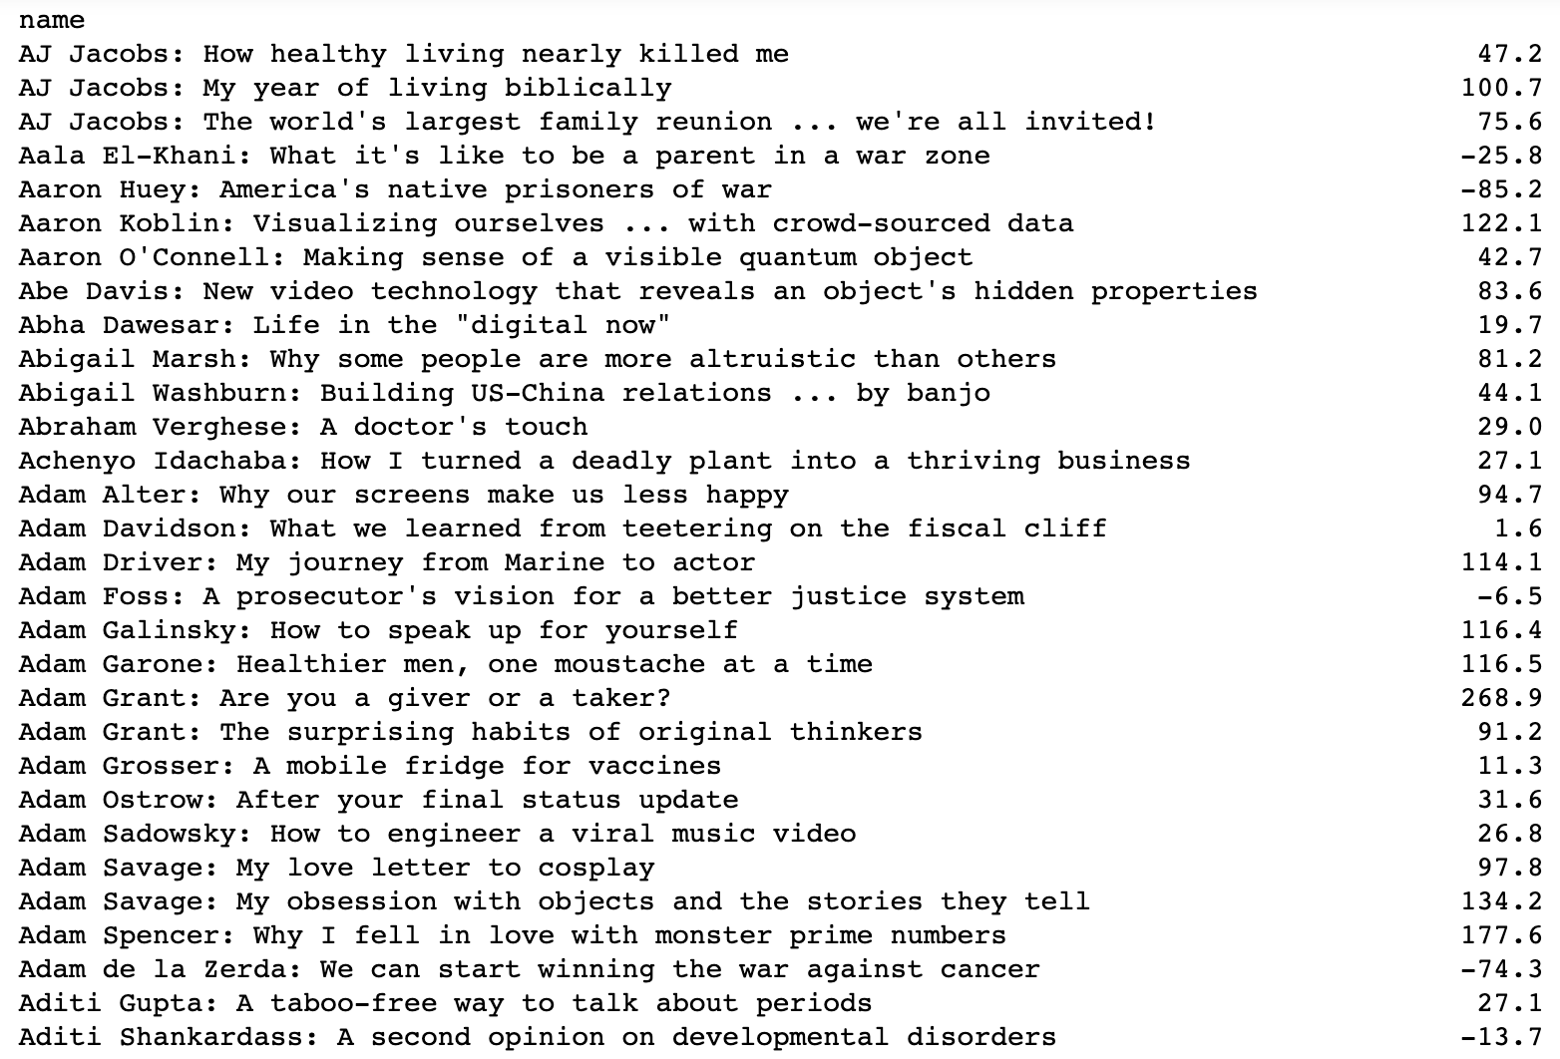
Sentiment Analysis and Neural Network
VADER lexicon:
VADER Lexicon Word Examples
TED Talk Transcript Polarity Examples
Notes:
I tried to predict the number of views using sentiment analysis of the transcript and title of each talk.
VADER: Valence Aware Dictionary and sEntiment Reasoner
Reduce each transcript into a single polarity value:
Positive value = positive
Negative value = negative
Large value = polar
Small value = non-polar
Left picture is the VADER lexicon text, right picture is the sentiment of the TED Talks according to the VADER Lexicon

Slide 13
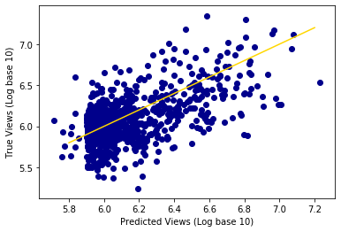
Sentiment Analysis and Neural Network
Neural network: Regressor
MAE: 881399.33
Features: # of Comments, Transcript
Polarity, # of Languages, # of Speakers,
Title Polarity
Target: # of Views
Notes:
Large numbers / large variety -> used log base 10 for the views
Range of views from 15,000 to 47,000,000, hence large RSME
Can see general trend, but large error

Slide 14
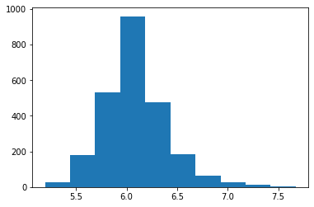
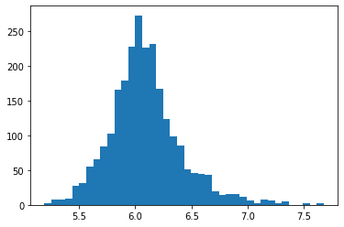
Sentiment Analysis and Neural Network
Log base 10 of views has a roughly normal distribution (10 bins vs 40 bins)
Can neural net classifier classify log base 10 of views based on same attributes?
Notes:
Used histograms to visualize the views distribution
Created bins based on the tick marks

Slide 15
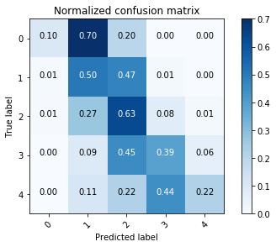
Sentiment Analysis and Neural Network
Neural Network: Classifier
MAE: 0.48
Features: # of Comments, Transcript
Polarity, # of Languages, # of Speakers,
Title Polarity
Target: # of Views
Notes:
Values: 0 - 4
Based on the tick marks of the histogram for ease
Confusion matrix:
Correct values along diagonal, shows what the predicted label was relative to what was correct
For example, when the true value was a zero, the 70% of the time the neural net predicted the value was 1
Ideally, the diagonal values are close to 1 for an effective classifier
Not very accurate, there are better ways to classify this!

Slide 16
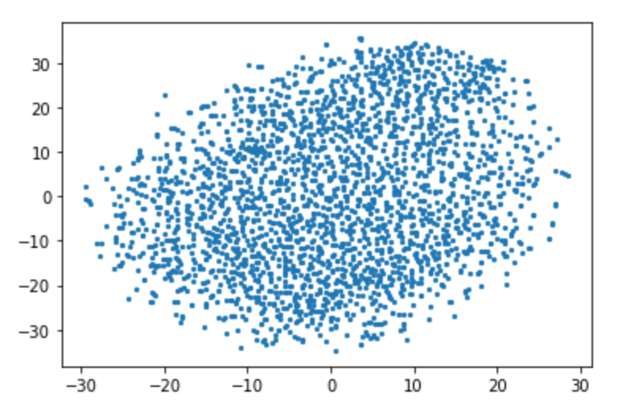
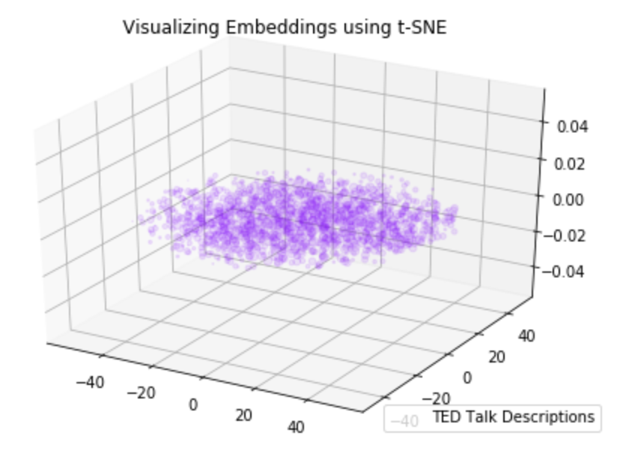
Doc2Vec Embeddings for TED Talk Descriptions
Example of a TED Talk Description:
With the same humor and humanity he exuded in "An Inconvenient Truth," Al Gore spells out 15 ways that individuals can address climate change immediately, from buying a hybrid to inventing a new, hotter brand name for global warming.
Doc2Vec (vector size 50), Dimension Reduced with t-SNE. 2D and 3D reduced data shown.

Slide 17
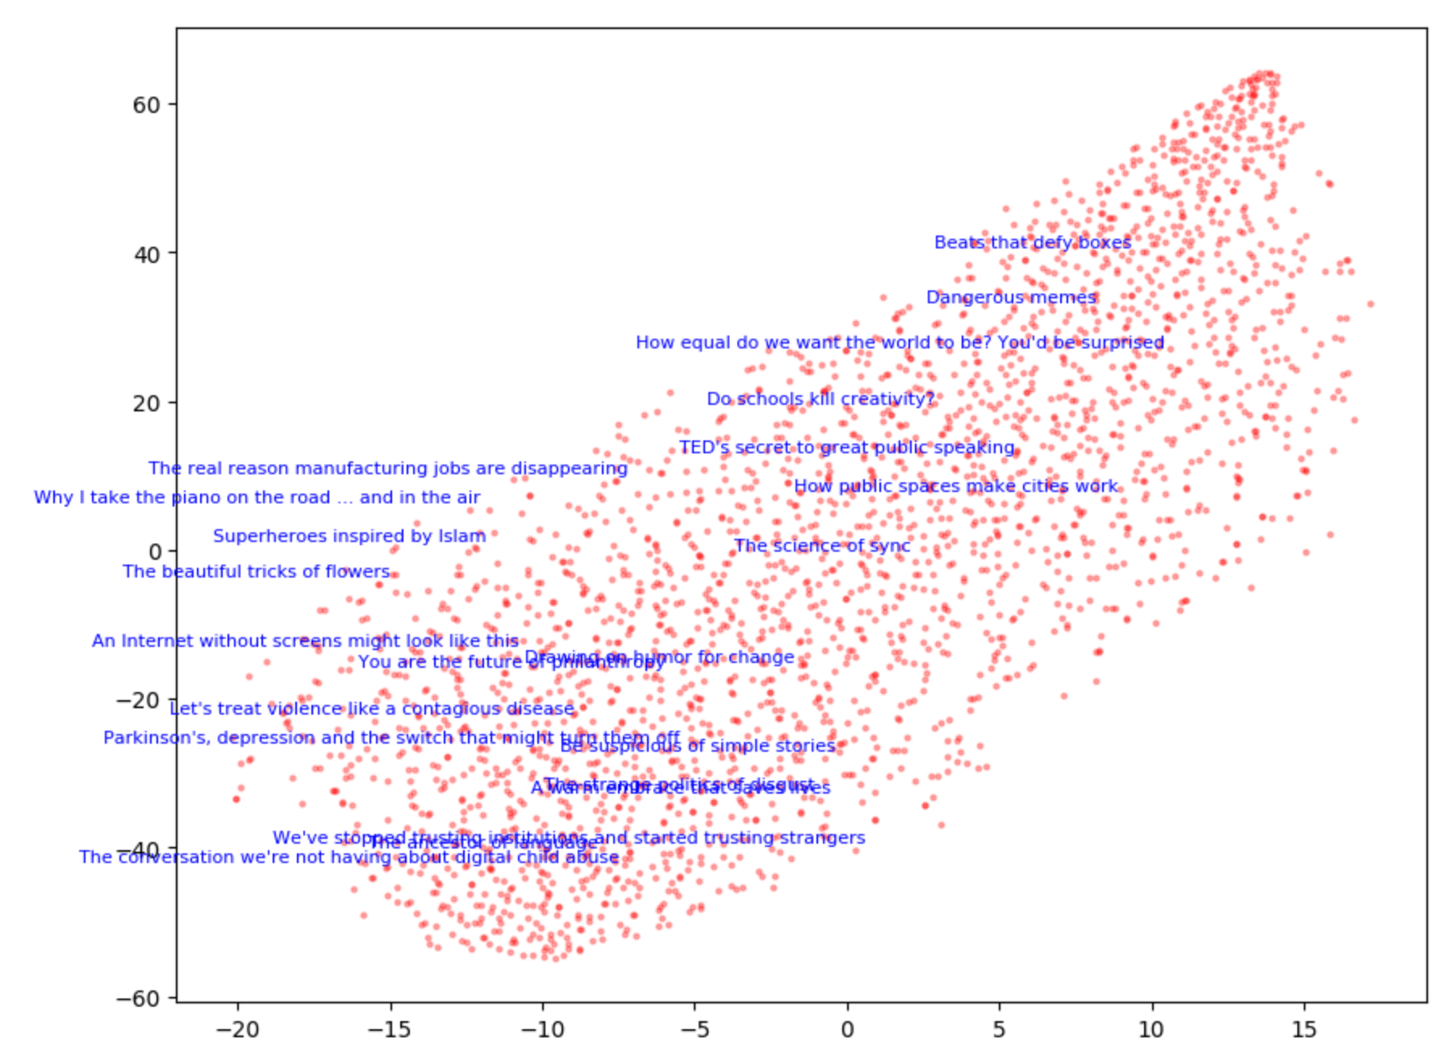
Doc2Vec Embeddings for TED Talk Titles

Slide 18
Doc2Vec Embeddings: Similarities?
The following embedded titles have >.98 cosine similarity to the embedded title,
‘My Wish: Once Upon a School’:
‘The Dog Song’
‘A mockingbird remix of TED2006’
‘A comic sendup of TED2006’
…. Some seem similar but others?

Slide 19
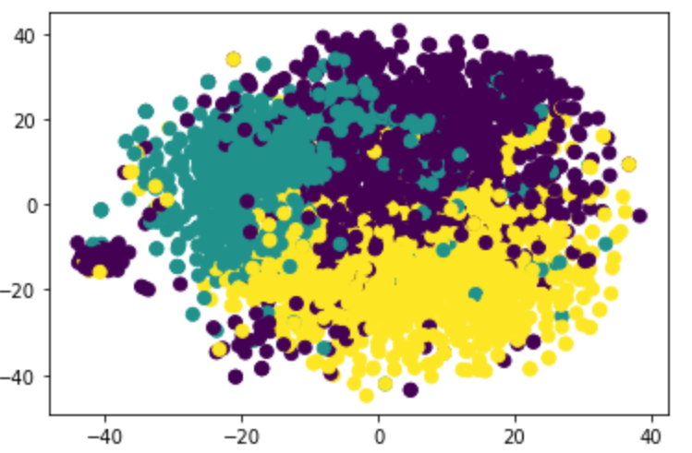
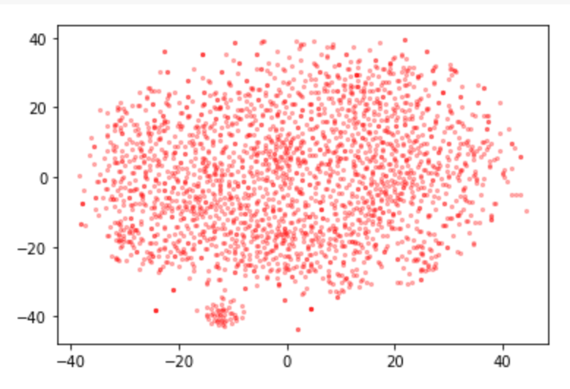
BERT Embeddings for TED Talk Titles
We consider the titles as sentences and see if using a pre-trained (on Wiki and Book Corpus), bi-directional model helps us understand relationships between titles. (bert-base-uncased)
To get one vector for the entire title, we averaged the second to last hidden layer of all the title tokens (a ‘simple’ approach’).
k=3 was best according to the silhouette score

Slide 20
Interesting Cluster Findings
Cluster 0:
'Let my dataset change your mindset',
"How we read each other's minds",
'What hallucination reveals about our minds',
'The world needs all kinds of minds',
'Know thyself, with a brain scanner',
'How many lives can you live?',
'Texting that saves lives',
'The game that can give you 10 extra years of life',
'The life code that will reshape the future',
'Robots will invade our lives',
"Things I've learned in my life so far",
'Are games better than life?'
Cluster 2:
'A new way to heal hearts without surgery',
'Ideas worth dating',
'A visual history of social dance in 25 moves',
'Ballroom dance that breaks gender roles',
'A better way to talk about love',
'Why you should love statistics',
'Beautiful new words to describe obscure emotions',
'Poetry, music and identity',
'Thoughts on humanity, fame and love',
'How I found myself through music',
'The mathematics of love',
'Hidden music rituals around the world',
'This is beatjazz’

