Slide 1

SDM COLLEGE OF ENGINEERING AND TECHNOLOGY, DHARWAD
6th Semester,Department of Information Science and Engineering
“CREDIT-CARD FRAUD DETECTION USING MACHINE LEARNING”
TEAM MEMBERS
Swaroop Kori 2SD15IS065
Sanath Joshi 2SD16IS043
Amruta Deshpande 2SD16IS064
UNDER THE GUIDANCE OF PROJECT CO-ORDINATOR
Prof. S.S Joshi Prof. Rajashekarappa and Prof. Biradar

Slide 2
Introduction
Online Shopping is one of the largest and fast growing trend and mode of payment will be by using credit card,debit card and netbanking.
Online payment does not require physical card.
If credit card details is known to others that will become a major risk.
Anyone who know the details of card can make fraud transactions.
Currently,card holder will come to know only after the fraud transaction is carried out.
No mechanism exist to track fraud transaction.

Slide 3
Throughout the financial sector, machine learning algorithms are being developed to detect fraudulent transactions. In this project, that is exactly what we are going to be doing as well. Using a dataset of of nearly 28,500 credit card transactions and multiple unsupervised anomaly detection algorithms, we are going to identify transactions with a high probability of being credit card fraud. In this project, we will build and deploy the following two machine learning algorithms:
Local Outlier Factor (LOF)
Isolation Forest Algorithm
Furthermore, using metrics suchs as precision, recall, and F1-scores, we will investigate why the classification accuracy for these algorithms can be misleading.
In addition, we will explore the use of data visualization techniques common in data science, such as parameter histograms and correlation matrices, to gain a better understanding of the underlying distribution of data in our data set. Let's get started!

Slide 4
Literature Review
The authors begin by explaining the method used for transactions through credit cards. They have proposed a system in which they integrate their algorithm with the payment gateway to detect fraudulence in real time. The authors used 7 techniques to develop the algorithm, which are Neural Networks, Rule Induction, Case-based reasoning, Genetic Algorithms, Inductive Logic Programming, Expert Systems, Regression. The authors determined, the ANN method would best serve this problem statement. The output of the neural network will be in the form of probability which tells the degree of a transaction being fraudulent. Neural network are trained on information based on the various categories about the card holder such as profession of the card holder, earnings, about the large amount of purchased are placed. The system will use back propagation learning algorithm in this phase to train the network. Depending on the numeric value of probability between 0 and 1, a transaction will be classified into one of the following categories: x Non-Fraudulent x Doubtful x Suspicious x Fraudulent. this system being developed will particularly focus on the merchant side of the industry which will be beneficial to the merchant by reducing the merchant’s losses which he has to bear if a transaction is fraudulent. Therefore it is limited by the availability of Merchant side transaction data which is hard to obtain on scale.

Slide 5
Authors focused on the Chinese market as it is rapidly growing and fast paced. The authors proposed a data mining technique using outlier detection using distance sum to identify fraud transactions. The authors preferred to use this method over traditional statistical methods like Regression and Discriminant analysis because outlier detection method is independent of the dataset distribution. The paper used Euclidean distance formula to calculate distance sum to detect outliers. The authors calculated a threshold value for distance, if the distance is above said threshold, the object is classified as an anomaly, or in this case, a fraud transaction. The authors collected data from a domestic bank in China, with 16000 observations. The authors achieved a highest accuracy of 89.4% for threshold value of 12. This method is highly dependent on the nature of distribution of the data, and may vary for data sources of different banks.

Slide 6
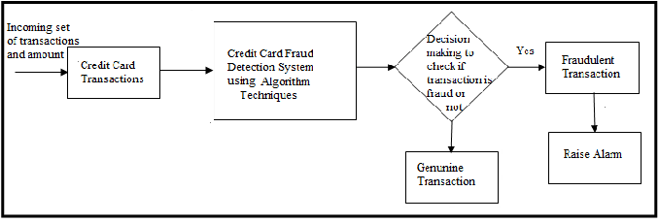
Block Diagram

Slide 7
Methodology
1. Importing Necessary Libraries
To start, let's print out the version numbers of all the libraries we will be using in this project. It ensures we have installed the libraries correctly.

Slide 8
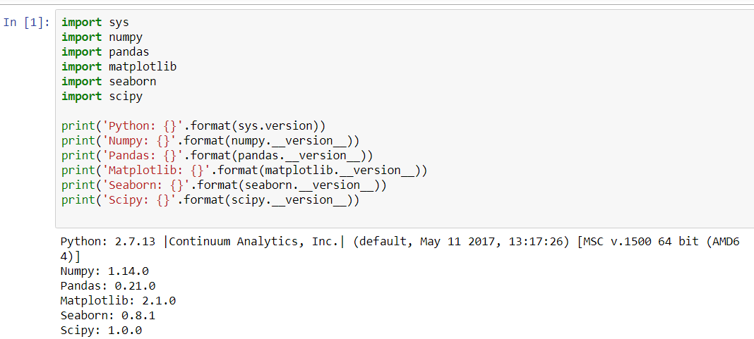
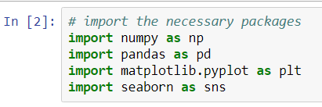

Slide 9
2. The Data Set
In the following cells, we will import our dataset from a .csv file as a Pandas DataFrame. Furthermore, we will begin exploring the dataset to gain an understanding of the type, quantity, and distribution of data in our dataset. For this purpose, we will use Pandas' built-in describe feature, as well as parameter histograms and a correlation matrix.

Slide 10
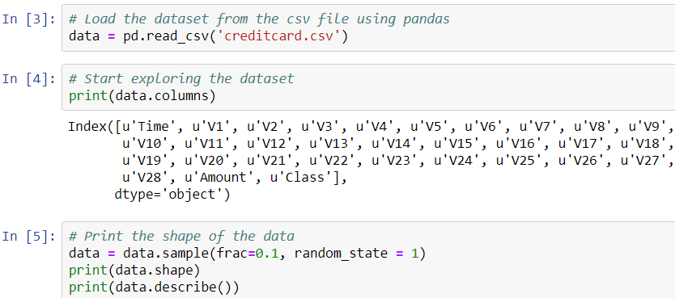
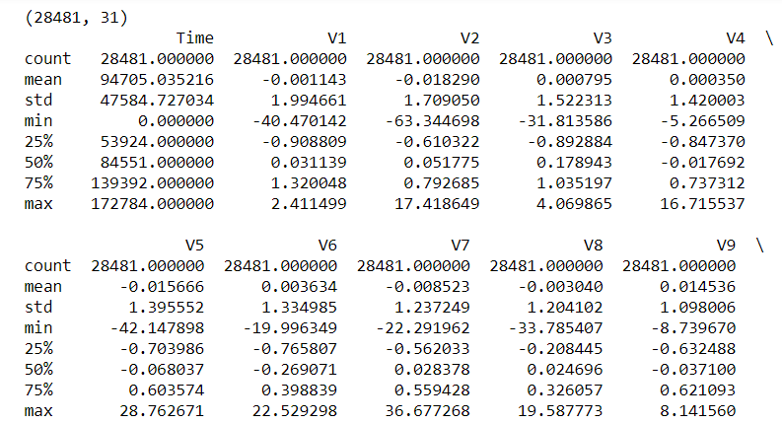
# V1 - V28 are the results of a PCA Dimensionality reduction to protect user identities and sensitive features

Slide 11
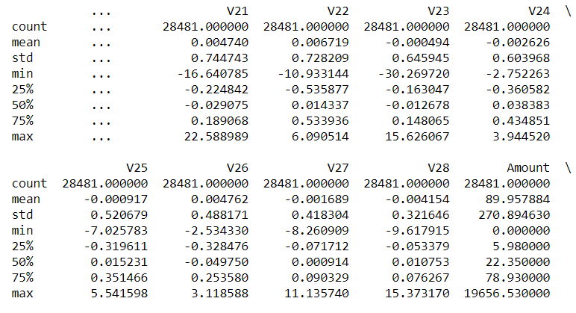
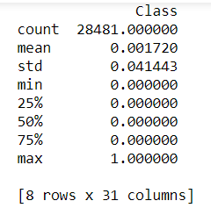

Slide 12
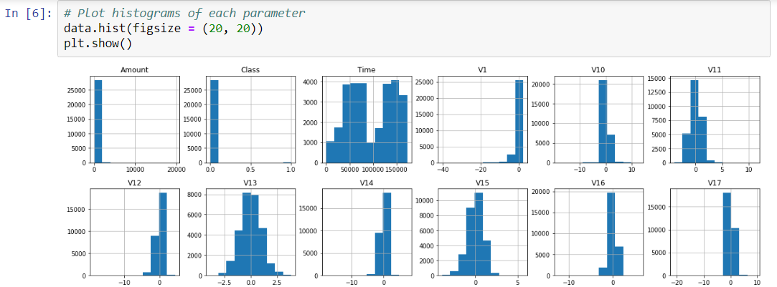

Slide 13
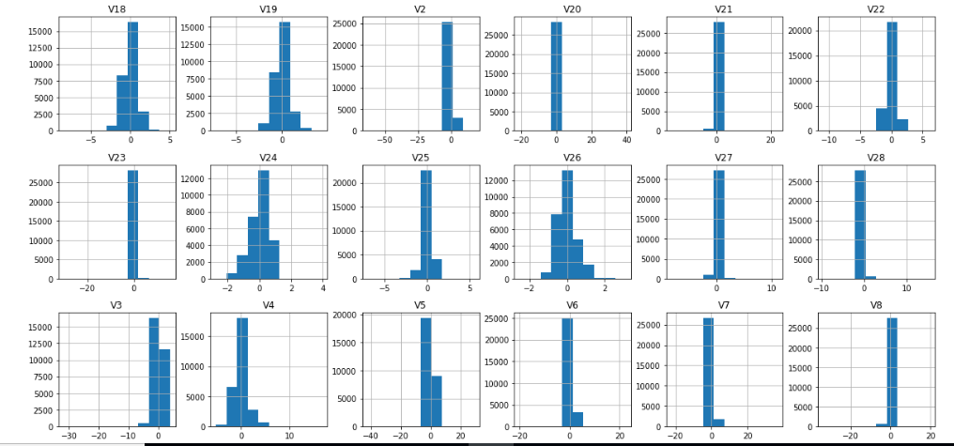
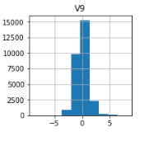

Slide 14
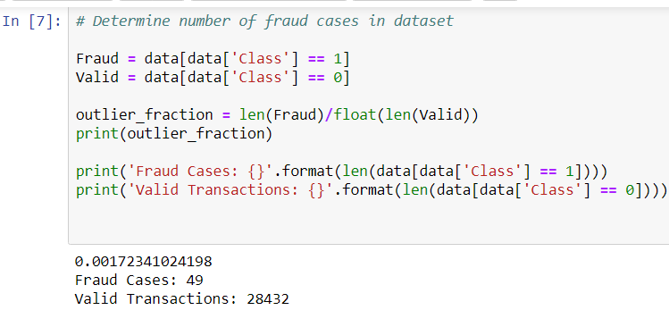

Slide 15
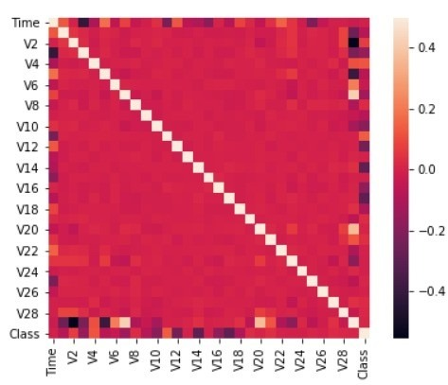
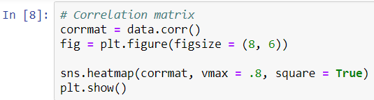

Slide 16
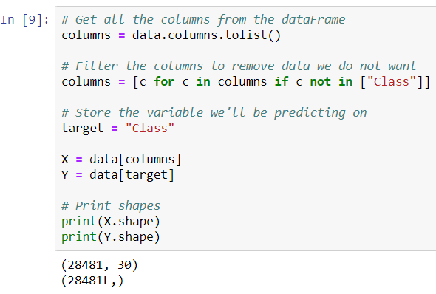

Slide 17
3. Unsupervised Outlier Detection
Now that we have processed our data, we can begin deploying our machine learning algorithms. We will use the following techniques:
Local Outlier Factor (LOF)
The anomaly score of each sample is called Local Outlier Factor. It measures the local deviation of density of a given sample with respect to its neighbors. It is local in that the anomaly score depends on how isolated the object is with respect to the surrounding neighborhood.

Slide 18
Isolation Forest Algorithm
The IsolationForest ‘isolates’ observations by randomly selecting a feature and then randomly selecting a split value between the maximum and minimum values of the selected feature.
Since recursive partitioning can be represented by a tree structure, the number of splittings required to isolate a sample is equivalent to the path length from the root node to the terminating node.
This path length, averaged over a forest of such random trees, is a measure of normality and our decision function.
Random partitioning produces noticeably shorter paths for anomalies. Hence, when a forest of random trees collectively produce shorter path lengths for particular samples, they are highly likely to be anomalies.

Slide 19
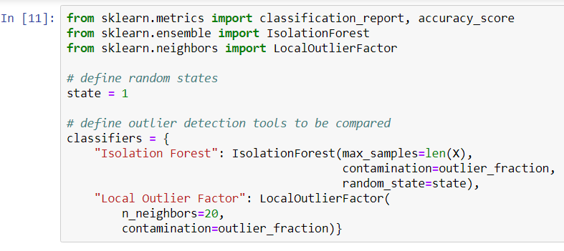

Slide 20
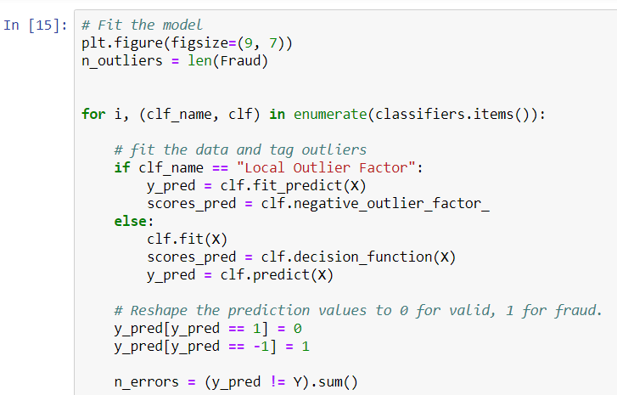
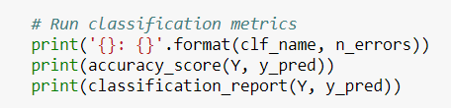

Slide 21
Results
In local outlier factor method, we have 97 total number of errors which is relatively high and accuracy of 99.65942207%.Precision and f1- score are not as good.For class 0 we have precision of 100% and for class one it is found to have very less amount of fraudalent transactions. In Isolation forest method, we have 71 total number of errors which is relatively high and accuracy of 99.750711%.For class one it is found to have 30% precision.f1 scores are good for isolation forest compared to local outlier factor method.Isolation forest method was able to produce better results.

Slide 22
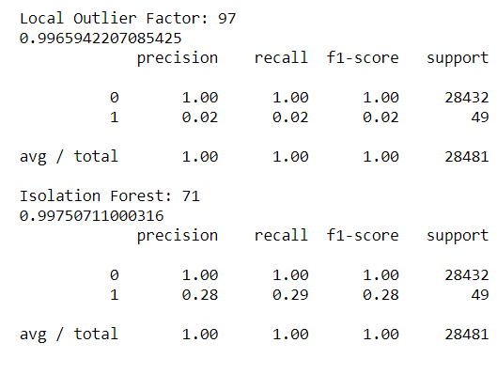

Slide 23
Advantages
Reduction in number of fraud transactions.
User can safely use his credit card for online transaction.
Added layer of security.

Slide 24
Disadvantages
It takes a significant amount of data for machine learning models to become accurate. For large organizations, this data volume is not an issue but for others, there must be enough data points to identify legitimate cause and effect relationship. Without the appropriate data, the machines may learn the wrong inferences and make erroneous or irrelevant fraud assessments.

Slide 25
Conclusion & Future Work
We imported csv data set,preprocessed it,exploring and describing data.And plotting histogram to check unusual parameters.
We did corelation matrix to know which parameters important for our class.Two algorithm used are Isolation forest and local outlier factor to do anamoly detection
In the dataset,We realised the importance of understanding the data and precision.
Fraud detection is a complex issue that requires a substantial amount of planning before throwing machine learning algorithms at it. Nonetheless, it is also an application of data science and machine learning for the good, which makes sure that the customer’s money is safe and not easily tampered with.
Future work will include a comprehensive tuning of the Random Forest algorithm. Having a data set with non-anonymized features would make this particularly interesting as outputting the feature importance would enable one to see what specific factors are most important for detecting fraudulent transactions.

Slide 26
References
[1] https://www.kaggle.com/datasets
[2] https://pythonprogramming.net/neural-networks-machine-learning-tutorial/
[3]https://www.datacamp.com/community/tutorials/convolutional-neural-networks-python

Slide 27
Thank You ☺

Slide 28
Any Questions?

