Slide 1

SDM COLLEGE OF ENGINEERING AND TECHNOLOGY, DHARWAD
Department of Information Science and Engineering
Presented by:
Nikita Joshi
Pooja Gunagi
Anjali Bhandiwad
Under the guidance of:
Dr. S.R Biradar
Dr. Rajashekarappa

Slide 2
PROJECT TITLE
Android Application
Based on
Restaurant Booking System

Slide 3
Introduction
The users can use this “Restaurant Booking System” app to order the food and book a table at a particular time period.
The admin can maintain the schedule of ordering table and food then the waiter can visit his schedule.
This system has several advantages over the existing system where the customers don’t have the facility to book the tables and will have to physically visit the restaurant to avail the facilities.

Slide 4
Objectives
The main objective of this project is to allow the management or employees of a restaurant to handle the customers and also the customers to place their orders online and to find free tables.
The aim of this project is to develop an android application to keep everything related to restaurant/hotel table management as simple as possible.
This project can be utilized by servers/manager/supervisors in a hotel to manage the customers and their orders.
This system will offer services to the customer and also to the management of the restaurant.
The offered services are food ordering and booking of table by the customer through the system.

Slide 5
HARDWARE REQUIREMENTS
System: Pentium IV 2.4 GHz.
Hard Disk: 40 GB.
Floppy Drive: 1.44 Mb
Monitor: 15 VGA Color.
Mouse: Logitech
Ram: 4GB

Slide 6
SOFTWARE REQUIREMENTS
Operating framework: Windows 10.
Coding Language: Java 1.6
Tool Kit: Android 2.2
IDE: Android Studio
Database: MySQL

Slide 7
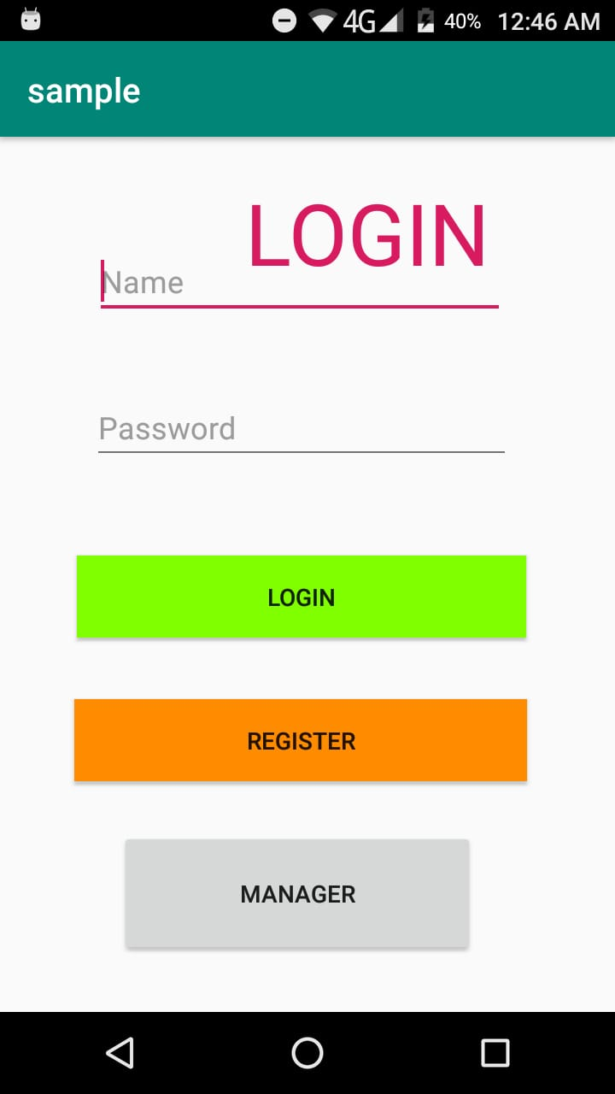
Login
The entire project is divided into two modules namely customer and administration/manager.
Only registered users can Login in to the Application and can access the application
New customer can register by pressing the REGISTER button and giving the necessary details.

Slide 8
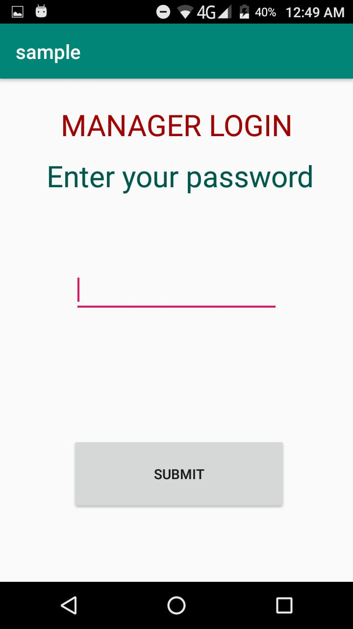
Manager login
Manager can login with their password and can check the food orders and table reservations made.
The manager/admin can maintain the schedule of ordering food and table reservation then the waiter can visit his schedule.

Slide 9
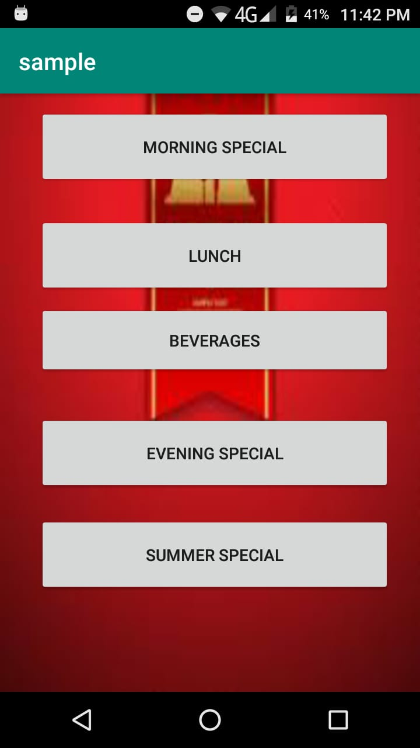
Main Menu
The Main Menu contains types of meals such as Morning Special, Lunch, Beverages, Evening Special and Summer Special.
Each meal type has several meal items which can be ordered by the customer.

Slide 10
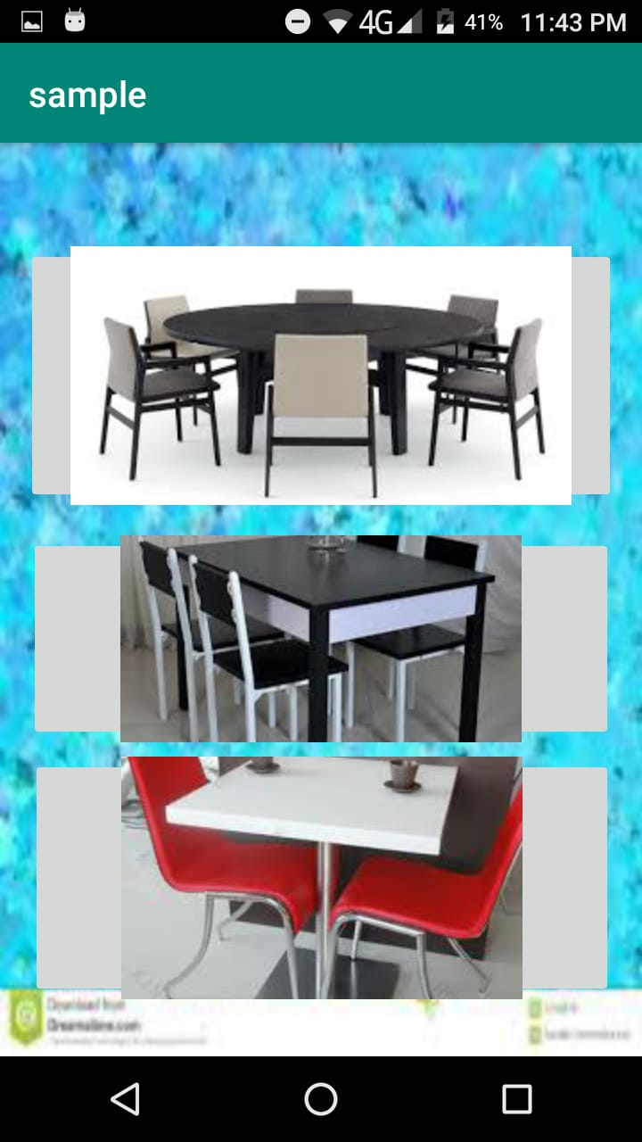
Table Reservation
The “Restaurant Booking system” allows user to ordering a food and reserving the table in the mobile application.
Table can be reserved depending upon the number of occupients.
The admin can view the details of food orders and table reservations.

Slide 11
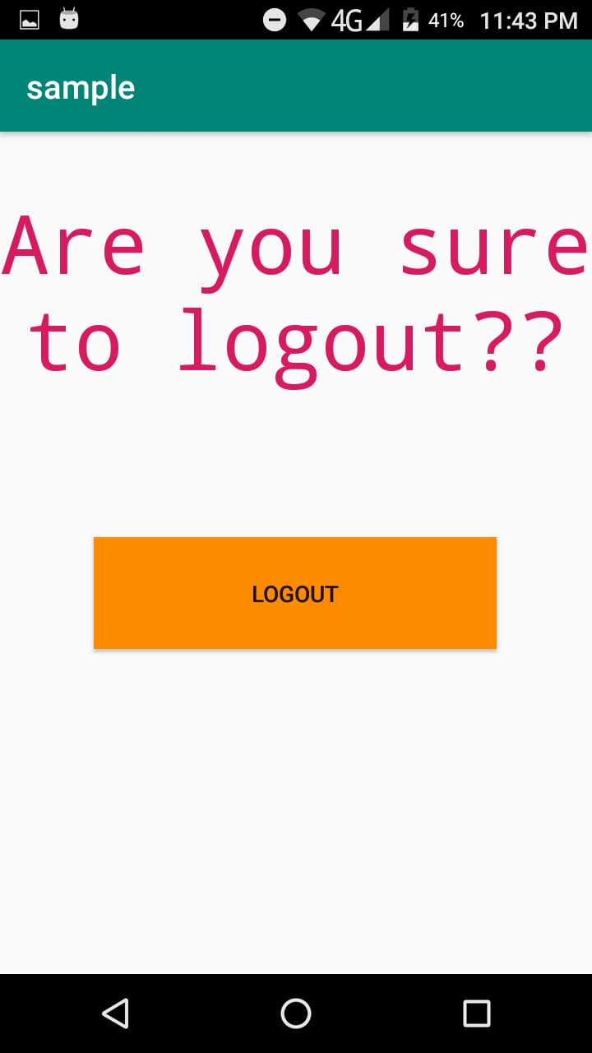
Logout
A user can logout this app by simply pressing the LOGOUT button.

Slide 12
Advantages
The manual table booking is replaced with online booking system.
Management can pull reports at any time to tell the current situation in order to put necessary order in place.
The system helps secure customer details since no details is disposed off.

Slide 13
Disadvantages
Requires an active internet connection.
It will provide inaccurate results if data not entered properly.
The system limits human interaction.

Slide 14
Conclusion
The “Restaurant Booking System” app allows customer to order the food and reserve the table through an android mobile phone.
The manual table booking is replaced with the online order system.

Slide 15
Thank You..

