Slide 1


HEALTH RECORD
MANAGEMENT SYSTEM

Slide 2


TEAM MEMBERS
Pooja Kumari
Megha Chaudhary

Slide 3


INTRODUCTION
Health Record Management System is the digital version of the clinical information regarding a user.
It involves collecting, storing, manipulating and using the available clinical information in delivering care to the user.
Our project aims to harness the power of technology to enhance healthcare services and user experiences.
A compact Online Health Record Keeping System designed with the goal of simplifying healthcare data management while emphasizing user-friendliness and accessibility.

Slide 4





TECHNOLOGIES
HTML/CSS/JS
php
MySql
These three technologies work together seamlessly to create modern, responsive, and engaging web experiences.
It is valuable when building web applications that require server-side logic, database integration, and dynamic content generation.
MySQL serves as the data storage and retrieval backbone for the projects, enabling efficient data management, security, and scalability.

Slide 5


Patients
MODULES
01
02
03
04
Admin
Physician
Reports
1.Multiple Administrators
2.New Admins
3.Edit Admin details
4.View Admin
1.Add Physician
2.List All Physician
3.Physician Records
4.Update Records
1.Generate Reports
2.Upload Reports.
3.Patient visits
4.Disease Records
1.Add New Patient
2.Edit Patient
3.List all Patient
4.View Patient Records
▪ User Management
▪ Add New Admin
▪ List All Admins
▪ Edit Admin Details
03

Slide 6
OUTPUT
Efficient Record Management
Improved Data Accuracy
Improved data Efficiency
Streamlined Administrative Processes
Remote Access

Slide 7
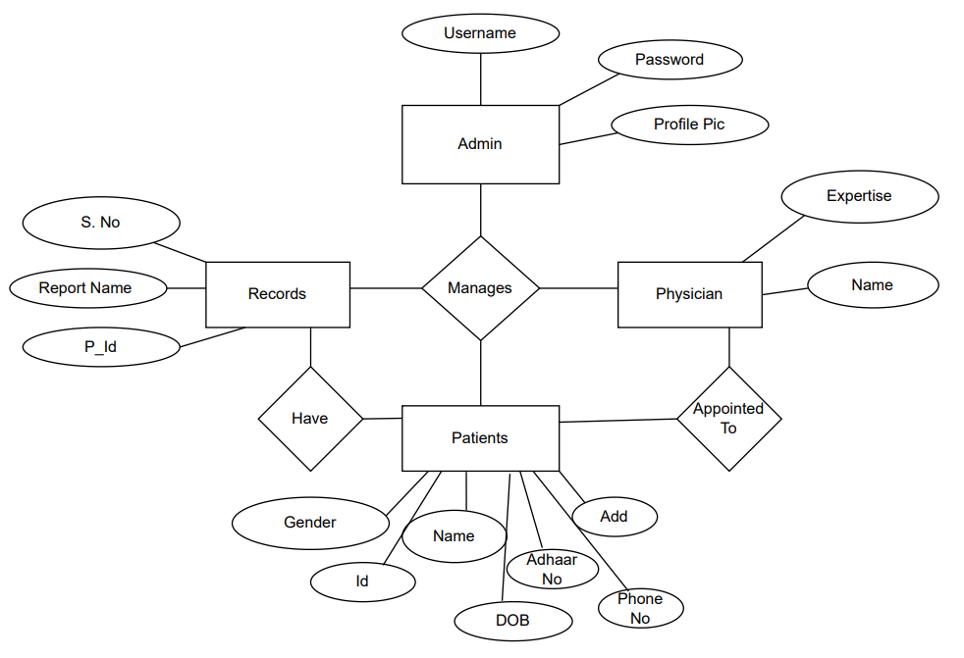
E-R Diagram

Slide 8
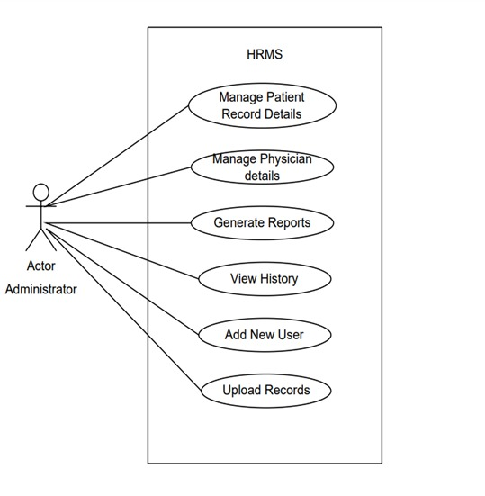
USE CASE Diagram

Slide 9
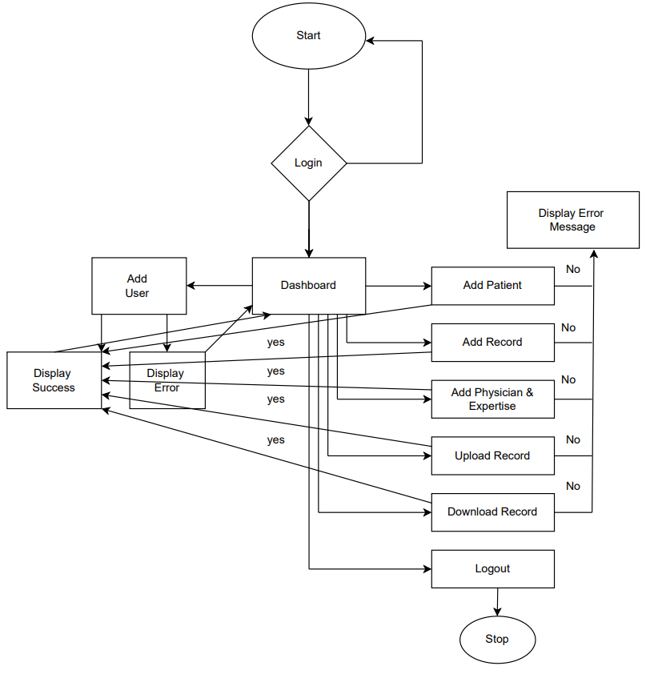
FLOW CHART

Slide 10
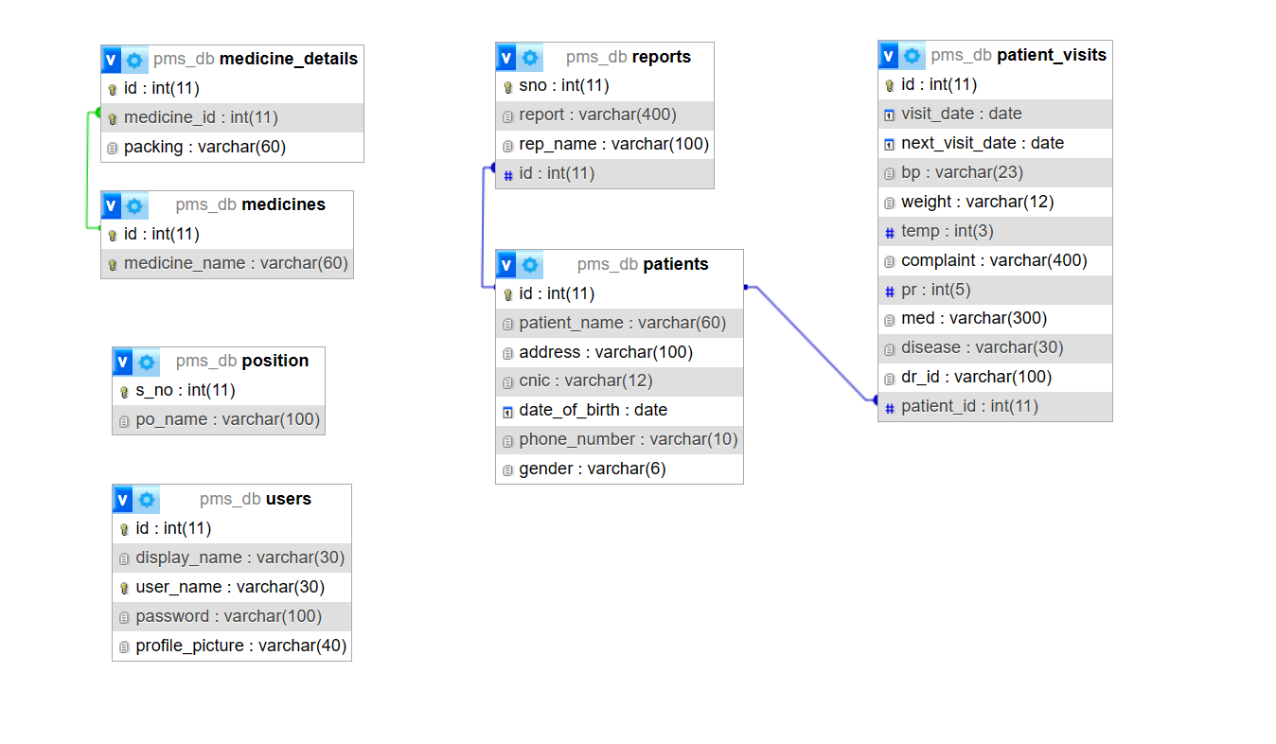
Tables

Slide 11
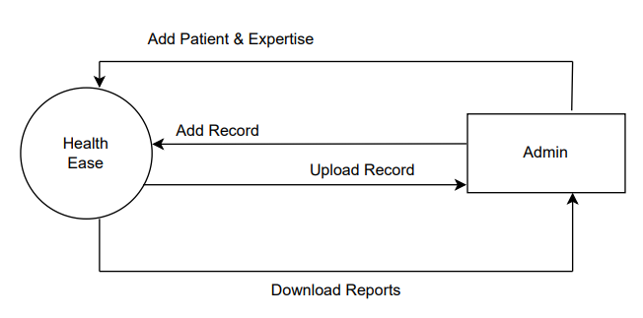
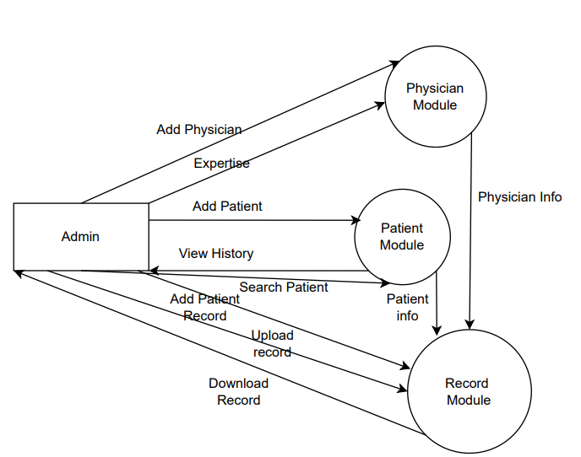
DFD
LEVEL 0 DFD
LEVEL 1 DFD

Slide 12


CONCLUSION
In conclusion, a Health Record Management System (HRMS) represents a transformative solution that addresses critical challenges in healthcare administration and user care. By digitizing and centralizing health records, an HRMS offers a wide range of benefits that ultimately enhance the overall healthcare ecosystem.

Slide 13
HOW SERVED THE SOCIETY
Improved Healthcare Efficiency
Contributing to the improvement of healthcare systems, public health initiatives, and healthcare accessibility.

Slide 14

THANK YOU

