Slide 1

Lowe’s Campus Hackathon

Slide 2
Team Name: Blue_Jays
Theme Name: Smart Store-Replenishment System
Team Members: Kruthika K, Ritu Sinha, Pooja Kumari

Slide 3
Solution Approach and Architecture:
We propose a system where the supervisor is able to view a comprehensive study of the store sales and inventory
The supervisor is informed of the stocks present and the items that need to be restocked urgently
He/she is also provided with an analysis of the various customers visiting the store with the top customers and customer segments
We also provide recommendations to restock inventory based on the current demand and price to give the most optimal solution to the supervisor and thus ensuring the store’s best interest
The supervisor is also provided with a direct restock option and the optimum amount to restock based on demand, price and expiration date

Slide 4
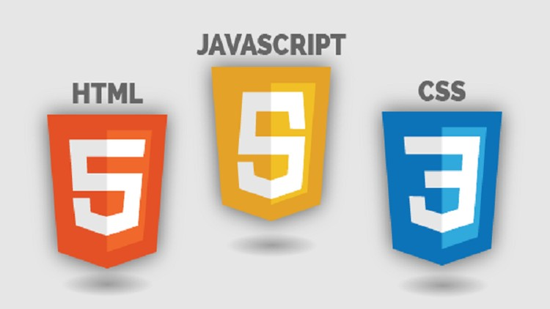







Technology/Tool/Cloud Stack:

Slide 5
Hardware Specifications:
Our application doesn’t require any specific hardware other than a computer and an internet connection.

Slide 6
Demo - Video/Prototype:
Check out our application video in the link below:
https://smart-replenishment-system.herokuapp.com/
Credentials to Sign-In:
Email: store_manager@lowes.com
Password: hackathon@lowes

Slide 7
Source code (zipped/ private GitHub repository):
https://github.com/ritusinha128/lowes-flask-app

Slide 8
Challenges Faced:
Deploying the model and integration with the front-end
Finding dataset for retail and sales including data such as StockCode, Description ,Quantity, InvoiceDate ,UnitPrice and CustomerID.
Providing an accurate prediction despite the variety of parameters affecting demand for a commodity

