Slide 1

AUTOMOBIL COMPANY
MRA PROJECT
MILESTONE - 1
Pooja Kabadi
PGP-DSBA Online Batch- A4
20-02-2022

Slide 2
Table of Contents:
Problem Statement
Data Analysis
Data Info, shape & summary
Exploratory Data Analysis
Univariate Analysis
Bivariate Analysis
Multivariate Analysis
Customer Segmentation using RFM analysis
Tool used, Parameters used & assumptions made
Output Table head
KNIME Workflow
RFM Inferences and identified Segments
Best customers
Customers on the verge of churning
Lost customers
Loyal Customers

Slide 3
Problem Statement:
An automobile parts manufacturing company has collected data of transactions for 3 years. They do not have any in-house data science team, thus they have hired you as their consultant. Your job is to use your magical data science skills to provide them with suitable insights about their data and their customers.
Auto Sales Data: Sales_Data.xlsx
Agenda & Executive Summary of the data
Contents of the presentation
Problem statement
About Data (Info, Shape, Summary Stats, your assumptions about data)
Exploratory Analysis and Inferences
Univariate, Bivariate, and multivariate analysis using data visualization
Weekly, Monthly, Quarterly, Yearly Trends in Sales
Sales Across different Categories of different features in the given data
Summarize the inferences from the above analysis
Customer Segmentation using RFM analysis (make 4 segments)
What is RFM?
What all parameters used and assumptions made
Output table head
When KNIME used, Workflow image to be put
Inferences from RFM Analysis and identified segments
Who are your best customers? (give at least 5)
Which customers are on the verge of churning? (give at least 5)
Who are your lost customers? (give at least 5)
Who are your loyal customers? (give at least 5)

Slide 4
Data Dictionary:
ORDERNUMBER : Order Number
CUSTOMERNAME : customer
QUANTITYORDERED : Quantity ordered
PHONE : Phone of the customer
PRICEEACH : Price of Each item
ADDRESSLINE1 : Address of customer
ORDERLINENUMBER : order line
CITY : City of customer
SALES : Sales amount
POSTALCODE : Postal Code of customer
ORDERDATE: Order Date
COUNTRY : Country customer
DAYS_SINCE_LASTORDER : Days_ Since_Lastorder
CONTACTLASTNAME : Contact person customer
STATUS : Status of order like Shipped or not
CONTACTFIRSTNAME : Contact person customer
PRODUCTLINE : Product line – CATEGORY
DEALSIZE : Size of the deal based on Quantity and Item Price
MSRP : Manufacturer's Suggested Retail Price
PRODUCTCODE : Code of Product

Slide 5
Executive Summary:
This project attempts to discover the underlying buying patterns of an automobile part manufacturer's customers analyzing transaction data from the last 3 years, and then recommend customized marketing strategies for various client segments.
Customer analysis and segmentation based on RFM
Possibilities for improvement
To drive business solutions, identify patterns and other analytical inferences.
About Data:
The data provided is from a Automobile parts manufacturing company of transactions for 3 years.
The data has 20 attributes and 2747 records.
This data reflects the purchasing behavior of customers in several categories.
The company is into automobile parts and has a variety of product lines, including classic cars, motorcycles, planes, trains, ships, buses, trucks, and vintage cars.
The company is dealing with 109 unique products across 7 different product line.
Currently, the company has 89 customers from 19 different countries.
The data is clean and has neither null values nor duplicate records

Slide 6
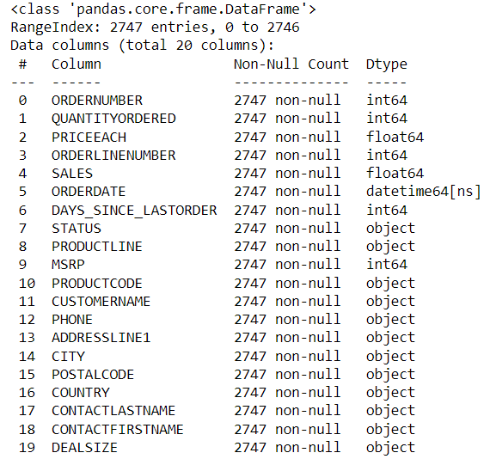
Data Information:
Data information:
The data is about an automobile parts manufacturing company of transactions for 3 years.
The dataset has 20 variables and 2747 records.
The data has 1 datetime64 , 2 float64, 5 int64, and 12 Object data types.
There are no null values in any column of the dataset.
There are no duplicates in the dataset.

Slide 7
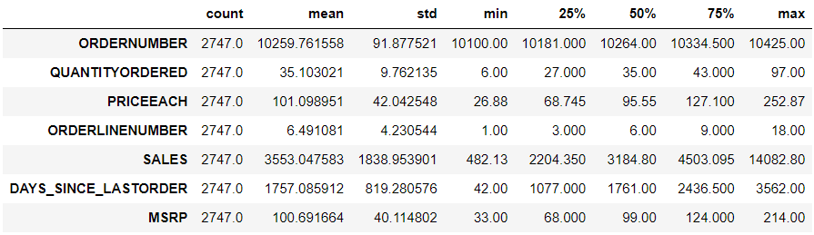
Data Description:
Summary of Numeric variables:
The mean sales of the automobile parts manufacturing company ranges from 482 to 14082 with average sales of 3553 and standard deviation of 1838.
From above summary we can infer that the price of each automobile parts is more than the MSRP [Manufacturer's Suggested Retail Price]
The average price of MSRP is 100.69 where price of each is 101.098.
The Quantity of ordered ranges from 9 to 97 with average of 35 orders.

Slide 8
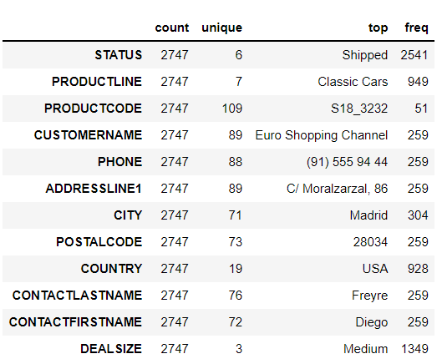
Data Description:
Summary of Categorical variables:
Status : There are 6 unique categories to define the order status out of which most of the orders are ‘shipped’.
Customer Name : There are 89 different customers out of which ‘Euro Shopping Channel’ is the one with maximum orders.
City : Orders are placed in 71 different cities with maximum orders from ‘Madrid’
Country : Orders are placed in 19 different countries with maximum orders from ‘USA’
Deal Size : There are 3 different categories of deal size. Most of the orders have ‘Medium’ deal size..

Slide 9
Exploratory Analysis
General Summary:
Shape of data: (2747, 20)
Continuous variables: 7
Categorical variables: 12
Date-Time variables: 1
Null values: 0
Duplicate records: 0
Tools & Libraries used:
PYTHON :
EDA for the dataset is performed using Python libraries:
Pandas
Numpy
Seaborn
Matplotlib
TABLEAU :
Data Visualization [Bivariate, Multivariate] is performed using tableau public.
KNIME :
RFM Analysis is performed using KNIME.

Slide 10
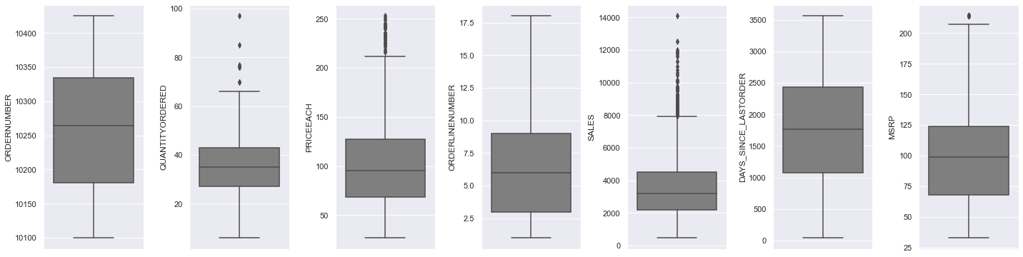
Outlier detection:
Inferences:
The data shows varied range of entries across each variables
We can see that, Sales and Price of each part of automobile have more number of outliers

Slide 11
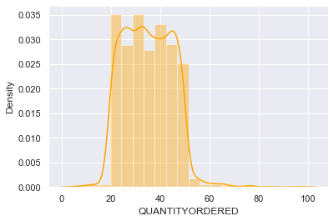
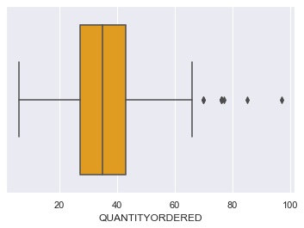
Univariate Analysis : Quantity Ordered
Inferences:
The distribution of ‘Quantity ordered' is slightly right skewed with skewness value of 0.37.
The distribution is almost normally distributed.
The distplot shows the distribution of most of data from 20 to 65.
The box plot of the ‘Quantity ordered' variable shows few outliers.

Slide 12
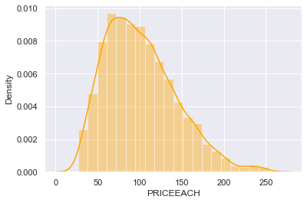
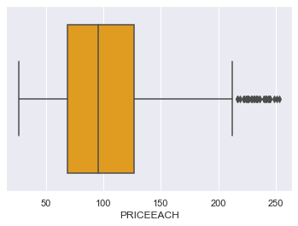
Univariate Analysis : Price of each item
Inferences:
The distribution of ‘Price each' is right skewed with skewness value of 0.7.
The distplot shows the distribution of most of data from 20 to 220.
The box plot of the ‘Price each' variable shows presence of outliers.

Slide 13
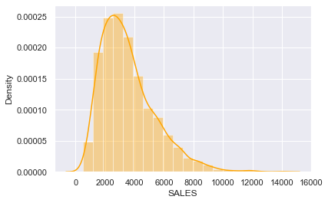
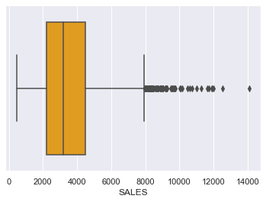
Univariate Analysis : Sales
Inferences:
The distribution of ‘Sales' is right skewed with skewness value of 1.16.
The distplot shows most of the sales are in range of 500 to 8000.
The box plot of the ‘Sales' variable shows presence of many outliers.

Slide 14
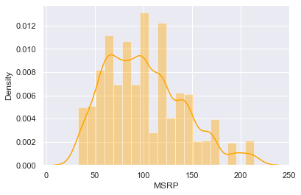
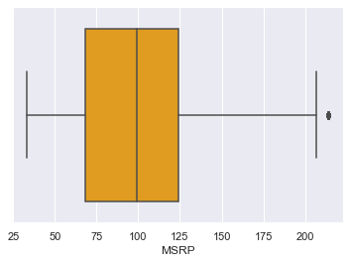
Univariate Analysis : MSRP
Inferences:
The distribution of ‘MSRP’ is slightly right skewed with skewness value of 0.58.
The distribution is almost normally distributed.
The distplot shows the range of MSRP from 35 to 200 of each item .
The box plot of the ‘MSRP' variable shows presence of one outliers.

Slide 15
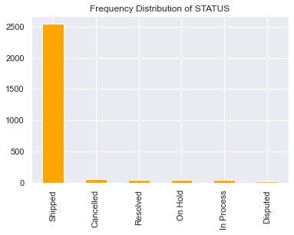
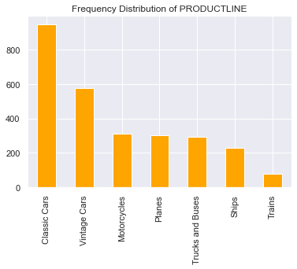
Univariate Analysis : Status , Product line
Inferences:
Status is categories into 6 different types, most of the items are shipped.
There are 7 different Product lines. Classic cars parts have the maximum orders followed vintage cars.
The train parts are having the least orders.

Slide 16
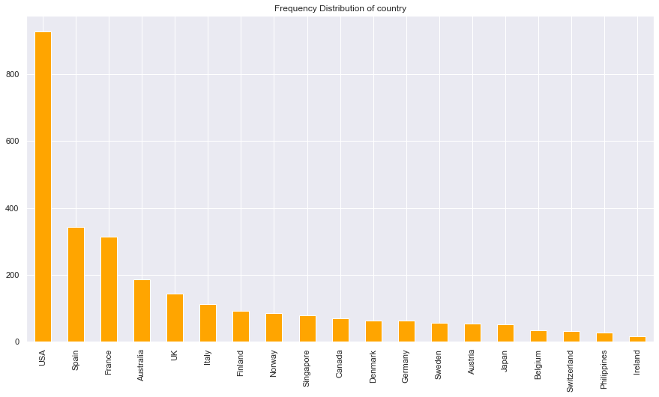
Univariate Analysis : Country
Inferences:
USA has the highest number of orders followed by Spain and France.
Ireland has minimum number of orders followed by Philippines and Switzerland.

Slide 17
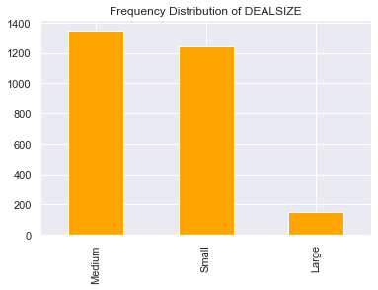
Univariate Analysis : Deal size
Inferences:
The deal size of orders are mostly median size followed small and the least are the large.

Slide 18
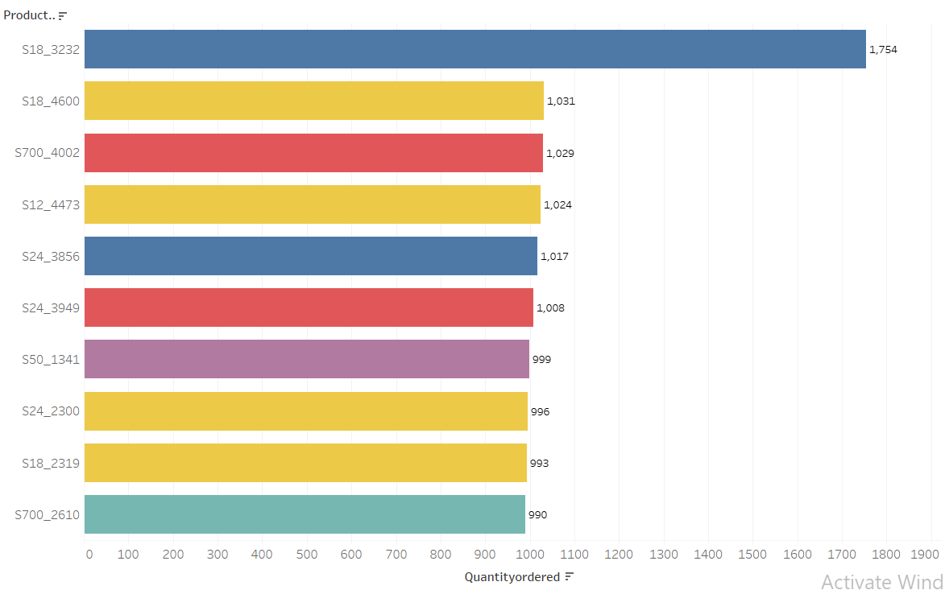
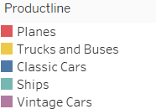
Top 10 purchased products

Slide 19
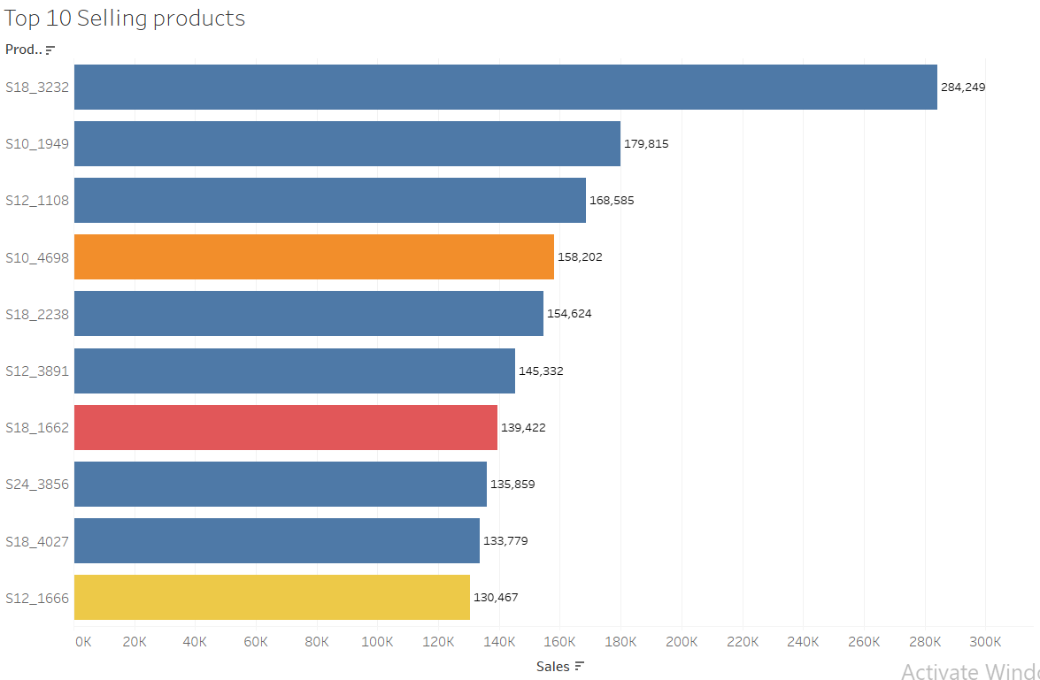
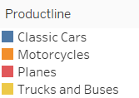
Top 10 selling products

Slide 20
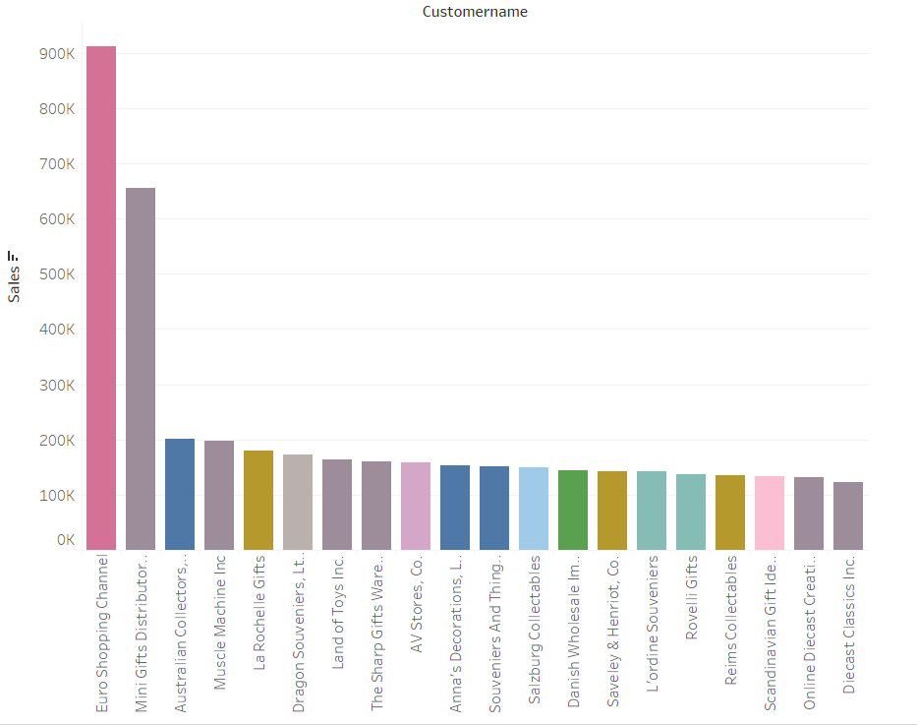
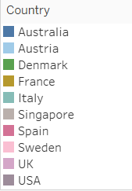
Top 20 Customers across Globe

Slide 21
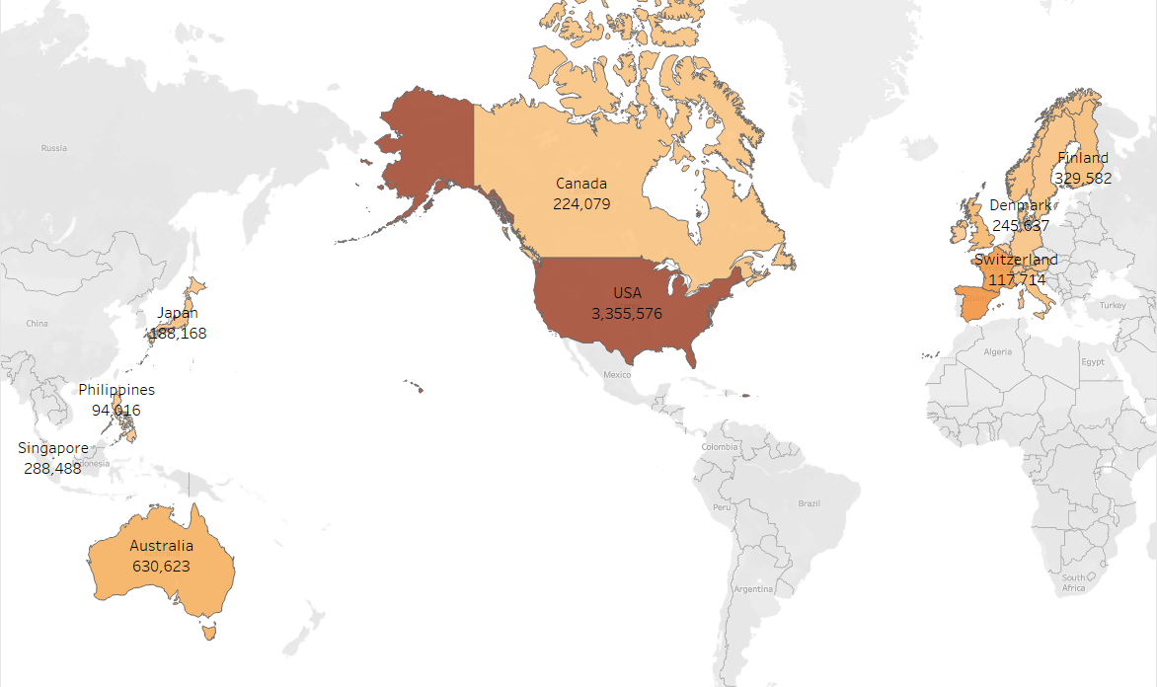
Bivariate Analysis : Sales across Countries
Inferences:
This graph shows the sales across different countries. The company is having a viable market across 19 countries.
USA is the primary market of the company contributing maximum turn-over Some European countries like Spain and Switzerland shows good amount of sales following USA.

Slide 22
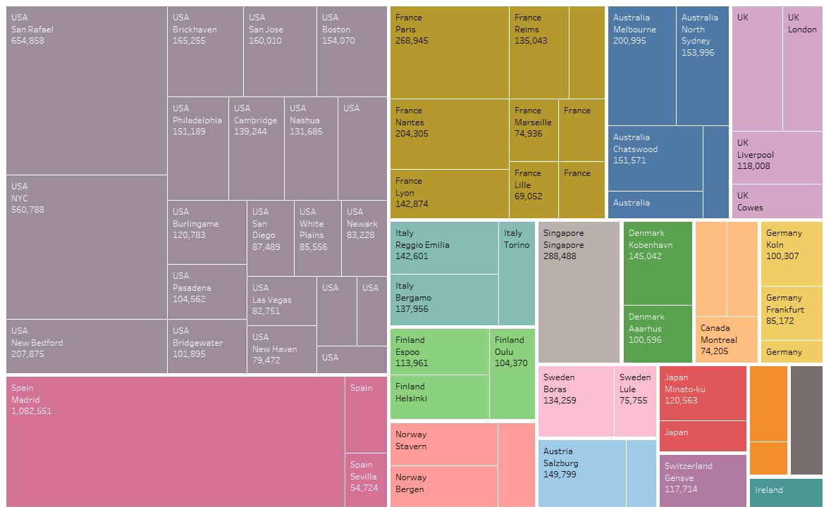
Sales across different cities around the globe
Inferences:
In USA, San Rafael and NYC are having major sales.
Madrid makes major turn over entire Globe.

Slide 23
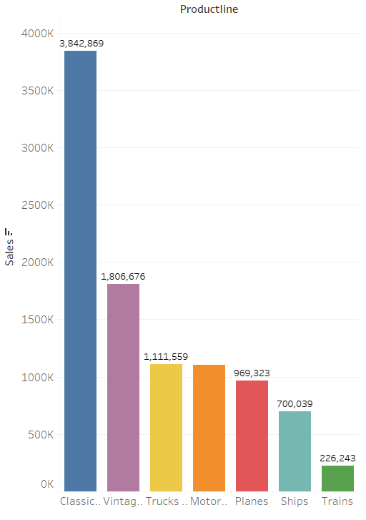
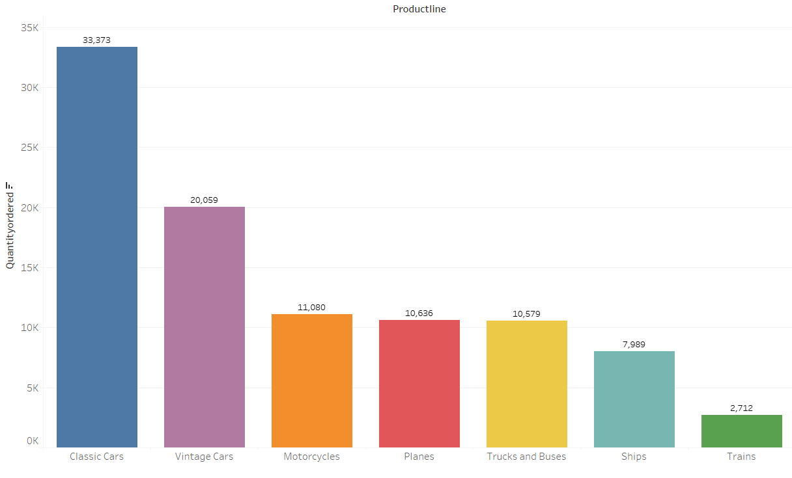
Sales across different Product line & Quantity of orders across different Product line
Inferences:
The Sales and the Quantity of orders are highest on the Classic car products followed by the vintage cars, where the sales of Classic car parts is almost double the sales of vintage car parts.
In both the cases the Train parts are contributing the least followed by the products of ship.

Slide 24
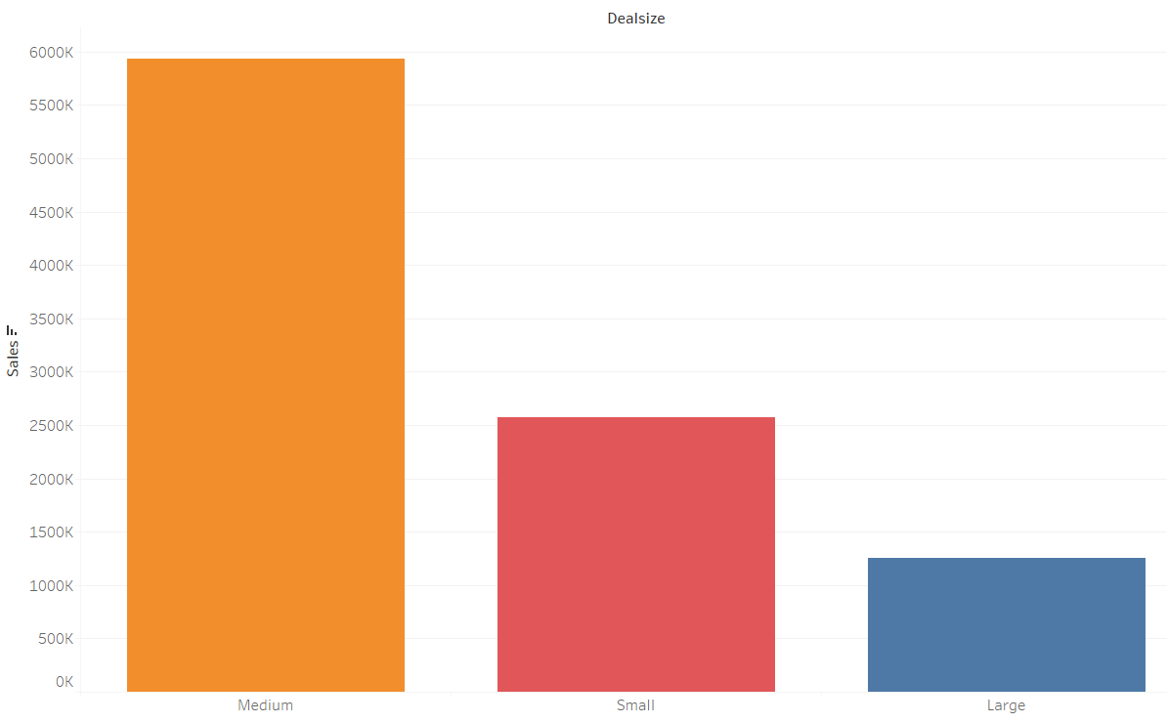
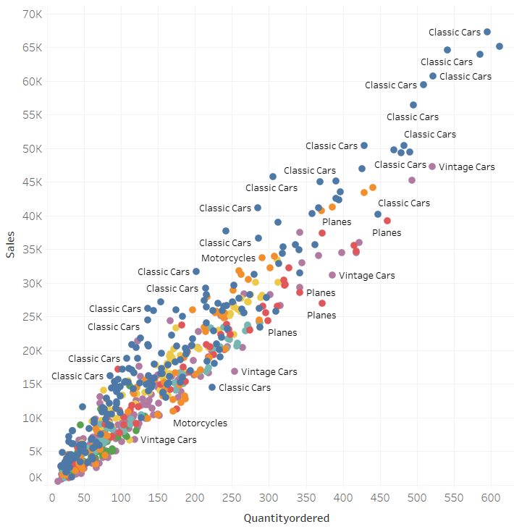
Sales vs Deal size & Sales, Quantity vs Product line
Inferences:
Clearly we can see that medium seal size are having the maximum sale of around approximately 600K.
The scatter plot represents the distribution of various product lines with respect to Quantity ordered and Sales price 2. Classic cars products are visibly the most selling product line followed by Vintage cars

Slide 25
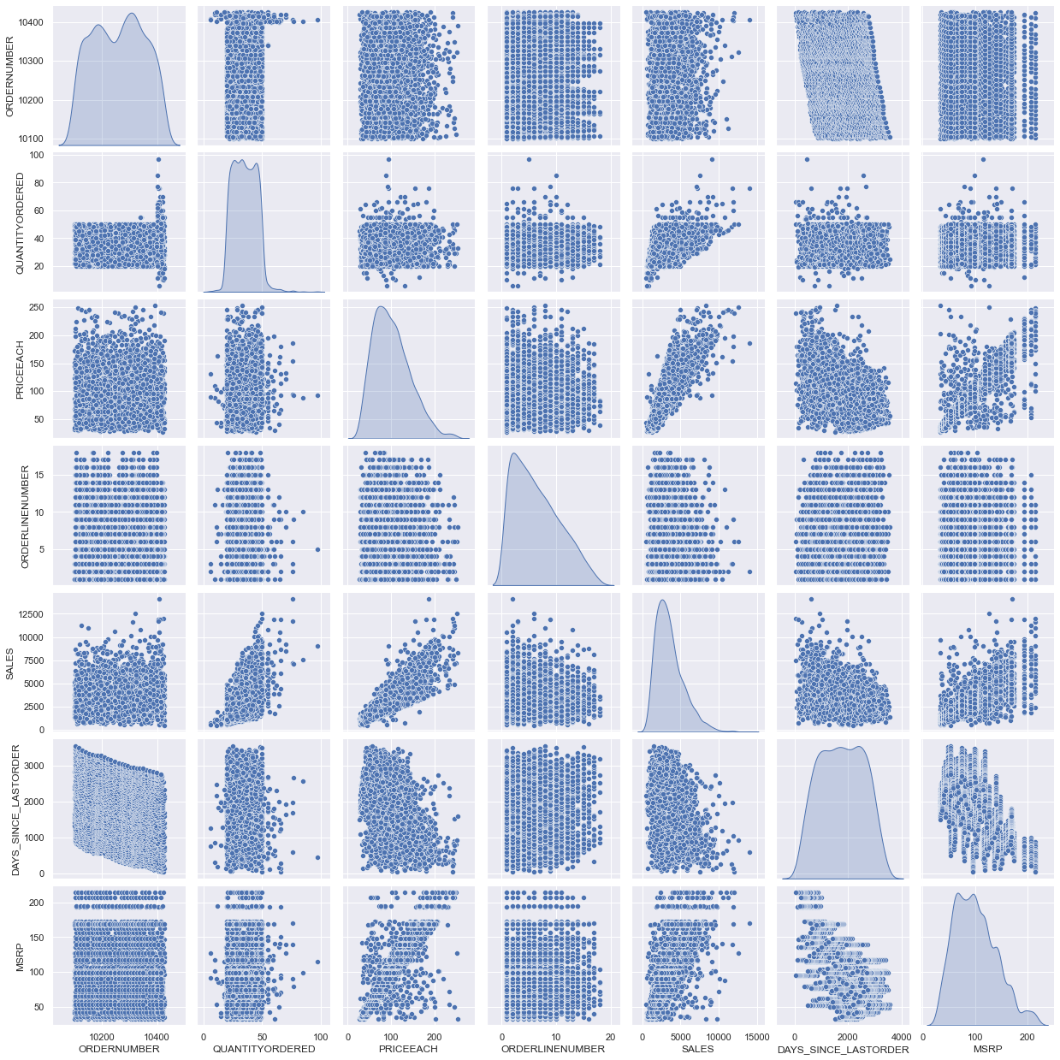
Multivariate Analysis : Pair plot
Inferences:
The pair plot shows all variables in data are normally distributed or slightly right skewed.
There is visible correlation between sales, MSRP and price each.
Other variables don’t show any signs of correlation and have cloud like distribution.

Slide 26
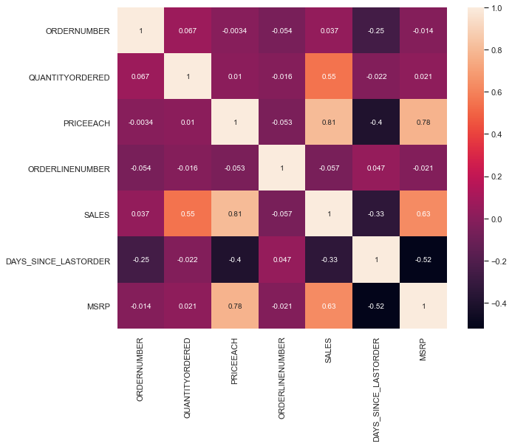
Multivariate Analysis : Heatmap
Inferences:
The heatmap provides asseveration to our observation in pair plot.
Sales variables is highly correlating with MSRP and Price each
There is also a partial correlation observed between Quantity of order and Sales.

Slide 27
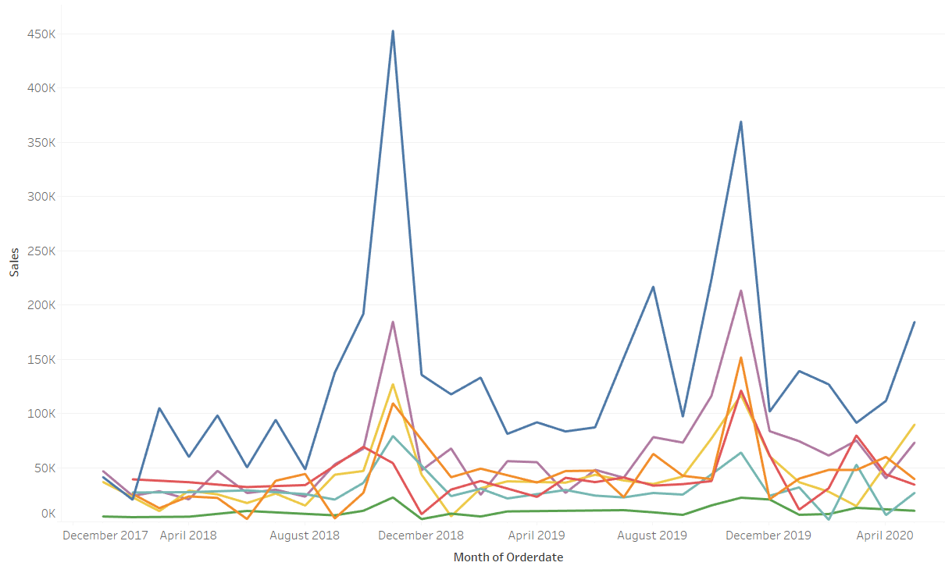
Sales over Time based on Product line

Slide 28
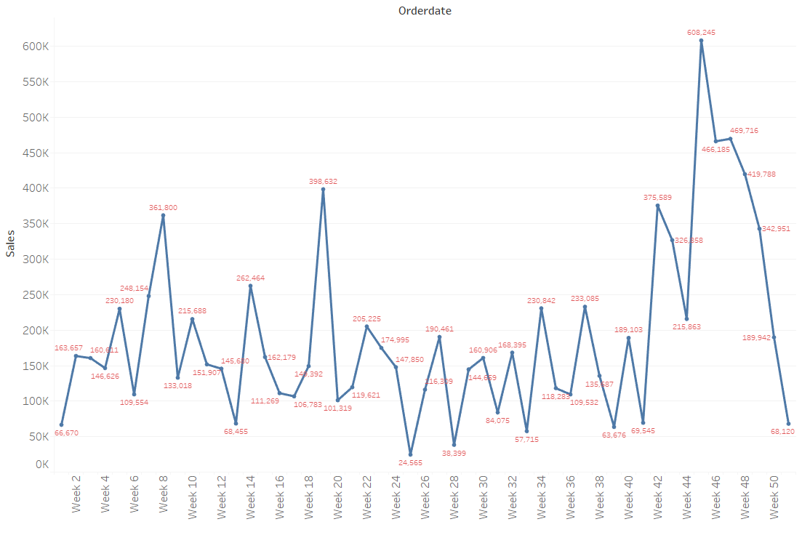
Weekly Trend of Sales
Inferences:
Sales are highest in the weeks commencing from 42 to 50 and partially low in the mid weeks of 20th to 40th week.
Sales of 2018 and 2019 are having almost same trend and 2020 is moving with same trend as well.

Slide 29
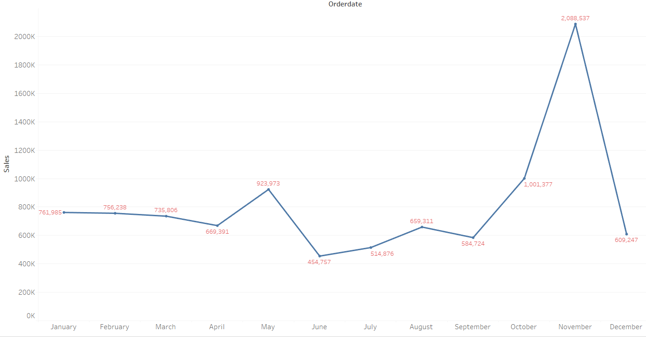
Monthly Trend of Sales
Inferences:
Highest sales are in the month of November.
Looks like the sales trend is exalting towards the end of the year i.e; from September to November.

Slide 30
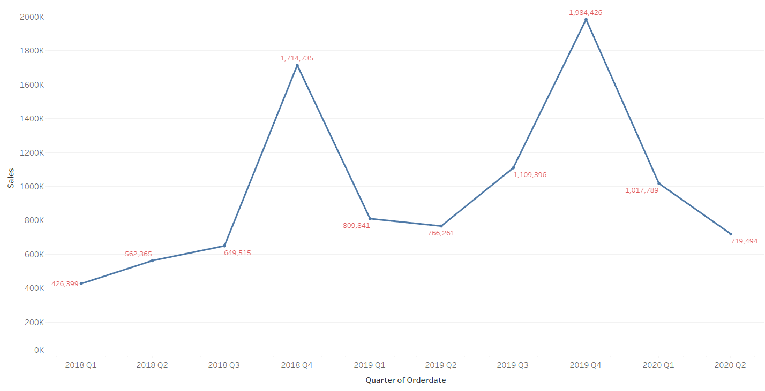
Quarterly Trend of Sales from 2018-20
Inferences:
Clearly, we can see that the sales are maximum at every 4th quarter affirming from the previous monthly trend.
The sales trend is least at the 1st quarter and has increasing trend at 4th and shows the seasonality pattern.

Slide 31
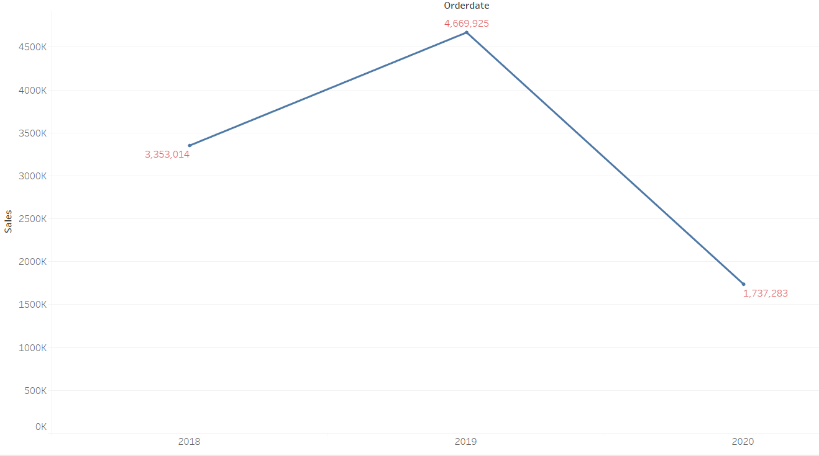
Yearly Trend of Sales from 2018-20
Inferences:
The sales has increased from 2018 to 2019 by approximately more than 30%
After 2019. the sales have been drastically decreasing.
Till 2019, the sales were to peak.

Slide 32
EDA Inferences
USA is the primary market of the company contributing maximum turn-over Some European countries like Spain and Switzerland shows good amount of sales following USA.
Ireland, Philippines and Belgium are performing very low in terms of sales
Madrid in Spain, Sand Rafael in USA are the cities which account for maximum sales
Most gold customers are present in USA market
Classic cars and Vintage cars product producing good sales. The company can focus on Trains and Ships more to generate more sales across all products.
The deal size of orders are mostly median size followed small and the least are the large. The company has highest sales in 4th quarter of the year
The sales trend is least at the 1st quarter and has increasing trend at 4th and shows the seasonality pattern.
Euro shopping channel present in Spain is the most loyal customer

Slide 33
Customer Segmentation using RFM Analysis
What is RFM?
RFM analysis stands for recency, frequency and monetary value. RFM analysis is a marketing approach that ranks and groups clients statistically based on the recency, frequency, and monetary amount of their recent transactions in order to find the best customers and conduct focused marketing campaigns.
KNIME tool to perform the RFM analysis on our data
What all parameters used and assumptions made?
Customer Name, Order Date, Price of each item, Quantity ordered and Product code are the major parameters which are used for this RFM analysis.
Assumptions made
For Recency value, we take Max(Order Date) – Order Date. In our case, Max(Order Date) is equal to 30st May 2020 as mentioned in FAQ.
For Monetary value, we take Price of each item X Quantity ordered
For Frequency value, we group the data set by Customer Name column to get Recency, Frequency and Monetary value of customers.
For Recency column binning, lowest value of recency gets best score of 4 while highest value of recency gets least score of 1.
For Frequency and Monetary value binning, highest values get best score of 4 while lowest scores get worst score of 1.

Slide 34
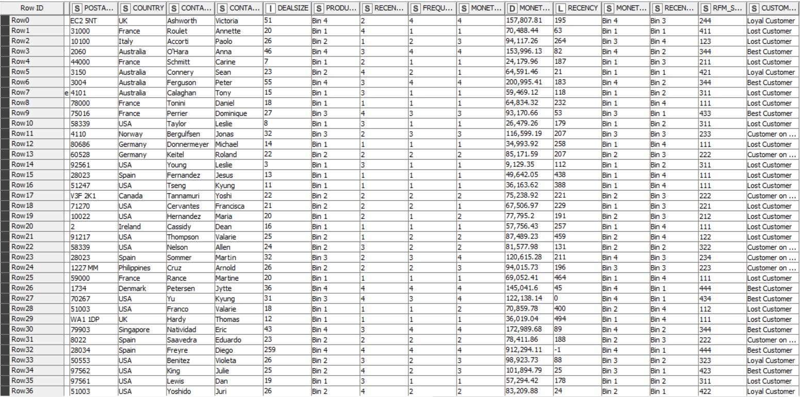
Output Table from KNIME
The RFM Analysis is done and customers are segmented into 4 bins from 1 to 4, 1 being the low and 4 the highest.
After the bins are generated from 1 to 4 based on there values, the RFM score is generated by combing the bind of Recency, Frequency and Monetary in the same sequence.

Slide 35
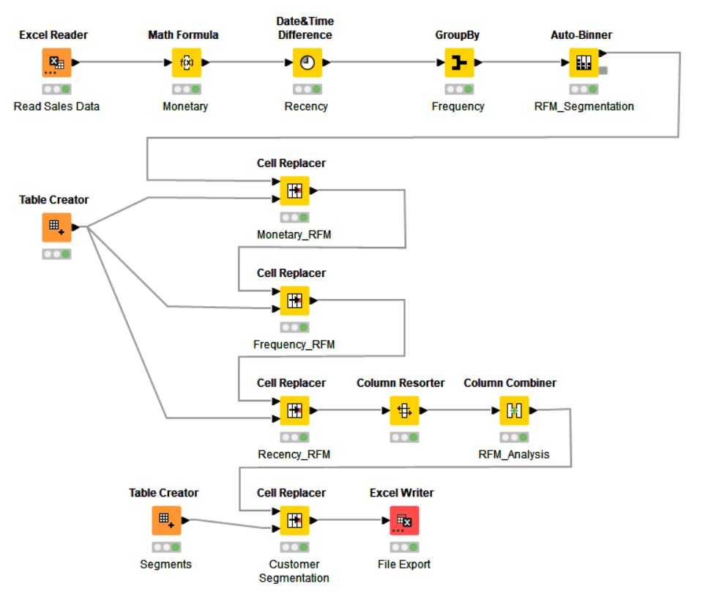
Work flow image from KNIME

Slide 36
KNIME Workflow Explanation
1 - Excel Reader : Reading all the entries from the excel data file.
2 - Math Formula : Math formula node is used to calculate the Monetary column by take product of price of each item and Quantity ordered.
3 - Date & Time difference : This node is used to calculate the Recency value by considering the fixed date difference. i.e; formula (Max(order date) – order date) where Max(order date) is 30st May 2020 as mentioned in FAQ’s.
4 - Groupby : Group by node is used to calculate the frequency of customers orders by grouping by customer name and keeping count of orders and products.
5 - Auto-Binner: Customer segmentation is done by binning the Recency, Frequency and Monetary values into 4 quartiles ranging from 0 - 0.25, 0.25 - 0.5, 0.5 - 0.75 and 0.75 - 1, into Bin 1, Bin 2, Bin 3 and Bin 4 respectively.
6 - Table Creator: To rename the bins, initially a manual table is created, where for monetary and frequency the higher scores has higher values and lower scores has lower values and for Recency high recency value has lower scores while low recency value has higher scores.
7 - Cell replacer nodes : Three cell replacer nodes are used to Recency, Frequency and Monetary to rename the scores of bins and the column of each are appended.
8 - Column Resorter : This node is used to sort the columns of Recency, Frequency and Monetary columns in sequence of RFM.
9 - Column Combiner : This node is used to combine all the values of Recency, Frequency and Monetary into one column of RFM score.
10 - Table Creator : Another table creator is used to assign the 4 categories of customer segmentations based on the RFM score.
11 - Cell replacer : This columns renames the customer segmentations into Best customers, Loyal customers, Customers on the verge of churn and Lost customers based on the previous table creator node.
12 - Excel writer : Finally exporting the RFM analysis into excel.

Slide 37
Inferences from RFM Analysis and identified segments
According to the RFM analysis, customers are classified into 4 segments, ranging from 1 to 4; 1 being the lowest and 4 being the highest.
Recency – High recency value has lower scores while low recency value has higher scores
Monetary and Frequency – High monetary and frequency values have higher scores while low values have lower scores.
These scores are then combined in a set order of RFM to finally get RFM scores. These scores range from 111 to 444 where 111 is the lowest score while 444 is the highest score.
Based on these scores, customers are segmented into 4 different categories:
Best Customers
Loyal Customers
Customers on the verge of Churning
Lost Customers
Recency | Frequency | Monetary
 |  | 4 | 3 | 2 | 1
4 | 4 | Best | Best
 | 3 | Best | Best
 | 2 |  | Best | Loyal | Loyal
 | 1 |  | Loyal |  | Lost
3 | 4 | Best | Best
 | 3 |  | Loyal | Loyal
 | 2 |  | Loyal | Churn
 | 1 |  |  |  | Lost
2 | 4 | Loyal
 | 3 | Churn | Churn
 | 2 |  | Churn | Churn | Lost
 | 1 |  |  | Lost | Lost
1 | 4 | Churn
 | 3 |  | Churn
 | 2 |  | Lost | Lost
 | 1 |  |  | Lost | Lost

Slide 38
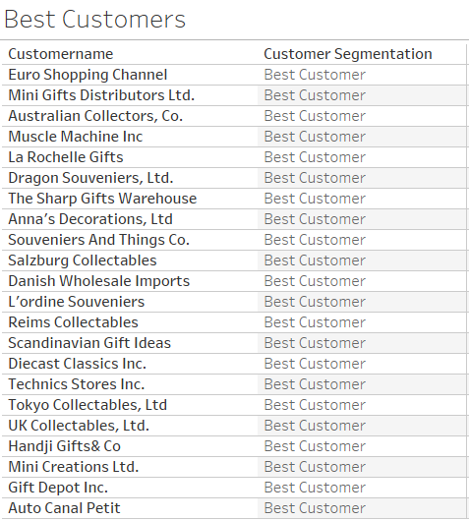
Best Customers [Based on RFM score]
Below mentioned are the customers which fall into Best Customers category based on RFM score.

Slide 39
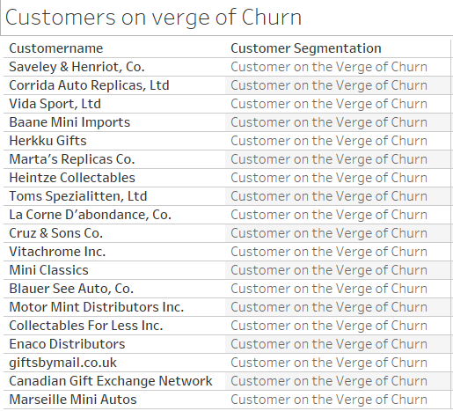
Customers on the verge of churning
[Based on RFM score]
Below mentioned are the customers which fall into Customers on the verge of Churn category based on RFM score.

Slide 40
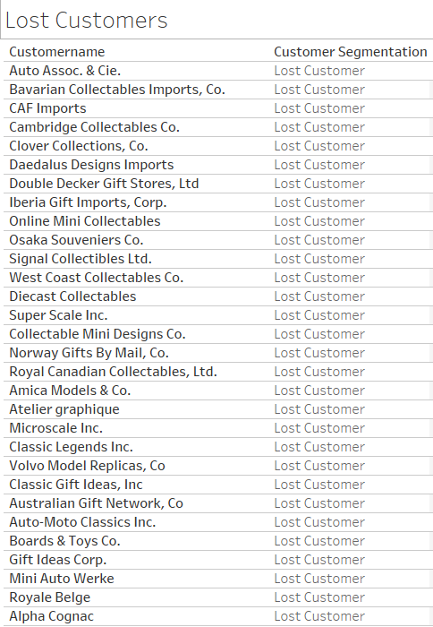
Lost Customers [Based on RFM score]
Below mentioned are the customers which fall into Lost Customers category based on RFM score.

Slide 41
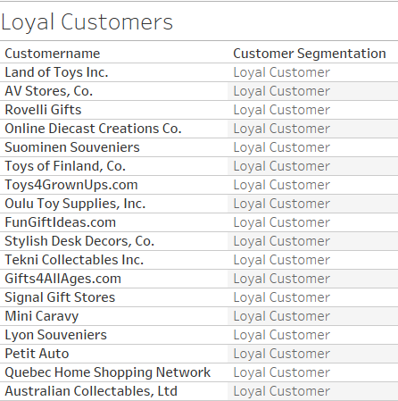
Loyal Customers [Based on RFM score]
Below mentioned are the customers which fall into Loyal Customers category based on RFM score.

Slide 42
Recommendations:
The best customers and Loyal customers are top priority. Focus can be given on the customers who are on the verge of churning.
The company can initiate loyalty programs and campaigns for customer relationship.
This model will help the company to maintain its sales and customers and can focus on criteria’s for many lost customers & can take actions.
In addition to US market, the company can invest and do more business in Spain, France and Australia, as they have promising sales performance.
In order to venture into new markets, Classic cars and Vintage cars product line will be most effective since most of the orders and sales are on it.

Slide 43
Reference Links:
1- EDA Data visualisation: https://public.tableau.com/app/profile/pooja.kabadi8245/viz/MRA-Milwstone1/SalesDistribution?publish=yes
2- RFM Customer segmentation : https://public.tableau.com/app/profile/pooja.kabadi8245/viz/RFMCustomersegmentation/BestCustomers?publish=yes
3 - Python file: Attached along with presentation pdf
4 – KNIME : Attached along with presentation pdf

Slide 44
Thank you

