Slide 1
Supermart Grocery Sales – Retail Performance Analysis
Data Analysis & Insights using Python
Tools Used: Python, Pandas, Seaborn, Matplotlib, Google Colab
Prepared by
Pooja Kasabe
UMID-01042527099

Slide 2
Objective
- Analyze grocery sales, profit, and discount trends
1
- Identify top-performing categories, cities, and regions
2
- Recommend business strategies for pricing, marketing, and planning
3

Slide 3
Data Preparation
- Removed duplicate records
- Converted 'Order Date' to datetime format
- Extracted: Order Day, Order Month, Order Year

Slide 4
Techniques & Libraries Used
- Python Libraries: Pandas, NumPy, Matplotlib, Seaborn
- EDA Techniques: Grouping & aggregation, Time series trends, Correlation heatmap, Scatter plots, bar charts, pie charts

Slide 5
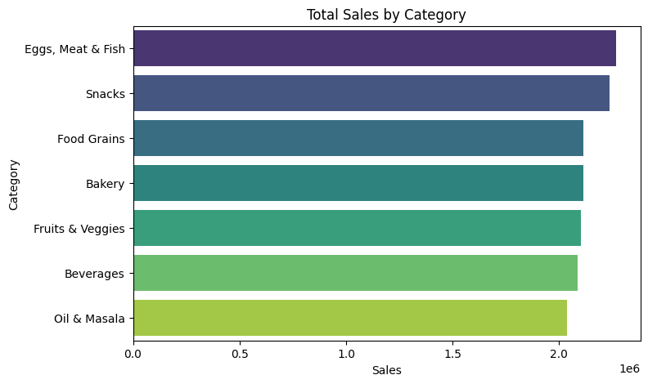
Category-wise Sales
The Eggs, Meat & Fish category contributed the highest to overall sales, followed closely by Snacks and Food Grains.
Beverages and Oil & Masala were among the lower-performing categories in terms of sales volume.
This suggests an opportunity to prioritize high-selling categories in promotions or inventory allocation.

Slide 6
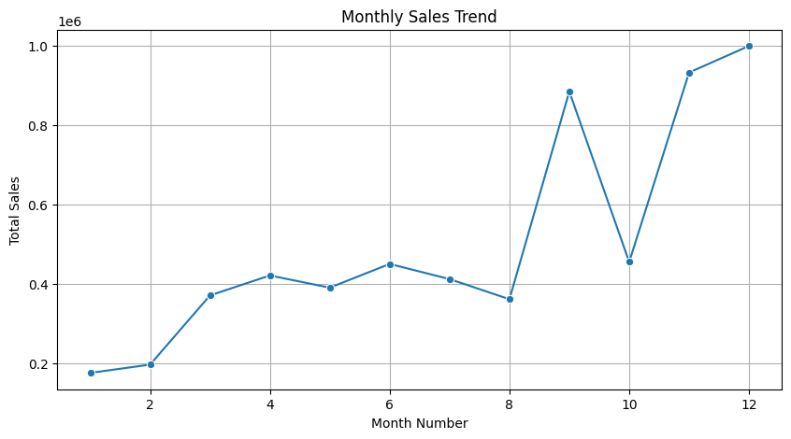
Monthly Sales Trends
- Sales peaked in October–December
- Seasonal trend observed
- Increase inventory/ads before festive season.

Slide 7
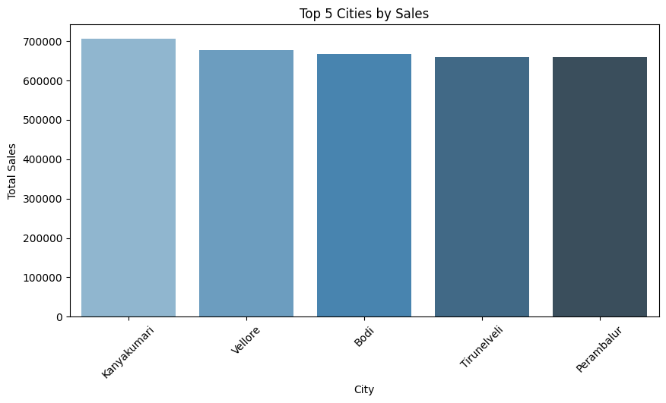
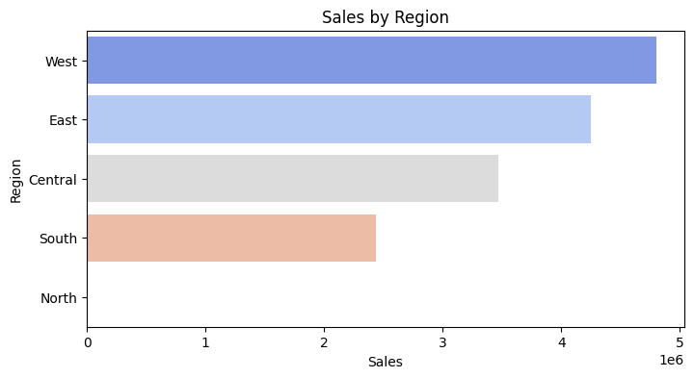
Sales by Region & City
- Kanyakumari, Vellore: Top cities by sales
- Western region leads in total revenue
- Focus on strong regions and explore city-level improvements.
-This highlights opportunities in Tier 2/3 cities and non-traditional regions

Slide 8
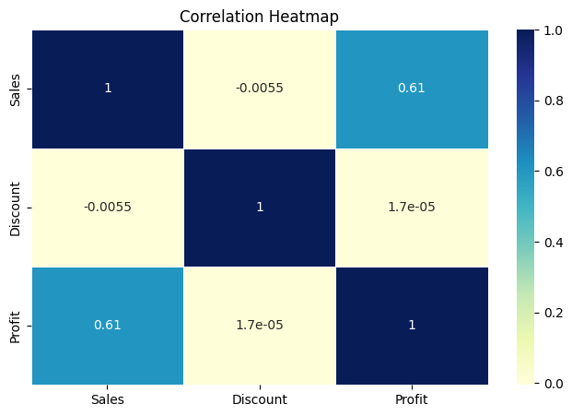
Correlation Heatmap
- Sales & Profit: Strong positive correlation (+0.61)
- Discount shows near-zero correlation
- Discounts don’t always drive more sales or profit
The correlation heatmap confirms a strong positive relationship between sales and profit (0.61), but no meaningful correlation between discount and either sales or profit. This suggests that in this dataset, discounting does not appear to influence sales or profitability in a linear way.

Slide 9
Key Business Insights
The Eggs, Meat & Fish category contributed the highest to overall sales, followed closely by Snacks and Food Grains. Beverages and Oil & Masala were among the lower-performing categories in terms of sales volume. This suggests an opportunity to prioritize high-selling categories in promotions or inventory allocation.
Based on the line chart, October–December had consistently higher sales, suggesting a strong festive season impact. This seasonal surge should be leveraged through campaign planning and supply readiness
Sales and Profit show a strong positive correlation (0.61) — as expected. Discount shows near-zero correlation with both Sales and Profit (~0), meaning it doesn’t drive results significantly in this dataset.
The top cities by sales were Kanyakumari, Vellore, and Bagalkot, not metro cities like Chennai — an important insight. The Western region outperformed others in total revenue. This highlights opportunities in Tier 2/3 cities and non-traditional regions.

Slide 10
Recommendations
Product Strategy
Focus marketing on high-selling items like Eggs, Meat & Fish.
Reassess pricing or bundling for low-performing categories.
Seasonal Planning
Boost stock & promotions before Q4 festive periods.
Discounting
Avoid deep discounts unless they are part of targeted campaigns.
Maintain balanced margins across discount brackets.
Regional Strategy
Invest in Western region and emerging Tier-2/3 cities.
Investigate underperforming areas for tailored interventions.
Continuous Monitoring
Track monthly trends to refine strategy dynamically.

