Slide 1
Supermart Grocery Sales – Retail Performance Analysis
Data Analysis & Insights using Python
Tools Used: Python, Pandas, Seaborn, Matplotlib, Google Colab
Prepared by
Pooja Kasabe
UMID-01042527099

Slide 2
Objective
- Analyze grocery sales, profit, and discount trends
1
- Identify top-performing categories, cities, and regions
2
- Recommend business strategies for pricing, marketing, and planning
3

Slide 3
Data Preparation
- Removed duplicate records
- Converted 'Order Date' to datetime format
- Extracted: Order Day, Order Month, Order Year

Slide 4
Techniques & Libraries Used
- Python Libraries: Pandas, NumPy, Matplotlib, Seaborn
- EDA Techniques: Grouping & aggregation, Time series trends, Correlation heatmap, Scatter plots, bar charts, pie charts

Slide 5
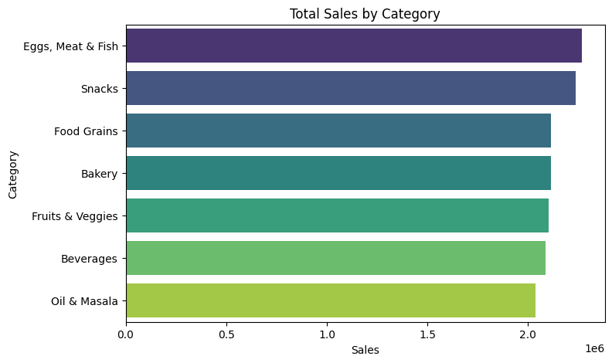
Category-wise Sales
The Eggs, Meat & Fish category contributed the highest to overall sales, followed closely by Snacks and Food Grains.
Beverages and Oil & Masala were among the lower-performing categories in terms of sales volume.
This suggests an opportunity to prioritize high-selling categories in promotions or inventory allocation.

Slide 6
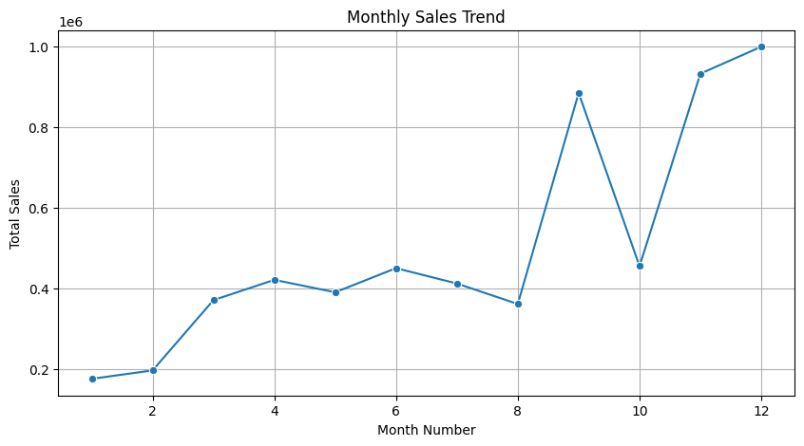
Monthly Sales Trends
- Sales peaked in October–December
- Seasonal trend observed
- Increase inventory/ads before festive season.

Slide 7
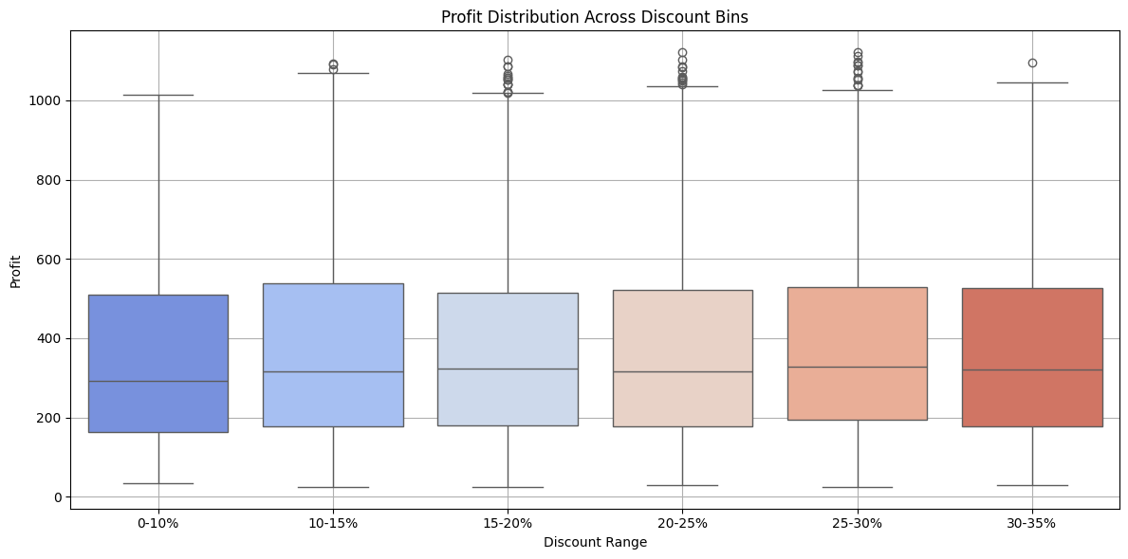
Profit Distribution Across Discount Ranges
The majority of profits across all discount bins are positive
0–10% and 10–15% discount bins show higher and more stable profits
Higher discount bins like 25–30% and 30–35% show greater variability
However, no major negative outliers are observed — profit remains largely positive

Slide 8
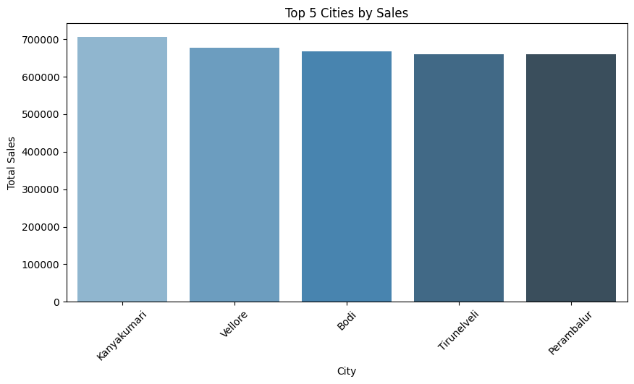
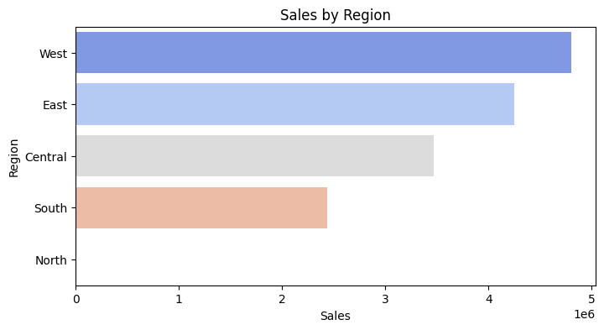
Sales by Region & City
- Kanyakumari, Vellore: Top cities by sales
- Western region leads in total revenue
- Focus on strong regions and explore city-level improvements.
-This highlights opportunities in Tier 2/3 cities and non-traditional regions

Slide 9
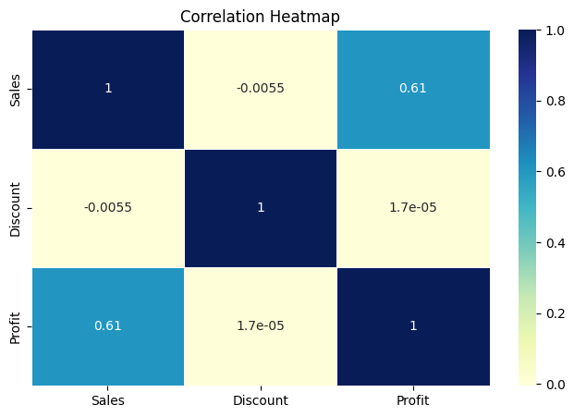
Correlation Heatmap
- Sales & Profit: Strong positive correlation (+0.61)
- Discount shows near-zero correlation
- Discounts don’t always drive more sales or profit
The correlation heatmap confirms a strong positive relationship between sales and profit (0.61), but no meaningful correlation between discount and either sales or profit. This suggests that in this dataset, discounting does not appear to influence sales or profitability in a linear way.

Slide 10
Key Business Insights
The Eggs, Meat & Fish category contributed the highest to overall sales, followed closely by Snacks and Food Grains. Beverages and Oil & Masala were among the lower-performing categories in terms of sales volume. This suggests an opportunity to prioritize high-selling categories in promotions or inventory allocation.
Based on the line chart, October–December had consistently higher sales, suggesting a strong festive season impact. This seasonal surge should be leveraged through campaign planning and supply readiness
Profit remained positive across all discount bins, with no negative outliers observed. 0–15% discount bins showed slightly more stable profit distributions. Higher discount bins did not cause losses — indicating discounting is currently well-managed.
Sales and Profit show a strong positive correlation (0.61) — as expected. Discount shows near-zero correlation with both Sales and Profit (~0), meaning it doesn’t drive results significantly in this dataset.
The top cities by sales were Kanyakumari, Vellore, and Bagalkot, not metro cities like Chennai — an important insight. The Western region outperformed others in total revenue. This highlights opportunities in Tier 2/3 cities and non-traditional regions.

Slide 11
Recommendations
🔹 Product Strategy
📌 Prioritize high-performing categories like Eggs, Meat & Fish and Snacks for marketing campaigns and restocking.
📌 Evaluate underperforming categories (Oil & Masala, Beverages) for pricing or bundling opportunities.
🔹 Seasonal Planning
📅 Increase stock levels and marketing efforts in Q4 (Oct–Dec) to capture festive demand.
🔹 Discount Optimization
💸 Since discounts show no strong correlation with sales or profit, avoid deep discounts unless tied to targeted promotions.
✅ Focus on maintaining consistent profit margins across all discount levels.
🔹 Regional Focus
📍 Invest in Western region and high-performing non-metro cities (e.g., Kanyakumari, Vellore) which showed unexpected strength.
🔍 Reevaluate strategies in low-revenue regions (e.g., North, South) for localized improvement.
🔹 Data Monitoring
📊 Continue tracking category and region performance monthly to adapt strategies in real time.

Slide 12
Conclusion
In this project, I performed exploratory data analysis (EDA) on a fictional grocery sales dataset using Python, Pandas, and visualization tools in Google Colab.
The analysis revealed that:
Eggs, Meat & Fish and Snacks were the highest revenue-generating categories.
Sales peaked during the October–December period, indicating strong festive season demand.
Discount levels did not show significant correlation with either sales or profit, and profits remained mostly positive across all discount bins.
Western region and non-metro cities like Kanyakumari contributed more than expected, challenging common assumptions.
These insights can guide decisions around inventory planning, regional strategy, and pricing optimization. The project demonstrates how data-driven analysis can uncover actionable patterns in business performance.

