Slide 1
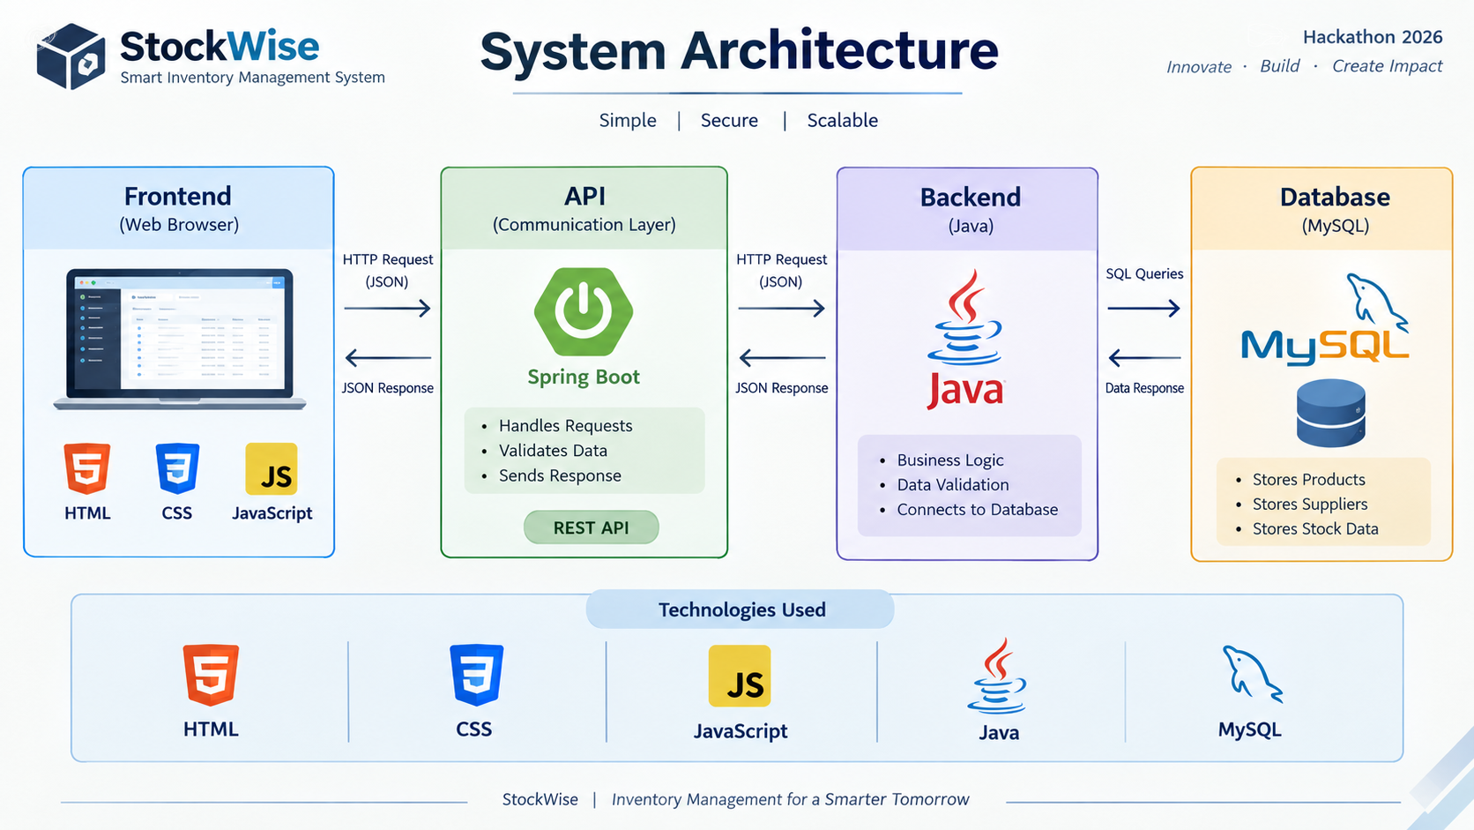
StockWise — System Architecture
How a user request moves through the web application and returns with a result.
Browser
User interface
HTML page
CSS layout
User actions
JavaScript
Frontend logic
• Form validation
• DOM updates
• fetch / async-await
REST API
HTTP endpoints
/api/auth
/api/products
/api/categories
/api/suppliers
Java + Spring Boot
Backend application
Controllers
Business logic
Repositories
MySQL
Persistent storage
Products & categories
Suppliers / batches
Low Stock & Expiry Alerts
User data
events
HTTP
request
SQL
Response returns to the browser (JSON / HTTP response)
Application areas
Authentication
Login / signup endpoints
(session flow where configured)
Products & Categories
Product CRUD
Category association
Suppliers & Batches
Supplier CRUD
Batch / expiry workflows
Inventory features
Stock tracking
Alerts / reports as implemented

