Slide 1


TEAM MEMBERS
Vasavi Surisetty
Pooja Kondagoli
Sindhu Putumbaka
Dinakar Narahari
BCIS 5110 SECTION 003 – PROGRAMMING LANGUAGES FO R BUSINESS ANALYTICS (SPRING 2024)

Slide 2
DATA MINDERS – REDFIN HOUSING DATA BUSINESS INSIGHTS
TEAM MEMBERS
Vasavi Surisetty
Pooja Kondagoli
Sindhu Putumbaka
Dinakar Narahari
BCIS 5110 SECTION 003 – PROGRAMMING LANGUAGES FO R BUSINESS ANALYTICS (SPRING 2024)

Slide 3
Contents
Executive Summary
Project Motivation
Data Description
Data Transformation
Data Analysis
Conclusion

Slide 4
Executive Summary
The project intended to bring out real estate data from Redfin using pandas packages in python. The given dataset, "Redfin_housing_data.csv" had a lot of qualities, for instance, price, features, and trends of the stipulated market. By exploiting data gathering, visualization, and analysis tools, the team tried to come up with the conclusion about changes in the housing market conditions, what trends influence prices and what factors play the most significant role when it comes to property value.

Slide 5
Project Motivation/Background
Fundamentally, the project endeavored to demonstrate that data-based strategies might help a better understanding of the challenges faced through the real estate market, with pandas data analysis and exploration as a particular tool.
The project aims to:
Illustrate housing market basics including supply and demand factors, pricing patterns, and some of the differences between regions of interest.
Bettering predictive power in property valuation via attributes like positions, house characteristics, and market conditions analysis.

Slide 6
Data Description & Data Transformation
The dataset is called "Redfin_housing_dat_2023" and it is formatted as a CSV file. The table consists of 98673 rows and 58 columns. Redfin housing data gives comprehensive data on home prices and amenities by region throughout the United States.
Data transformation is a necessary step for preparing the Redfin housing dataset, concentrated on 2023 data, for analysis. It involves feature engineering, creating or modifying features; normalization for consistent scaling; encoding categorical variables; and dealing for missing values through imputation or removal.
Filtering: Extracting
Identification: Identify null values
Calculation: Finding % of null values
Null Handling: Imputation
Substitution: Finding and replacing with mean value.

Slide 7
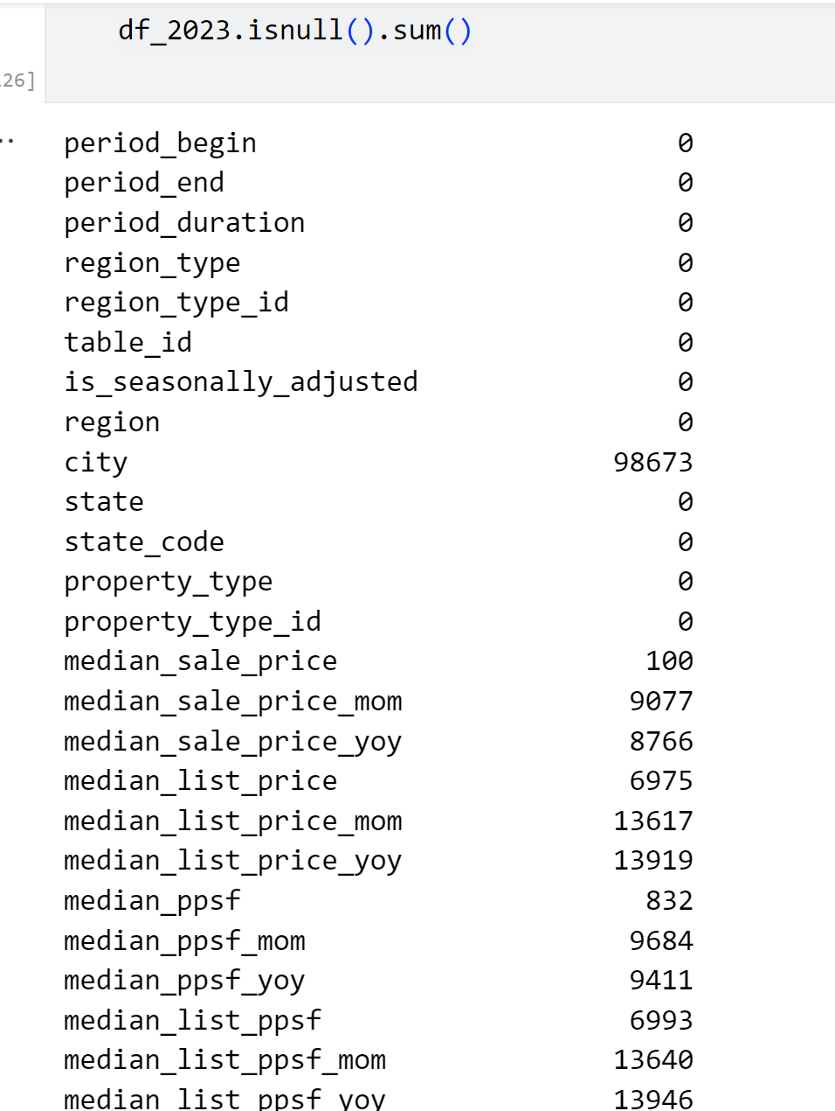
Data Description & Data Transformation
The dataset is called "Redfin_housing_dat_2023" and it is formatted as a CSV file. The table consists of 98673 rows and 58 columns. Redfin housing data gives comprehensive data on home prices and amenities by region throughout the United States.
Data transformation is a necessary step for preparing the Redfin housing dataset, concentrated on 2023 data, for analysis. It involves feature engineering, creating or modifying features; normalization for consistent scaling; encoding categorical variables; and dealing for missing values through imputation or removal.
Filtering: Extracting
Identification: Identify null values
Null Handling: Imputation
Calculation: Finding % of null values
Substitution: Finding mean and replacing with it
Grouping: Grouping by month

Slide 8
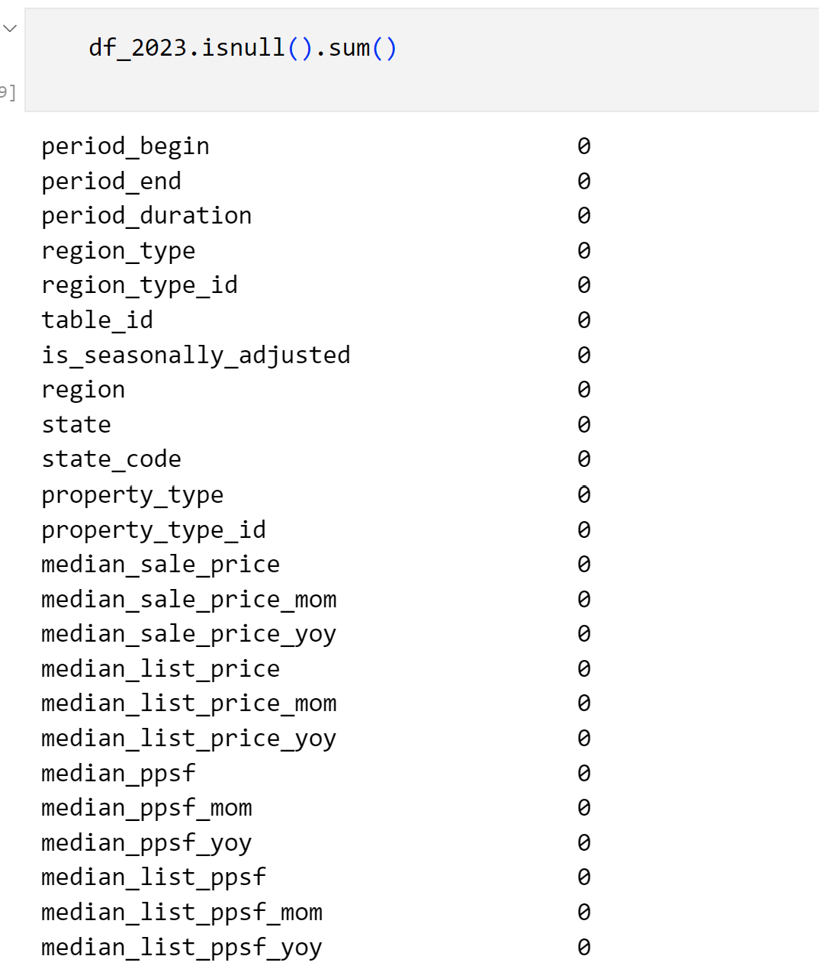
Data Description & Data Transformation
The dataset is called "Redfin_housing_dat_2023" and it is formatted as a CSV file. The table consists of 98673 rows and 58 columns. Redfin housing data gives comprehensive data on home prices and amenities by region throughout the United States.
Data transformation is a necessary step for preparing the Redfin housing dataset, concentrated on 2023 data, for analysis. It involves feature engineering, creating or modifying features; normalization for consistent scaling; encoding categorical variables; and dealing for missing values through imputation or removal.
Filtering: Extracting
Identification: Identify null values
Null Handling: Imputation
Calculation: Finding % of null values
Substitution: Finding mean and replacing with it
Grouping: Grouping by month

Slide 9
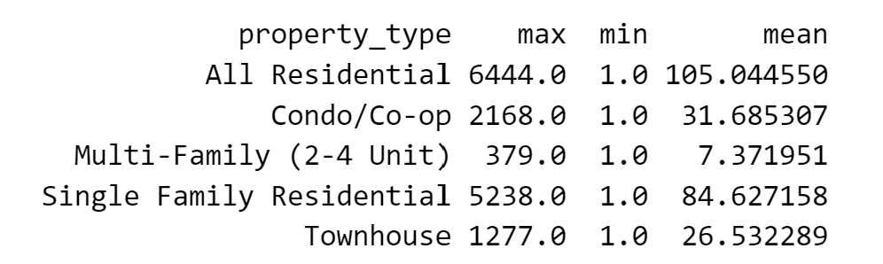
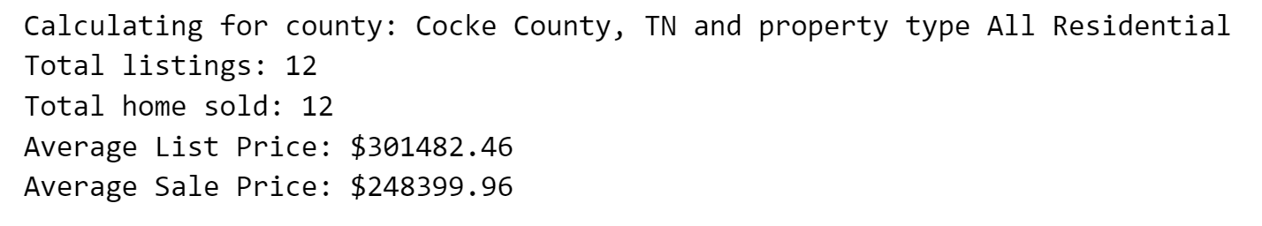
Questions
1. In what way are the maximum, minimum, and average home sales vary across different property types?
The Property_type_analysis function is defined to analyze the data and to classify property types in the data with their home sold vales.
Groupby function is used to group the data by ‘property_type’ column, this step enables the function to isolate the values and analyze each property type separately and within each group max,min and average home sale value is calculated.
2. How is the study of home listings and pricing vary based on the chosen county and property type?
The function ‘calculate_avg_prices’ is defined to analyze redfin real estate data for a specific county and property type provided by the user and calculates total count of home listing, total number of home sold, average list price and average sale price using pandas aggregation like count and mean.

Slide 10
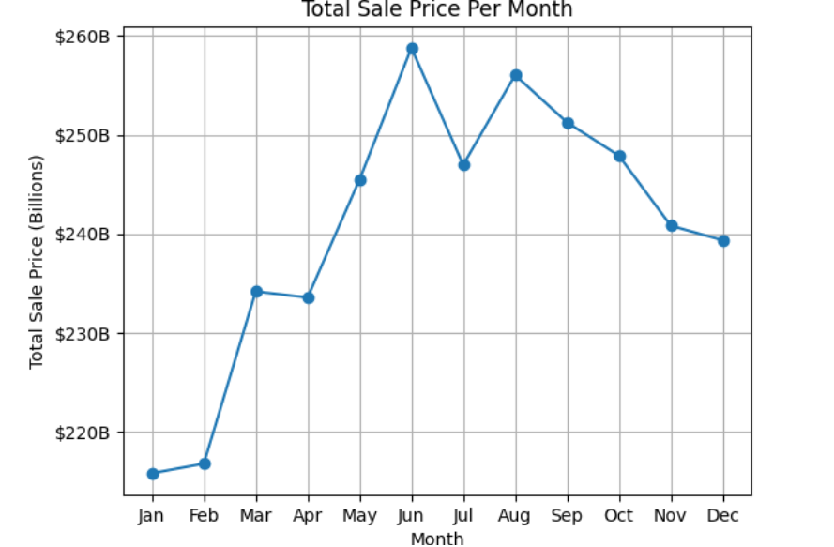
3. What is the regular monthly total sales for the period through the year 2023, and how do we visually present those using a line graph?
The function total_Sales_per_month is defined to visualize the total sales for each month using line graphs.
4. Which state has maximum sales?
The function Maximum_sales_state is defined to determine which state has the maximum total sales for the year 2023. Using idxmax function, we can get the maximum sales with the corresponding state and then print function prints the result indicating the state with the maximum sales and its corresponding total sales amount in billion dollars.

Slide 11


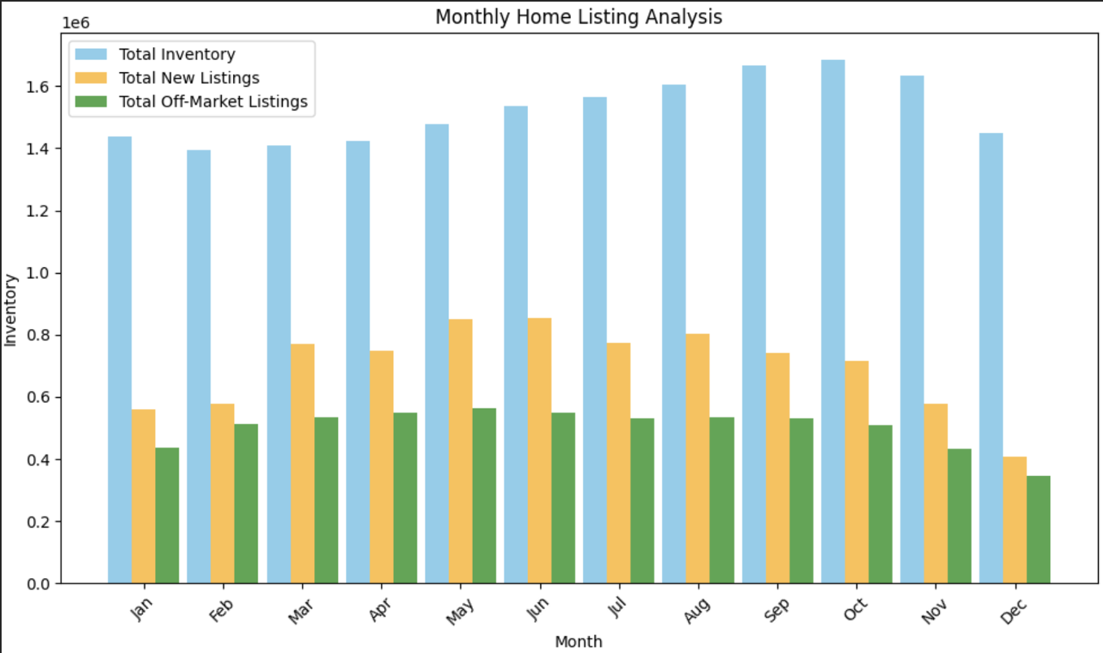
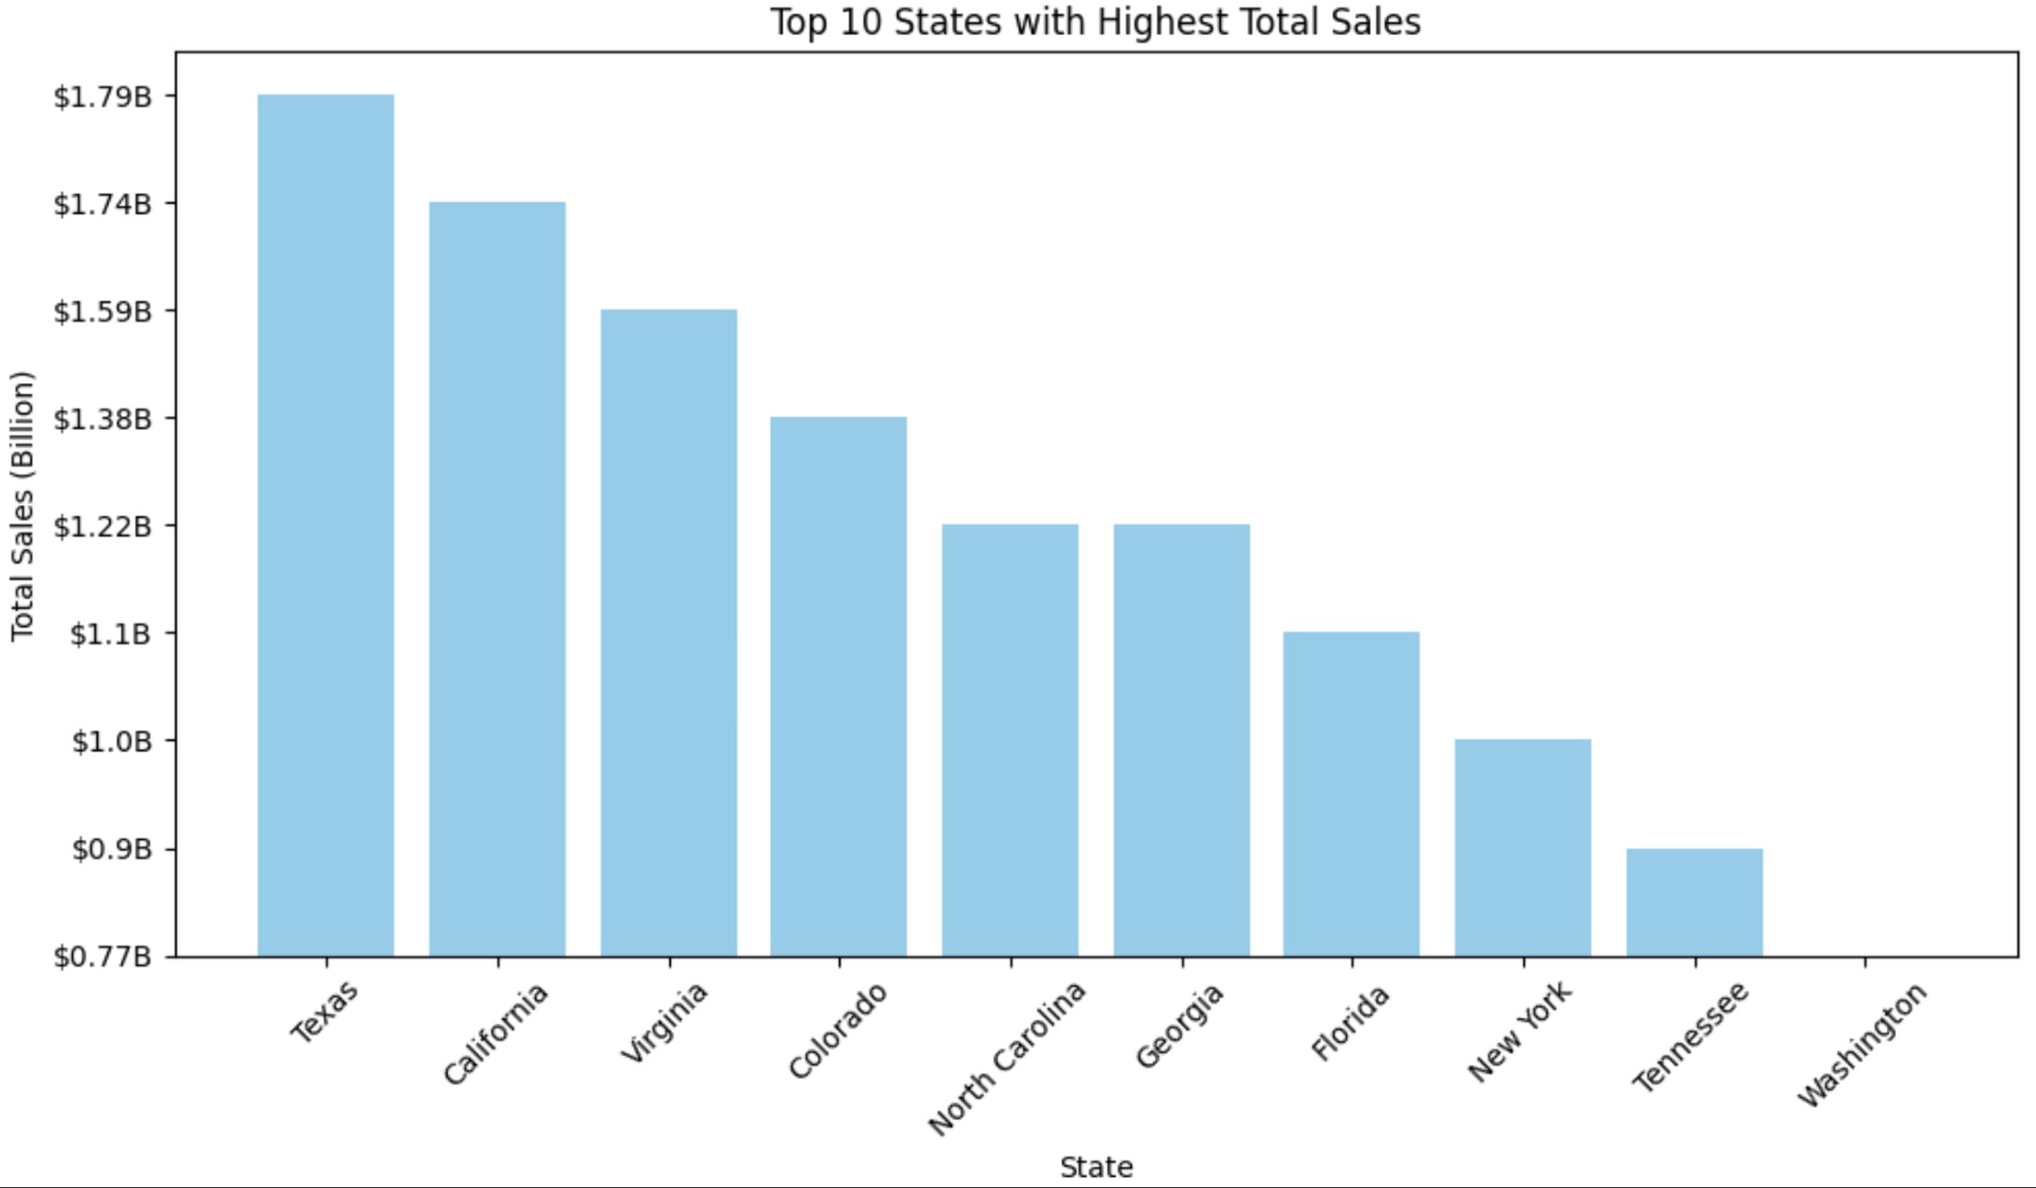
Q5. How does the analysis of home listings vary on a monthly basis, and could you plot a side-by-side graph to visualize these differences?
The monthly_analysis function defines a comprehensive analysis of monthly home listings using housing data which is provided as input. This function calculates the total inventory, total new listings, and total off-market listings for each month by grouping the data by month using the groupby function. These statistics are aggregated and stored in a DataFrame named monthly_stats.
Q6.List the top 10 states with maximum sales
The state_maximum_sale_price function is defined to analyze the top 10 states with the highest total housing sales prices based on the housing data, then the function selects the top 10 states with the highest total sales prices using the nlargest function and sorts them in descending order

Slide 12
Conclusion
The project presented a deep data collection, cleansing, analysis and visualization process which led to revelation of 2023 real estate market dynamics by utilization of the Redfin housing dataset. Reported results include tendencies in the housing market, such as fluctuations in housing prices and patterns related to a particular area. Such revelations enable the stakeholders to have a clear perspective of whether to purchase, sell, or invest in properties. Altogether, the study shows how data-informed techniques can be used in exploring and resolving the intricate issues of the real estate market.

