Slide 1
Digital Portfolio
STUDENT NAME: M. POOJA
REGISTER NO AND NMID: 212401020/F957628BD785B589E0B4E1588D2E02BB
DEPARTMENT: Computer Applications
COLLEGE: UNIVERSITY OF MADRAS

Slide 2
PROJECT TITLE
DIGITAL PORTFOLIO USING FRONT END WEB DEVELOPMENT

Slide 3


AGENDA
Problem Statement
Project Overview
End Users
Tools and Technologies
Portfolio design and Layout
Features and Functionality
Results and Screenshots
Conclusion
Github Link
3/21/2024 Annual Review

Slide 4

PROBLEM STATEMENT
"Design and develop a digital portfolio website using front-end technologies (HTML, CSS, and JavaScript) to showcase personal details, skills, projects, and contact information. The portfolio should be responsive, user-friendly, and visually appealing, serving as an online resume and project showcase."

Slide 5

PROJECT OVERVIEW
Here’s a crisp Project Overview for your portfolio project 👇
Project Overview: This project focuses on creating a digital portfolio website using front-end technologies such as HTML, CSS, and JavaScript. The portfolio highlights personal information, skills, academic/work achievements, and projects in an interactive and visually appealing format. It serves as an online platform to showcase professional identity, improve visibility, and provide easy access for recruiters or collaborators.

Slide 6

WHO ARE THE END USERS?
The end users of a digital portfolio developed using front-end technologies are primarily recruiters, hiring managers, and clients who wish to evaluate an individual’s skills, experience, and projects before offering career or freelance opportunities. It also caters to educators and mentors who may use the portfolio for academic or training assessments, as well as peers and colleagues for networking and collaboration. Additionally, the portfolio serves the general audience interested in learning about the individual’s work and professional identity. In this way, the digital portfolio acts as a versatile platform to present one’s skills and achievements to a wide range of users in an accessible and visually engaging format.

Slide 7

TOOLS AND TECHNIQUES
The end users of a digital portfolio developed using front-end technologies are primarily recruiters, hiring managers, and clients who wish to evaluate an individual’s skills, experience, and projects before offering career or freelance opportunities. It also caters to educators and mentors who may use the portfolio for academic or training assessments, as well as peers and colleagues for networking and collaboration. Additionally, the portfolio serves the general audience interested in learning about the individual’s work and professional identity. In this way, the digital portfolio acts as a versatile platform to present one’s skills and achievements to a wide range of users in an accessible and visually engaging format.

Slide 8
POTFOLIO DESIGN AND LAYOUT
The design and layout of the digital portfolio are created to be simple, responsive, and user-friendly, ensuring a smooth browsing experience across devices. The portfolio typically begins with a header section containing the name, logo, and navigation menu for easy access to different sections. The About Me section introduces the individual with a short bio and profile image, followed by a Projects section that highlights work samples in a grid or card-based layout with descriptions and links. A Skills section displays technical and professional competencies using lists, icons, or progress indicators. The Contact section includes a form and social media links for communication. Consistent use of colors, typography, and spacing maintains visual appeal, while responsive design techniques such as Flexbox and CSS Grid ensure adaptability on mobile, tablet, and desktop screens. The layout balances professionalism with creativity, showcasing both content and design aesthetics effectively.
8

Slide 9
FEATURES AND FUNCTIONALITY
The digital portfolio developed using front-end technologies offers several key features and functionalities to effectively showcase personal and professional details. It provides a structured layout with sections such as About Me, Projects, Skills, Resume, and Contact, ensuring clear navigation and easy access to information. The portfolio is designed to be responsive, adapting seamlessly to different screen sizes including desktops, tablets, and mobiles. Interactive elements like navigation menus, hover effects, animations, and image galleries enhance user experience, while JavaScript-based form validation ensures secure and error-free submissions in the contact section. Additional functionalities include integration of downloadable resumes, external links to GitHub/LinkedIn, and dynamic project showcases. The design emphasizes both usability and visual appeal, combining professional presentation with modern front-end practices to create a platform that is engaging, accessible, and impactful for end users.

Slide 10
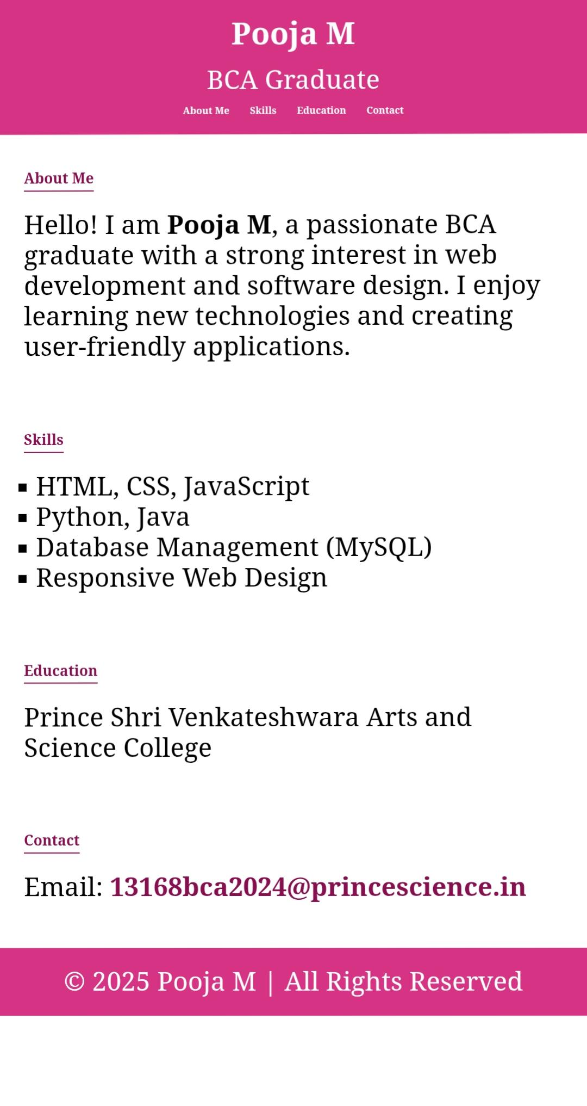

RESULTS AND SCREENSHOTS
The result of the digital portfolio using front-end development is a responsive and interactive personal website that displays profile details, skills, projects, and contact information in a visually appealing manner. The screenshots highlight sections such as the homepage, about, projects, skills, and contact, demonstrating smooth navigation, professional design, and user-friendly functionality.
3/21/2024 Annual Review
10

Slide 11
CONCLUSION
The digital portfolio using front-end development provides an effective platform to showcase personal and professional details in a structured, interactive, and visually appealing manner. By utilizing HTML for structure, CSS for design and responsiveness, and JavaScript for interactivity, the portfolio enhances user experience while ensuring accessibility across devices. It serves as an online resume and project showcase, helping individuals highlight their skills, achievements, and work to recruiters, clients, and peers. Overall, the project achieves its objective of creating a responsive, user-friendly, and professional portfolio that strengthens personal branding and career opportunities.
11

Slide 12
GitHub link
https://poojam-dotcom.github.io/Pooja.portfolio/

