Slide 1
E-commerce Furniture Sales Prediction
Final Project Summary by Pooja Mahesh

Slide 2
🎯 Objective
Predict the number of furniture items sold (sold) using:
- Product Price
- Original Price
- Discount Percent
- Shipping Type (tagText)

Slide 3
📁 Tools Used
- Excel: Data Cleaning, Calculated Discount
- MySQL: Basic Insights
- Python (VS Code): Analysis & Prediction
Libraries:
pandas, numpy, matplotlib, seaborn, sklearn

Slide 4
✅ Phase 1 – Data Cleaning
- Loaded Excel file with pandas
- Removed rows with missing values in important columns
- Columns used:
productTitle, originalPrice, price, sold, tagText, discountPercent

Slide 5
📊 Phase 2 – Visualizations
- Distribution of Items Sold (Histogram)
- price vs sold (Scatterplot)
- discountPercent vs sold (Scatterplot)
- Avg sold by tagText (Bar Chart)

Slide 6
🧪 Phase 3 – Correlation Analysis
- Heatmap of correlations
- price & originalPrice had high correlation (0.84)
- One-hot encoding used for tagText

Slide 7
🤖 Phase 4 – Model Building
- Linear Regression Model
- Features used: price, originalPrice, discountPercent, tagText
- Data split: 80% Train, 20% Test

Slide 8
📈 Phase 5 – Evaluation
- Predicted vs Actual Items Sold (scatter plot)
- General trend followed with some outliers
- Potential for better performance with advanced models

Slide 9
🏁 Conclusion
✅ Built complete Python-based sales prediction model
✅ Performed EDA, data cleaning, visualization
✅ Applied regression and evaluated results
📌 Optional Next Step: Try Random Forest for improved accuracy

Slide 10
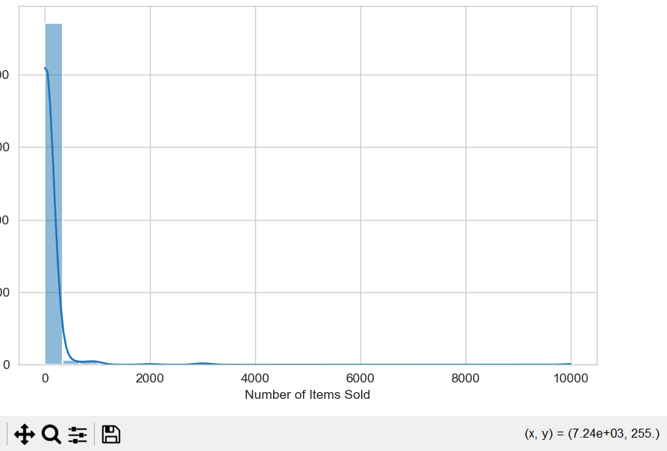

Slide 11
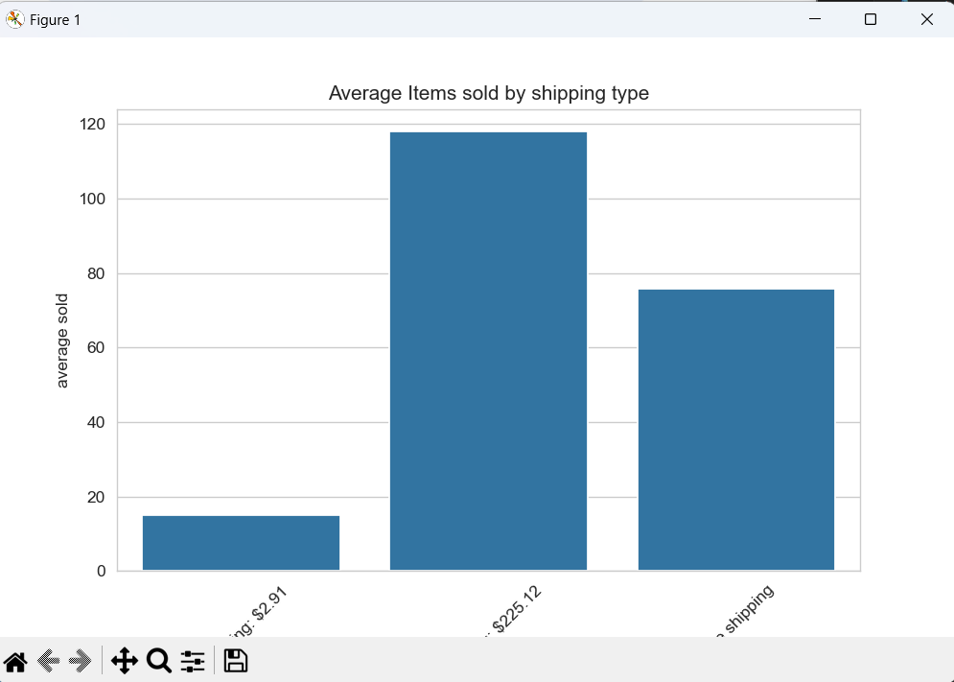

Slide 12
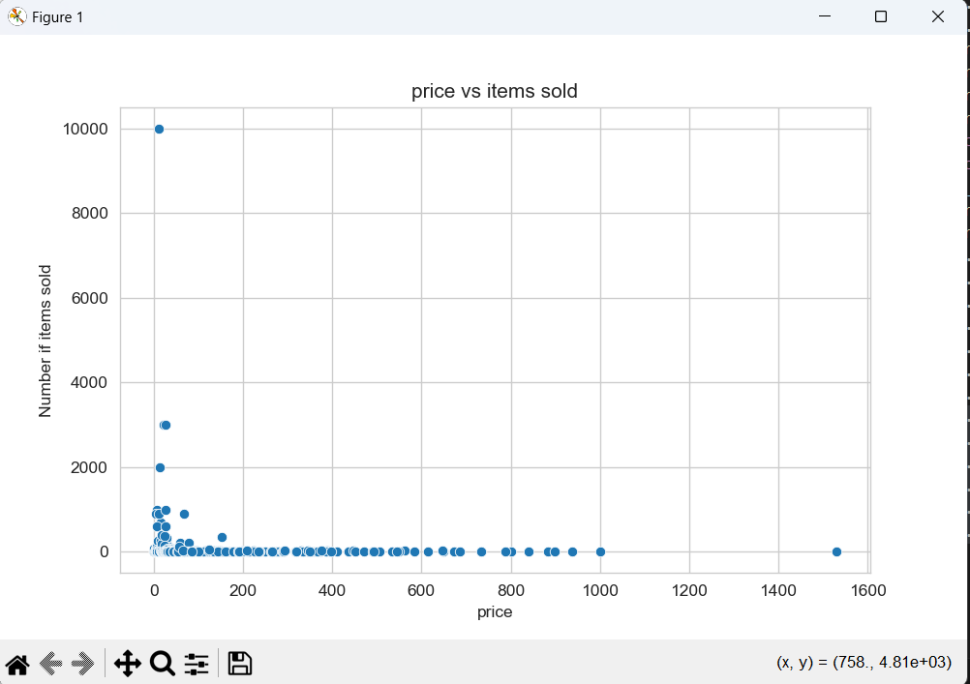

Slide 13
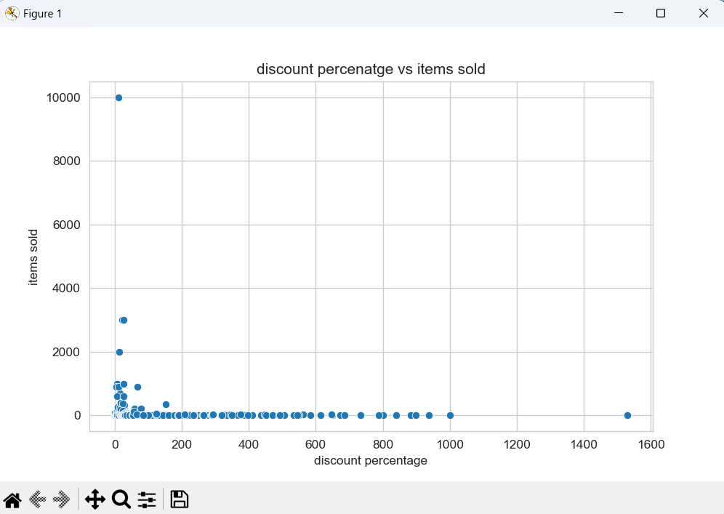

Slide 14
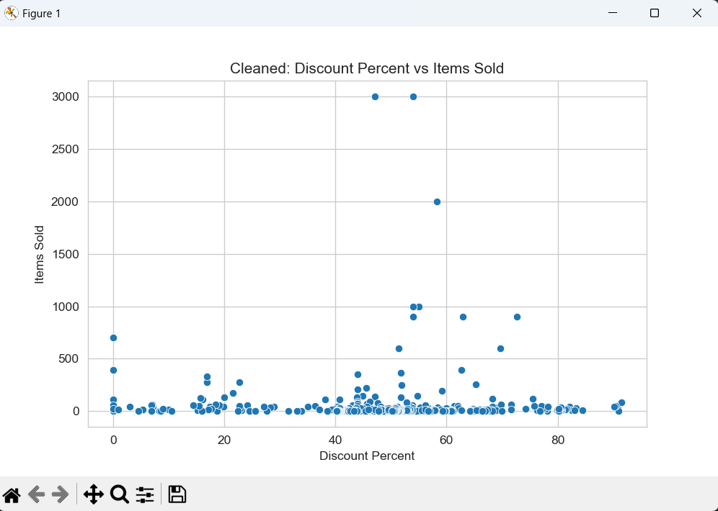

Slide 15
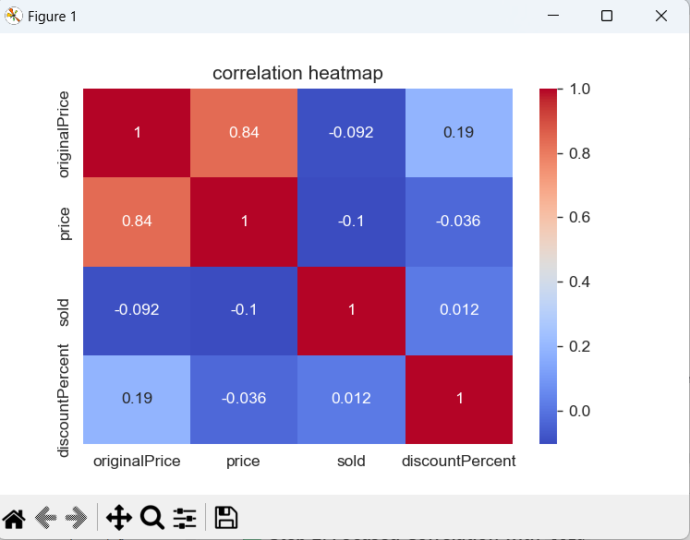

Slide 16
