Slide 1
Python-session2

Slide 2
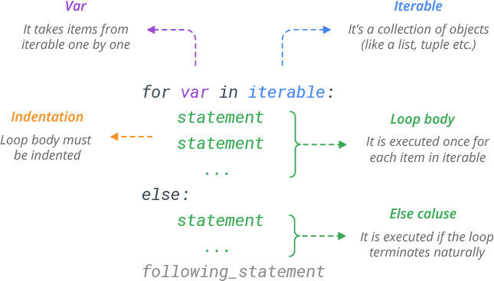
For Loop

Slide 3
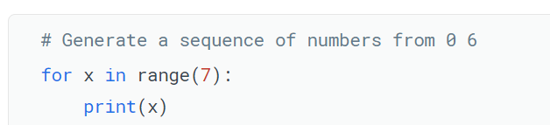
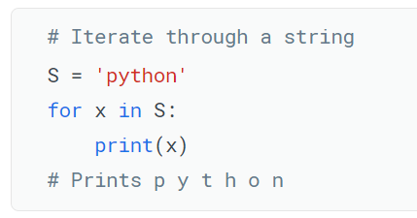
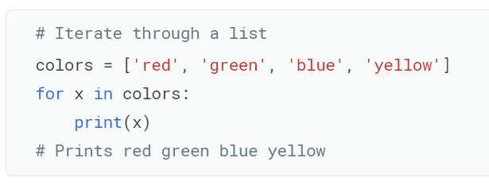
For Loop Example
Output:
0
1
2
3
4
5
6
range(start, stop, step)

Slide 4
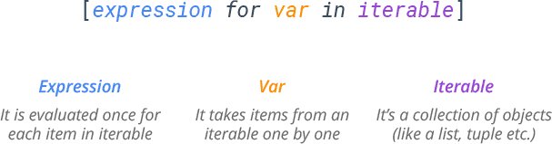
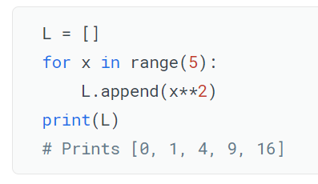
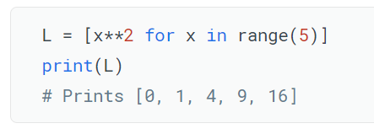
List Comprehension

Slide 5
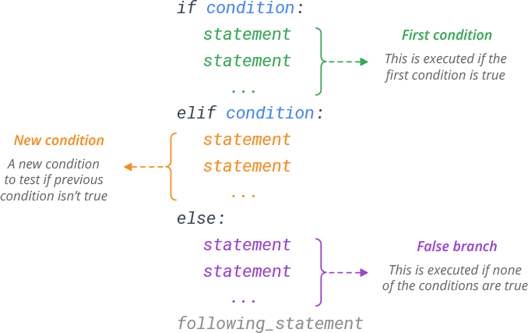
If…else..

Slide 6
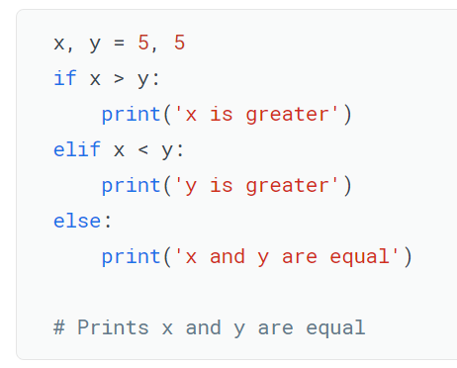
If..else.. Example

Slide 7
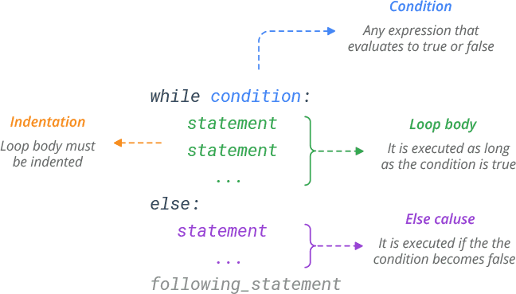
While

Slide 8
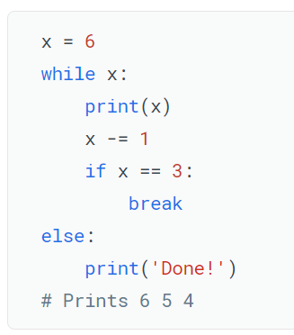
While example

Slide 9
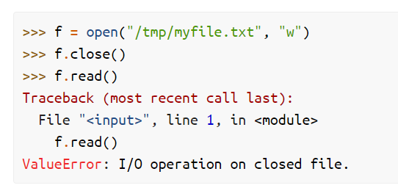
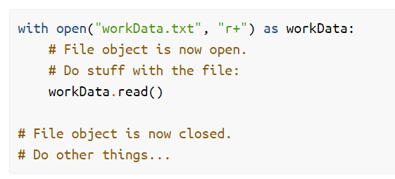
File Handling
By using Open function
By using with open function

Slide 10
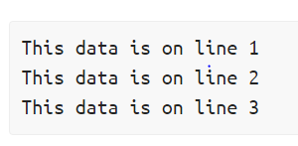
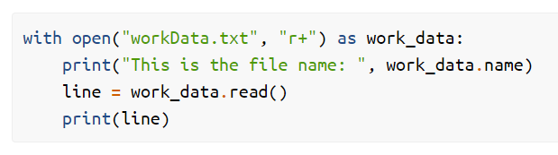
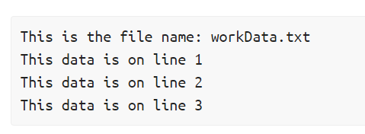
File Handling example
workData.txt
Program
Output

Slide 11
Decorators
A decorator is a function that accepts a function as input and returns a new function as output, allowing you to extend the behavior of the function without explicitly modifying it.
Sometimes you want to modify an existing function without changing its source code.
A common example is adding extra processing (e.g. logging, timing, etc.) to the function.

Slide 12
Generators
Python provides a generator to create your own iterator function.
A generator is a special type of function which does not return a single value, instead it returns an iterator object with a sequence of values.
In a generator function, a yield statement is used rather than a return statement.

Slide 13
OS module
The OS module in Python provides a way of using operating system dependent functionality.
The functions that the OS module provides allows you to interface with the underlying operating system that Python is running on – be that Windows, Mac or Linux.
It is performed by importing os module import os

Slide 14
Python OOPs
Class
Inheritance
Polymorphism
Encapsulation
Abstraction

Slide 15
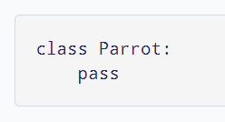

Class and Object
Class
A class is a blueprint for the object.
Object
An object (instance) is an instantiation of a class.

Slide 16
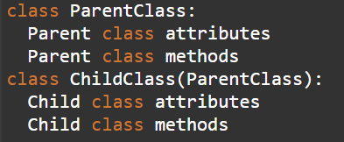
Inheritance
Inheritance allows us to define a class that inherits all the methods and properties from another class.
Parent class is the class being inherited from, also called base class.
Child class is the class that inherits from another class, also called derived class.
Syntax

Slide 17
Polymorphism
Polymorphism defines the ability to take different forms.
Polymorphism in Python allows us to define methods in the child class with the same name as defined in their parent class.
1) Overloading -- Python does not support function overloading
2) overriding -- it is supported

Slide 18
Encapsulation
Encapsulation — Information hiding.
Using OOP in Python, we can restrict access to methods and variables.
This prevents data from direct modification which is called encapsulation.
In Python, we denote private attributes using underscore as the prefix i.e single _ or double __.

Slide 19
Abstraction
Abstraction — Implementation hiding
Abstract classes are used to implement abstraction in Python.
An abstract class contains abstract methods(a method without implementation detail).
An abstract method is a method that has a declaration part but does not contain any implementation part.
The abstract classes cannot be instantiated, it means it is not possible to create an object of an abstract class.
An abstract class provides us the details of the interface only(What methods must be in subclasses and what must be their behavior).
In other words, A class having partial implementation only is known as an abstract class. A class having complete implementation is known as a concrete class.

