Slide 1
ROBOT FRAMEWORK

Slide 2
Overview
Introduction
Installation
Robot file structure
Setup and Teardown
Variables
Keywords
Libraries
BDD structure
Execution of sample robot script and viewing the log.

Slide 3
Introduction
Robot Framework itself is open source.
Robot Framework is a generic test automation framework.
It utilizes the keyword-driven testing approach.
Its testing capabilities can be extended by test libraries.
Users can create new higher-level keywords from existing ones using the same syntax.
It is operating system and application independent. The core framework is implemented using Python.
Notes:
Reference : https://robotframework.org/

Slide 4
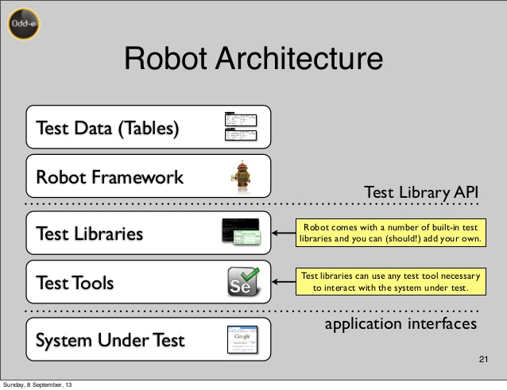
Robot Framework Architecture and Test Flow
When test execution is started, the framework first parses the test data.
It then utilizes keywords provided by the test libraries to interact with the system under test.
Libraries can communicate with the system either directly or using other test tools as drivers.
Test execution is started from the command line and at the end of execution you get report and log HTML format as well as XML output.

Slide 5
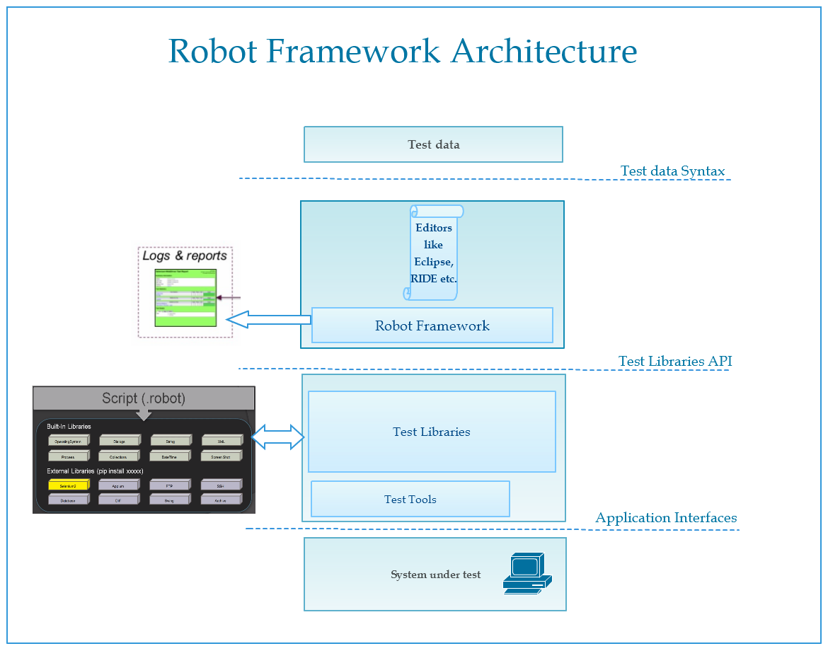

Slide 6
Installation
Install Robot Framework with pip.
Pip is the standard Python package manager and is already installed if you’re using Python 2 >=2.7.9 or Python 3 >=3.4
Step-1: Install Python
Download and install Python 3.6.5 version
Step-2: Install Robot Framework
Open command prompt and run below command.
pip install robotframework
To install specific version
Pip install robotframework==3.1.2

Slide 7
Installation
Install RIDE with below pip command
pip install robotframework-ride
Install Selenium2Library
pip install robotframework-selenium2library

Slide 8
Robot Test Case File Structure
*** Settings ***
Documentation Example using the space separated format.
Resource resource_file.robot
Library OperatingSystem
*** Variables ***
${MESSAGE} Hello, world!
*** Test Cases ***
My Test
[Documentation] Example test.
Log ${MESSAGE}
My Keyword ${CURDIR}
Another Test
Should Be Equal ${MESSAGE} Hello, world!
*** Keywords ***
My Keyword
[Arguments] ${path}
Directory Should Exist ${path}

Slide 9
Setup and Teardown
Suite Setup
Test Setup
Test case_1
Test Teardown
Test Setup
Test case_2
Test Teardown
Test Setup
Test case_3
Test Teardown
Suite Teardown

Slide 10
Variables
There are three types of variables in Robot Framework. They are:
# Scalar Variable
# List Variable
# Dictionary Variable
Variable | Syntax
Scalar Variable | ${variable_name}
List Variable | @{variable_name}
Dictionary Variable | &{variable_name}

Slide 11
Keywords
There are two types of keywords in Robot Framework. They are:
# In-Built Keywords
# User defined keywords
In-Built Keywords
Log
Run Keyword If
Catenate
:FOR
ELSE
Exit for loop if
Get Length
Get count
Sleep
Convert to Number
…..
Notes:
https://robotframework.org/robotframework/2.1.2/libraries/BuiltIn.html

Slide 12
Libraries
There are two types of Libraries in Robot Framework. They are:
# In-Built Libraries
# User defined Libraries (using python)
In-Built Libraries:
Collections
Datetime
Dialogs
Operating System
Process
String
Screenshot
Telnet
….

Slide 13
BDD
BDD stands for Behavior Driven Development. Basically BDD is used to have more readability of the test case.
Given : The static preconditions
When : The Action to be performed on System Under Test
Then : The expected results of the behaviour under the given and When Statements
A Test case/Keywords can have multiple Given, When and Then Statements.
Multiple Given/When/Then can be separated with ‘And’
“Given”, “When”, “Then” and “And” are ignored at the beginning of user keywords.

Slide 14
Execution of sample robot script and viewing the log
Run the Test on Command Prompt
robot <file_name>.robot
Report and log results will be automatically generated after the test execution.
Python path can be specified if you have an external python libraries:
robot –-pythonpath=<python file path> <robot_file_name>.robot

