Slide 1
DATA CYCLE AUTOMATION
A multitier webapp for Purge Framework GDPR

Slide 2

Use Case Earlier before DCA Tool
A user had to write lots of SQL queries manually, like to create just one purge table a user had to write queries for:
Logging in each server
Inserting the query
Creating a purge schema in the purge DB
Deploying a job took a lot of time(build -> deploy -> verify )
Imagine for a bigger scenario! (Such tasks may take upto a lot of time{eg: 3-4 hrs for one table})
Lot's of time, efforts and resources consumed. Even the queries weren't stored or managed properly.
Anything that is manually done, is prone to various errors.

Slide 3

Use Case with the help of the DCA Tool
User friendly UI has been provided, which provides quick results
Most of the things are automated
Less time, efforts and resources consumed ({for one table <1min })
Less prone to errors(SQL Queries validation is also implemented)
Queries used to carry out operations are now stored in a DB, thus better management of data
Reports are generated which can be used to monitor the jobs being carried out in the respective servers

Slide 4


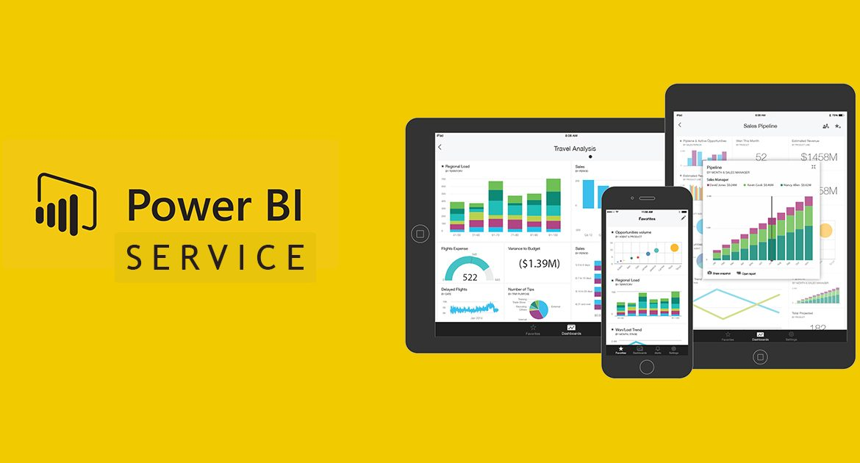




Technologies Used
FRONTEND
MIDDLEWARE
REPORT GENERATION AND MONITORING
BACKEND

Slide 5
The functionalities of the DCA tool
Phase 1 (Implemented)
Deploy GDPR framework directly to Production like data purging with the help of a user friendly UI, which provides quick results
Execute Jobs, just by a click of a button
Edit and have a quick glance at the current requests and history of requests made as well
Monitor reports regarding the jobs being held in various servers
Phase 2 (Future Scope)
Sign in process, to authenticate users to use the DCA tool
Register new servers, along with the database and users' permissions details
Approval process and checking the previously approved/rejected requests
Date based purging can be implemented

Slide 6

Workflow of the DCA Tool
Register/modify server
Reports and Monitoring
User’s Requests
User
User’s Approvals
Execute Jobs

Slide 7










Register/Modify
Register
Add Details
Add Users and permissions
Sign In
USER
Modify
Select the Server
Send details to user due to which the request got rejected
Add More
Rejected
Select the Database and tables to perform actions on
Write the queries and other details
Request for approval
Mail
Approver
Accepted
Deploy

Slide 8
Deploy Requests
/reject Approvals
My requests/approvals
My current requests/approvals
USER
My requests’/approvals’ history
Execute Jobs
Select the Server
Execute the required job
USER
Monitoring
Select the Server
Monitor the reports generated by POWER BI
USER

Slide 9
If I had more time, what else I could have contributed
I would have made the UI more attractive and more scalable
Would have worked on phase 2 of the project(Registration of new servers, approval process, date based purging etc.)
Would have tried to make the overall project more general and flexible

Slide 10
Gracias!

