Slide 1

CS 542 Project
Link-State Routing Algorithm
Professor : Dr. Michael Y. Choi
TA : Niket Bhogilal Patel
By : Patel Pooja Hemantkumar
CWID : A20396099
Seat # : 42

Slide 2
Link-State Routing Protocol
One of the routing protocol used for routing in packet switching networks for computer communications
It is performed by each and every switching node/router which is used to forward the packet
Every node has a map which is in the form of graph which has information of which node is connected to which other node
Every node finds or evaluates the best path from itself to every other node in the network
All the nodes/routers has the routing table which is formed by all the best paths calculated in the topology given
The entire routing table is not broadcasted by the routers
Only information related connectivity is passed in link-state routing
It is best for large networks and hierarchical networks
Commonly used : OSPF , ISIS

Slide 3
Link-State Routing Algorithm
The main steps of this algorithm is initialization and looping
Steps:
Initialization
Mark the source u = visited
For all nodes v
If : v is neighbor of u
then D(v) = c (u,v)
Else : D(v) = Infinity
Loop :
Find node w not visited and who’s D(w) = min
Mark node w as visited
Update D(v) for all the neighbor v of w , not visited
Set D(v) = min (D(v) + D(w) + c(w,v))
/* new cost to v is either the old cost to v or least cost of the path to w + cost from w to v */
Repeat unless all the nodes are visited
Source / Reference : Textbook – Computer Networking – A Top Down Approach

Slide 4
Link-State Routing Algorithm
Explanation:
u : Source node , w: Not visited node
D(v) : least cost from source u to destination v
C(u,v) : It is the cost on the link which is incurred to send a packet from node u to v and is infinity when there is no direct connection or link between the node and I have used -1 for the same in the project
In the initialization step:
Mark the source as the visited
Search for all the neighbors of u and if node is neighbor then find the cost from u to v
[ c(u,v) ] and store in D(v)
And If the node is not neighbor of u then set D(v) = infinity
Loop the following steps until and unless all the nodes in the topology are visited:
Find the node w which is not visited and whos distance i.e. D(w) is min. and mark it as visited
Then set the distance D(v) for each of its neighbor v of w which are not visited as the minimum of the old cost to v or least cost to w + cost from node w to node v

Slide 5
Execution of the Program
Steps:
Double click the Simulator.bat file
The command prompt will open
Thereafter the Main menu is displayed then choose the options you want the Simulator to perform
For this the Simulator.jar ,Simulator.bat and the topology.txt file should be in the same folder
Note : If by double clicking the Simulator.bat file, it doesn’t work :
Execute “java –jar Simulator.jar” command in the command prompt
For this the Simulator.jar and the topology.txt file should be in the same folder

Slide 6
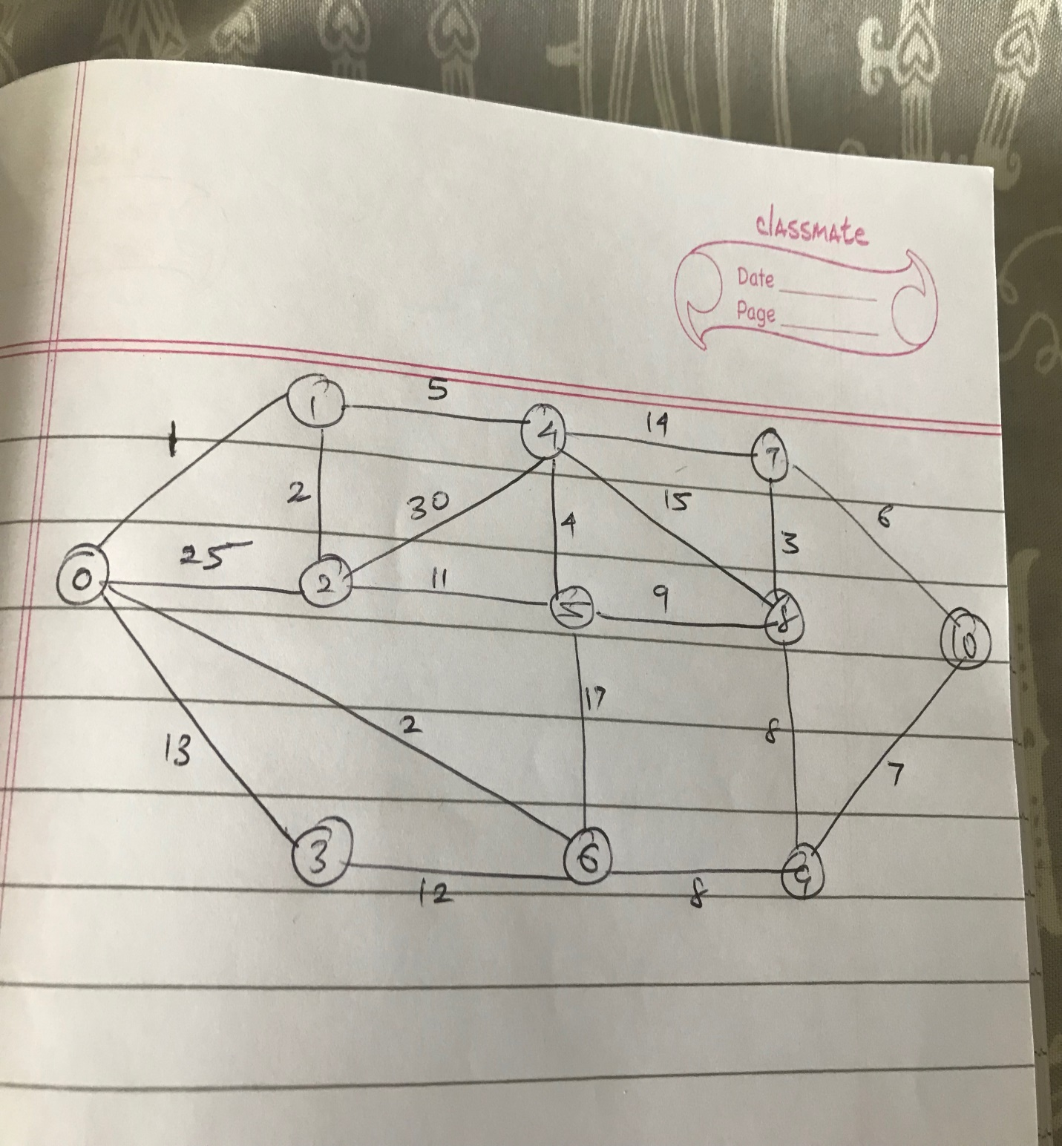
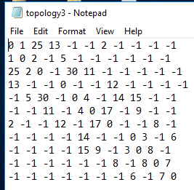
Network Topology & Adjacency Matrix
The network topology and its adjacency matrix on which I worked is as given below:
Fig.: Network Topology
Fig.: Adjacency Matrix

Slide 7
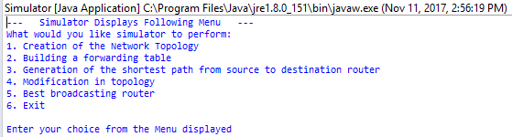
Output – Display Simulation Menu
Display Menu
Explanation :
When the program is run by the user, it displays the Menu above and asks the user for what s/he wants the simulator to perform from the given options

Slide 8
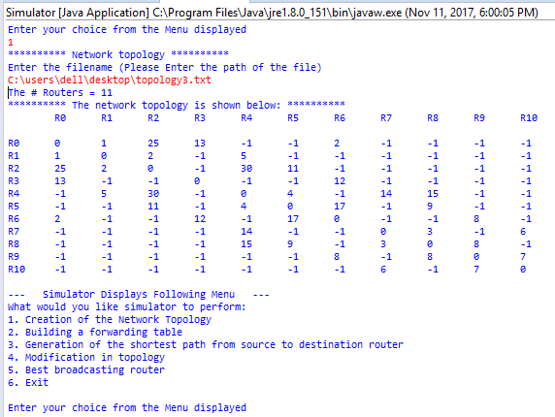
Output – Command 1
Network Topology Creation
Explanation :
When the user selects the 1st option the Simulator asks the user to input the file path (text file) which contains the network topology
Then it displays the no. of routers the network topology contains
Thereafter the network topology is displayed in the form of matrix

Slide 9
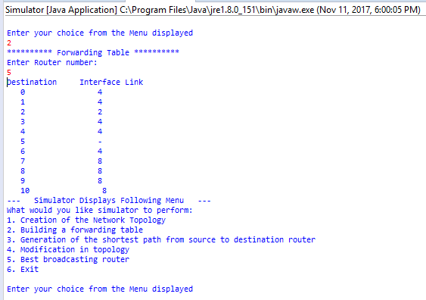
Output – Command 2
Forwarding Table
Explanation :
When the user selects the 2nd option the Simulator asks the user to input the
router number for which forwarding table should be displayed
The routing table is displayed which has 2 columns : Destination and Interface link
Here, the forwarding table for router 5 is displayed

Slide 10
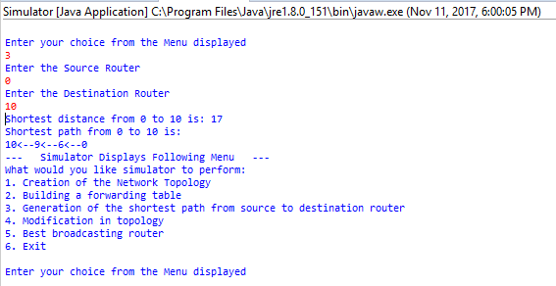
Output – Command 3
Shortest Path (Dijkstra’s)
Explanation :
When the user selects the 3rd option the Simulator asks the user to input the
source and the destination router no.
It then displays the cost of the shortest path from source to destination and also displays the shortest path
Here, the Source router is 0 and destination router is 10, hence , shortest distance is 17 and shortest path is 10←9←6←0 from 0 to 10 from the given network topology

Slide 11
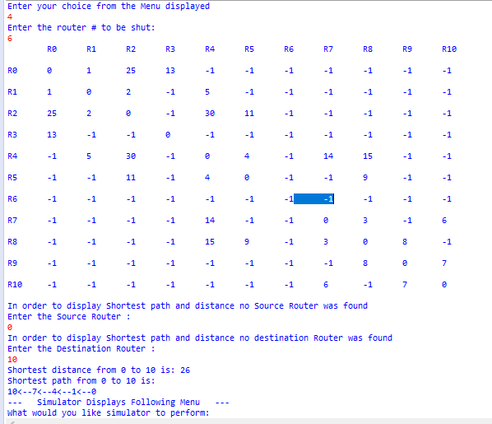
Output – Command 4
Topology Modification

Slide 12
Output – Command 4
Topology Modification
Explanation :
When the user selects the 4th option the Simulator asks the user to input the router no. which is down and is to be shut and then displays again the network topology and also the shortest distance and path from the given source to destination
The user wants to turn off the router 6 (Which is also a part of the shortest path from 0 to 10 )
So when this router is turned off the simulator calculated new path from 0 to 10 and displays the shortest path and the shortest distance
Also here the source and destination router is asked again by the simulator as the user did not user the source and the destination or did not compute the shortest path before

Slide 13
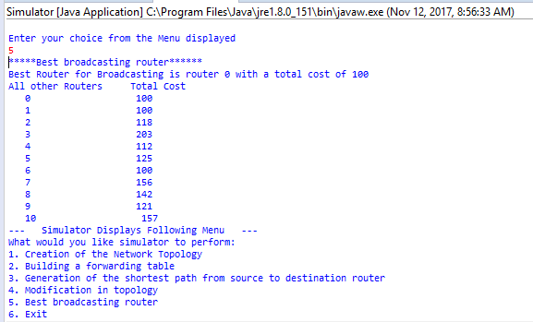
Output – Command 5
Best Broadcasting Router
Explanation :
When the user selects the 5th option the Simulator displays the best broadcasting router i.e. the router that has the min. sum of the costs from itself to all other routers
Here, the best broadcasting router is router 0 with the total cost of 100 from itself to all other routers and also the total cost for all others routers is displayed too

Slide 14
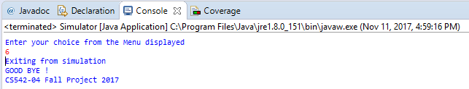
Output – Command 6
Exit
Explanation :
When the user selects the 6th option the user exits from the simulation and displays “GOOD BYE !” , “CS542-04 Fall Project 2017”

Slide 15
Thank You ☺

